Slide 1
MY Year 7 NOTEBOOK
The Ancient World
Name
Class
Period

Slide 2
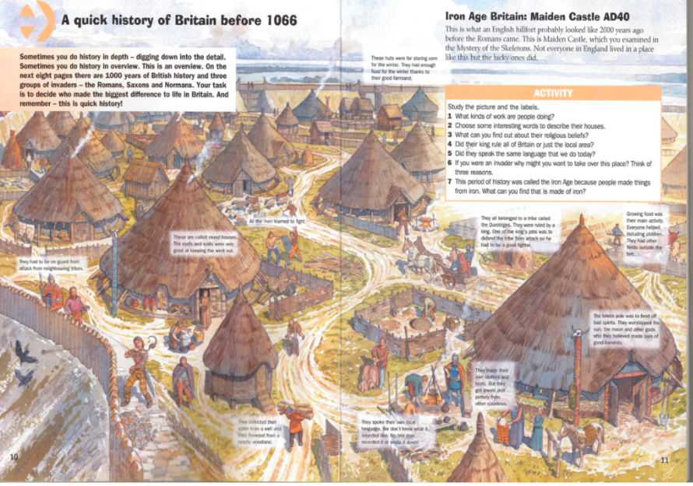
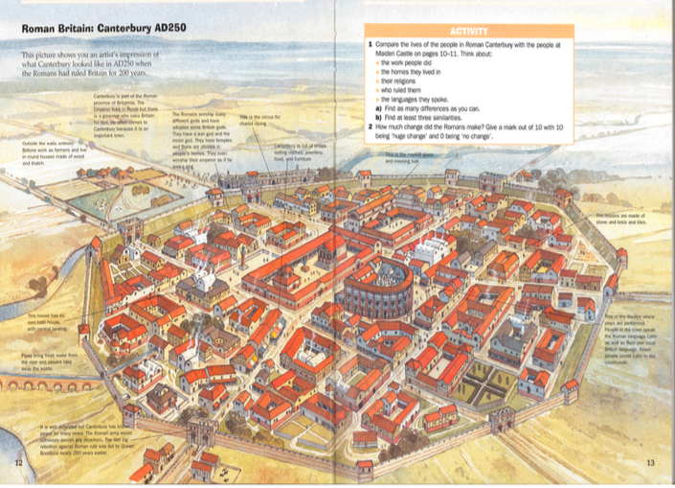
Task 1 - Comparing villages – Ad40 – AD650
Iron Age Village AD 40 – What can you see?
Roman Town AD250 - what can you see?

Slide 3
5 things that have changed
5 things that have remained the same
How would you describe the pace of change?
How would you describe the nature of change?
How would you describe the direction of change?
How would you describe the things that have stayed the same?

Slide 4
 | Compare | Contrast
Timeline and duration
Geography
Size

Slide 5
 | Compare | Contrast
Structure of society
Rulers and systems of government

Slide 6
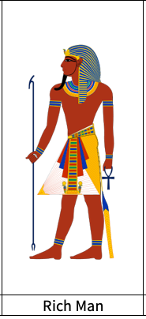
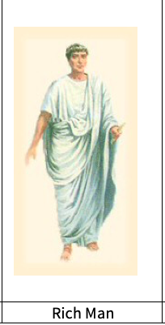
Life for a rich man in Ancient Egypt and Rome
Your task is to research what life was like for four different groups of people who lived in Ancient Rome. You should consider the following areas of everyday life for each of the people above;
ü Homes and living
ü Jobs/education
ü Food
ü Clothing
ü Entertainment
ü Position in society
How to research
§ Use the websites and links provided on the Humanities website to guide you through your research.
§ Make notes on the key facts that you find about each group of people.

Slide 7
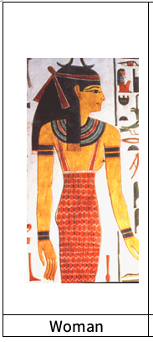
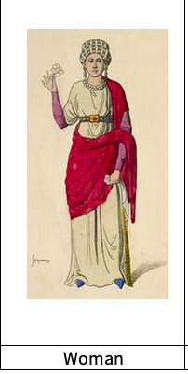
Life for a woman in Ancient Egypt and Rome
Your task is to research what life was like for four different groups of people who lived in Ancient Rome. You should consider the following areas of everyday life for each of the people above;
ü Homes and living
ü Jobs/education
ü Food
ü Clothing
ü Entertainment
ü Position in society
How to research
§ Use the websites and links provided on the Humanities website to guide you through your research.
§ Make notes on the key facts that you find about each group of people.

Slide 8
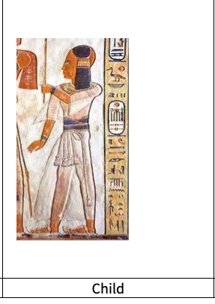
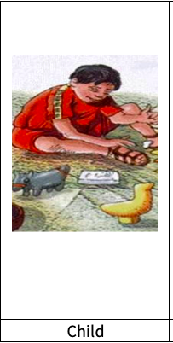
Life for a child in Ancient Egypt and Rome
Your task is to research what life was like for four different groups of people who lived in Ancient Rome. You should consider the following areas of everyday life for each of the people above;
ü Homes and living
ü Jobs/education
ü Food
ü Clothing
ü Entertainment
ü Position in society
How to research
§ Use the websites and links provided on the Humanities website to guide you through your research.
§ Make notes on the key facts that you find about each group of people.

Slide 9
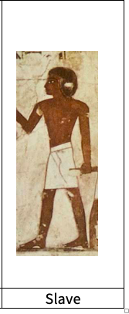
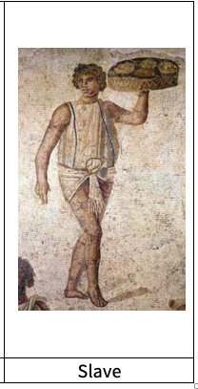
Life for a Slave in Ancient Egypt and Rome
Your task is to research what life was like for four different groups of people who lived in Ancient Rome. You should consider the following areas of everyday life for each of the people above;
ü Homes and living
ü Jobs/education
ü Food
ü Clothing
ü Entertainment
ü Position in society
How to research
§ Use the websites and links provided on the Humanities website to guide you through your research.
§ Make notes on the key facts that you find about each group of people.

Slide 10
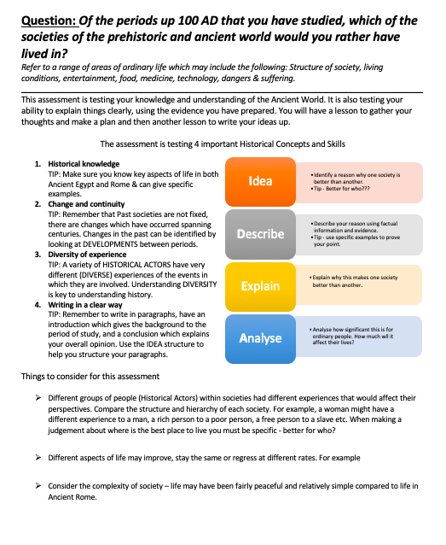

Slide 11
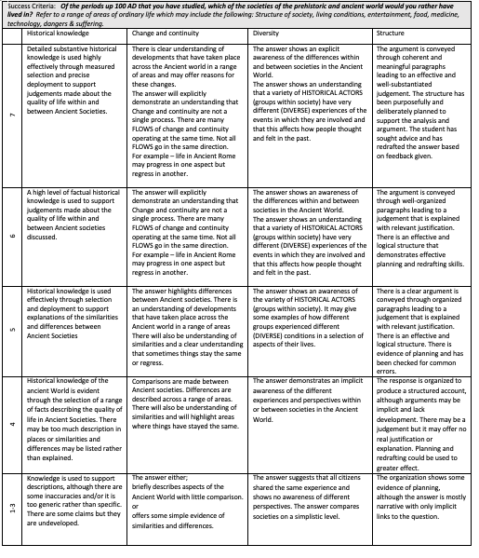
This is the mark scheme that your teacher will use to mark your work. Read through the levels in advance to get some ideas on what you need to include.

Slide 12
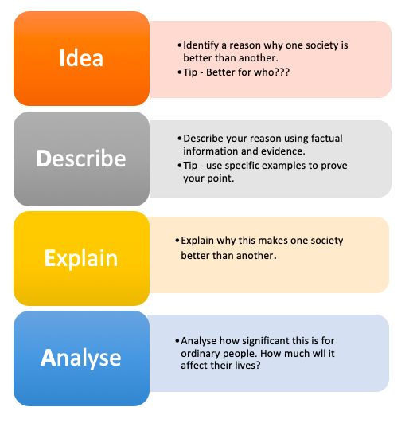
Essay notebook: drafting
Question: Of the periods up 100 AD that you have studied, which of the societies of the prehistoric and ancient world would you rather have lived in?
Your text goes in here.
Take ideas from your prewriting section and start organizing it here. Decide what you think your three main ideas will be and gather details to support them in their text boxes. Use the introduction to show the reader why it’s important. Use the conclusion to show the reader what he/she just read and what to do going forward. This is just a summary! You’ll go into more detail when you start writing.
Your text goes in here.
Your text goes in here.
Your text goes in here.
Your text goes in here.

