Slide 1




Pre-IB Programme
Subject: Economics SL/HL

Slide 2
The nature of Economics…
Economics is an exciting, dynamic subject that allows students to develop an understanding of the complexities and interdependence of economic activities in a rapidly changing world.
At the heart of economic theory is the problem of scarcity. While the world’s population has unlimited needs and wants, there are limited resources to satisfy these needs and wants. As a result of this scarcity, choices have to be made. The economics course, at both SL and HL, uses economic theories to examine the ways in which these choices are made:
at the level of producers and consumers in individual markets (microeconomics) at the level of the government and the national economy (macroeconomics) at an international level where countries are becoming increasingly interdependent through international trade and the movement of labour and capital (the global economy).
The choices made by economic agents (consumers, producers and governments) generate positive and negative outcomes and these outcomes affect the relative well-being of individuals and societies. As a social science, economics examines these choices through the use of models and theories. The Diploma Programme (DP) economics course allows students to explore these models and theories, and apply them,

Slide 3
The nature of Economics…
How do consumers and producers make choices in trying to meet their economic objectives?
When are markets unable to satisfy important economic objectives—and does government intervention help?
Why does economic activity vary over time and why does this matter?
How do governments manage their economy and how effective are their policies?
Who are the winners and losers of the integration of the world’s economies?
Why is economic development uneven?

Slide 4
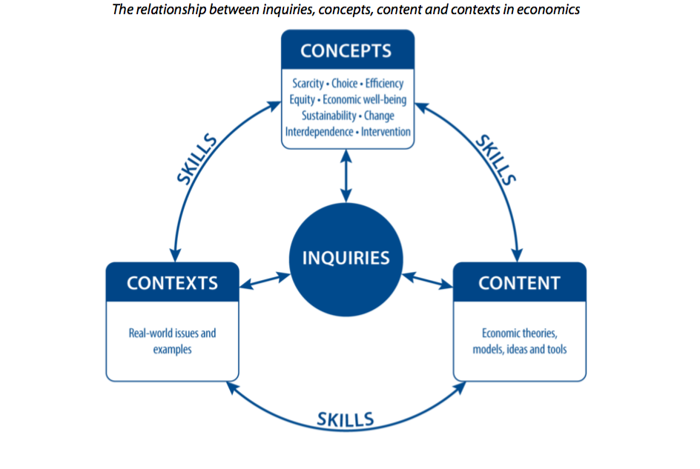
The nature of Economics…

Slide 5
The aims of the Economics course are to enable students to:
Economics aims
The aims of the economics course at SL and HL are to enable students to:
  develop a critical understanding of a range of economic theories, models, ideas and tools in the areas of microeconomics, macroeconomics and the global economy
  apply economic theories, models, ideas and tools and analyse economic data to understand and engage with real-world economic issues and problems facing individuals and societies
  develop a conceptual understanding of individuals’ and societies’ economic choices, interactions, challenges and consequences of economic decision-making.

Slide 6
Curriculum overview and IB modules covered at BIS Houston:
Unit 1 - Foundations of Economics
Unit 2 - Microeconomics
Unit 3 - Macroeconomics
Unit 4 - Global Economy

Slide 7
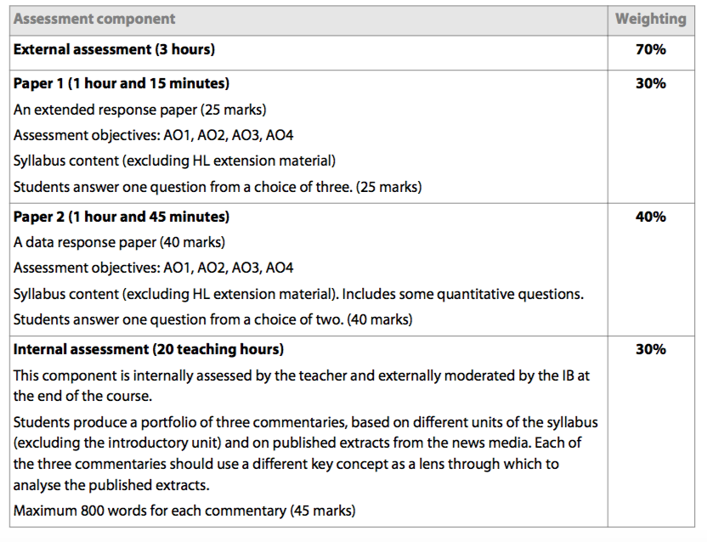
Assessment outline:
Rationale
Internal assessment in economics enables students to demonstrate the application of their knowledge and understanding of economic theory in relation to real-world situations.
Requirements
Both SL and HL economics students produce a portfolio of three commentaries based on articles from published news media. Each article must be based on a different unit of the syllabus (excluding Unit 1: Introduction to economics): Unit 2: Microeconomics, Unit 3: Macroeconomics and Unit 4: The global economy.

Slide 8
Key dates:
Task published: Friday 22nd May
Pre-IB lesson: 3b Thursday 28th May

Slide 9
1.0 Foundations of Economics
ACTIVITY 1: The Economic Problem of Scarcity: The Economics of Zoo Keeping
ACTIVITY 2: The Challenge of Data: Where Would you Most Like to Live?
ACTIVTY 3: Use of Models in Economics: How Bad will the Recession Be?

Slide 10
Activity 1:The Problem of scarcity
The Economics of Zoo Keeping
Directions: You are the manager of a new business that has decided to open a zoo. Your zoo is a private, profit-seeking business that will charge admission to visitors. The purpose of the zoo , as with any business, is to earn a profit.
Your task is as follows:
You have to decide which animals to include in your zoo, but space is limited.
You have 25 acres on which to build your zoo.
Each type of animal requires a different amount of space, so you must choose which animals to put in your zoo. Remember, you need at least one male and one female of each animal so they can reproduce.
Choose which animals you will put in your zoo.
Below each animal is the number of acres just one of the animals requires. For example, one lion requires two acres of land. If you want four lions, therefore, you must use eight of your 25 acres for lions.
Take a large piece of paper (at least A3) and using a marker, design the layout of your zoo. The paper represents the 25 acres you have for animals. Once you have decided which animals to include, how many of each animal, and calculated how many acres are to be used for each animal, cut out the animals you have chosen and paste each animal into its dedicated enclosure.
Once you have completed construction of your zoo, answer the discussion questions that follow.

Slide 11
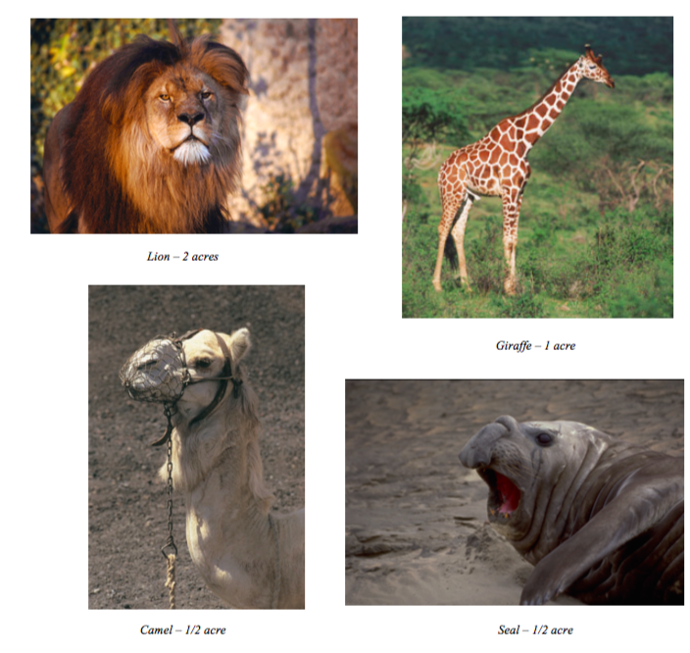

Slide 12
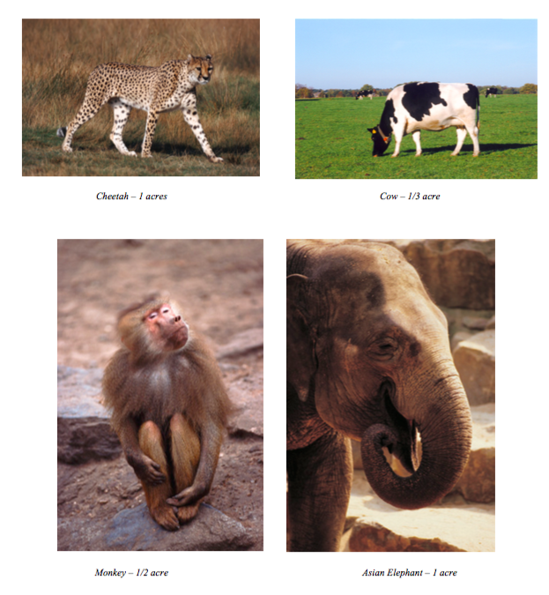

Slide 13
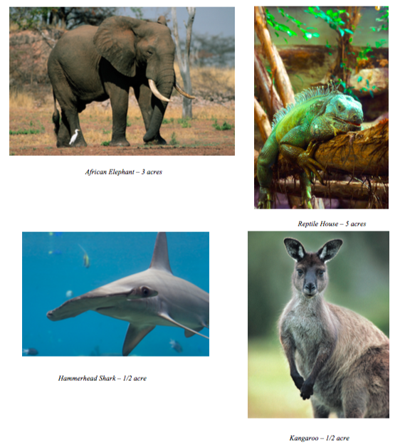

Slide 14
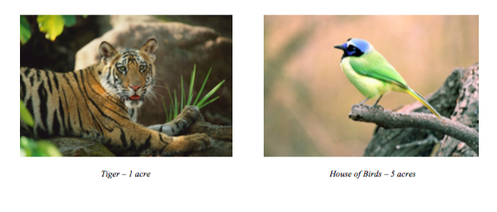

Slide 15
Discussion Questions for Thursday (Please pre-think your answers or write them down before Thursday)
Did every animal make it into your zoo? Why or why not?
Did you include a turkey or a cow in your zoo? Why or why not?
Why didn't you have a zoo with only monkeys?
Which type of elephant did you choose? Why did you choose the type you did and not the other?
What was the last animal to make the cut for your zoo?
What was the animal that just missed the cut for your zoo?
Did everyone in your group agree to include the same animals?
Would everyone in your group have made the same choices if they did it alone?

Slide 16

Activity 2: Where would you go to live?
The importance of data and analysis
Task:
Listen to the audio recording
What are the 3 most important measurements for making your decision?
Which country would you like to live in, explain why with reference to the 3 measures of data (aim to write a paragraph)
Do you think that quantitative data alone will be enough to make your decision, what else might you need?

Slide 18
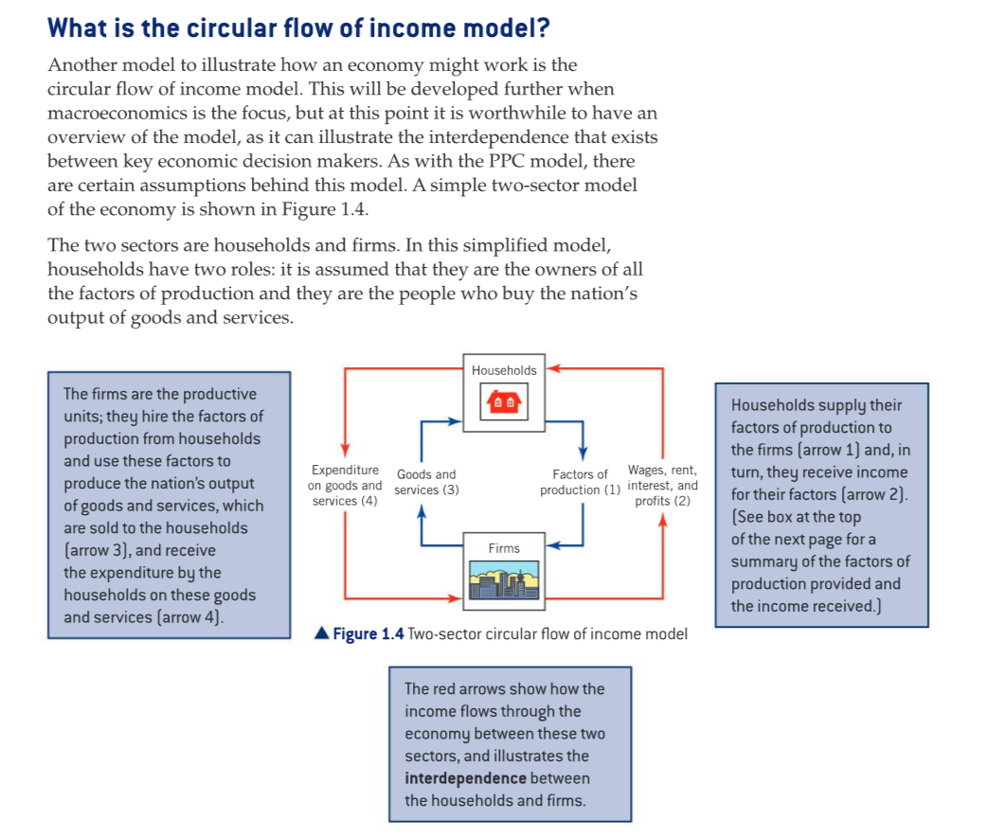
Activity 3: How has the Covid-19 pandemic affected GDP?

Slide 19
Activity 2: How has the Covid-19 pandemic affected GDP?

Slide 20

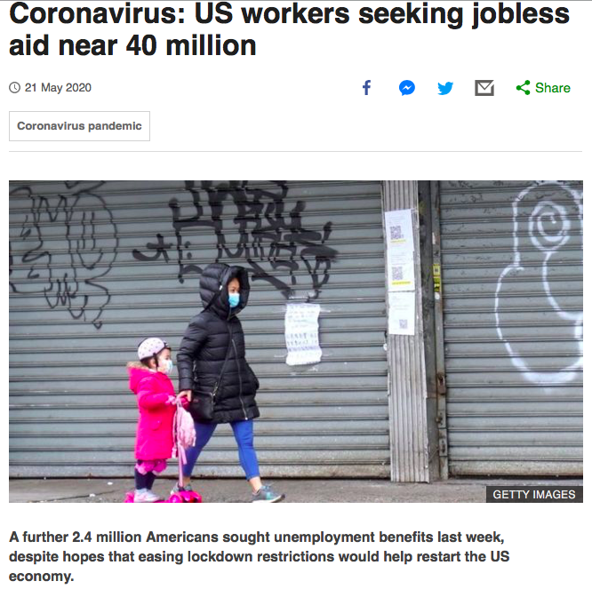
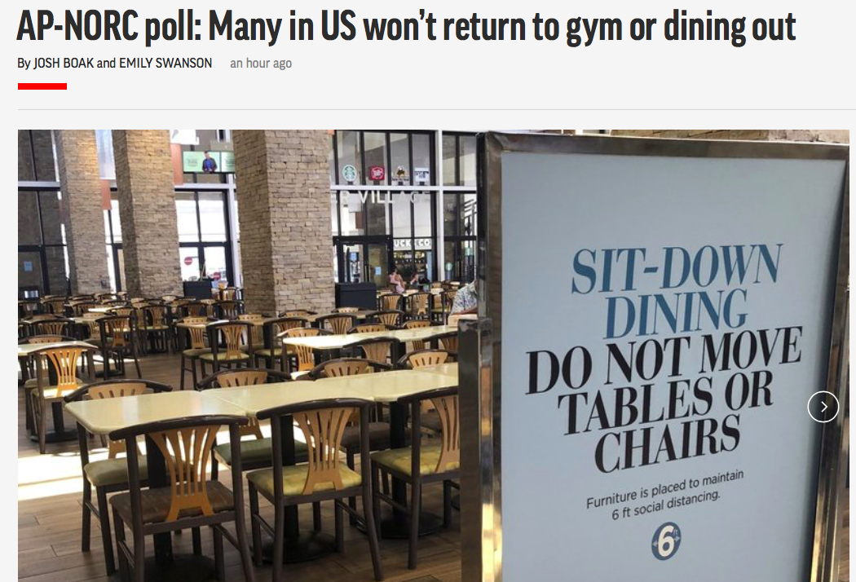
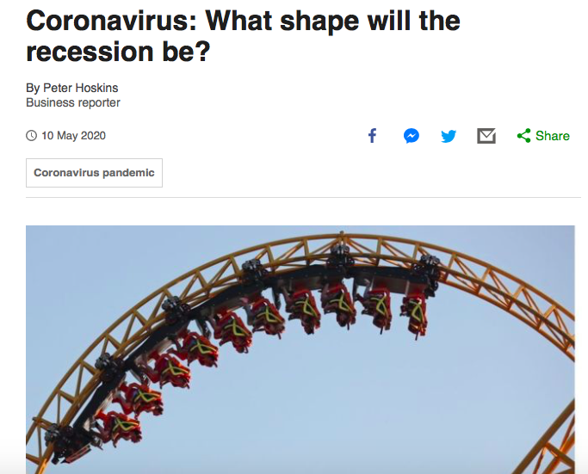
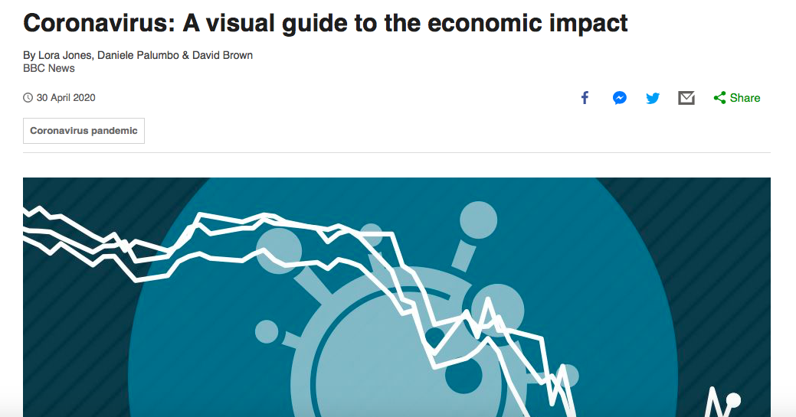
What sort of recovery will the US and global economy experience?
Use the following sources of data (HYPERLINKED ARTICLES) to consider the severity of the recession facing the USA. What does the Circular Flow of Income Model suggest about the length of the recession. Can you give your opinion as to whether you are expecting a ‘V’, ‘U’, ‘W’ or ’L’ shaped recession? You can jot down your ideas, remember to think about how each article relates to the CFI model.
Source C:
Source B:
Sources to help form your ideas:
Source A:
Source E:
Source D:

Slide 21
Conclusion, can you write a brief conclusion about what sort of recession the USA will experience as a result of the pandemic (to make sense of the letters you will need to have read Data source E):
Evidence for ‘V-shaped’ | Evidence for ‘U-shaped’
Evidence for ‘W-shaped’ | Evidence for ‘L-shaped’

Slide 22
