Slide 1
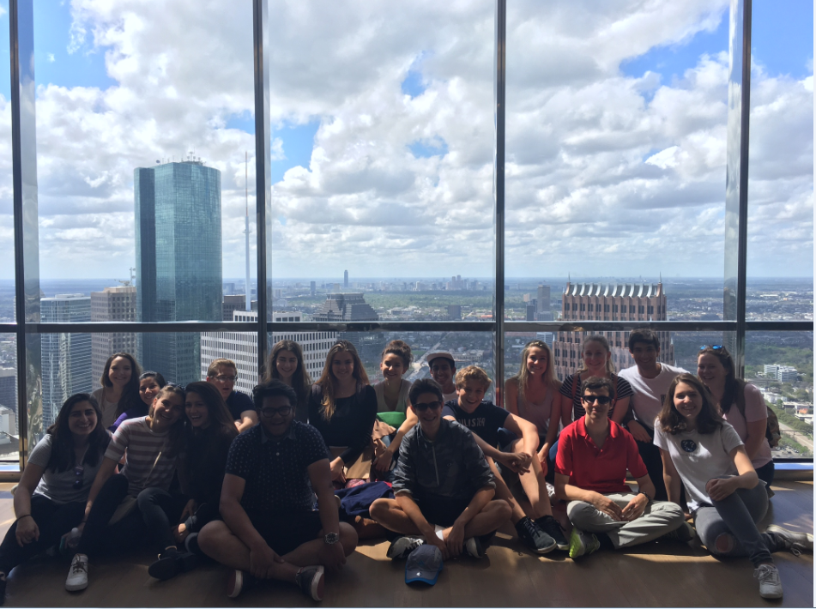
IA Introduction
A: Fieldwork question and geographic context (0-3 marks) – 300 words

Slide 2
Objectives
What: Introduction to your Geography IA
How: Use the guidelines on Weebly to construct your coursework introduction.
Why: To enable you to achieve success in this very important element of your Geography IB

Slide 3
Section A: geographical context and research question

Slide 4
IA Introduction: Checklist
Clearly state the research question for investigation
State the part of the syllabus it relates to (optional unit G: Urban Environments)
Locate Houston and provide relevant background information e.g. function, size, layout etc (include a location map)
Include an annotated map(s) of Houston to show locational context (could have a map to show Houston within Harris county and a map showing the features of downtown). Annotations must be entirely relevant to your enquiry. IB love hand drawn maps!
Explain the theory that underpins the investigation i.e. the core-frame model (you could annotate a copy of the model to save words – though you should provide a sentence or two to introduce it).
You could also use supporting theories e.g. bid-rent theory, distance decay model, core-frame predictions model. Make sure you explain he relevance of these theories to your investigation.
Finally state your subsidiary questions/hypotheses. These will be the key ideas that you will be testing e.g. does building height decrease with distance from the presumed PLVI? Include no more than 3 sub-questions.

Slide 5
Getting started
You are going to focus on the Optional Theme G, Urban environments, specifically characteristics of the CBD.

Slide 6
What to Include In Section A: AREA OF STUDY (Research question)
Make sure that your research question is stated on the front cover and at the beginning of your introduction. Your research question gives your investigation focus. Your hypotheses are related to your research question and give your investigation greater direction.
Example: To what extent does Houston Downtown fit the core-frame model?

Slide 7
What to Include In Section A: INTRODUCTION TO STUDY LOCATION
Introduce where Houston, Texas is. Include a map of its location. You can also include what Houston is like in terms of function, layout etc…
You should also give some detail about what Downtown Houston is and give some context to the sites studied.

Slide 8
What to Include In Section A: INTRODUCTION TO THEORY
This will depend on your research question. If you are looking at the core/ frame model explain your understanding of this.
Basically show the examiner that you understand the geographical ideas related to your research.
You should also relate your investigation to the specification e.g. urban environments.

Slide 9
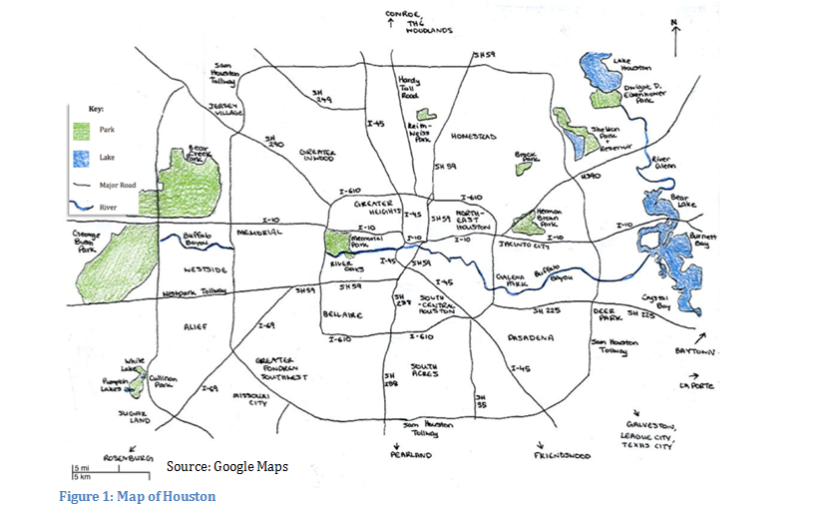

Slide 10
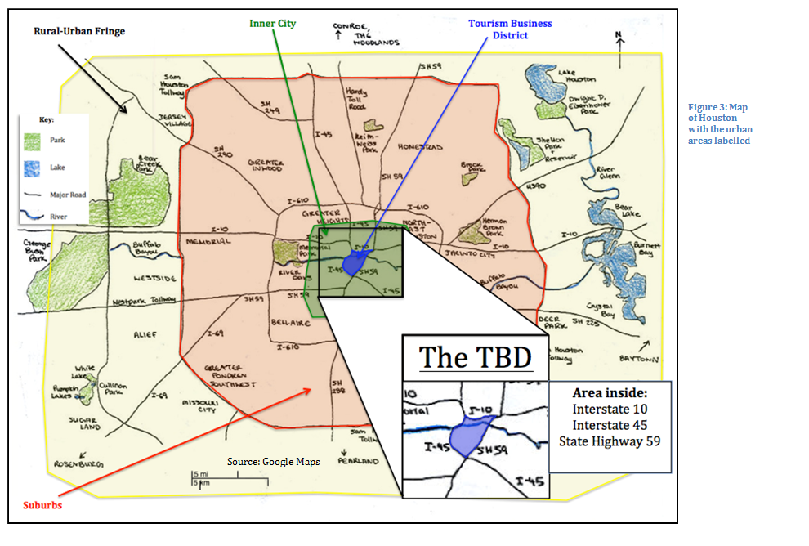
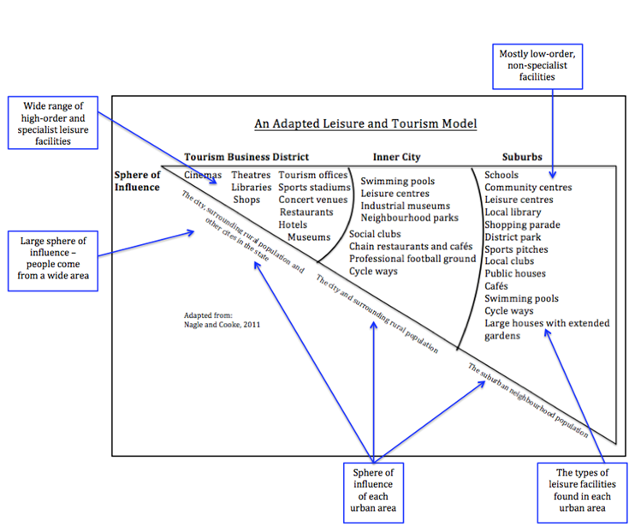

Slide 11
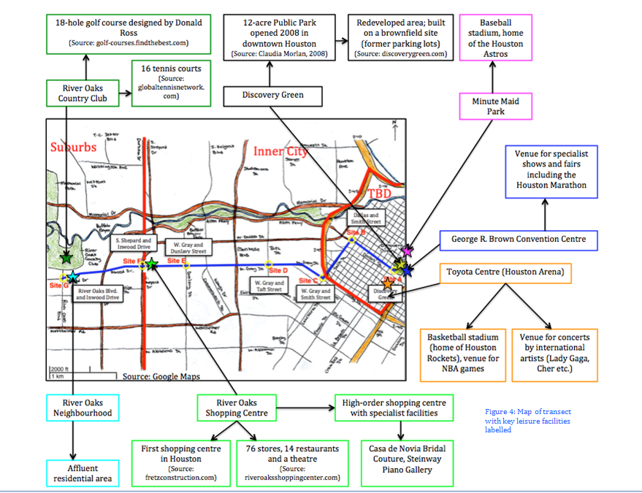

Slide 12
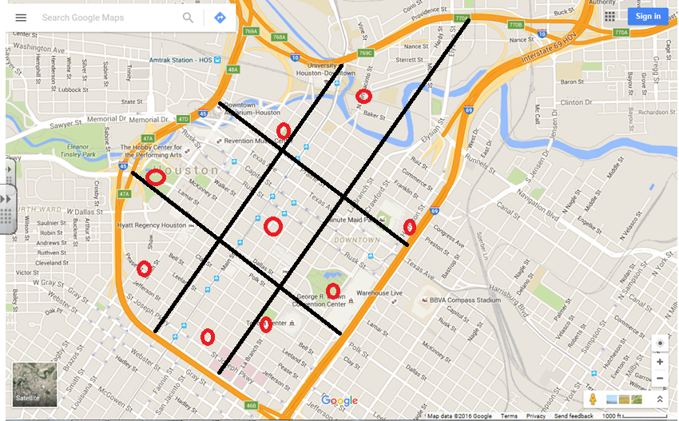
Sites for investigation
Site 1

Slide 13
Suggestion- annotate core/ frame model related to Houston

Slide 14
Back ground theory

Slide 15
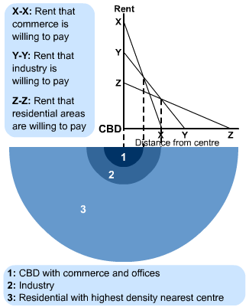
The bid rent theory
If including this in your coursework introduction you need to make sure you can explain its relevance to your fieldwork question
This bid-rent theory explains one pattern of urban land-use that is also identified by Burgess' concentric ring model.
Bid rent theory is a geographical theory that refers to how the price and demand on land changes as the distance towards the CBD (Central Business District) increases.
The different land users all compete with one and other for the more accessible land. The amount that they are willing to pay is called Bid Rent. As a direct result of this, a pattern of concentric rings of land use develops.
The diagram shows what various land-users are prepared and able to pay for good access to the CBD

Slide 16
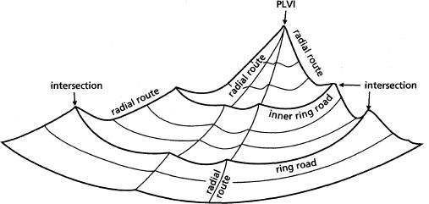
Distance Decay principal
PLVI – Peak land value intersection

Slide 17
Distance decay
If including this in your coursework introduction you need to make sure you can explain its relevance to your fieldwork question
The CBD of a city will be the location of the PLVI.
This means is the highest rated, busiest and most accessible part of the city – meaning land prices are also the highest.
Secondary peaks also exist in urban areas. These are areas that are also very accessible and so highly rated e.g. Houston – the Medical Center, Energy Corridor, Galleria District are all secondary peaks.
How would we know where the PLVI is?
Where do you think it is in Houston?

Slide 18
Aims of the investigation
1. To delimit the City Core / CBD of Houston
2. To distinguish the core, the frame, zone of assimilation and zone of discard by using a set of parameters e.g. land use, building height etc.
3. To test the hypothesis formulated.
4. To explain any anomalies and uniqueness of the Houston city centre

Slide 19
What to Include In Section A: Hypotheses
A hypothesis is a prediction or statement that you attempt to prove or disprove through your research. It is possible to complete an internal assessment without hypotheses but it generally gives you greater direction. A good number of hypotheses is three. This gives you plenty to talk about, but will not exceed your word limit.
Your hypotheses must be SMART:
Specific
Measurable
Achievable
Realistic
Time-related
Very briefly explain why you expect your hypotheses to be true, make a link to geographic theory. Also state why investigating the impacts of tourism and/or globalization is important.

Slide 20
Below are examples of hypotheses that you may choose:
The building height will decline as you move away from the core/ PVLI
The quality of the environment will worsen as you move away from the Core/ PVLI
The number of pedestrians will decrease as you move away from the core / PVLI
The quality of shops will decline as you move away from the core / PVLI
There will be more high order services in the core than the frame
The oil institutions tend to cluster near the core / PVLI

Slide 21
Sites for investigation
Site 1: Chevron building 1400 Smith St
Site 2: Cathedral 1111 St Joseph Pkwy, Houston, TX 77002 Site 3: Toyota Centre 1510 Polk St, Houston, TX 77002 Site 4: Discovery Green Site 5: Minute Maid park- corner of Congress and Crawford Site 6: Prison District: Fannin and Crawford Site 7: Chase tower: 600 Travis St Site 8: Green Street: 1201 Fannin St, Houston, TX 77002 Site 9: City Hall: 901 Bagby St. 77092

Slide 22
Site 1: Chevron buildings
Edge of CBD but does show some characteristics of the core (i.e. TNCs, tall buildings) but also car parks

Slide 23
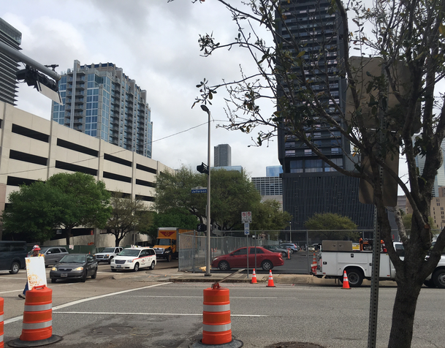
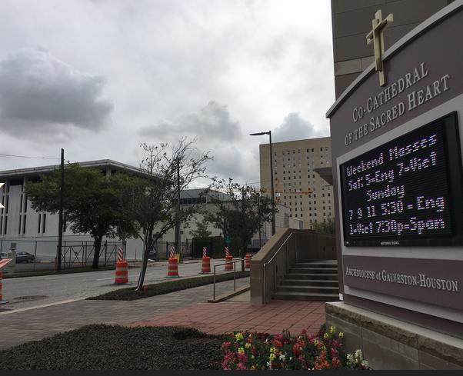
Site 2: Cathedral
Cathedral (modern) so on the edge.
Evidence of regeneration of brownfield sites around area- new hotels e.g. Holiday Inn and new apartments

Slide 24
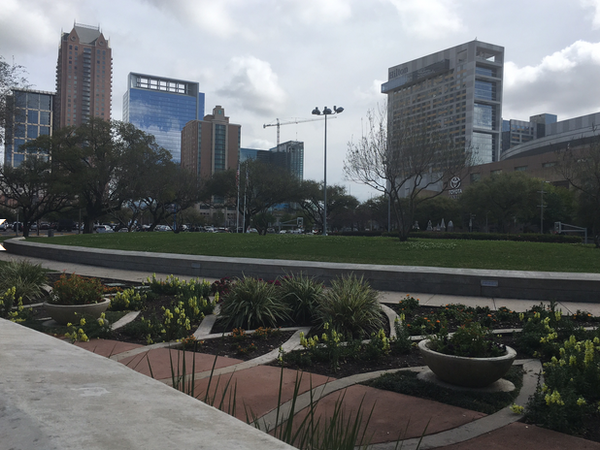
Site 3: Toyota Centre
Many car parks etc. to support major sports and concert venue
Landscaping/ park to make area attractive for visitors

Slide 25
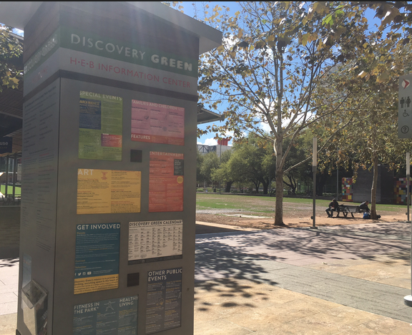
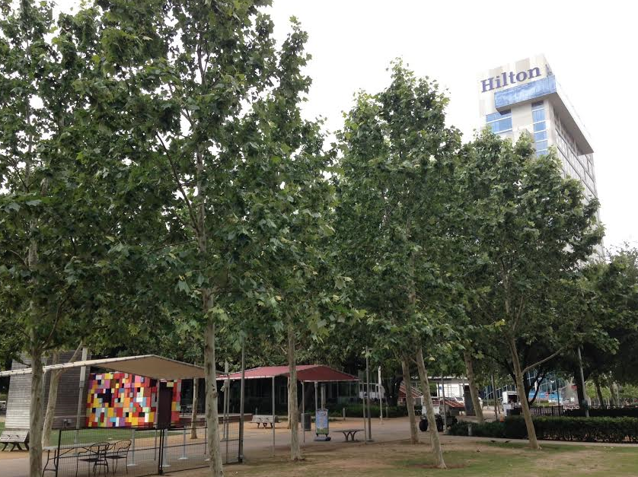
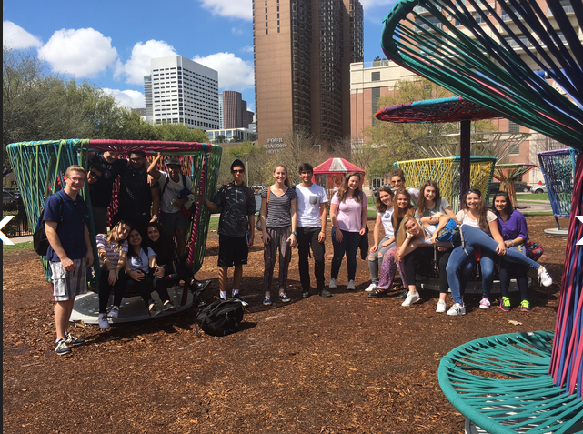
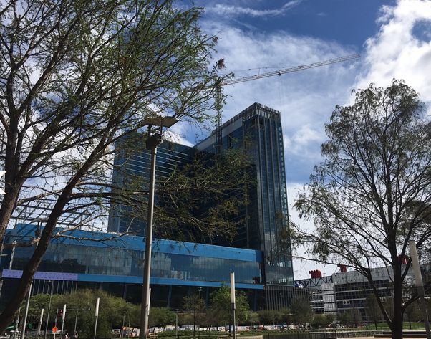
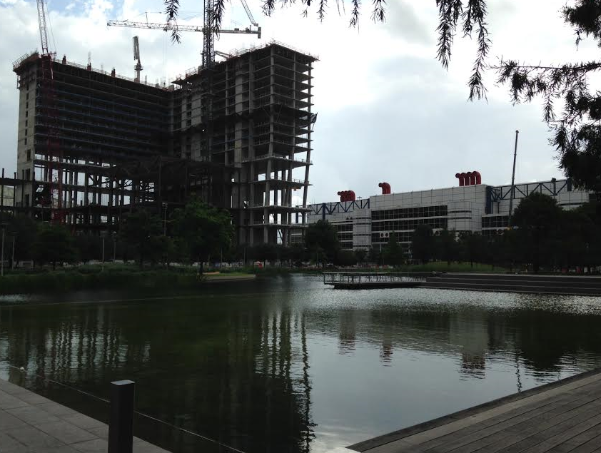
Site 4: Discovery Green (zone of assimilation?)
Green space- playgrounds/ lakes etc
New hotels
restaurants
Convention centre
New development - hotel
Same hotel in May 2015

Slide 26
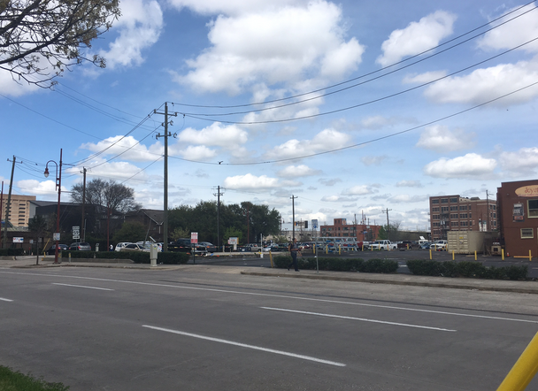
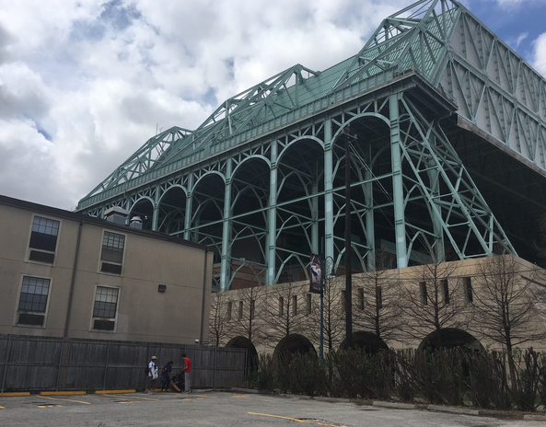
Site 5: Minute Maid Park (Crawford and Texas)
Baseball ground
Homeless shelters
Salvation army/ women's centre
Car parks
Bail bonds
Bars

Slide 27
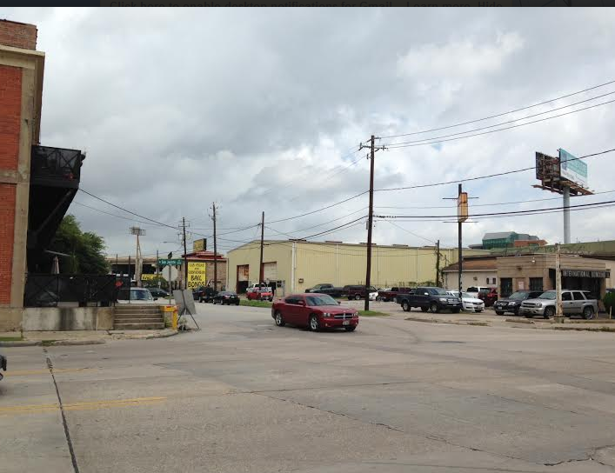
Site 6: Sheriffs office/ Jail – San Jacinto and Baker (zone of Discard?)
Sheriffs office
Jail
Bail bonds
Residential
Near University of Houston

Slide 28
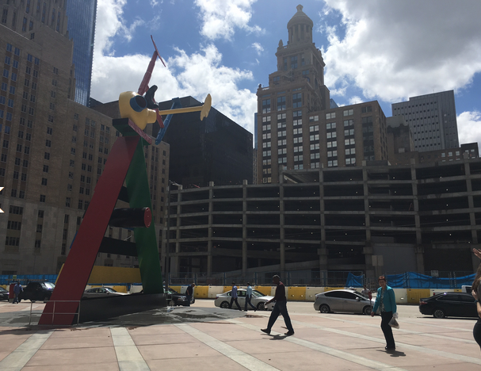
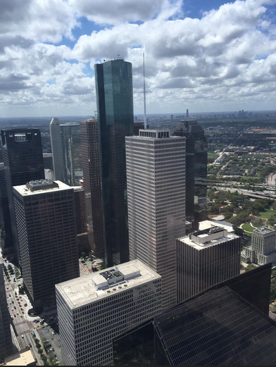
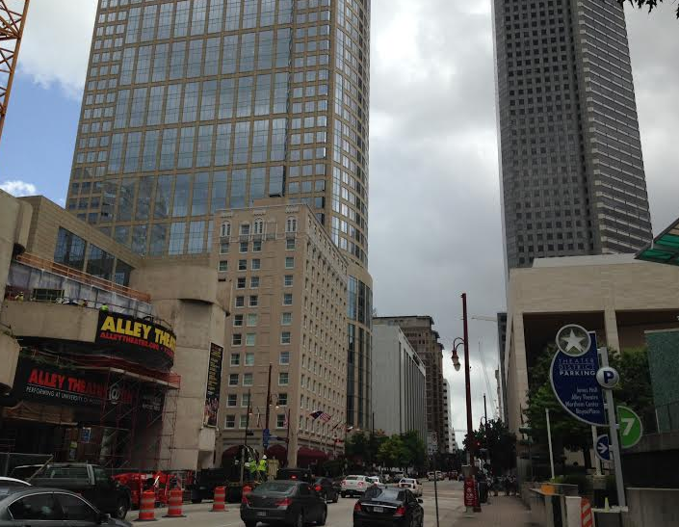
Site 7 : Theater District/ Chase Tower
Concentration of theatres- Alley/ Wortham Ballet )/ Jones Hall- symphony
Restaurants
Hotels
Concert venue
Chase- highest building- PVLI
Concentration of offices

Slide 29
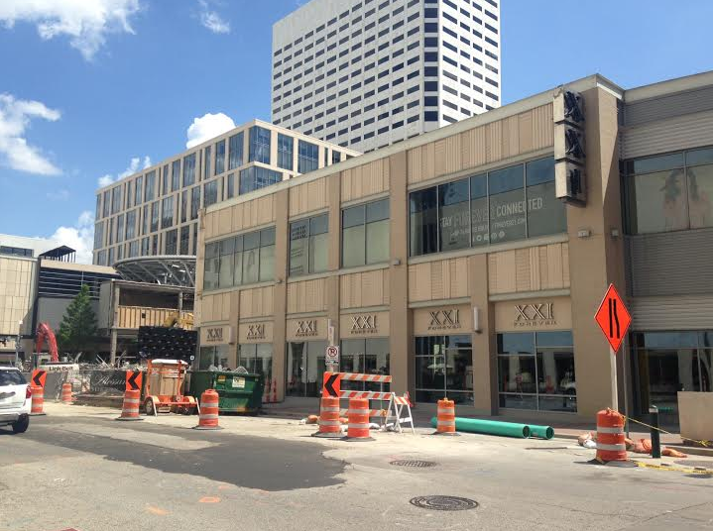
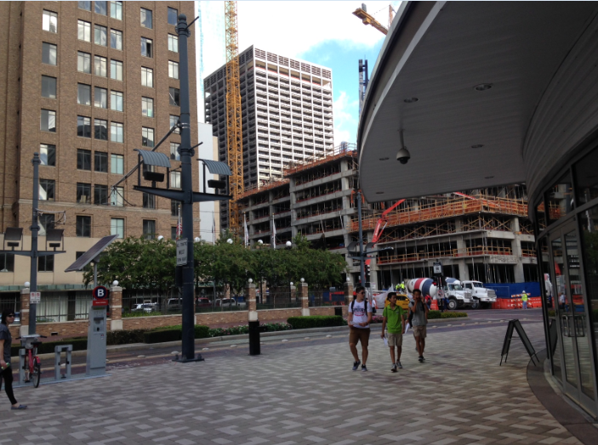
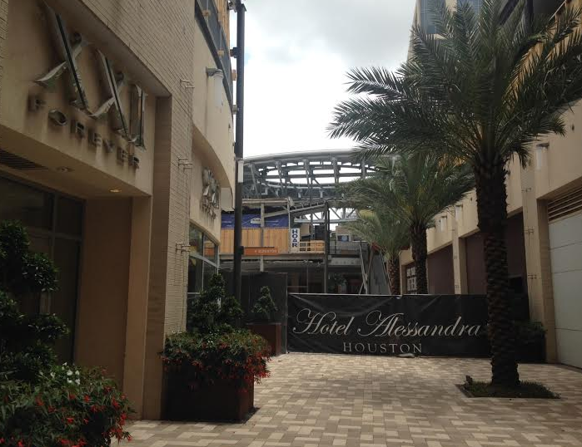
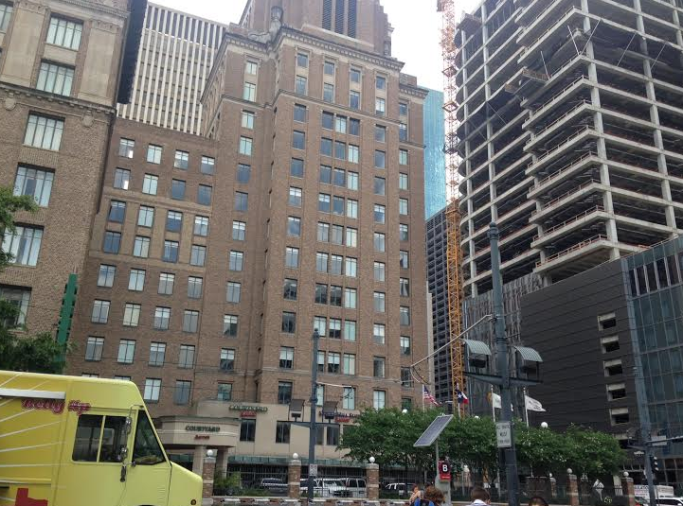
Site 8: Retail (under regeneration)- Main and Dallas
Shopping (but many abandoned- i.e. Macy’s)
Hotel
Cafes/ restaurants
Good access to sustainable transport

Slide 30
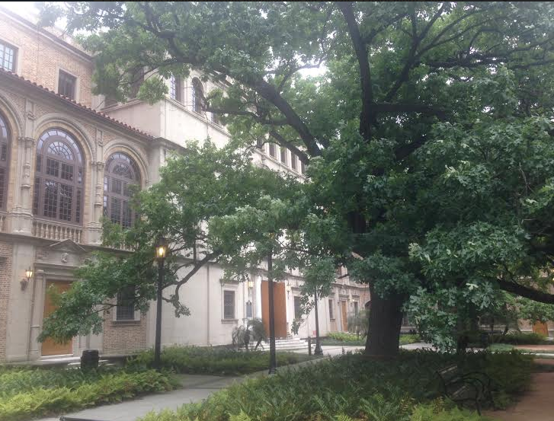
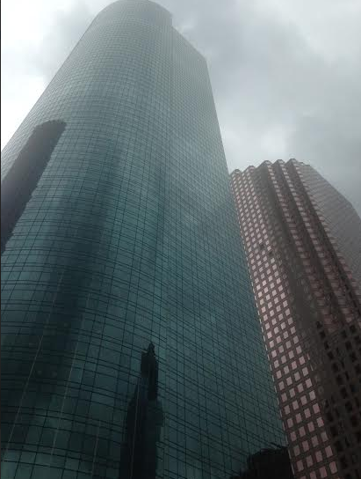
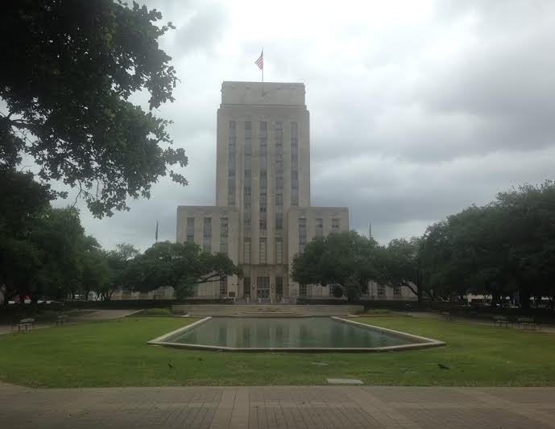
Site 9: Library/ Town Hall (core)
City hall
Green space
Central Library
High rise office blocks

Slide 31
Top tip
The IB love maps but you must make them your own in some way (this could mean hand drawn or use detailed annotations). Ensure that you include a scale/ north arrow and source if applicable.
All figures need a clear title and figure number.

Slide 32
Criterion A Fieldwork question and geographical context (worth 3 marks)
Your field work question is narrowly stated
The fieldwork question is posed as a question
You have sub hypothesis to help answer the main fieldwork question
You have explained the geographic context- explaining why the fieldwork investigation is to be carried out
You have explained the geographic context- explaining where the fieldwork investigation is to be carried out
You have made a brief judgment (prediction) linked to geographical theory answering the fieldwork question
The geographical context includes spatial, physical, socio-economic conditions and other background information, concepts or characteristics (if appropriate)
You have included a map of the field work area (hand drawn)
The map has all of the standard conventions (title, scale, north arrow etc)
You have stated the area(s) of the syllabus to which the study relates

Slide 33
Peer assessment:
What grade and why?
What was good about it?
What could be improved?
What have I learnt for my own IA?

