Slide 1
Learning outcomes
What: How did William take control of England after the Battle of Hastings.
How: By reviewing historical and pictorial evidence.
Why: To understand that to assume power you must control opposition and reward your supporters.

Slide 2
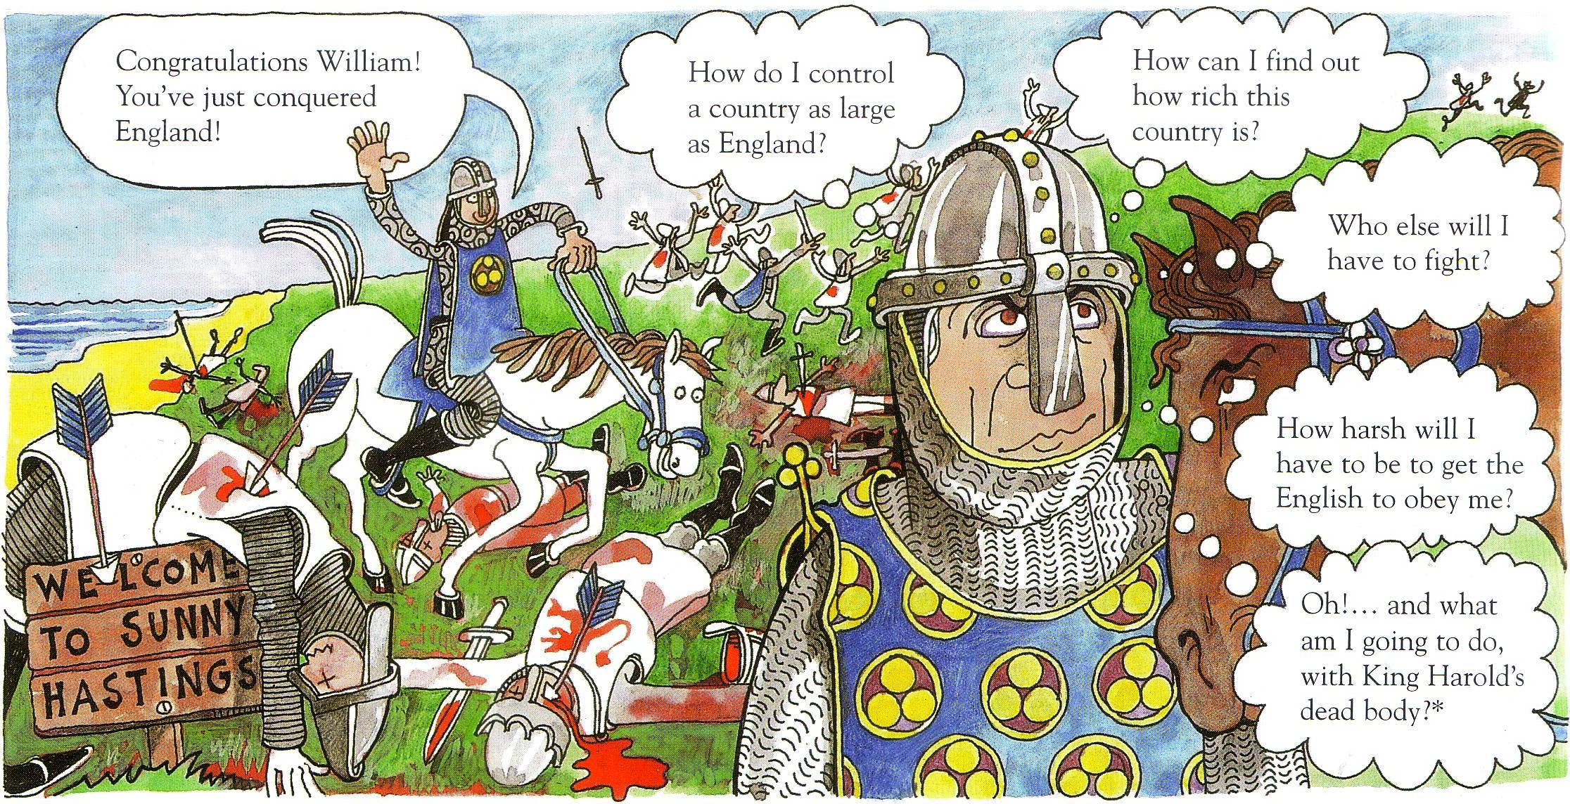

Slide 3
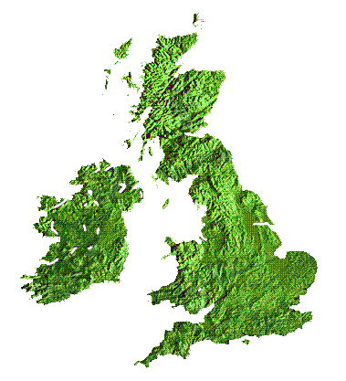
What problems did William face?
Much of Northern England supports invasion by the Scandinavians.
The English lords cannot be trusted.
Some of Harold’s troops did not come to Hastings and are still in London.
Money is required, but there is no record of the wealth of the country.
At Dover, there is a strong castle full of English soldiers.

Slide 4
Problems
What problems did William face as a new king of England?
List as many problems as you can. Make a list in your exercise book.

