Slide 2
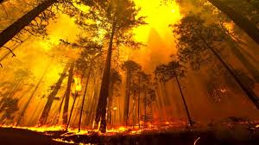
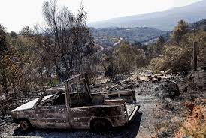
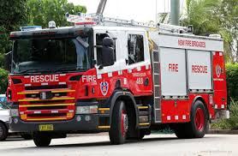
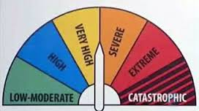
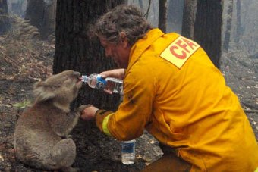
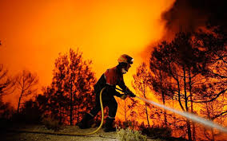
Starter: can you explain this video?
http://www.bbc.co.uk/news/world-australia-35157302
What type of hazard is shown?

Slide 3
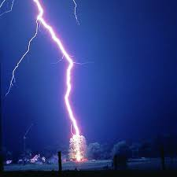
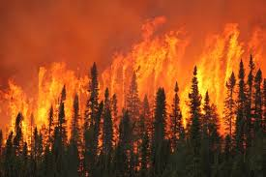
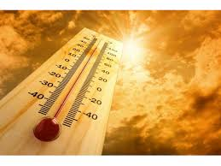
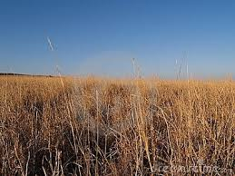
Wildfires
Aims:
To describe the causes of wildfires, the effects they have, and how we can respond to them
Starter:
What is a wildfire and what causes them?
Notes:
https://www.youtube.com/watch?v=GZv-PN63MwE

Slide 4
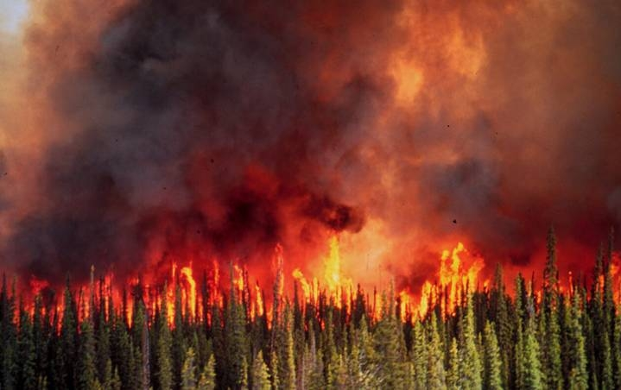

Slide 5
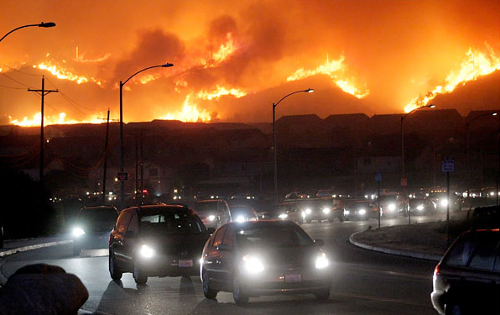

Slide 6
What is a wildfire?
Wildfires
= a large uncontrolled destructive fire that burns quickly over woodland or grassland.
There are three types:
Ground fire:
Where the ground burns, e.g. peat, tree roots; slow burn with no flame and little smoke
Surface fire:
Leaf litter and low lying vegetation burn
Crown fire:
Fire moves rapidly through the canopy; fires are intense and fast moving

Slide 7
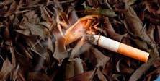
What causes wildfires?
Sort these into natural and human causes.
SPARKS FROM MACHINERY
LIGHTNING
CIGARETTES
VOLCANIC ERUPTIONS
BARBECUES
FIREWORKS
ARSON
CAMPFIRES
MANAGED FIRES

Slide 8
What causes wildfires?
Sort these into natural and human causes.
SPARKS FROM MACHINERY
LIGHTNING
CIGARETTES
VOLCANIC ERUPTIONS
BARBECUES
FIREWORKS
ARSON
CAMPFIRES
MANAGED FIRES

Slide 9
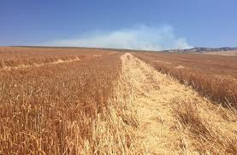
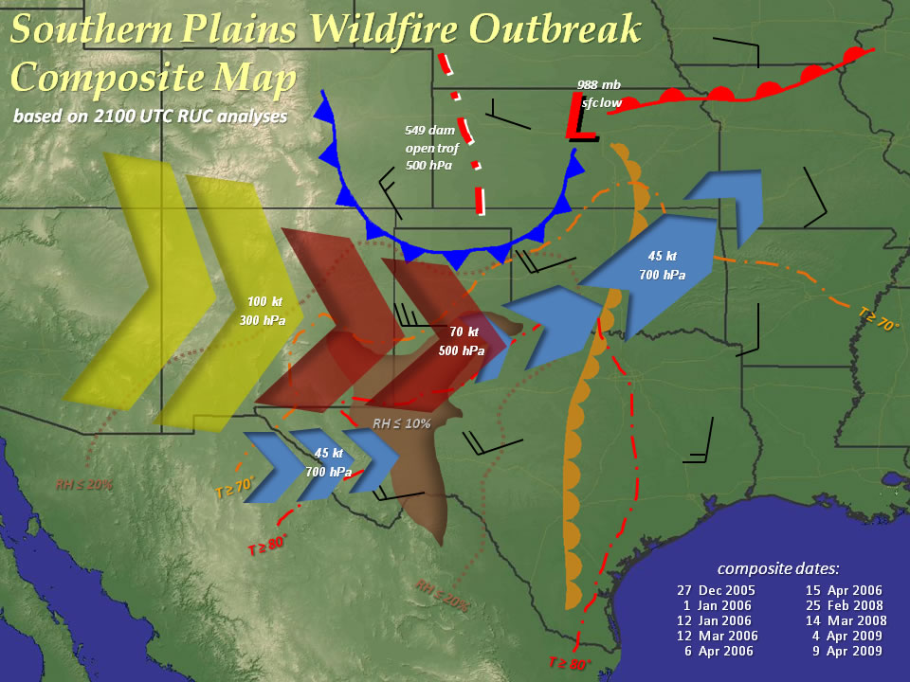
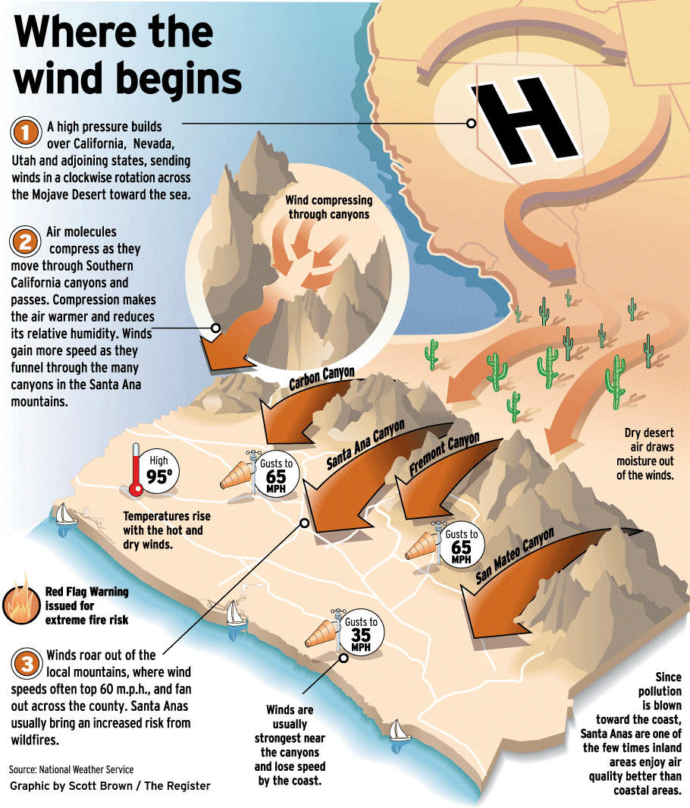
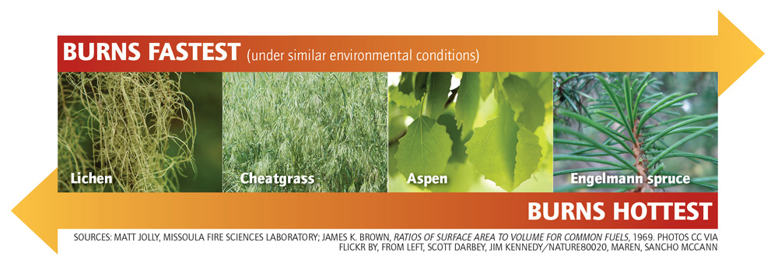
Conditions needed for wildfires
What conditions are needed to create wildfires?

Slide 10
The causes of Wildfires
Lightening – 23%
Farming – 10%
Arson – 37%
Campfires – 13%
Trains – 1%
Other – 16%
Task 1: Using the information above can you draw a pie chart – remember to add a title.
Extension:
Can you describe your pie chart.

Slide 11
A range of human and natural causes
Lightening
Spontaneous heating of material
Volcanoes
Accidents
Broken bottles act as magnifying glasses
Slash/burn farming techniques
Arson

Slide 12
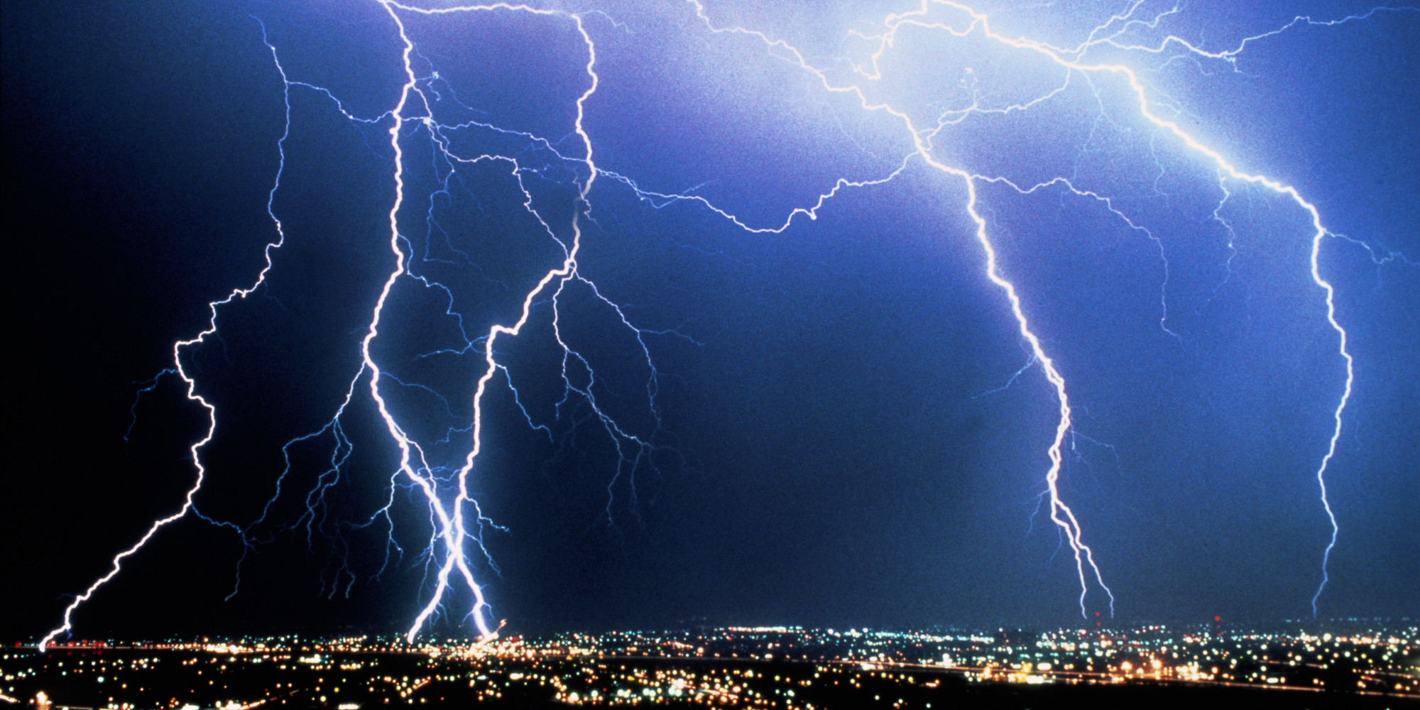
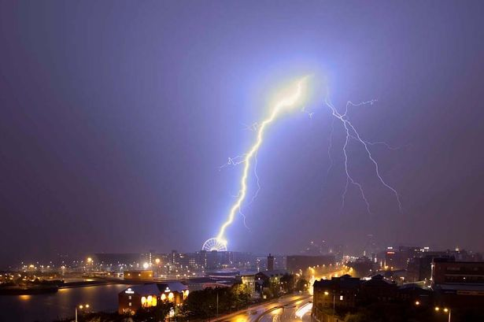
Lightening
The biggest single natural cause of wildfires.
Lightening strikes can cause fires to start but most these are small and soon die out.
When conditions are right, fires started by lightening can spread quickly.

Slide 13
Spontaneous heating
When material becomes heated to the point at which it will catch fire without a spark being present.
Often large amounts of plant material build up heat.
You need hot humid conditions for this to occur.

Slide 14
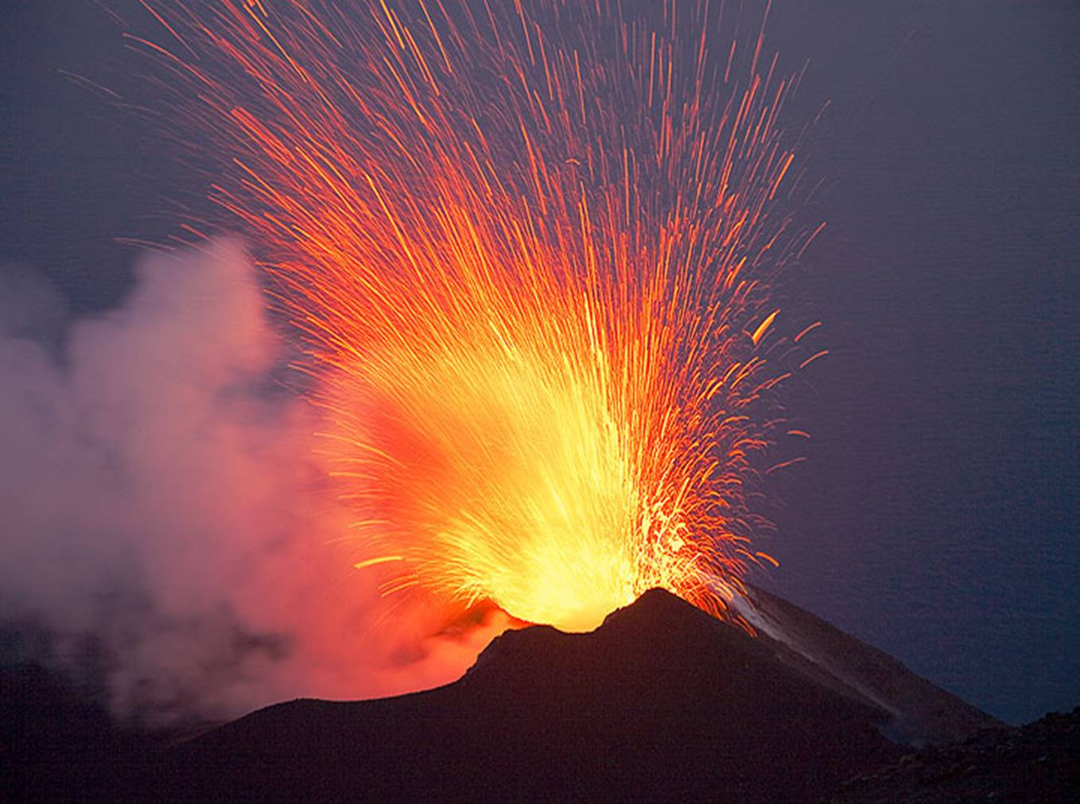
Volcanoes
Emit red hot lava and ash. These can start wildfires.
Earthquakes can also trigger fires – destroying phone lines etc.

Slide 15
Accidents
Accidents are to blame for many wildfires. Children playing with matches, campfires that haven't been put out properly and cigarettes that are thrown away.
Broken bottles that have been thrown away can act as a magnifying glass concentrating the suns rays. This can set fire to dry plants/shrubs or even litter.

Slide 16
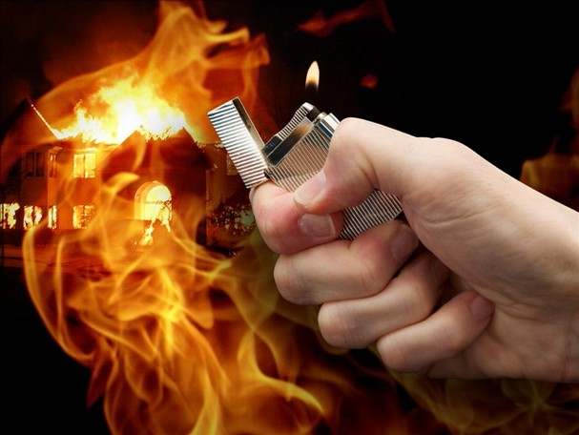
Arson
The act of deliberately starting fires. In some areas it can amount to up to 30% of wildfires.
A major cause of the Australian wildfires in 2009.

Slide 17
Slash and Burn
A type of farming method used to clear land to grow crops. These can easily get out of control an spread.
Other causes can include sparks from trains or machinery, military training, barbeques.

Slide 18
Task 2: In your books draw a spider diagram outlining the causes of
Wildfires – include details.
Task 3: categorize those causes into human and natural. Use 2 colors
Human
Natural
The causes of Wildfires
Extension: To what extent do you think wildfires are a natural hazard?

Slide 19
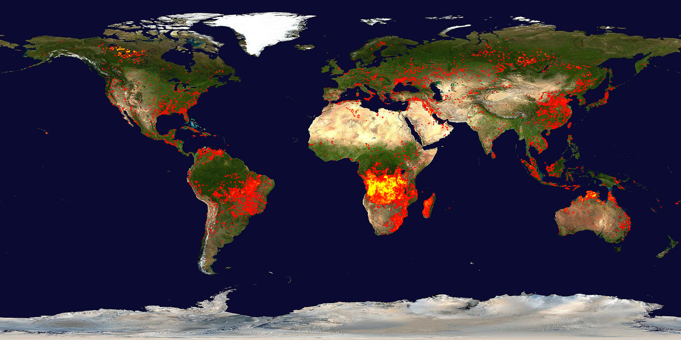
Task:
On you map highlight the areas affected by Wildfires.
Extension: Highlight MEDC’s/LEDC’s
Is there any pattern?
http://www.fire.uni-freiburg.de/current/globalfire.htm

Slide 20
Conditions needed for wildfires
Mix and match the condition to its description.
Vegetation type | Creeping fires move across the ground surface fairly slowly Running fires spread rapidly and are more intense Fires can throw out burning debris that help the fire spread and become more intense
Fuel characteristics | Rainfall must be sufficient for vegetation to grow Fires normally happen in places with dry seasons with no rain and high temperatures for a long time, allowing vegetation to dry out Strong winds provide more oxygen to help the fire burn and spread
Climate and recent weather | Thick undergrowth Closely spaced trees, enabling fires to move quickly Trees containing lots of oil, e.g. pine and eucalyptus burn more quickly Eucalyptus trees shed strips of bark enabling fires to spread quickly
Fire behaviour | Fine, dry material, e.g. twigs, catch fire and burn easily Large amounts of fuel that form continuous cover will help the fire burn for longer and spread

Slide 21
Conditions needed for wildfires
Mix and match the condition to its description.
Vegetation type | Creeping fires move across the ground surface fairly slowly Running fires spread rapidly and are more intense Fires can throw out burning debris that help the fire spread and become more intense
Fuel characteristics | Rainfall must be sufficient for vegetation to grow Fires normally happen in places with dry seasons with no rain and high temperatures for a long time, allowing vegetation to dry out Strong winds provide more oxygen to help the fire burn and spread
Climate and recent weather | Thick undergrowth Closely spaced trees, enabling fires to move quickly Trees containing lots of oil, e.g. pine and eucalyptus burn more quickly Eucalyptus trees shed strips of bark enabling fires to spread quickly
Fire behaviour | Fine, dry material, e.g. twigs, catch fire and burn easily Large amounts of fuel that form continuous cover will help the fire burn for longer and spread

