Slide 1
Managing a wildfire
You're in charge!
Population 5000
Population 50
Population 1000

Slide 2
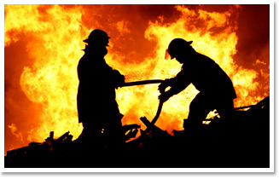
There will be reports coming in during the wildfire season.
Your job is to plan how to fight the wildfire most effectively.
There will be three options available for each report. Think ahead, what would be the best course of action?

Slide 3
Latest news:
There have been 2 months of hot conditions with no rain. Logging is increasing at the Carmel camp. Winds are light

Slide 4
Latest news:
A small fire has broken out south-east of Benedict

Slide 5
Latest news:
Winds have strengthened

Slide 6
Latest news:
The winds have blown embers and started a spot fire at the picnic site on the Angelus river

Slide 7
Latest news:
Winds have changed direction, now blowing north

Slide 8
Latest news:
A large fire is burning in the deadwood area south of the Carmel camp. A fire has also started south of Francis town center.

Slide 9
Latest news:
The fire threatens homes on the outskirts of Francis town. The main road has been cut off. Carmel logging camp has been destroyed.

Slide 10
Latest news:
Rain is forecast.

Slide 11
How did you get on?
Now, we will go over the scores for each decision you made
There are 10, 5 and 0 points available
Add up your score at the end.
What was the main challenge of fighting the fire?
What was the most effective technique? Direct or indirect?

