Slide 1
Who are the Native Americans and where did they come from?
Notes:
Look at the plastic Map of the world – gather round and discuss senario

Slide 2
How did the Native Americans adapt to life in the New World? How did the colonists affect the life for Native Americans? And vice versa?
Notes:
Look at the plastic Map of the world – gather round and discuss senario

Slide 3
Written Task
  Where did the ‘Native Americans’ come from?
  Why is it difficult for historians to know the truth about ancient peoples?
  (Use the Native Americans as an example)
  Use PEEL to answer

Slide 4
three definitions:
Anthropologist: someone who studies people and their culture (the way they live their lives).
Archaeologist: someone who searches for the artifacts of the people of the past.
Artifact: anything that was made by a human (tools, weapons, clothes, etc.).

Slide 5
The ‘Big’ Questions
  Where did the ‘Native Americans’ come from?
  Why is it difficult for historians to know the truth?
  Who were the key tribes who settled in North America?

Slide 6
Migration: when people or animals move from one place to live in another place…
  Migrate is the root word of immigrate.
  Migration is the root word of immigration.

Slide 7
5 Migration Theories of how humans first came to America
Humans crossed the Pacific Ocean to get to America.
Humans crossed the Atlantic Ocean to get to America.
Humans crossed dry land or ice-covered land to get to America.

Slide 8
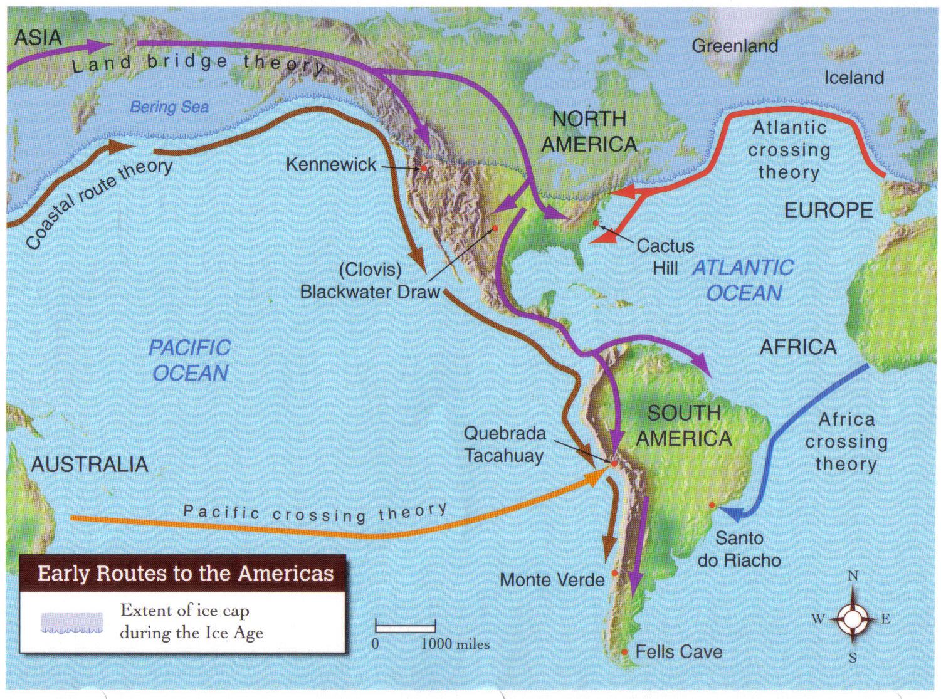

Slide 9
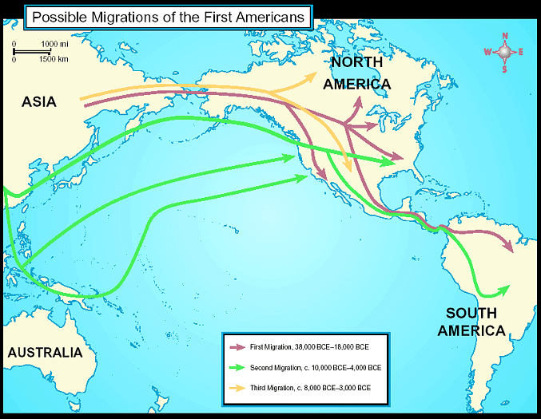
Early Human Migrations
    1st Migration, 38,000-1800 BCE
    2nd Migration, c. 10,000-4,000 BCE
    3rd Migration, c. 8,000-3,000 BCE

Slide 10
BERINGIA: the area between Siberia (in Asia) and Alaska (in North America).
Based on the work of anthropologists and by examining the artifacts found by archaeologists, the most widely known migration theory is the Beringia land crossing theory.
Anything named ‘Bering’ is named in honor of the Russian explorer, Vitus Bering.
https://www.youtube.com/watch?v=9EBknU7D1OI

Slide 11
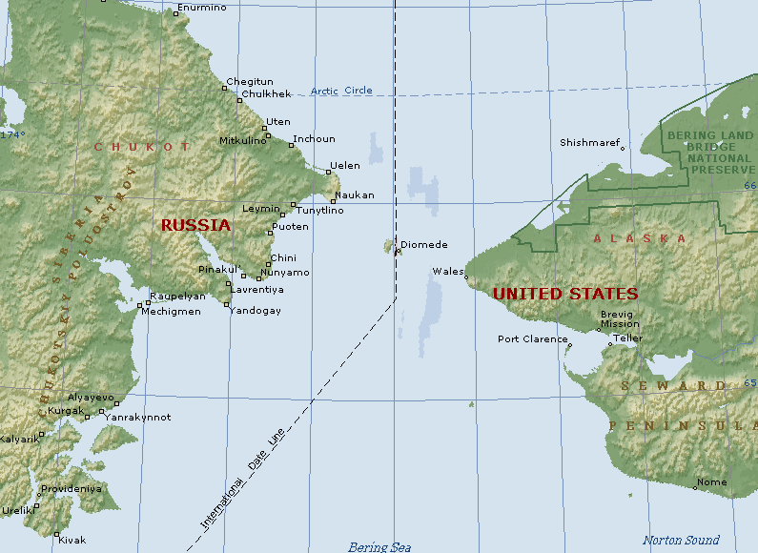

Slide 12
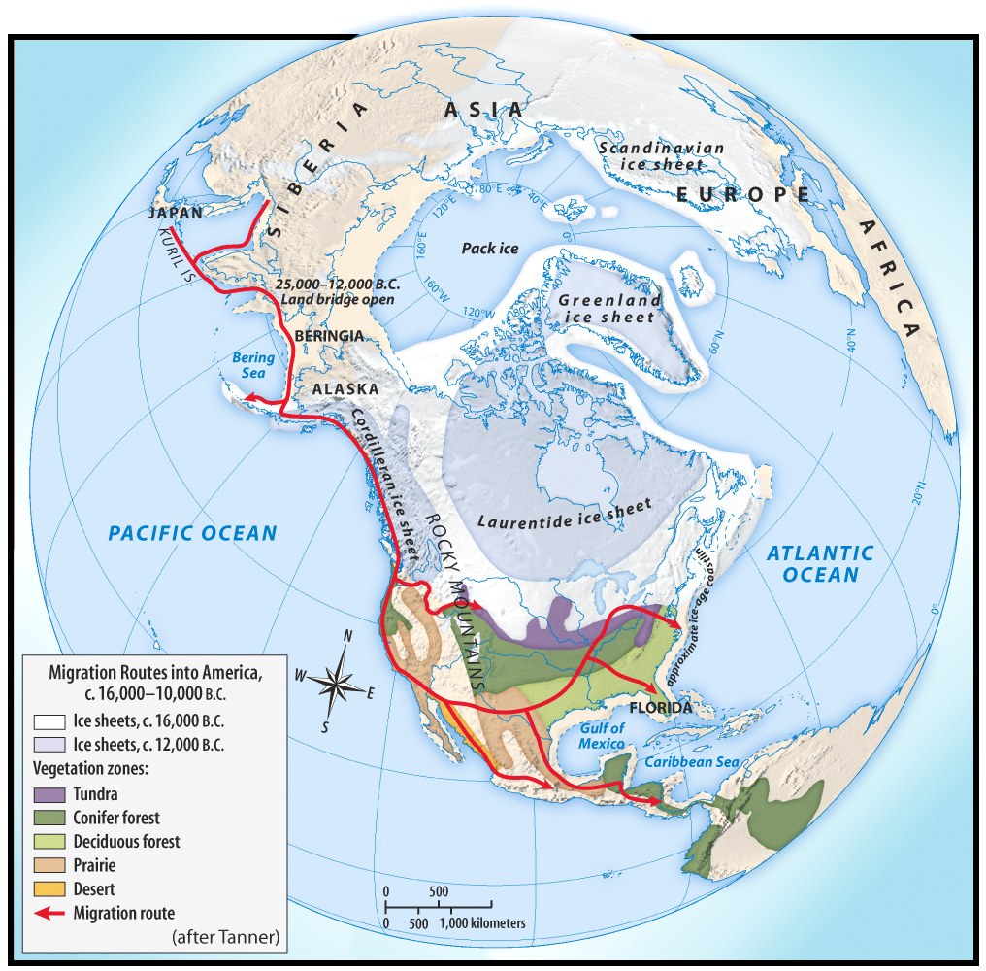
Pre-Columbian time period.
First Americans came from Asia
Crossed the Bering Strait during the Ice Age
Following a food source
Gradual migration

Slide 13
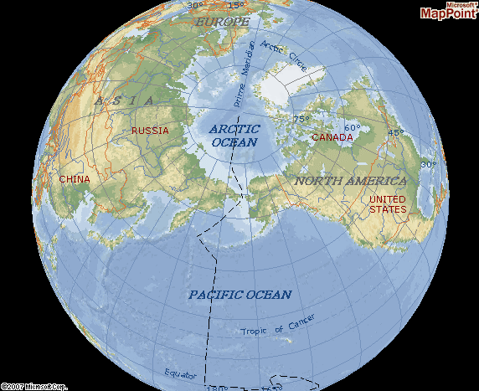

Slide 14
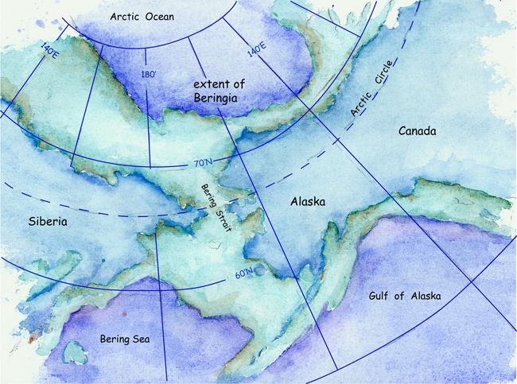

Slide 15
Migration
c. 30,000 years ago – people began to travel back and forth between Asia and America
c. 15,000 years ago – people began shifting further to the south and east
  moved into what is the present-day USA
  moved through present-day Mexico
  settled as far south as present-day Chile

Slide 16
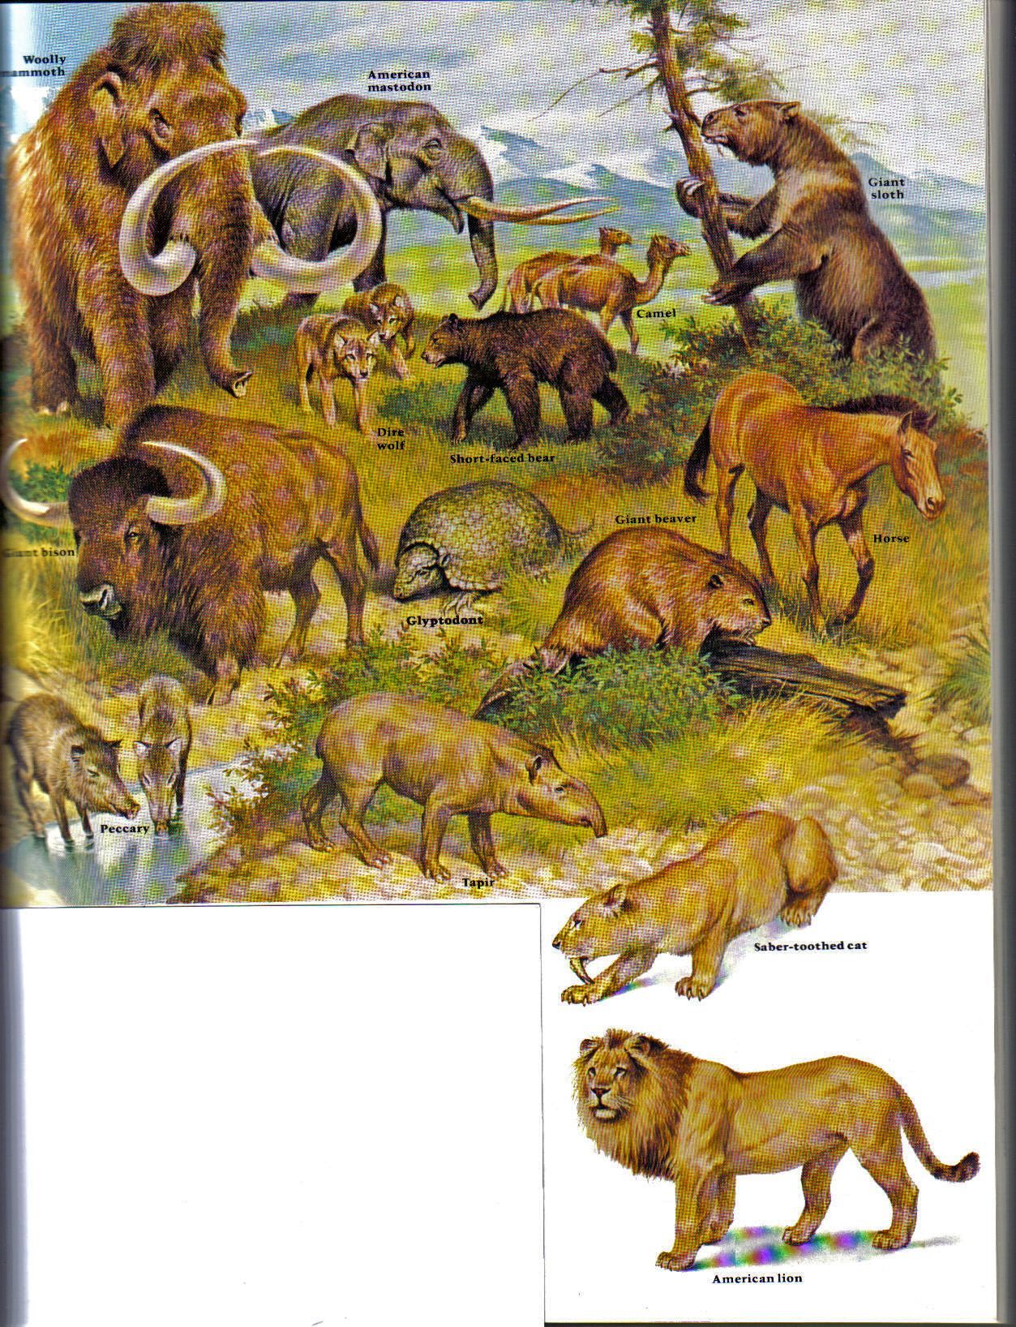
Animals of North America at the time of the arrival of humans.

Slide 17
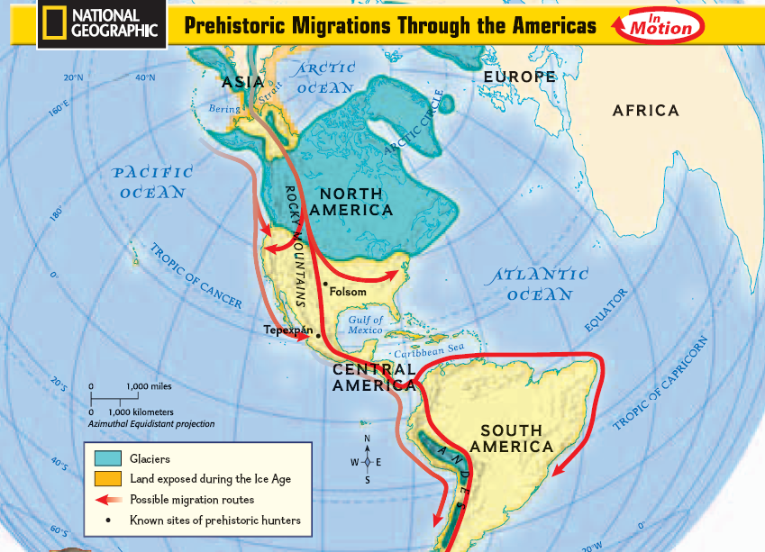

Slide 18
A Fishy Fossil
An amateur archaeologist was exploring in a remote mountain region in Wyoming known as Owl Creek. On a sheltered southern exposure hillside overlooking a natural spring the archaeologist discovered petrified fish scales. Through closer study of the general site, skeletal remains of an unknown fish were discovered. Once the site was carefully excavated, the fish remains were sent to a lab for identification. The lab made the following discoveries:
The fish bones and scales were left behind, the meat of the fish was not left at the site, it was removed from the scales and skeleton. The skeleton had marks that indicated that a knife like tool had been used to remove the flesh from the bones.
The fish was identified as a rare freshwater fish that is only found in the northeastern areas of Asia.
No other fish of this origin had ever been found in North America.
On further lab tests, traces of fire carbon were found on the skeletons.
Using the above information, form a hypothesis about this archaeological find. Make sure you note the laboratories findings in your hypothesis of the situation.

Slide 19
However….....
https://www.youtube.com/watch?v=E_k9uE6vrb8

Slide 20
Written Task
  Where did the ‘Native Americans’ come from?
  Why is it difficult for historians to know the truth about ancient peoples?
  (Use the Native Americans as an example)
  Use PEEL to answer

Slide 21
PEEL
  Point – 1 sentence
  Explain context to point made
  Example
  Link back to question - answer

