Slide 1
Where do our clothes come from?
Geographical enquiry
Find 20 items of clothes in your wardrobe- list the countries they were made

Slide 2
Where Mrs. Bennett’s clothes have come from?
Skirt, shoes, dress: China
Top: Vietnam
T-shirt: USA
T-shirt: Bangladesh
Scarf: India
Coat, dress: Turkey
Sunglasses: Italy
Investigating where our clothes have come from was a form of geographical research

Slide 3
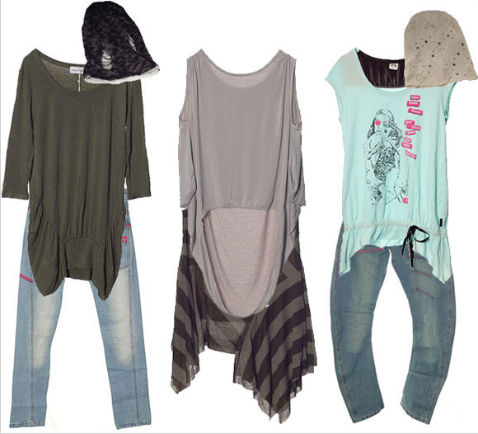
Where have your clothes come from?
As a class tally where all of your clothes have come from
Discuss with a partner what may be a good way to present this data,

Slide 4
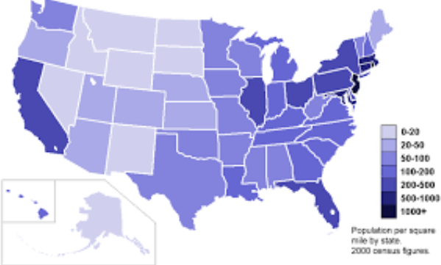
Create a choropleth map of where our clothes have come from
WHY: Geographical skills of data presentation and analysis
Success criteria:
Choose an appropriate scale and colour scheme
Shade in your world map with this colour scheme
Ensure your map has a clear title and scale
Describe the pattern shown on the map using examples of specific countries and areas and data from the key
Explain why you may have this pattern
Evaluate your presentation method- why was your chosen method appropriate?

