Slide 1
What is a nation-state?
Stalin defines the nation as a
"historically evolved, stable community of language, territory, economic life and psychological make-up manifested in a community of culture."

Slide 2
Nation, Nation – State, and Nationalism.
What is the difference between a Nation, a State and a Nation – State?

Slide 3
So what is a Nation – State?

Slide 5
What is the USA?

Slide 7
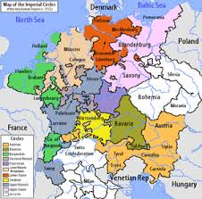
Types of Nationalist Movements
Unification: mergers of politically divided but culturally similar lands
(Example: 19th century Germany and Italy)
Separation: culturally distinct group resists being added to a state or tries to break away
(Example: French-Speaking Canadians)
State-building: culturally distinct groups form into a new state by accepting a single culture
(Example: United States)

Slide 8
Culture
a shared way of life
History
a common past or experience
Language
different dialects of one language
Nation States
Territory
its land
Nationality
a belief in a common ancestry
Religion
A belief shared by most or all

Slide 9
Patriotism v Nationalism
Nationalism is not to be confused with patriotism. Both words are normally used in so vague a way that any definition is liable to be challenged, but one must draw a distinction between them, since two different and even opposing ideas are involved. By ‘patriotism’ I mean devotion to a particular place and a particular way of life, which one believes to be the best in the world but has no wish to force on other people. Patriotism is of its nature defensive, both militarily and culturally. Nationalism, on the other hand, is inseparable from the desire for power. The abiding purpose of every nationalist is to secure more power and more prestige, not for himself but for the nation or other unit in which he has chosen to sink his own individuality. Orwell

Slide 10
What is a Nation – State?
What is your nationality?
How do you know?
What makes you XXXX?

Slide 11
Contemporary survey measurement of ethnic and civic national identity
Some people say that the following things are important for being truly [e.g., American]. Others say they are not important. How important do you think each of the following is?
[Not important at all, not very important, fairly important, or very important]
To have been born in [America]
To have [American] citizenship
To have lived in [America] for most of one’s life
To be able to speak [English]
To be a [Christian]
To respect [America’s] political institutions and laws
To feel [American]
To have [American] ancestry
􏰀 Born, lived and ancestry items pick up ethnic conceptions of national identity.
􏰀 Feel, language and respect items reflect civic national identity

Slide 12
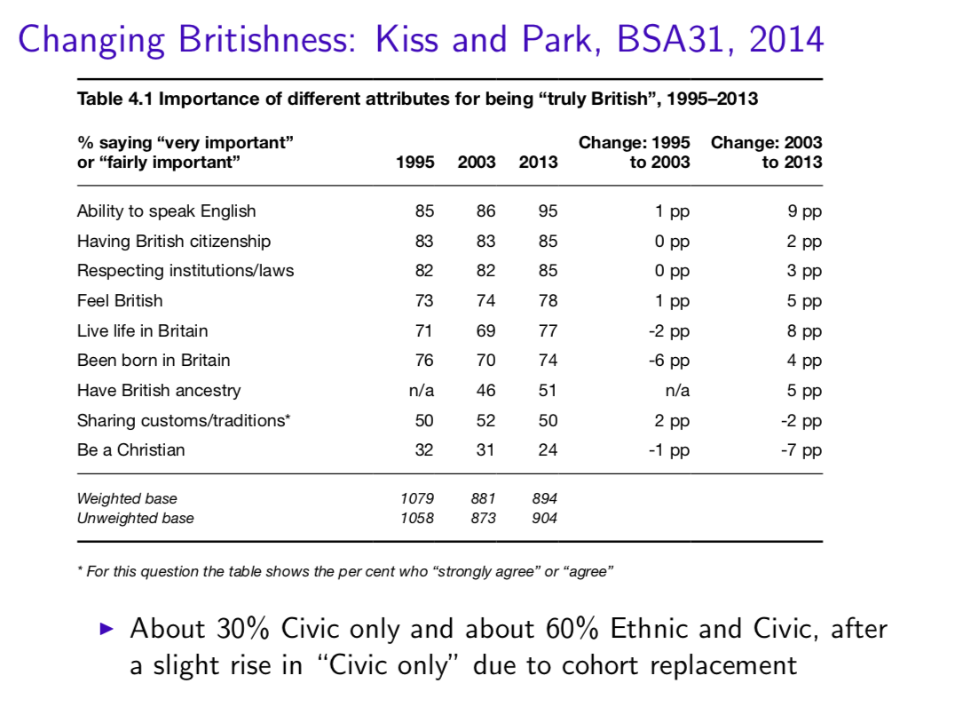

Slide 13
So what is the problem?
A state and a country are objective and easy to categorise using a set of criteria.
The issue is when trying to define the concept of a Nation. What is a nation? How do we know? Where does it come from? Is it ancient or is it modern?
Is it real or is it imagined?
It is this uncertain concept that has led to a wide range of theories, debate and dispute.

Slide 14
What is a Nation?
“a principle which holds that the political and national unit should be congruent” (Ernest Gellner) – also all modernists, cf. Eric Hobsbawm, John Breuilly...
“nationalism is a political doctrine” (John Breuilly)
nationalism is “an ideology which imagines the community in a particular way (as national), asserts the primacy of this collective identity over others, and seeks political power in its name, ideally ... in the form of a state for the nation” (Spencer & Wollman)
nationalism is a social and political movement
one can understand nationalism as an organising political principle that requires national homogenisation and gives absolute priority to national values and ‘interests’ in aiming to achieve ‘national goals’ → nationalist perspectives
“a named population sharing a historic territory, common myths and historical memories, a mass public culture, a common economy and common legal rights and duties for its members” (Smith)
“is imagined because the members of even the smallest nation will never know most of their fellow-members, meet them, or even hear of them, yet in the minds of each lives the image of their communion” (Anderson)
The product of nationalism (Gellner)
“nationalism is, above all, political” (Michael Hechter)

Slide 15
What's in a word?
The word nation is believed to have originated from the Latin word 'nasci', which means 'to be born’.
In ancient Rome it referred to foreigners who lived in Rome. Since they were not entitled to Roman citizenship, only they had 'national identity’.
In the Middle Ages, in European universities, the term 'nation' referred to students who belonged to the same country or region.
In the late Middle Ages it acquired a new meaning, a 'community of opinion', in the context of the ecclesiastical councils.
Later 'nation' was used to refer to 'elites' or the 'representatives of authority’.
It is only in the modern period that the word 'nation' came to mean the people in a modern political sense.

Slide 16
What came before?
Nationalism is a modern (C18th) phenomenon, so what came before?
Ruling classes with a (pan-European) culture and small locally distinctive communities of mainly peasants (Gellner)
No national culture specific to and ubiquitous within the political unit, even if there are some shared identities (e.g. Catholicism)
Political authority based on personal (king, duke etc.) and dynastic relationships. (Anderson)
A corresponding ethnic group: according to primordialists (e.g. Smith)

Slide 17
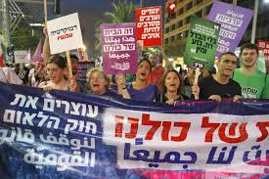
Nationalism – The debate
Nationalism has played a crucial role in the political history of the last two centuries.
It has inspired numerous political movements and led to countless wars that have broken up empires and created many sovereign states.
It has also paved the way for the construction of collective identities and has inspired and mobilized millions of people.
National assertions have resulted in the formation of the nation-state which, even now, is seen as the ideal political institution that embodies the aspirations of the people.
And today, the nation-state has become the principal political institution of the world, and national identity, is often one's primary, if not the only identity.

Slide 18
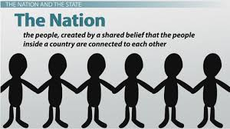
One feature of nationalism is ·its enormous mobilizing power. Nationalism inspires and unites unknown millions into a single unit.
The nation and its symbols arouse passion. Its triumphs, failures and sorrows are ardently shared by the masses.
Even in our globalizing world, nationalism continues to be an inspiring force. Such a survival of nationalism is contrary to the expectations of nineteenth century scholars, both liberals and Marxists, who saw it as a passing phenomenon giving way to universalism.
Nationalism, however, has not only survived but has become one of the most influential factors in world politics.

Slide 19
Europe Faces Revolutions
In the first half of the 1800s, three forces struggled for power within the countries of Europe. Conservatives supported the kings who had ruled these lands for many centuries. These were nobles and other people who owned large amounts of property. Liberals wanted to give more power to elected legislatures. They were typically middle class merchants and business people. They wanted to limit voting rights to people who were educated and owned property. Radicals wanted the end of rule by kings and full voting rights for all people, even the poor.
At the same time, another movement in Europe arose in Europe – nationalism. This was the belief that a person’s loyalty should go not to the country’s ruler but to the nation itself. Nationalists thought that many factors linked people to one another. First was nationality, or common ethnic ancestry. Shared language, culture, history, and religion were also seen as ties that connected people. People sharing these traits were thought to have a right to a land they could call their own. Groups with their own government were called nation-states.

Slide 20
The emergence of nationalism is generally viewed in association with the French Revolution.
The revolution acknowledged and incorporated in the Rights of Man as Citizen, perhaps for the first time in history, the nation as the source of political authority.
Since then nationalism has immensely influenced political developments all over the world.
In Europe, during the nineteenth century, a series of national movements emerged which had, at their core, the hopes for liberation and unification of many oppressed or fragmented people. Italy, Germany and Poland were the most significant among them.
The influence of these national assertions spread beyond the borders of these countries and inspired many communities in the rest of the Europe.
In the twentieth century national aspirations and national movements continued to be a very powerful political force.
This century also witnessed the universalisation of the phenomenon. In the first half of the century Europe remained the center of national assertions. However, in the second half, colonial peoples raised the slogan of nationalism resulting in the emancipation of a large number of Afro-Asian states from colonial rule.
Later, in the last quarter of the century, a new wave of nationalism, what is generally referred to as ethnic or ethno- nationalism, appeared on the political landscape.

Slide 21
Different types of nationalism (Kohn, Brubaker)
Civic nationalism
National identity is about citizenship and is acquired.
Classic examples include Roman citizenship and post-revolutionary French nationalism.
Ethnic nationalism (or perhaps cultural nationalism)
National identity is about ancestry and cannot be acquired. Related to anti-immigrant sentiment and hostility to ethnic minorities
The national identity, not the political claims they make.

Slide 22
The confusion
In spite of being a prominent political phenomenon for a long period, there is a lot of confusion about the exact nature of nationalism.
This is because scholars on nationalism hold diverse views. They see it as a political doctrine, a sentiment, a movement or as an instrument to capture power.
Accomplished scholar Anderson observes that the nation and nationalism is notoriously difficult to define.

Slide 23
Why is it so hard to define?
In fact, the main obstacle towards developing a clear idea of the nation/nationalism arises from its occurrence in highly diverse circumstances across time and place.
It surfaces in industrially developed countries as well as in under-developed and agrarian societies. Sometimes nationalism emerges among economically affluent groups, while sometimes national assertions are from poorer people.
The marked difference in the conditions of its formation makes nationalism an elusive and complex phenomenon which is not easy to define.

Slide 24
It is a feeling
According to this view, nationalism is a feeling or an approach that places the nation at the centre of all activities and tries to uphold its concerns and values. It defines nationalism as "that outlook which gives an absolute priority to the values of the nation over all other values and interests".
A natural extension of this view considers nationalism as love or loyalty towards one's state which is similar to patriotism. Common parlance like Indian nationalism, Russian nationalism, American nationalism, etc, often conveys this dimension of the phenomenon.

Slide 25
An Ideological Movement
“Designed to further the alleged aims and interests of the nations".
Smith also considers nationalism as an ideological movement.
A closely related notion of nationalism is that of a response, or an
awakening, of people who encounter adverse situations. The situations can be
economic, cultural or political or a combination of these factors. The sense of
backwardness, collective grief, humiliation or fear of a threat awakens and
inspires people to change existing conditions, and this may culminate in a
movement.
Minouge describes it as a political movement depending on a feeling of the collective grievance against foreigners.
The nationalist doctrine that appeared during the French Revolution received universal acceptance afterward. It awoke the oppressed people by conveying the message that they are the real source of political power and inspired them to assert their right to be independent. It is through such movements many societies, which are severely fragmented on the basis of religion, region, caste, language, class, etc., are knit together and transformed into a unit by national consciousness. It is in this sense that national movement becomes the motor behind the formation of a nation.

Slide 26
A political tool
Some scholars view nationalism in the instrumentalist sense and argue that a precise understanding of it is possible only by comprehending the instrumental nature of it.
Some argue that nationalism has been a weapon in the hands of various sections of society to achieve their goals and control the state or the people. In other words, various sections that hold different, even opposite aims, can appropriate nationalism.
In fact, paradoxically it has been noted that nationalism is a politics of interest, not identity, so it must be explained by focusing on the calculation of the elites.
It has, thus, been argued by Breuilly that "to focus upon culture, ideology, identity, class or modernisation is to neglect the fundamental point that nationalism is, above and beyond all else, about politics, and that politics is about power. Power, in the modem world, is primarily about control of the state. The central question, therefore, should be to relate nationalism to the objective of obtaining and using state power."
The underlying perception of Marxists, who consider nationalism as an ideological weapon in the hands of an emerging bourgeoisie to achieve a big national market and to combat class loyalty, is similar to this.

Slide 27
An imagined community
Anderson sees nations and nationalism as products of the modern world
He points out that despite their relatively recent origins nations like to see themselves as having ancient origins
For Anderson nations are best thought of as ‘imagined communities’
What is imagined is a form of social solidarity – a horizontal comradeship of citizens. The members of a nation will never know each other or have face-to-face contact But each is confident that others throughout the nation share similar experiences: read the same newspapers, celebrate the same national holidays, watch the same television programmes, share a common culture etc
In this way the members of a nation imagine themselves to be members of a community
Nations became possible due to
Capitalism that introduced the masses into politics (unions)
Printed message – the reading public guided to ‘imagine’ itself

Slide 28
A hybrid approach - Hroch
Nation-building was never a mere project of ambitious or narcissistic intellectuals, and ideas could not flow through Europe by their own inspirational force. Intellectuals can ‘invent’ national communities only if certain objective preconditions for the formation of a nation already exist.

Slide 29
Primordialism
In order to understand the concept adequately we should begin by asking whether nation is a feature of the modern period or it existed in the past also. Some scholars believe that the nation is much older than the modem era. Smith points out the concept of primordialism. According to this view, the nation is primordial and natural and is part of the human condition which is outside time and history.
Primordial nationalism focuses on historic and inherent social practices as the source of the roots of its nation. The most fundamental factors of primordial nationalism are:
That people are inherently group orientated and nations are a product of this.
National identity is forged by common descent, shared language and a sense of territorial belonging.
Nations are historical entities
Nationalism is characterised by deep emotional attachments that resemble kinship ties. “individuals identify with families, villages, regions, age, sex groups, classes, religions, ethnic and national communities”
Such views are shared with philosophers such as Johann Herder who argues that each nation has a “volksgeist” which is the spirit of the people which expresses itself through song, myths and legends.

Slide 30
Constructivist - Modernists
The outlook of modernists is markedly different. They see the nation as a modern political community that evolved in the context of modern developments.
According to Hobsbawm, for example, the characteristic of the nation and everything connected with it is its modernity. In his book Nations and Nationalism, he carefully studies the meaning of the word nation in major European languages and points out that the modern notion of nation - as a body of citizens whose collective sovereignty constitutes them a state - arose only in the eighteenth century.
The constructivist theory states that national identity is forged in response to social and historical circumstances in which nationalism is a method of finding replacements for the loss of some cultural concepts. Constructivism links the origins of nationalism to the process of modernization. Constructivism can be related to three very important themes which are:
The emergence of industrial economies which created new social tensions and broke traditional social bonds which begged the need for a national identity for the people.
States play an important role in creating a sense of national identity which constructs a nation.
The spread of mass education and mass literacy was a massive contribution towards national identity.
Ernst Gellner, Nations and Nationalism
Ernst Gellner a philosopher stated that emerging industrial societies promoted social mobility and competition which inevitably required a new source of cultural cohesion which was to be provided by nationalism. Nationalism invented the nation not the other way around, “Having a nation is not an inherent attribute of humanity but it has now come to appear as such” . He illustrates and discusses a nation in which for two men to be in the same nation requires two things:
Common culture, as in a mutual understanding of each others meanings
Recognition of mutual rights and duties to each other and virtue of shared membership in it.

Slide 31
Hroch – Taxonomy of national movements
The three-phase division of the national movement
1. Intellectuals who were concerned with the cultural and historic aspects of their society.
2. Followed by a politically oriented group which desired to alter the unhappy condition of their society. However, even though the elite and the intelligentsia at the periphery want to counter this adverse situation, they are not resourceful enough to do it by themselves. Their only resource is people and the elite and intelligentsia are left with no option but to mobilise them.
Thus, they are forced to invoke whatever similarities they share and speak in a language that would give them access to the lower classes and touch their sentiments. And these compulsions lead to the "political baptism" of the lower classes.
In other words, with the emergence of the national conscience.

Slide 32
3. The neglected masses are not only "invited into history" but also become the centre of political discourse.
To mobilize the masses, national movements and their leaders utilise whatever sources that are available to them. Natural features like rivers, mountains, meadows, historical events, myths and legends-all become effective weapons in the process of building community feeling.
The moral values, unique qualities and ancient glories of the community are invoked and the nation is usually referred to as a big family. Through such a process, a political community with a unique identity and moral purpose is envisioned and slowly evolves over time.

Slide 33
The historic outcome of these national movements was the mobilization of formerly passive communities into active political units, that is, nation. In other words an overarching national identity, undermining many local or particular loyalties, emerged. In the process, former subjects were brought into the political community of citizens and a new state, the collective political institution of the people, realised.

Slide 34
What is nationalism? Much debate
􏰀 A political ideology: nations should be the basis of states.
􏰀 General universal principle selectively applied or appealed to on a self serving basis by nationalists
􏰀 Implies a belief that there are nations
􏰀 A kind of social identity and related sentiments
􏰀 Thinking of yourself as British, English etc., i.e. as part of a nation
􏰀 Views about what it means to be and who can count as British, English etc.
􏰀 Patriotism and national pride
􏰀 Maybe also jingoism and other extreme views
􏰀 A kind of (basis for a) social movement
􏰀 Nationalism has no force without some kind of political organisation and activity.

Slide 35
Watch the video
https://www.youtube.com/watch?v=Uwv9XjTZh2c

Slide 36
So……
Nationalism is neither exclusively “constructed” or primordial, that it is a combination of these two theoretical approaches which forms the concept of nationalism. I believe that nationalism is founded primarily naturally and that the need to build a fundamental power structure influences the ignition of constructivism. Primordial nationalism acts a building block towards constructivism, without either of these two theoretical approaches nationalism would not exist.

Slide 37
Share certain commonalities
Language
Geographic area
Historical development
Religion (but, not always)
Culture
They see or feel themselves to be part of the nation
Enemy may bring them together

Slide 38
Did people always feel themselves part of a nation?
No
Legacy of French Revolution
People started to see themselves as part of France rather than just people who lived in various regions of a country called France
France ceased to be the property of the monarchs in 1792
It now belonged to the people

Slide 39
So, what is the nation?
every attempt to answer this unresolved question depends on the belief that nations are real entities - BUT
“Everyone agrees that nations are historically formed constructs.” (Brubaker)
in contemporary writings nation is no longer regarded as unchanging and primary social entity

Slide 40
So, what is the nation?
Miroslav Hroch is convinced that nations are real (note: not eternal) and should be defined as including: remembered common past of the group, linguistic or cultural ties enabling social communication within the group, perceived equality of all who belong to the group
Ernest Gellner decided to omit definition of the nation; “nations can be defined only in terms of the age of nationalism”

Slide 41
Definition of the Nation - Hroch
a large social group integrated not by one but by a combination of several kinds of objective relationships (economic, political, linguistic, cultural, religious, geographical, historical), and their subjective reflection in collective consciousness. Many of these ties could. be mutually substitutable—some playing a particularly important role in one nation-building process, and no more than a subsidiary part in others. But among them, three stand out as irreplaceable: (i) a ‘memory’ of some common past, treated as a ‘destiny’ of the group—or at least of its core constituents; (ii) a density of linguistic or cultural ties enabling a higher degree of social communication within the group than beyond it; (iii) a conception of the equality of all members of the group organized as a civil society.

Slide 42
Key Questions
What is the difference between a State, a Nation and a Nation State?
Explain the difference between civic and ethnic nationalism.
Explain 3 different views of how nations are created.
Explain the 3 stages of the development of Nationalist Movements according to Hroch.
What is your definition of a nation?

