Slide 1
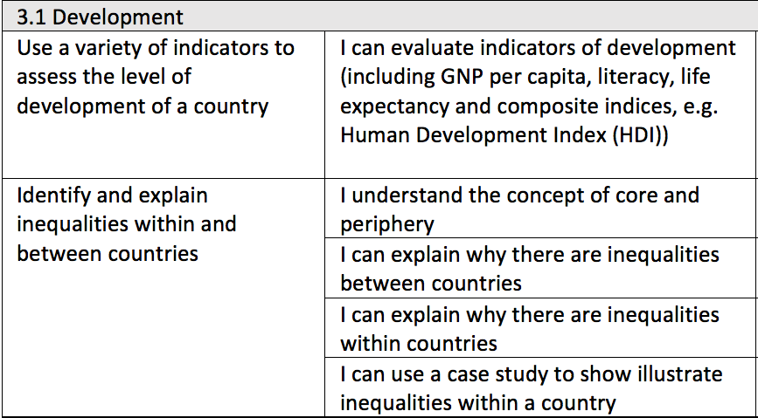
IGCSE Geography
3.1 Development

Slide 2
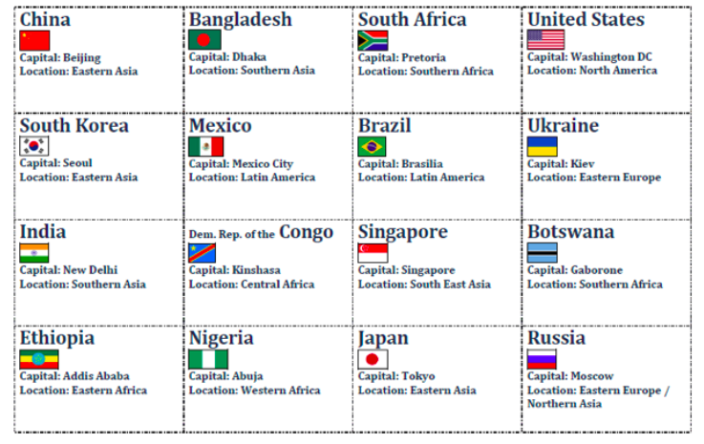
Singapore
Mexico.
Which Order?
Botswana
Brazil.
Bangladesh
Ukraine
South Africa.
India.
United States
DR Congo
South Korea.
Put these statements into the correct order of development
- How did you decide on the order?
​- How did you define development?
Nigeria
Ethiopia
Japan
China
Russia

Slide 3
Evaluating development indicators
Indicator of development | Definition | What does it indicate about the social development? | What are the limitations? | How does the measure vary globally?
Literacy rate
People per doctor
Access to safe water
Life expectancy
Infant mortality
Birth Rate
Death Rate

Slide 4
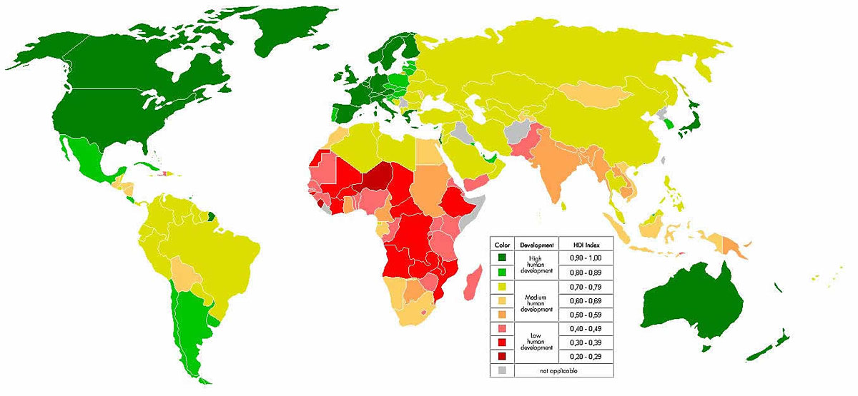
What are the relationships between different indicators?
Figure 3: World HDI
USA
UK
Japan
Zimbabwe
Brazil
Turkey
China
Nigeria
Bangladesh
Ivory coast
________________________________________________________________________________________________________________________________________________________________________________________________________________________________________________________________________________________________________________________________________________________________________________________________________________________________________________________________________________________________________________________________________________________________________________________________________________

Slide 5
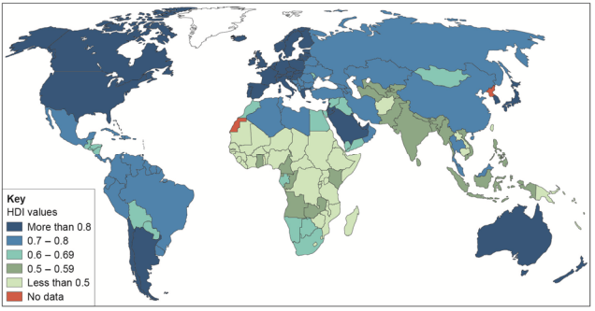
Exam question
Study Figure 4, a world map showing the global distribution of Human Development Index (HDI) values.
HDI combines data on life expectancy, educational levels and income, with values ranging from 0 (worst) to 1 (best).
Using Figure 4, compare HDI values in Africa and South America. (4 marks)
_________________________________________________________________________________________________________________________________________________________________________________________________________________________________
________________________________________________________________________________________________________________________________________________________________________________________________________________________________________________________________________________________________________________________________________________________________________________________________________________________________________________________________________________________________________________________________________________________________________________________________________________

Slide 6
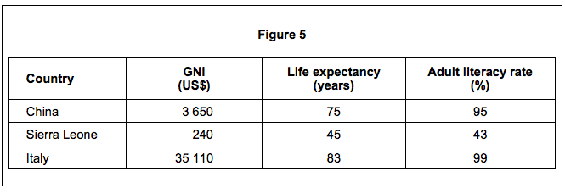
Exam question
Study Figure 5, a table showing indicators of development for three countries.
_______________________________________________________________________________________________________________________
________________________________________________________________________________________________________________________________________________________________________________________________________________________________________________________________________________________________________________________________________________________________________________________________________________________________________________________________________________________________________________________________________________________________________________________________________________________________________________________________________________________________________________________________________________________________________________________________________________________________________________________________________________________________________________________

Slide 7
Factors affecting development
Cause | Description | Link to uneven development | Country example | Other information
Trade
Colonialism
Conflict
poverty
Natural hazards
climate
Landlocked

Slide 8
Landlocked
7
8
9
10
Corruption
Raw
materials
4
5
6
Colonialism
Trade
3
2
Natural
Hazards
1
Poverty
Climate
Which factor is the most significant?
Conflict
Water
shortage
Notes:
Production costs have increased by 20%

Slide 9
UNEVEN DEVELOPMENT WITHIN CHINA
https://www.youtube.com/watch?v=KNXg-kYkLU&feature=emb_logo
How many people have left rural areas to seek work?
b. Outline the reasons why people left.
c. In 1978, how much did farmers earn?
d. What are the negative aspects of migration?
e. What has happened to the wealth gap over time?
f. What changes has Shenzhen seen since 1978?
g. Outline the comparative GDP values of coastal regions compared to western countries.
h. What change is China seeing in terms of location of manufacturing industry?

Slide 10
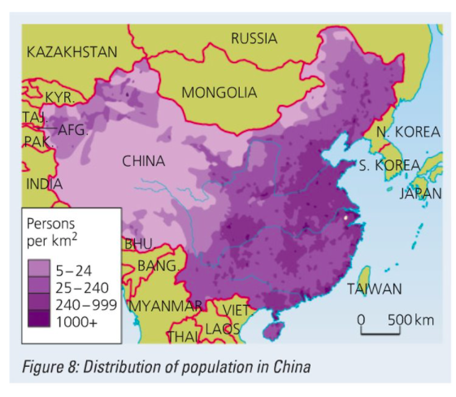
Describe the population distribution of China
________________________________________________________________________________________________________________________________________________________________________________________________________________________________________________________________________________________________________________________________________________________________________________________________________________________________________________________________________________________________________________________________________________________________________________________________________________________________________________________________________________________________________________________________________________________________________________________________________________________________________________________________________________________________________________________

Slide 11
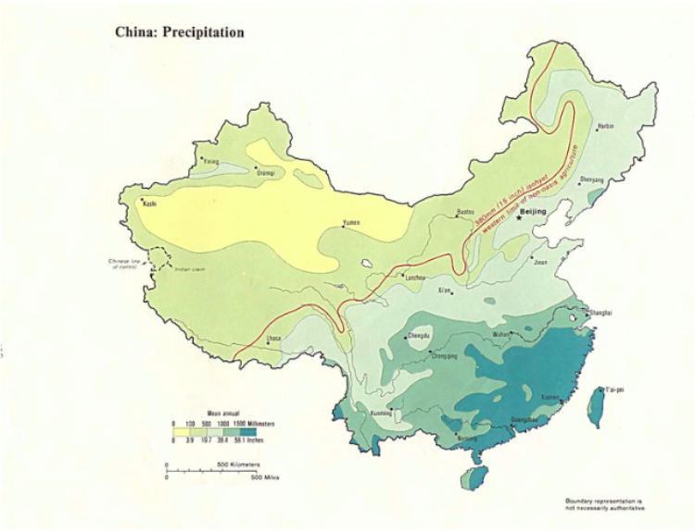
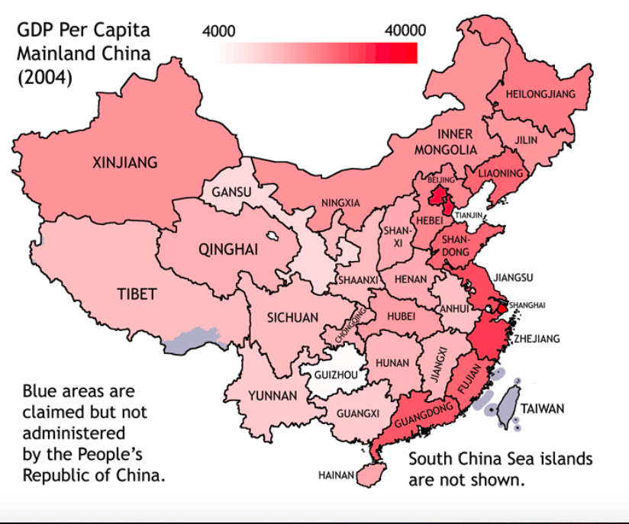
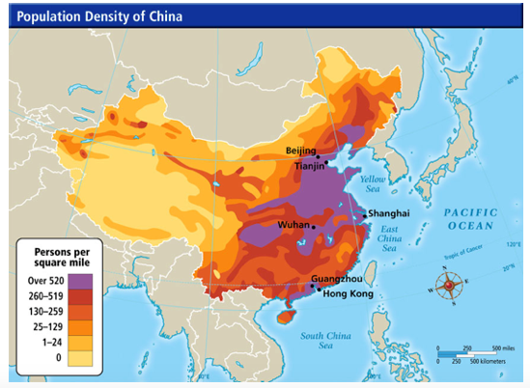
Task: 1. Use the maps above to highlight why there would be disparities between areas within China 2. Annotate the map to highlight characteristics and features of core and periphery areas of China to show the inequalities within the country.

