Slide 1
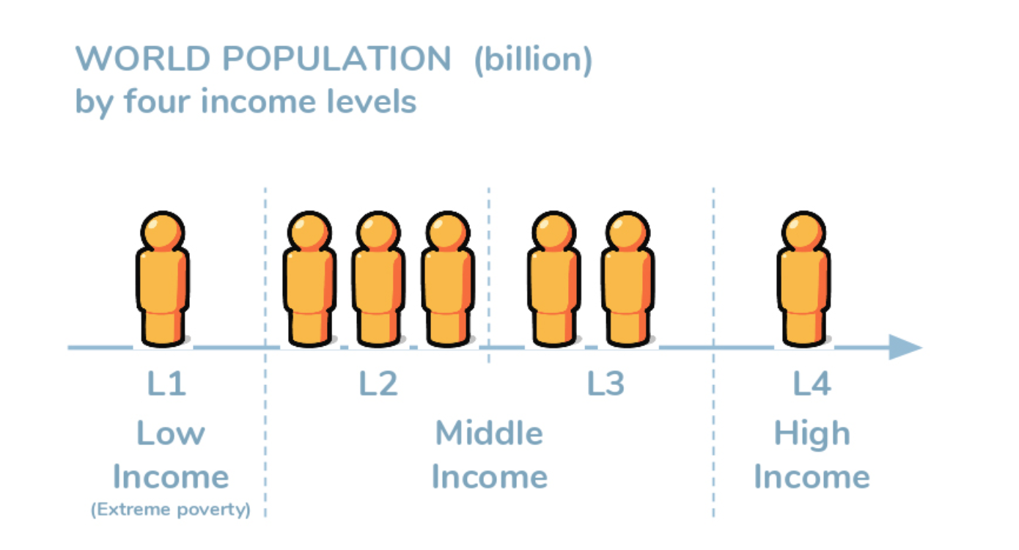
MY Geography NOTEBOOK
Is Development a good thing?
Name
Class

Slide 2
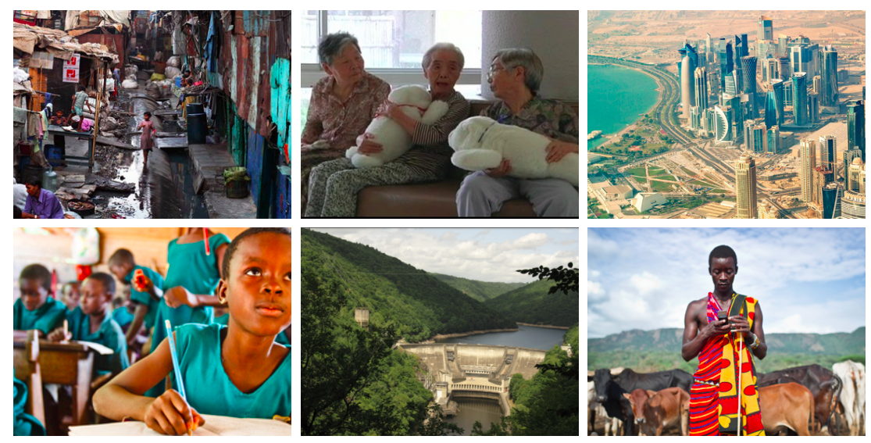
Think, see, wonder
Use this arrow to label.
Use this arrow to label.
Use this arrow to label.
Use this arrow to label.
Use this arrow to label.
Use this arrow to label.
Use this arrow to label.
Use this arrow to label.
Use this arrow to label.
Use this arrow to label.

Slide 3
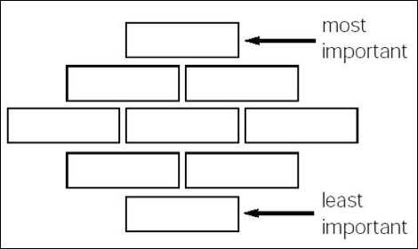
To change things for the better
Development Indicators
To reach our full potential
Read through the development indicators. Which do you think are the most important?
Drag and drop the development indicators into the order that you think they belong.
To earn a good living
A good education
Freedom from poverty
Justice for everyone
Living more sustainably
A more equal society
Explanation - Why did you select your top three indicators? Why are they more important than the rest?
To live a long and healthy life

Slide 4
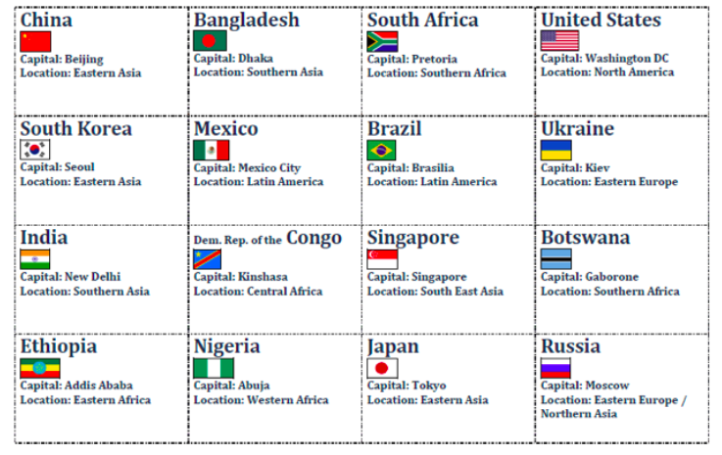
Singapore
Mexico.
Which Order?
Botswana
Brazil.
Bangladesh
Ukraine
South Africa.
India.
United States
DR Congo
South Korea.
Put these statements into the correct order of development
- How did you decide on the order?
​- How did you define development?
Nigeria
Ethiopia
Japan
China
Russia

Slide 5
4 levels of income
Four Income Levels | Level 1 | Level 2 | Level 3 | Level 4
Drinking Water
Transport
Cooking
Eating
Sleeping

