Slide 1
Recap Economics Introduction
What is the economy?
Why does the economy matter?
What is Economics
Why does Economics matter?

Slide 2
Economic questions:
Why does the price of gas fluctuate so frequently?
Why do sports players and television stars make more than doctors and politicians?
How does an increase in the minimum wage affect the economy?
Why does 5% of the American population own 90% of its assets?
How can we encourage greater investment in green technologies?

Slide 3
Economics is about 3 Questions that are fundamental to humans everywhere
What to produce ? (Discuss some examples with you partner)
How to produce ? (Discuss some examples with you partner)
For whom to produce for? (Discuss some examples with you partner)

Slide 4
To what extent is university education an economic choice?
To what extent is university education an economic choice?

Slide 5
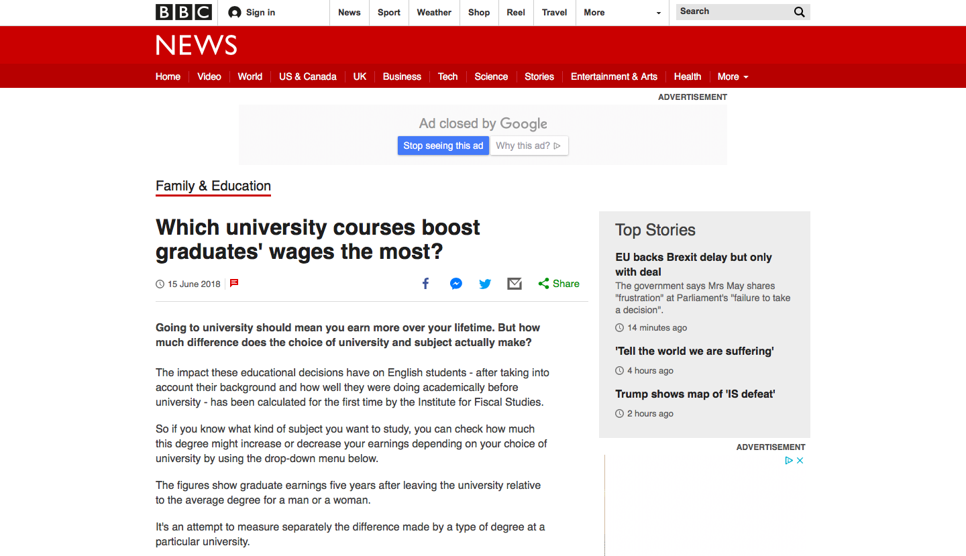
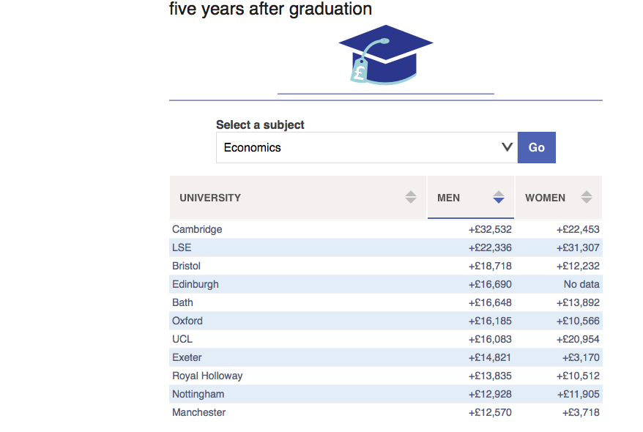
C
A
R
E
E
R
S

Slide 6
In most societies PRICE is the main way that these 3 questions are answered…
With a partner discuss how PRICE answers the questions:
What to produce?
How to produce?
For whom to produce for?

