Slide 1
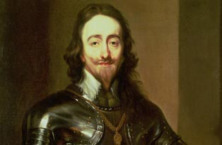
What did Charles do wrong?

Slide 2
Would you have been a better King than Charles I?
Learning objective: To be able to judge the issues Charles I had
TRIANGLE | SQUARE | CIRCLE
Identify two ways in which Charles I annoyed the people | Explain mistakes that Charles I made | Make a supported judgement on the decisions that Charles I made and how this would have affected his rule

Slide 3
After Guy Fawkes was executed for treason in 1605, King James ruled the country for the next twenty years.
There were good times and bad times.
King James wasn’t very good with money and people didn’t like his friends especially a man called Buckingham.
When King James died in 1625, his son Charles became King of England.
Over the next few years King Charles did some extremely foolish things.
The things he did caused a Civil War in 1642.
Would YOU have made the same foolish decisions?

Slide 4
Your Aims:
You will be faced with a number of Charles major decisions from his life. You must choose what you would do for each one to be a more successful ruler and try and prevent the English Civil War.

Slide 5
Decision 1:
It is 1625 and you have decided to get married. A marriage could be a strong alliance for your country. Will you . . .
a. Marry a good, wholesome English Protestant.
0
b. Marry the pretty, young, French Roman Catholic princess, Henrietta Maria.
5
c. Take a trip to Spain and turn up unannounced in the chamber of the Infanta, the King of Spain’s eldest daughter and demand her hand.
10

Slide 6
Charles’ decision
He tried ‘c’, but after that failed he chose ‘b’
He married Henrietta Maria.
Are there any problems of marrying a French Catholic?

Slide 7
Decision 2:
It is 1626. Your main adviser Buckingham has wasted lots of money on a failed naval attack against Spain. Parliament want him punished. Will you . . .
a. Take their advice and sack him.
0
b. Get mad! How dare they tell you what to do. Have the MPs who want him punished arrested.
10
5
c. Ignore them and take no action.

Slide 8
Charles’ decision
He chose ‘b’
Buckingham had been a good friend of his father and Charles was very loyal to him.
Do you think Charles is right to anger Parliament?
In response Parliament refused to give Charles the right to collect taxes for life. They said he must consult them every year before raising taxes.

Slide 9
Decision 3:
It is 1628.
You have run out of money and need to raise taxes. Taxes can only be raised by consulting Parliament. Will you . . .
a. Call Parliament, listen to their advice and agree with them about how to raise more money.
0
b. Raise a tax without consulting Parliament – you are the King after all and do not have to answer to anyone.
10

Slide 10
Charles’ decision
He chose ‘b’.
As far as the King was concerned, Parliament had no right to tell him what to do.

Slide 11
Decision 4:
It is 1629.
The members of Parliament are angry that Charles has not consulted them before raising taxes. Will you . . .
a. Dissolve Parliament (close them down) and rule the country on your own.
10
b. Listen to Parliament’s grievances and promise to work with them in future.
0

Slide 12
Charles’ decision
He chose ‘a’.
Many Kings and Queens before him had ruled without the help of Parliament.
He ruled without them for eleven years.
Do you think people are more or less likely to pay a tax if Parliament have not agreed to it?

Slide 13
Decision 5:
It is 1634.
You have run out of money again. Will you . . .
a. Force the coastal counties to pay a tax called ‘Ship Money’. (This tax was normally only paid at times of war.)
10
b. Re-call Parliament and ask them to help you find money.
0

Slide 14
Charles’ decision
He chose ‘a’
England was not at war and there was no need to improve the navy.
Would you be happy if you lived in the coastal counties?
Although taxes are great, people only privately breathe out a little discontent and lay down their purses, for I think the great tax of Ship Money is so well accepted.

Slide 15
Decision 6:
It is 1635.
Ship Money has been very successful – a lot of money has been collected. Will you . . .
a. Continue to collect Ship Money from the coastal counties every year.
5
b. Stop the Ship Money tax and re-call Parliament.
0
c. Demand Ship money from the inland counties as well and make it a permanent tax to be collected every year.
10

Slide 16
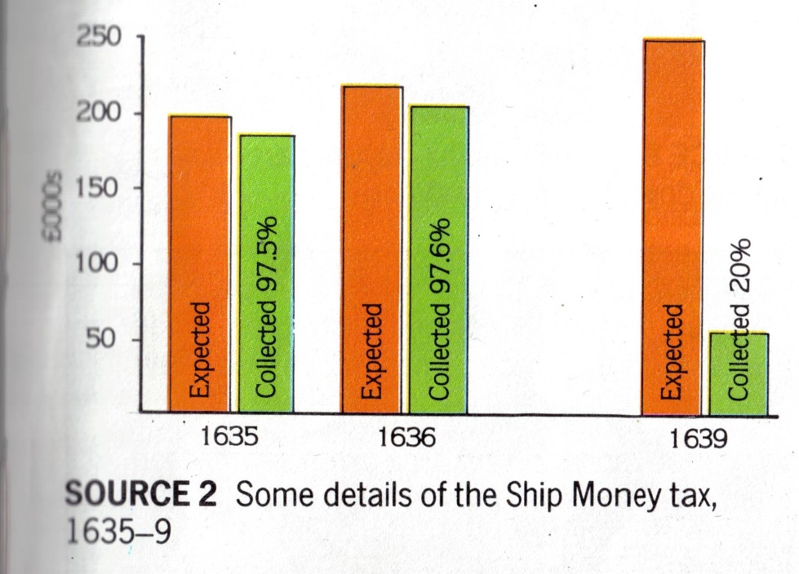
Charles’ decision
He chose ‘c’.
The whole country was now paying Ship Money. People in the inland counties had never had to pay it before.
HOW POPULAR WAS THE TAX?

Slide 17
Decision 7:
It is 1637.
A man called John Hampden has refused to pay the Ship Money tax, saying that it is illegal for the King to raise taxes without Parliament’s permission. Will you . . .
a. Execute John Hampden for his disobedience and use this as an example for anyone else who refuses to pay the Ship Money tax.
10
b. Listen to John Hampden. Stop collecting Ship Money and re-call Parliament.
0
c. Put John Hampden on trial for not paying the tax. The courts are bound to rule in your favour because you control them.
10

Slide 18
Charles’ decision
He chose ‘c’.
The judges decided that the King was right, but the trial received a lot of publicity.
How do you think the people of England reacted when they heard about the trial?

Slide 19
Decision 8:
It is the 1630s.
There is still religious unrest in the country but most people are Protestants. You want people to feel closer to God. Will you . . .
5
a. Make churches even plainer.
b. Order a new prayer book to be written and tell Protestant ministers to decorate their churches.
10
0
c. Leave things as they are.

Slide 20
Charles’ decision
He chose ‘b’.
Charles and his Archbishop (Laud) genuinely believed that for people to be closer to God there needed to be more decorations in churches. They also weren’t very keen about the clergy preaching about the Bible.
What do you think the Puritans thought about this?

Slide 21
Decision 9:
Many Puritans are campaigning against the changes you have made to the Church and are producing pamphlets attacking both you and the Archbishop of Canterbury. Will you . . .
a. Lose you temper and order their ears to be chopped off.
10
b. Calm their fears by saying that you support the Protestant religion.
5
c. Blame the Archbishop for the changes, remove him from his position and replace him with someone who the Puritans will be happier with.
0

Slide 22
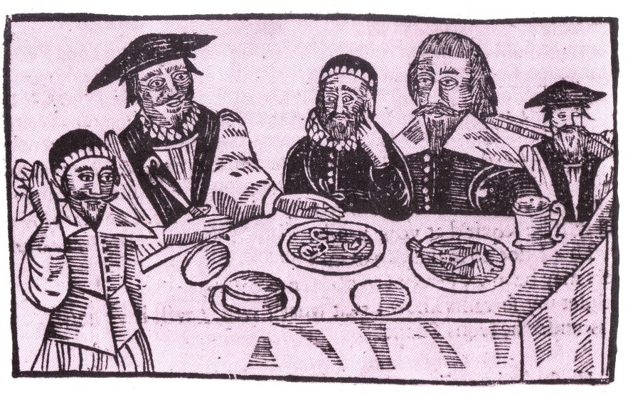
Charles’ decision
Charles chose ‘a’.
“The executioner cut off Mr Burton’s ears, deep and close, in a cruel manner with much bleeding and an artery being cut. Mr Prynne’s cheeks were seared with an iron made exceeding hot, after which the executioner cut off one of his ears and a piece of his cheek; then hacking the other ear almost off, left it hanging.”
This just gave the Puritans more reasons to attack him in pamphlets.

Slide 23
Decision 10:
You are king of both England and Scotland. However the Scots do not follow the same religion as the English – they are very strict Puritans. Will you . . .
a. Consult the Scottish church about bringing in some changes to their services to make them more in line with the Church of England.
5
b. Demand that the Scots use the English Prayer Book for their services.
10
c. Leave things as they are.
0

Slide 24
Charles’ decision
He chose ‘b’.
The Scots hated anything that even looked like Catholic practices.
How do you think they reacted?

Slide 25
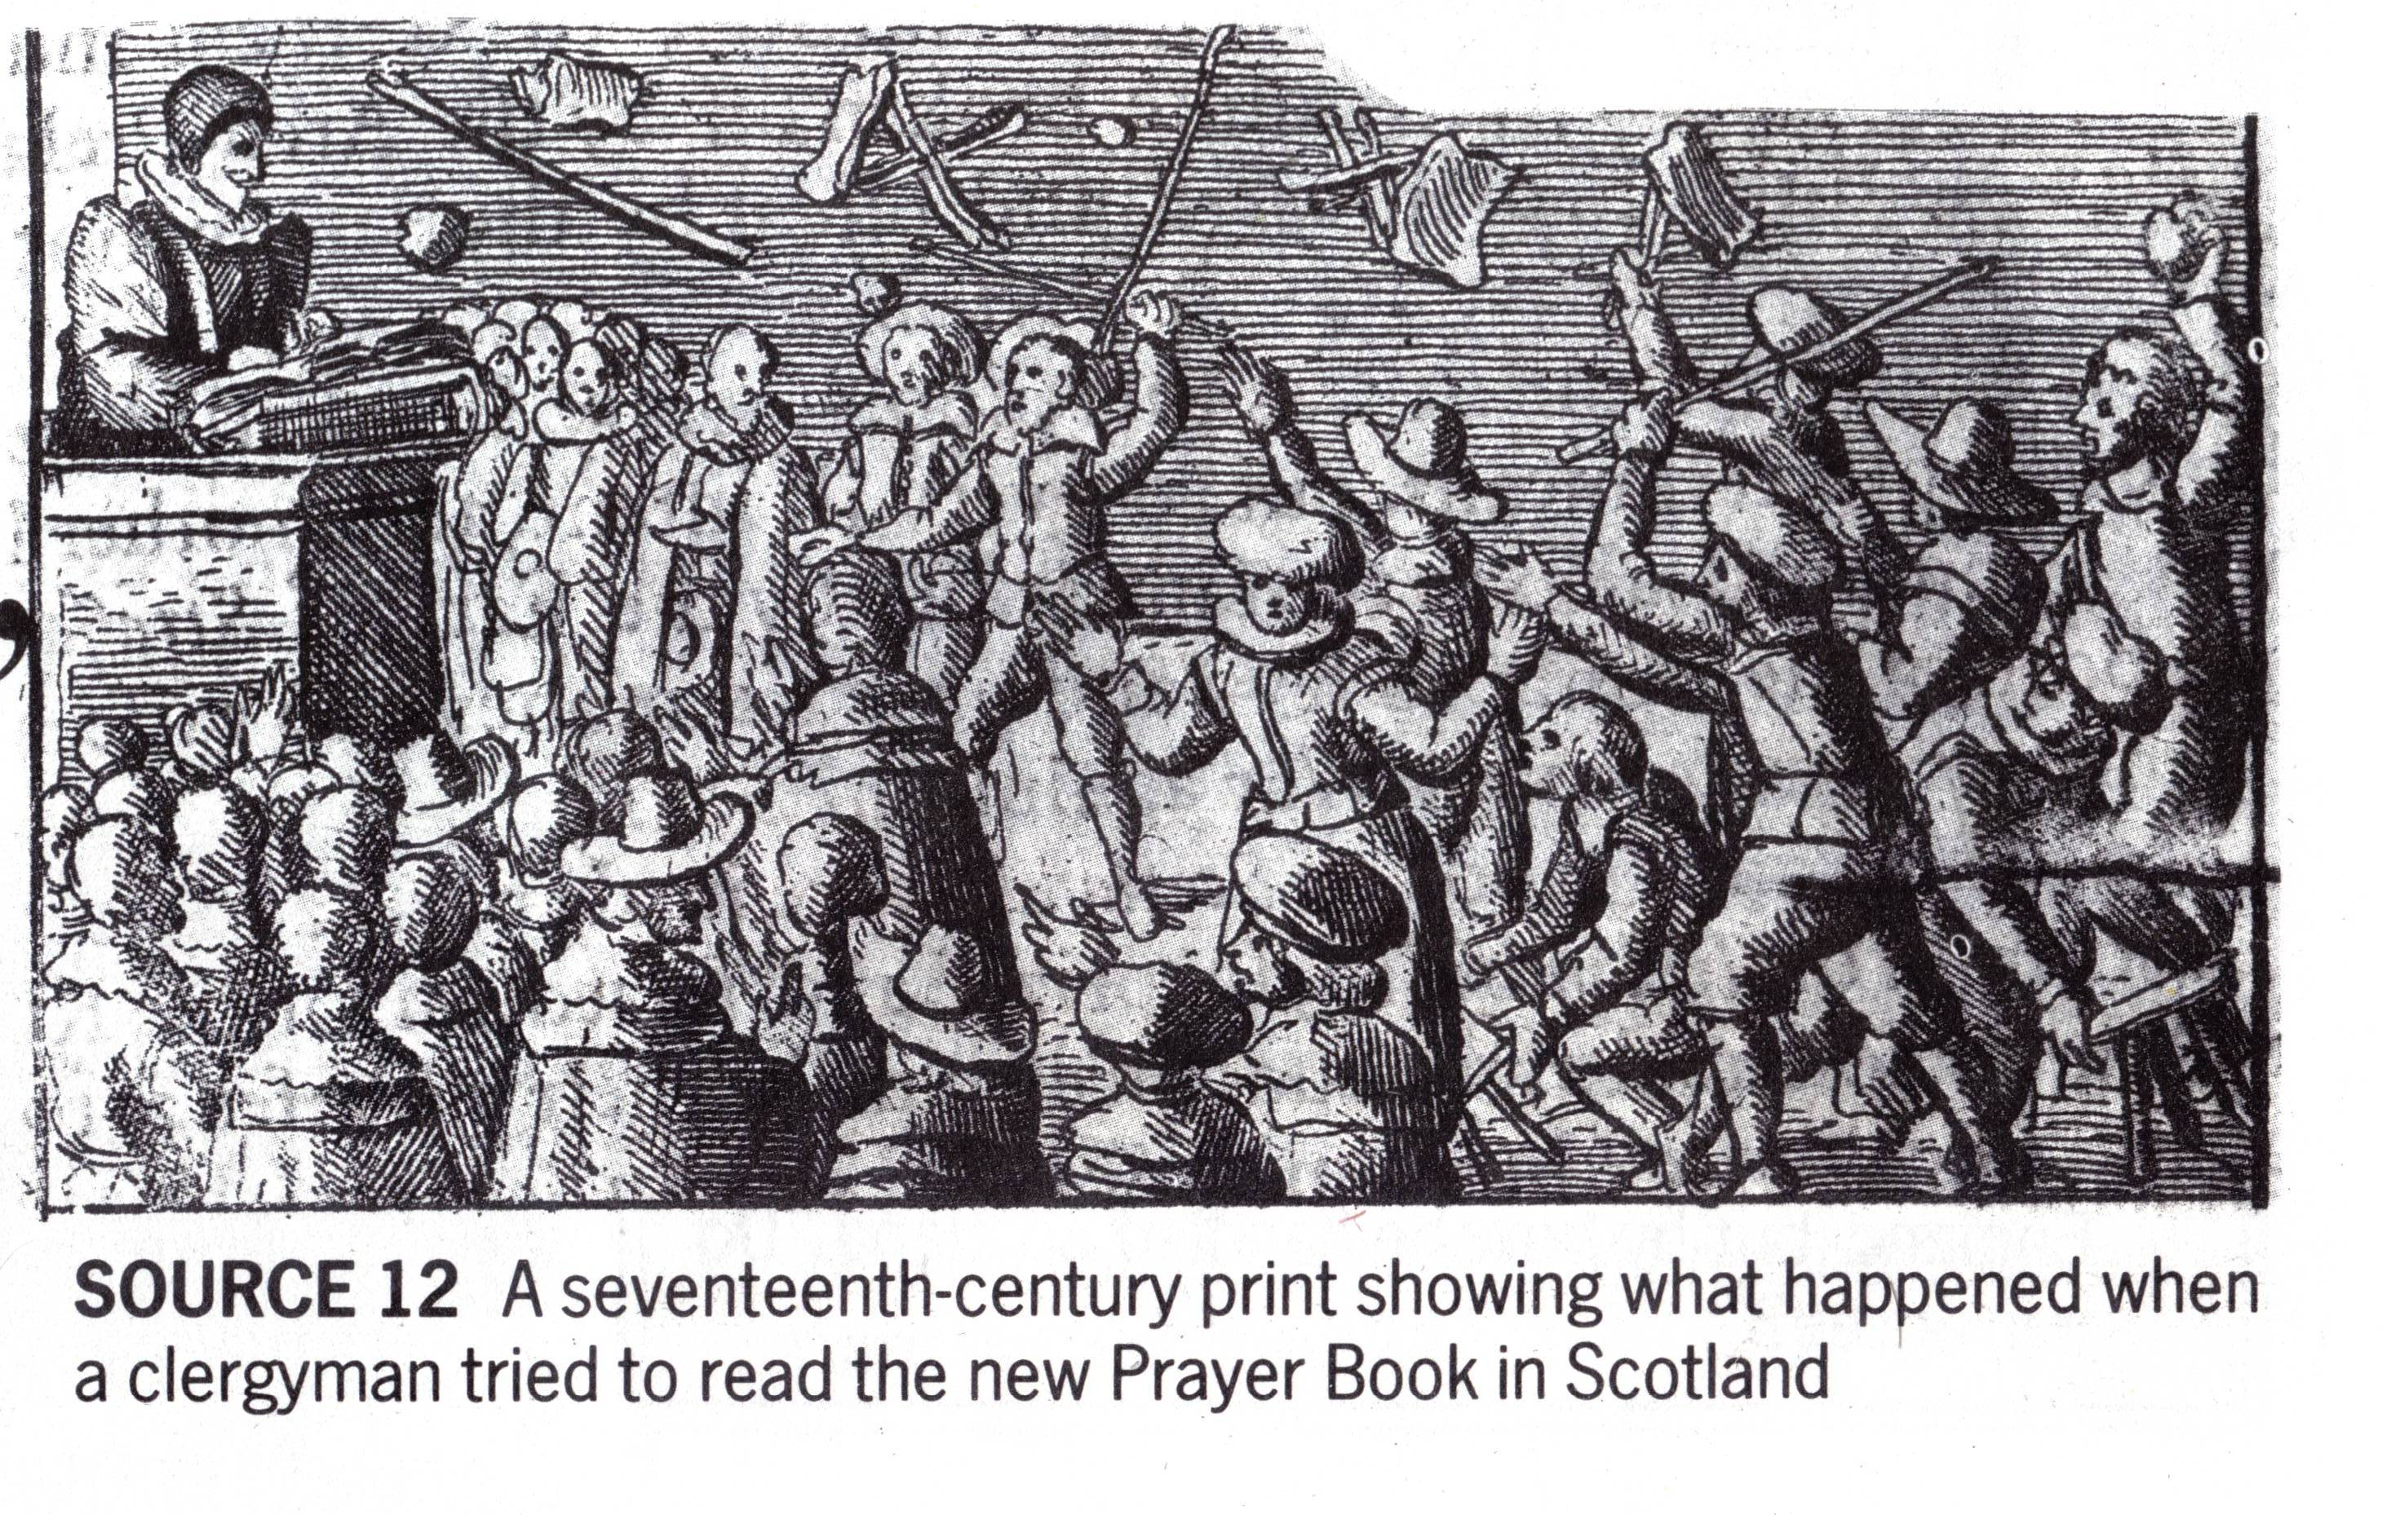

Slide 26
Decision 11:
The Scots have reacted badly to the new prayer book and are rioting. You want to raise an army to deal with them but need money to pay for it. Will you . . .
a. Do nothing – Scotland’s a long way away.
5
b. Re-call Parliament and ask for their help to deal with the Scots.
0
c. Raise a new tax to pay for the army and declare war on the Scots.
10

Slide 27
Charles’ decision
He chose ‘c’.
A new tax called ‘Coat and Conduct Money’ was introduced to pay for the army.
Given what happened with Ship Money how do you think people will react?
The new tax produced a taxpayers’ strike in 1639-40. The gentry refused to collect the tax. Soldiers broke open jails to release those imprisoned for refusing to pay the tax.

Slide 28
Decision 12:
It is April 1640. Charles calls Parliament.
Your new taxes have caused major problems in England. You have gone to war with the Scots but Parliament still refuse to grant you any money unless you end your unpopular taxes and stop your reforms to the Church. Will you . . .
a. Agree to Parliament’s demands and accept their advice at long last.
0
b. Close Parliament down again – what right do they have telling you what to do?
10

Slide 29
Charles’ decision
He chose ‘b’.
Parliament refused to give Charles any money unless he stopped his religious reforms and ended his taxes.
Charles sent Parliament home after three weeks. It became known as the Short Parliament.

Slide 30
Decision 13:
It is November 1640.
Your army has been defeated by the Scots. They have now invaded the north of England and are demanding money from you before they will leave. Parliament have said they will help you if you agree to give them more power. Will you . . .
10
a. Raise a new tax to get the money to pay off the Scots without consulting Parliament.
b. Re-call Parliament and agree to their demands to punish your ministers, end your unpopular policies and increase the power of Parliament.
0
c. Re-call Parliament and ask for money but refuse to agree to all of their demands.
5

Slide 31
Charles’ decision
He chose ‘c’.
Charles agreed to most of Parliament’s demands such as regular meetings of Parliament and punishment of his ministers.
But he refused to reverse his reforms of the Church. This was not good enough for Parliament.
Some MPs however began to feel that things were going too far.

Slide 32
Decision 14:
It is January 1642.
You have been arguing with Parliament for well over a year now but you are certain that there are 5 main troublemakers convincing the other MPs to turn against you. Will you . . .
10
a. Break down the doors of the House of Commons and try to arrest the 5 MPs.
b. Start to agree to some of Parliament’s demands to win the support of some of the MPs.
0
c. Arrange for the 5 MPs to be arrested in secret.
5

Slide 33
Charles’ decision
He chose ‘a’.
It might have worked, but the MPs had been warned and had fled by boat down the Thames. They were then protected by the Council of London and treated like heroes.

Slide 34
Decision 15:
It is March 1642.
There is a rebellion in Ireland and an army is needed to deal with it. Parliament does not want you to have control of the army and have asked you if you will let them control the army. Will you . . .
a. Let them have control of the army.
0
b. Refuse to let them control the army.
10

Slide 35
Charles’ decision
He chose ‘b’
Kings had always controlled the army in the past.
Parliament simply took control of the army without his permission.
Think about how much fuss Parliament made when the King raised money without their permission – now they are breaking the law!

Slide 36
Decision 16:
It is June 1642.
Parliament have made another list of demands called the Nineteen Propositions. Essentially if agreed to, this would give Parliament all of your power. Will you . . .
SOME OF THE NINETEEN PROPOSITIONS
All affairs of state must be agree with Parliament.
All ministers must be approved by Parliament.
Parliament must control the education of the King’s children.
The Church must be reformed as Parliament wants.
Parliament is to control the army.
a. Say, “Thank God” and let them run the country.
0
b. Refuse and begin to raise an army.
10

Slide 37
Charles’ decision
He chose ‘b’
He claimed the Nineteen Propositions would make him a ‘mere phantom of a king’.
It also split the MPs in Parliament. Many felt they had gone too far and declared their support for the King.
Both sides started to organise armies.

Slide 38
Decision 17:
Parliament prepares its army for war against the King. Will you . . .
a. Hold fire. Talk to Parliament and attempt to prevent the outbreak of civil war in England.
0
b. Raise your standard and declare war on Parliament.
10

Slide 39
Charles’ decision
He chose ‘b’.
On August 22nd 1642 he raised his standard at Nottingham.
The Civil War had begun.

Slide 40
If you scored 125 or more . . .
You are completely unsuited to kingship. You are hasty, thoughtless and downright stupid! It only needed you to make one or two different decisions and the English Civil War would never have happened!

Slide 41
If you scored between 40 & 125 . . .
You haven’t done too badly. Like Charles you clearly believe that you have been chosen by God and should be obeyed. The people of England will probably tolerate you because they believe so strongly in the monarchy. At least the chances of there being a Civil War are quite remote.

Slide 42
If you scored less than 40 . . .
If only you had been King instead of Charles. None of this would have happened. You clearly understand that an English monarch in the seventeenth century needs to have a good relationship with Parliament. You probably would have had many more children so that the Stuart Kings and Queens would still be with us today!

Slide 43
Learning objective: To be able to judge the issues Charles I had
TRIANGLE | SQUARE | CIRCLE
Identify two ways in which Charles I annoyed the people | Explain mistakes that Charles I made | Make a supported judgement on the decisions that Charles I made and how this would have affected his rule
Write 5 sentences to describe the problems that Charles I had | Explain two of the problems that Charles I had. Did he make the wrong or right decisions? | How far do you agree that Charles I was a bad king? Explain your answer

