Slide 1
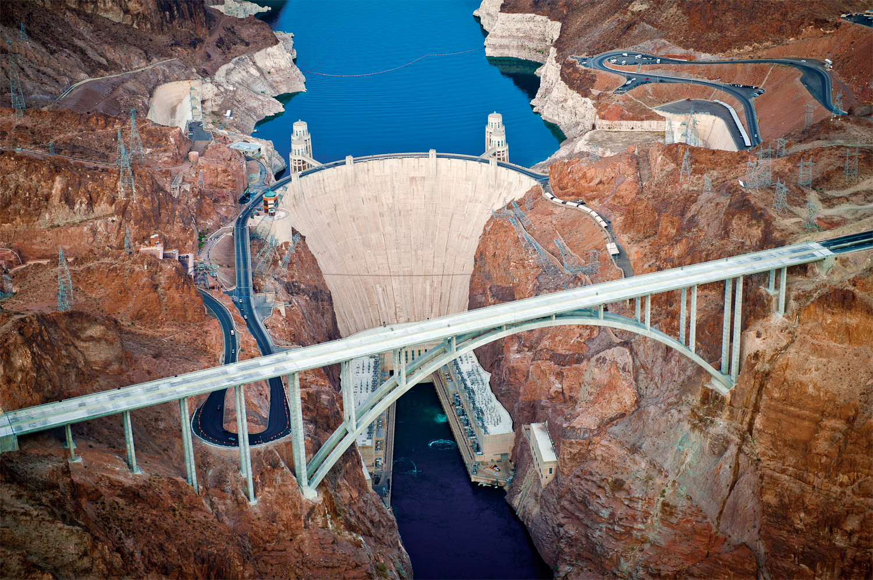
Question grid
?
Is?
Present
Did?
Past
Can?
Possibility
Would/could?
Probability
Will?
Prediction
Might?
Imagination
What?
Event
Deeper thinking
Where?
Place
When?
Time
Which?
Choice
Deeper thinking
Who?
Person
Why?
Reason
How?
Meaning
Bell starter

Slide 2
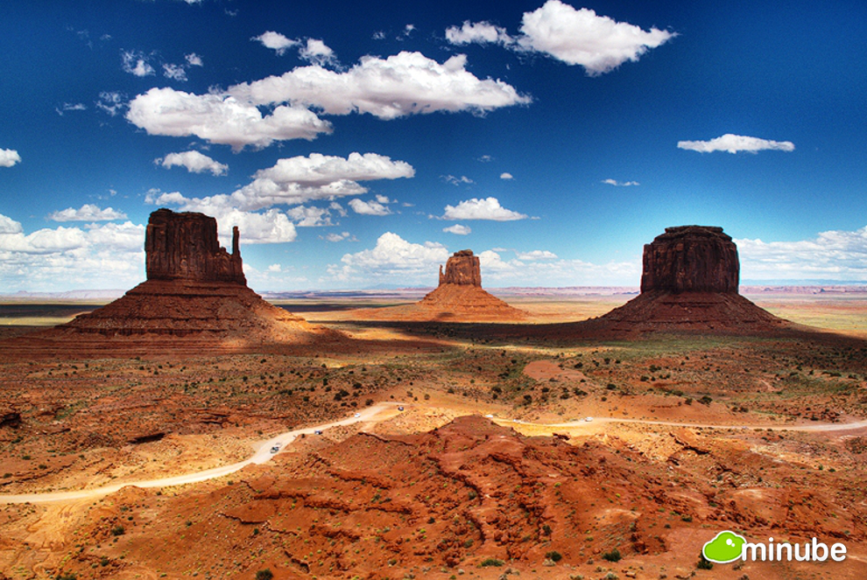
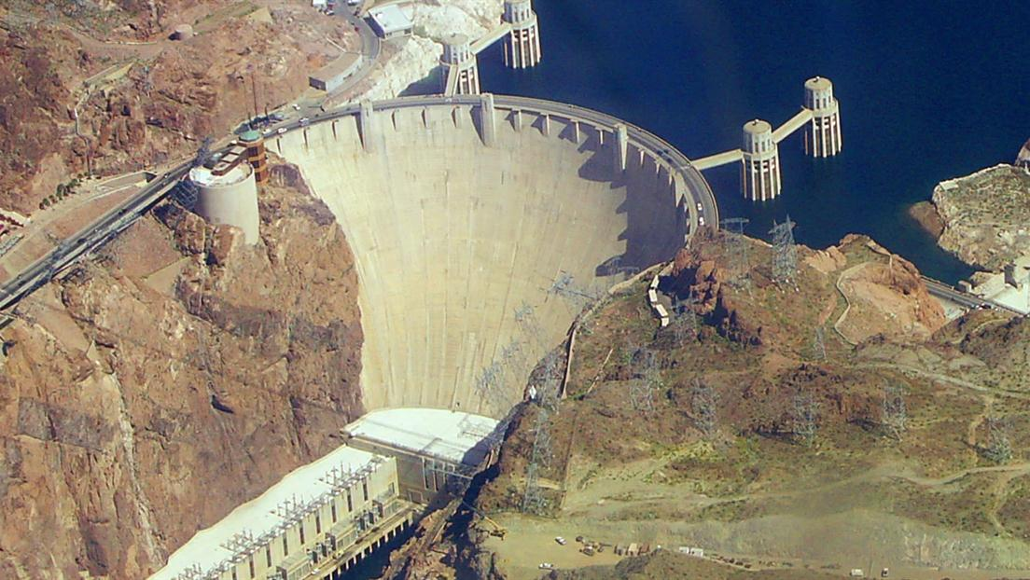
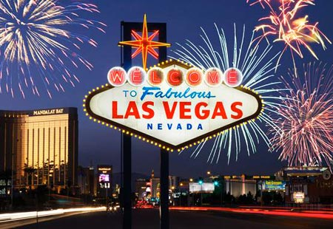
Does the Western Desert have a sustainable future?
Lesson objectives;
To develop a greater knowledge of the water crisis in the Western Desert.
To assess how the water issues are being managed

Slide 3
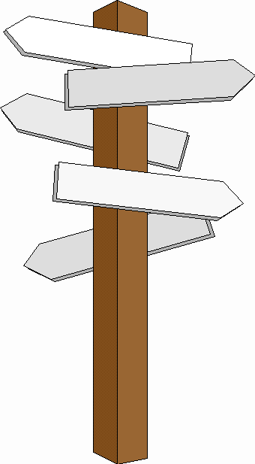
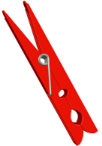
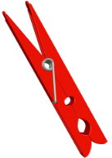
Starter
Decide where you stand on the decision line in relation to the statement. Be prepared to justify!
Yes
Maybe
“New golf courses should be allowed permitted near cities such as Las Vegas and Phoenix”
No
Yes!
Maybe?
No!
Why is it the best way?
What are the most influential reasons?
What should we worry most about?
What is making you unsure?
What would it take for you to make a decision?
What are both sides of the argument?
Why not?
What is a better way?
Which negatives particularly outweigh the positives?
What are the advantages of creating golf courses?
What are the disadvantages of building golf courses?
What are the conditions like in cities such as Las Vegas and Phoenix?
What examples can you use to illustrate the advantages and disadvantages?
How can you decide?

Slide 4
Why would this area have a water crisis?

Slide 5
Does the Western Desert have a sustainable future?
The American southwest is an important economic and environmental region located in an extremely arid climate zone. The main water resource is the Colorado River which flows from the Rockies down to the Pacific Ocean in the Gulf of California. The region is currently in the grip of the worst drought in living memory which could threaten the viability of famous cities like Las Vegas. With the population of the Colorado Basin set to almost double to 77 million by 2060 and a drier climate predicted, does the Southwest have a sustainable future?

Slide 6
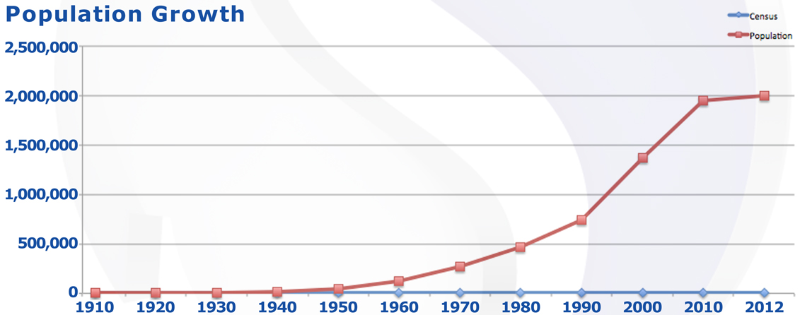
c) Describe and explain the growth of Las Vegas

Slide 7
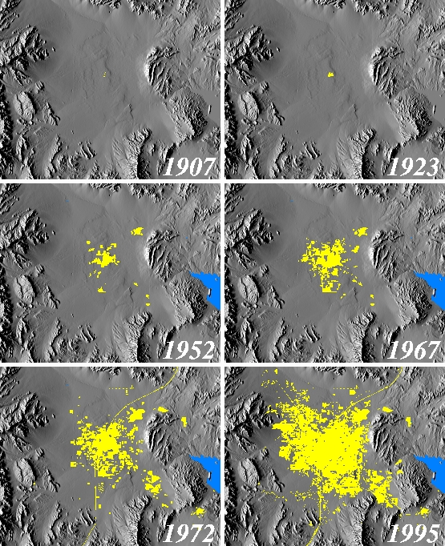
The geographical growth of Las Vegas – an increasing area

Slide 8
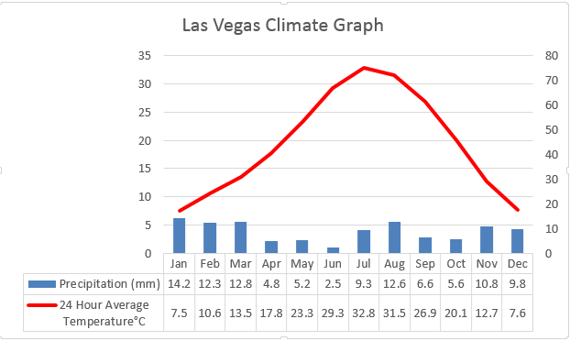
Climate graph – Las Vegas
Temperature ⁰C
Precipitation (mm)
Annual climate data | Value
Total annual precipitation | 108 mm
Annual average Temperature | 19.5 ⁰C
Describe the climate of Vegas using the data shown

Slide 9
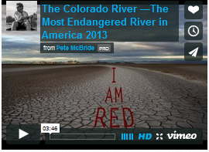
Case study river: The Colorado River
https://vimeo.com/63943253
Why is this river causing conflicts?
Who may these conflicts be between?

Slide 10
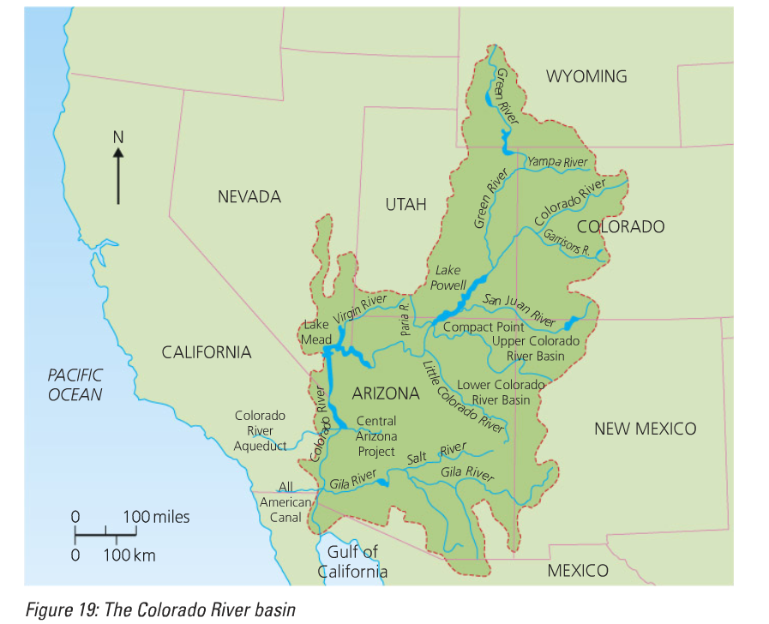
Colorado river basin: Geographical location
Name the states who share the River basin

Slide 11
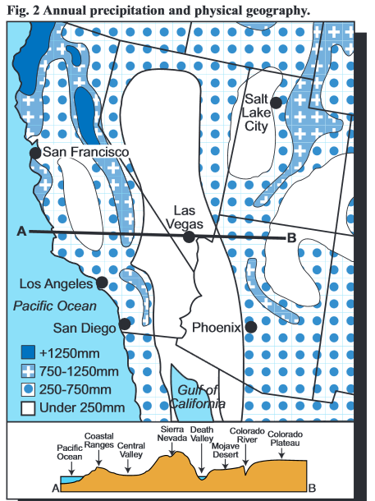
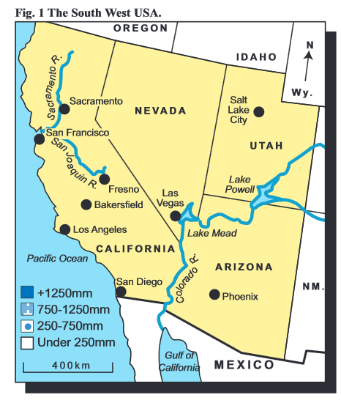
Locational context

Slide 12
Task: Describe the locational context of the Mojave Desert (4)

Slide 13
IDEAL analysis
I
Identify what can you see?
D
Describe why is this required in a desert?
E
Explain- what are the advantages and disadvantages?
Complete the IDEAL analysis on your sheet.
A
Apply- how did this create economic opportunities for the USA?
Literacy
Challenge
Can you use these key terms:
Sandbanks
Irrigation
Tourism
Agriculture
Water transfer
Meltwater
Hydroelectric power
Flow rate
Can you now answer the following question using the IDEAL analysis to help you:
To what extent was the Colorado dam successful in brining about economic opportunities in the Western Desert?
L
Link- how is this development affecting the water crisis in the Western Desert?

Slide 15
Identify
__________________________________________________________________________________________
Describe
__________________________________________________________________________________________
Explain
_______________________________________________________________________________________________________________________________________
Apply
_______________________________________________________________________________________________________________________________________
Link
_______________________________________________________________________________________________________________________________________

Slide 16
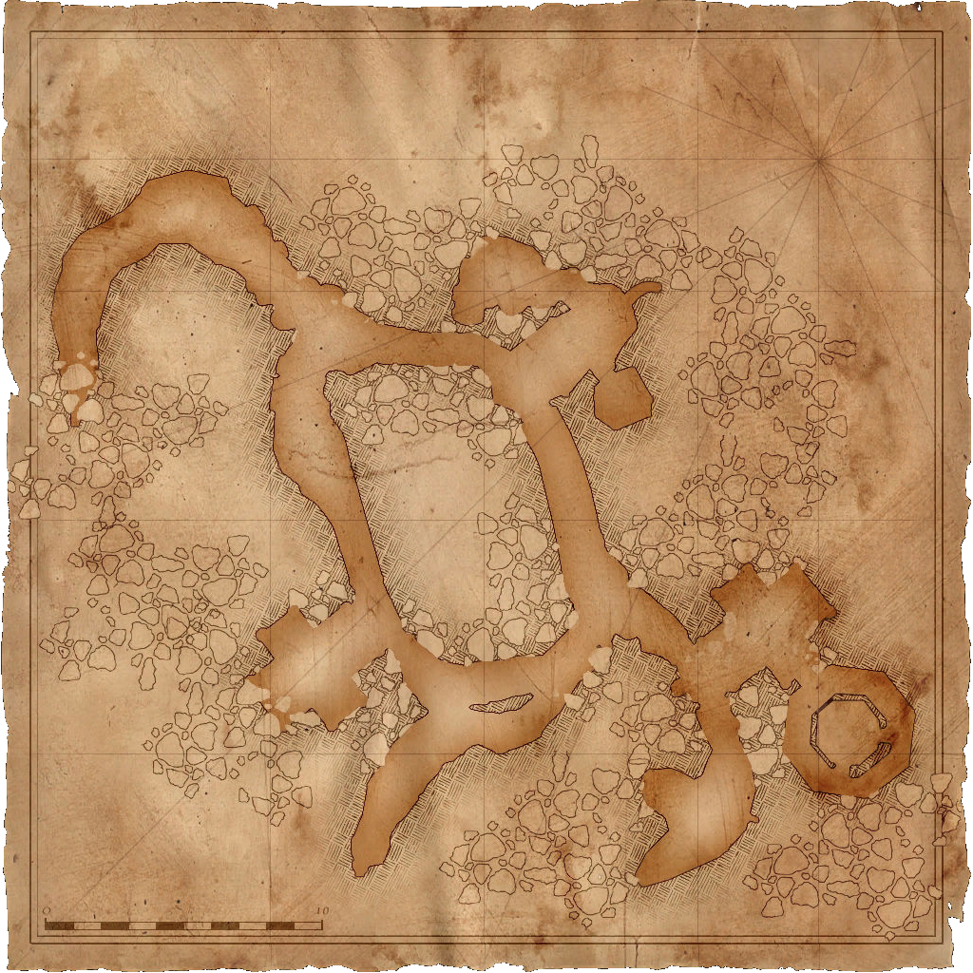
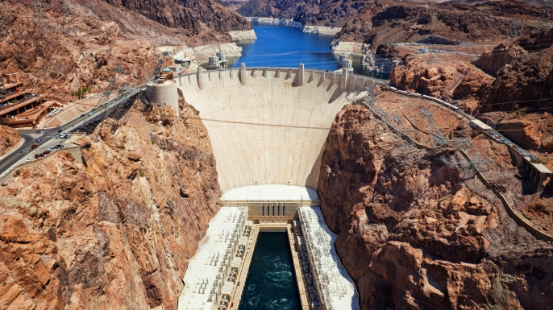
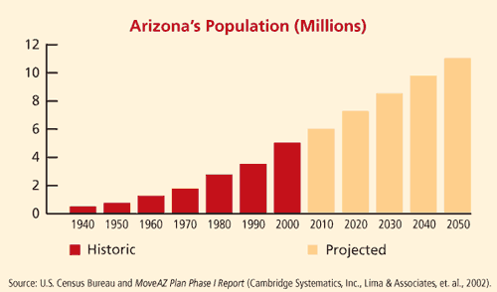
What is the Western Deserts water crisis?
Map from memory
Western Desert cities have prospered as a result of the huge water transfer schemes. However population growth is going to prevent this from continuing.
Levels 1-3
You are able to describe the Western Desert water crisis and the solution to the problem.
Levels 4-6
You are able to explain the Western Desert water crisis and the solution to the problem, using clear facts.
Levels 7-9
You are able to evaluate the solution to the Western Deserts water crisis problem using clear facts.

Slide 18
Take a journey down the Colorado River
http://wgsg.maps.arcgis.com/apps/MapTour/index.html?appid=8d81698048ee4fb785637835100f44ed
Takes a journey down the Colorado River from source to mouth and explore the key places connected to the current American southwest water crisis.
Which areas are under threat from the water crisis?
Which areas are causing the crisis?

Slide 19
Case study detail:
Watch the following video and make notes on…
Why is the management needed?
What has been done to manage the river
What conflicts have occurred? Why are there these conflicts?
Case study detail
https://www.youtube.com/watch?v=BE1RbFJTZdI
https://www.youtube.com/watch?v=JAHHu6tbtow

Slide 20
Solutions?

Slide 21
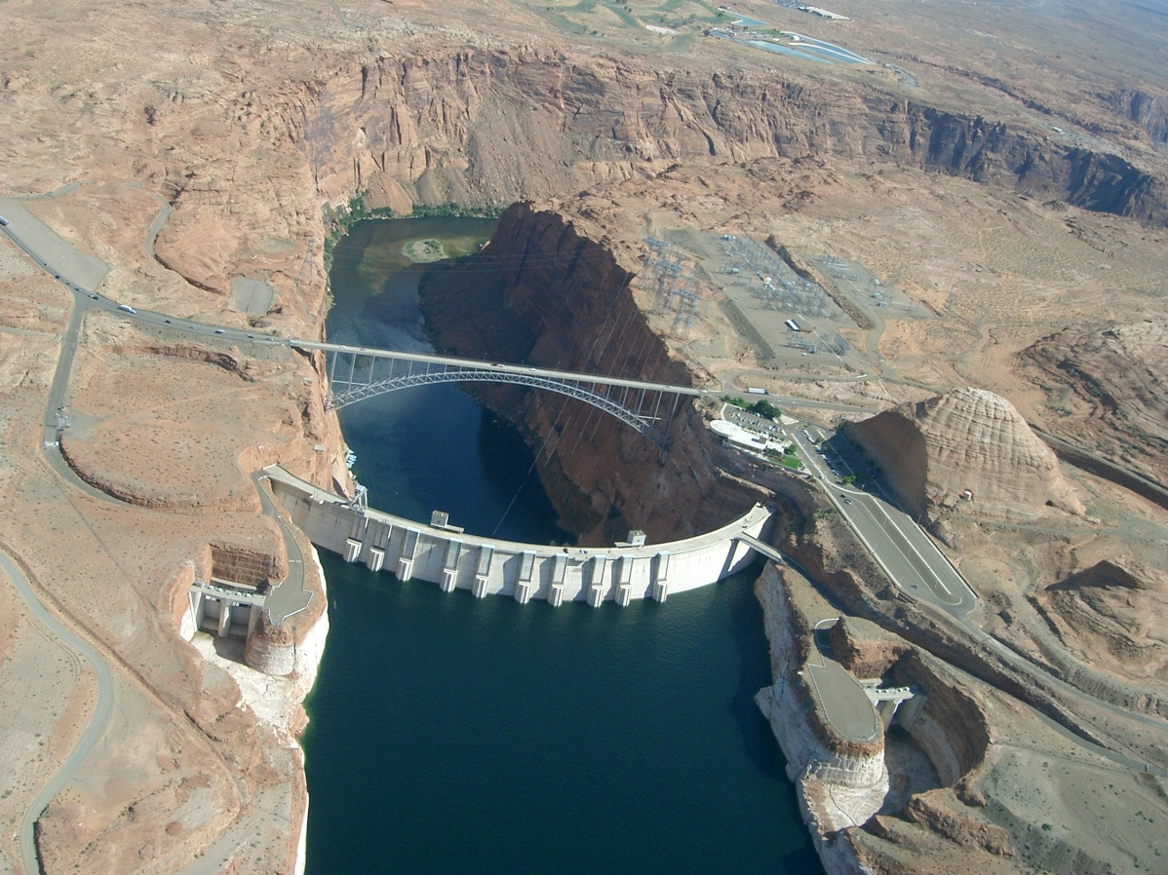
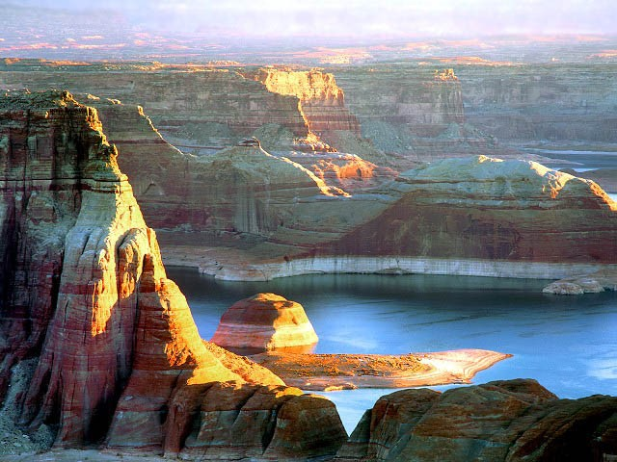
Glen Canyon and Lake Powell

Slide 22
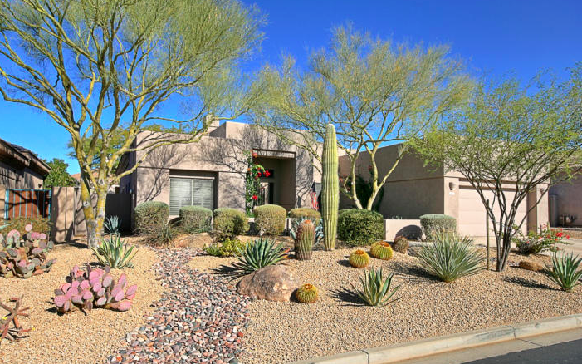
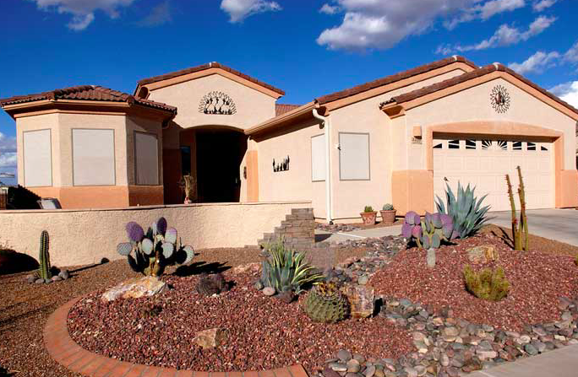
Xeriscaping
Xeriscaping: a type of landscaping in which everything is designed to help reduce or eliminate the need for supplemental water from irrigation or other watering methods.
It’s popular in Las Vegas because of a number of reasons:
Weather is both hot and dry
The Southern Nevada Water Authority places watering restrictions on homeowners
Excessive watering can be expensive
Las Vegas is in a drought and people want to do their part in conserving water
Video: How people are trying to live more sustainably in Las Vegas

Slide 23
Research:
News resource1: Can America's Desert Cities Adapt Before They Dry Out And Die?
News resource 2: National geographic: The Drying of the West ‘
Geofile: Managing the Colorado river basin

Slide 24
Exam question
For a hot desert environment you have studied, to what extent has the water been managed in a sustainable way? (7 marks)
B
ox the command word (s)
Step 2: On one hand...
Step 3: On the other hand...
Sustainability of the management
Problems of the management :
U
nderline the key words
M
Because
Challenge
Because
arks- How many?
This means
Example
Example
Can you explain what conclusion you would reach?
This means
Levels1 (Basic) Below 4
You describe the main ways in which water is being managed in the Mojave Desert
Link
Point
Link
Point
Level 2 (Clear) 5-6
You explain the opportunities and challenges of water management in the Mojave Desert
Literacy
Level 3 (Detailed) 7
You fully evaluate the opportunities and challenges of water management in the Mojave Desert-with case study detail
Can you use these key terms:
Whereas
However
On the other hand
How is water being managed in the Mojave Desert in a sustainable way?
What are the challenges of the water management in the Mojave Desert?

