Slide 1
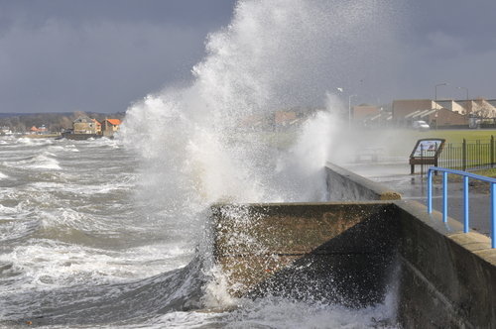
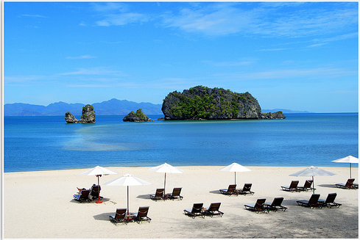
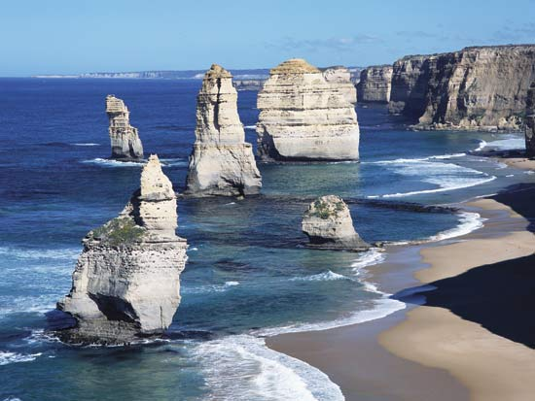
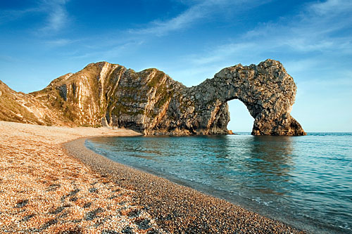
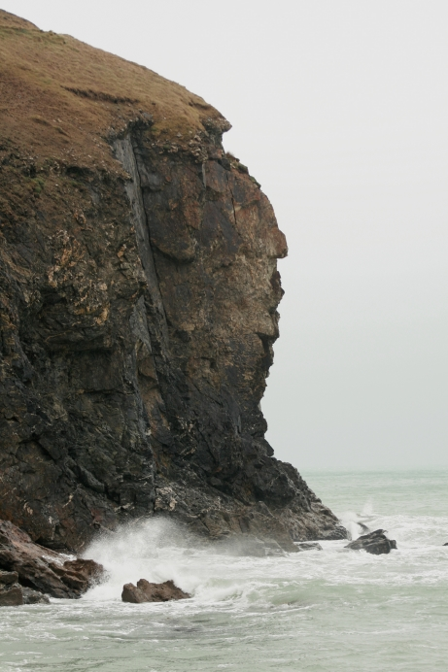
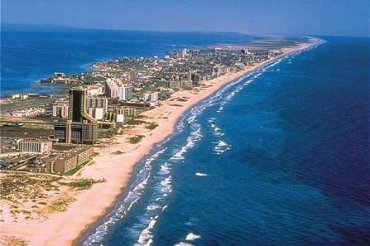
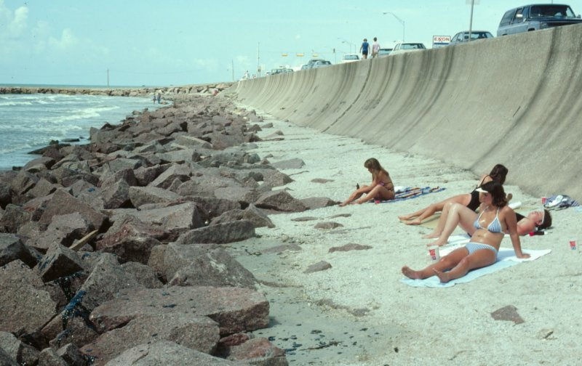
An introduction to coasts

Slide 2
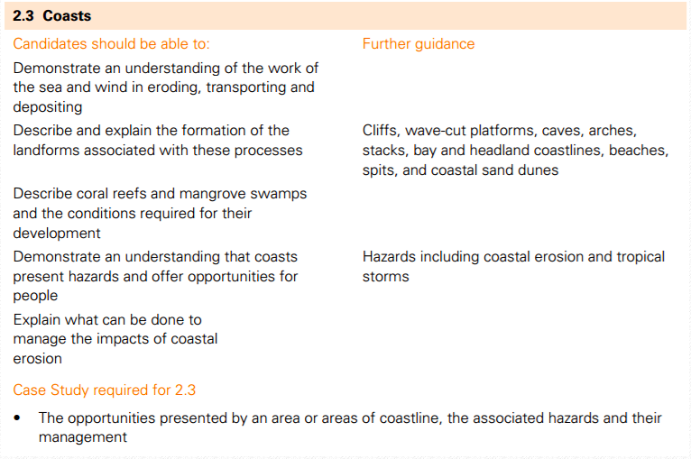
Fill out learning objective sheet and stick in book

Slide 3
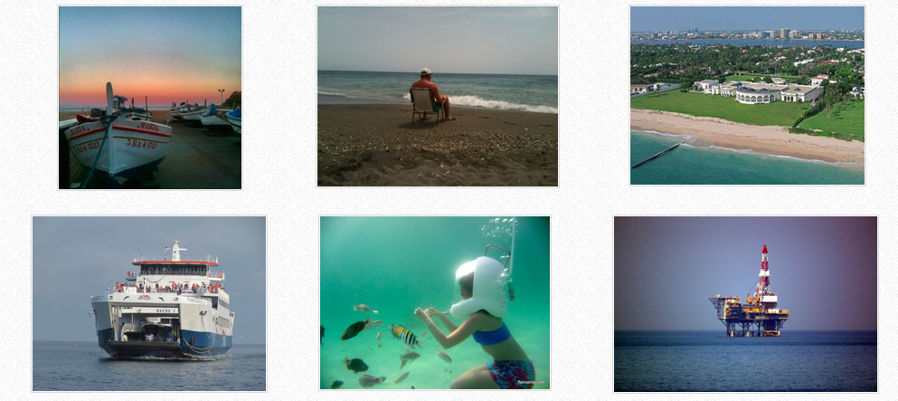
Why study coasts?
Starter: Using the images above and your own knowledge, explain how coasts are used and why they are important. You can record your thoughts on the worksheet

Slide 4
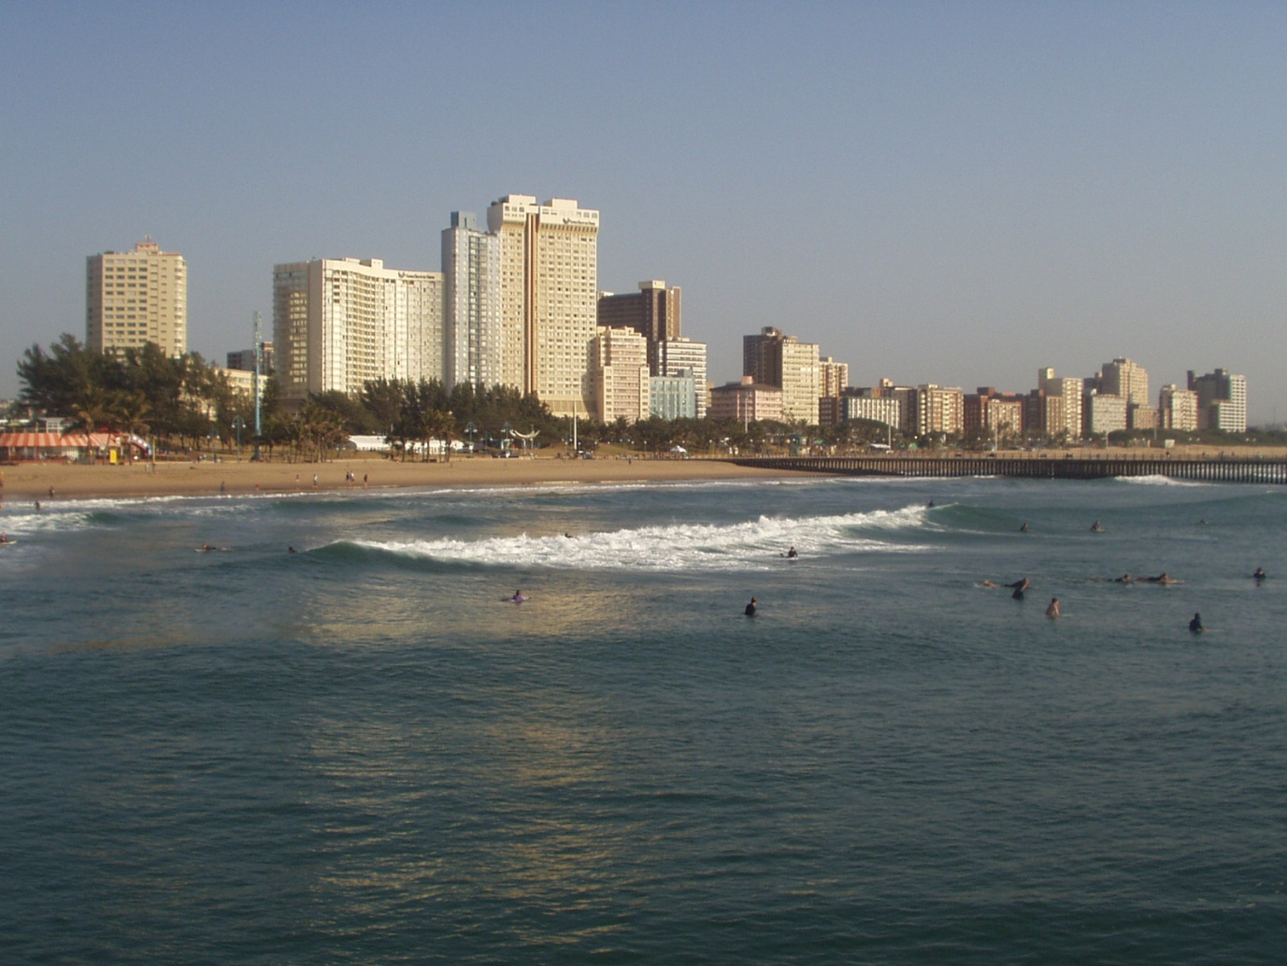
Waves
What are constructive and destructive waves?
Why? They cause different landforms along the coast

Slide 5
Watch the video that provides an introduction to waves
Find out the following:
What are the different types of waves?
What causes different types of waves?
What are the characteristics of the different wave types?
Any other useful information
https://www.youtube.com/watch?v=dv_Sis0Hntk
https://timeforgeography.co.uk/videos_list/coasts/types-waves/

Slide 6
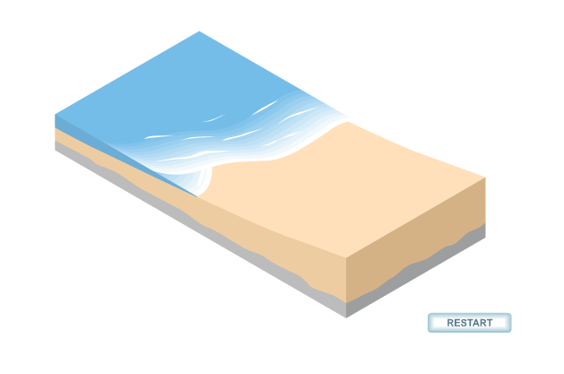
Key terms: swash and backwash
Swash: Water rushing up the beach from the energy of the wave
Backwash: When the wave has lost energy and it rushes back down the beach
http://www.youtube.com/watch?v=tN42EWWTP3w
http://www.thegeographeronline.net/coasts.html

Slide 7
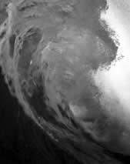
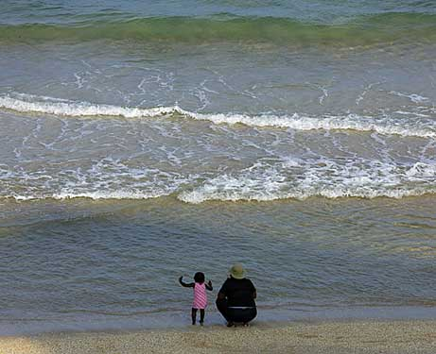
Constructive and Destructive waves

Slide 8
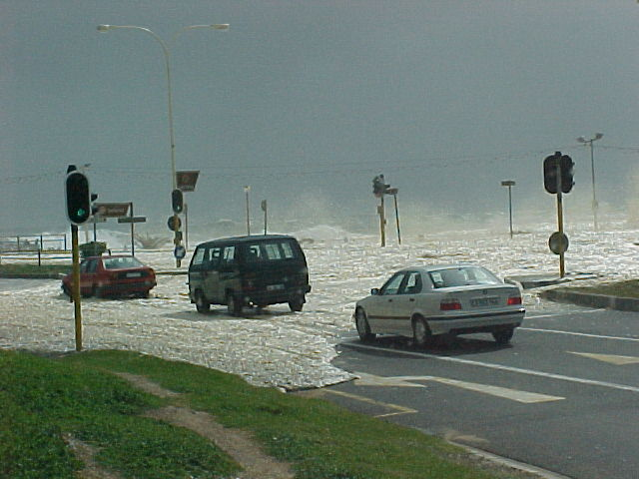
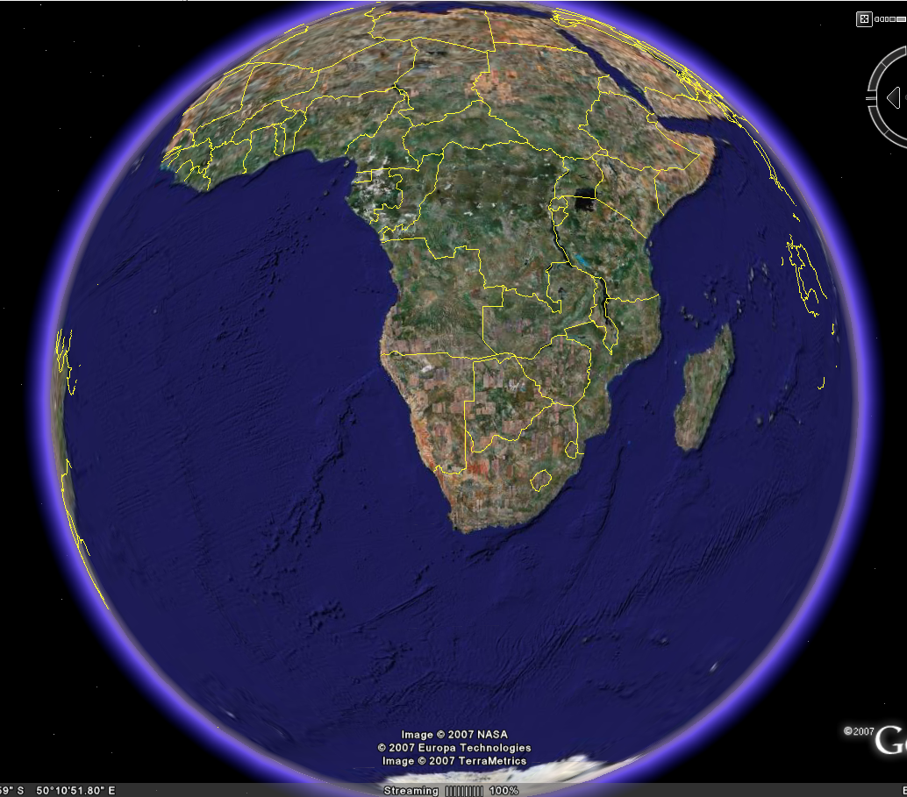
Storm waves
Durban
Wave fetch:
South Africa
Extremely long fetch

Slide 9
Watch the animation and draw an annotated diagram of a constructive and destructive wave
Animation

Slide 10
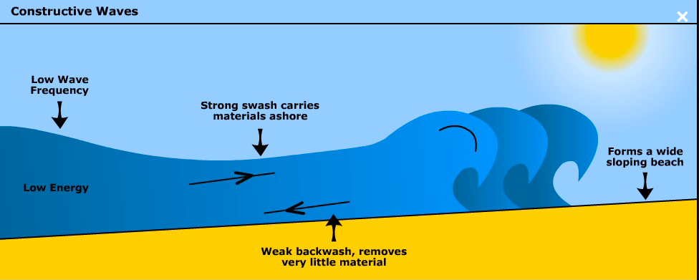
Small oceans with small fetch develop constructive waves. Constructive waves have low wave height and long wave length with low frequency, between 6 and 8 waves per minute. Constructive waves are associated with weak backwash and strong swash, which builds up wide flat beaches and so more associated with coasts of deposition. Constructive waves also tend to form sandy beaches.

Slide 11
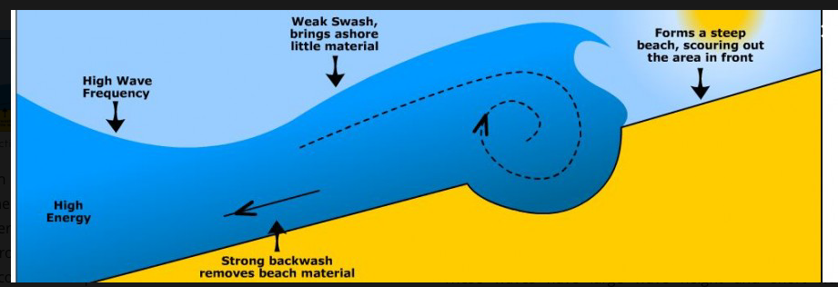
Large oceans with large fetch produce large waves, called destructive waves. These waves have large wave height and short wave length and are characterised by tall breakers that have high downward force and a strong backwash. They have high frequency, between 13 and 15 waves per minute. This downward energy helps erode cliifs. In addition, due to a dominant backwash they erode the beach making for narrow steep beach profiles. Localised storms with high wind speed also form destructive waves as well as steep depth gradients around headlands. Destructive waves also tend to form pebbly beaches.

Slide 12
Most likely to…
Destructive
Most likely to have a strong swash
Most likely to have a strong backwash
Most likely to be tall
Most likely to have a long wavelength
Most likely to occur in winter
Most likely to be a steep wave
Most likely to be powerful
Most likely to build up a beach
Most likely to be slow moving waves
Most likely to be a longer time between each wave
Have a low frequency
Have a high frequency
Main process erosion
Main process deposition
Constructive

Slide 13
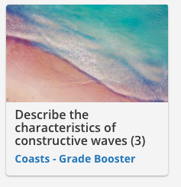
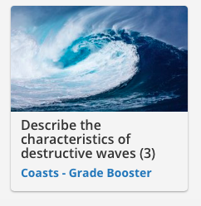
Answer these 2 questions and watch the hyperlinked videos to check your answers…

Slide 14
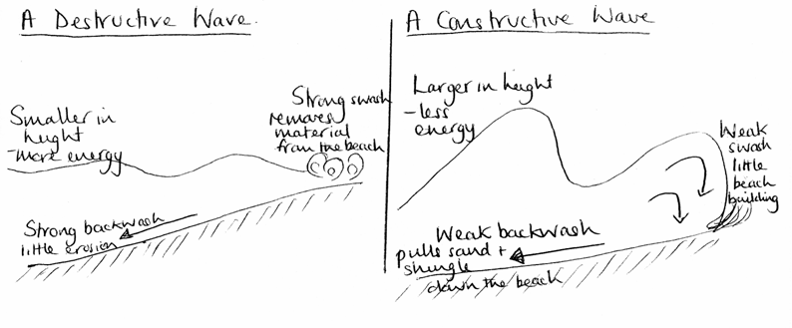
Beat the teacher- where did I go wrong?
Constructive waves help to build beaches up with their strong backwash. They move fast unlike destructive waves. Destructive waves are small, steep waves. They have a strong swash and remove beach material. Destructive waves have a long wave period unlike constructive waves.

Slide 15
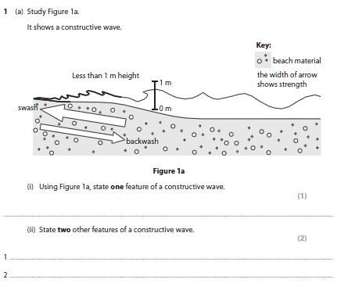

Slide 16
Mark scheme

