Slide 1
The water–food–energy nexus

Slide 2
Objectives
What: Impacts of changing trends in resource consumption
Why: Understand how pressure on resources affects the future security of places
How: Today we will start to investigate the water–food–energy “nexus” and how its complex interactions affect:
national water security, including access to safe water
national food security, including food availability
national energy security, including energy pathways and geopolitical issues

Slide 3
Objectives for section 2
​1. The water–food–energy “nexus” and how its complex interactions affect: • national water security, including access to safe water • national food security, including food availability • national energy security, including energy pathways and geopolitical issues 2. The implications of global climate change for the water–food–energy nexus 3. Detailed examples of two countries with contrasting levels of resource security 4. The disposal and recycling of consumer items, including international flows of waste

Slide 4
What is the water–food–energy “nexus”?
https://www.youtube.com/watch?time_continue=116&v=CKW_ux2Xo_w

Slide 5
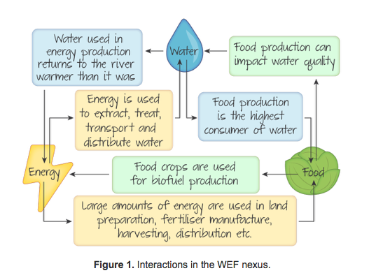
Use the diagrams and video clip to explain the concept of the “water-food-energy nexus”

Slide 6
"Trade-offs between energy and water, or between energy and food, are increasingly being debated in terms of the 'nexus' – a buzzword which has risen in prominence over the past few years as a way of thinking about interconnections between food, water, energy and the environment. These systems are inextricably linked, and integrated approaches are required, which move beyond sectoral, policy and disciplinary silos" - ​James Wilsdon and Rose Cairns June 2014

Slide 7
Example exam questions (for the end of this section)
State and explain two reasons why a nexus approach to the global water-food-energy situation is important. [1+2 + 1+2] “Water, food and energy security can no longer be viewed as isolated global problems” – critically examine this statement (10)
“Discuss the value of the nexus approach with respect to food security” (10)

Slide 8
Hexagons activity
Purpose:
This approach involves using key pieces of information displayed on hexagons.
Your job is to organise these into categories of your choice, with hexagons being placed adjacent to each other to highlight links between the factors described.
These groups are then glued down onto sugar paper and then the diagram is developed.
Titles should be written over each category, and arrows being used to connect the different categories and to chart a ‘path’ through the diagram.
The annotations over these arrows can provide the opening topic sentences for each paragraph of an essay that can be a concrete outcome of the activity.

Slide 9
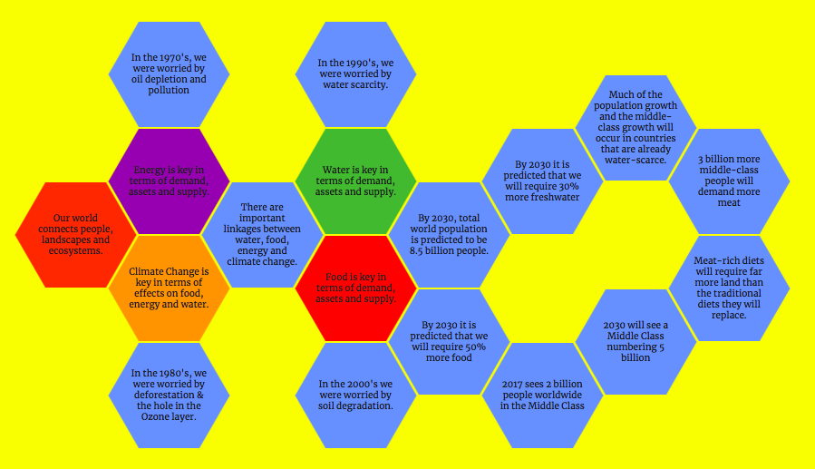

Slide 10
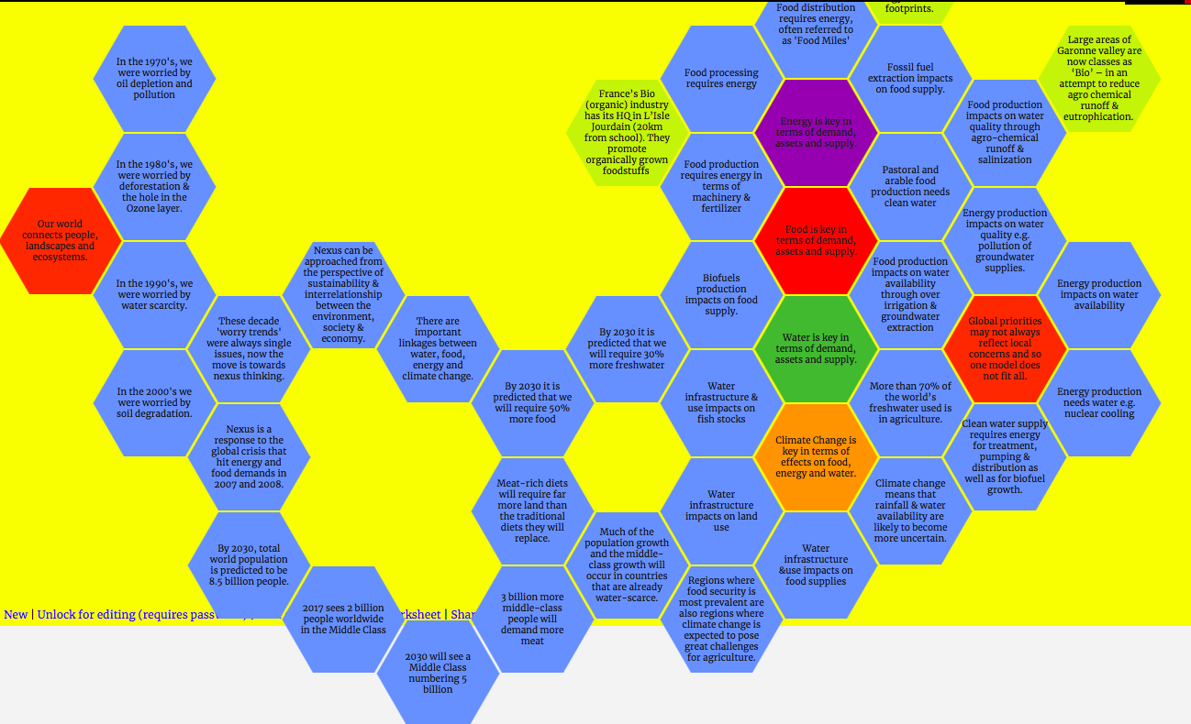

Slide 11
The FEW Nexus in Summary...
You are going to be completing three brief summary sheets that show how the Nexus complex interactions affect: ​ • national water security, including access to safe water • national food security, including food availability • national energy security, including energy pathways and geopolitical issues Your starting point is to read this summary article from United Nations Water - here. ​ Split into groups of three. Each person in the group is focus on one of the areas below. Your job is to research your interactions and produce a presentation to give to your partner on the issue as well as a completed exam question (3+3) as follows: 1. Discuss how Nexus interactions affect national water security and access to safe water. 2. Evaluate how Nexus interactions affect national food security and food availability. 3. Explain how Nexus interactions affect national energy security and geopolitical issues. You must include one global 'case study' example in your presentation and exam response.

Slide 12
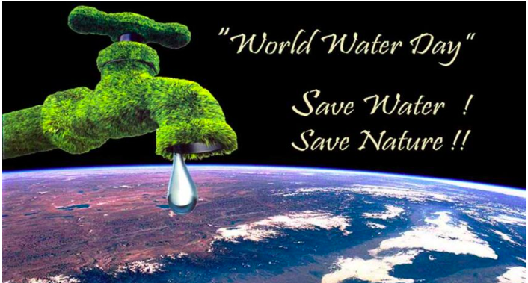
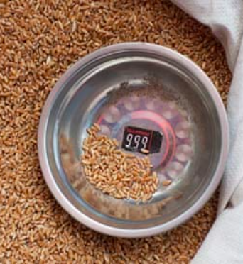
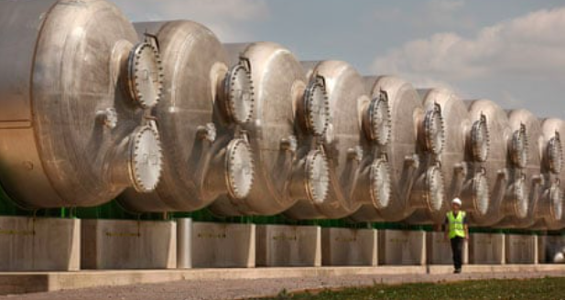

Slide 13
FEW – Guardian Articles
Tackling the food security nexus: achieving more with less
'Energy for water' may have greater impact on the nexus
‘The Nexus between ‘Water and Jobs’

