Slide 1
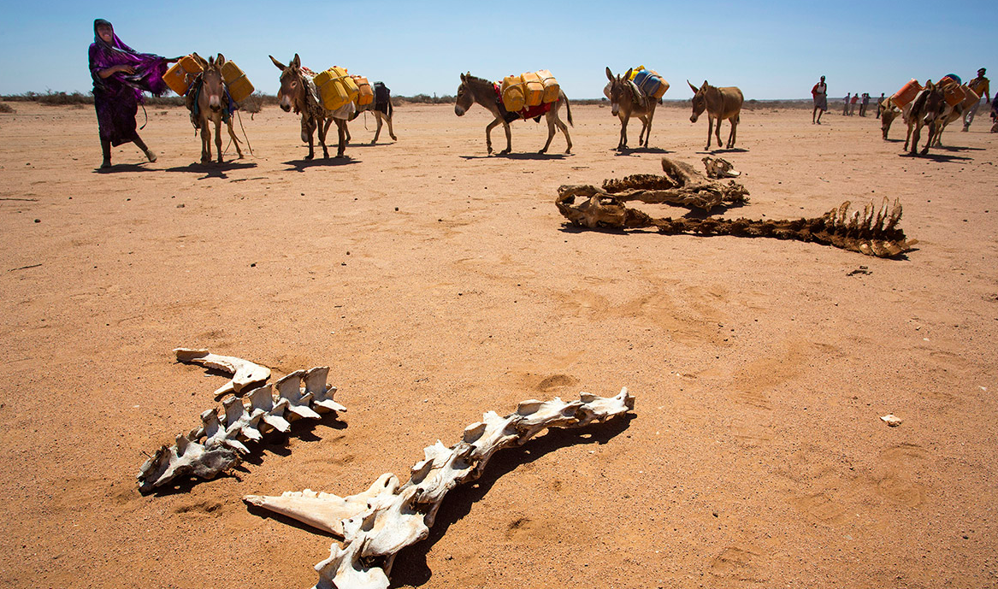
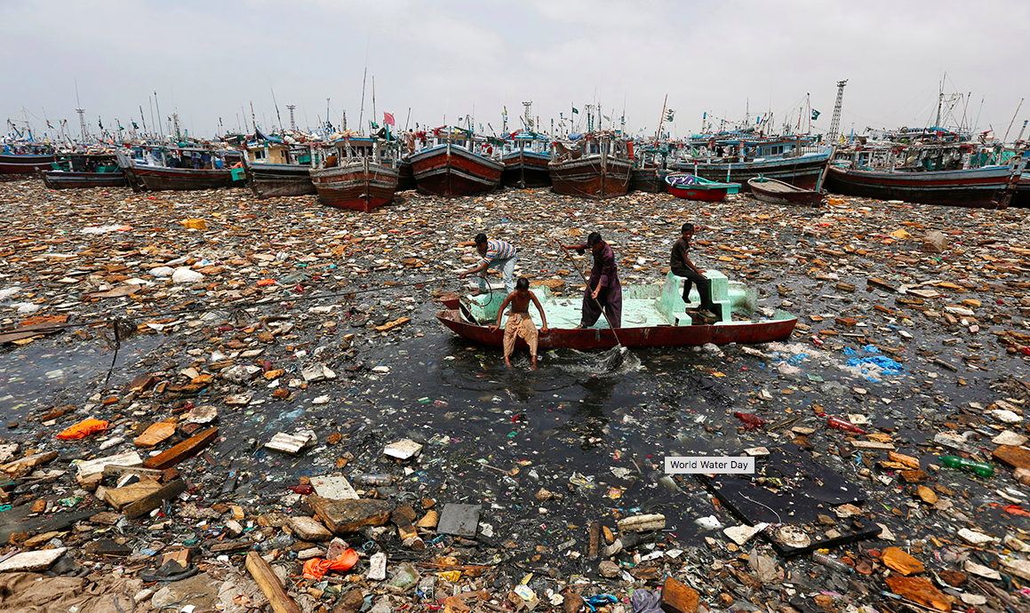
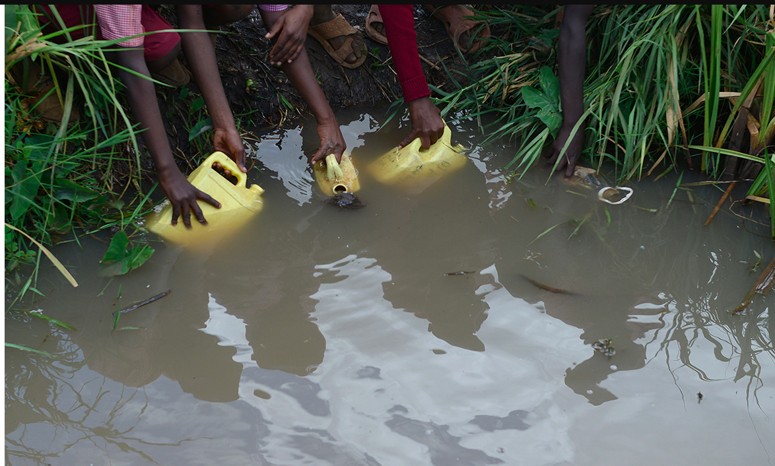
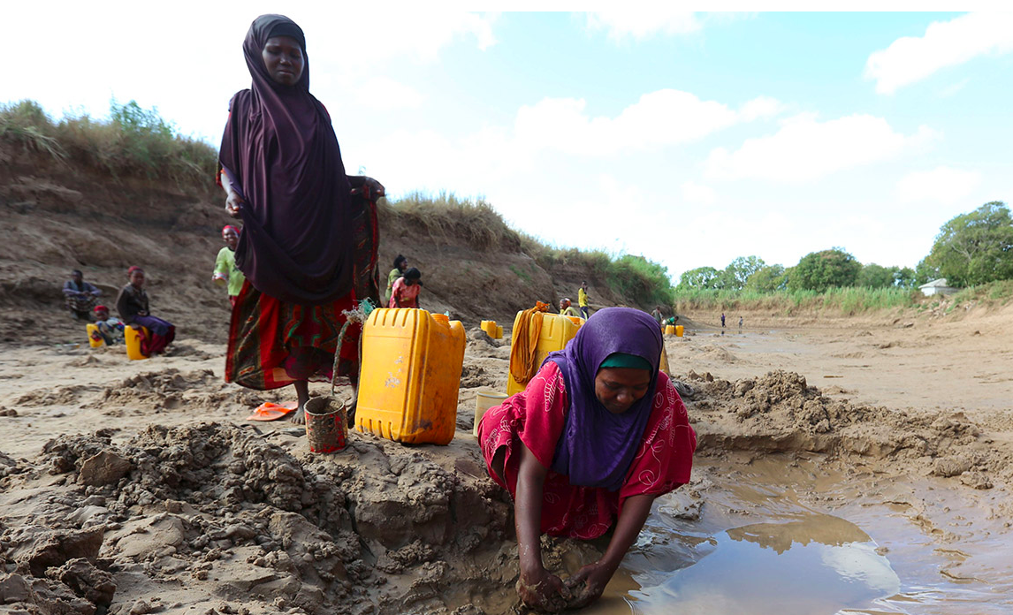
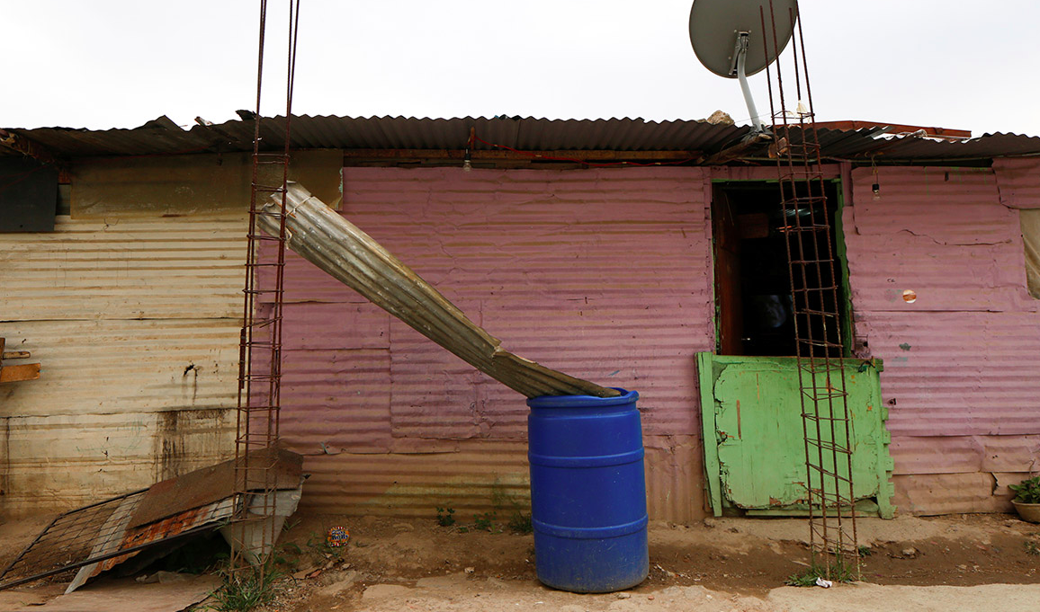
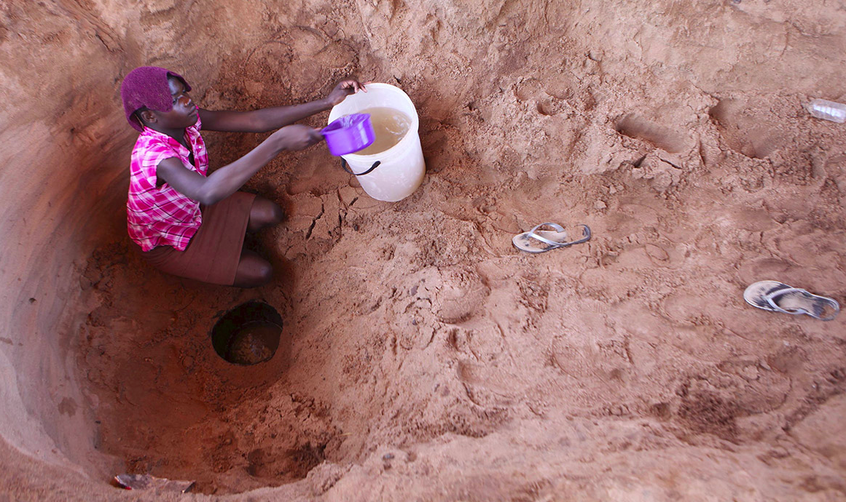
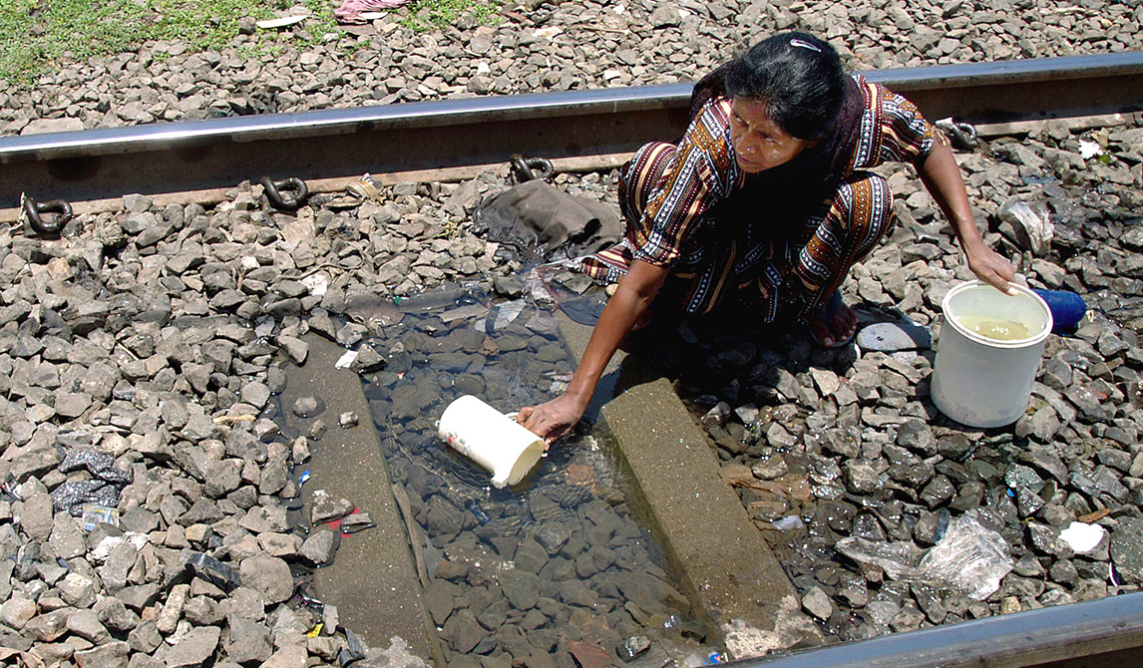
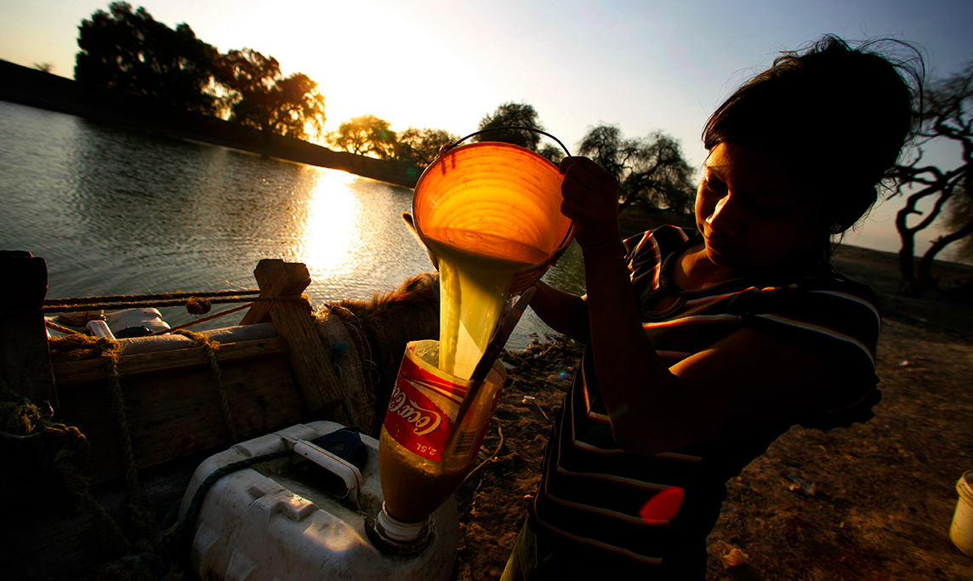
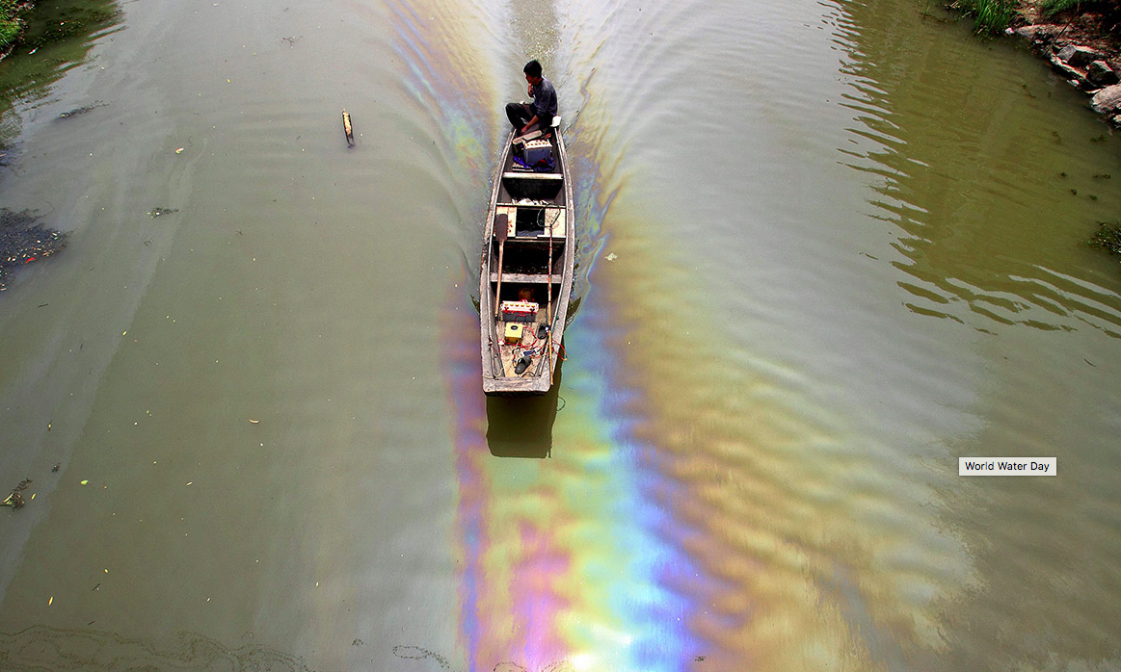
See, Think, Wonder

Slide 2
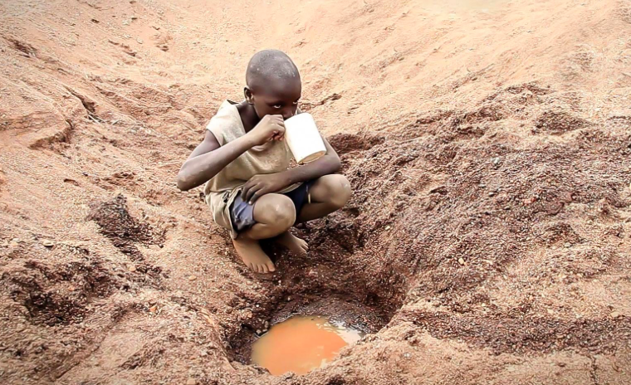
Water

Slide 4
Key term: Water consumption: measured by comparing how much water used at home (domestically), for farming (agriculture) and industry.
How much water have you used today?

Slide 5
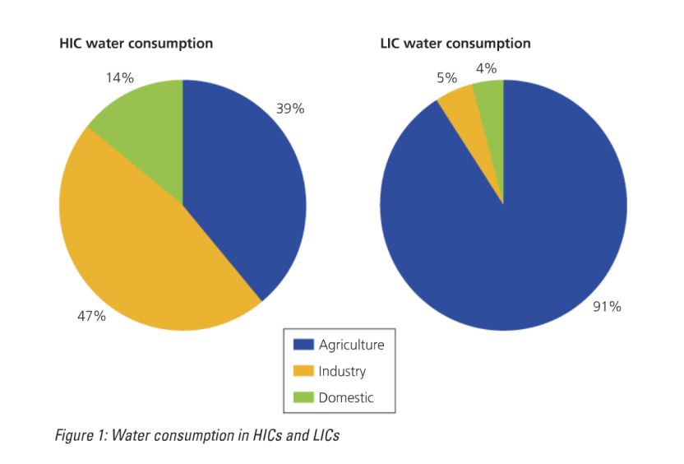
Water consumption use in MEDCs v LEDCs
Describe the differences in water consumption between HICs and LICs (3)
Explain why the water consumption varies between HICs and LICs in terms of (a) agriculture, (b) industry and (c) domestic use (6)

Slide 6
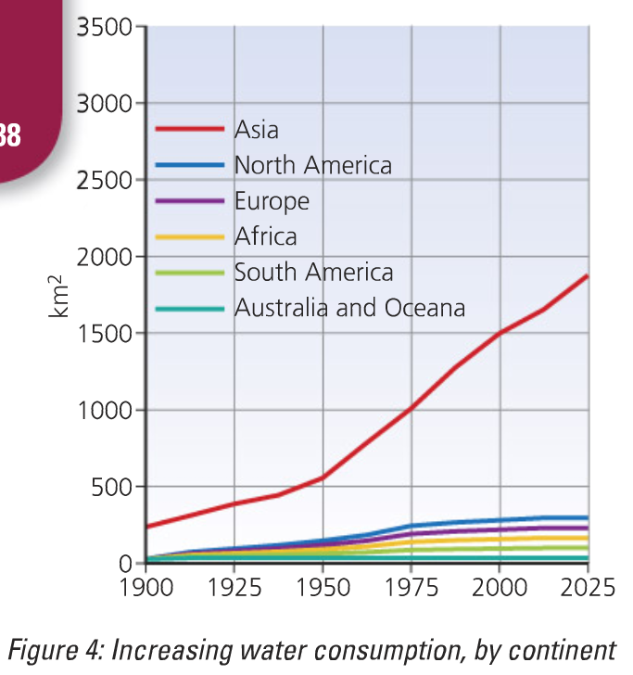
Explain the pattern shown on the graph

Slide 7
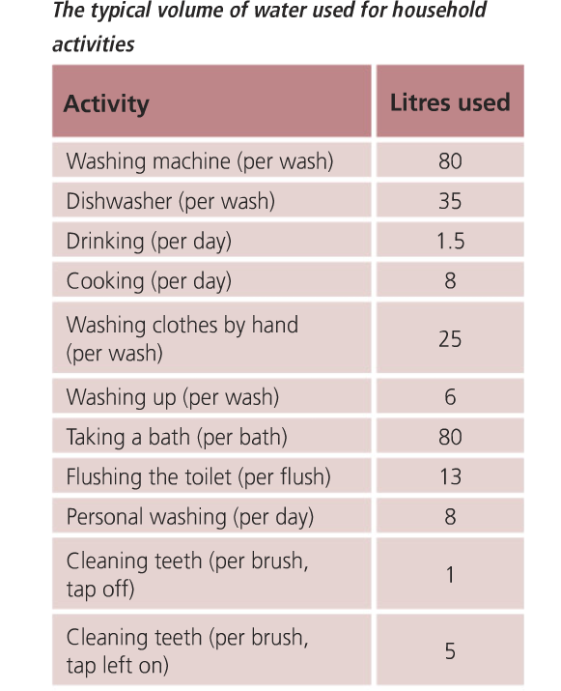

Slide 8
Explain the reasons why that as a country develops it may use more water

Slide 9
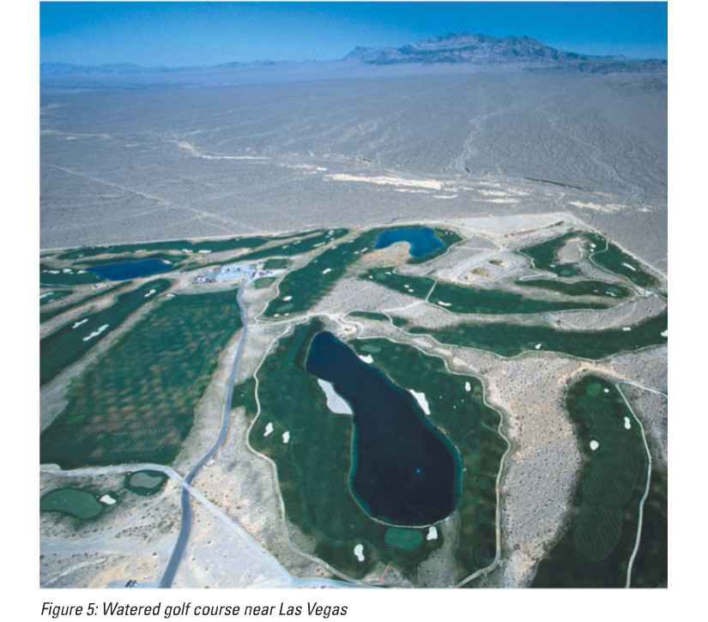

Slide 10
Greater wealth and increasing levels of development are the major contribution to increasing water consumption.
As a country’s economy becomes stronger, then the wealth of the individual increases and there is more money available for luxuries. (i) The range of demands for water is continually increasing in HICs from the ‘showering society’ to the use of labour-saving equipment such as washing machines: – There has been an incredible growth of labour-saving devices such as washing machines and dishwashers that use a considerable amount of water. -There has also been a change in personal hygiene. Before the 1950s it was quite common for there to be a weekly bath night. Now, people have bath or shower several times a week. (ii) The growth of the leisure and tourism industry has seen huge demands on the use of water. For instance, in countries such as Spain which are very dry in the summer, so much water is used on golf courses and swimming pools that local communities often suffer water shortages.

Slide 11
Question: Explain how greater wealth affects water consumption. (4)
Examiner tips: When answering this type of question, focus on two points and develop each of them with full explanation. If you are going to comment on opposite contexts e.g. greater and less wealthy people, ensure that the point raised for each is different and not just a mirror-image statement, for example ‘people in HICs use greater amounts of water as they have bought more water hungry devices, whereas people in LICs cannot afford them therefore use less water’. Higher scoring candidates tend to focus on the concept of showering societies as a reason for greater water use in HICs. Such candidates often develop answers beyond the simple description e.g. ‘people have more showers in HICs therefore use more water’. Higher scoring candidates more commonly give answers such as: ‘A higher income results in a greater amount of disposable income. This enables people to buy devices which use large amounts of water such as power showers. In addition, the fact that people shower at least once or twice per day, and for 10 minutes at a time on average, means that a larger amount of water is used.’ Remember to link points together with conjunctions to show the examiner the explanation in your answer.

Slide 12
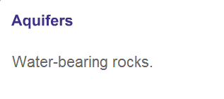
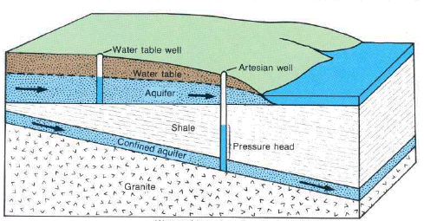
Groundwater : Aquifers

Slide 13
Key word: Aquifer:
A porous rock formation that allows water to move in and then hold water in tiny holes, such as a layer of chalk. The aquifer must occur above a layer that prevents the water seeping away, such as clay. The highest level of water in an aquifer is known as the water table. To extract water from an aquifer a hole is drilled down to below the water table and pressure will cause the water to flow up the pipe to the surface.

Slide 14
Aquifers in India
Watch the following 2 videos about the aquifers in India…
http://www.youtube.com/watch?v=o1QsCa7RmmU
Coca cola in Rajasthan case study from 8.20
https://www.youtube.com/watch?v=KBSI6Du2yhk
Who collects water from these?
How do they collect this water?
What issues are there?

Slide 15
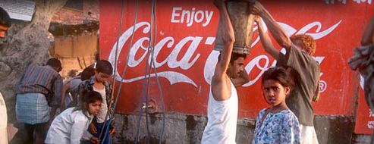
Coca-Cola established a bottling plant in the village of Kaladera in Rajasthan at the end of 1999. Rajasthan is well known as a desert state, and Kaladera is a small, impoverished village characterised by semi-arid conditions. Farmers rely on access to groundwater for the cultivation of their crops. but since Coca-Cola's arrival, they have been confronted with a serious decline in water levels. Locals are increasingly unable to irrigate their lands and sustain their crops, putting whole families at risk of losing their livelihoods.
http://www.waronwant.org/media/coca-cola-drinking-world-dryhttps://bassaleggeography.wordpress.com/2012/01/18/coca-cola-causes-water-shortages/

Slide 16
Key words…

Slide 17
Physical Water Scarcity means the natural reasons for low water supply i.e. low rainfall. Deserts, such as those in the Middle East are obvious examples of physical water scarcity
Economic Water Scarcity means the human reasons for low water supply i.e. lack of plumbing infrastructure. LEDCs such as the Democratic Republic of the Congo are an obvious example of areas with economic water scarcity because, although the Congo has no shortage of rainfall the lack of plumbing infrastructure in the Congo results in many Congolese people living without a reliable supply of fresh water.

Slide 18
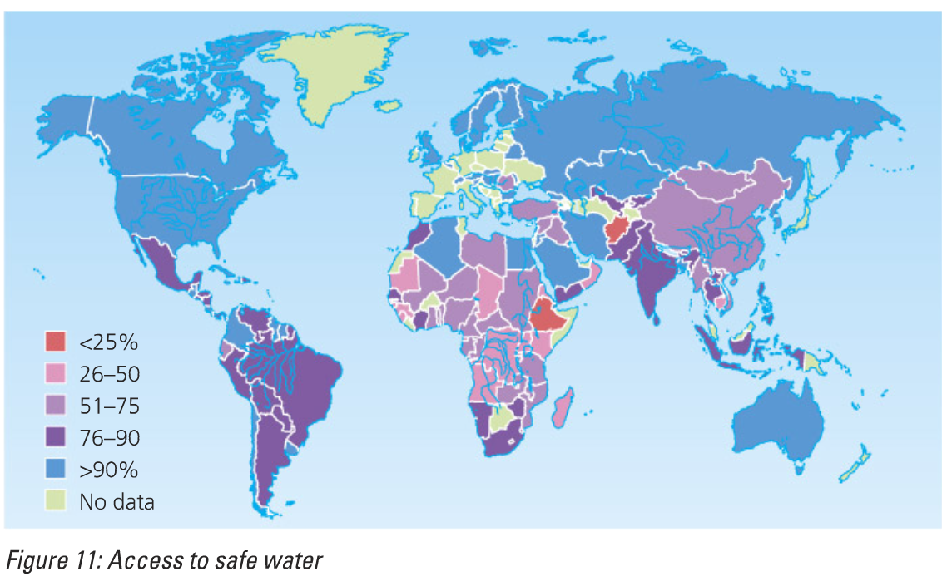

Slide 20
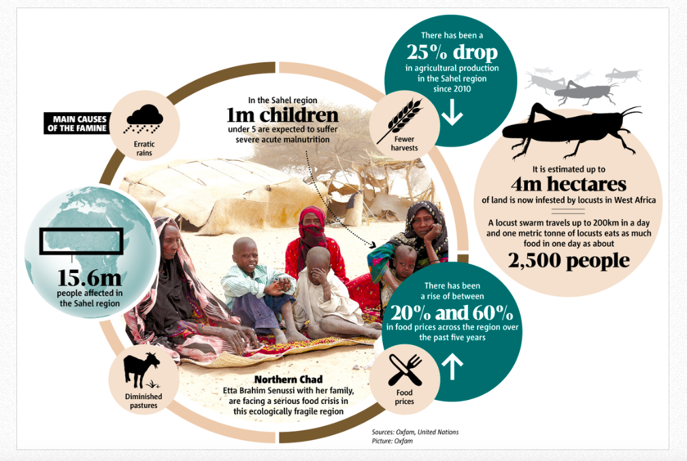
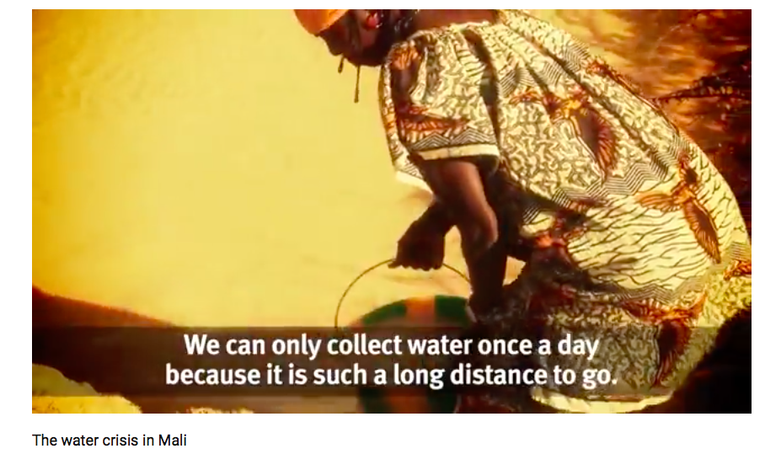
Lack of available water in The Sahel
Using the resources on the weebly and we have learnt in the food production unit
Why is there a lack of water in many LICs?
What issues does this create for the populations?
What can be done about the issue?

Slide 21
How is water usage being managed in LICs?

Slide 22
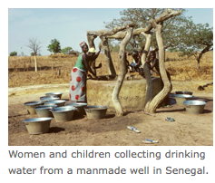
In LEDCs using appropriate technology is usually the best way to manage supply.
Wells, dug by hand, are a common way of accessing water - but the supply can be unreliable and sometimes the well itself can be a source of disease.
Gravity-fed schemes are used where there is a spring on a hillside. The water can be piped from the spring down to the villages.
Boreholes can require more equipment to dig, but can be dug quickly and usually safely. They require a hand or diesel pump to bring the water to the surface.
In addition to locating new sources of water, some strategies help to reduce the need for water. These include:
harvesting (collecting) rainwater landing on buildings
recycling waste water to use on crops
improving irrigation techniques
growing crops less dependant on a high water supply
minimising evaporation of water

Slide 23
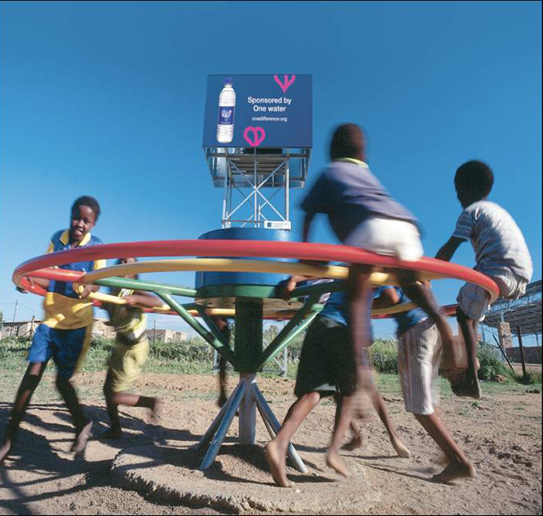
Notes:
This is a PlayPump® water system. As children spin on the roundabout, fresh clean water is pumped from deep underground into a storage tank for use by the entire community. A simple idea that is changing the lives of thousands of African people.
One turn of the roundabout pumps one litre of clean water out of the ground. This water is pumped into a storage tank. The tank hold 2,500 litres of water (or about 5,000 bottles).

Slide 24
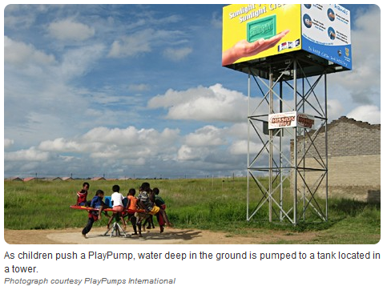
Case study of appropriate technology: Play pumps
http://www.youtube.com/watch?v=uQu_Jppvzyk&feature=results_video&playnext=1&list=PL76991DECF166D530
Task: Write a summary of play pumps
How does it work
What benefits does it give?
Why is it an e.g. of appropriate technology

Slide 25
Case study of appropriate technology: Play pumps
As the merry-go-round spins, it pumps clean water up from deep underground and stores it in a huge tank. People are welcome to come and help themselves to the water. In rural Africa, clean water is a luxury. Most people don’t have plumbing in their homes. Instead, they often must walk long distances to wells and haul heavy containers of water back.
So far, more than 800 PlayPumps are operating in schools and communities in four African countries, providing water for almost two million people
The PlayPump can pump up to 370 gallons (1,400 liters) of clean water an hour.
http://video.nationalgeographic.com/video/kids/green-kids/playpumps-kids/

Slide 26
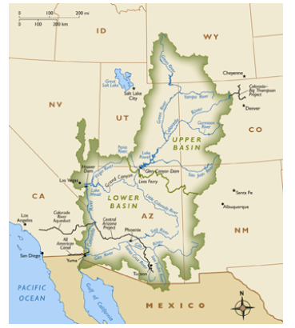
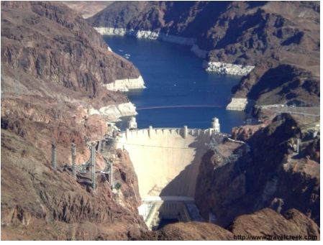
Lack of water: The Colorado River Basin
Use notes from Deserts and on the Weebly
Why is there a lack of water?
What issues does this cause?
How is the issue being managed?

Slide 27
7 mark questions
2010: Describe how people can be provided with a reliable supply of safe drinking water. You should refer to an area or country which you have studied. [7]
2010: Many areas have a shortage of water supplies. Describe the likely impacts of a water shortage on the people and development of a named area which you have studied. [7]

Slide 28
Describe how people can be provided with a reliable supply of safe drinking water. You should refer to an area or country which you have studied. [7]

Slide 29
Many areas have a shortage of water supplies. Describe the likely impacts of a water shortage on the people and development of a named area which you have studied. [7]

