Slide 1
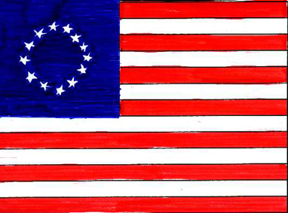
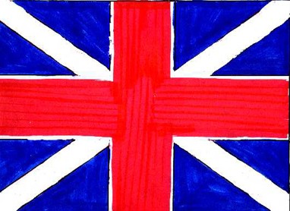
Why was the War of Independence fought?

Slide 2
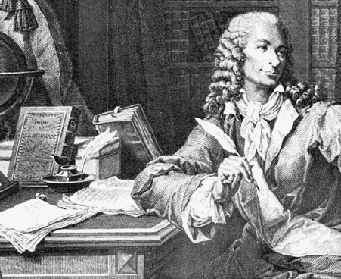
The Enlightenment
The Age of Reason
Philosophers used reason and logic to think of ways to improve the world.
How should government work to best serve the people?

Slide 3
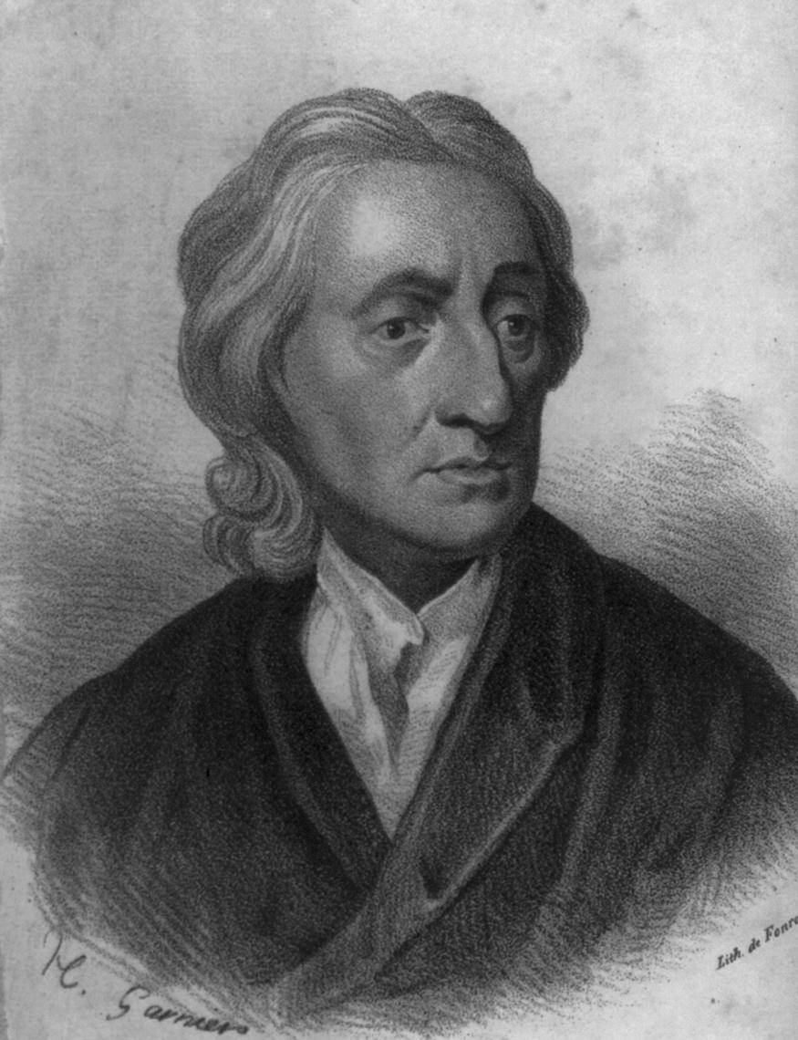
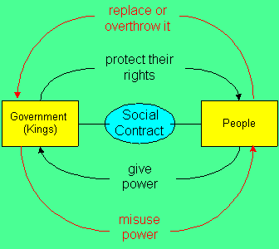
The Enlightenment
II. JOHN LOCKE: believed a social contract, or agreement, existed between political leaders and the people they ruled.

Slide 5
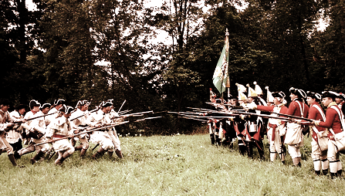
How might these ideas fuel REVOLUTION throughout the colonies?

Slide 6
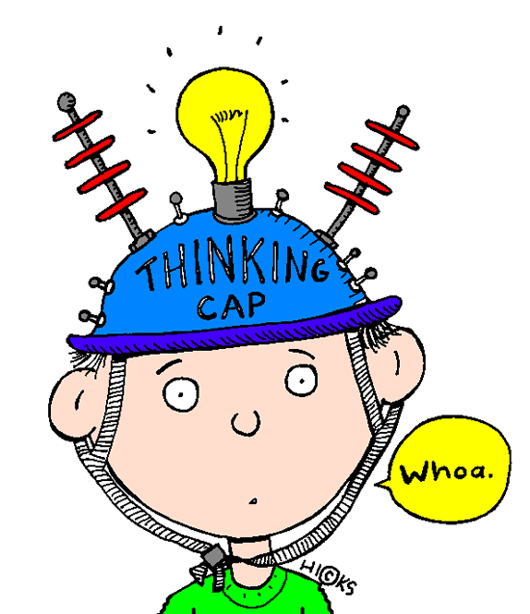
The USA Today
What do you already know?

Slide 7
In groups around your table, list the 13 colonies on the piece of paper. If you finish this, try listing all 50 states!! (Most Americans struggle to list all 50 states….can you do any better?)
NO CHEATING!!

Slide 8
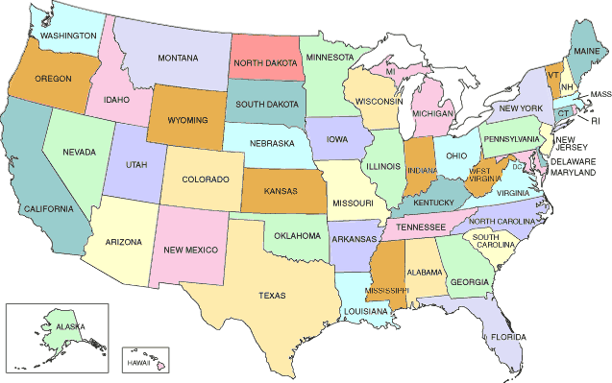
The USA Today
The USA has 50 states, covering over 3.5million square miles with a population of over 300 million.
The UK covers 94,000 square miles and has a population of 60million.

Slide 9
The USA Today
Alabama
Alaska
Arizona
Arkansas
California
Colorado
Connecticut
Delaware
Florida
Georgia
Hawaii
Idaho
Illinois
Indiana
Iowa
Kansas
Kentucky
Louisiana
Maine
Maryland
Massachusetts
Michigan
Minnesota
Mississippi
Missouri
Montana
Nebraska
Nevada
New Hampshire
New Jersey
New Mexico
New York
North Carolina
North Dakota
Ohio
Oklahoma
Oregon
Pennsylvania
Rhode Island
South Carolina
South Dakota
Tennessee
Texas
Utah
Vermont
Virginia
Washington
West Virginia
Wisconsin
Wyoming

Slide 10
Introduction
The United States had been occupied by Native Americans since prehistoric times, and European white settlers from 1492.
The strip of land along the eastern coast of America became the original 13 British colonies.
By the 1770s the 13 colonies had grown to contain over 2.5million people.

Slide 11
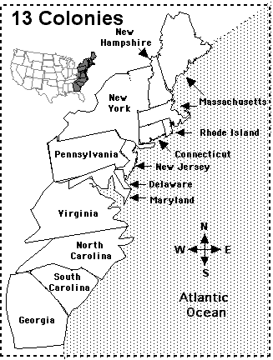
The 13 Colonies
Connecticut
Delaware
Georgia
Maryland
Massachusetts (Boston)
New Hampshire
New Jersey
New York
North Carolina
Pennsylvania
Rhode Island
South Carolina
Virginia

Slide 12
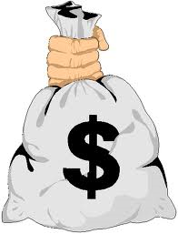
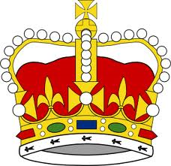
+
Why was the American Revolution fought?
What 3 things caused the American Revolution?
+

Slide 13
+
Why was the American Revolution fought?
What 3 things caused the American Revolution?
+
MONEY GOVERNMENT PHILOSOPHY

Slide 14
+
Why was the American Revolution fought?
+
HIGH TAXES NO REPRESENTATION WANT TO BE FREE
MONEY GOVERNMENT PHILOSOPHY

Slide 15
What was the “spark”?
All of these causes provided the “TNT” or “gunpowder” that would potentially start a war. They are the long term causes.
But to start a war there must be a “spark” or short term cause to make our “TNT” or “gunpowder” explode.

Slide 16
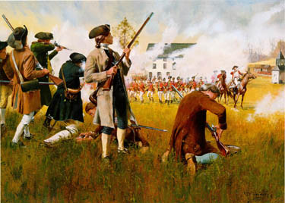
The Battles of Lexington and Concord
QUESTIONS
What were the British planning to do in Lexington and Concord?
What did the British find when they got there?
What is the “Shot Heard Round the World”?
Who won the Battle of Lexington?
What happened at the Battle of Concord?

Slide 17
The Second Continental Congress
Following the fighting at Lexington and Concord a meeting was called in Philadelphia on 10th May 1775 to assemble delegates to the Second Continental Congress.
Those present included Sam Adams, Patrick Henry, John Hancock, John Adams, Benjamin Franklin, and George Washington.
Some wanted to declare America independent immediately; some wanted to avoid war at all costs.
So Congress did both! They sent a document called the Olive Branch Petition to King George III to see if their differences could be settled once and for all, but also created an army and appointed George Washington as commander-in-chief (just in case!).
King George III refused to even read the document, and so Britain and America were officially at war.
The Declaration of Independence would not be written and signed until 2nd August 1776.

Slide 18
The Declaration of Independence
http://www.youtube.com/watch?v=hhqzGy8EguI

Slide 19
Declaration of Independence
In your groups, you are going to have a go at writing your own Declaration of Independence.
You need a list of 10 bullet points/sentences declaring yourselves independent and free from British rule.

Slide 20
REVOLUTIONARY RAP
The thirteen colonies in America
Were ruled by England’s king.
The colonists were so happy
The king’s praises they did sing.
Then he began to change things
That were not one bit funny.
He started to tax them
Which means they paid extra money.
As King George made new laws
New taxes he began to shout.
Many colonists became upset
And some even spoke out.
And that is when it happened
The king taxed the tea.
But it wasn’t quite a tea party
This you will plainly see.
Some colonists boarded ships
On a cold day in December.
They dumped 250 chests of tea
This you must remember.
The Redcoats came from Britain
It was order they wanted to keep.
Colonists formed the minutemen
And kept watch to hear one peep.
Paul Revere was paying attention
To see how many lights shone.
When he saw the lights he leapt on his horse
And rode out all alone.
“The Redcoats are coming. The Redcoats are coming.”
He began to warn.
Paul Revere was right
For the Redcoats arrived the next morn.
The shot heard round the world
Was not extremely loud.
It began a war that led
To a new nation that would be proud.
In 1776, American leaders met to sign
The Declaration of Independence
That gained freedom, yours and mine!

Slide 21
Questions
How were the colonies ruled?
What Act of Parliament strained the relationship between Britain and the colonies?
What did this Act say?
What happened at the Boston Tea Party in 1773?
Why did the colonists call the First Continental Congress?
What did the First Continental Congress do?
Why was the Second Continental Congress called?

