Slide 1
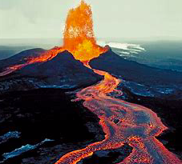
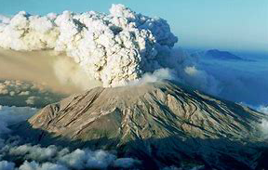
Volcanoes in the USA
Where is the riskiest place to live in the USA?
LO: To understand the differences in risk between the varying types of volcanoes within the USA

Slide 2
Starter:
1. identify some of the differences between these two volcanoes found in the USA
2. Why may there be these differences?

Slide 3
Task: Use the link from the USGS to describe the distribution of volcanoes within the USA
https://volcanoes.usgs.gov/index.html

Slide 4
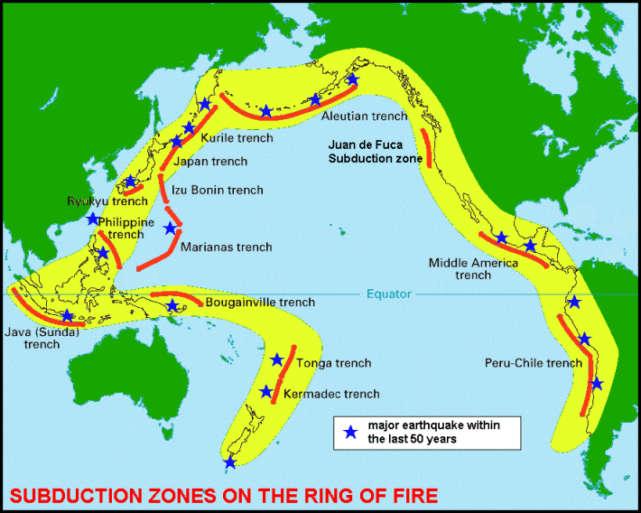

Slide 5
Volcano example 1: Mt St. Helens

Slide 6
Starter: Complete the Quiz:

Slide 7
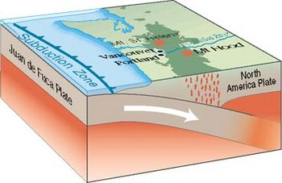
The little Juan de Fuca ocean plate slides under the continent.
As the ocean plate descends the rock melts and magma rises.
This has created the Cascade Range of volcanoes.
https://www.youtube.com/watch?v=4CVk68ZuBm4

Slide 8
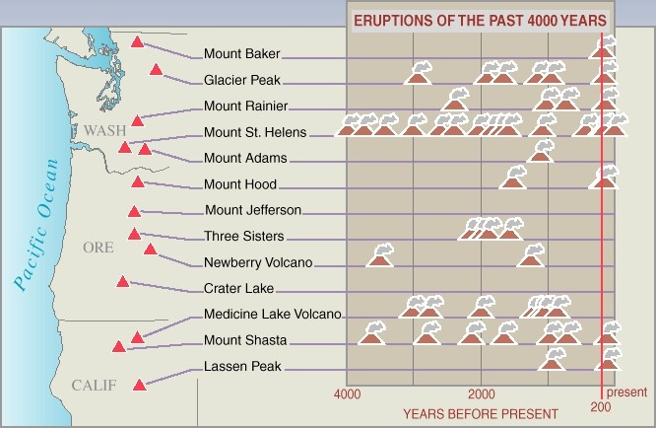

Slide 9
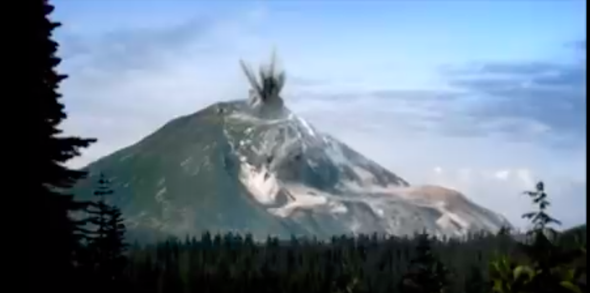
Watch the video…
What were the:
Causes
Effects
Management of the Mt. St Helens eruption?

Slide 10
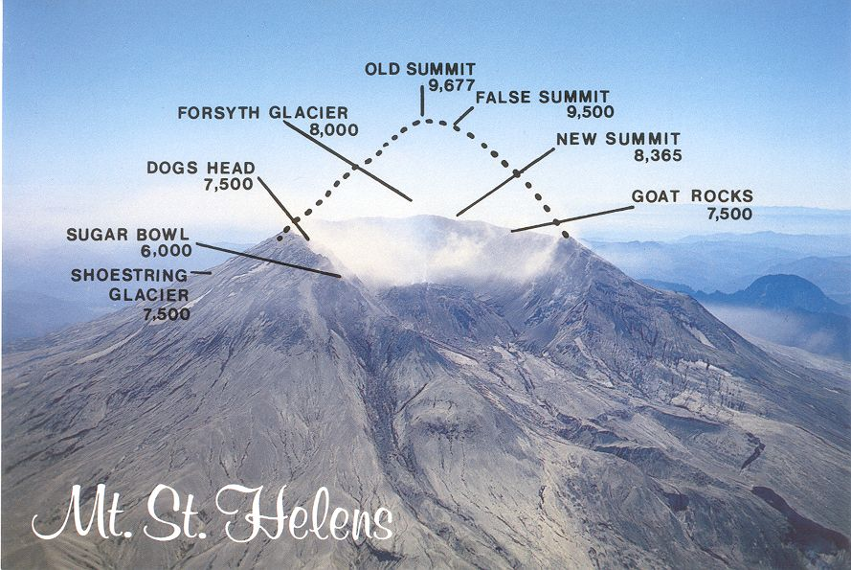
The nature of the eruption

Slide 11
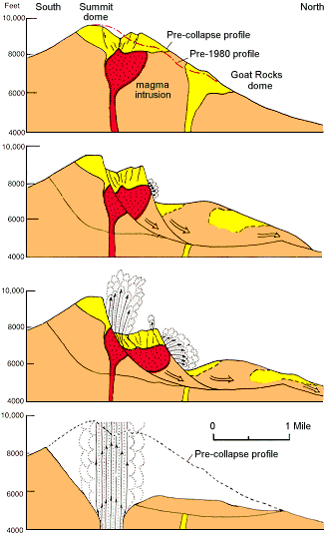
April May 1980
A bulge was growing on the north flank.
May 18th at 8.32 a.m.
An earthquake occurs under the volcano and triggers a huge landslide.
May 18th at 8.33 a.m.
With the pressure released a huge lateral blast heads northwards
May 18th rest of the day
More and more ash shoots up high into the atmosphere. It gradually blows around the world.

Slide 12
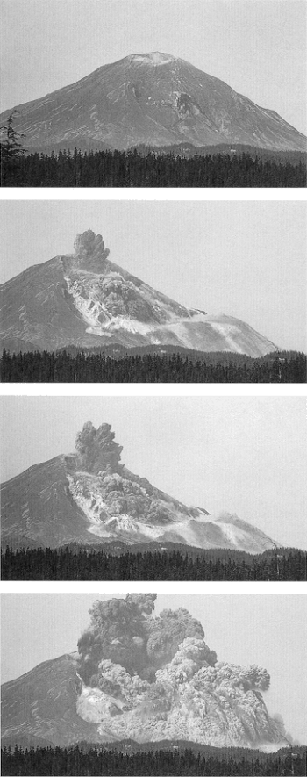
The first minute of the eruption produced a 2.8 cubic kilometre debris avalanche,
a powerful laterally directed (to the north and northwest) blast,
and the start of a 9-hour-long plinian eruption.

Slide 13
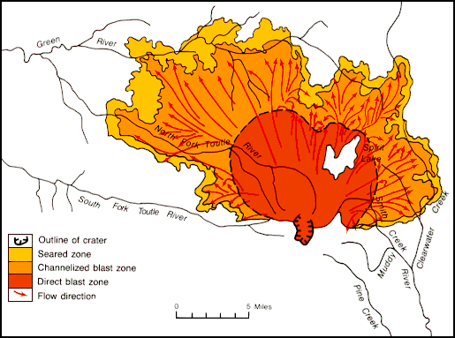
Blast zone to north
Peak
The blast zone stretching north

Slide 14
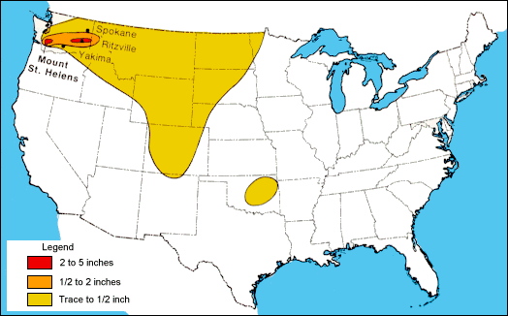
The drift zone of ash blowing gradually westwards
And falling like rain to a depth of several centimetres.

Slide 15
The EFFECTS of the Mount St. Helens eruption can be classified as:
SOCIAL EFFECTS – affecting people and communities.
ECONOMIC EFFECTS – affecting work and business.
ENVIRONMENTAL – affecting the surroundings.
Effects can also be
SHORT TERM – lasting days or weeks
LONG TERM – lasting months or years
There can also be GOOD EFFECTS
and BAD EFFECTS.

Slide 16
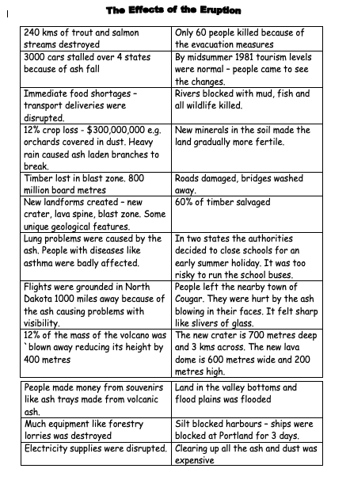
INSTRUCTIONS:
Cut out and sort out the captions into, SOCIAL, ECONOMIC and ENVIRONMENTAL piles.
Put the heading in your book and then
stick the captions under the three side headings.
Or write them out
Or write an account in your own words
Shade long term effects in a colour and make a key.
Use a + sign for good effects and a – sign for bad effects.

Slide 17
Mt St Helens Song:
https://www.youtube.com/watch?v=UR6aY5brXck

Slide 18
The Volcano is about to erupt ! What are you going to do?
You can take three things from this list | You can take three things from this list | You can travel by one of these
Food | Walking boots | Walk
Medical kit | Hat | Train
Water | Money | Motorbike
Jumper | Radio | Bicycle
Blanket | Your dog | Bus
Dust mask | TV | Car
Tent | Sweets | Helicopter

Slide 19
The dust from the volcano is making you choke. If you have a dust mask you get 5 points.
You find an empty house with electricity. If you have a TV or Radio you can hear/see the news and find out the best way to travel. You get 3 points.
You are carrying too much and it is very heavy. If you have a TV, you loose 3 points.
You meet some children who know the quickest way to the nearest town. If you have some sweets or money they will take you there and you get 2 points.
Dust and ash from the volcano clog engines. If you walk or have a bicycle you get 5 points.

Slide 20
All the shops are destroyed and you can’t buy any food or water. If you have food or water you get 5 points. If you have both, you get 10 points.
There is a mudflow travelling at 50 miles per hour. If you have a car to get away you get 5 points.
Ash is clouding in the atmosphere. If you are getting away by a helicopter, then you lose 5 points.
There are no places to stay as you move away from your village. If you have a tent you get 5 points.
The dust from the volcano has risen up and blocked the sun. If you have a jumper or a blanket, you get 5 points. If you have both, you get 10 points.

Slide 21
You are feeling very sad but a bit of company will cheer you up. If you have a your dog, you get 2 points.
The water supply has been cut off because the pipes have burst due to the eruption. If you have some water, you get 5 points.
You have got lots of dust in your eyes. If you have a medical kit, you get 2 points.
A thick blanket of ash from the volcano ruins the crops. If you have some food, you get 5 points.
It is difficult to walk across the destroyed landscape. If you have walking boots, you get 2 points.
There is a lot of dust and ash around which is getting in your hair. If you have a hat, you get 2 points.

Slide 22
How come the most volcanic place on Earth is nowhere near a plate margin?
Volcanoes in Hawaii

Slide 23
What is a hotspot volcano?

Slide 24
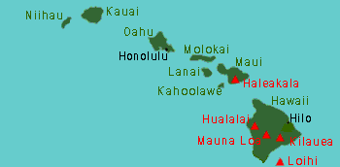
Hawaii
Many volcanoes but only 5 are active.

Slide 25
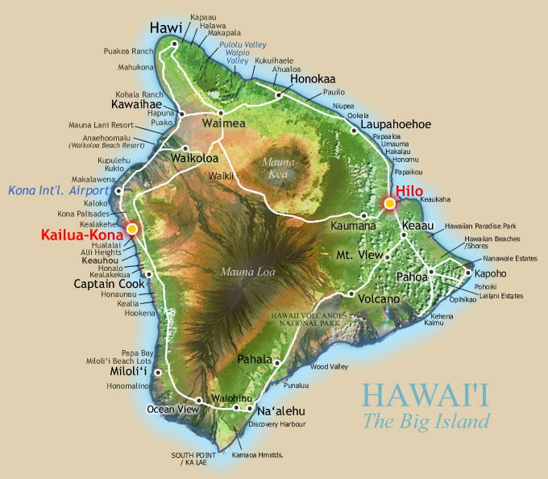
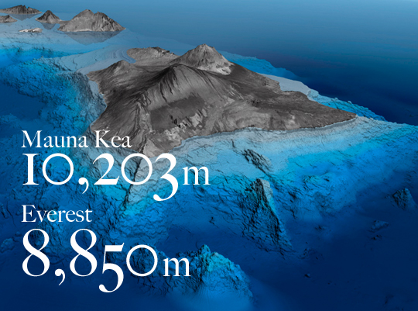
The summit of Mount Everest is higher above sea level than the summit of any other mountain, but Mauna Kea is the tallest when measured from base to summit.
kilauea

Slide 26
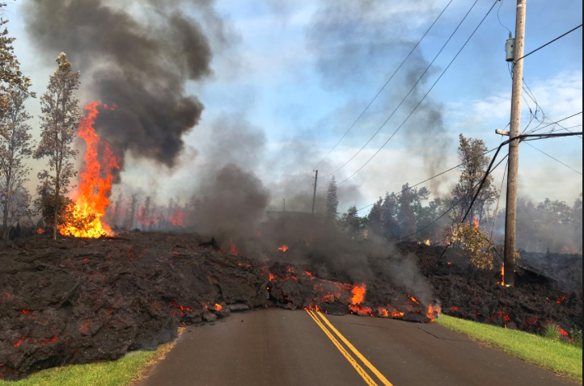
Eruptions in Hawaii
What are the eruptions like in Hawaii?
How are they different than the eruption of Mt St. Helens?

Slide 27
Understanding Kilauea – A Storymap with maps, images and video of the 2018 eruption

Slide 28
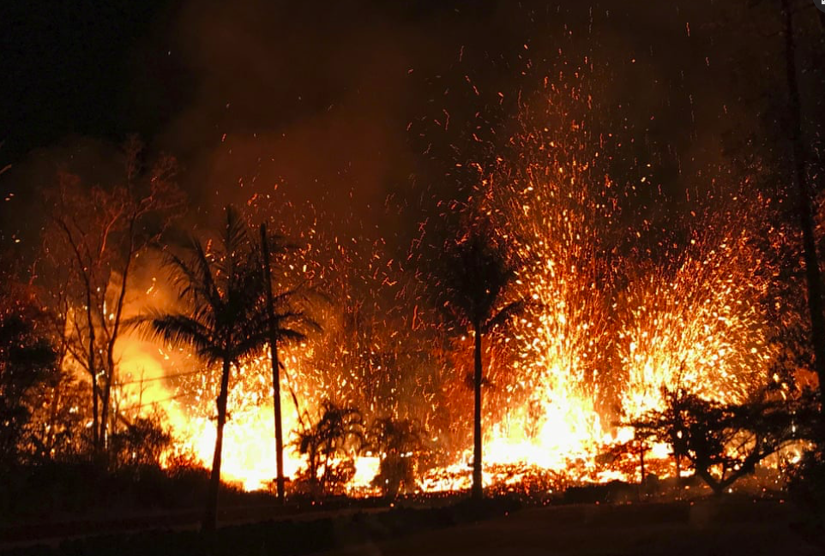
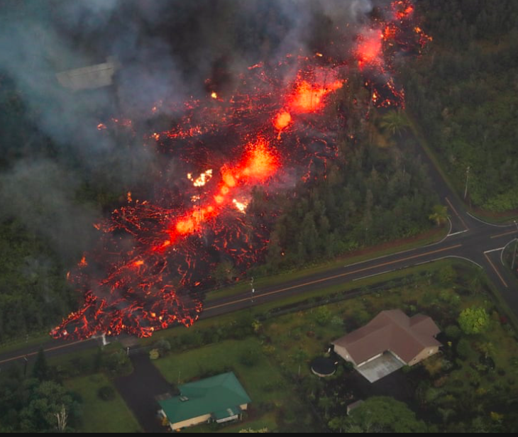
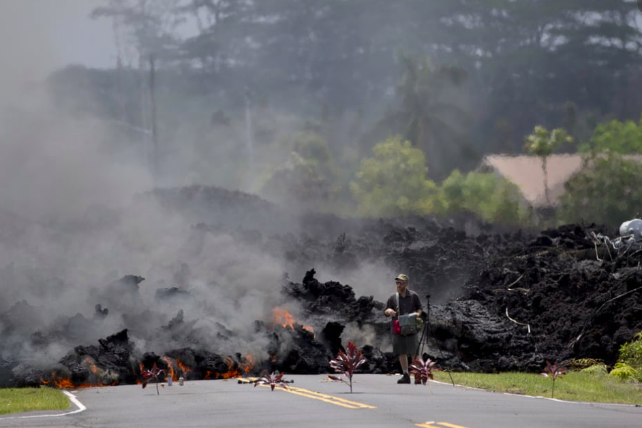
Guardian: Hawaii's Kilauea volcano erupts – in pictures

Slide 29
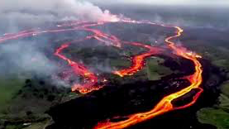
Task: Comparing Mt. St Helens and Kilauea
How does this help us determine ’Where is the riskiest place to live in the USA?’

