Slide 1
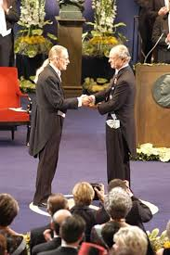
THE VERNON SMITH EXPERIMENT

Slide 2
HOW REALISTIC A MODEL IS MARKET EQUILIBRIUM?
IF YOU ARE A BUYER YOUR CARD IS GREEN IF YOU ARE A SELLER YOUR CARD IS RED
DO NOT DISCLOSE THE VALUE/COST ON YOUR CARD TO ANYONE ELSE
AIM: YOU MUST MAXIMISE THE DIFFERENCE BETWEEN THE VALUE/COST ON YOUR CARD AND THE PRICE YOU PAY
TO BEGIN: ANYONE AND ALL CAN CALL OUT A ‘PRICE’ FOR BUYING AND SELLING.
IF THERE IS A WILLING TRADE BETWEEN A BUYER AND SELLER SHOUT THE SALE PRICE SO THAT ALL CAN HEAR AND THEN SIT TOGETHER
NOW CONSTRUCT THE DEMAND AND SUPPLY CURVE, WHAT WAS THE MARKET EQUILIBRIUM PRICE, WHAT WAS THE MARKET EQUILIBRIUM QUANTITY?

Slide 3
WHAT ARE THE MAIN INSIGHTS THAT THE VERNON SMITH EXPERIMENT CAN PROVIDE? TRY TO LIST AT LEAST 5 IDEAS…

