Slide 1
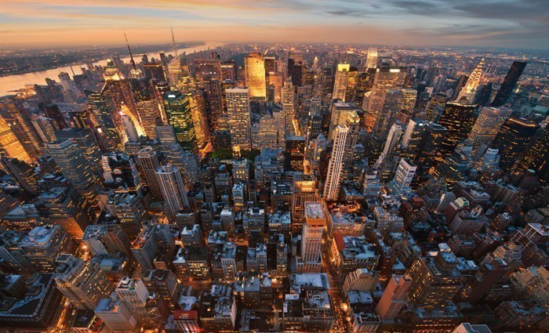
What problems might be experienced in this environment?

Slide 2
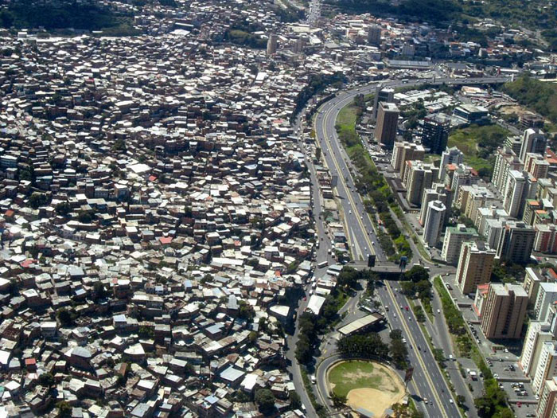
Problems associated with rapid urbanisation
Outcomes:
All will be able to describe the problems associated with rapid urbanization.
All will be able to explain congestion, transport, employment, crime and environmental issues.

Slide 3
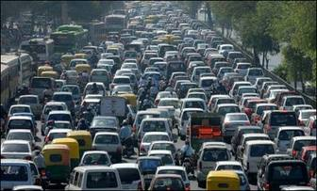
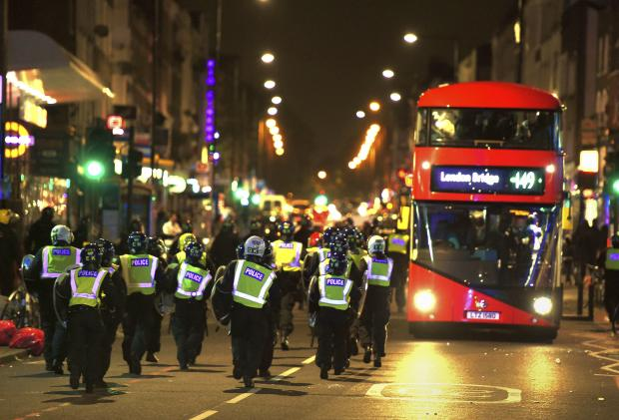
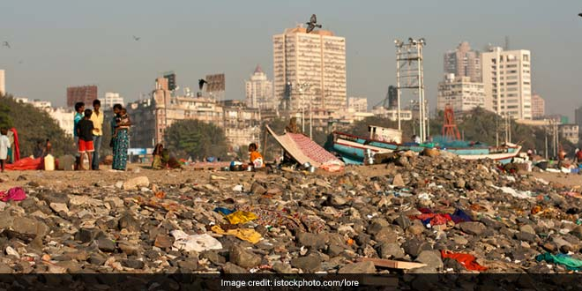
Challenge 1 – Match up the image to the type of problem associated with rapid urbanisation
Congestion
Transport
Employment
Crime
Environment

Slide 5
Challenge 2 - Carousel:
You will have 10 minutes in order to develop an understanding of the particular problem associated with urbanization before moving on to the next. Fill in your sheet with as much detail as possible.

Slide 6
Problem | Details
Congestion
Transport
Employment
Environment
Crime

Slide 7
Environmental Issues
Google: ‘effects of urbanisation on the environment’ or follow the links below (Green less detailed than red).
Notes:
https://www.centreforcities.org/reader/cities-outlook-2020/air-quality-cities/

Slide 8
Crime Issues
Google: ‘effects of urbanisation on crime’ or follow the links below (Green less detailed than red).
Notes:
https://assets.publishing.service.gov.uk/government/uploads/system/uploads/attachment_data/file/912406/Crime_August_2020.pdf

Slide 9
Employment Issues
Google: ‘effects of urbanisation on employment’ or follow the links below (Green less detailed than red).

Slide 10
Transport Issues
Google: ‘effects of urbanisation on transport’ or follow the links below (Green less detailed than red).
Notes:
https://transportgeography.org/contents/chapter8/transportation-urban-form/

Slide 11
Congestion Issues
Google: ‘effects of urbanisation on congestion’ or follow the links below (Green less detailed than red).

Slide 12
Challenge 3:
You need to spend time creating something to show your understanding of the problems associated with rapid urbanisation.
You could do:
A diary entry for a recent rural to urban migrant
A video news report on the issues being experienced in rapidly urbanised areas
A PowerPoint / Slides presentation
A poem about the urban problems
A song about the problems
Anything else that you would like to do to demonstrate your learning
Extra Challenge – Make sure to explain why the problems exist and include examples and data to support your work!

Slide 13
To Finish
Think of your lived experience relating to being in Katy or generally Houston and the wider metropolitan area. Write down the problems that you have experienced most due to living in a major urban area.

