Slide 1
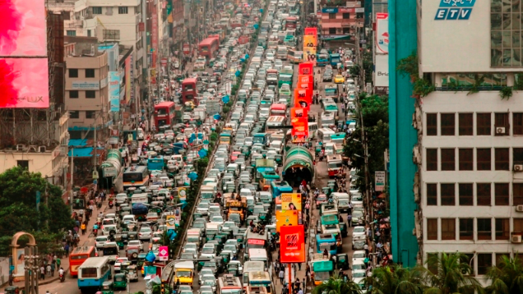
Dhaka: A rapidly urbanizing LIC city

Slide 3
Revision- Dhaka recap
Name 1 industry in Dhaka
Name 2 reasons why people move to Dhaka
Name 3 issues in Dhaka

Slide 4
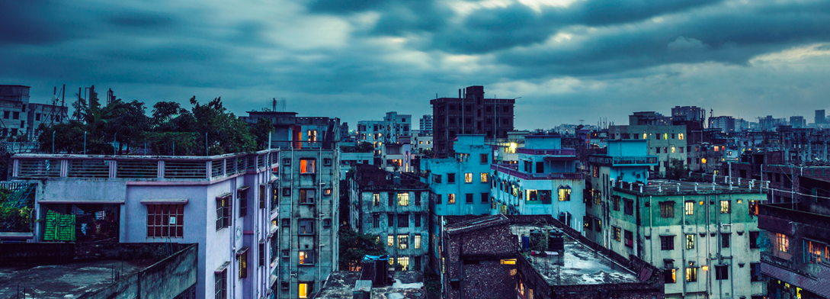
Urbanisation in Bangladesh
According to 2017 estimates, Bangladesh has been urbanizing at an annual rate of 3.17 percent, with 36.6 percent of the country’s 158 million population now living in urban areas

Slide 5
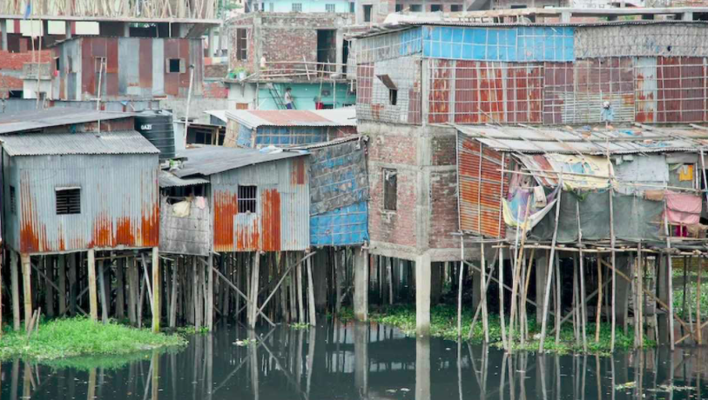
Dhaka is the capital of Bangladesh and the most densely populated city on earth.
It has a population of 19 million, with an average of 45,000 people packed into each square kilometre.
The city’s 4,000 informal settlements are home to 3.5 million people. While most of the city has access to drinking water, half the amount consumed does not meet safety standards.

Slide 7
Causes of rapid growth:
Natural Increase – 60% population growth (1.5%)
2. Rural-urban migration – push and pull factors
Rural Push Factors – Mechanisation of farming, lack of education and jobs (literacy rate 57%)- escape from rural poverty, natural hazards- flooding and cyclones
There are no migrant restrictions in Dhaka unlike China
Urban Pull Factors – Higher wages ($38- 67/ mth), public utilities e.g. water (25%), electricity. Growth of secondary industry such as textiles
The city has become a magnet for men and women escaping rural poverty

Slide 8
Watch:
Why do people move to Dhaka? (push and pull factors)
2. In video, find an example for each of the "8 Common Rapid Urbanization Problems "and write in your book: 1. Housing 2. Education 3. Access to Water & Electricity 4. Traffic Congestion 5. Health 6. Social Problems 7. Employment 8. Environmental (Pollution)

Slide 9
Summary of impacts
19 million population – overpopulation (1,000/ day)
People living on marginal slums (‘bostis) subject to annual flooding between Jun- Nov
Little housing provided to accommodate numbers
Overcrowding – spread of diseases e.g. measles, diarrhoea
Water pollution and rotting piles of waste cause dysentery and cholera.
High unemployment – informal economy e.g. begging, prostitution and shoe shining (Children earn 12p/ day) ,70% of population earn less than $170 per month
Little public transport leads to reliance on rickshaws – congestion, air pollution - 60% say they contacted diseases due to air pollution
20% of slum children have access to education

Slide 10
The informal economy
In LICs, some people also have formal jobs but large numbers of workers have informal jobs. These jobs are often unskilled and labour intensive, require little money to set up, offer no protection to the workers and they pay no tax. Examples include street sellers, minibus drivers, money changers and market traders. These jobs form part of the informal economy which is also called the grey economy.

Slide 11
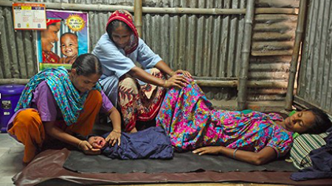
Solution: 1 Manoshi project
In 2007, around 86 percent of slum births took place at home, where multiple families might share a confined space in unhygienic conditions= maternal mortality rate of 294 deaths per 100,000 live births and a neonatal mortality rate of 43 deaths per 1,000 live births.
One issue is that health workers don’t know where to locate pregnant mothers. In the Manoshi project comprehensive map of slum communities was created to locate pregnant women, mothers, and their children. This information was then used to guide healthcare workers and increase the availability of health services.
The project has almost halved the number of maternal deaths among its’ patients to 135 per 100 000 live births.

Slide 12
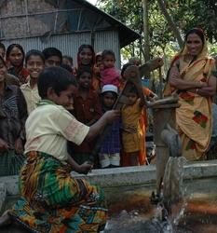
Solution 2: Tube wells
Old Zhimkhana, a slum community had no safe water or toilets
Prodiplan (an NGO) are working with the community to help deliver water, sanitation and hygiene education.
Six tube wells have been constructed saving people time and energy in collecting water
Tube well system prevents contamination of fresh water with sewage
Two sanitation blocks provide toilets and water for washing
People are no longer continually ill.
Locals run the project themselves.

Slide 13
7 mark Exam questions
For a named country you have studied, explain why internal migration takes place from rural areas to rapidly growing urban areas. Name of country .............................................
For a named urban area you have studied in an LEDC, describe the strategies used to improve the living conditions of people in squatter settlements. Name of urban area .......................................
For an urban area you have studied, describe the strategies used to reduce problems caused by the growth of squatter settlements.
For a named town or city you have studied, describe the impact of urbanisation on the people who live there.

