Slide 1
The characteristics of, and changes in, land use in urban areas: case study HOUSTON
Objective: To find out how urban areas are structured in terms of land use and how this is changing in modern times.

Slide 3
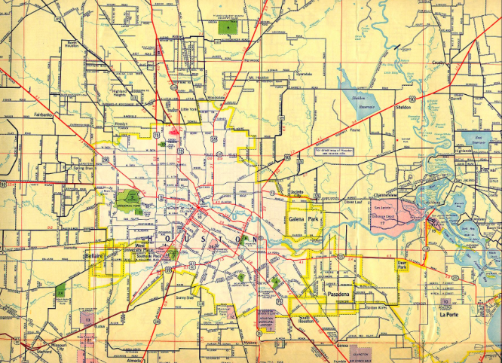
Houston in 1955

Slide 4
Houston today

Slide 5
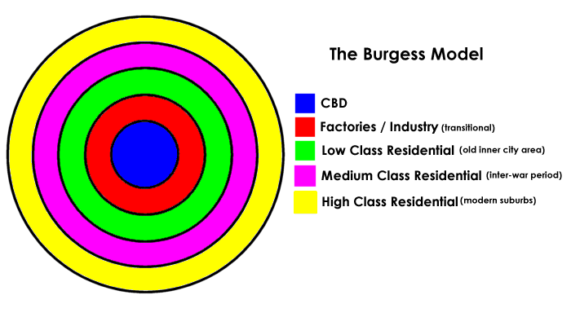
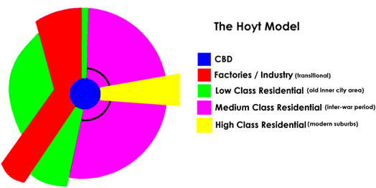
Changing urban models in MEDCs
L/O: To recognise land use models and be able to compare them and apply them to ONE MEDC.
What do these show us? Can you connect these models to Houston ?

Slide 6
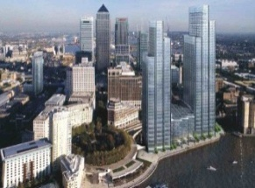
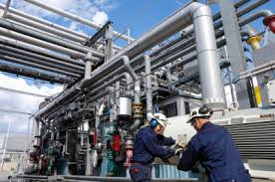
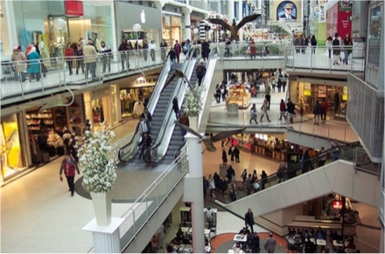
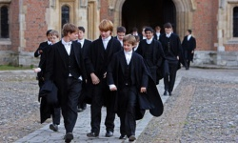
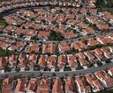
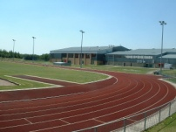
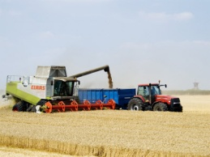
Think – land use!
How is land used in an urban area?
List what sorts of ways land could to be used in an urban area? E.g. offices
Commercial: This is businesses, mainly offices. The main commercial area will normally be in the CBD. | Residential: This is housing and is where people live. Apartment type housing is found near the CBD and bigger houses towards the suburbs. | Industrial: This is factories, traditionally found in the transition zone, they are now more likely to be found in the rural-urban fringe. | Agricultural: This farming and is obviously normally found in rural areas although some cities may have some small urban farms. | Recreational: Any activity that people do in their spare time. This land use may include golf courses, football pitches, museums, sports centres and tennis courts. | Retail: This is shops. Traditionally the main shopping areas have been in the CBD but increasingly shops have been relocating to shopping malls in the rural-urban fringe. | Educational: Any building connected to education e.g. libraries, schools and universities. This land use may be found anywhere in urban areas.

Slide 7
Land use models in a MEDC
Land use models are theories that attempt to give a pattern to the land use in most cities.
The concentric model was created by Ernest Burgess and is based on Chicago, where he claims all settlements start from an central point going outwards.
As you move out from the CBD (central business district) the higher the income of the average person becomes. The centre (CBD) is usually the oldest part of the city however it should be also the most advanced and as the needs of the CBD grows the city will also grow in all directions.
The yellow area is High class residential, this means that they are usually fully detached (not attached to another house) and are biggest, and usually containing a garden.
The low class residential area is the area most close to the factories, the housing will usually be attached on both sides (detached) and very small and closely packed when compared to the high class residential. This is to put more people in a smaller area. So workers can get to their jobs easier (in the factories)

Slide 8
Land use models in a MEDC
Land use models are theories that attempt to give a pattern to the land use in most cities.
This model was based on the land use in cities before public transport. This means that factories had to be placed along rivers or railway lines which could be used transport of raw materials into the manufactured good out of the city. They were also in the centre close to lots of workers ( a large work force)
Features of a CBD: high density of people and buildings (there are lots of them close together), offices, businesses, expensive land, oldest part, small alleys and medieval streets, perhaps pedestrianised (no cars can drive there.)

Slide 9
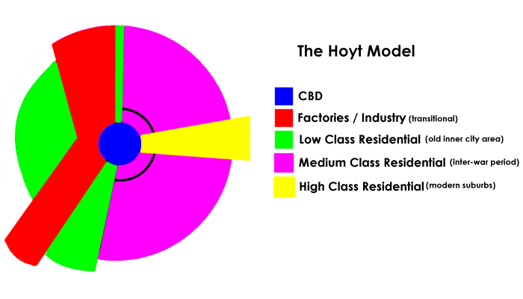
Hoyt model
The sector (Hoyt) was created by Hoyt and was created after the introduction of public transport so that workers can live further away from work and still get there quickly, this also means that buses and trains can get around the city helping people get around the city.
Roads help vans and lorries get into manufacturing areas bringing raw materials and out of the areas bringing manufactured goods from the factories and into the shops. Factories can now be built outside the city

Slide 10
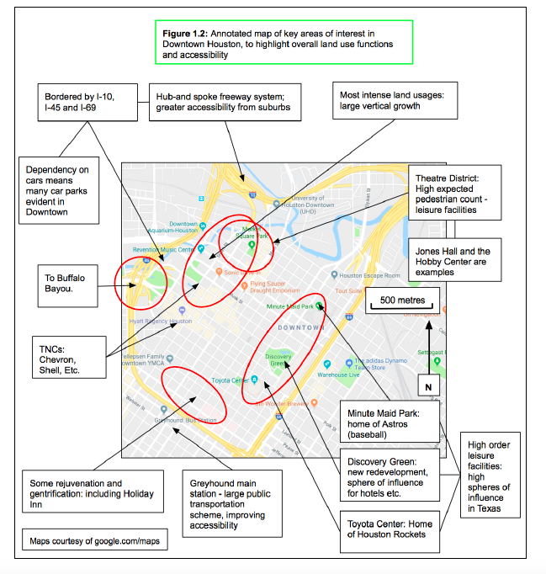
Features of Houston’s CBD

Slide 11
All the major freeways in Houston lead to Downtown- this makes is the most accessible part of the city. Downtown Houston has many tall buildings. This is because of the high cost of land so buildings need to build upwards rather than outwards to save space. There are many TNC headquarters located in the CBD like Chevron and BG group because they are the ones that can afford the high cost of the land (many are oil and gas companies due to Houston’s proximity to to the Gulf of Mexico. The environmental quality in the CBD is generally high as the companies here want to to be attractive to their customers- parks (such as Discovery Green) have been created to keep the environmental quality high. There are many services that will be used by the whole city such as city hall and the main justice courts for the city. There is not shopping in Downtown Houston- this has located in more easily accessible malls in the suburbs.

Slide 12
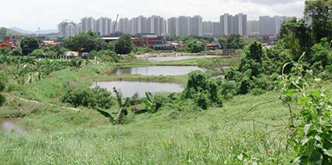
The Rural-Urban Fringe
Rural-urban fringe: The boundary between the urban area (towns and cities) and the rural area (countryside).
Because so many cities are expanding, more houses need to built and often this means building on greenfield sites and the rural urban fringe. This means different groups frequently come into conflict over how to use it.
Groups that may come into conflict include:
House developers
House buyers
Farmers
Hikers and cyclists
Road builders
Factories
Supermarkets
Business or science parks

Slide 13
Key Word Definitions:
A brownfield site is land that has been used, abandoned and now awaits some new use. Commonly found across urban areas, particularly in the inner city.
A greenfield site is a plot of land, often in a rural or on the edge of an urban area that has not yet been subject to any building development.
https://www.youtube.com/watch?v=UDcdFJc5G9M&list=PLnHzp8tnptFXpKags1hvgvGkSgYCkJjY7
Notes:
https://www.youtube.com/watch?v=UDcdFJc5G9M&list=PLnHzp8tnptFXpKags1hvgvGkSgYCkJjY7

Slide 14
Task:
Sort the cards into two categories. Advantages of building on a brownfield site and advantages of building on a greenfield site.
More space for gardens. | Roads already exist.
Easier to get planning permission as councils want to see brownfield sites used. | Pleasant countryside environment may appeal to potential home owners.
Land cheaper on the outskirts so plots can be larger. | Sites in cities are not left derelict and/or empty.
Near to facilities in town centres, e.g. shops, entertainment and places of work. | No restrictions of existing road network.
Some shops and business parks on the outskirts provide local facilities. | Utilities such as water and electricity are already provided.
Cuts commuting. | New sites do not need clearing so can be cheaper to prepare.
Challenge:
Which of the two sites to build on do you think benefits:
The developer.
The potential residents of the new homes.

Slide 15
Developing the rural urban fringe
Imagine a shopping centre was being built on the outskirts of Houston there would be advantages and disadvantages for the local residents!
ADVANTAGES TO LOCAL RESIDENTS IN RURAL-URBAN FRINGE | DISADVANTAGES TO LOCAL RESIDENTS IN RURAL-URBAN FRINGE
New public transport links may be developed There will be new facilities that local residents can access and use Local residents may get jobs in the new shopping centre. The shopping centre may pull more people into the area and may benefit existing services, possibly owned by local residents (positive multiplier effect). | There will be an increase in congestion as more people travel to shopping centre by car. The shopping centres may create noise, air and visual pollution all affecting local residents (negative externality) Shopping centres may destroy greenfield sites that have previously been used and enjoyed by local residents.

Slide 16
The location of Memorial Mall, Houston

Slide 17
Why is shopping moving to the suburbs?
Skill: annotate this image to explain why memorial has located in the suburbs

Slide 18
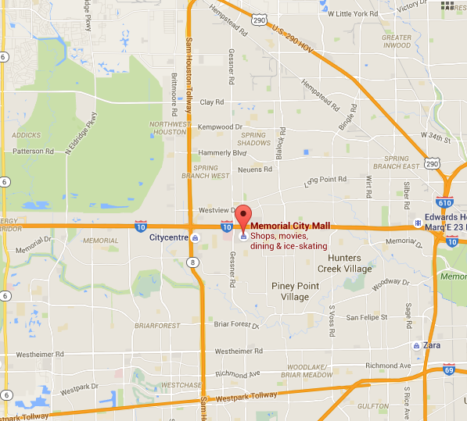
Excellent transport links- I10
Away from city centre so more land available for cheaper parking and bigger stores
Near wealthy residential areas in the West of Houston such as Memorial and Lakes and Eldridge

Slide 19
Case Study: The location of retail- i.e. Memorial, Houston
Explain the factors that affect the location of tertiary industry. Use an example in your answer. (6)

Slide 20
Explain the factors that affect the location of tertiary industry. Use an example in your answer. (6)
Memorial shopping Mall is part of the retail industry. It is located in an suburban area of Houston, Texas. It is a very large mall with ? square feet of space; a location within the suburbs was therefore appropriate as land is cheaper than in the CBD. An important consideration for the retail industry is accessibility for customers and deliveries of merchandise. The mall is located just off the I10 – a major arterial route of the e city; this enables large numbers of people to reach the mall easily. It is an upscale mall and so it is located in the west of the city; this is a wealthier area of the city and so customers have ample disposable income to spend. The location of the mall in the suburbs means that there are many people living in residential areas surrounding the mall providing both workers and customers. The area surrounding the Memorial is multi-use; there are many offices in the area increasing the consumer base still further.

Slide 21
Task 1- google maps to try and apply the Burgess and Hoyt model to Houston
Using google maps….
Compete the table using google street mapview to find evidence of different land use zones within Houston and desecribe the evidence
Task 2:
Transfer this information onto the wall map of Houston to make a display. Things to include:
Images of different areas of Houston- and an explanation of why the land use is different in each of these areas
Key terms associated with the land use maps (CBD/ inner city/ Suburbs/ industy/ low class residential/ high class residential/ rural-urban fringe)
Success criteria: make the display detailed and informative but also readable and attractive

Slide 22
Land use in Houston- annotate a map to show and explain the land use in Houston, Tx

Slide 23
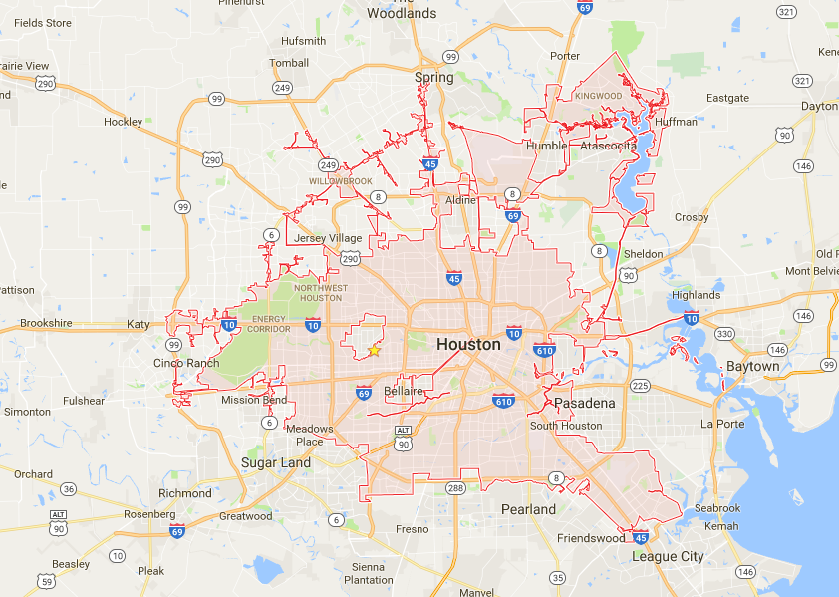
Downtown Houston (the CBD) is in the center of the city with the greatest accessibility- different to the theory there is no shopping located in Houston’s CBD
Houston is a good example of urban sprawl
Sh
In Houston shopping tends be located in suburban areas (i.e. Memorial Mall) where there is good road access, more space and closer to the customers
On the Eastern Inner city there are poorer neighborhoods such as the third ward- smaller houses and ethnic divides
Industrial developments on the East of the city along the canal and the 1-10 freeway for accessibility. Good access needed to oil in the Gulf of Mexico
Newer, larger, high class houses in the outer suburbs (such as Katy)- here there is more land available- this conforms to the theory
In Houston some of the wealthiest residential areas (i.e. River Oaks) are located in the inner city area- this differs from the theory on the model
In Houston there is a general West/ east divide in terms of quality of life (West having higher quality of Life)

Slide 24
Exam question

Slide 25
Named city: Houston, Tx
Houston is a city that has experienced Urban sprawl and this has impacted it’s morphology. Downtown Houston (the CBD) does lie in the center of the city and has many of the characteristics you would expect of a CBD such as high rise buildings and offices. The CBD of Houston does not have shopping as a main land use- in Houston this is located in the suburbs (i.e. Memorial mall) due to closer access to transport links (the I10), more space for building and accessibility to the population.
Industry is located on the East of the city along transport routes (such as the I10 and canal) similar to the Hoyt model.
Large, higher class residential homes have developed on the edge of the city (i.e. in Katy) similar to the Burgess model.
There is an east, west divide in terms of quality of life in Houston with the Eastern inner city having smaller, poorer homes (i.e. the Third Ward), but also some of the richest mansions (in River Oaks) on the Western inner city which is a land use that differs from the model.

Slide 26
1.7 Urbanisation
Learning objectives:
• Explain the problems of urban areas, their causes and possible solutions
What we need to know:
Different types of pollution (air, noise, water, visual), inequality, housing issues, traffic congestion and conficts over land use change

Slide 27
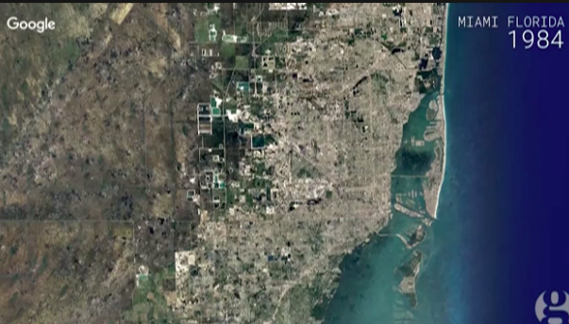
Google timelapse shows changing earth
https://www.theguardian.com/environment/video/2016/dec/05/evolving-earth-captured-by-google-timelapse-video

Slide 28
Key term: urban sprawl

Slide 29
Question:
Describe the pattern shown on this graph (3)

Slide 30
Brownfield- A site that has been built on before. Normally associated with urban areas.
Greenfield- Sites that have not been built on before. Often rural / countryside areas.
As a decision maker you are faced with two options:
1. Develop existing Brownfield sites
2. Develop new Greenfield sites
Complete the worksheet to find out the positives and negatives of brownfield and greenfield sites

Slide 31
Urban sprawl

Slide 32
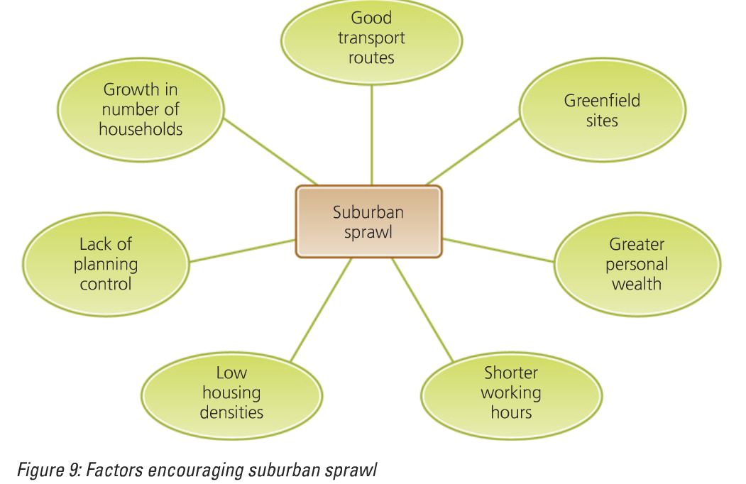
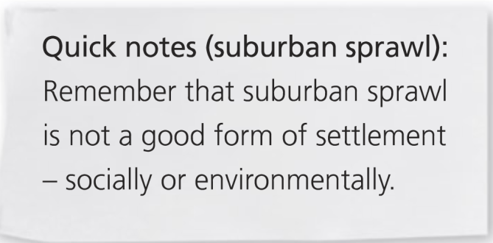
How do each of these lead to urban/suburban sprawl

Slide 33
1. Expanding the outer suburbs = urban sprawl
Advs
Near the countryside for leisure, plenty of space, not too far to commute to CBD for work, the construction out of town shopping centres means that there are often plentiful services nearby.
Disadvs
Involves building on greenfield sites which means the loss of countryside e.g. for leisure purposes/habitats for animals.
Results in high dependence of the car to move around the sprawl e.g. for shopping, schools and to get to the commuter train.

Slide 34
General theory: A number of problems are associated with the growth of urban areas.
A number of problems are associated with the growth of urban areas. These include:
Congestion in the CBD
Very high land prices in the CBD
Overcrowding
Housing shortages
Traffic congestion
Unemployment
Racial conflict
Urban decay and dereliction
Deprivation
Pollution of air and water

Slide 35
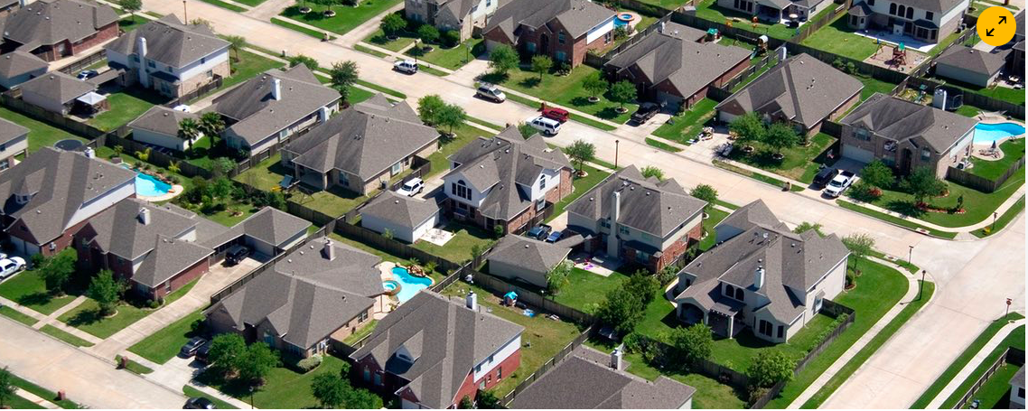
Discuss:
What are the benefits and problems of urban sprawl in Houston?

Slide 36
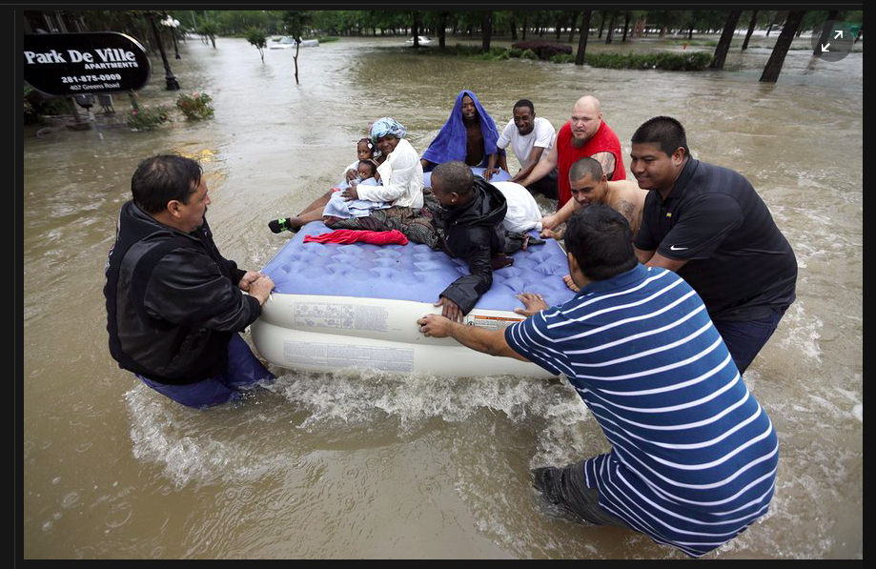
Urban sprawl in Houston
Benefits
Issues
Large houses/ gardens etc (high quality of living)
Cheap land= cheaper houses
Development of industry
Car dependent- cannot develop public transport systems
A lot of greenspace lost due to development on Greenfield sites
Risk of flooding increased- due to increased urbanisation
Long commute times and
Increase in illnesses such as diabetes due to being car dependent
Inequality

Slide 37
For a named urban area you have studied, describe the problems which are caused by urban sprawl (7)
Because of no planning restrictions or space restrictions Houston has uncontrollably spread onto the greenspace surrounding it. This has lead to over-reliance on the car. Many commuters are travelling 30-40 miles a day each way to get to work (i.e. from the suburb of Katy to Downtown Houston) . This leads to many cars on the road (the main freeway running through Houston, the i10 is the widest in the world) and so there is large amounts of air pollution. The heavy reliance on the car means that many people live sedentary lifestyles so there is a high prevalence of diseases such as diabetes and obesity.
The urban sprawl has meant that many greenspaces have been lost. The site of Houston was orginally swamp land which would have absorbed all of the rainfall. This has increased the risk of flooding because of increased run-off such as during hurricanes such as Harvey.

Slide 38
Exam question practice:
The building of new housing, roads and services often results in urban sprawl.
Name an example of a town or city which you have studied where urban sprawl has taken place. Describe its effects on people and the natural environment. [7]

Slide 39
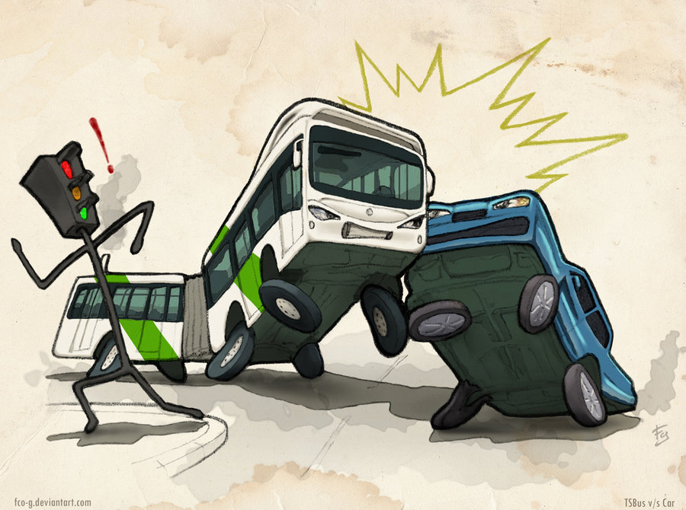
Solutions to Urban sprawl Managing Urban Transport
LO: Explain the management of transport in urban areas and evaluate how this reduces urban sprawl

Slide 40
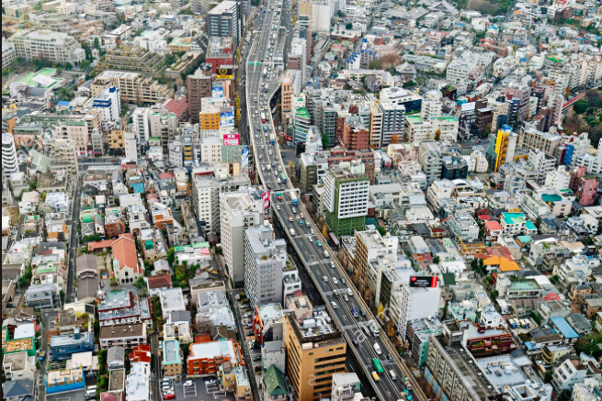
Recap: Think, pair share
What do you think are the 3 biggest issues of urban sprawl
Is this the same in all cities?

Slide 41
Question:
Describe the pattern shown on this graph (3)

Slide 42
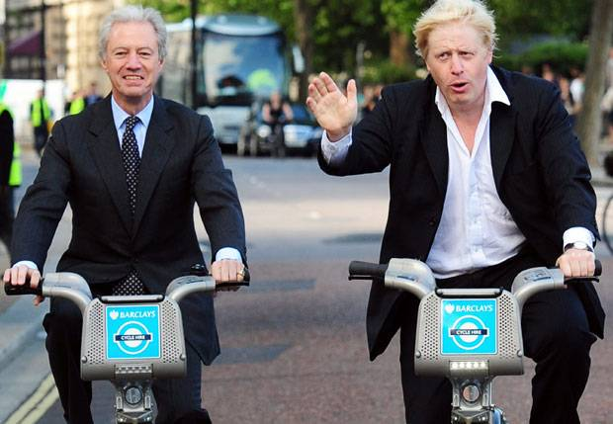
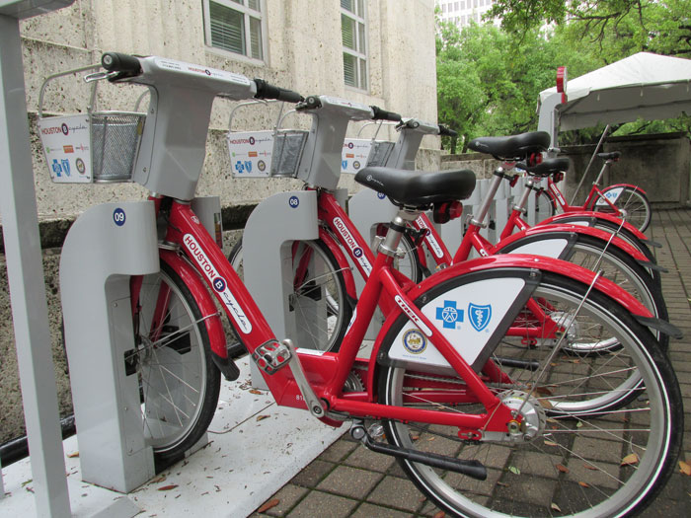
Bike share schemes e.g. Barclay’s Bikes, London Velib, Paris, B-Cycle, Houston
Barclay’s Bikes, London:
http://www.youtube.com/watch?v=p6t7OqR73AA
https://www.youtube.com/watch?v=EgIPGx02VKc
B-Cycle, Houston:
http://www.youtube.com/watch?v=_isWKKs5kHY
http://www.youtube.com/watch?v=7JUDUlZV5Vk

Slide 43
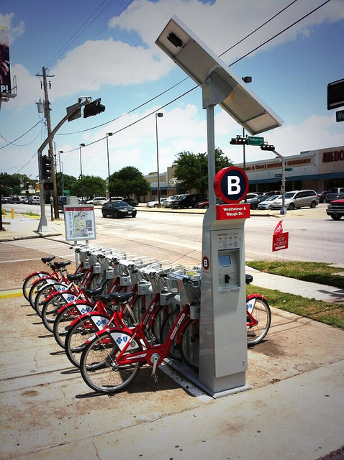
Houston B-Cycle
Houston B-cycle is a bicycle sharing system owned and operated by Houston Bike Share a non-profit organisation.
The program launched May 2012 with just 18 bikes at 3 stations.
May 2013, Houston B-cycle expanded from 3 to 25 stations and 215 bikes.
The program aims to expand to 1,000 bikes at 100 stations by the end of 2017 to include the Texas Medical Center and local universities, as well as additional neighborhoods such as Houston Heights, Midtown and Montrose.

Slide 44
Houston B-cycle is a bicycle sharing system owned and operated by Houston Bike Share a non-profit organisation.
The program launched May 2012 with just 18 bikes at 3 stations.
May 2013, Houston B-cycle expanded from 3 to 25 stations and 215 bikes.
The program aims to expand to 1,000 bikes at 100 stations by the end of 2017 to include the Texas Medical Center and local universities, as well as additional neighborhoods such as Houston Heights, Midtown and Montrose.

Slide 45
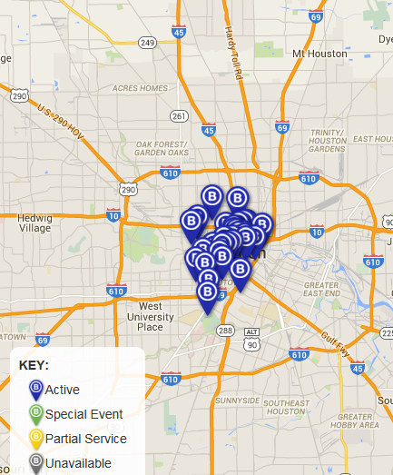
Map of B-Cycles in Houston

Slide 46
Evaluation
Why may a bike scheme work better in London than Houston.
List at least 3 points.

Slide 47
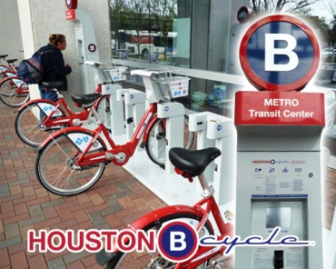
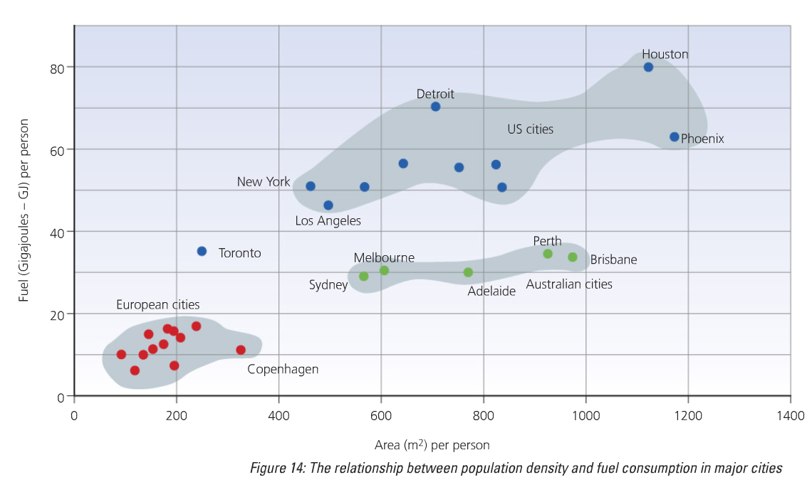
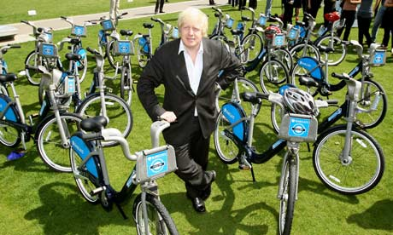
Bike sharing schemes
Houston has adopted its own bike sharing scheme but it is much more limited in its extent as it is a low density city
Work best in compact (high density cities) such as those in Europe e.g. London and Paris)

Slide 48
Park and ride Houston
Direct nonstop service to downtown, the Texas Medical Center and other major employment centers in the METRO service area is available from Park & Ride lots.
Park & Ride facilities also serve as a staging area for vanpools and carpools.

Slide 49
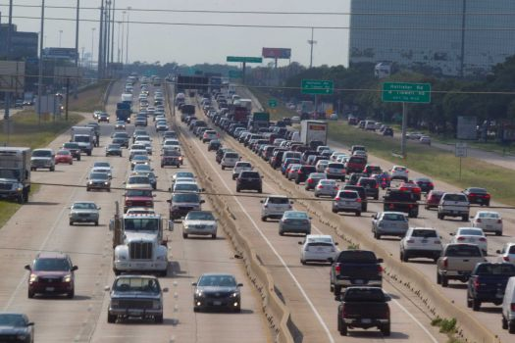
Sustainable Transport Houston
In cities such as Houston, Texas creating a sustainable public transport network is a problem as the city has sprawled rapidly outwards, occupying a total land area of 650 square miles. Many sustainable transport solutions therefore rely on the continued use of private vehicles.
The city’s freeways also offer HOV (High occupancy vehicle lanes) to try to encourage car pooling to decrease Co2 levels through fewer vehicles on the road.

Slide 50
Houston HOV

Slide 51
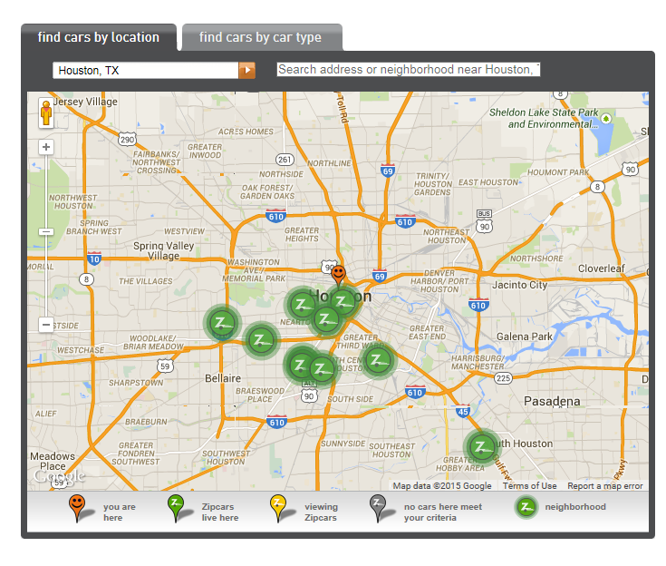
Need a car for a few hours near Houston, TX? Zipcar is an alternative to car rental and car ownership. It's a car, but only when you need one. Check out the map below. Enter an address, zip code, or neighborhood to find Houston, TX Zipcars.
http://www.bing.com/videos/search?q=what%20is%20zipcar&qs=n&form=QBVR&pq=what%20is%20zipcar&sc=6-14&sp=-1&sk=#view=detail&mid=AE5D3460CAE6905A53B3AE5D3460CAE6905A53B3
http://www.bing.com/videos/search?q=what%20is%20zipcar&qs=n&form=QBVR&pq=what%20is%20zipcar&sc=6-14&sp=-1&sk=#view=detail&mid=BD79666A8EE62CD32717BD79666A8EE62CD32717

Slide 52
Exam Question
Outline how transport is being managed in urban areas. Explain how this reduces some of the negative impacts of urban sprawl (6)

Slide 53
For a town or city you have studied describe what has been done to manage urban sprawl (7)
In Houston traffic is a major issue because of of uncontrolled urban sprawl. Many commuters are travelling 30-40 miles a day each way to get to work. To manage this many park and ride areas have been developed in the suburb areas such as Katy. This tries to reduce the amount of the cars on the road. Additionally, HOV (high occupancy vechile) lanes have been created on the main freeways to allow cars with more than one passenger in them are allowed to travel into the city more quickly. Near the city centre a shared bicycle scheme (b-cycles) has been developed to the city centre to encourage people to take bikes rather than cars. This can reduce the impact of air pollution and wasted productivity time.
Urban sprawl has increased the risk of flooding because of removal of the absorbative swamp land and increased with urban surfaces that increased run off. To do this wetlands on the edge of the city, such as Katy Prarie, have been developed to preserve absorb the heavy rainfall.

Slide 54
Outline how transport is being managed in urban areas. You should refer to a number of different sustainable schemes in your answer. (6)
There are a number of different ways to combat urban transport problems that arise from urban sprawl e.g. poor air quality and emission levels, congestion and accidents. The congestion charging zone in London is a scheme that aims to address these problems. It charges private cars a fee of 10 pounds to visit the city during peak times (7am-6pm Mon-Fri). This has reduced traffic in central London by 21% and the funds raised from congestion charging are being used to further improve public transport. These schemes can be seen as sustainable as they are limiting the impact that transport emissions could have on climate change that may impact on current and future generations.

