Slide 1
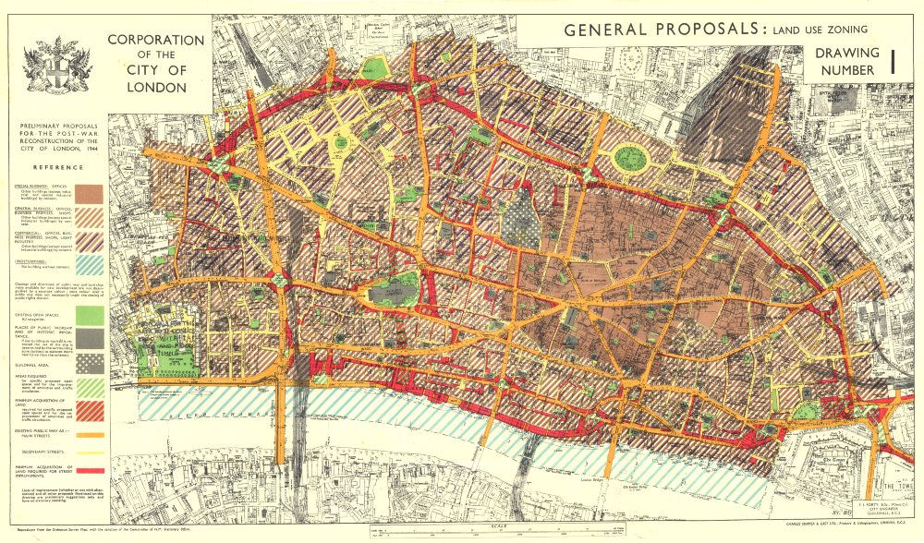
What might these maps be showing?

Slide 2
Title - Factors affecting urban land use patterns
Outcomes
All will be able to describe and explain urban land use patterns.
All will be able to discuss how locational needs, accessibility and land values affect land use patterns.

Slide 3
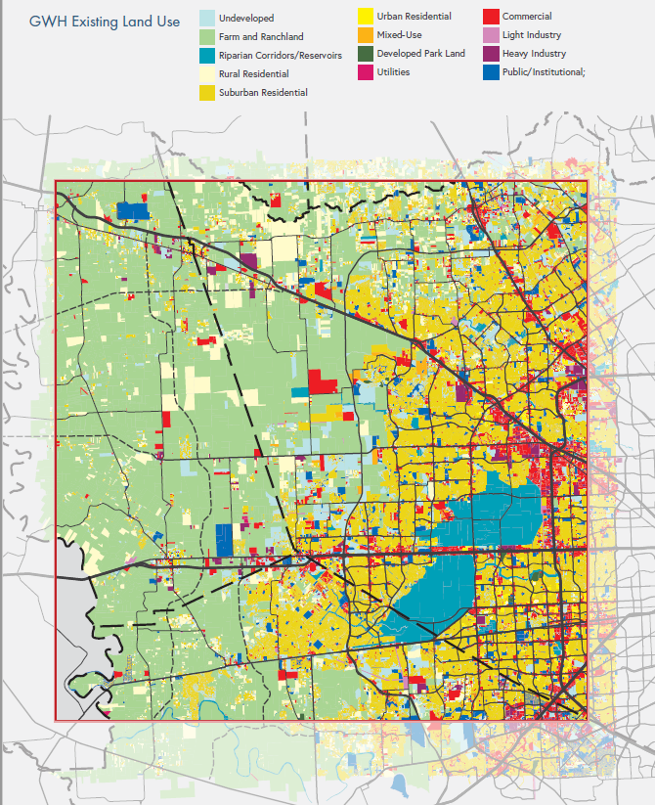
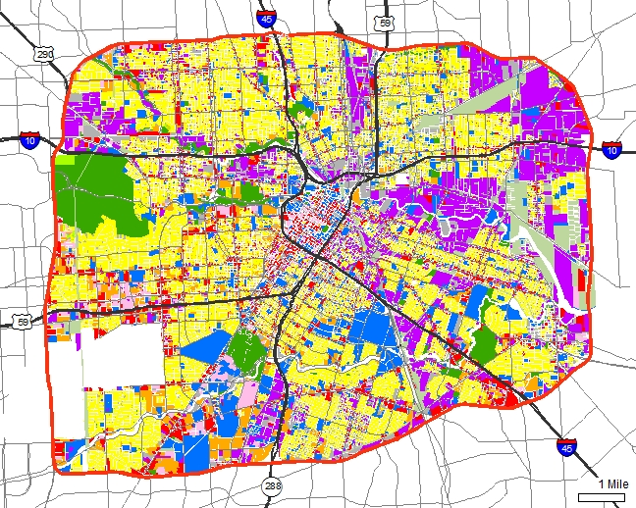
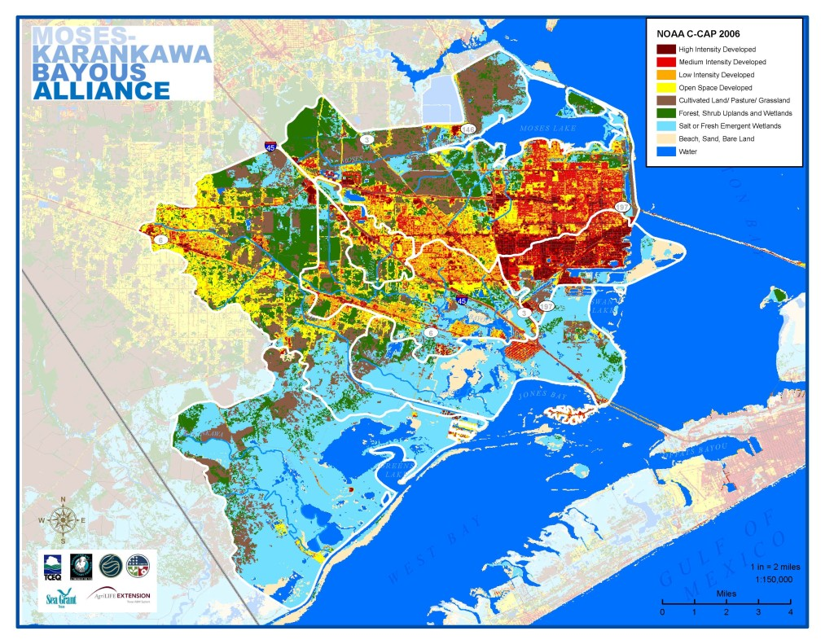
What’s good about these land use maps?
Challenge 1: Annotate the 3 maps to describe what’s good about the maps and what things they might have in common.
Extra challenge – Try to explain some of the land use patterns you are seeing.

Slide 7
What causes the segregation of different urban land uses?
Land Value
Locational Needs
Accessibility Needs

Slide 8
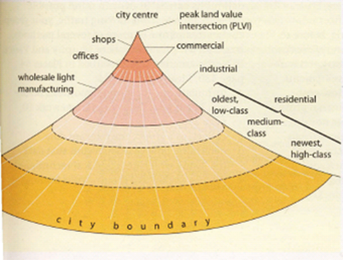
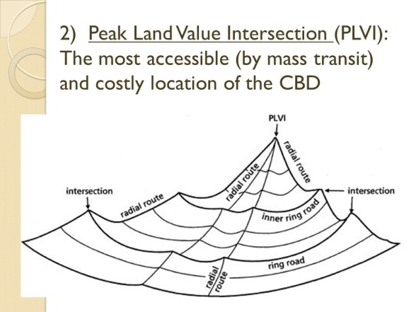
Which of the following is likely to make the most money from land and property?
Retail (shops etc.)
Housing
Services (banking, insurance etc.)
Industry (car manufacturing etc.)
Challenge – Choose one of the diagrams and and describe what it is showing, then define Peak Land Value.
Extra Challenge – Explain what it is showing.

Slide 10
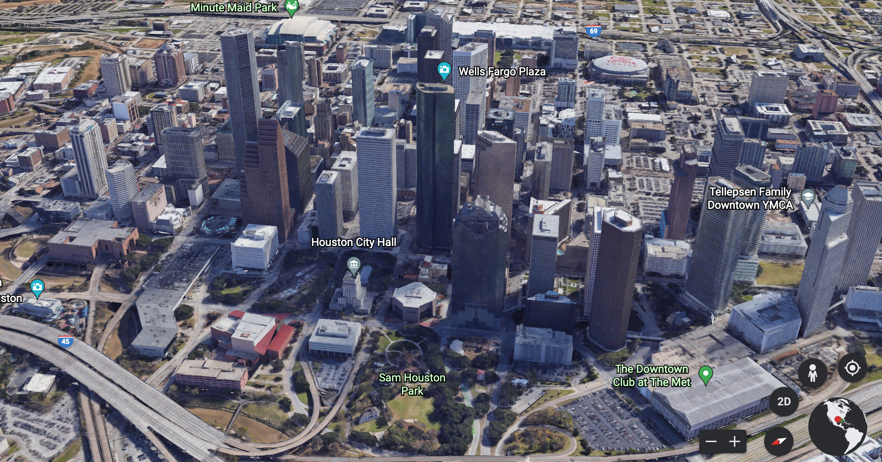
How does the urban land market affect land use?
Challenge – Use page 166 to annotate the diagrams to explain how land value dictates the way in which the land is used.
Challenge – Use Google Earth or Google Maps to explore the land use of Houston and to see if it matches what you have looked at.

Slide 11
How do locational and accessibilty needs affect land use?

Slide 12
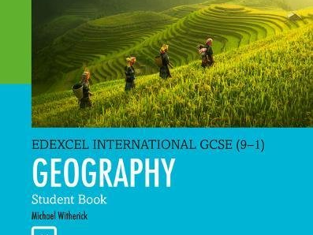
Challenge 3 – Read through page 167 of the textbook and then answer the following questions:
Why do retailing and commercial businesses cluster around the centre? What is this area called?
What type of locations does manufactuing need? Why?
Why does manufacturing rarely exist in a CBD?
Why is housing often pushed away from the centre of a city?
What happens to housing as you move further away from the centre?

Slide 13
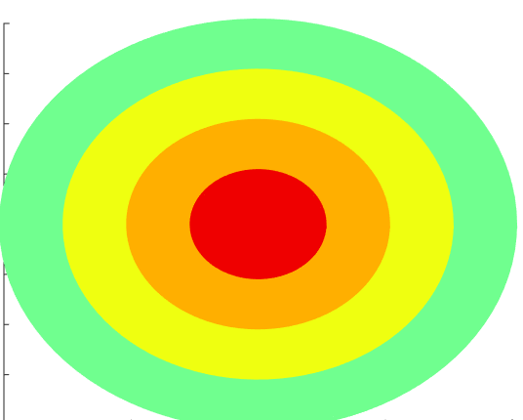
Challenge: Use the play doh to create an urban concentric zone model, then use the information on page 167 to create annotation cards for the model.
Option – Colour in the concentric circles available and annotate this.

Slide 14
Title - Factors affecting urban land use patterns
Outcomes
All will be able to describe and explain urban land use patterns.
All will be able to discuss how locational needs, accessibility and land values affect land use patterns.

Slide 15
Challenge 3 – Read through page 167 of the textbook and then answer the following questions:
What does retailing and commercial businesses cluster an and around the centre? What is this area called?
What type of locations does manufactuing need? Why?
Why does manufacturing rarely exist in a CBD?
Why is housing often pushed away from the centre of a city?
What happens to housing as you move further away from the centre?
Challenge 3 – Read through page 167 of the textbook and then answer the following questions:
What does retailing and commercial businesses cluster an and around the centre? What is this area called?
What type of locations does manufactuing need? Why?
Why does manufacturing rarely exist in a CBD?
Why is housing often pushed away from the centre of a city?
What happens to housing as you move further away from the centre?
Challenge 3 – Read through page 167 of the textbook and then answer the following questions:
What does retailing and commercial businesses cluster an and around the centre? What is this area called?
What type of locations does manufactuing need? Why?
Why does manufacturing rarely exist in a CBD?
Why is housing often pushed away from the centre of a city?
What happens to housing as you move further away from the centre?

Slide 16
