Slide 1
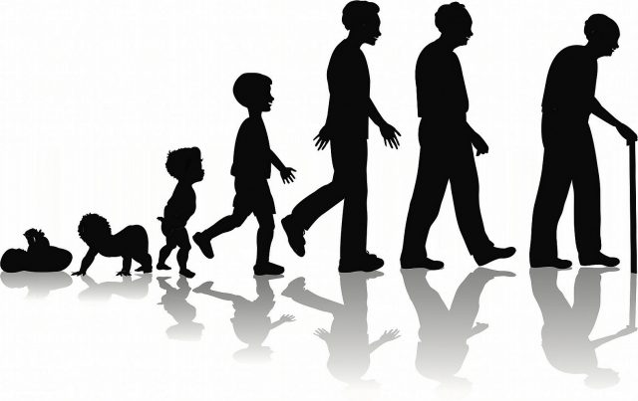
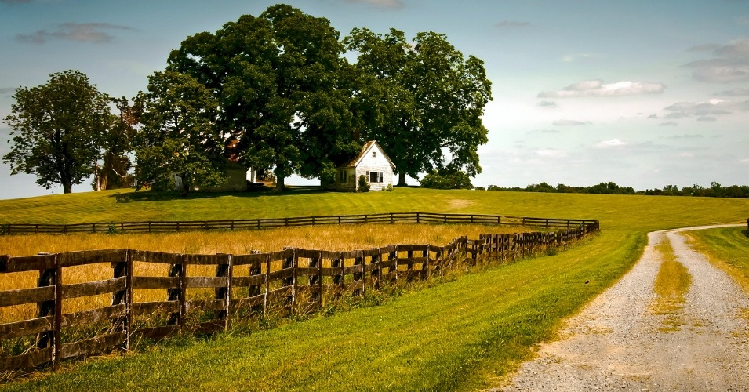
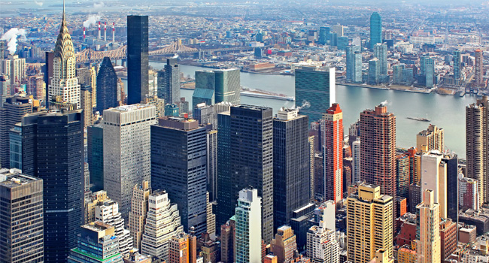
Use these 4 images to come up with a lesson title for today

Slide 2
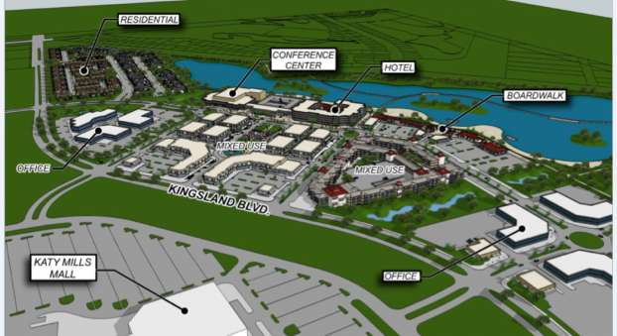
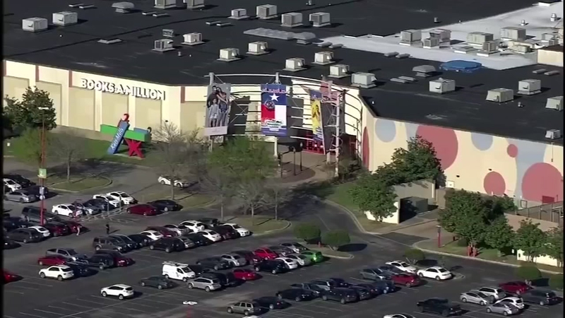
Developments on the urban-rural fringe
Outcomes:
All will be able to describe the changes taking place on the urban rural fring
All will be able to explain the changes

Slide 3
Challenge 1:
Sort the push and pull factors linked to changes on the urban fringe.
Housing is old, congested and relatively expensive | New developments on the outskirts are favoured by the personal mobility allowed by car drivers | There are various forms of environmental pollution – air quality is poor, and noise levels are high | Closeness to main roads and motorways allows for quicker and easier customer contacts
Companies find that there is a shortage of land for building new shops, offices and factories. So, any unused land is costly | Land is cheaper so houses are larger | Factories can be more spacious and have plenty of room for workers to park their cars | Can you make another? ____________________________________________________________________________________________
Extra Challenge:
What would be the biggest push and pull factor for a business. How does this differ to a family?

Slide 4
Housing is old, congested and relatively expensive | New developments on the outskirts are favoured by the personal mobility allowed by car drivers | There are various forms of environmental pollution – air quality is poor, and noise levels are high | Closeness to main roads and motorways allows for quicker and easier customer contacts
Companies find that there is a shortage of land for building new shops, offices and factories. So, any unused land is costly | Land is cheaper so houses are larger | Factories can be more spacious and have plenty of room for workers to park their cars | Can you make another? _____________________________________________________________________________________
Housing is old, congested and relatively expensive | New developments on the outskirts are favoured by the personal mobility allowed by car drivers | There are various forms of environmental pollution – air quality is poor, and noise levels are high | Closeness to main roads and motorways allows for quicker and easier customer contacts
Companies find that there is a shortage of land for building new shops, offices and factories. So, any unused land is costly | Land is cheaper so houses are larger | Factories can be more spacious and have plenty of room for workers to park their cars | Can you make another? _____________________________________________________________________________________
Housing is old, congested and relatively expensive | New developments on the outskirts are favoured by the personal mobility allowed by car drivers | There are various forms of environmental pollution – air quality is poor, and noise levels are high | Closeness to main roads and motorways allows for quicker and easier customer contacts
Companies find that there is a shortage of land for building new shops, offices and factories. So, any unused land is costly | Land is cheaper so houses are larger | Factories can be more spacious and have plenty of room for workers to park their cars | Can you make another? _____________________________________________________________________________________
Housing is old, congested and relatively expensive | New developments on the outskirts are favoured by the personal mobility allowed by car drivers | There are various forms of environmental pollution – air quality is poor, and noise levels are high | Closeness to main roads and motorways allows for quicker and easier customer contacts
Companies find that there is a shortage of land for building new shops, offices and factories. So, any unused land is costly | Land is cheaper so houses are larger | Factories can be more spacious and have plenty of room for workers to park their cars | Can you make another? _____________________________________________________________________________________

Slide 5
Challenge 2 – Speed Date
You each have 5 minutes to become an expert on your type of urban fringe development (phones and page 102/3 173/4 can be used for this).
Once you have become an expert, you will spend 2 minutes with the others, gathering the information for the other schemes.
Notes:
https://maxwatsongeography.wordpress.com/section-b/urban-environments/changes-at-the-edge-of-hics/
https://quizlet.com/184483101/edexcel-igcse-geography-urban-environments-flash-cards/

Slide 6
Attempt the question from a previous IGCSE paper

