Slide 1
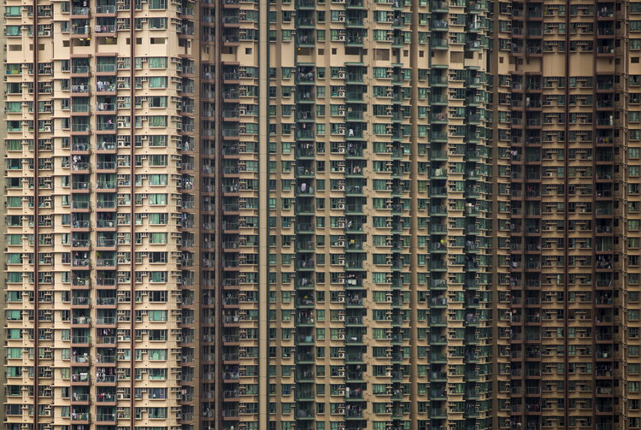
Urban challenges in the developed world
IGCSE Geography Edexcel 9-1
Case study: Hong Kong

Slide 2
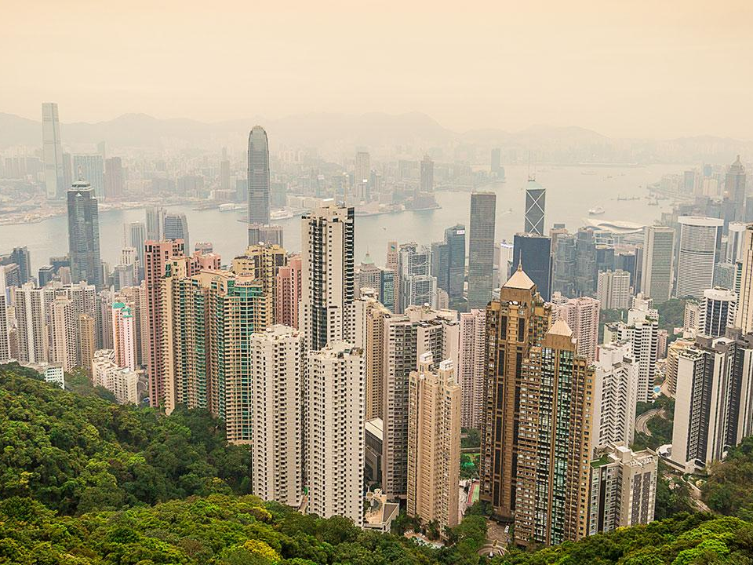
Title – Urban Challenges in Hong Kong
Outcomes:
All will be able to describe the urban challenges that Hong Kong experiences linked to food, energy, transport and waster disposal demands, concentrated resource consumption, and segregation.
Most will be able to explain the urban challenges that Hong Kong experiences linked to food, energy, transport and waster disposal demands, concentrated resource consumption, and segregation.
Some will be able to analyse what the biggest problems are and then come up with solutions to help manage.

Slide 3
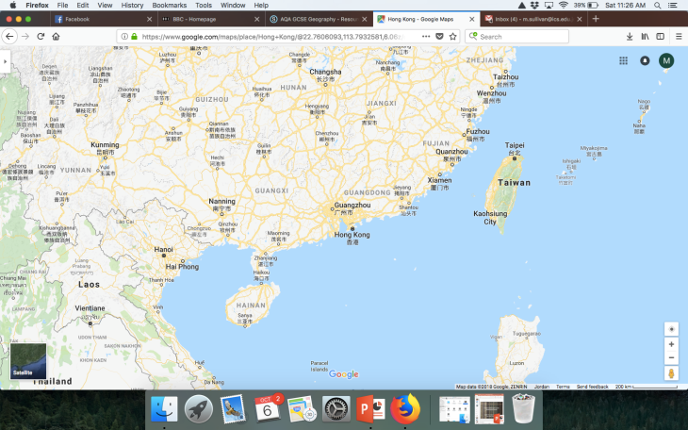
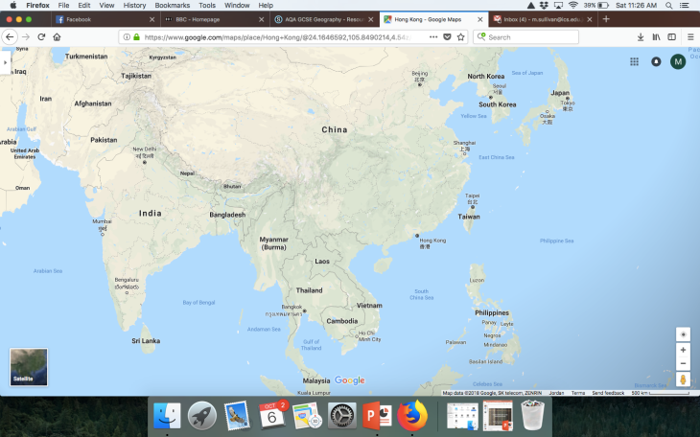
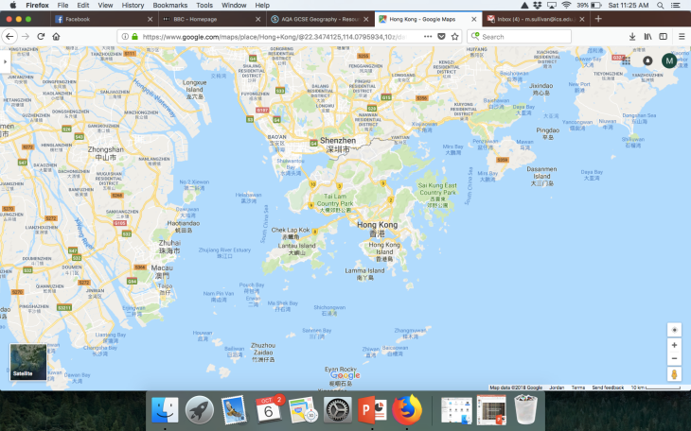
Challenge 1:
Describe the location of Hong Kong, making sure to include:
Continent
Nearby Countries
Compass Points

Slide 4
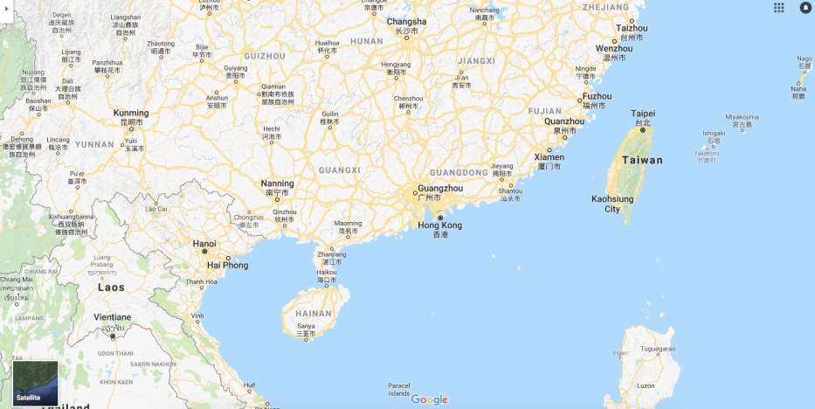

Slide 5
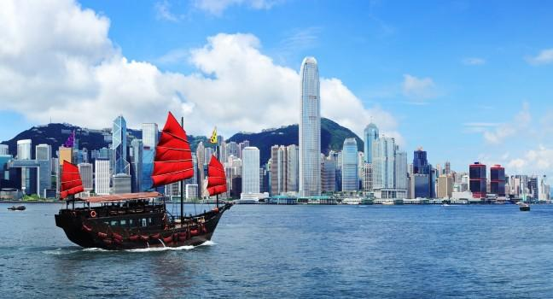
Case study: Hong Kong

Slide 6
Case study: Hong Kong
Occupied by the UK in 1841, in1984, Hong Kong became the Hong Kong Special Administrative Region of the People's Republic of China on 1 July 1997. In this agreement, China promised that, under its "one country, two systems" formula, China's socialist economic system would not be imposed on Hong Kong and that Hong Kong would enjoy a "high degree of autonomy" in all matters except foreign and defence affairs for the subsequent 50 years.

Slide 7
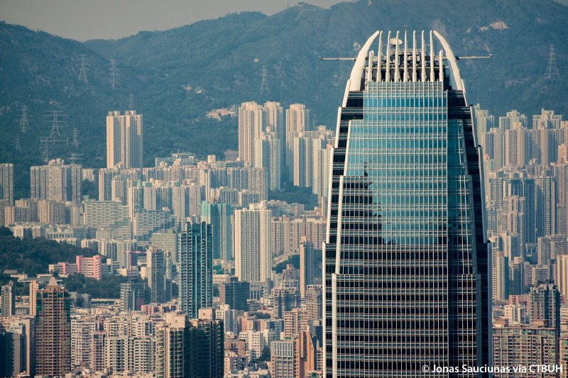
Global city/developed country
Hong Kong has a land area of over 1000 km² and over 7m population
It is both a world city and an autonomous country with some political independence from China.
It is one of the world’s top financial and business centres

Slide 8
‘S.E.E.’ challenges
The challenges faced by developed world cities fall under 3 categories:
Social, Economic and Environmental
Challenge 2 – Colour code the challenges as either Social, Economic or Environmental
Extra Challenge – Which do you think might be the biggest challenges and why?

Slide 9
Deindustrialisation
Social services and housing
Pollution and waste disposal
Ecological Footprint
Globalisation
Poverty and deprivation
Food supply
Sustainability
Ethnic segregation
Transport and traffic
Hazard Risk
Quality of life
Energy supply
Service provision
Energy, land, water
Green Space
Ageing population
Terrorism and crime

Slide 10
Economic challenges
These are mostly:
Deindustrialisation
Globalisation
Food supply
Transport and traffic
Energy supply
Service provision

Slide 11
Social challenges
These are mostly:
Social services and housing
Poverty and deprivation
Ethnic segregation
Quality of life
Ageing population
Terrorism and crime

Slide 12
Environmental challenges
These are mostly:
Ecological footprint
Pollution and waste disposal
Energy, land, water
Green space
Hazard risk
Sustainability

Slide 13
Social Challenges | Economic Challenges | Environmental Challenges

Slide 14
Challenge 3 - Read about the challenges in more detail and add some of the detail to your tables / spider / bullet points.
Extra Challenge – Look through the PowerPoint I’ve shared with you see what surprises you most. Add extra detail to your notes.
Deindustrialisation/Globalisation
Hong Kong has benefited from globalisation, but with its economy based on trade and financial services manufacturing has never been a major part of the economy, so it has not been affected by deindustrialisation as such.
It is the world’s 11th largest trading country and the world’s largest re-export centre. These products are mostly made in mainland China.
Food supply
With very little arable land on which to farm, agriculture contributes only 0.1% of its GDP. Most food is imported.
Ethnic segregation
A factor leading to social polarisation.
94% of population is of Chinese descent, 6% from Phillipines, Indonesia, Nepal and India. Most employed in domestic service industry.
Also British, Americans, Canadians, Japanese and Koreans. They work in commercial and financial sector and live in wealthier areas.
Transport and traffic
HK has a well-developed transport network and so movement is relatively easy.
Over 90% of the 11 million journeys made daily are on public transport (railways, buses, ferries)
Poverty and deprivation
It is extremely difficult for people to move from public to private housing
This reduces social mobility leading to social polarisation (the process of segregation within a society based on income inequality and socio-economic status)
Extreme wealth as well as poverty and deprivation found in the same area
Slum areas – many in Kowloon City – cleared away in 1990s. Today slums are on rooftops – ‘penthouse slums’ or ‘rooftop shanty towns’. These are illegal and unique to HK.
Water supply
There are very few rivers or lakes
Groundwater is difficult to access
Rainfall seasonal and variable
HK has to import water 70% of its water from China
Energy supply
Energy supply is mostly from electricity. 75% is generated from fossil fuel power stations (mostly coal)
25% is generated from nuclear power, imported from China.
Social services and housing
HK provides good education and healthcare
Housing has become ‘vertical’ as a result of population density
50% live in public housing, rented from the government.
Private housing is the 3rd most expensive globally
Ecological footprint – it’s bad!
HK burns large amounts of fossil fuels
Marine environment damaged due to large amounts of land reclaim from the sea
Smog (smoke and fog) drifts in from industrial areas
Waste disposal (vast amounts of landfill) with recent attempts to recycle and use it as an energy source.
Resources
Due to its size, economic activity and population, HK is a huge consumer of resources. Its ecological footprint is therefore ‘deep’

Slide 15
Economic challenges
Deindustrialisation/Globalisation
Hong Kong has benefited from globalisation, but with its economy based on trade and financial services manufacturing has never been a major part of the economy, so it has not been affected by deindustrialisation as such.
It is the world’s 11th largest trading country and the world’s largest re-export centre. These products are mostly made in mainland China.

Slide 16
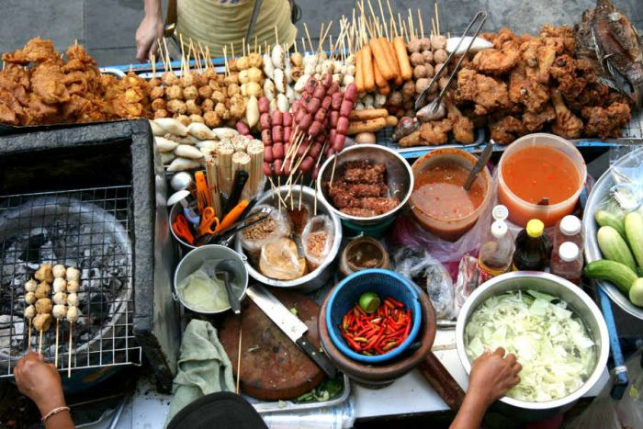
Economic challenges
Food supply
With very little arable land on which to farm, agriculture contributes only 0.1% of its GDP. Most food is imported.

Slide 17
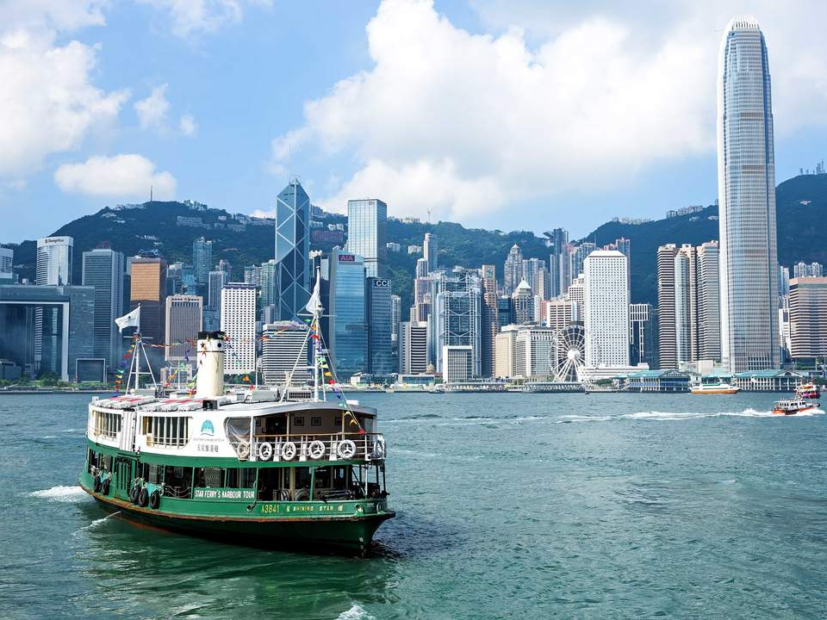
Economic challenges
Transport and traffic
HK has a well-developed transport network and so movement is relatively easy.
Over 90% of the 11 million journeys made daily are on public transport (railways, buses, ferries)

Slide 18
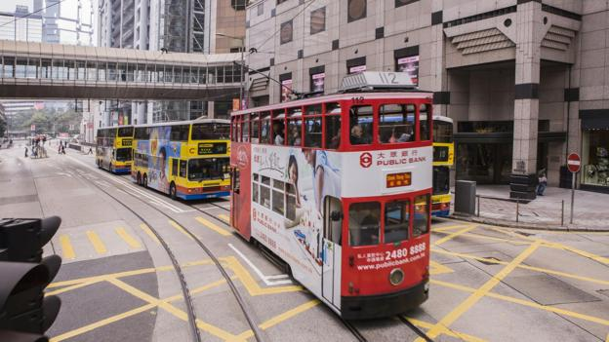

Slide 19
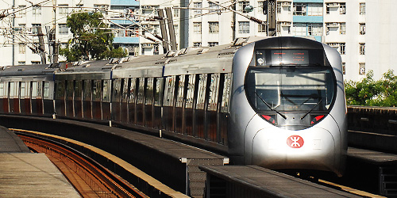

Slide 20
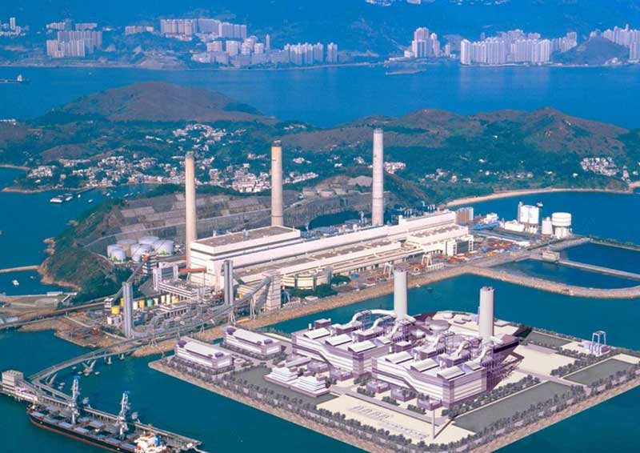
Economic challenges
Energy supply
Energy supply is mostly from electricity. 75% is generated from fossil fuel power stations (mostly coal)
25% is generated from nuclear power, imported from China.

Slide 21
Social challenges
Social services and housing
HK provides good education and healthcare
Housing has become ‘vertical’ as a result of population density
50% live in public housing, rented from the government.
Private housing is the 3rd most expensive globally

Slide 22
Social challenges
Poverty and deprivation
It is extremely difficult for people to move from public to private housing
This reduces social mobility leading to social polarisation (the process of segregation within a society based on income inequality and socio-economic status)
Extreme wealth as well as poverty and deprivation found in the same area
Slum areas – many in Kowloon City – cleared away in 1990s. Today slums are on rooftops – ‘penthouse slums’ or ‘rooftop shanty towns’. These are illegal and unique to HK.

Slide 23
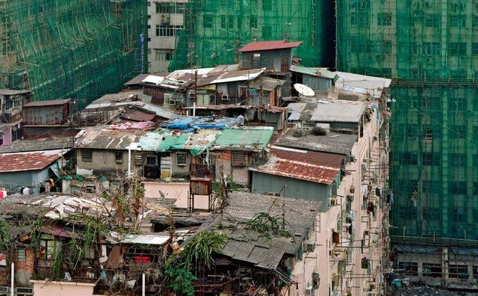
Hong Kong's Informal Rooftop Communities.

Slide 24
Boxed in: life inside the 'coffin cubicles' of Hong Kong – in pictures
Photographer Benny Lam has documented the suffocating living conditions in Hong Kong’s subdivided flats, recording the lives of these hidden communities
From The Guardian newspaper/website Wed 7 Jun 2017
Link: https://www.theguardian.com/cities/gallery/2017/jun/07/boxed-life-inside-hong-kong-coffin-cubicles-cage-homes-in-pictures

Slide 25
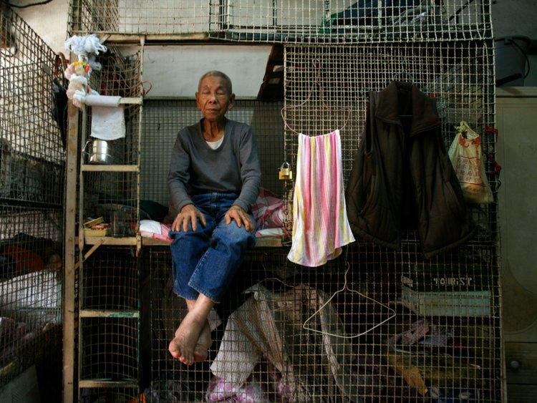
Hong Kong's 20-square-foot 'coffin homes' expose a terrifying truth about the future of cities
Photo: Damir Sagolj/Reuters

Slide 26
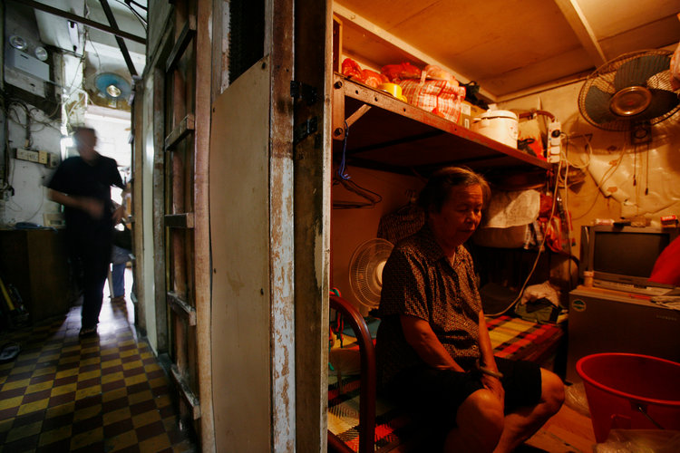
Photo: Damir Sagolj/Reuters

Slide 27
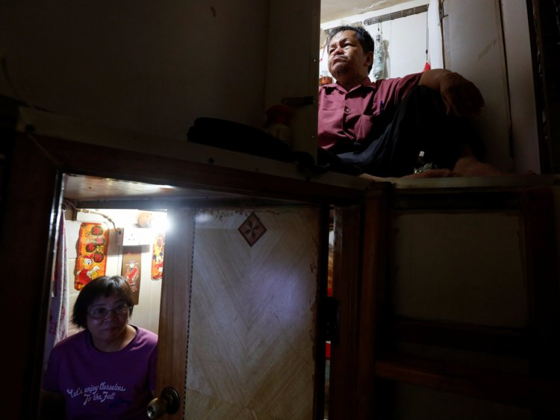
Photo: Damir Sagolj/Reuters

Slide 28
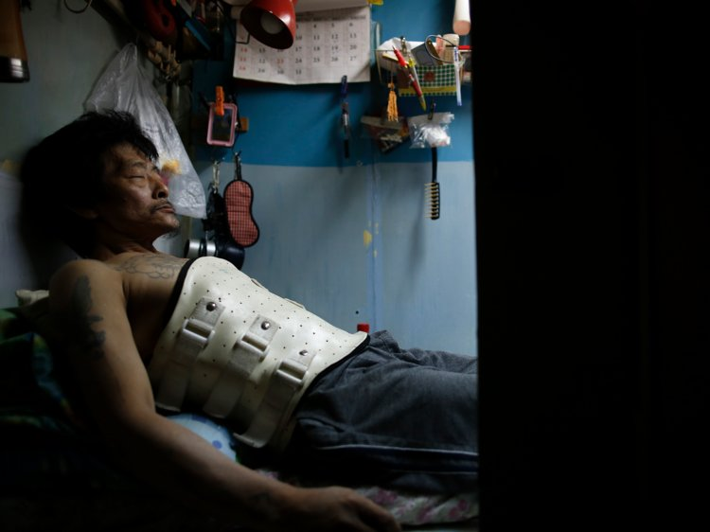
Photo: Damir Sagolj/Reuters

Slide 29
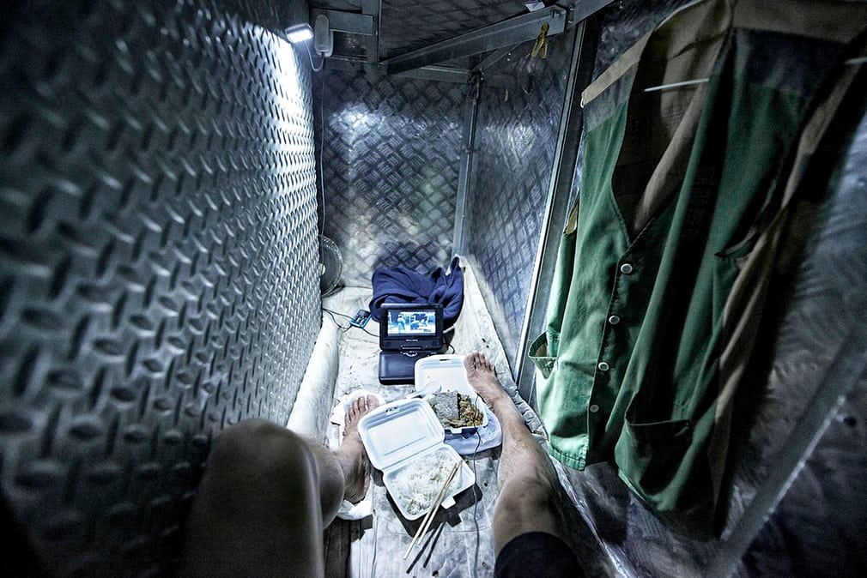
Cage homes are minuscule rooms lived in by the poorest people in the city. Over the last 10 years, the number of cage homes made of wire mesh has decreased, but they’ve been replaced by beds sealed with wooden planks

Slide 30
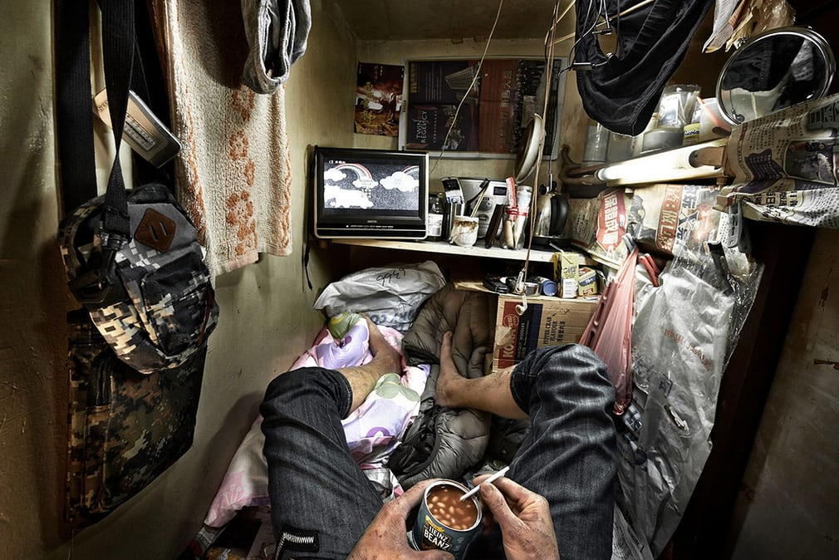
These small, wooden boxes of 15 sq ft, are known as ‘coffin cubicles’

Slide 31
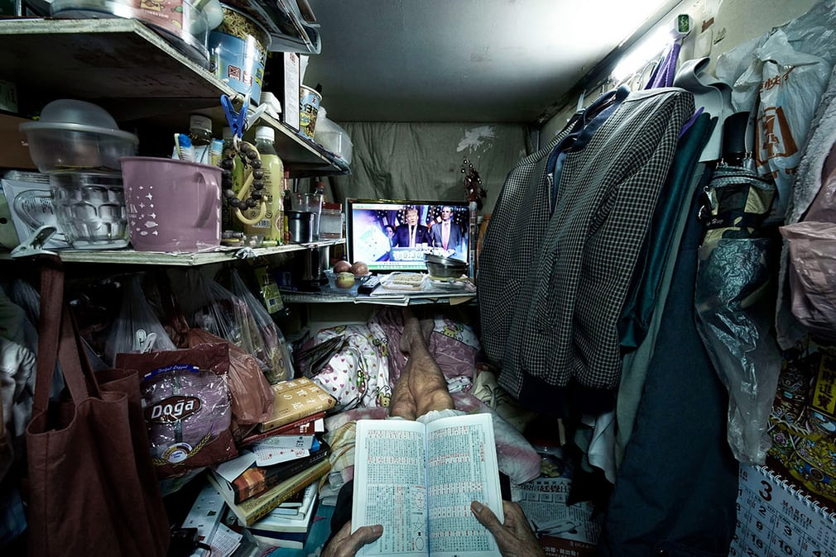
A 400 sq ft flat can be subdivided to accommodate nearly 20 double-decker sealed bed spaces

Slide 32
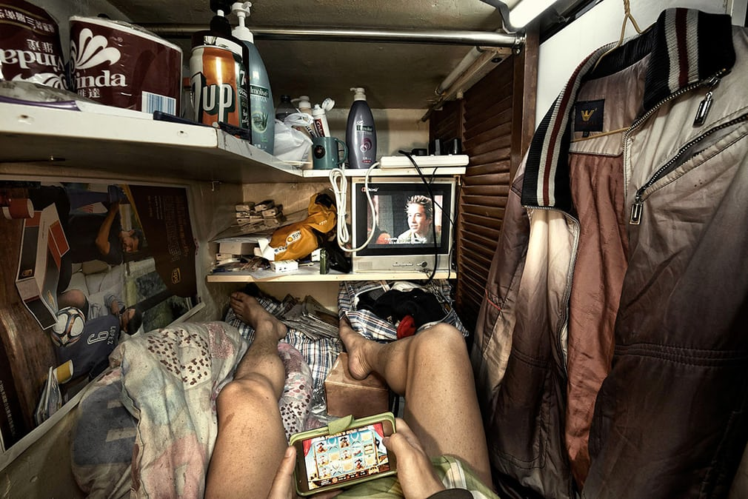
The tenants are different ages and sexes – all unable to afford a small cubicle, which would allow more room to stand up

Slide 33
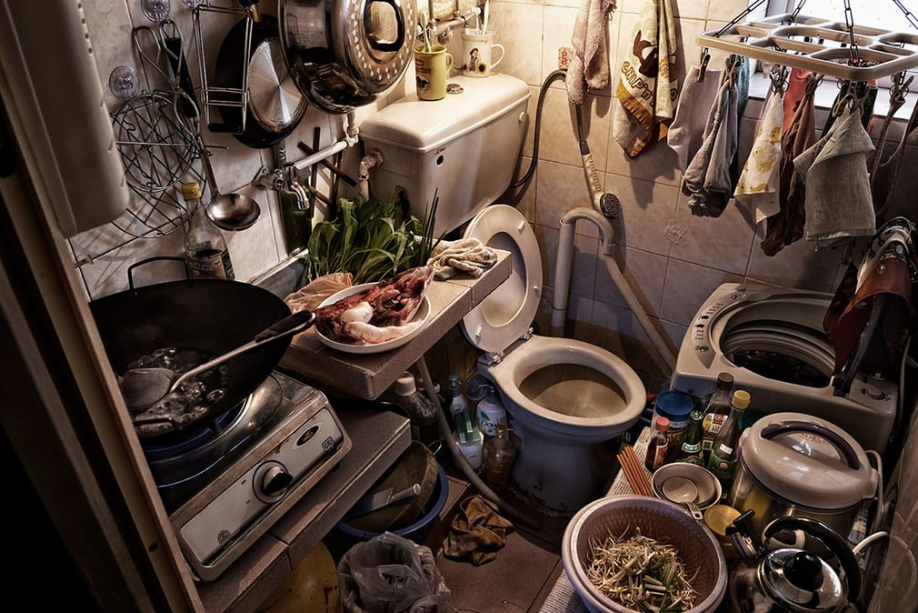
A kitchen-toilet complex in a cage home

Slide 34
Hong Kong's 'cardboard grannies': the elderly box collectors living in poverty
Inadequate support for Hong Kong’s ageing population means for some older citizens, scavenging and selling boxes and scrap is the only way to scrape by.
From The Guardian Tue 24 Apr 2018
Link: https://www.theguardian.com/cities/2018/apr/24/hong-kong-cardboard-grannies-elderly-box-collectors-recycling-poverty

Slide 35
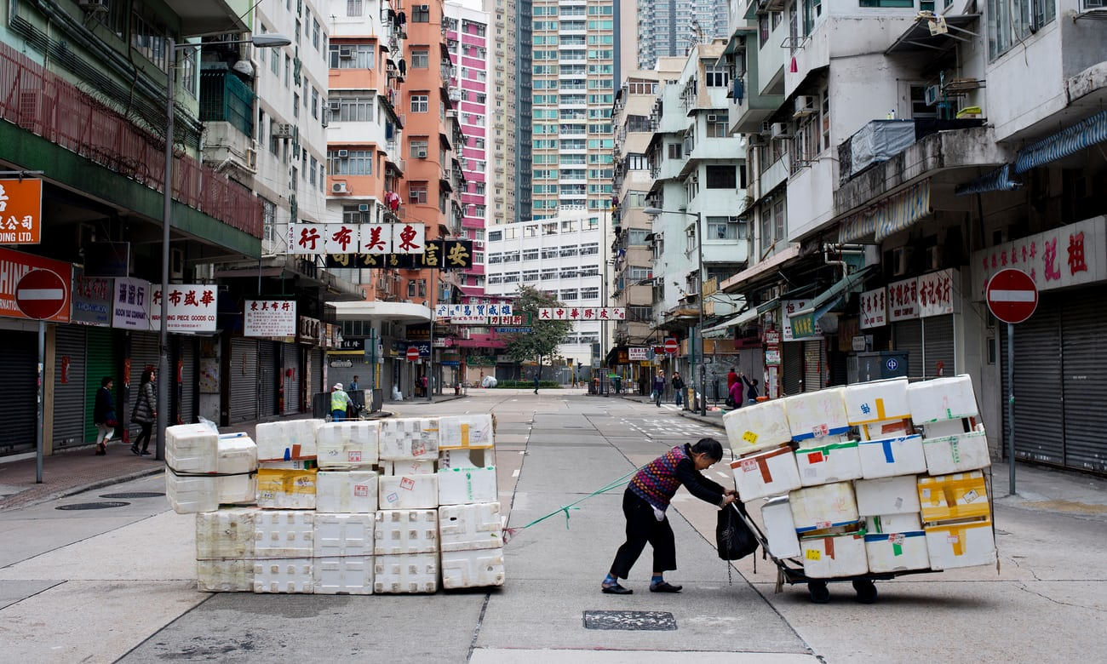
A third of Hong Kong’s older people live in poverty. The city now has the longest life expectancy in the world. Photograph: SOPA Images/LightRocket via Getty Images

Slide 36
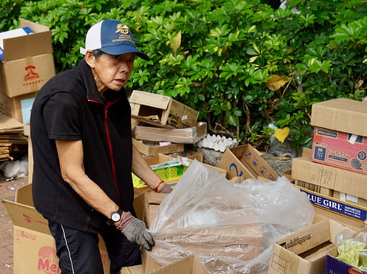
Miss Wong, 65, scavenges the streets of Hong Kong’s Sheung Shui area in search of disused cardboard to sell to local recycling plants. She starts her day at 7am and often works until 9pm, seven days a week. For her efforts, she receives about HK$41 (£3.60) per day.
Wong is one of an estimated thousand senior citizens nicknamed “cardboard grannies” who collect and sell waste boxes and other scrap across nine of the poorest districts in the city.
When the company Wong distributed promotional leaflets for closed down, she found herself unable to find other employment. With no savings, family support, sufficient pension or social security income, selling cardboard has become her only means of scraping by. “I ended up homeless because I didn’t have enough money to pay the rent,” says Wong. “Even a sub-divided flat costs around HK$4,000 per month and I didn’t have the money for that.”

Slide 37
The other half live better …

Slide 38
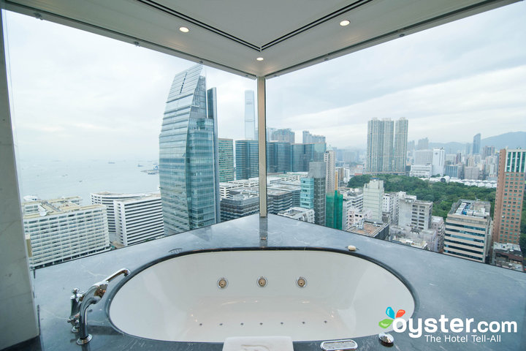

Slide 39
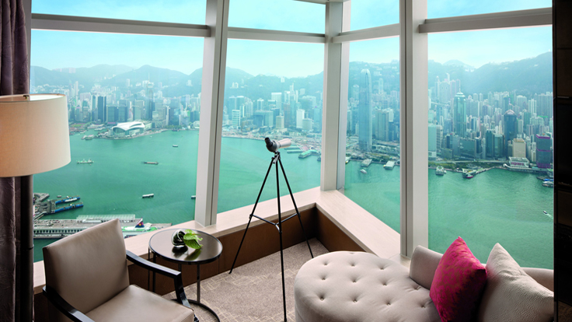

Slide 41
Social challenges
Ethnic segregation
A factor leading to social polarisation.
94% of population is of Chinese descent, 6% from Phillipines, Indonesia, Nepal and India. Most employed in domestic service industry.
Also British, Americans, Canadians, Japanese and Koreans. They work in commercial and financial sector and live in wealthier areas.

Slide 42
Environmental challenges
Ecological footprint – it’s bad!
HK burns large amounts of fossil fuels
Marine environment damaged due to large amounts of land reclaim from the sea
Smog (smoke and fog) drifts in from industrial areas
Waste disposal (vast amounts of landfill) with recent attempts to recycle and use it as an energy source.

Slide 43
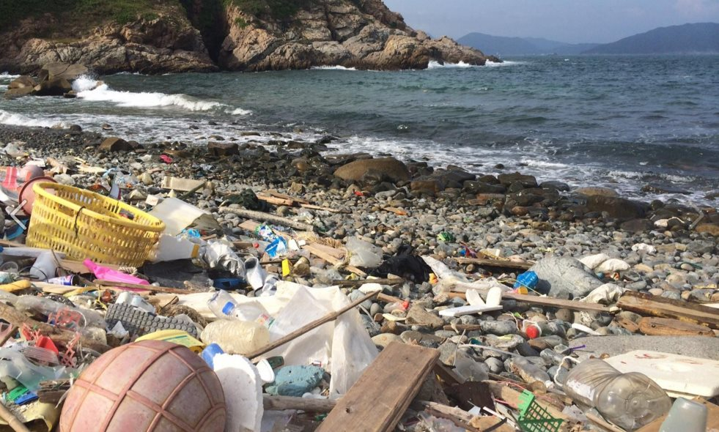
Hong Kong's over-packaging problem: Supermarkets are not the only ones who need to change | Hong Kong Free Press

Slide 44
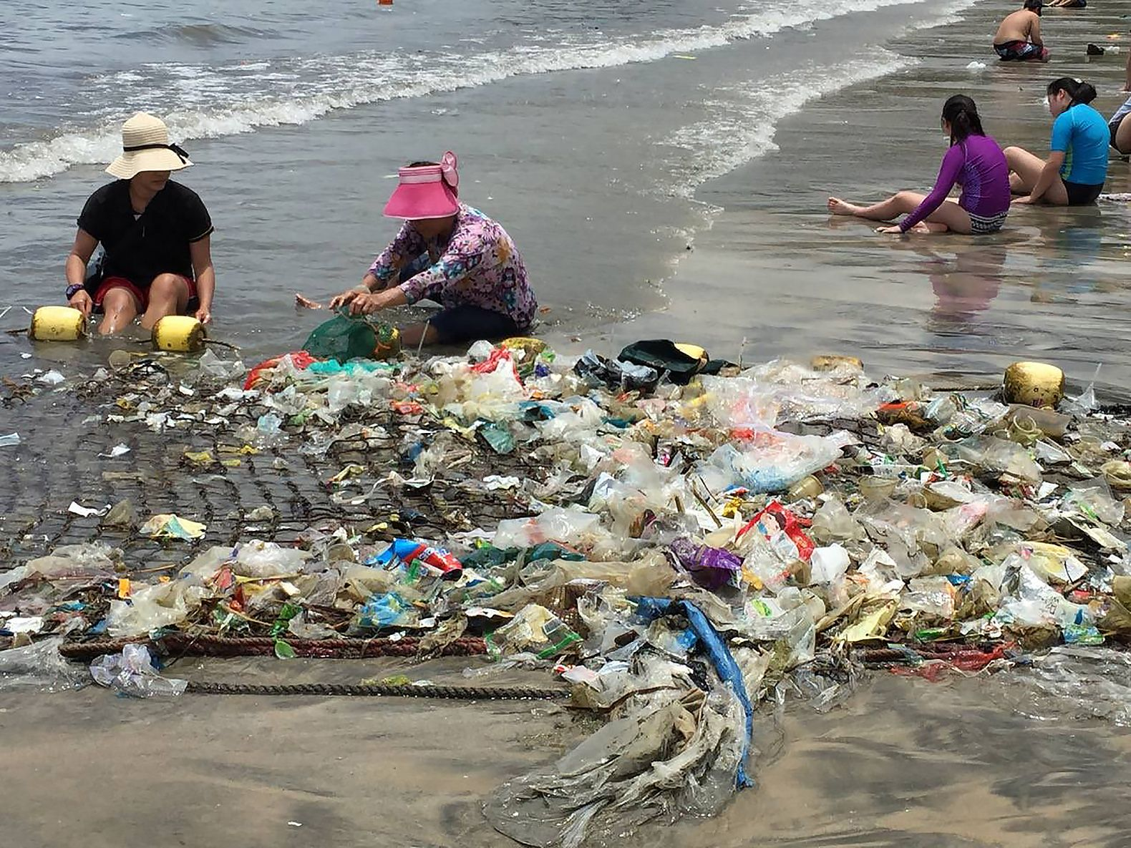

Slide 45
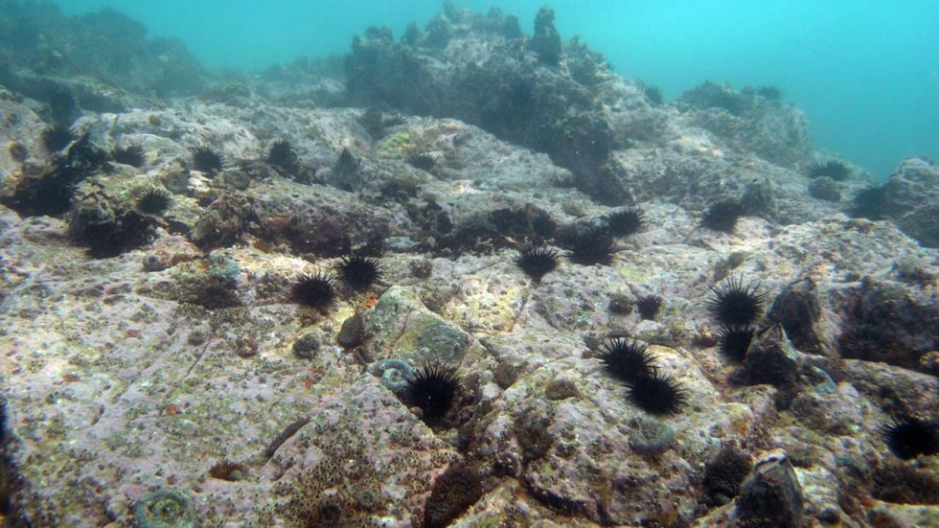
Hong Kong’s coral in crisis as climate change and pollution take their toll.
The waters around Hong Kong used to be filled with a wide variety of coral species, but many have succumbed to climate change, land reclamation and water pollution, and scientists are urging the government to take action to protect the ecosystem
http://www.scmp.com/news/hong-kong/health-environment/article/1971725/hong-kongs-coral-crisis-climate-change-and

Slide 46
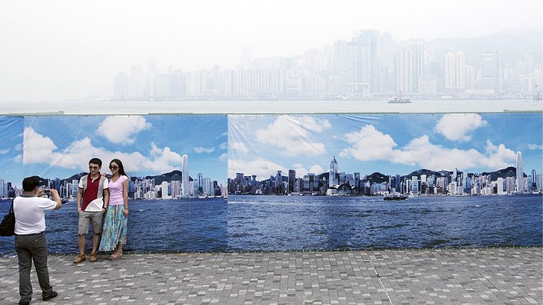
Hong Kong Smog is So Bad Tourists are Getting Their Picture Taken with a Clean Backdrop
https://inhabitat.com/hong-kong-smog-is-so-bad-tourists-are-getting-their-picture-taken-with-a-clean-backdrop/

Slide 47
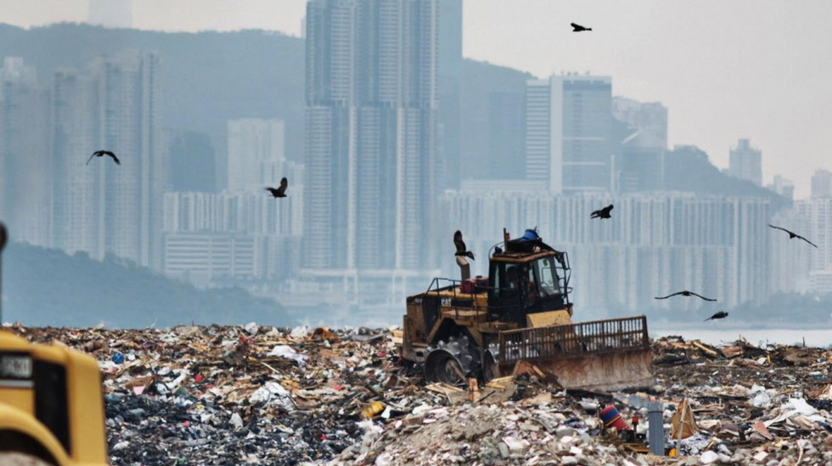
Straight to landfill? Why Hong Kong is recycling less rubbish
Even as Hong Kong landfills are rapidly running out of space, the city's recycling levels are decreasing
http://www.scmp.com/lifestyle/article/1859106/why-hong-kong-recycling-less-its-rubbish-time-goes

Slide 48
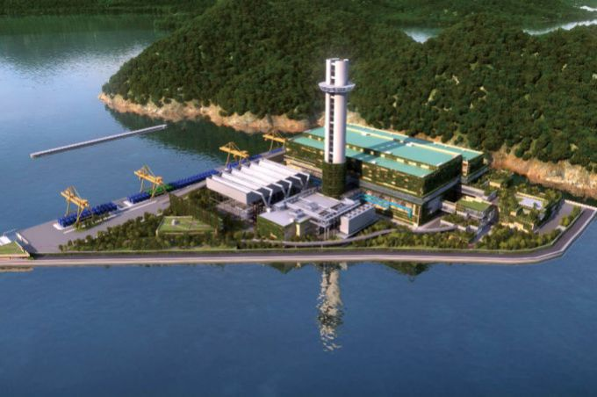
US$4bn Waste to Energy Deal for Keppel Seghers in Hong Kong
Waste to energy and infrastructure firm Keppel Seghers and its Chinese partner, Zhen Hu, have been awarded a contract worth $4 billion for Hong Kong’s first integrated Waste Management Facility to be built on a reclaimed island.
https://waste-management-world.com/a/us4bn-waste-to-energy-deal-for-keppel-seghers-in-hong-kong

Slide 49
Environmental challenges
Water supply
There are very few rivers or lakes
Groundwater is difficult to access
Rainfall seasonal and variable
HK has to import water 70% of its water from China

Slide 50
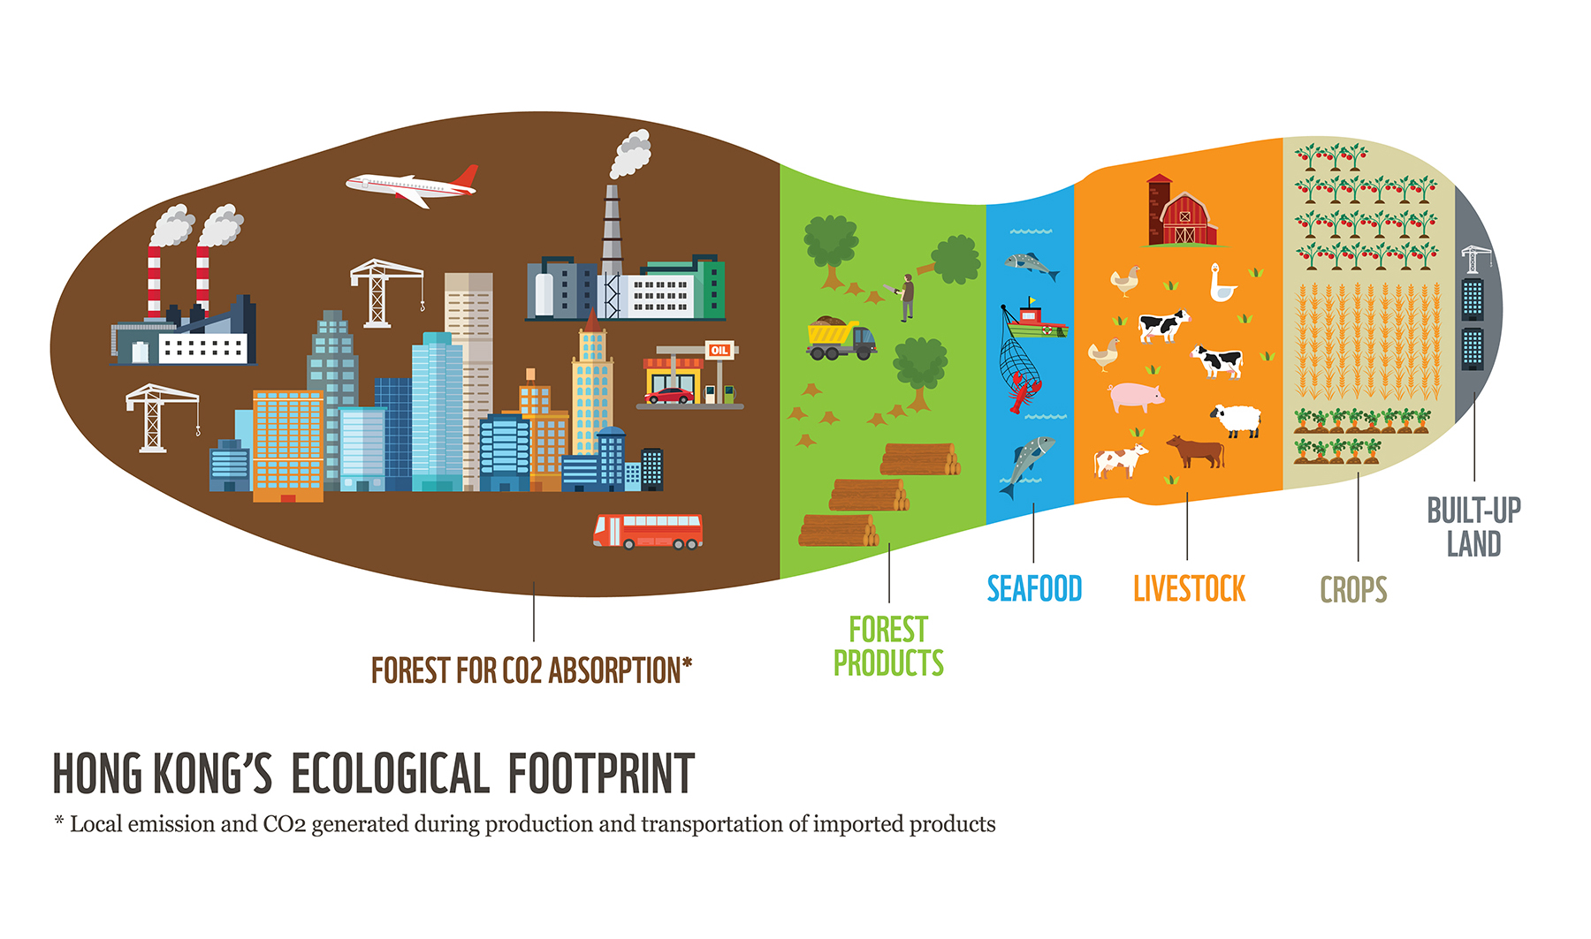
Resources
Due to its size, economic activity and population, HK is a huge consumer of resources.
Its ecological footprint is therefore ‘deep’

Slide 51
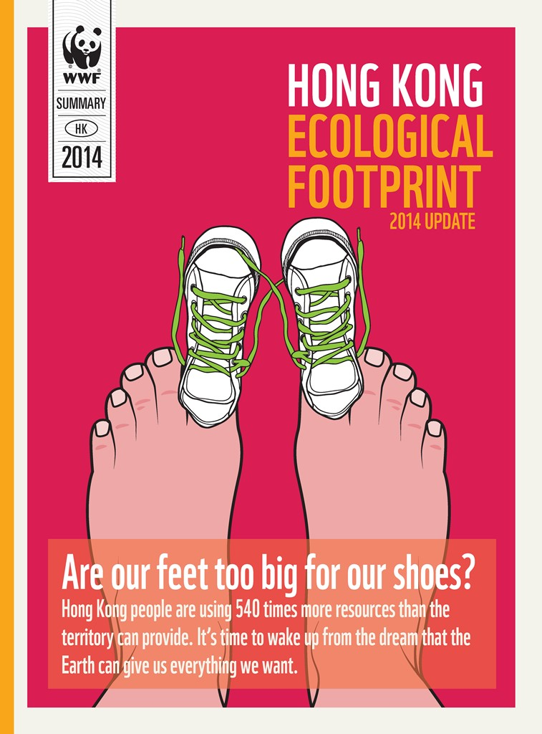
According to the latest data of Hong Kong's Ecological Footprint issued by WWF, Hong Kong people are living beyond the Earth’s limits. 3.1 Earths are needed if everyone lived the lifestyle of Hong Kong people. Hong Kong’s footprint is larger than the global average of 1.5 Earths. WWF calls for immediate actions from Hong Kong Government, businesses and individuals, to transform Hong Kong into a more sustainable city.
http://awsassets.wwfhk.panda.org/downloads/wwf_hk_footprint_eng_web_141017_1.pdf

Slide 52
Video links
My week in Lucky House: the horror of Hong Kong's coffin homes
Benjamin Haas joins the retirees, working poor, drug addicts and convicted criminals who live crammed into the city’s tiny plywood cubicles
Russian rooftopper skateboards & somersaults on ledge of Hong Kong skyscraper (VIDEO)
Hong Kong Struggles with Pollution | FT World
According to some measures, Hong Kong has the second worst air quality in China. It's a problem the city must address if it wants to maintain its position as Asia's leading international city, especially with Singapore offering a more pleasant environment and Shanghai's rise to prominence. The FT's Tom Griggs investigates.

Slide 53
Exam question
With reference to case study/ies describe some of the challenges faced by developed world cities? (8marks)

Slide 54
According to the latest data of Hong Kong's Ecological Footprint issued by WWF, Hong Kong people are living beyond the Earth’s limits. 3.1 Earths are needed if everyone lived the lifestyle of Hong Kong people. Hong Kong’s footprint is larger than the global average of 1.5 Earths. WWF calls for immediate actions from Hong Kong Government, businesses and individuals, to transform Hong Kong into a more sustainable city.
http://awsassets.wwfhk.panda.org/downloads/wwf_hk_footprint_eng_web_141017_1.pdf

Slide 55
US$4bn Waste to Energy Deal for Keppel Seghers in Hong Kong
Waste to energy and infrastructure firm Keppel Seghers and its Chinese partner, Zhen Hu, have been awarded a contract worth $4 billion for Hong Kong’s first integrated Waste Management Facility to be built on a reclaimed island.
https://waste-management-world.com/a/us4bn-waste-to-energy-deal-for-keppel-seghers-in-hong-kong

Slide 56
Issues Hong Kong Faces
dofo
ygrnee
porsttnar
astwe ispolasd
concentrated rceuoser consumption
niotagresge
Issues Hong Kong Faces
Food
Energy
Transport
Waste Disposal
concentrated resource consumption
Segregation
Extra Challenge – Define the problem in 1 sentence

Slide 57
Lesson Title – Urban Challenges in Hong Kong
Outcome – All will be able to demostrate their understadning of the urban challenges Hong Kong Faces

Slide 58
Lesson Challenge
Using what you now know about the challenges Hong Kong faces, put together a piece of work to highlight the key points. You must include:
Social Challenges
Environmental Challenges
Economic Challenges
You could do:
A poster
A vlog
A news report
A story
A diary
A poem
Any other idea that you feel is appropriate!

Slide 59
Issues Hong Kong Faces
dofo
ygrnee
porsttnar
astwe ispolasd
concentrated rceuoser consumption
niotagresge
Issues Hong Kong Faces
dofo
ygrnee
porsttnar
astwe ispolasd
concentrated rceuoser consumption
niotagresge
Issues Hong Kong Faces
dofo
ygrnee
porsttnar
astwe ispolasd
concentrated rceuoser consumption
niotagresge
Issues Hong Kong Faces
dofo
ygrnee
porsttnar
astwe ispolasd
concentrated rceuoser consumption
niotagresge

