Slide 1
Edexcel IGCSE History P1: Depth Study 7
A Divided Union: Civil Rights in the USA, 1945-1974

Slide 3
Edexcel IGCSE History P1: Depth Study 7
A Divided Union: Civil Rights
in the USA, 1945-1974
4. Other Protest Movements
Students, Women & anti-Vietnam

Slide 4
(a) Growth of Protest Movements
1960-1961 First ‘Sit-Ins’ were first student protests.
Young people used their experiences to organize more.
African-Americans who had faced prejudice inspired others to challenge it where they found it – Hispanic Americans, Native Americans & Women.
WW2 (1941-1945) changed US Society – more women worked & it was assumed equality would follow the final defeat of the Nazis. Instead, the 1950s saw USA revert back to pre-war attitudes + WHITE MEN prospered still.
JFK seemed to offer a promise of change in 1960, but his assassination before his policies came to fruition depressed many Americans. JFK’s death in 1963 may explain why there was so much protest across the USA 1964-1974.

Slide 5
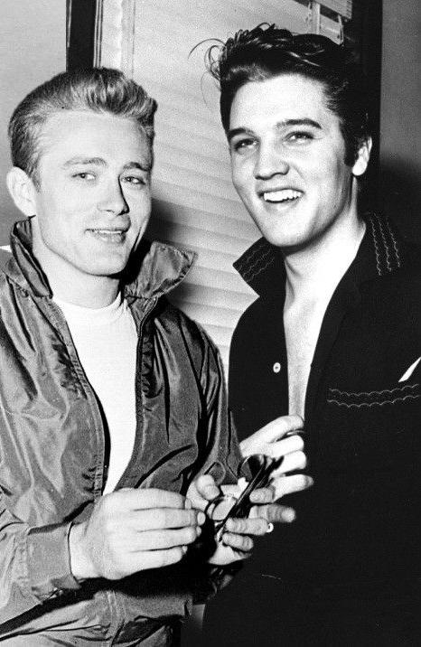
(a) Growth of Protest Movements
1950s saw emergence of the ‘teenager’ – rebelling against their parents, questioning beliefs & values. This led to a separate culture developing – embodied by JAMES DEAN + ELVIS PRESLEY. When the 1950s ‘teenagers’ went to Colleges & Universities in the 1960s, this angry questioning attitude grew into protest groups.
The move from newspapers to TV also impacted protests. Most US homes owned a TV set, so all the newsworthy events (like the Vietnam War) got huge coverage + people were much better informed about what their Government did in their name. This, in turn, led to media coverage sparking protests after 1965. TV coverage raised awareness, attracted support + increased opposition. Tut-tutting over newspapers was replaced by outrage + action.

Slide 6
(a) Growth of Protest Movements
Expectations of the Federal Government had grown, ever since FDR helped those suffering during the 1930s Great Depression. By the 1960s, Federal support against injustice was a clear desire – but protestors tried to provoke Presidents to intervene on their behalf against unfair State laws & City laws.
Other factors inspiring protests in 1960s USA were:
MUSIC + THE ARTS – Bob Dylan, Jimi Hendrix + Janis Joplin as individuals; bands like The Beatles + Country Joe & the Fish; promoted alternative lifestyles.
ECONOMIC PROSPERITY – While WASPS prospered, they soon controlled the majority of US wealth. Those who were less fortunate were highlighted, so protested.
WORLDWIDE PROTESTS – May 1968 saw Paris demonstrations against the French Government + workers go on strike against capitalism + traditional values.
TECHNOLOGY - Contraceptive Pills & labor-saving devices in the 1960s (washing machines, tumble-driers & dish-washers) saw women question their role in Society, decide whether they should protest for more rights + demand equality with men.

Slide 7
Exam-Style Question
‘TV was the main reason for the explosion of protest movements in the USA in the 1960s.’
How far do you agree?
You may use the following in your answer:
Television
The Civil Rights Movement
You must also use information of your own.
(16 marks)

Slide 10
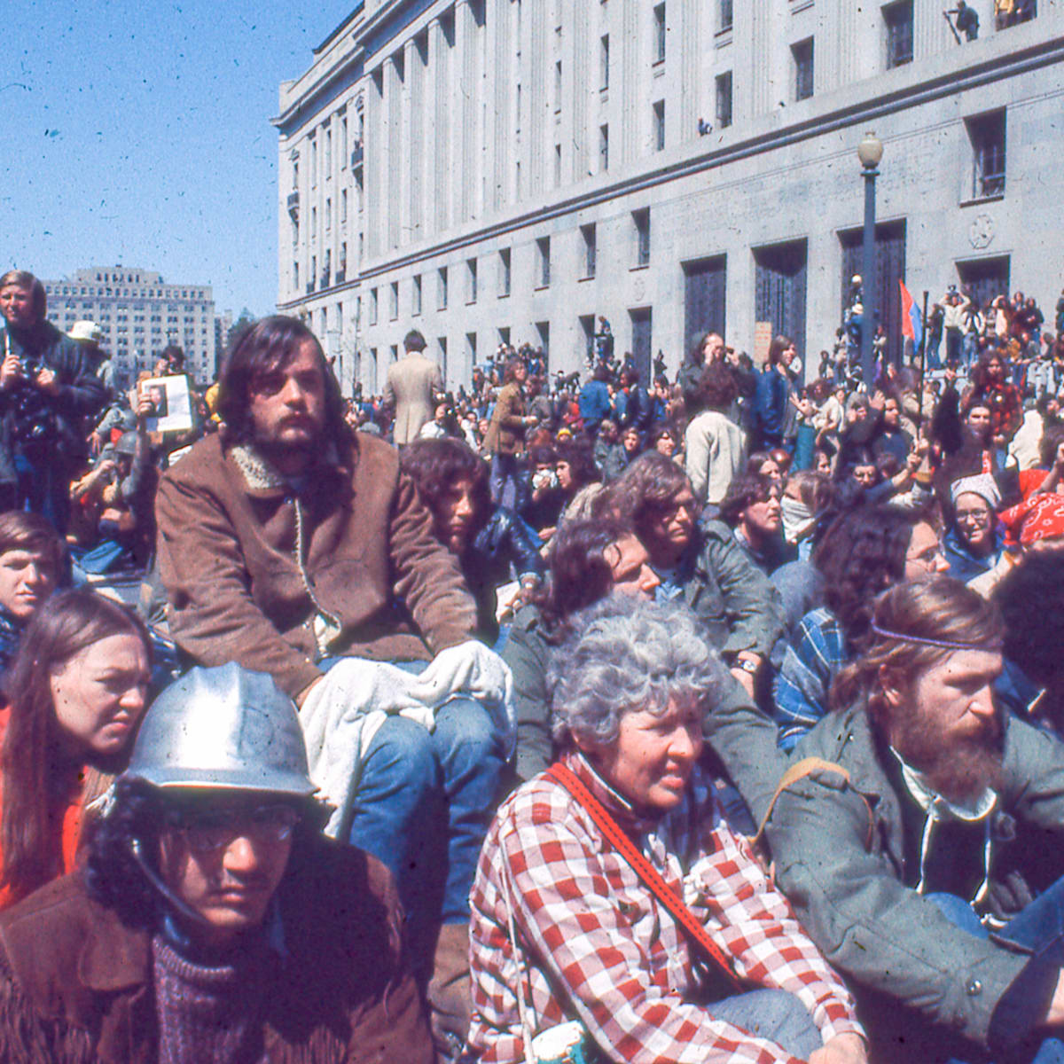
(b) Student Protests
After WW2 ended, there were a lot more Americans attending University compared to before WW2.
By 1970, nearly 40% of young people went on to Higher Education after leaving School.
The vast majority of those were white, middle-class students, whose parents expected them to think & behave like them … but they didn’t!
US Universities had been places for study, sporting & social life, but the 1960s saw them become radical centers for campaigning against injustices that existed in US Society.

Slide 11
(b) Student Protests
The 1960s + 1970s saw campaigns on civil rights for African-Americans, other ethnic groups, gay rights, women’s rights, poverty, US foreign policy, nuclear disarmament & environmental concerns. They joined existing groups like CORE + SNCC, but also set up their own activist groups to challenge their Government and their Colleges.
Students saw the elders in US Society as the enemy – their parents’ generation seemed corrupt, greedy & unfair in their attitudes towards others. “DON’T TRUST ANYONE OVER 30!” soon became a popular protest slogan. Students joined left-wing groups, interested in improving the lives of ALL citizens – demanding direct involvement of citizens in improving their own lives.
Conversely, some students rejected radical politics & supported the traditional, conservative attitudes towards education & Government … but their right-wing voices were drowned out by the more influential left-wing. New terminology for US Society grew in popularity – “THE MACHINE” + “THE SYSTEM” – and students felt that it needed repair.

Slide 12
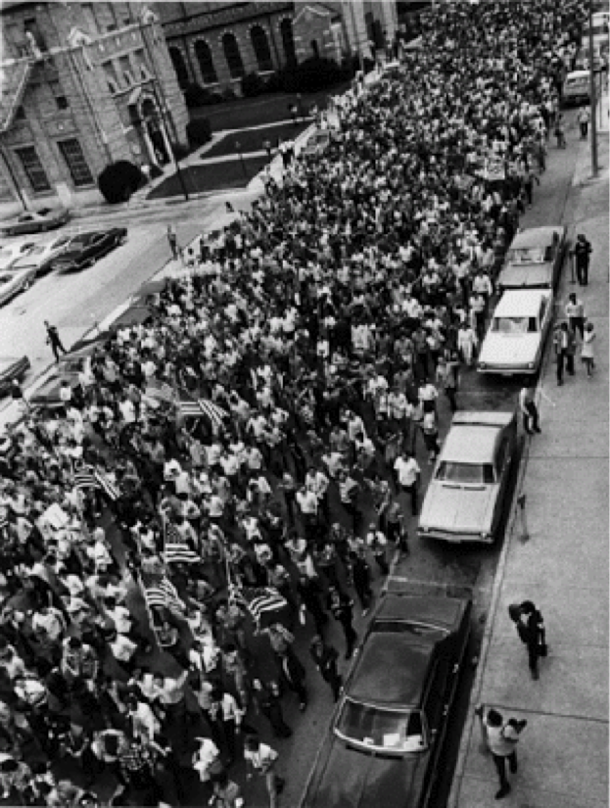
(b) Student Protests
STUDENTS FOR A DEMOCRATIC SOCIETY was one of the first protest organizations set up in 1960 in the University of Michigan. After a 1962 meeting, it put out the Port Huron Statement – outlining its aims against ‘racial injustice, war & the violation of human rights.’ This meant members took part in “Sit-Ins” at the end of the 1950s and “Freedom Rides” in the early 1960s. More importantly, the SDS campaigned for better student rights at Universities & Colleges. They pushed for more student input to rules & regulations and protested against Universities acting like parents; even enforcing curfews to return to accommodation! By the end of the 1960s, the small SDS had grown to include 150 Colleges & US Universities, with a membership of 100,000 students. This was to increase more dramatically in response to the Vietnam War.

Slide 13
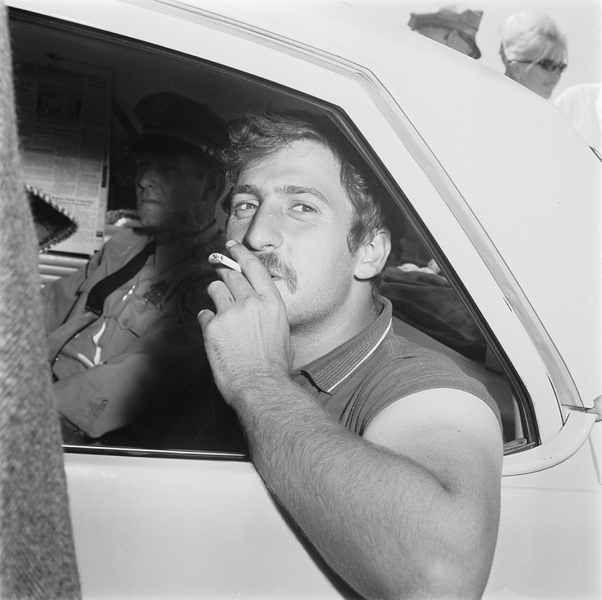
(b) Student Protests
BERKELEY FREE SPEECH MOVEMENT was another protest organizations started at the University of California in the autumn of 1964. Influenced by the Freedom Summer in Mississippi, the demanded an end to racial discrimination on the Uni. Campus. The Uni. Responded by banning all forms of protests on Uni. Grounds as “OFF CAMPUS POLITICAL + SOCIAL ACTION.” Students ignored the ban, continued protests & some got suspended. Police were called and, when they arrested JACK WEINBERG, the police car was blocked-in for 32 hours + made critical speeches against the Uni. More police were drafted to the Campus, but the students negotiated with the Uni’s President & the protestors dispersed. After this, the FREE SPEECH MOVEMENT was created, so that students could change rules about Campus protests.

Slide 14
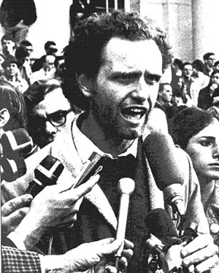
(b) Student Protests
BERKELEY FREE SPEECH MOVEMENT was led by Jack Weinberg & MARIO SAVIO and it contained conservatives, moderates & radicals. Leaflets were printed, rallies were held, badges were made & worn, Xmas cards were designed & sold – the FSM had 14,000 members at its peak (over half of all the Berkeley students) standing in solidarity with its aims & objectives. In Nov. 1964, however, the original protestors suspended were charged with breaching Uni. Rules. The FSM quickly organized a rally & sit-in at the Admin. Building on 2nd Dec. 1964; 6,000 students protested & the Police took 12 hours to arrest just 750 who refused to leave the building. Reluctantly, a few days later, University staff voted to permit protests of any kind on Campus. A victory for the FSM on the surface, but those arrested were convicted & fined. FSM leaders got sentenced to 1-4 months in jail.

Slide 15
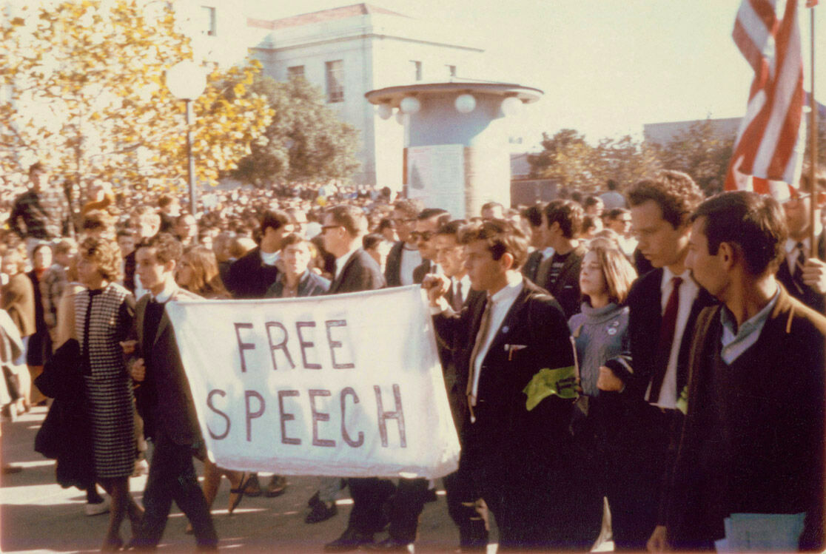

Slide 16
(b) Achievements of the Student Movement
Limited by the confrontational approach – the more radical ideas that were suggested, the less moderates could give their support to the protests.
Campus protests did not win-over local communities. Outsiders were appalled by the behavior of students & swear-words on signs saw moral outrage from those who may have supported the students – the FSM was soon seen to stand for the “FILTHY SPEECH MOVEMENT” in conservative eyes.
Student protestors were caricatured as troublemakers with nothing better to do than stir up civil unrest.
The vast variety of issued that students hoped to achieve diluted the overall message, so students never truly win mass societal support.

Slide 17
Exam-Style Question
Explain two effects of
the Student Movement
on the USA.
(8 marks)

Slide 19
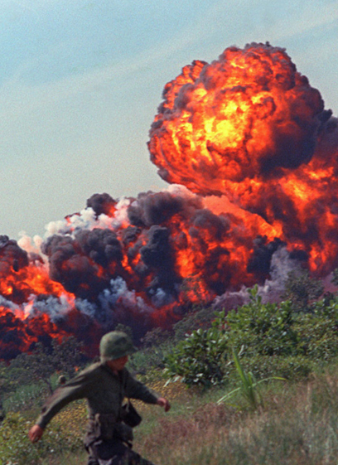
(b) Student Protests
The Vietnam War united the Student Movement like no other issue had. After JFK had increased US support for South Vietnam against the North Vietnamese Viet Cong fighters, LBJ went further and, in response to the Gulf of Tonkin attack on US gunboats in 1964, Congress gave him power to do “anything necessary” to protect US troops in Vietnam. 1965 started with US planes bombing North Vietnam & US troops landing in Vietnam to support South Vietnamese fighters. By 1969, 500,000 US soldiers were in Vietnam & fighting what seemed to be an unwinnable war in hostile jungles – where Viet Cong guerilla tactics were seeing the North clearly beating the South. Nixon pulled US troops out of Vietnam in 1973. 1975 saw the North seize the South … all the US effort in Vietnam had failed to stop a Communist victory & the fall of Saigon on 30th April 1975 was sickening for US society.

Slide 20
(b) Student Protests
Protests against the Vietnam War grew steadily in the mid to late 1960s & protestors objected to a variety of aspects of US policy in Vietnam:
HUGE COSTS OF US INTERVENTION IN UNWINNABLE WAR
DEATHS + INJURIES TO US TROOPS
SUPPORTING A CORRUPT SOUTH VIETNAMESE REGIME (ALBEIT ANTI-COMMUNISM)
ACTING LIKE AN IMPERIAL POWER, ENFORCING ITS WILL ON OTHERS
TACTICS IN VIETNAMESE JUNGLES – Operation “Rolling Thunder” saw bombs dropped irrespective of civilians & “Agent Orange” defoliants destroying jungle and crops.
UNFAIR DRAFT SYSTEM – Average age 19, but WW2 was 26. Poor white boys drafted as unlikely to go to College!

Slide 21
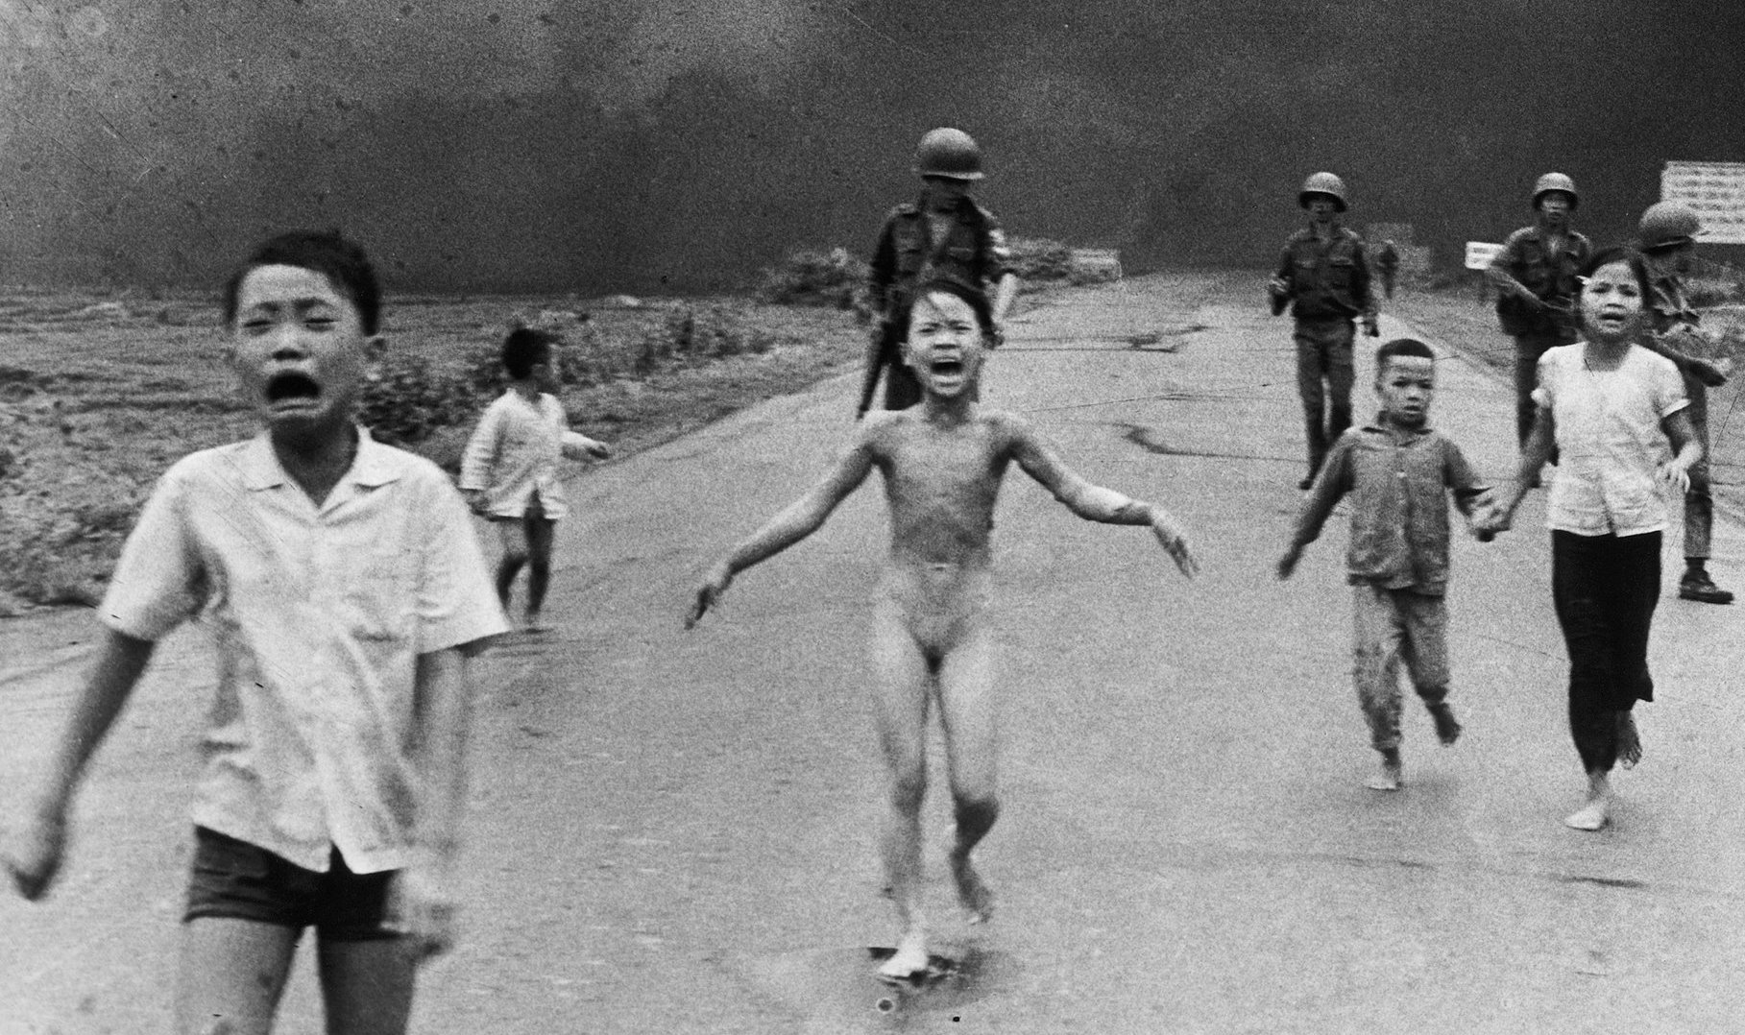
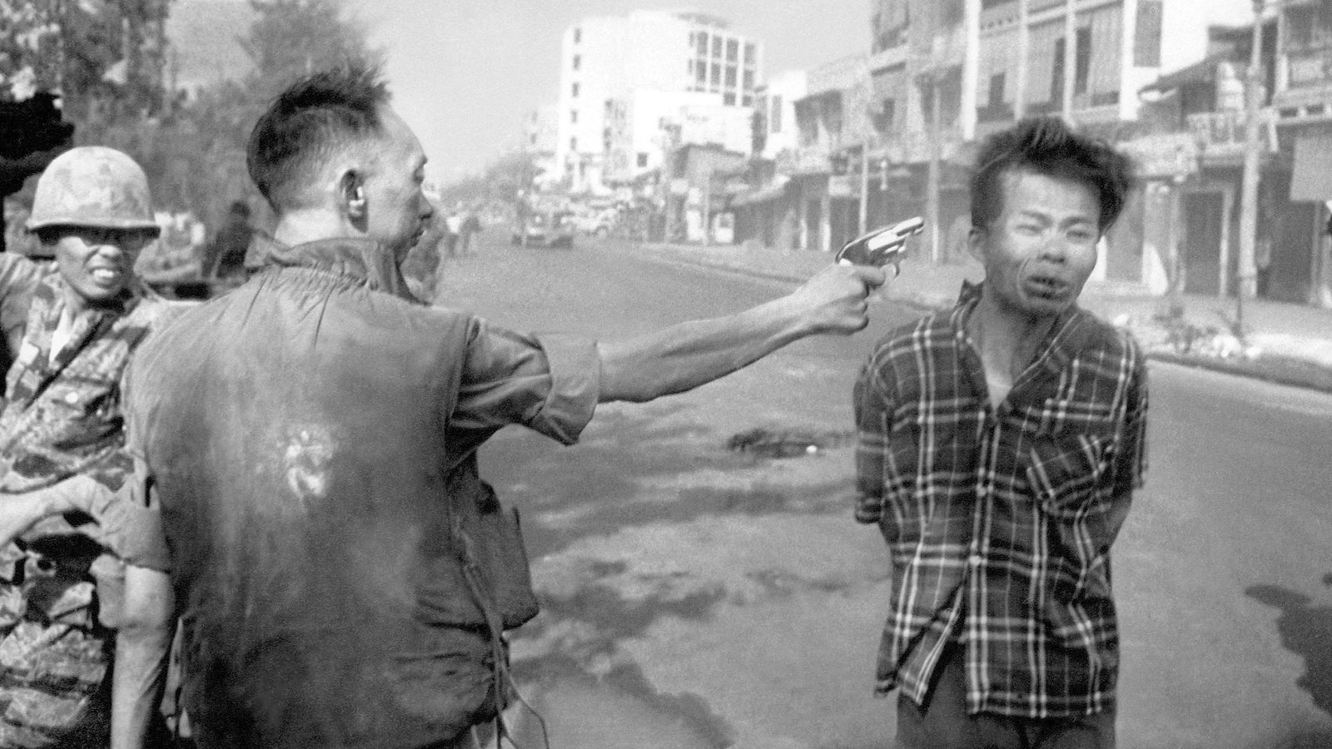
(b) Student Protests
By 1965, the anti-war movement was gathering support & Oct. 1965 saw the SDS publicly declare its opposition & membership rocketed. TV also played a huge role in creating opposition, as cameras were allowed to broadcast whatever they wished from the front lines – US tactics, even the dodgy ones, were broadcast live in the US and TV viewers were horrified at burning villages, injured & dying children, executions of Viet Cong leaders and demoralized US troops who wished to return home. Even older people joined the student anti-war movement; including outraged Veterans & Reservists who created “VETS FOR PEACE.”

Slide 22
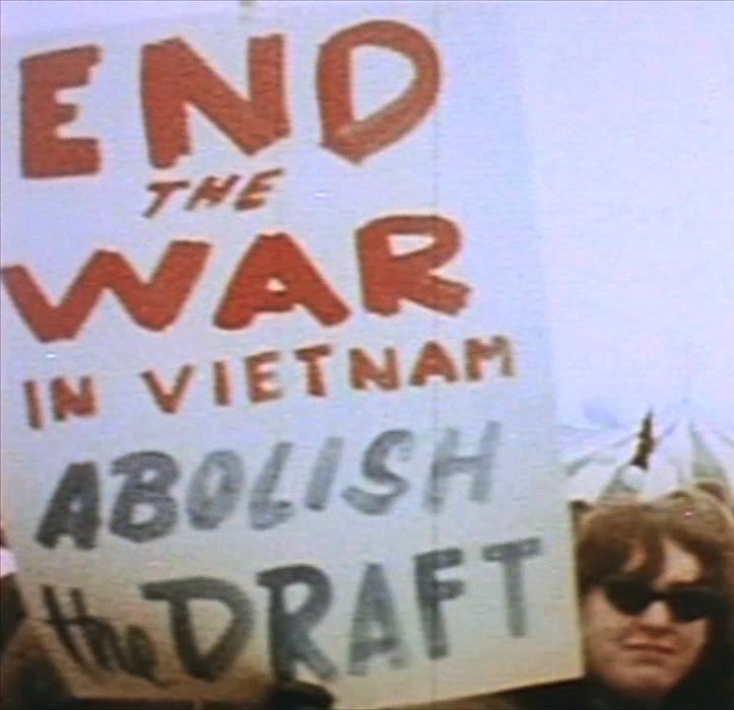
(b) Student Protests
METHODS OF PROTEST AGAINST THE VIETNAM WAR
Mass rallies were held, where chants against President Johnson included: “Hey, hey, LBJ, how many kids did you kill today?” & anti-drafters burnt drafts yelling “Hell, no, we won’t go!!” The US Commander of Vietnam, General Westmoreland was ridiculed as “Wastemoreland.”
“Sit-Ins” & “Teach-Ins” were held, where public lectures on the conflict occurred while occupying public buildings, army recruitment centers & even on railway tracks transporting troops to airbases ready to fly to Vietnam.
Supporting anti-drafters by hiding those who wished to avoid going to war or helping them leave the country to avoid being drafted.

Slide 23
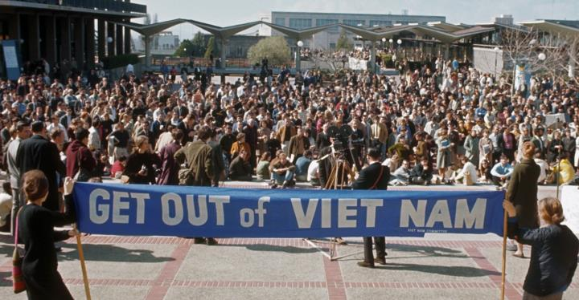

Slide 24
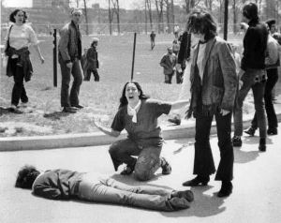
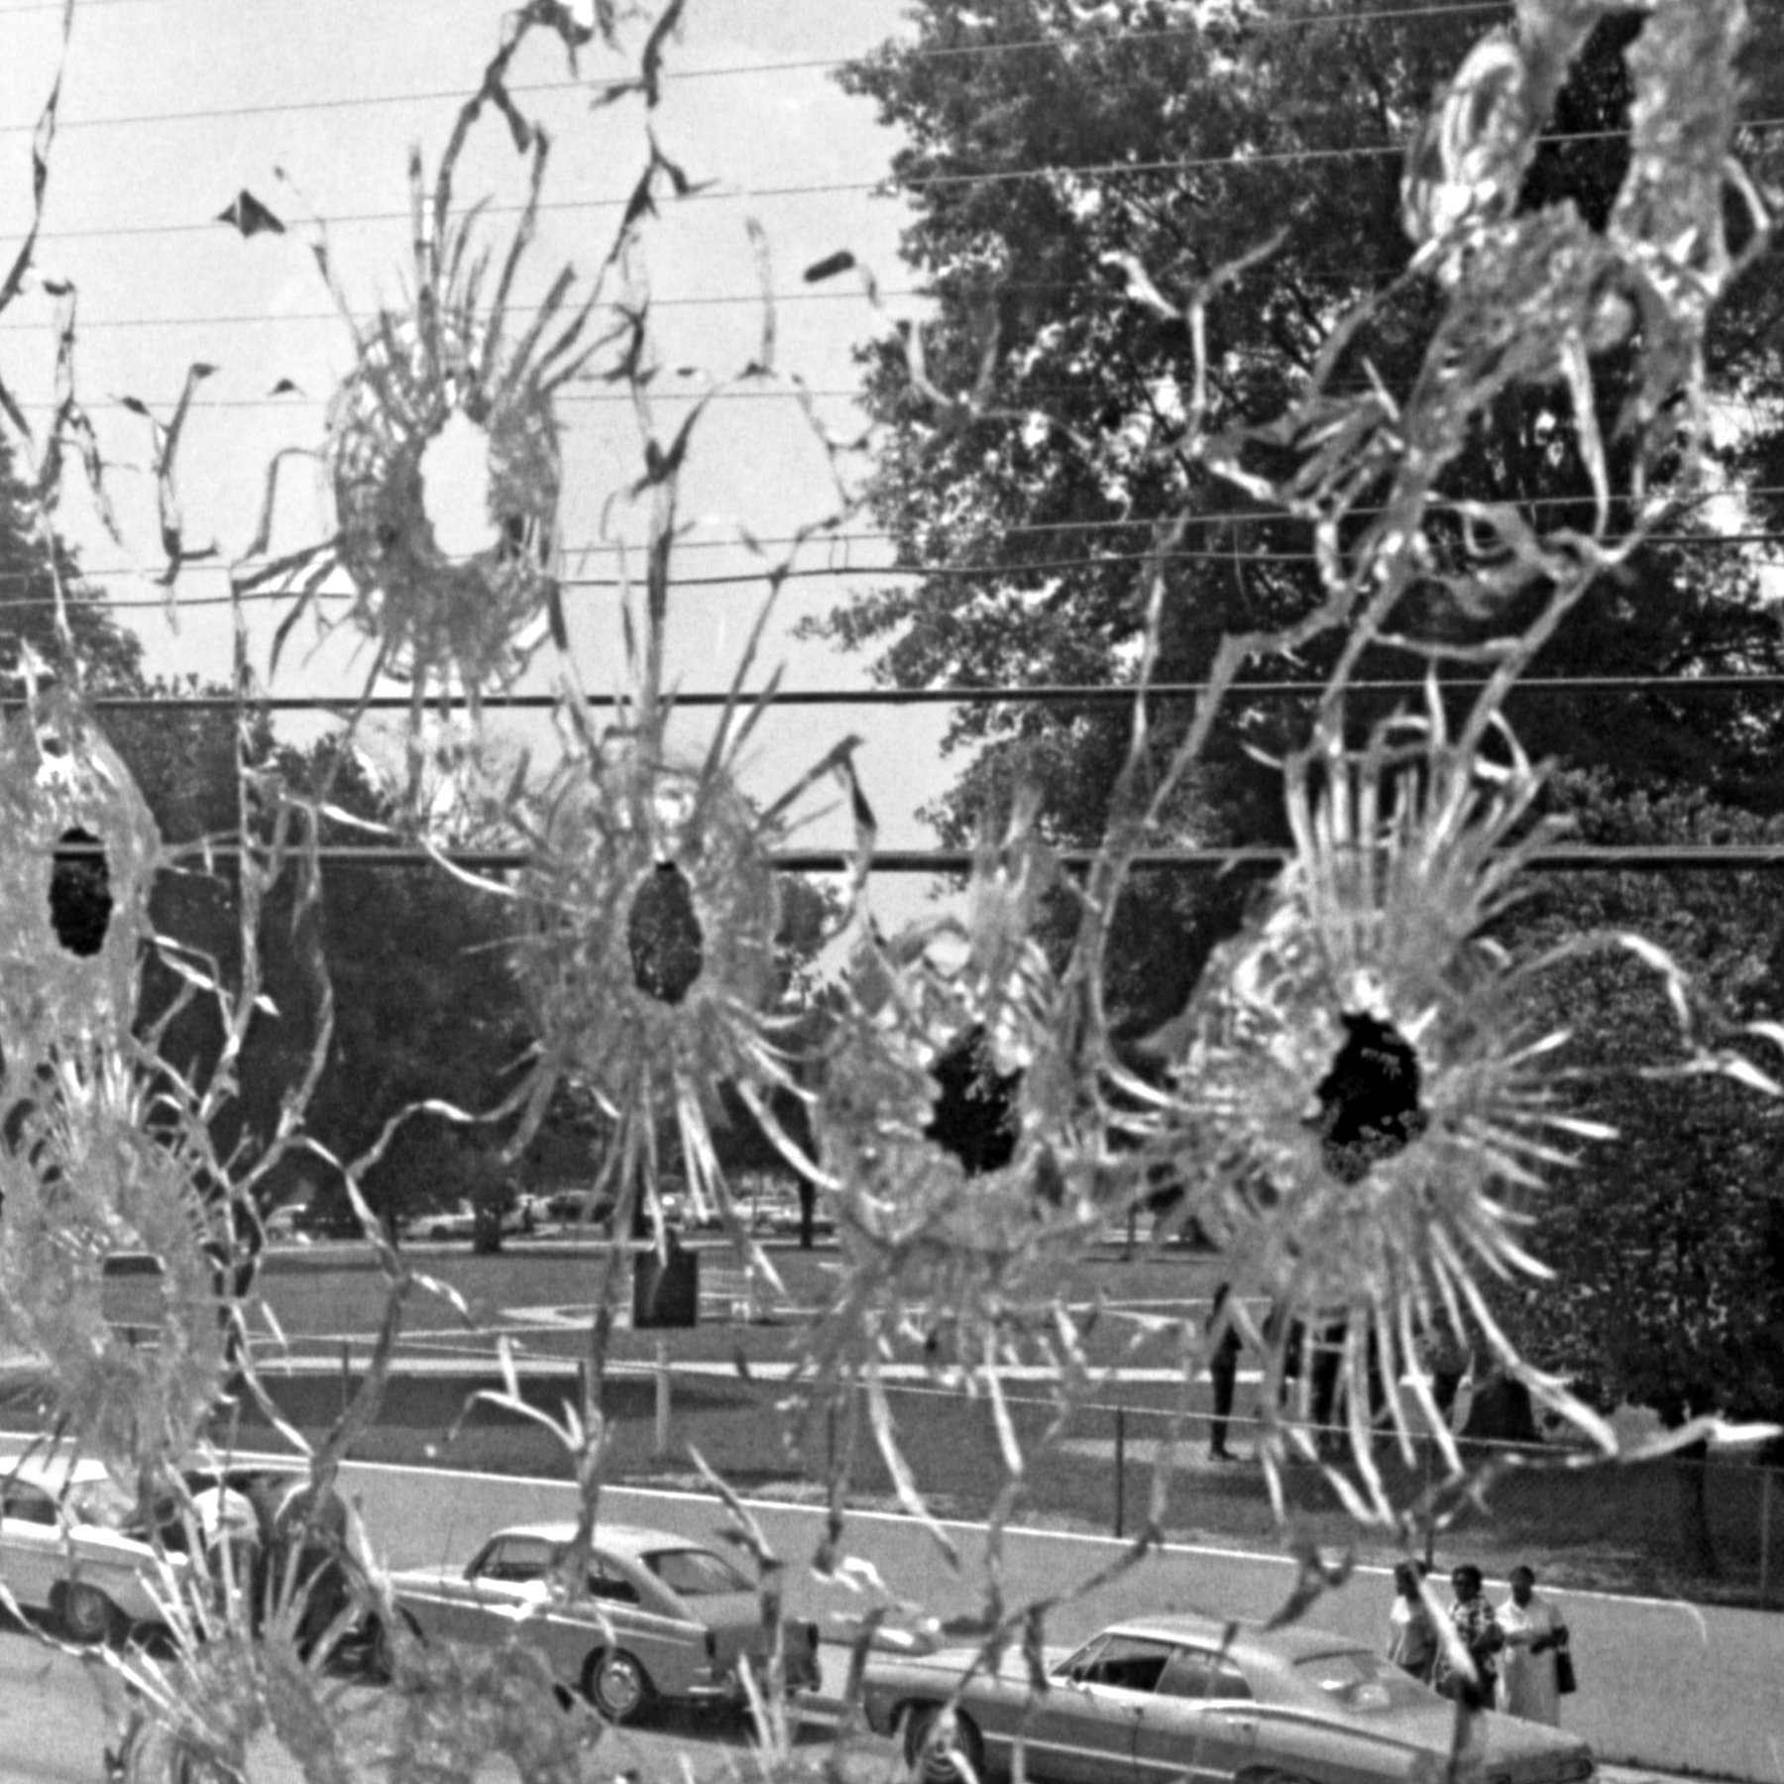
(b) Impact of Anti-War Protests
At their peak, 1968-1970, protests were seen as successful … even though the US remained involved in the Vietnam War. The largest protest was a March on Washington in Nov. 1969 with over 500,000 there.
Like most protests in the late 1960s, violence crept in & clashes with Police resulted. Kent State Uni, Ohio, saw a protest on 4th May 1970 where National Guards had to be sent in – tear-gas failed to disperse crowds of angry students, so troops fired at them & 4 were killed + 11 injured. Similarly, Jackson State Uni saw a protest 2 weeks after the Kent State Uni protest, where 2 African-American students were shot + killed by Police as they dealt with the protestors.

Slide 25
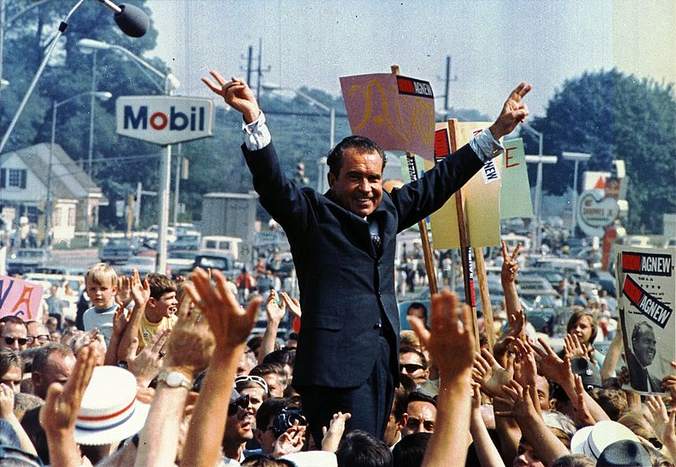
(b) Impact of Anti-War Protests
Society was certainly divided into those FOR the war & those AGAINST it. LBJ is believed, by historians, to have refused to stand for re-election in 1968 due to the pressures of protests after ordering “Rolling Thunder”. Nixon, historians also believe, was elected instead of LBJ as a result of the Vietnam War – as was ‘Vietnamization’ a product of protests. Most believe the US would have withdrawn without the pressure from protestors.
Support for the protestors was not overwhelming & some in Society saw them as unpatriotic – especially the flag-burners, pro-Communist & pro-North Vietnam set. Nixon reckoned the “US Silent Majority” just supported his policies & did not protest. Opinion Polls proved him right; they showed that more people approved than disapproved of ‘Vietnamization.’

Slide 26
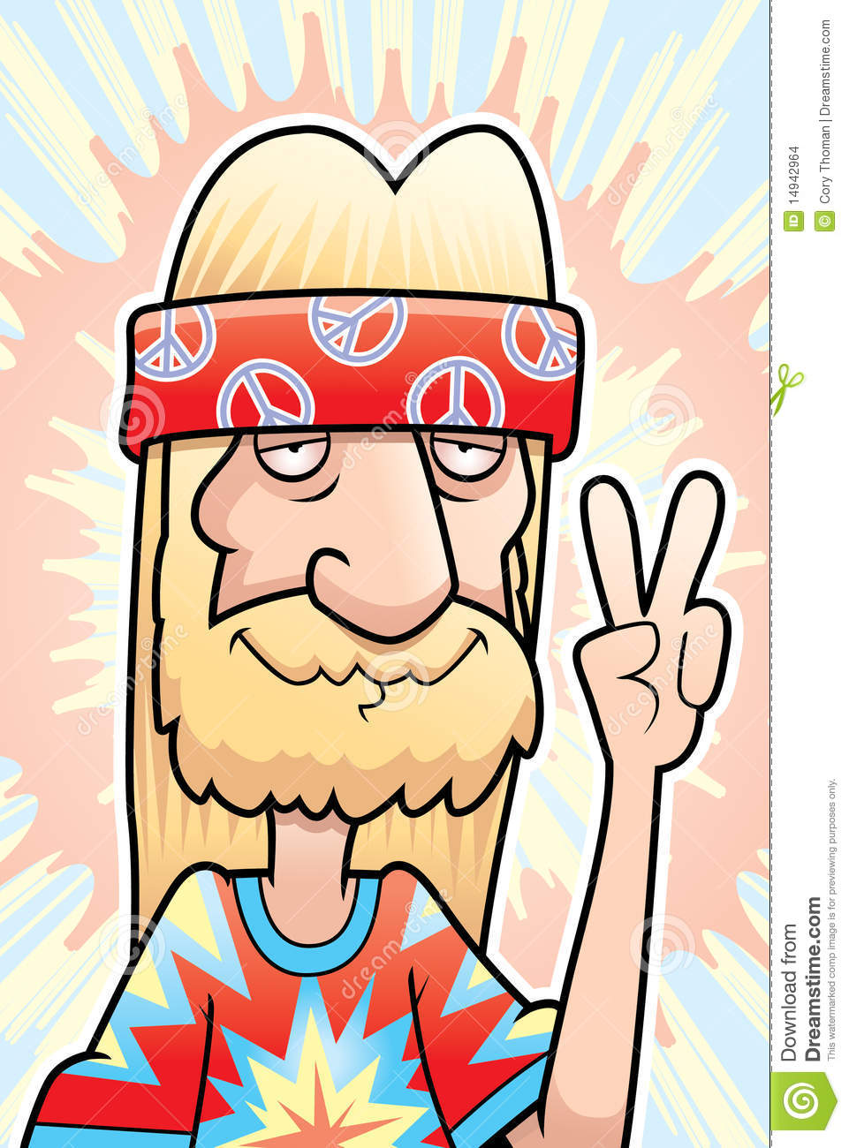
(b) Hippies
Alongside student protests & anti-war protests, some chose to “drop out of society” & reject the constraints of the USA. Hippies chose not to work & not to go to College. Many set up Communes, in cities like San Francisco, while other Hippies travelled around & lived out of buses or vans. The Hippy counter-culture was in opposition to traditional US Society & had moral codes centered around peace, love + happiness. Hippy slogans included “MAKE LOVE, NOT WAR” & “IF IT FEELS GOOD, DO IT.” They experimented with sex, drugs & art-forms, esp. music. The Woodstock Music Festival in Aug. 1969 saw 500,000 people gather together to share Hippy ideas to the sound of Rock. Hippies had long, un-styled hair & wore colorful clothes & jewelry. Nakedness was encouraged, weather permitting. Hippies handed out flowers to Police & soldiers as “flower children.” They were not passive, however, campaigning passionately for civil rights, women’s rights & organizing anti-war campaigns. On Environmental issues too.

Slide 27
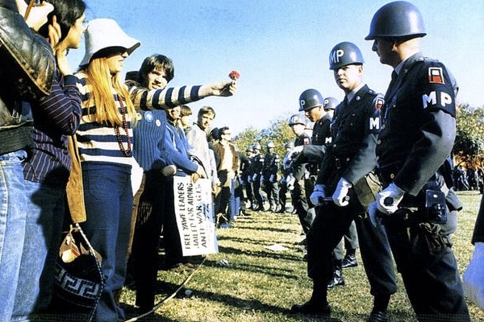

Slide 28
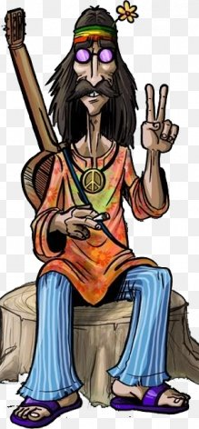
(b) Impact of Hippies on USA
US Society was largely shocked by the Hippies. They were seen as ‘wasters’ & parents could not understand why their children wished to reject the society THEY had secured in 2 World Wars.
Hippies were seen as corrupting the country & harming America overall.
Unsurprisingly, Hippies had little impact on Government policies – existing in their own world outside US Society.
In the long term, however, the Hippies had a lasting impact – wearing unusual clothes, listening to Rock music + experimenting with drugs are integral to youngsters’ own counter-culture. Ideas of equality, individuality & tolerance towards all (no matter what their sexuality, race or gender) are the foundations of modern freedoms.

Slide 29
‘Because of hippies’ sexual openness, alternative lifestyles such as homosexuality & transsexuality are generally more accepted. Young adults have become more sexually active at a younger age because of the influence of past generations. Overall, the hippie movement was a time of not only exploring oneself & rebelling against society, but it was also a time of acceptance. After the hippie movement, African Americans, working women, homosexuals, nudity & non-traditional apparel became generally more accepted. Without the hippie movement, the USA would not be as free & adoptive as it is today. The 1960s was a highly influential time & the hippies were highly influential people.’
From a modern article about the cause & effect of the 1960s hippies
What impression does the author give about the impact of hippies on the USA? (6m)

Slide 31
(c) The Women’s Movement
WW1 & WW2 expanded the female job opportunities & increased women within the workforce.
By 1960, however, most Americans believed a woman’s primary role was home-making.
Married women were expected to give up their jobs & stay at home raising children.
Some US Companies even dismissed female employees once they wed.

Slide 32
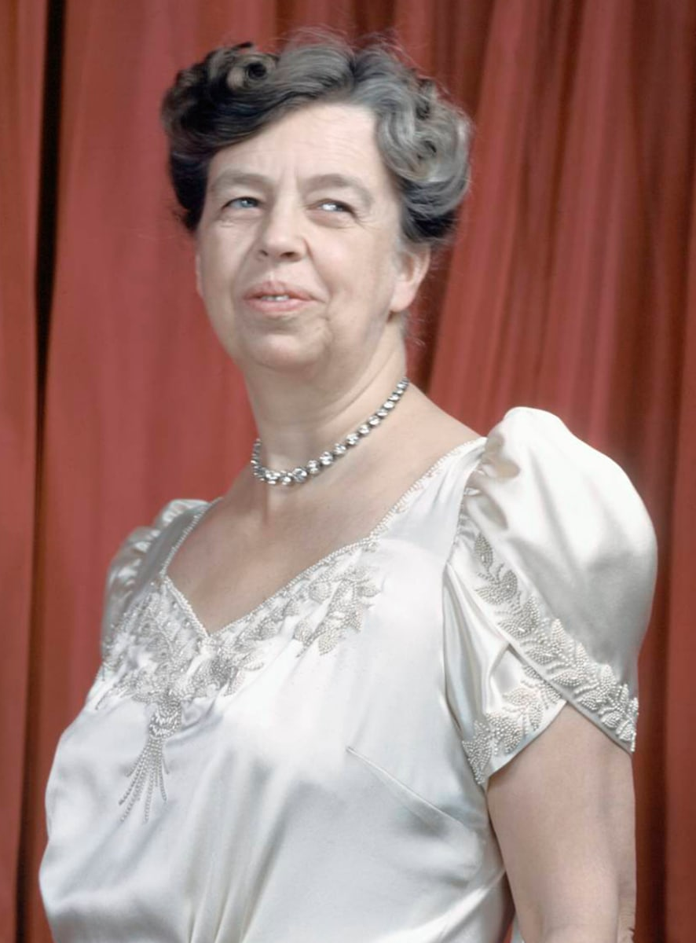
(c) The Women’s Movement
ELEANOR ROOSEVELT
The First Lady of President FDR was an influential campaigner for improved rights & opportunities for women, 1933-1962. She was the first President’s wife to hold her own press conferences + allowed only women to attend them; forcing the newspapers & radio-stations to employ female journalists! She undoubtedly helped increase support for women’s rights & ushered in legislation for greater equality.

Slide 33
(c) The Women’s Movement
ELEANOR ROOSEVELT
She also influenced the Democratic Party; agreeing to support JFK as a Presidential candidate, only if he set up a Commission on the status of women if he was successful. True enough, he created the President’s Commission on the Status of Women in 1961 & made Mrs. Roosevelt the first Chair. She died before her first Report, but it highlighted huge inequalities & found women were almost exclusively in low-paid unskilled jobs. Only 4% of lawyers were women & 7% of doctors were women.

Slide 34
(c) The Women’s Movement
ELEANOR ROOSEVELT
The Report also found that women earned 50% to 60% of what men earned doing the same job & few women ever progressed in their career.
As a result of the shocking statistics being published in the Commission’s Report, the EQUAL PAY ACT was signed by JFK in June 1963 – it made it illegal to pay people different rates for the same job.
The Civil Rights Act, 1964 also made it illegal to discriminate on grounds of gender.

Slide 35
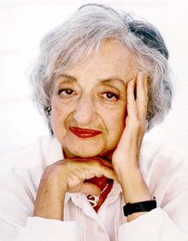
(c) The Women’s Movement
BETTY FRIEDAN
Some historians claim that Mrs. Roosevelt was eclipsed in influencing the women’s movement by journalist & author of ‘The Feminist Mystique’, Betty Friedan. Published in 1963, her book baulked at the idea that women found satisfaction at home & as housewives. At a College reunion in 1957, Friedan had asked fellow female graduates if they were happy in their lives and ‘The Feminist Mystique’ was the result of the negative responses.

Slide 36
(c) The Women’s Movement
BETTY FRIEDAN
According to Friedan, women’s homes were “COMFORTABLE PRISON CAMPS” and she encouraged women to escape & find new happiness in paid employment. The book was an American bestseller & inspired many women to pursue equal political, economic & social rights. It also empowered women to no longer be satisfied with with being seen as suitable for low paid unskilled jobs.

Slide 37
(c) The Women’s Movement
NATIONAL ORGANIZATION FOR WOMEN
Betty Friedan & other feminists set up N.O.W. to enforce the clear equality guaranteed in the Equal Pay Act, 1963 & the Civil Rights Act, 1964. As NOW’s first President, Betty Friedan led its first conference in 1967, where a Bill of Rights was drawn up.

Slide 38
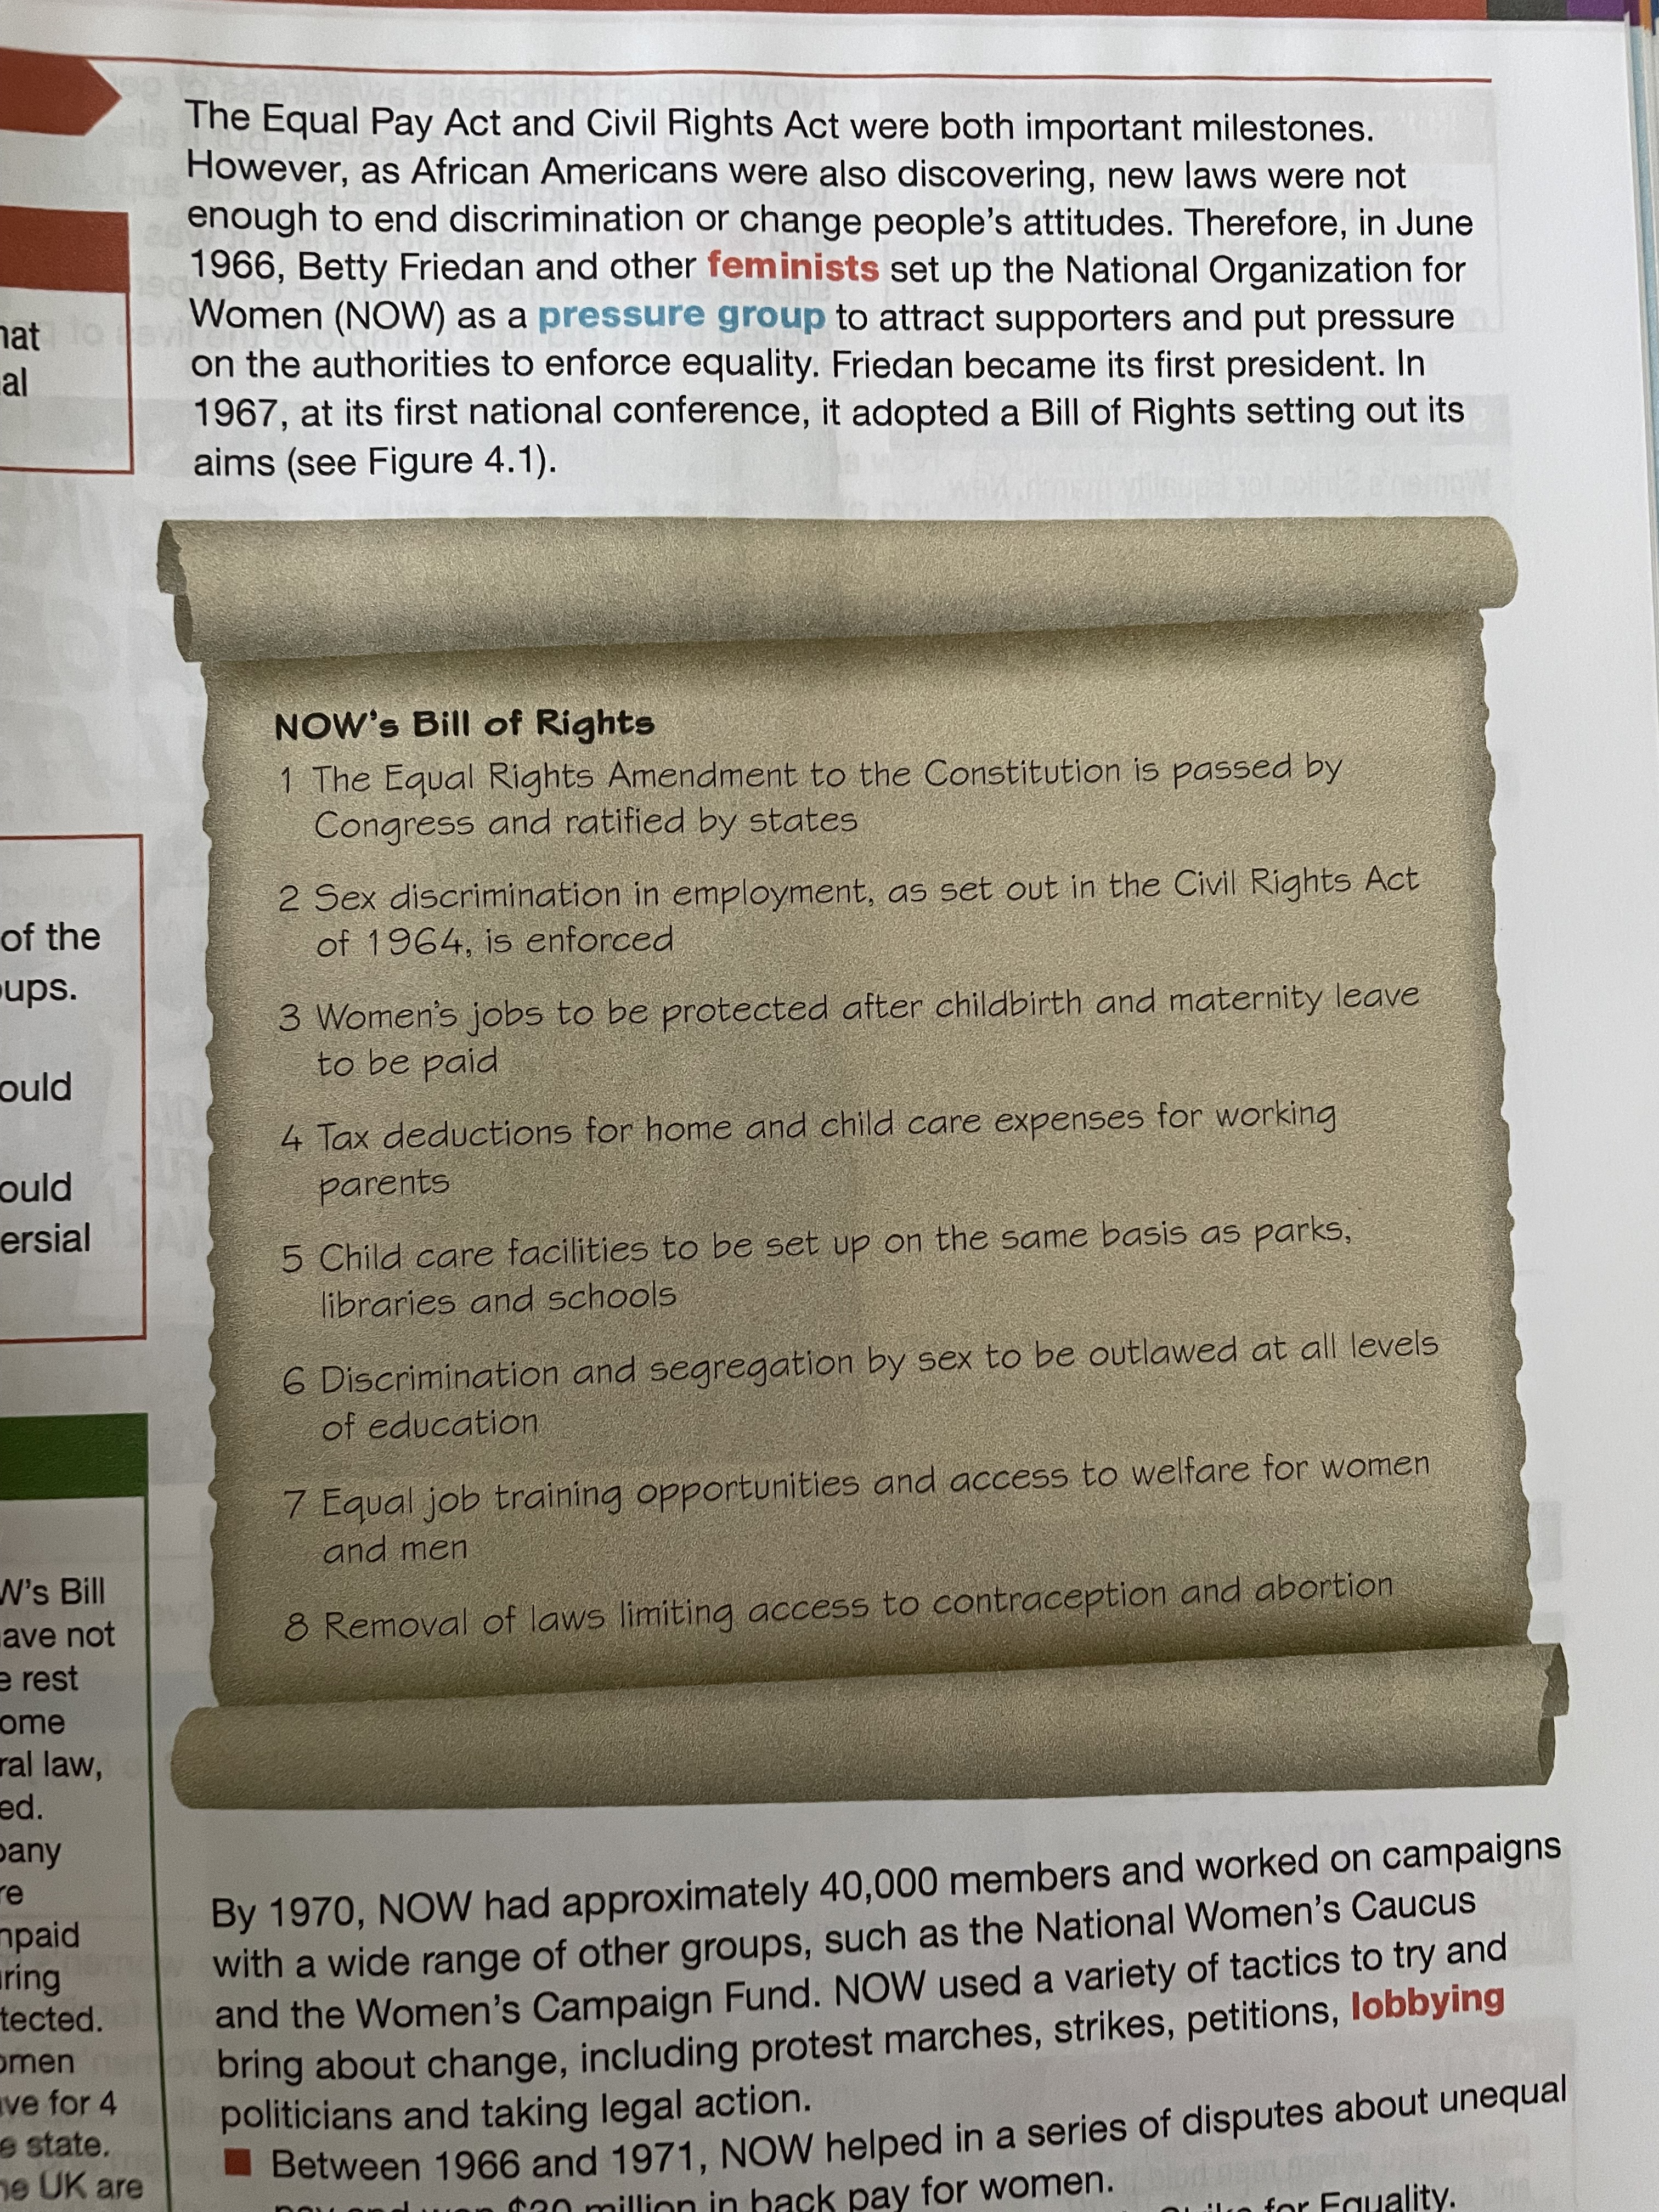

Slide 39
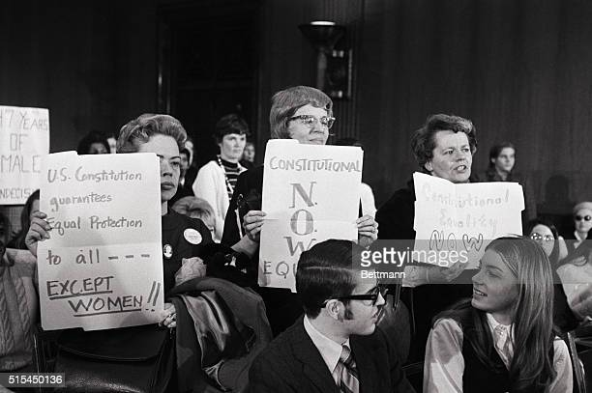
(c) Impact of N.O.W.
By 1970, NOW had 40,000 members driving campaigns & establishing groups like the National Women’s Caucus & the Women’s Campaign Fund. They used a variety of tactics to bring about change: marches, strikes, petitions, lobbying politicians & taking legal action in Courts.
1966-1971 NOW helped in a series of pay disputes over unequal pay & won over $30,000,000 in back-pay for women.
Feb. 1970, NOW members disrupted a Senate debate – demanding that the Equal Rights Amendment be discussed & passed.

Slide 40
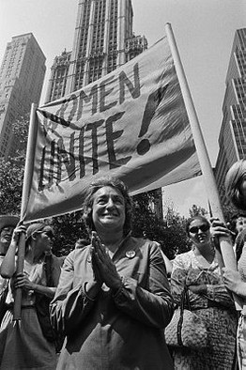
(c) Impact of N.O.W.
26th Aug. 1970 NOW organized the Women’s Strike for Equality – thousands of women across the USA went on strike to highlight unequal pay & discrimination in workplaces. New York’s Fifth Avenue saw the largest protest march of 50,000 participants.
NOW increased awareness of the gender inequality in the USA + inspired women to challenge the system. There were critics, however, due to it being too radical and, controversially, supporting abortion rights. Moreover, NOW supporters were often middle-class or upper-class women, so some argued NOW did little to help the lives of poor working-class women.

Slide 41
Exam-Style Question
Explain two effects of
the Women’s Movement
on the USA.
(8 marks)

Slide 43
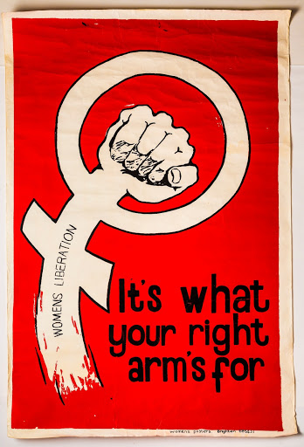
(c) The Women’s Movement
WOMEN’S LIBERATION MOVEMENT
While NOW existed as a moderate group for the promotion of women’s rights within society, family units & marriage, a much more radical organization was WOMEN’S LIB. These were feminists who sought to destroy the traditional system of the ‘Patriarchy’ to “LIBERATE” or free women from their patriarchal limitations. Most Women’s Lib supporters saw men as the enemy & some believed that lesbians were the only women in Society who were truly liberated.

Slide 44
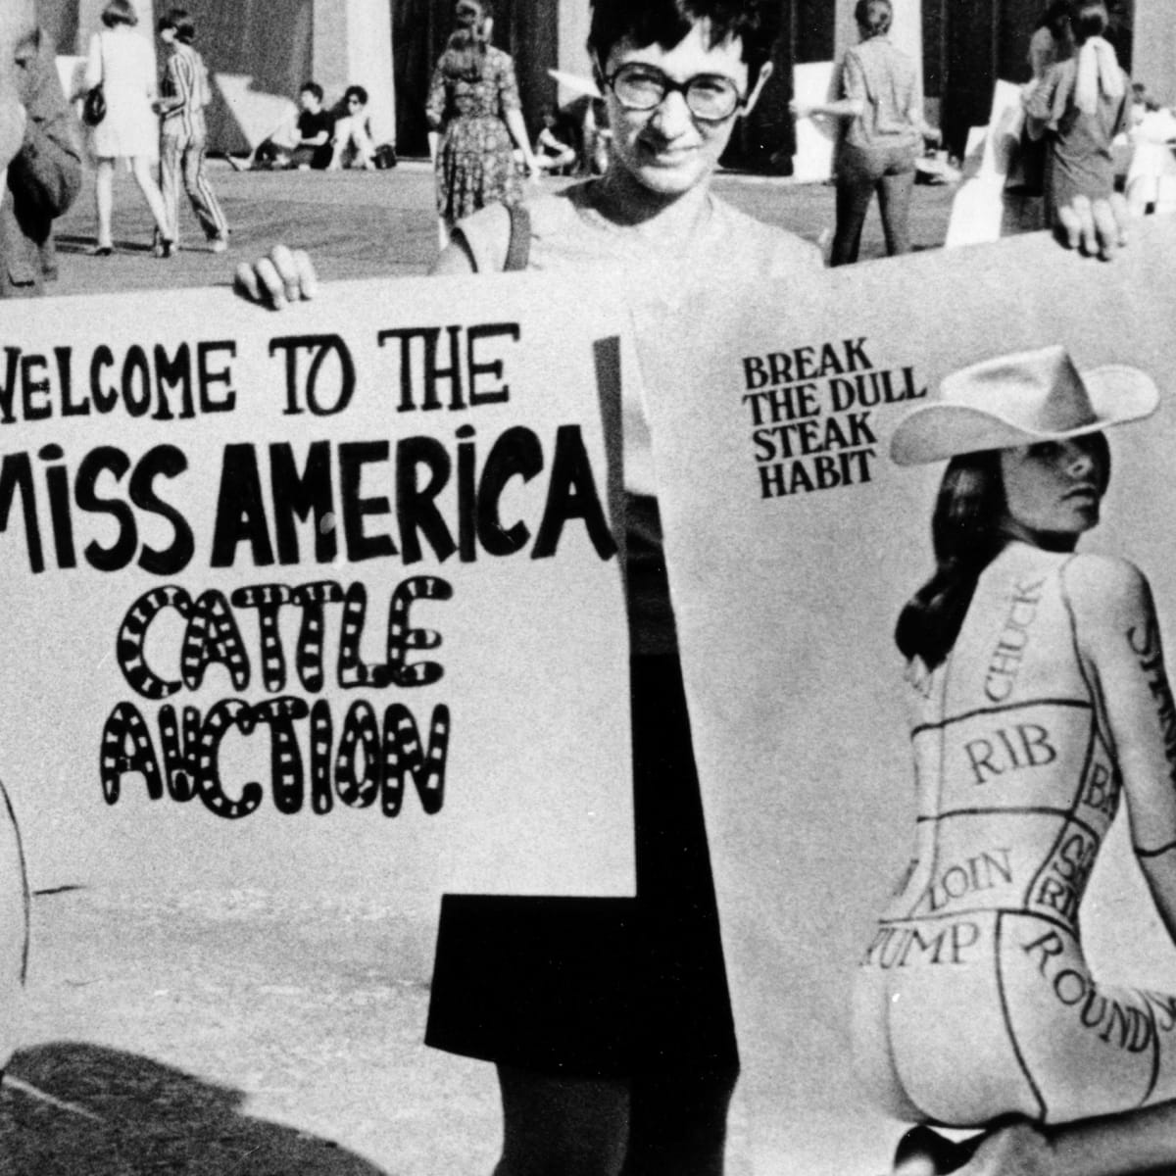
(c) The Women’s Movement
WOMEN’S LIBERATION MOVEMENT
Protests by Women’s Lib groups were noticeably different to those of NOW; they were more aggressive (holding “Sit-Ins” of offices creating sexist adverts) & they famously interrupted the 1968 Miss America Contest in Atlantic City – holding up placards, giving out leaflets, binning products promoting Beauty + crowned a sheep Miss America! Unfortunately, almost all media coverage was negative … portraying protestors as jealous uglies.

Slide 45
(c) The Women’s Movement
WOMEN’S LIBERATION MOVEMENT
After the 1968 Miss America affair, Women’s Lib changed tactics – it started helping more women at a local level & set up support groups to share experiences of sexism at work, in education & in relationships. This was far more effective & meant individuals began to express ideas that could be replicated across America – how women dressed, how women were seen & how they were treated – and the personal became political. More importantly, 1974 saw Women’s Lib groups helping women with issues like rape & domestic violence, preventing suicides through support.

Slide 46
(c) The Women’s Movement
ABORTION
In 1960, abortions were illegal throughout the USA, unless the mother’s life was at risk by her pregnancy. NOW & WOMEN’S LIB campaigned for abortions to be made legal. They argued that it was a woman’s right to choose what happens to her body & it was unfair to force a woman to have a child she doesn’t want. They also highlighted that illegal “back-street” abortions were occurring anyway, by unqualified people + increasing the dangers. Protestors held marches & rallies where women took part in “SPEAK-OUTS” – telling audiences their experiences of illegal abortions, giving reasons for them & justifying them under current legal constraints.

Slide 47
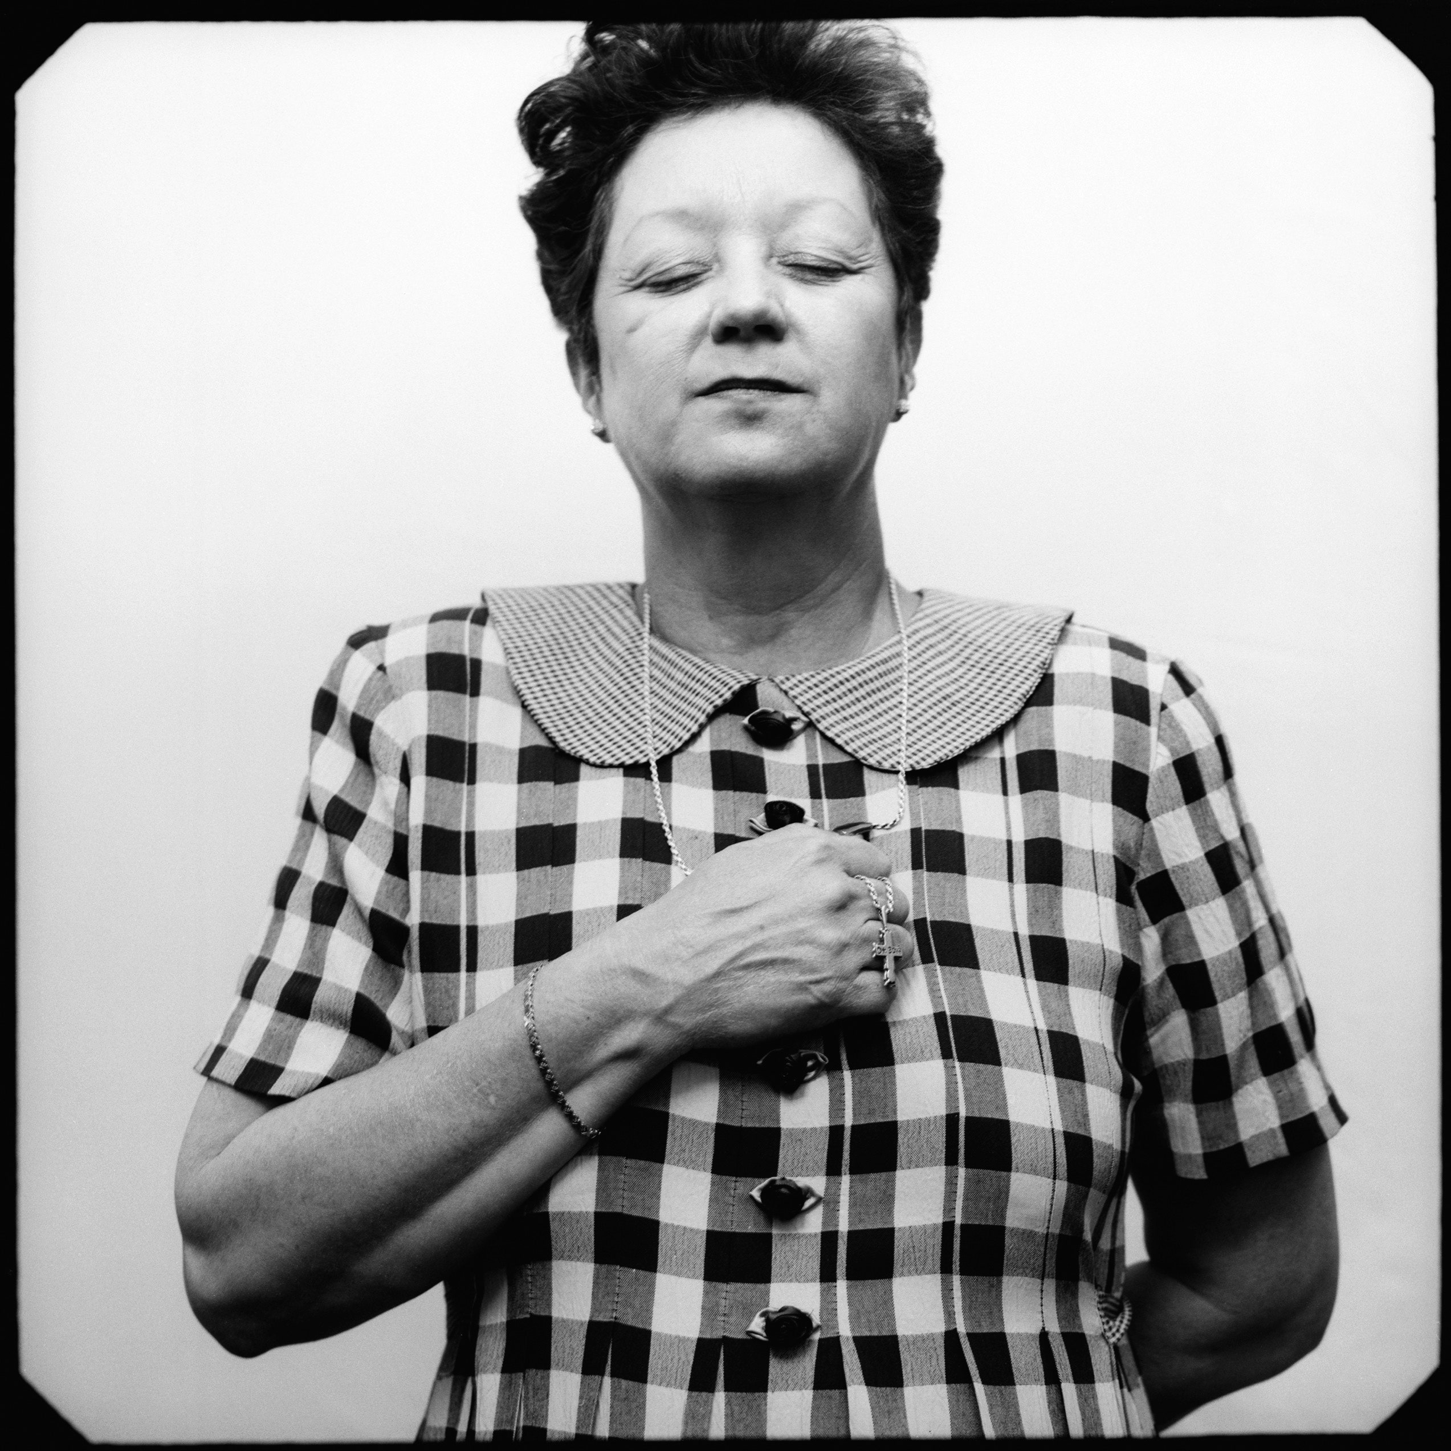
(c) The Women’s Movement
ROE v. WADE, 1973
In 1970, Norma McCorvey (under the name Jane Roe) took the Dallas D.A. (Henry Wade) to Court in a claim to have the right to an abortion. She already had 2 children, she’d adopted away, so a third child was unwanted also. Roe’s case was successful, but the Dallas Court ruled this was a one-time-only-deal (not a new precedent) – but Roe’s legal team then appealed to the Supreme Court. On 22 Jan. 1973, the Supreme Court voted by 7:2 to rule that abortion laws broke a woman’s 14th Amendment right to privacy & freedom of choice. Certain limitations were imposed (6 months, if mother in danger) but abortions became more available across the USA.

Slide 48
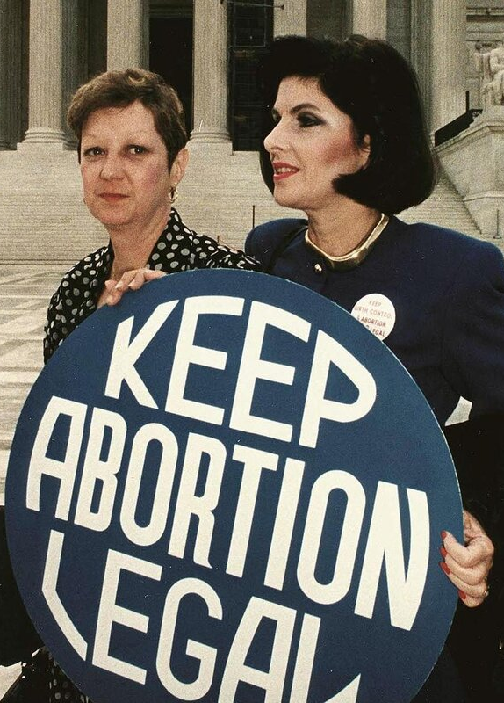
(c) The Women’s Movement
ROE v. WADE – THE AFTERMATH
Campaigners did have some effect on abortion laws and, by 1974, New York State changed their law to permit abortions up to the 24th week of pregnancy.
Alaska, California, Hawaii, Oregon & Washington passed similar laws shortly after.
NOW & WOMEN’S LIB began to loan women the funds to travel to these 6 States for “legal abortions”, yet the vast majority of US States remained against any legal abortions, except when the mother’s life was endangered.

Slide 49
‘The decision in the case of Roe v. Wade was a landmark in the history of the pursuit of women’s rights … For the traditional defenders of home & family, it struck at the root of what they held most dear. It was almost the most controversial, as well as the most significant event, since it was underpinned by arguments relating to a woman’s right to control her own body & to make decisions on child bearing.’
From a modern book on Civil Rights, published in 2009
What impression does the author give about the Roe v. Wade decision? (6m)

Slide 51
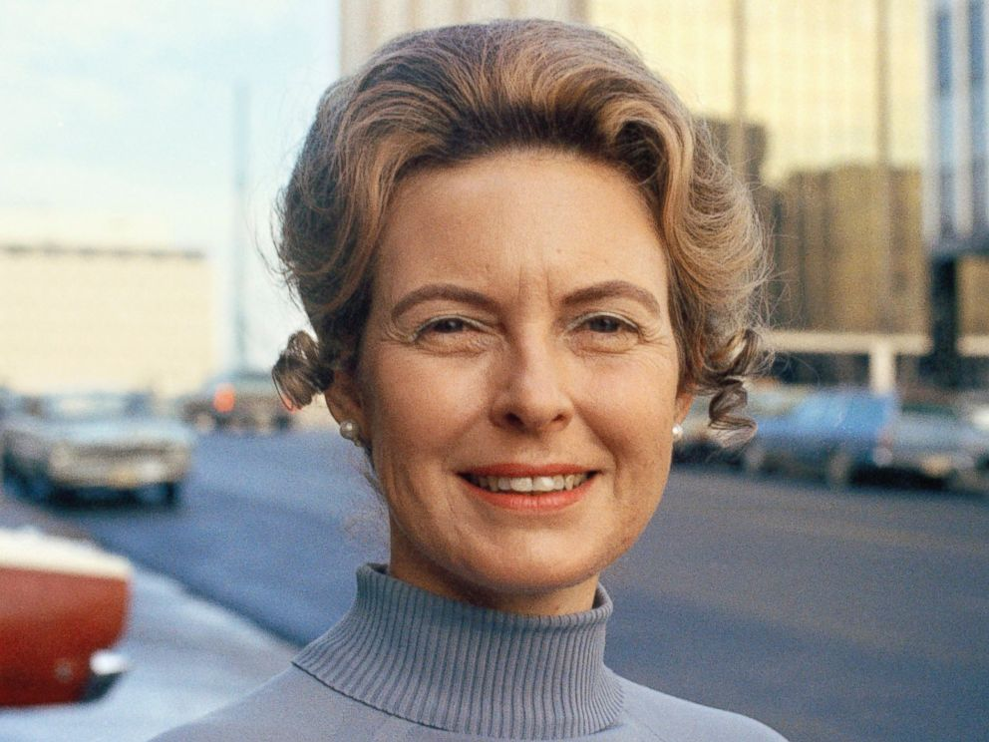
(c) The Women’s Movement
PHYLLIS SCHLAFLY
Men & women reacted differently to the Women’s Movement. Some were sympathetic supporters; some suspicious & cynical; many more were critical & coverage in the media ridiculed protestors & their cause. Some objected to the movement’s rejection of traditional gender roles (men as ‘protectors’ & women as ‘natural housewives’) or opposed campaigners as feminist lesbians or women too ugly to actually secure a husband! Abortion demands were also a step too far.
ANTI-FEMINISM emerged & Phyllis Schlafly was its dynamic leader.

Slide 52
(c) The Women’s Movement
PHYLLIS SCHLAFLY
A conservative & Catholic mother of 6 children, politically active since 1950 & stood for Congress in 1952, Schlafly pushed the idea that motherhood was what Nature intended for women. Abortion, she argued, was against God & against Nature. Her fierce speeches & vitriolic writings convinced many ordinary women to reject the NOW & WOMEN’S LIB cause and to join the ever-growing Anti-Feminist cause.

Slide 53
(c) The Women’s Movement
THE EQUAL RIGHTS AMENDMENT
The ERA would mean women be treated as totally equal under the US Constitution. It had been put before Congress repeatedly since 1923, but was only passed in 1972. Schlafly founded “STOP ERA” to prevent the Amendment being ratified in States – she campaigned tirelessly all over the USA, thus successfully delaying ratification to its 10-year time limit in 1982. In 2016, the ERA has still not become US Law, so men & women remain unequal under the US Constitution. Virginia was the last State to ratify the ERA in 2020 … 40 years too late to see it added to the USC!!

Slide 54
(c) Impact of the Women’s Movement
Moderate feminists argue WOMEN’S LIB damaged the movement’s fair pay & work discrimination aims by focusing on Abortion.
1972 Educational Amendment Act made sexual discrimination in education illegal & Institutions had to regulate who & what was taught.
1974 Equal Credit Opportunities Act made it illegal to refuse credit based on gender, so more women could buy homes, finance education & start businesses.
The range of jobs did expand in the 1970s, as most households required 2 wages … but just how far the feminists (not economics) influenced this is up for debate.

Slide 55
(c) Impact of the Women’s Movement
TYPES OF WORKER | 1950 | 1960 | 1970 | 1980
All Women | 28% | 33% | 38% | 44%
White Collar | 40% | 43% | 48% | 55%
Professional | 40% | 38% | 40% | 46%
Managerial | 14% | 14% | 17% | 28%
Clerical | 62% | 68% | 74% | 81%
Sales | 34% | 37% | 39% | 49%
Private Houses | 95% | 96% | 96% | 97%

Slide 56
Exam-Style Question
‘The extremism of the Women’s Liberation Movement was the main reason women failed to bring full equality for women.’
How far do you agree?
You may use the following in your answer:
Television
The Civil Rights Movement
You must also use information of your own.
(16 marks)

Slide 59
Unit 4 Recall Quiz
Give 3 aims of student protests, except for ending the Vietnam War.
What was SDS?
What was the Berkeley Free Speech Movement campaigning for?
Name 2 leaders of the Berkeley FSM.
Give 3 reasons why many young people protested against the Vietnam War.

Slide 61
Unit 4 Recall Quiz
What methods did the anti-Vietnam War movement use to protest?
Who were the Hippies?
What was the name of Betty Friedan’s book that historians believe began the women’s movement?
What does ‘feminist’ mean?
Who was Phyllis Schlafly?

Slide 63
Edexcel IGCSE History P1: Depth Study 7
A Divided Union: Civil Rights
in the USA, 1945-1974
5. WATERGATE – Nixon & Ford

Slide 64
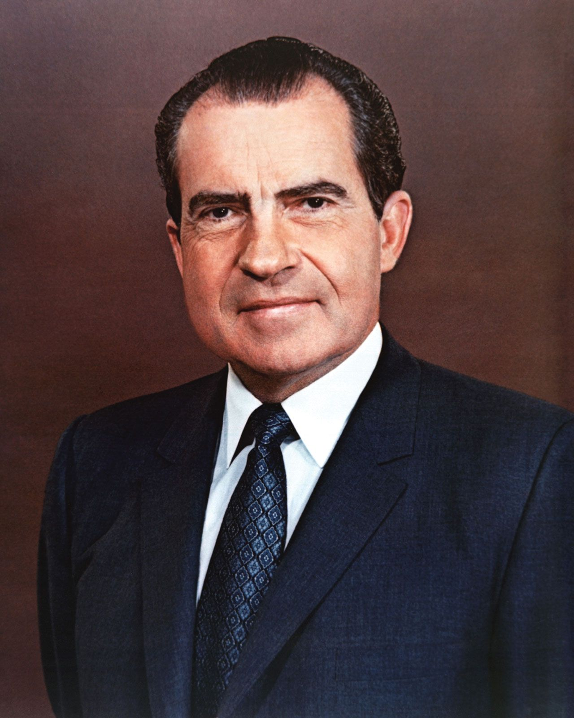
(a) Watergate
PRESIDENT NIXON
Richard Nixon began his career after election to the House of Representatives in 1947. He shot to fame for sending Alger Hiss for trial & was elected to the Senate in 1950. Nixon was Vice-President to Dwight Eisenhower 1952-1960 and narrowly lost in the Presidential race to JFK in 1960. He was chosen by the Republican Party to run in 1968 and became President on 20th Jan. 1969. Despite great intelligence & a tireless work ethic, Nixon suffered from suspicious paranoia – he was accused of rewarding loyalty & holding resentments against those who were against him – which was to lead to his fall from power in 1974.

Slide 65
(a) Watergate
WHITE HOUSE PLUMBERS
In June 1971, the New York Times newspaper published articles on the Vietnam War based upon the Pentagon Papers. The documents were confidential & had been leaked to the NYT by Daniel Ellsberg, a Pentagon employee. After this, Nixon’s suspicions were immense & he set up a group called the WHITE HOUSE PLUMBERS – to prevent leaks of sensitive information.
In Sept. 1971, some of the Plumbers broke into Ellsberg’s Psychiatrist’s Office to steal documents that could be used to discredit him. They didn’t find anything … but it proved the Plumbers would to anything in the service of their President.

Slide 66
(a) Watergate
COMMITTEE TO RE-ELECT THE PRESIDENT
In 1972, Nixon set up CREEP to raise funds for his re-election as President. John Mitchell, former A.G., was Director of the Committee. Secretly, Mitchell was given funds to pay the Plumbers to spy on Nixon’s political opponents. The Plumbers unearthed damaging info on several Democrat candidates, disgraced them & they withdrew from the race. Edward Muskie’s wife had damaging (UNTRUE!) articles published about her, Muskie broke down in tears & he then lost the Democratic primaries.
On 17th June 1972, 5 men were arrested after breaking into the National Democratic Committee, Watergate Complex, Washington DC. They were trying to repair bugging devices (they had earlier installed on 28th May 1972!)

Slide 67
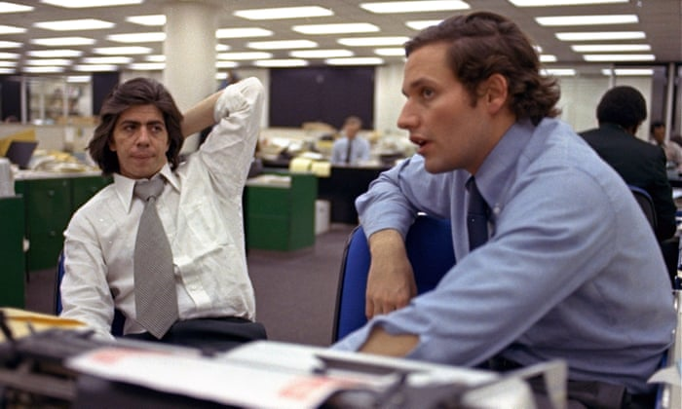
(a) Watergate
INVESTIGATIONS
2 reporters from the Washington Post, BOB WOODWARD + CARL BERNSTEIN, were suspicious about the break-in & discovered links to CREEP – but John Mitchell denied any links. The FBI found links to CREEP & the White House – but the White House repeatedly denied this. The FBI also discovered that 2 Plumbers had planned the whole break-in; Howard Hunt & Gordon Liddy. Over the next 2 years, the FBI gradually revealed the extent of the campaign to spy on & sabotage the Democrats. Donations intended for CREEP was shown to have been channelled into staged break-ins!

Slide 68
(a) Watergate
THE ‘WATERGATE SCANDAL’
At the outset, many believed the break-in was just CREEP supporters acting alone. When Nixon stated that White House lawyer, JOHN DEAN, had investigated & found “No White House staff involvement” people believed him. Nobody ever thought that Government officials would be involved in illegal activity!
On 8th Jan. 1973, the 5 White House burglars (and Hunt & Liddy) were put on trial for burglary, conspiracy & wire-tapping. 5 pleaded Guilty & 2 were found Guilty. All 7 were due to be sentenced on 23rd March 1973 but, astoundingly, the trial judge got a letter from James McCord (Director of Security for CREEP) on 19th March 1973. The letter clearly stated that White House officials had instructed the burglars to lie during their trial. President Nixon denied he knew any offices were to be burgled.

Slide 69
(a) Watergate
THE ‘WATERGATE SCANDAL’
On 17th April 1973, Nixon announced a new investigation led by Archibald Cox (Special Prosecutor for the White House).
On 30th April 1973, Nixon suddenly announced he had sacked JOHN DEAN + BOB HALDEMAN (Chief of Staff), adding that JOHN ERLICHMAN (Head of the Plumbers) had resigned; all men acknowledging their part in both the burglary & cover-up.
In May 1973, the FBI investigations were televised & the nation was gripped & shocked by all the allegations of corruption at the highest level. JOHN DEAN’S TESTIMONY WAS SENSATIONAL – he alleged that Nixon himself was involved in the cover-up!
The President refused to be questioned upon the subject.

Slide 70
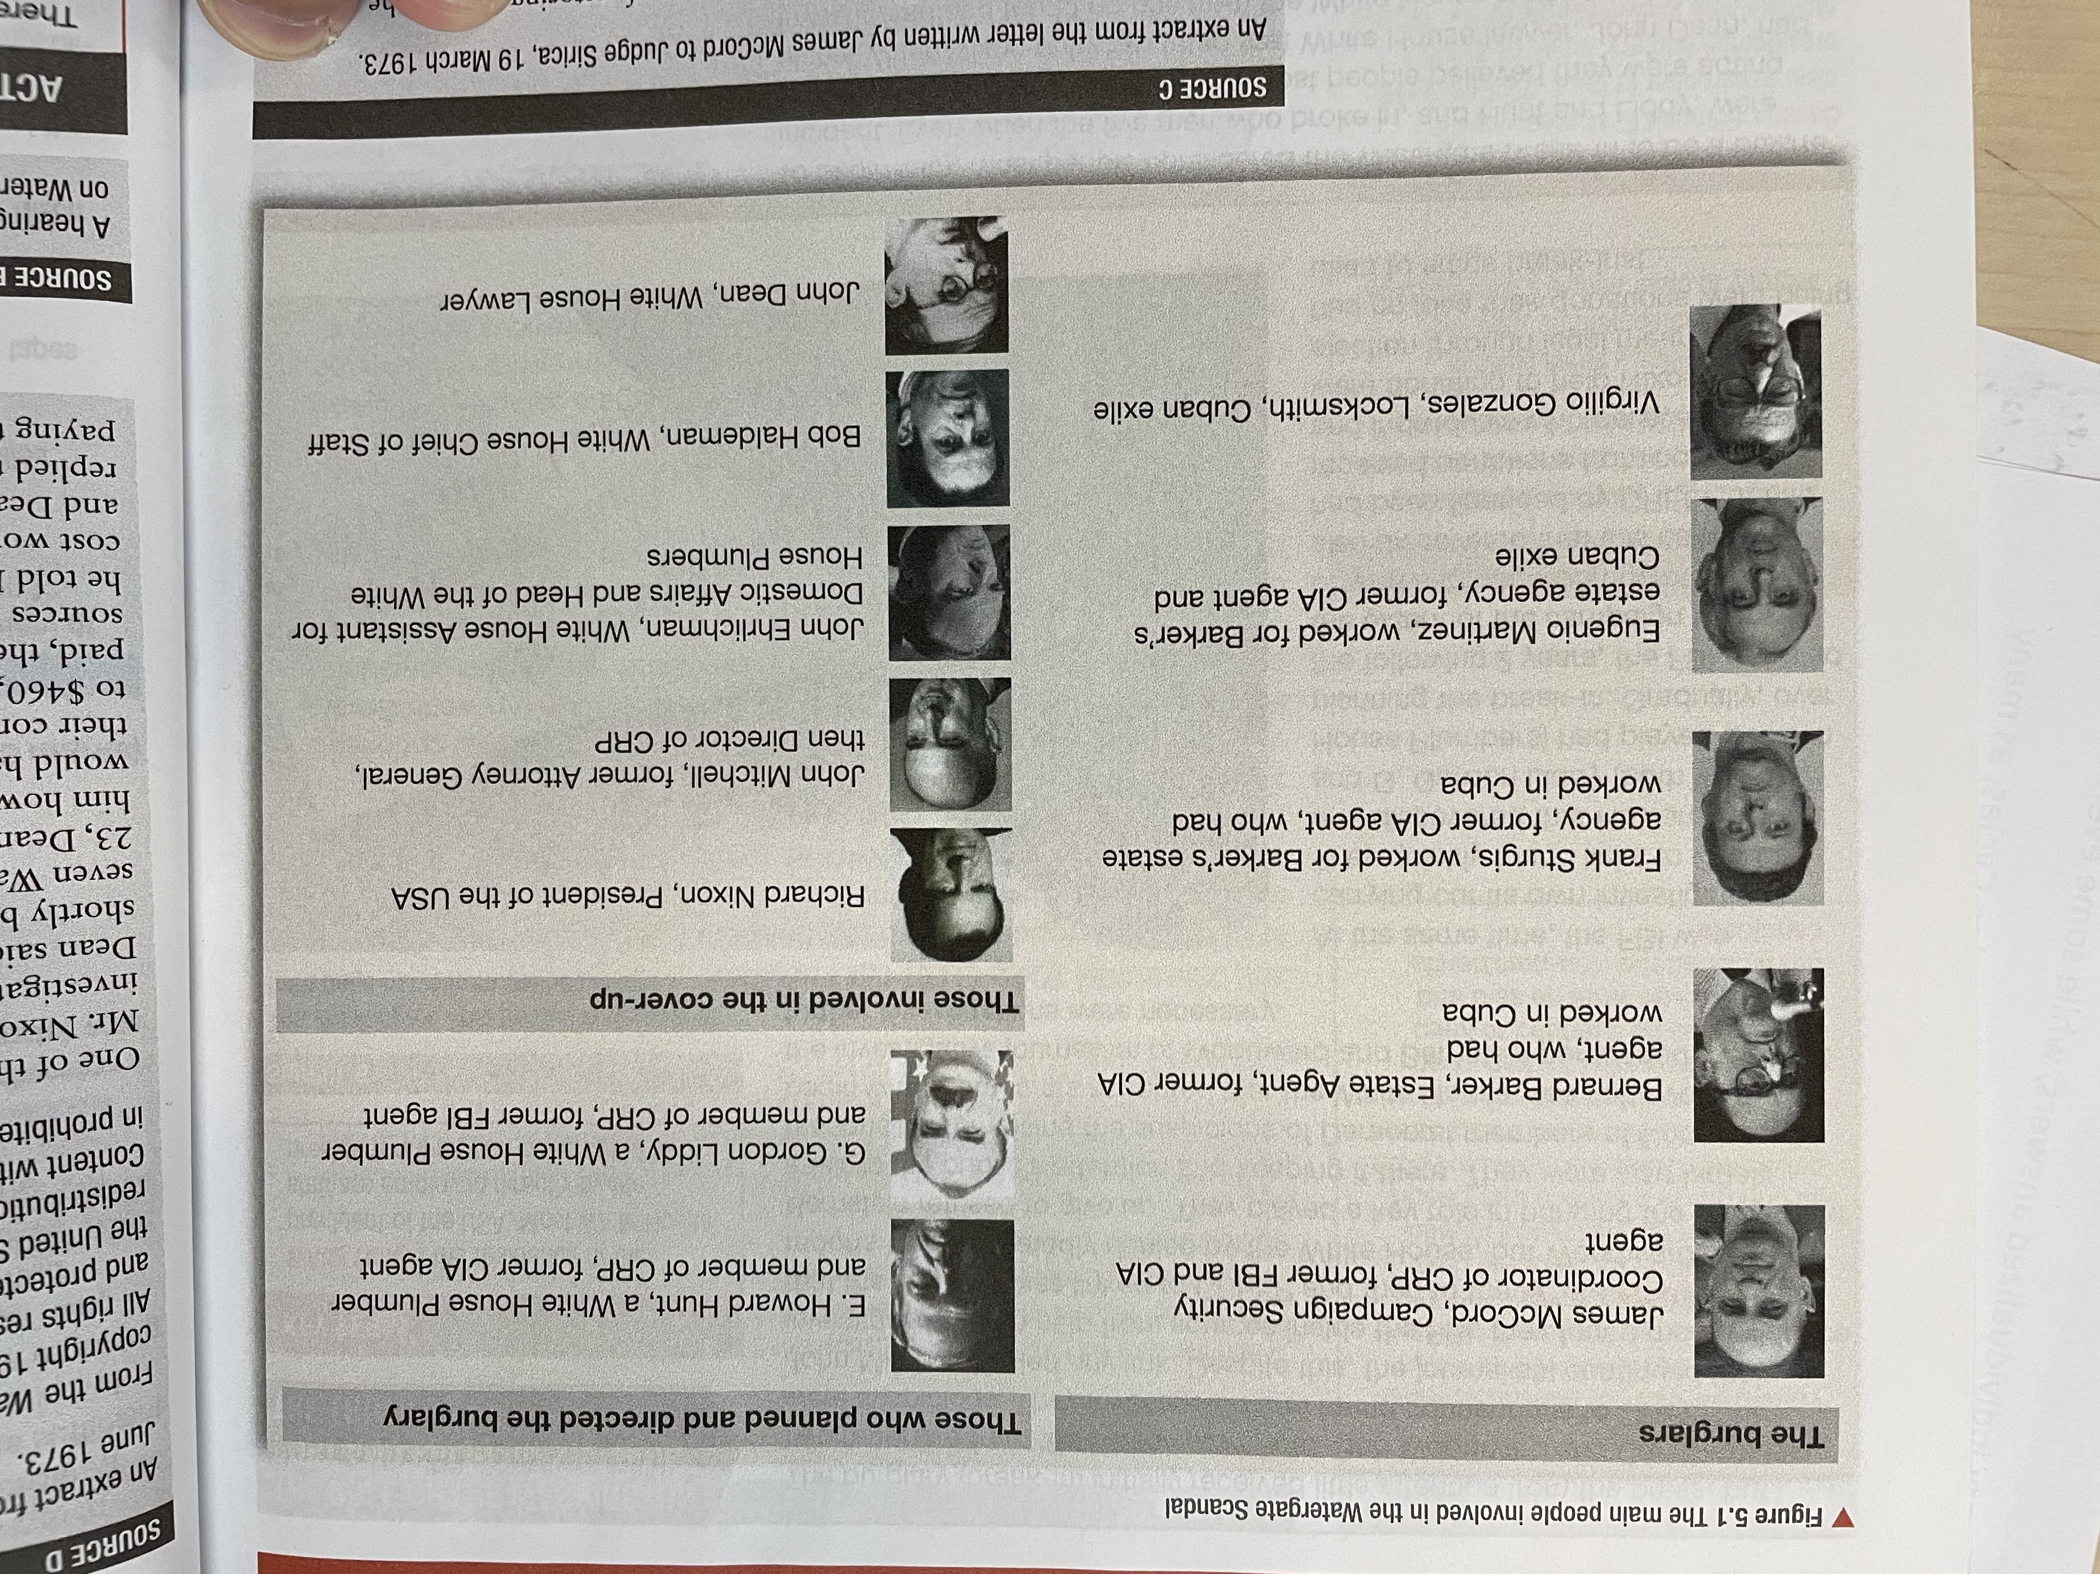

Slide 71
(a) Watergate
THE WATERGATE RECORDINGS
The scandal only increased when it came to light that all telephone conversations in Nixon’s Office had been recorded (as all Presidents’ had since FDR) so Archibald Cox tried to get access to to the tapes to see whether Nixon had or hadn’t been involved. Nixon utterly refused to release the recordings – on grounds of “National Security.”
In Oct. 1973, Nixon released some edited scripts of conversations.
In April 1974, more UNEDITED scripts were released – but the term “Expletive Deleted” was used where Nixon used bad language. The public were suspicious why Nixon was so reluctant to release the scripts & protestors gathered outside the White House waving signs that read “IMPEACH THE EXPLETIVE DELETED!”

Slide 72
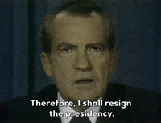
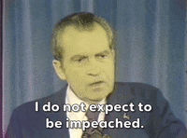
(a) Watergate
THE WATERGATE RECORDINGS
On 24th July 1974, Nixon was ordered by the Supreme Court to hand over all the recordings.
On 5th August 1974, a recording from 23rd June 1973 revealed Nixon had tried to block the FBI investigation into the break-in … proving that he HAD tried to cover-up the Watergate Scandal from the start. This was the “smoking gun” that proved the President’s involvement.
Nixon resigned on 9th August 1974, before he could be impeached.

Slide 73
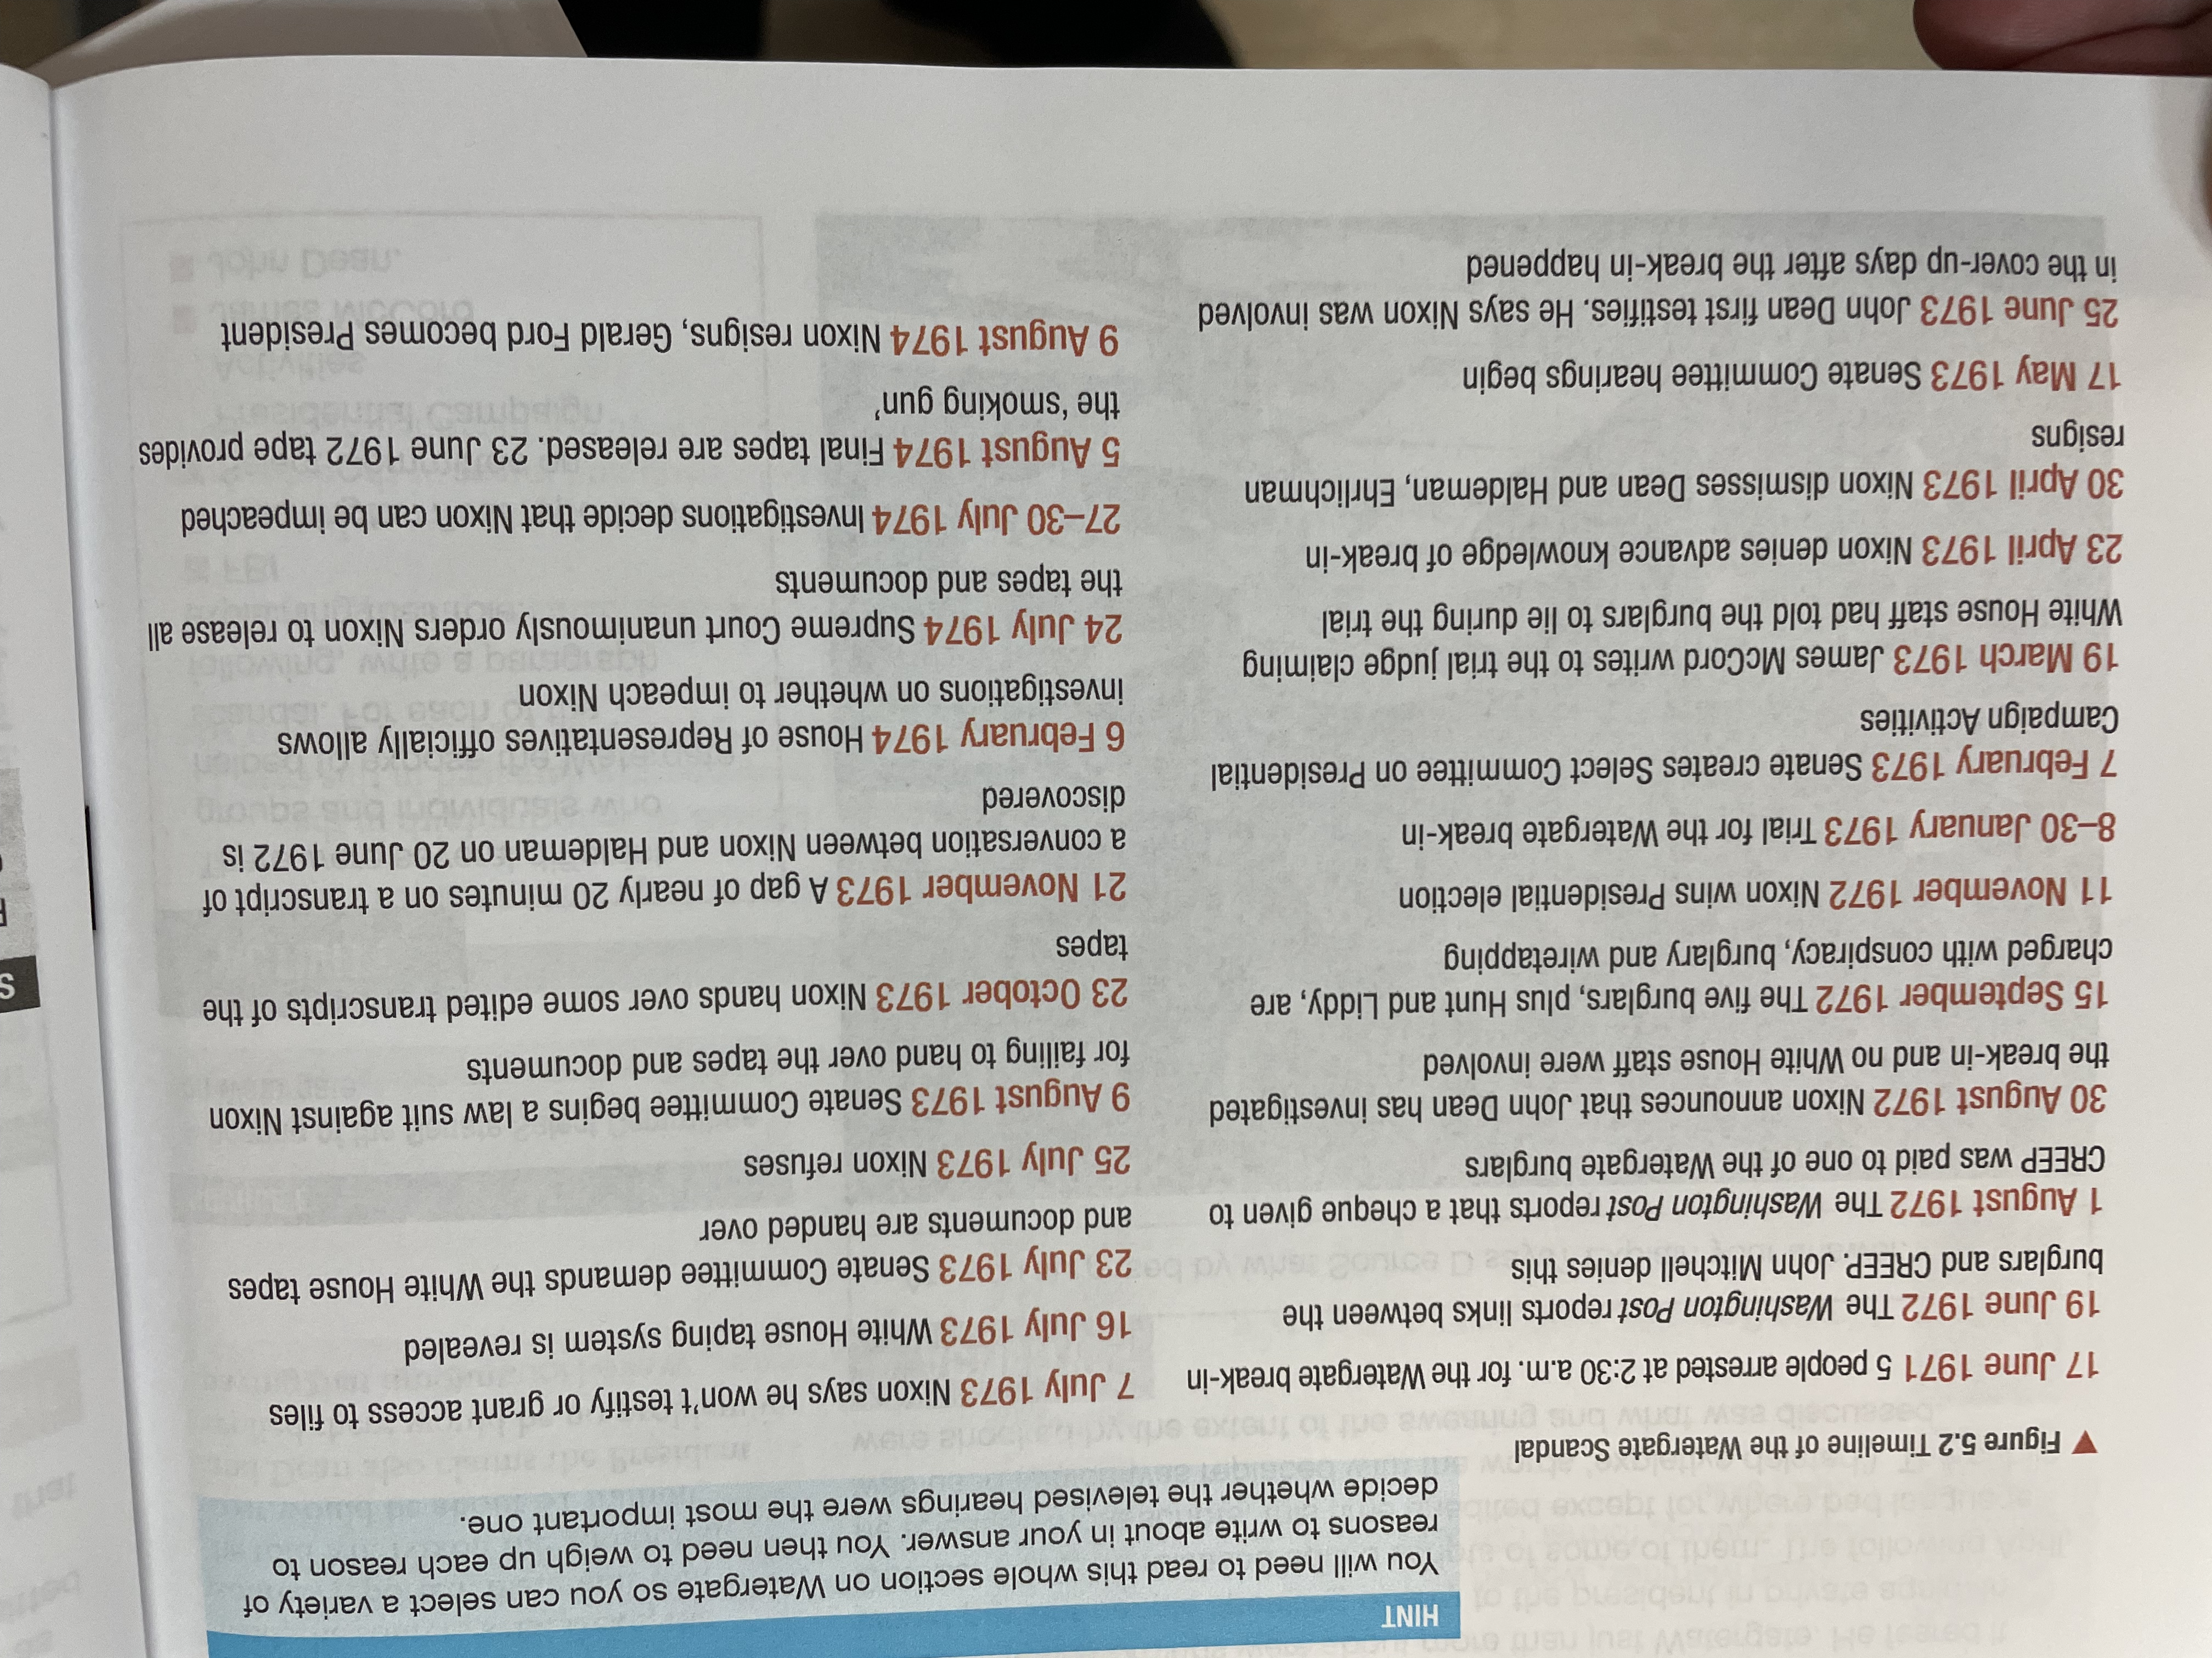

Slide 74
Exam-Style Question
‘The most important reason the Watergate affair developed into a scandal was TV hearings of the Senate Committee.’
How far do you agree?
You may use the following in your answer:
Driving away white supporters of Civil Rights
Improving life in the ghettoes
You must also use information of your own.
(16 marks)

Slide 77
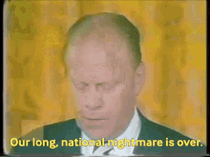
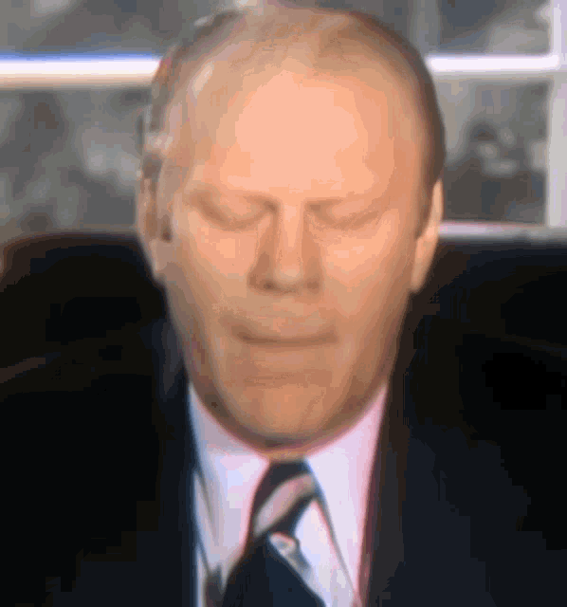
(b) Ford & the Presidential Pardon
Hours after Nixon resigned, Vice President Gerald Ford was sworn in & said “OUR LONG NATIONAL NIGHTMARE IS OVER.” Ford had to restore faith in Government & the role of US President. His calm personality & his true honesty regained some confidence in the battered role of President. Unfortunately, the new President is remembered for just one thing only – which is the main reason he went on to lose the 1976 election – just one month after taking over from Nixon, Gerald Ford PARDONED THE FORMER-PRESIDENT OF ANY CRIMES COMMITTED. Nixon was denied a criminal trial & justice could not be done. Many thought a deal had been done but Ford defended his pardon by saying it was “the only way to move on.”

Slide 78
(b) Impact of Watergate
Nixon’s career ended with his resignation. He avoided impeachment & a trial, but he also never apologized or acknowledge any wrongdoing at all. He even appeared to believe Presidents should not be answerable to the Law!
The scandal put any of his other achievements in the dark & “TRICKY DICKY” stuck as his nickname; setting up the Environment Protection Agency, the final desegregations of Schools and improved relations with China & the USSR were all overshadowed by Watergate.
30 Government officials received prison sentences & the Republican Party was severely damaged by the scandal – Democrats chose the unknown JIMMY CARTER as their Presidential candidate (honest, religious & likeable) and he won … despite lacking the necessary skills. Honesty, not capability, was what the USA sought after the scandal.
Trust in the Federal Government plummeted from 75% of Americans trusting their Government in 1958 to just 35% trusting them in 1974.

Slide 79
(b) Impact of Watergate
The media was praised for seeking out the truth & journalists became “INVESTIGATIVE” rather than merely news-reporters. WOODWARD & BERNSTEIN were lauded & inspired positive (& negative) exposés in future.
New laws were passed to regulate the behavior of future Presidents:
1973 HOUSE + SENATE OPEN MEETING RULES – to prevent private meetings.
1973 WAR POWERS ACT – to prevent war without Congress approval.
1974 ELECTION CAMPAIGN ACT – to limit campaign spending & contributions.
1974 FREEDOM OF INFORMATION ACT – to give access to Govt. docs one featured in.
1974 PRIVACY ACT – to limit collection of information on individuals in the USA.
1974 CONGRESSIONAL BUDGET CONTROL ACT – to govern how Presidents use money
The suffix ‘-GATE’ was added to any worldwide scandal after 1974. “Camillagate” in 1993, where Prince Charles’ phonecalls to Mrs Parker-Bowles rocked the UK and “Monicagate” in 1998, where President Bill Clinton had an affair with a White House intern, Monica Lewinsky.

Slide 80
Unit 5 Recall Quiz
What was the CRP (also known as CREEP)?
How many people were first put on trial for the Watergate break-in?
Name the 2 journalists who uncovered the truth behind the Watergate break-in?
How did James McCord actions lead to the Watergate affair becoming a scandal?
What was the name of the Senate investigation Committee on Watergate?

Slide 82
Unit 5 Recall Quiz
When did Nixon resign?
Why did Ford pardon Nixon?
Name 3 White House officials, except Nixon, who were part of the cover-up.
Why were many new laws passed after Watergate?
What did the 1974 Election Campaign Act do?

