Slide 1
Edexcel IGCSE History P1: Depth Study 7
A Divided Union: Civil Rights in the USA, 1945-1974

Slide 3
Edexcel IGCSE History P1: Depth Study 7
A Divided Union: Civil Rights
in the USA, 1945-1974
3. Impact of Civil Rights Protests, 1960-1974

Slide 4
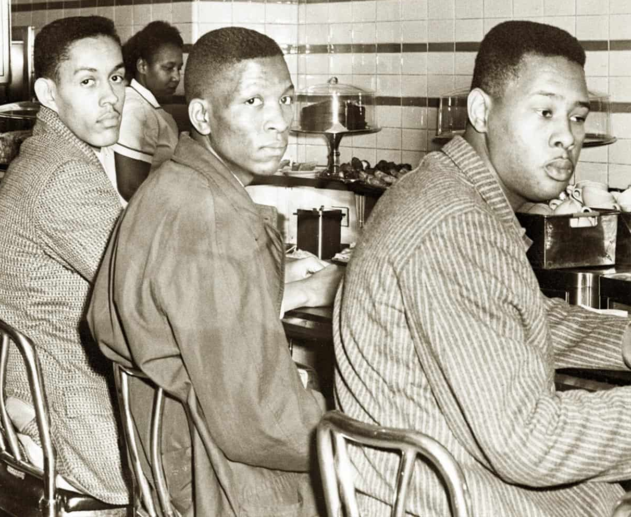
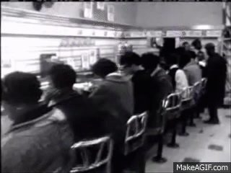
(a) Protests, 1960-63
The earliest major Civil Rights protests of the 1960s were not organized by major hitters like the NAACP – College students, instead, began non-violent direct action. On 1st Feb. 1960, 4 black students from the North Carolina Agriculture & Technology College sat at the “whites-only” lunch counter in Woolworth’s, Greensboro. After being asked to leave, they remained until the store closed. The next day, all 4 returned & took seats again; plus an extra 25 students took turns to “SIT-IN” in shifts. On 3rd Feb. 1960, 80 more students joined the “SIT-IN.” On 4th Feb 1960, over 300 students were present. Other towns soon saw similar protests in N.C. & soon the South saw “SIT-IN”s being used to try to desegregate lunch counters. 70,000 in all took part.

Slide 5
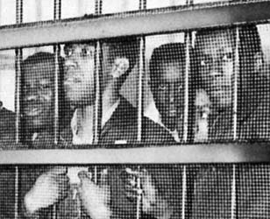
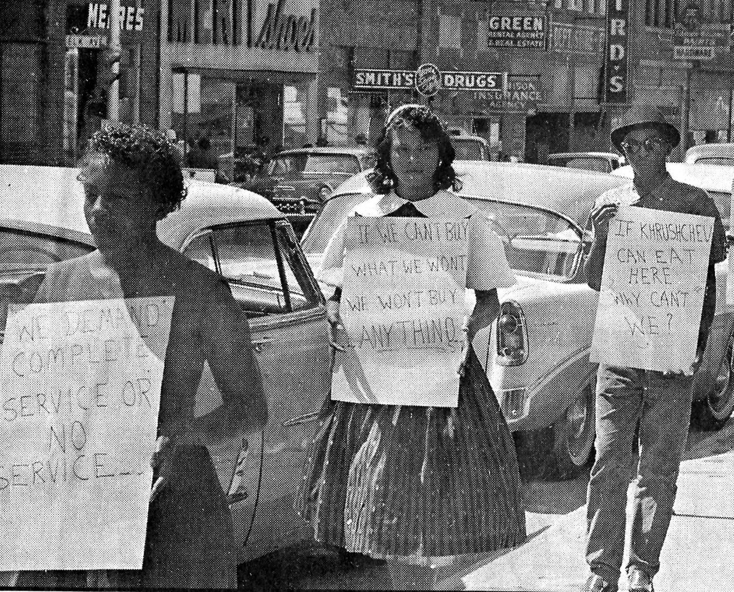
(a) Protests, 1960-63
The typical response to sit-in protestors was abuse from white segregationists – insults were hurled, they were spat at and food & drink were often thrown at them. Despite much provocation, each protestor knew to meet violence with non-violence. After arrests, a new policy of “JAIL, NOT BAIL” was begun – attracting media attention, as jails were very overcrowded with peaceful protestors – which garnered even more support for their cause & inspired even more sit-ins. The success of student protests took big organizations by surprise but, soon, activists from the NAACP, CORE (Congress of Racial Equality) and SCLC (Southern Christian Leadership Council) began boycotting stores with segregated lunch counters + successfully spread sit-ins in the South & the North.

Slide 6
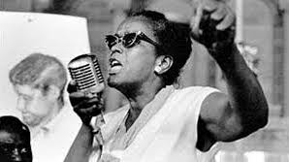
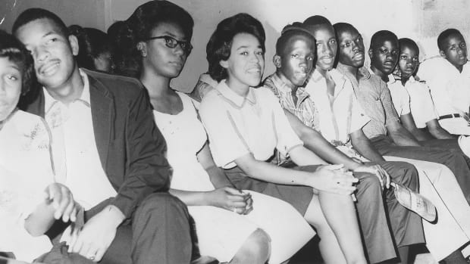
(a) Protests, 1960-63
NAACP + SCLC leader, ELLA BAKER, arranged for MLK to visit Greensboro to address the student protestors. Baker also arranged for Shaw University students to meet up to discuss a way forward. MLK wanted all the student protestors to join SCLC, but Baker wanted them to set up their own Civil Rights group. At the Shaw University meeting on 15th April 1960, the SNCC (Student Nonviolent Co-ordinating Committee, known as “Snick”) was established & the SCLC gave them a grant of financial assistance.

Slide 7
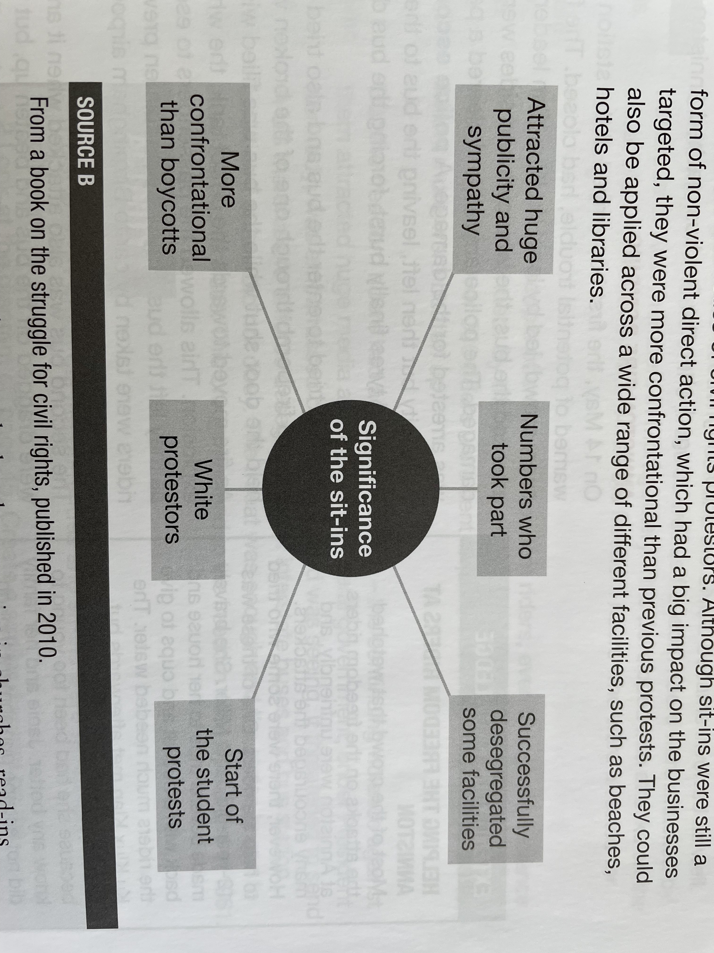
Eisenhower said “I am deeply sympathetic to the efforts of any group to enjoy the rights of equality they are guaranteed by the Constitution.” (16th March ‘60)
120 lunch counters were These new tactics could be replicated at beaches, hotels & libraries to challenge segregation.

Slide 8
“Soon there were wade-ins on the beaches, pray-ins in churches, read-ins in libraries … Whereas African Americans in Montgomery had protested segregation by staying away, this was by confrontation. By August 1961, over 70,000 people had participated in some kind of direct action protest. Hundreds of thousands more joined economic boycotts supporting the sit-ins. Within a year, over 100 communities had desegregated their lunch counters and some – starting with San Antonio in Texas in March 1960 – to prevent sit-ins from even starting. On 25th July 1960, after renewed demonstrations, the lunch counter in Greensboro’s Woolworth’s served its first black customer.
From a History book on the Struggle for Civil Rights, 2010
What impression does the author create about the impact of civil rights protests in 1960? (6m)

Slide 9
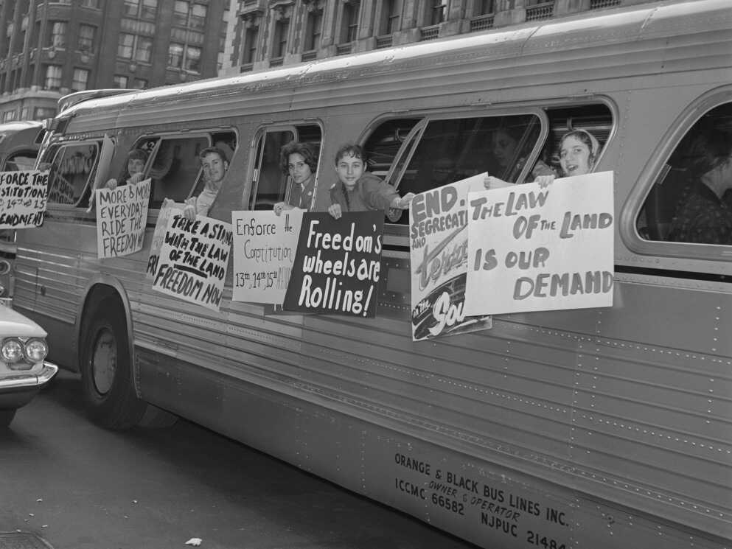
(a) Protests, 1960-63
4 years after State transport was desegregated, in 1960, the Supreme Court confirmed a 1946 ruling that Interstate transport should also be desegregated – even Waiting Rooms had to desegregate & be integrated. In 1961, CORE activists planned “FREEDOM RIDES” to show how these rulings were not being followed. CORE aimed to provoke a violent reaction, generate publicity & media interest, so that the Federal Government would be forced to act. On 4th May 1961, the first 2 buses of “FREEDOM RIDES” left Washington DC heading to the South.

Slide 10
“We planned the Freedom Rides with the specific intention of creating a crisis. We were counting on the bigots in the South to do our work for us. We figured that the Government would have to respond if we created a situation that was headline news all over the world, and affecting the nation’s image abroad. An international crisis – that was our strategy.”
From James Farmer, founder of CORE, on the Freedom Riders’ aims
Why was the Freedom Rider strategy so dangerous? Was it likely to be more successful?

Slide 11
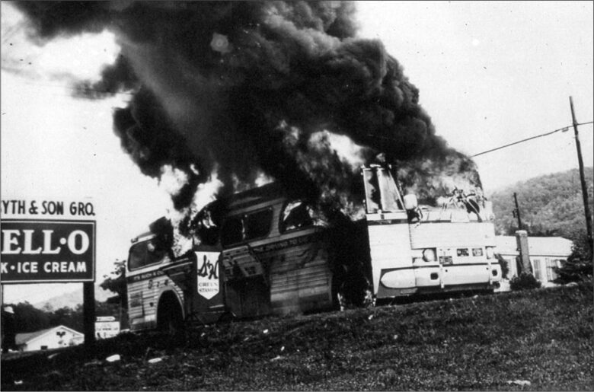

Slide 12
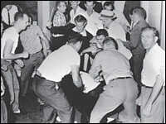
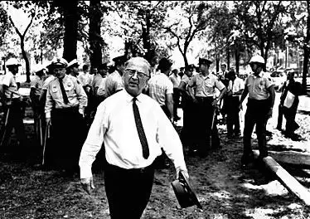
(a) Protests, 1960-63
On 14th May 1961, the first bus arrived in Anniston, Alabama – but found the bus station closed. WILLIAM CHAPPELL, a local KKK leader, had gathered a mob to attack the bus: Windows & tyres were damaged; the Police tried to escort the bus to safety; the tyres were burst by the mob who had followed the bus; the KKK tried to enter the bus to roll it; then a fire-bomb was thrown into it & the doors held shut. After the mob ran away, fearing an explosion, the passengers got off the bus … only to be attacked again. The second bus was also attacked upon arrival in Anniston, yet the KKK clashes did not prevent them continuing to Montgomery, Alabama. Police Chief “BULL” CONNOR ordered police to do nothing.

Slide 13
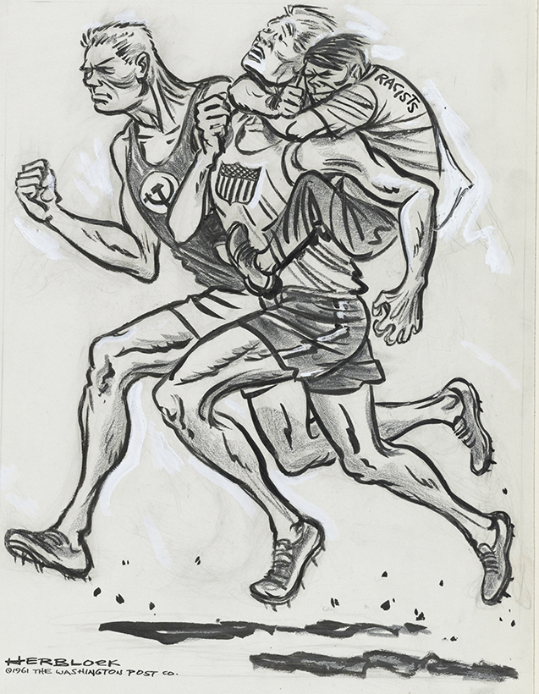
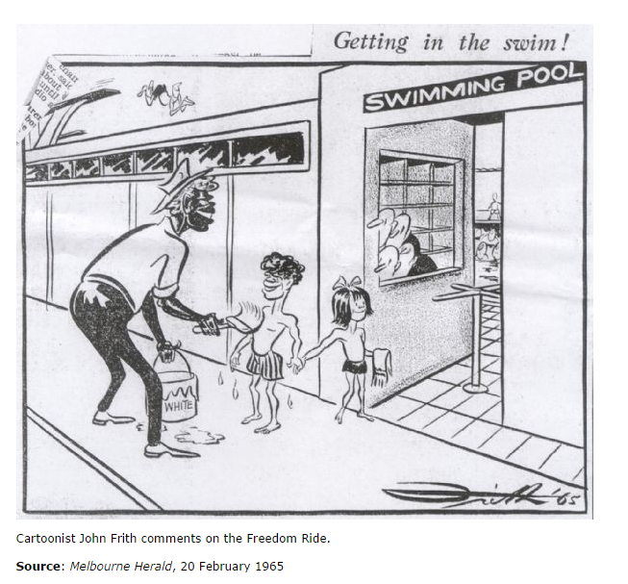

Slide 14
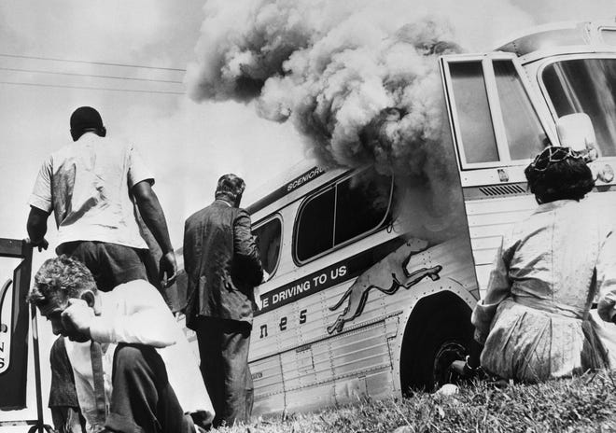
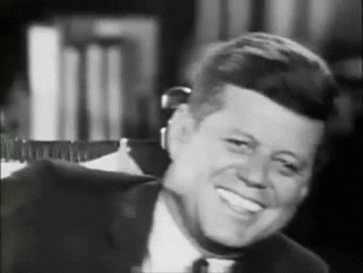
(a) Protests, 1960-63
The Freedom Rides were not halted after the Anniston fire-bombing – indeed, CORE + SNCC arranged even more. On 20th May 1961, the press riding with the freedom riders were attacked by the KKK in Montgomery. Violent involved all of the wider black community, but the only ones arrested were the Freedom Riders for “starting a riot.” By the end of the Summer 1961, 60 Freedom Rides had been completed and over 300 riders were sat in jail in Jackson, Mississippi. The Freedom Riders were so successful in exposing Southern racism that the new President, JFK, was so embarrassed that he threatened to send US Marshals to enforce integration on Interstate bus services & facilities.

Slide 15
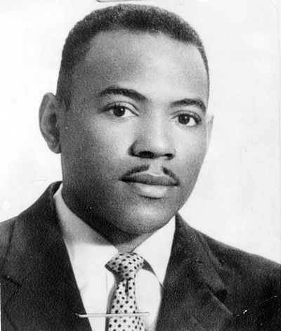
(a) Protests, 1960-63
Universities, like Schools, took time to desegregate. When JAMES MEREDITH applied for a place at Mississippi Uni in May 1961, he was rejected. With NAACP support he went to Court and, in June 1962, the Supreme Court told the Uni to accept him. They didn’t – as Governor of Mississippi, Ross Barnett, had assured voters “No school will be integrated while I am your Governor.” Just to make sure Meredith could not join the Uni, in Sept 1962, the State legislature quickly passed a law to deny admission to anybody with a “felony offense” … knowing that he had been convicted of “false voter registration.” Meredith could not go to Uni.

Slide 16
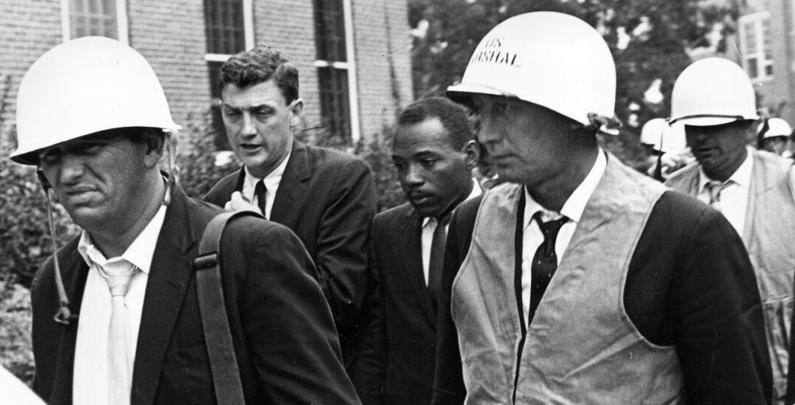
(a) Protests, 1960-63
On 29th September, JFK intervened and ordered all those “obstructing the Law to desist.” That evening, riots broke out on the University campus when those against James Meredith joining the Uni protested. JFK sent Federal officials, including US Marshals, to escort Meredith to registration on 30th Sept. 1962. But, even then, riots broke out again & 300 were injured and 2 civilians died. JFK sent 2,000 Federal troops to Mississippi & only then did rioting cease. On 1st Oct. 1962, Meredith successfully registered and was guarded by 300 State troops each day until he graduated with a degree in Political Science the following year.

Slide 17
Exam-Style Question
Explain two effects of the Freedom Rides on the USA.
(8 marks)

Slide 18
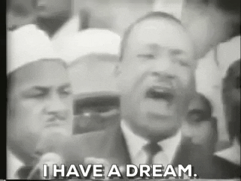
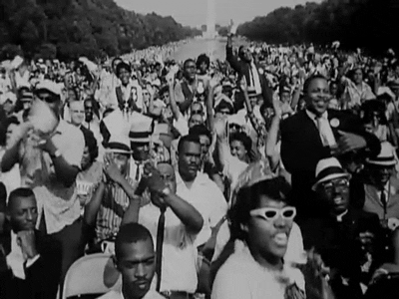
(b) Protests, 1963-65
MLK is by far the most famous Civil Rights campaigner. After the 1963 March on Washington & his “Dream” speech, MLK was seen as the leader of the Civil Rights movement. King had 4 personal qualities that endeared him to all races, classes & ages:
He was well-educated, well-spoken & a passionate speaker.
He continually advocated non-violence.
He worked with all races to forge unity.
He was a Baptist Minister, respected by African Americans church-goers & those with a strong Christian faith in America.

Slide 19
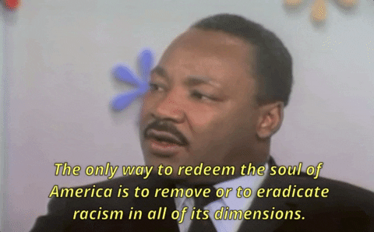
(b) Protests, 1963-65
Inspired by Gandhi’s non-violence that achieved Indian Independence, MLK was by no means passive in his protests. Direct action, like boycotts & marches, was MLK’s favored methods – even though they were confrontational & dangerous. Publicity was essential to bringing about change & MLK lived in constant fear of being attacked. His speeches won over many ordinary white Americans & politicians – by continually showing support for the US political system & Constitution, he won over those afraid of too much change.

Slide 20
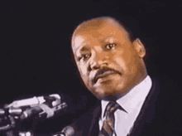
(b) Protests, 1963-65
In 1966, MLK tackled discrimination in the North – starting with Chicago. His views changed & he was disappointed that protest & negotiation wasn’t seeing progress or improvements anymore. He sounded Socialist – urging an end to poverty, unemployment & housing shortages irrespective of race – which lost him some supporters. As his once great influence was weakening, he went to support a worker’s strike in Memphis and was assassinated on 4th April 1968. His importance is illustrated by roads, schools & institutions named after him – MLK Day is the 3rd Monday of January each year – but he is not the only person involved in the struggle for Civil Rights in the 1950s, the 1960s and beyond.

Slide 21
‘Clearly, Dr. King had a large impact on how the civil rights movement was perceived by other Americans and by people around the world. His ability to speak eloquently and thoughtfully gave him a high profile in the age of television … However, it was not just the delivery of his speeches that made King so significant, it was also the message. His support for non-violent, peaceful protest elevated the civil rights cause to a high spiritual and religious level. As a minister, he turned the civil rights cause into a religious movement … Through the use of media and by linking the civil rights cause directly with the declaration of Independence & the Constitution. King occupied the high moral and political ground.’
From a History book on US Civil Rights, 2008
What impression does the author create about the influence of MLK on the USA? (6m)

Slide 22
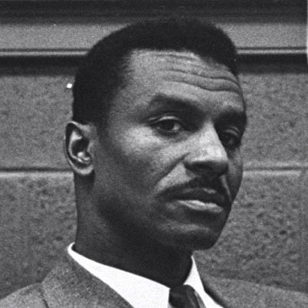
(b) Protests, 1963-65
Civil Rights protests exploded across the USA in 1963. In Birmingham, Alabama, the “Project C Campaign” was led by SNCC, SCLC and ACMHR (Alabama Christian Movement for Human Rights). The groups aimed to end segregation via coordinated sit-ins, boycotts & marches. “C” stood for “Confrontation.” REV. FRED SHUTTLEWORTH was the very successful leader of the ACMHR and was just as influential as MLK in the ”Project C campaign.” Birmingham was chosen for a number of reasons:
45% of the city’s 500,000 inhabitants were black.
KKK were very active; nicknamed “Bombingham”
Police Chief “Bull” Connor would overreact.

Slide 23
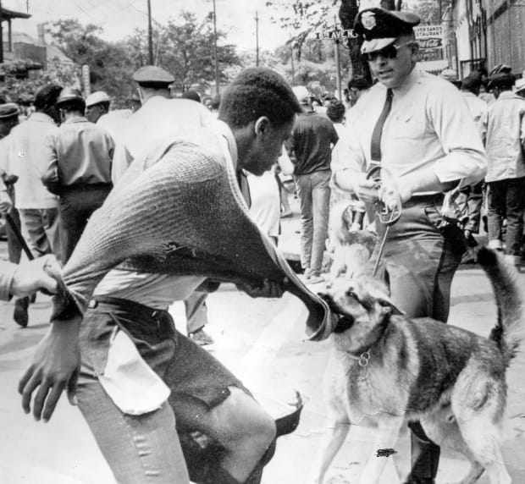
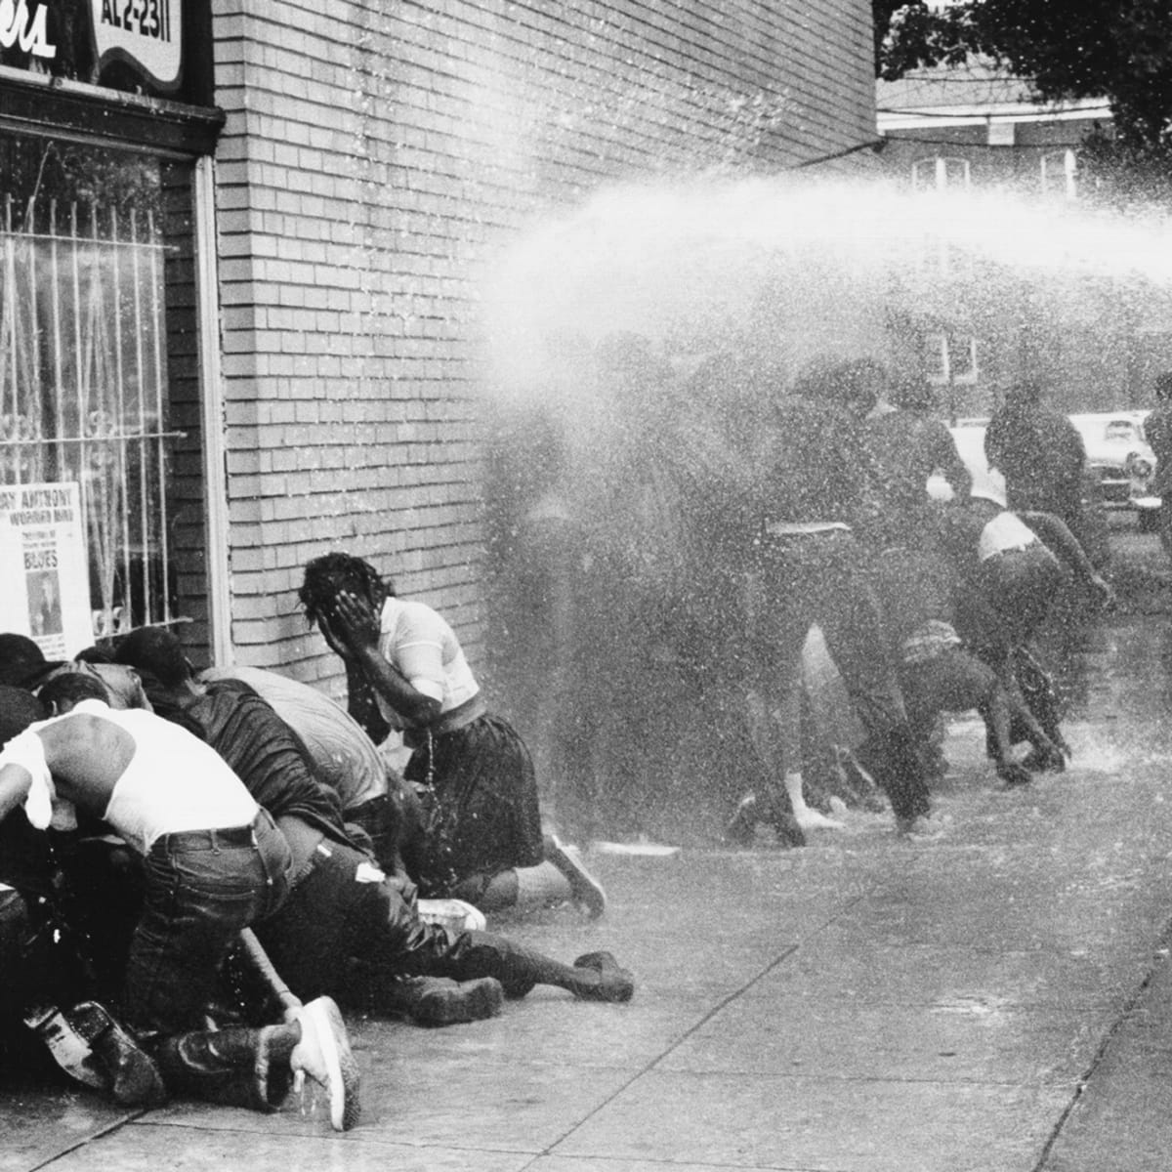
(b) Protests, 1963-65
The first March took place on 3rd April 1963. “Bull” Connor’s officers arrested protestors. Within weeks, most of the marchers were in jail – including MLK & Fred Shuttleworth. The SNCC began training young people in non-violent protest and, on 2nd May 1963, the first Children’s March took place. Most were teens, but some were 6-years-old. By the end of the day, over 1,000 children had been arrested. On 3rd May 1963, even more children marched. As the jails were full, “Bull” Connor set dogs & fire-hoses on the protestors – TV footage & photographs of this created the publicity Project C desired.

Slide 24
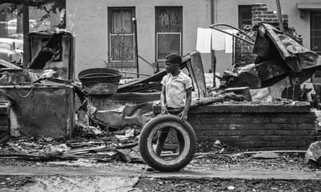
(b) Protests, 1963-65
The impact of Project C was better than expected. JFK sent a negotiator to Birmingham to broker a peace. Talks began on 10th May 1963, but State Troops were sent in by the Governor of Alabama. This stirred up violence – black businesses & homes were bombed. Protestors remained non-violent & resisted temptation to respond violently. Extreme violence on 10th + 11th May, however, saw the first serious black riots. JFK restored calm by sending in Federal troops. The mayor agreed some concessions, but desegregation was very limited. Many facilities remained segregated.

Slide 25
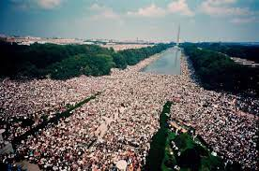
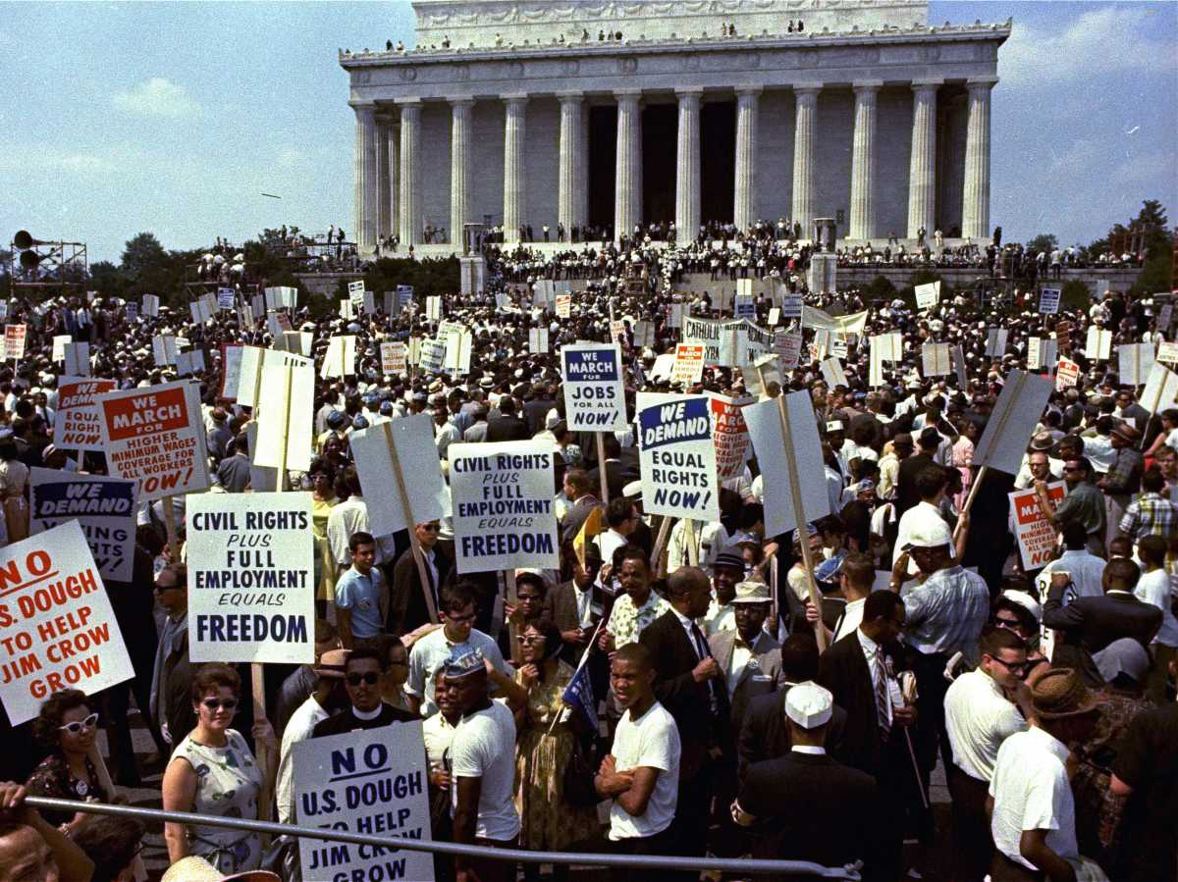
(b) Protests, 1963-65
The March on Washington was fully planned immediately after the successful Birmingham March. The protestors aimed to show support for the new Civil Rights Bill being debated in DC. It proved to be the largest ever political gathering in US history. Washington authorities were fearful of violence & rioting, so JFK tried to persuade the organizers to call it off – but they refused. So 1,000 extra Police were put on duty & 2,000 members of the National Guard were on stand-by … but they were not needed. On 28th August 1963 – exactly 100 years after the abolition of slavery – over 250,000 people (black and white) took part in a peaceful march through the city to the Lincoln Memorial. It was broadcast to the world on live TV.

Slide 26
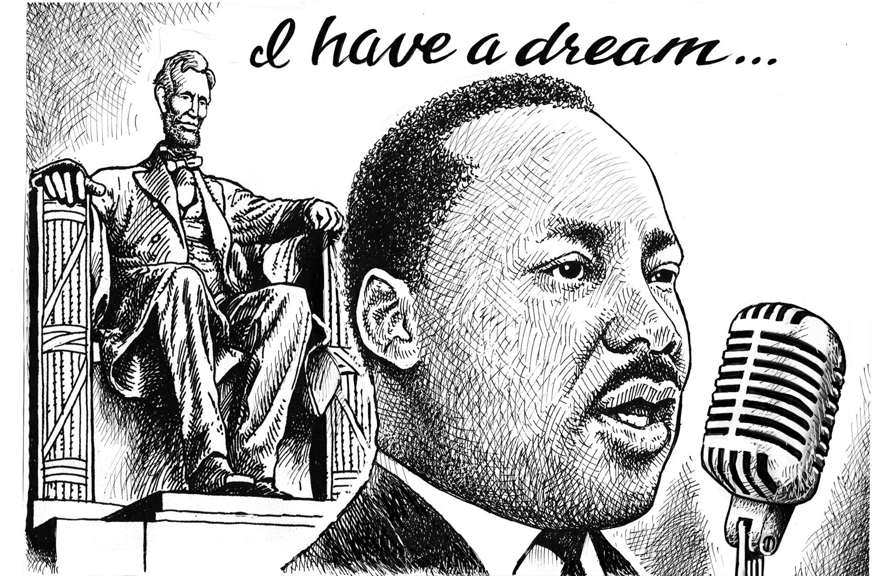
https://www.youtube.com/watch?v=o8dzxh7Ybqw

Slide 27
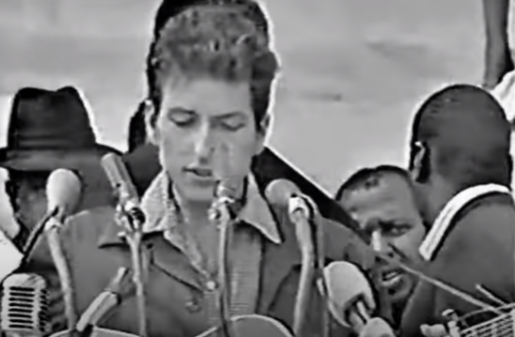
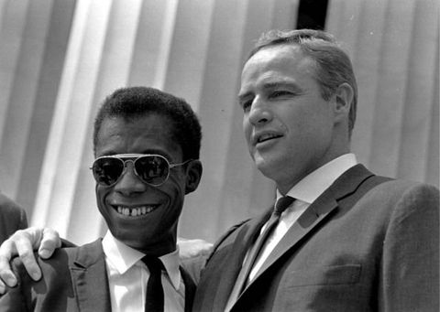
(b) Protests, 1963-65
The March on Washington was important for several reasons:
Huge numbers of people participating showed that Civil Rights was supported by 250,000 peaceful protestors.
Media attention was immense – not only due to the size of crowds, but the attendance of US celebrities like Bob Dylan, Paul Newman & Marlon Brando.
It piled pressure on politicians, as the Civil Rights Bill was moving in Congress.
After his “Dream” speech, MLK clearly emerged as leader of the movement.

Slide 28
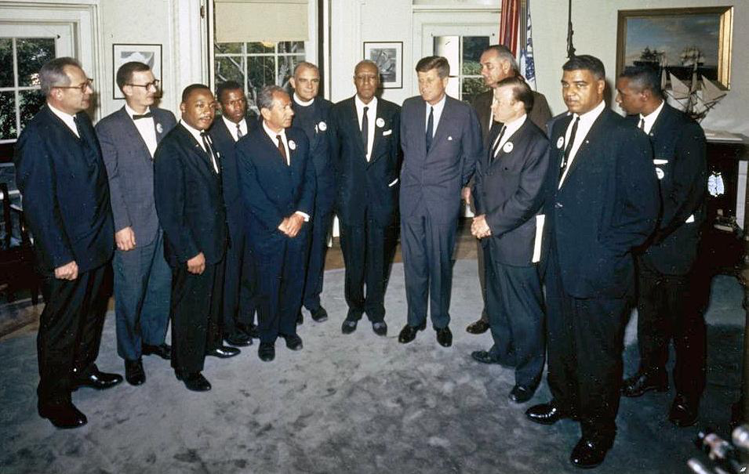
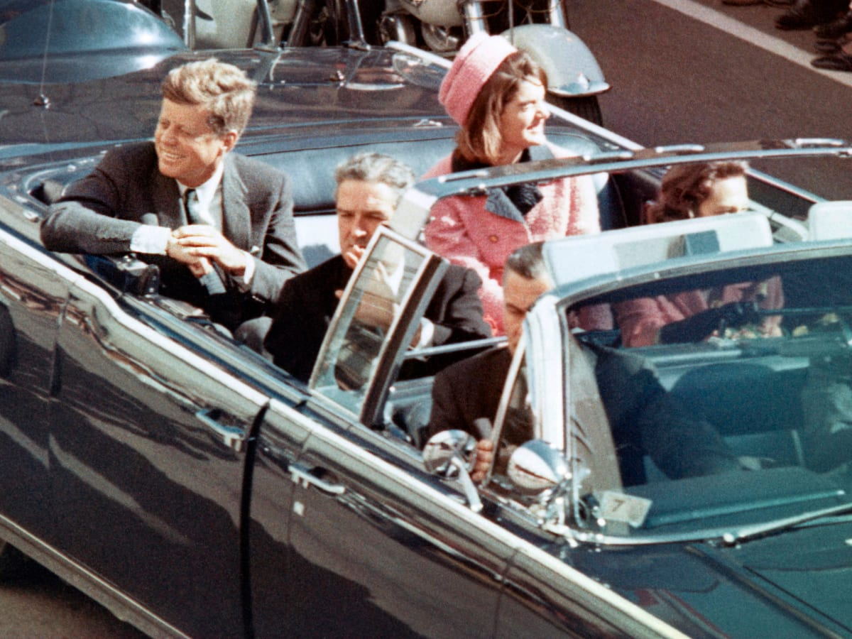
(b) Protests, 1963-65
After the March on Washington ended on 28th Aug. 1963, Civil Rights leaders met JFK + Vice President Johnson in the White House. JFK assured protestors that the Federal Government was completely committed to seeing the Civil Rights Bill pass through Congress. Everybody knew that getting such a Bill passed would be a difficult task … but then, on 22nd Nov. 1963, JFK was assassinated whist in an open-top car in Dallas, TX. His killer was Lee Harvey Oswald and, 2 days later, he was shot in the stomach by Jack Ruby. Conspiracies suggest that the CIA, the KGB, Cuban exiles, Vice-President and even Mrs Jackie Kennedy were involved!

Slide 29
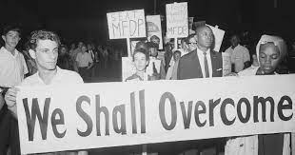
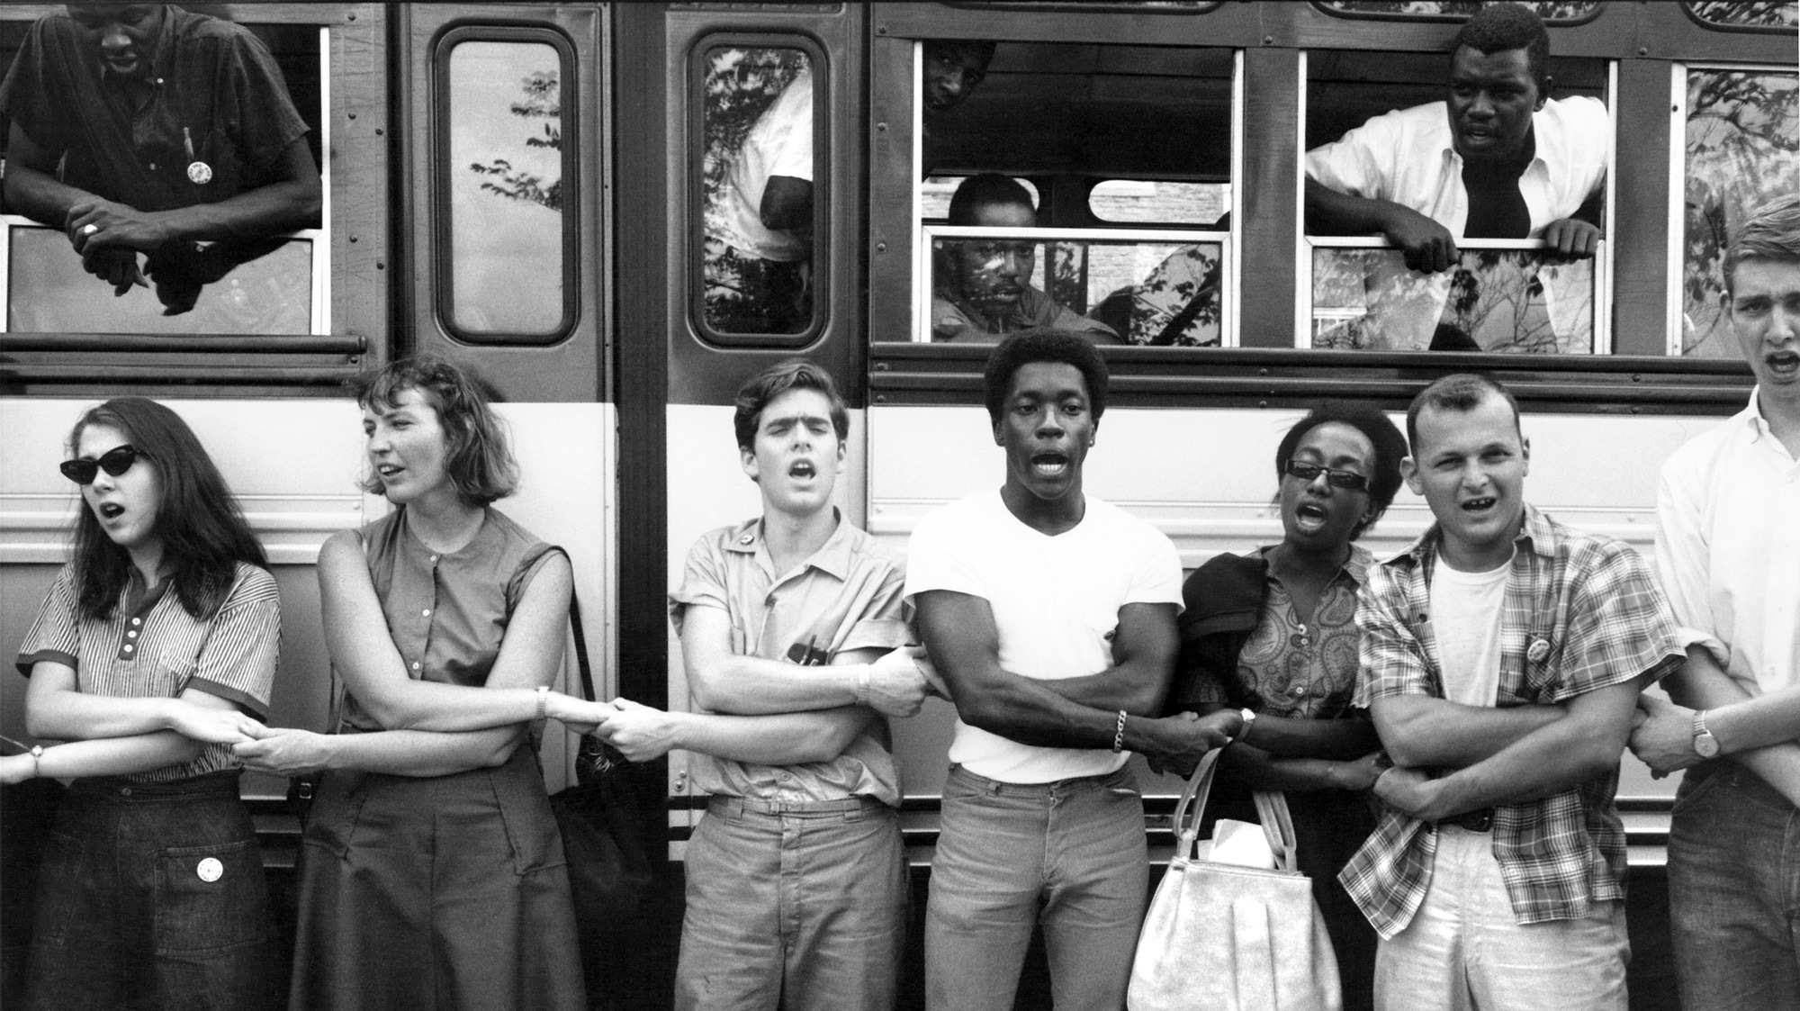
(b) Protests, 1963-65
The ‘Freedom Summer’ campaign in 1964 focused on Mississippi – where fewer than 7% of African-Americans registered to vote, due to the harsh literacy tests (plus those who passed them being beaten & prevented from registering in the end) – so a new political party was established. The MFDP (or Mississippi Freedom Democratic Party) was a direct challenge to the all-white Democratic Party in Mississippi, supported black men & women to pass literacy tests and even taught black history to citizens. SNCC recruits in Mississippi were young white College students and they were often chosen as volunteers to maximize the publicity if violence erupted against them.

Slide 30
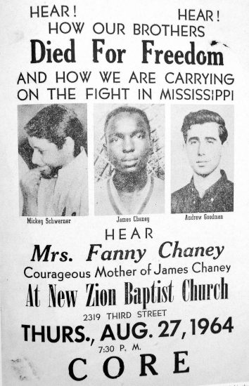
(b) Protests, 1963-65
The KKK could not resist attacking those who took part in the Freedom Summer, 1964. They beat up campaigners, bombed Churches and even shot at Freedom supporters.
21st June 1964, CORE members MICHAEL SCHWERNER, ANDREW GOODMAN & JAMES CHANEY were arrested for traffic offences by a police officer who was also a Klan member. When they were released from prison, they were never seen again … until 6 weeks later, their bodies were found – SCHWERNER & GOODMAN shot in the chest & CHANEY beaten to death.
The murders did attract attention to the cause, but division in the campaign was caused because some said interest was only increased because SCHWERNER & GOODMAN were white. Radical action was needed.

Slide 31
(b) Protests, 1963-65
In January 1965, MLK was asked to speak in Selma, Dallas County, Alabama, as part of the campaign to increase voter registration. Unsurprisingly, during 2 months of campaigning, violent confrontations with the police & many arrests occurred – one protestor, white pastor REV. JAMES REEB, finally being murdered. On Sunday, 7th March 1965, a protest march left Selma heading for Montgomery … but it was stopped by police at the Edmund Pettus Bridge. Tear-gas, horses, clubs & cattle-prods were used by State troops & the Police – it became known as “Bloody Sunday” and TV footage was broadcast around the world. MLK talked protestors out of a second march – he did not want to risk further confrontations – but President Johnson used the first march to push through a new Voting Rights Act in Congress.

Slide 32
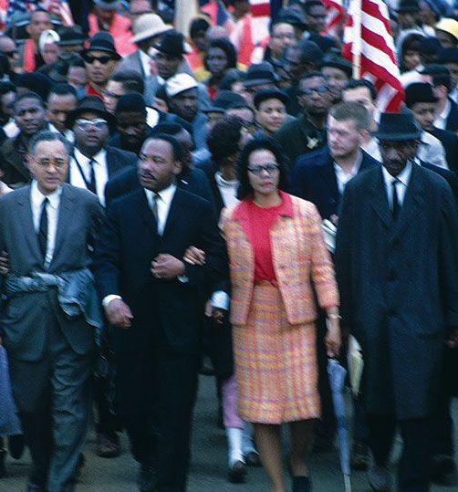
(b) Protests, 1963-65
The impact of Selma was not just the Presidential involvement – sending the National Guard to escort the marchers (over 25,000 led by MLK on 25th March 1965 in Montgomery) – but it also led to divisions emerging in the tactics of the Civil Rights movement. SNCC members desired direct confrontation, whereas MLK advocated a non-violent approach. More & more protestors began to feel that violent methods, a fight for civil rights, would be more effective – especially Malcolm X, saying things like “I don't advocate violence; but if a man steps on my toes, I'll step on his...”

Slide 33
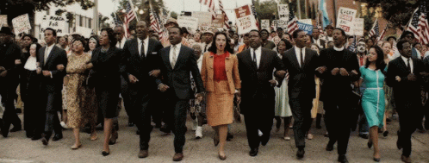

Slide 34
(c) Civil Rights Legislation
The stalling of the Civil Rights Bill through Congress when JFK was assassinated in Nov 1963, saw Lyndon B Johnson try to push it through. A Dixiecrat insertion of the word ‘sex’ (to outrage some into not signing it) a filibuster failed to stop the bill becoming law and, on 2 July 1964, the Civil Rights Act was signed by President Johnson. Unlike the earlier Civil Rights Acts, the 1964 one ended segregation … but not discrimination.

Slide 35
(c) Civil Rights Legislation
President Johnson had been forced to remove the voting sections from the 1964 Civil Rights Act to ensure it got passed, but Freedom Summer & Selma highlighted they needed to be passed as soon as possible. Johnson tried his hardest to persuade the Dixiecrats & succeeded in winning sufficient support to get the Bill passed in record time – the Bill passed on 6th August 1965. Many historians believe this was more significant than the Civil Rights Act.

Slide 37
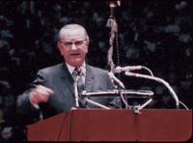
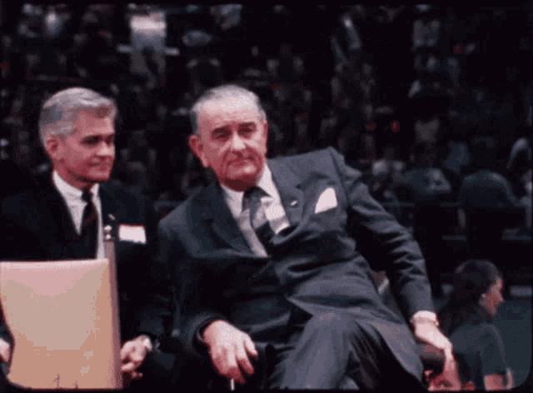
(c) Civil Rights Legislation
Despite Truman’s 1947 promises to pass laws to improve Civil Rights for African Americans, it was 1964 + 1965 before anything significant occurred. Congress was against passing such laws, believing them unnecessary, while Southerners were against them. The reasons for change were clear:
PRESIDENTIAL ATTITUDES
CONGRESS’ DESIRE TO “DO THE RIGHT THING”
EMERGENCE OF RADICAL ACTIVISTS & ACTION TO FORCE GOVT. TO ACT

Slide 38
“100 years ago, the Emancipation Proclamation was signed by a President who believed in the equal worth of every human being … While slavery has vanished, progress for the Negro has been too often blocked & delayed. Equality before the law has not always meant equal treatment & opportunity. And the harmful, wasteful & wrongful results of discrimination & segregation still appear in virtually every aspect of national life, in every part of the Nation … Race discrimination hampers our economic growth by preventing the maximum development & utilization of our manpower. It hampers our world leadership by contradicting at home the message we preach abroad. It mars the atmosphere of a united & classless society in which this nation rose to greatness. It increases the costs of public welfare, crime, delinquency & disorder. Above all, it is wrong.”
JFK’s message to Congress, 28th February 1963

Slide 39
“And then, last March, with the outrage of Selma still fresh, I came down to this Capitol one evening and asked the Congress and the people for swift and for sweeping action to guarantee every man & woman the right to vote. In less than 48 hours I sent the Voting Rights Act of 1965 to Congress. In little more than 4 months, the Congress – with overwhelming majorities, enacted one of the most monumental laws in the entire history of American freedom.”
LBJ’s speech after signing the Voting Rights Act, 6th Aug. 1965

Slide 40
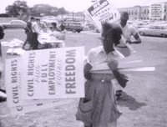
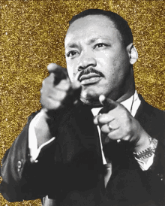

Slide 41
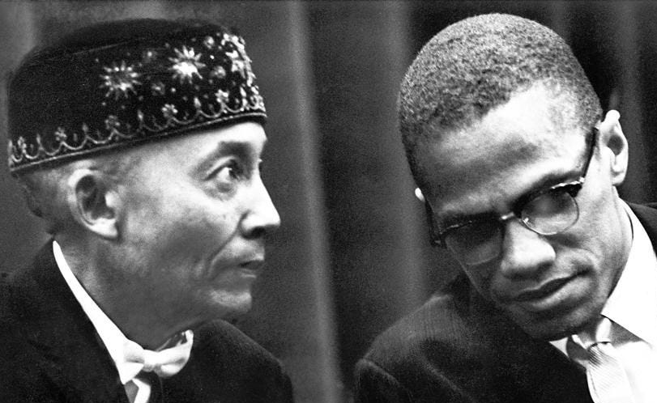
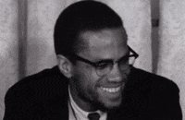
(d) Protests, 1966-1974
From 1966 on, division was clear within the Civil Rights movement:
Peaceful Protest, integration & working with the Government to achieve aims.
BLACK NATIONALISM, separation from other races & violence to achieve aims.
Perhaps the most famous group advocating Black Nationalism was NATION OF ISLAM. Set up in 1930, it had always argued that racial integration would not bring equality or end discrimination – because whites would always think themselves superior. They wanted segregation to continue, with equal & separate standards. In 1952, it had 500 members; by 1962, it had 40,000 members.

Slide 42
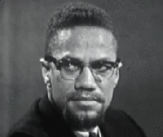
(d) Protests, 1966-1974
Malcolm Little’s father was hit by a tram when Malcolm was 6-years-old. (But he could have been beaten & dumped on the tram-line by the Black Legion – a white supremacist group). After going to prison for burglary in the 1940s, Malcolm joined the Nation of Islam & changed his name to Malcolm ‘X’. He left prison in 1952 & became a minister for the Nation of Islam – touring the USA trying to convert people to join too. He criticized the work of MLK & dubbed the March on Washington “THE FARCE ON WASHINGTON.” He also felt that not retaliating to violence was foolish.

Slide 43
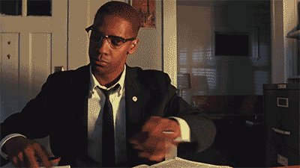
(d) Protests, 1966-1974
In 1964, Malcolm X argued with Elijah Muhamad & left the Nation of Islam. He became a Muslim, went to Mecca (where he saw Muslims of all races treated equally) and abandoned his previous Black Nationalism views. Upon arrival back in the USA, he set up the Organization of Afro-American Unity to promote Civil Rights & links with African heritage. He even stated that this new organization would work with MLK & white people! He never got the chance – assassinated on 21st Feb 1965 in New York, by 3 members of the Nation of Islam who were angered by his new views.

Slide 44
“So we have formed an organization which has the same aim & objective – to fight whoever gets in our way, to bring about the complete independence of people of Aftrican descent here in the Western Hemisphere, and first here in in the United States, and bring about the freedom of these people by any means necessary. That’s our motto: We want freedom by any means necessary. We want justice by any means necessary. We don’t feel that in 1964, living in a country that is supposedly the leader of the free world, we don’t think that we should have to sit around & wait for some segregationist congressmen & senators and a President from Texas in Washington D.C. to make up their minds that our people are due now some degree of civil rights. No, we want it now or we don’t think anybody should have it.”
From a speech by Malcolm X at the 1st rally of the OAAU, 29th June 1964

Slide 45
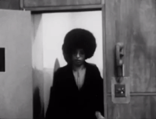
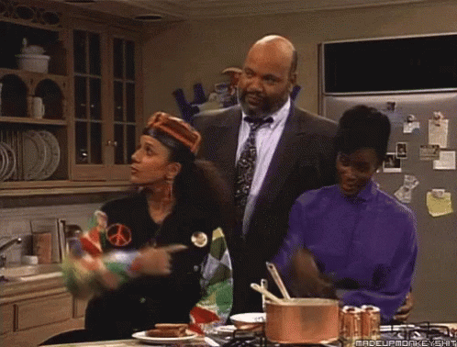
(d) Protests, 1966-1974
Malcolm X was certainly more influential in death than in life. His philosophy of BLACK PRIDE, VIOLENCE IN SELF-DEFENCE & REJECTION OF NON-VIOLENT GROUPS inspired others to establish radical organizations:
BLACK POWER, coined in a speech in 1966, aimed at self-determination for black people via black-owned business.
BLACK PANTHERS, a Marxist-Leninist black political party set up in 1966.
Malcolm X also impacted all Civil Rights groups to focus on economic & social problems facing African-Americans.

Slide 46
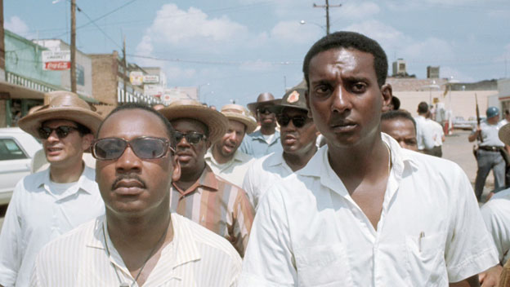
(d) Protests, 1966-1974
In June 1966, JAMES MEREDITH led a ‘March against Fear’ through Mississippi. He was shot on the second day of the march. As he recovered, MLK & Stokely Carmichael led the march instead. Their speeches struck very different tones – MLK highlighted the real need for further peaceful protest, while Carmichael made a much more militant demand for “Black Power!”

Slide 47
“This is the 27th time I have been arrested. I ain’t going to jail no more. The only way we gonna stop them white men from whuppin’ us is to take over. We been saying ‘freedom’ for 6 years and we ain’t got nothin’. What we gotta start saying now is ‘Black Power’!”
From a speech by Stokely Carmichael upon release in June 1966

Slide 48
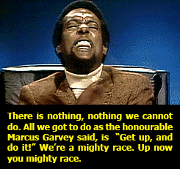
(d) Protests, 1966-1974
Stokely Carmichael was a SNCC campaigner & became leader in May 1966. Originally supportive of non-violent methods, he got frustrated by slow progress of such peaceful protest. Inspired by Malcolm X, he adopted the same militance – rejecting white help, radical action & respecting African culture – using the term “Black Power!” to attract young African-Americans from poorer areas to improve their lives.

Slide 49
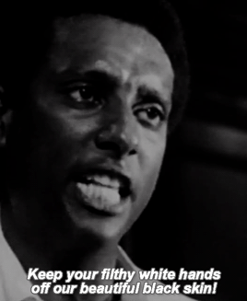
(d) Protests, 1966-1974
BLACK POWER GREW FOR 4 REASONS:
Many black people were frustrated by slow progress of traditional approach.
The movement expressed the anger many felt about lack of employment opportunities & city “ghettoes.”
SNCC evolved into many Black Power groups & publicity stunts (like the 1968 Olympics) increased awareness.
Black Power groups encouraged African-Americans to be proud of their race, culture & heritage. “Black is beautiful!” chants at meetings.

Slide 50
(d) Protests, 1966-1974
BLACK POWER SALUTE IN MEXICO ‘68
Ignoring the calls to boycott the Mexico Olympics, black US athletes chose to show the world their prowess. TOMMY SMITH + JOHN CARLOS won the Gold & Bronze medals in the 200m Sprint and, during the medal ceremony, they made the Black Power salute (clenched fist) & wore only socks (to highlight poverty of shoeless African-Americans). They saw anger & criticism, death threats & got banned from future Olympic Games … but their Black Power salute was seen by millions & got worldwide attention.

Slide 51
(d) Protests, 1966-1974
Black Power made moderate Civil Rights campaigners concerned & scared white Americans. Extreme actions by Black Power groups justified extreme force used by Police against all protestors.
Black Power had a positive impact too. Malcolm X’s legacy continued & more African-Americans took pride in their roots. This inspired self-confidence in young black people & encouraged projects to improve their living conditions. Economic & Social focus helped to address these issues long after.

Slide 52
(d) Protests, 1966-1974
The Black Panther Party was founded in Oakland, California in Oct. 1966. BOBBY SEALE + HUEY NEWTON saw it as a political Black Power group & it only had 2,000 members at its peak across 25 US cities. Members wore black berets, black trousers & black leather belts (plus guns too). Despite the distinctive & dangerous look, they actually were willing to work with white people who shared their beliefs. Their most notorious action was “Patrolling the Pigs” (stalking the Police to stop violence) & Communist views meant FBI monitoring of them.

Slide 54
(d) Protests, 1966-1974
The Black Panthers were very successful with schemes to help poorer communities to improve their lives:
Medical Clinics to provide free healthcare for black people
Breakfast Clubs for black kids before Schools opened
Free shoes for black kids
Black History lessons
Co-operation between gangs to reduce street violence

Slide 55
Exam-Style Question
‘The main impact of the Black Power movement was to drive away white supporters of Civil Rights.’
How far do you agree?
You may use the following in your answer:
Driving away white supporters of Civil Rights
Improving life in the ghettoes
You must also use information of your own.
(16 marks)

Slide 56
(d) Protests, 1966-1974
Just 2 weeks after the signing of the Civil Rights Act 1964, a large riot occurred in New York – it showed that people were still very angry & determined to take direct action. 1964-1968 saw 329 major riots in over 257 US cities; 200 people died; 1,000s were injured; 10,000 plus were arrested & over $1 billion worth of damage was done. The largest riot was in Watts, L.A., 11th to 17th Aug. 1965; MARQUETTE FRYE was arrested for DUI, he resisted arrest … but rumors swirled Police had beaten his mother & pregnant girlfriend; after violent clashes, 14,000 California National Guards were sent to enforce a curfew & to restore order. In the end, 34 were dead, 1000 injured, 4000 arrested & hundreds of shops + homes severely damaged.

Slide 57
(d) Protests, 1966-1974
In 1968, the KERNER REPORT was set up to investigate the Riots. It was inconclusive about which group started riots, but stated the following causes:
Frustration & anger at the poor living conditions in ghettos caused by segregation & discrimination.
Failure of Police to respond
Unfair treatment by the Police, whose use of violence made situations worse.
Recommendations to set up more social programmes were never put in place, however, as Richard Nixon became President in Jan. 1969 + it was ignored.

Slide 58
‘Despite the civil rights gains of the 1960s, however, racial discrimination & repression remained a significant factor in American life. Even after President Johnson declared a war on poverty & MLK initiated a Poor People’s Campaign in 1968, the distribution of the nation’s wealth & income moved towards greater inequality in the 1970s. Civil Rights advocates acknowledged that desegregation had not brought significant improvement in the lives of poor blacks.’
From a book about US History & Culture, published in 1996
What impression does the author give about progress made in African-American civil rights? (6m)

Slide 59
(d) Protests, 1966-1974
The problem with the Race riots of the mid-1960s was that they lost sympathy of white supporters & increased fear of young African Americans. The media often exaggerated portrayals of civil rights campaigners as lawless thugs intent on rioting. Money was given by the Federal Government to improve living conditions in ghettos, but many States spent this on weapons & Police training to deal with riots … not their cause. Positively, the focus of the Civil Rights campaign moved towards social & economic problems. Overall, however, rioting overshadowed MLK’s peaceful protests & non-violence.

Slide 60
(d) Protests, 1966-1974
MLK announced, on 7th Jan. 1966, that the Chicago Freedom Movement was aiming to improve the terrible conditions in one of the worst ghettos in America. They launched “OPERATION BREADBASKET” to improve HOUSING, EDUCATION & EMPLOYMENT by boycotting & pressurizing Businesses into employing more poor black citizens. MLK met with City Officials to try to convince them to improve living conditions. In July 1966, however, Race Riots broke out and August 1966 saw a protest march end with marchers being pelted with bricks, rocks & glass bottles. MLK reached an agreement with the Chicago Mayor to build public housing & for Mortgage Bankers Association to agree mortgages irrespective of race. But, in the end, the Chicago authorities relented on these agreements & little changed there.

Slide 61
(d) Protests, 1966-1974
MLK also announced the “POOR PEOPLE’S CAMPAIGN” in December 1967. It was to help all races, not just blacks – Mexican Americans, Native Americans & poor white Americans too. Their demands were:
Extension of welfare to help unemployed
Fair minimum wage
Education of poor adults & children to boost self-esteem & employment hopes
Focused on Washington DC, protestors set up temporary shelters near Congress to make their point. On 4th April 1968, MLK was assassinated by JAMES EARL RAY, a white supremacist, sparking further Race Riots & the food programs in DC were overshadowed by violence. Unity ended post-MLK.

Slide 63
(d) Protests, 1966-1974
LBJ was concerned by the Race Riots & extreme Civil Rights campaigning after 1965, hoping that the Civil Rights Act 1964 could be used to cut School funding for those Southern Schools resisting integration. He used this tactic so effectively that, by the time his Presidency ended in 1968, 60% of Southern Schools had desegregated. The way in which this was also achieved was via the new method of BUSSING; where children were transported by bus from black areas to white areas to go to integrated schools. Once again, those who opposed this simply moved out of urban areas to avoid their children having to share educational space with black children. Overall, however, bussing was a success & allowed Johnson to slash desegregation numbers across the USA.

Slide 64
(d) Protests, 1966-1974
LBJ also encouraged “AFFIRMATIVE ACTION” where a type of positive discrimination gave African-Americans opportunities ahead of white Americans (esp. if Universities or Employers were prepared to accept lower qualifications or skills). This outraged black & white Americans alike – blacks felt quite patronized and whites felt unfairly treated. Nevertheless, Johnson’s engagement with Civil Rights meant that his successor, Richard Nixon, was duty-bound to continue the positivity that Johnson was trying to build. Nixon 1969-1974, however, was not as committed to improving Civil Rights as Johnson had been 1963-69.

Slide 65
(d) Protests, 1966-1974
Richard Nixon was less active in reducing funding for Schools resisting desegregation & openly criticized ‘bussing’ on TV – he even tried to over-turn a Supreme Court ruling SWANN v CHARLOTTE-MECKLENBURG, 1971 allowing bussing by Law. Later, the Supreme Court ruled that bussing was only allowed “where segregation was deliberate” in MILIKEN v BRADLEY, 1974. After peaking at 60% desegregation during Johnson’s Presidency up to 1968, Nixon oversaw that desegregation actually dropped to 40% by 1974. The only Civil Rights that Nixon changed was an Equal Opportunities Act, 1972 – after the Supreme Court said “affirmative action” was unconstitutional in GRIGGS v DUKE, 1971.

Slide 66
(d) Protests, 1966-1974
Between 1968 and 1974, minor improvements in education & employment were evident, but disunity in the Civil Rights movement & a President who was reliant on Southern voters limited any move forwards. No replacement for MLK, to try to work with Nixon to push for further reform, meant that African-Americans continued to live in poverty & social equality seemed a long way off. Progress had been made, but legality without action was hollow.

Slide 67
Unit 3 Recall Quiz
What is meant by the term “Sit In”?
What was “Bull” Connor & why is he significant to Civil Rights protests?
What were the SCLC + SNCC?
Outline the terms of the 1964 Civil Rights Act and the Voting Rights Act 1965.
Explain the methods of protest used by MLK.

Slide 69
Unit 3 Recall Quiz
What happened in Selma in 1965?
Give 3 reasons for the growth of Black Power.
Who was Stokely Carmichael?
Who founded the Black Panthers?
Give 3 consequences of the Race Riots, 1964-1968.

