Slide 1
Edexcel IGCSE History P1: Depth Study 7
A Divided Union: Civil Rights in the USA, 1945-1974

Slide 3
Edexcel IGCSE History P1: Depth Study 7
A Divided Union: Civil Rights
in the USA, 1945-1974
2. Civil Rights in the 1950s

Slide 4
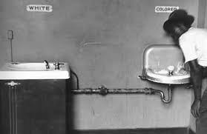
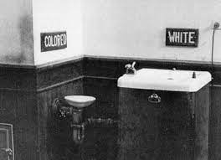
(a) Segregation and Discrimination
Segregation is the simple act of making black & white people use different facilities. In the 1950s, most states had segregation laws & the Southern states enforced C.19th “Jim Crow” Laws; whereby African-Americans had to use separate areas in restaurants, libraries, cinemas, parks, swimming pool & public transport. Northern states had fewer legal barriers but racism & discrimination saw the African-Americans live separately from white people. Black wages were half of white wages, so black people could only afford to live in the poorest neighborhoods, so communities were segregated without the need for laws.

Slide 5
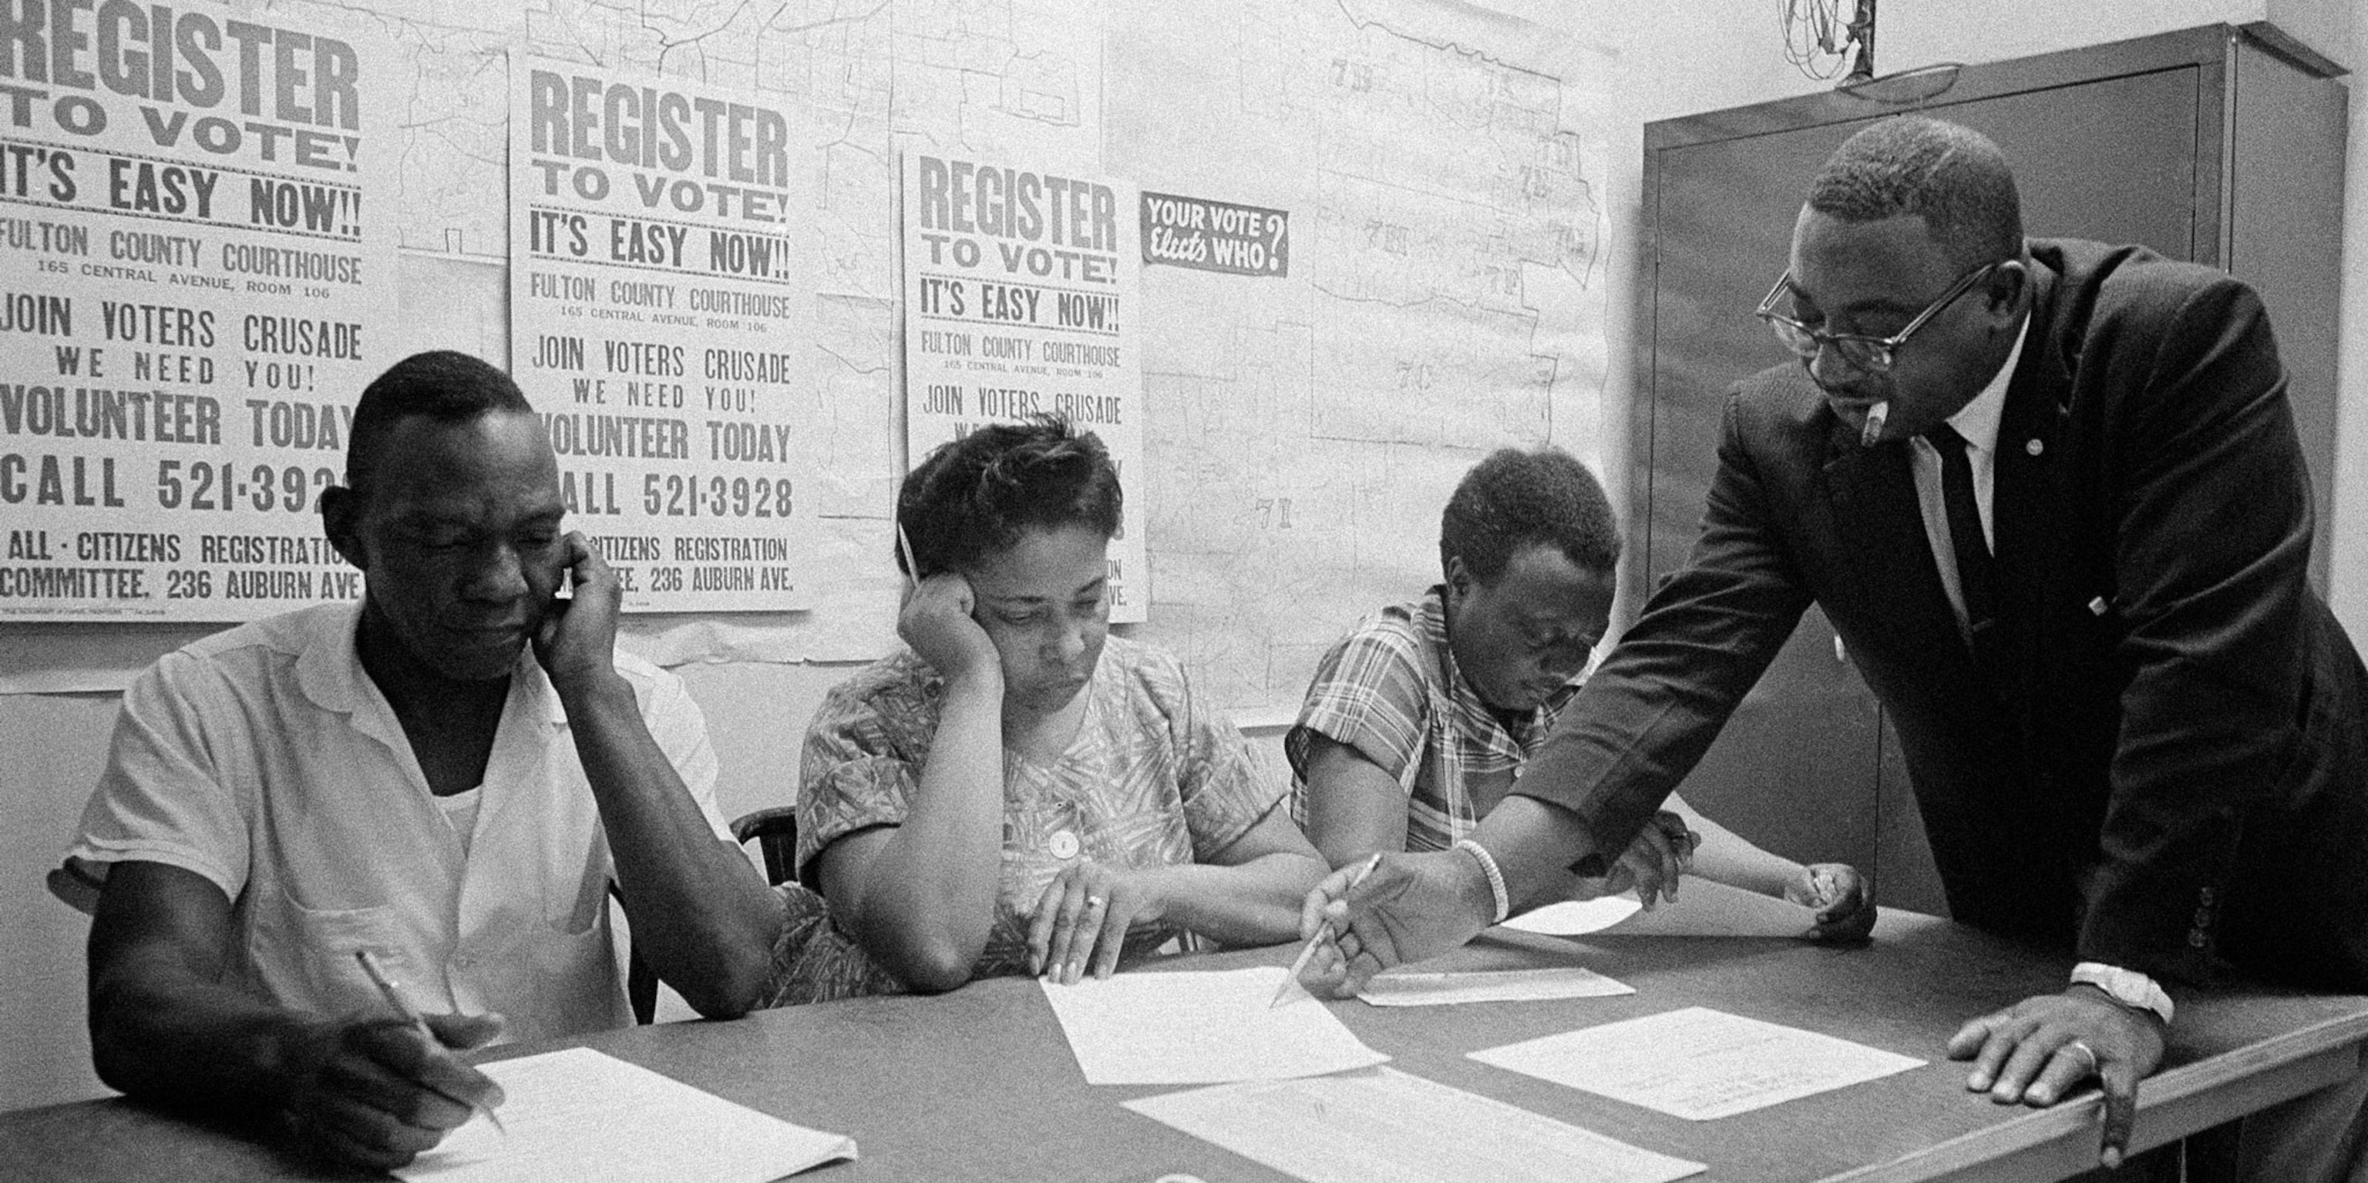
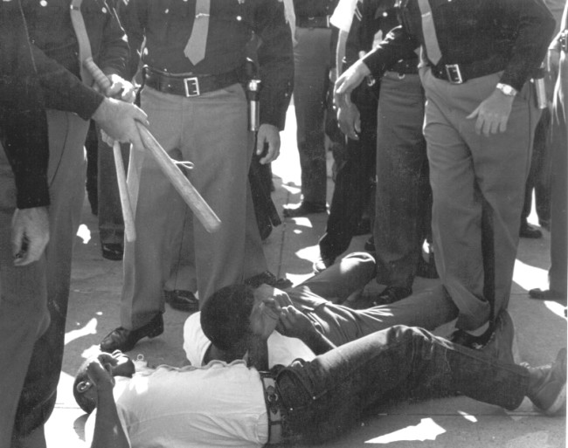
(a) Segregation and Discrimination
According to the Constitution, all US citizens had the right to vote. In the 1950s, however, very few African-Americans were able to vote. Southern states used various methods to stop black people registering to vote:
LITERACY TESTS – African-Americans had very little education in segregated schools, so their literacy levels were low … and white people were exempted from literacy tests!
POLL TAX – African-Americans could not afford to pay this, so disqualified themselves by not paying the required poll tax.
VIOLENCE – African-Americans were prevented from registering to vote using violence or the threat of violence against them.

Slide 6
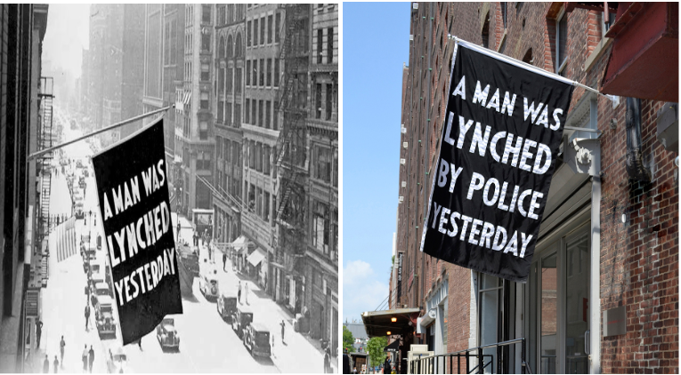
(a) Segregation and Discrimination
In addition to segregation & discrimination, the Southern states saw an increase in violence against black people. Racist white mobs often took the law into their own hands and carried out LYNCHINGS. Though the act of murdering black people via lynchings had declined by the 1950s, fear of a white mob suddenly attacking remained within black communities. THE POLICE (the very men who should have been protecting black citizens from racist mobs) WERE SOMETIMES A PART OF RACIST MOB attacking black people. When cases reached Court, white people accused of attacking African-Americans were usually found “Not Guilty” by all-white, all-male Juries before a white, male Judge.

Slide 7
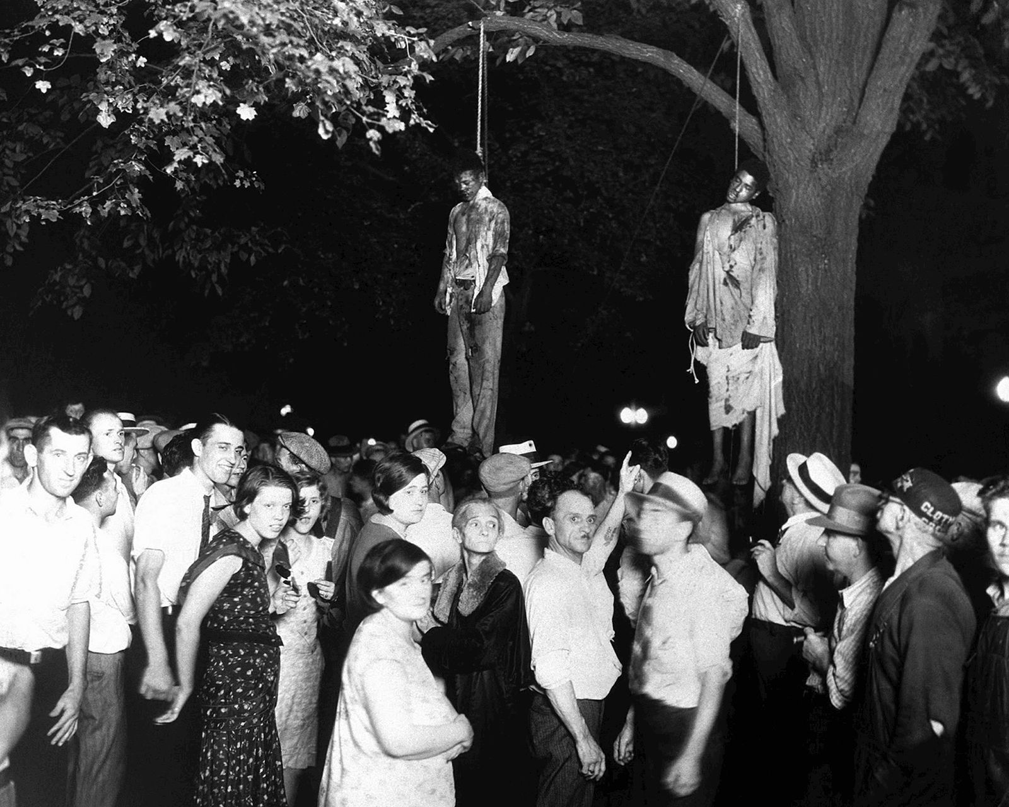
An ordinary gathering of American citizens?

Slide 8
A Lynching

Slide 9
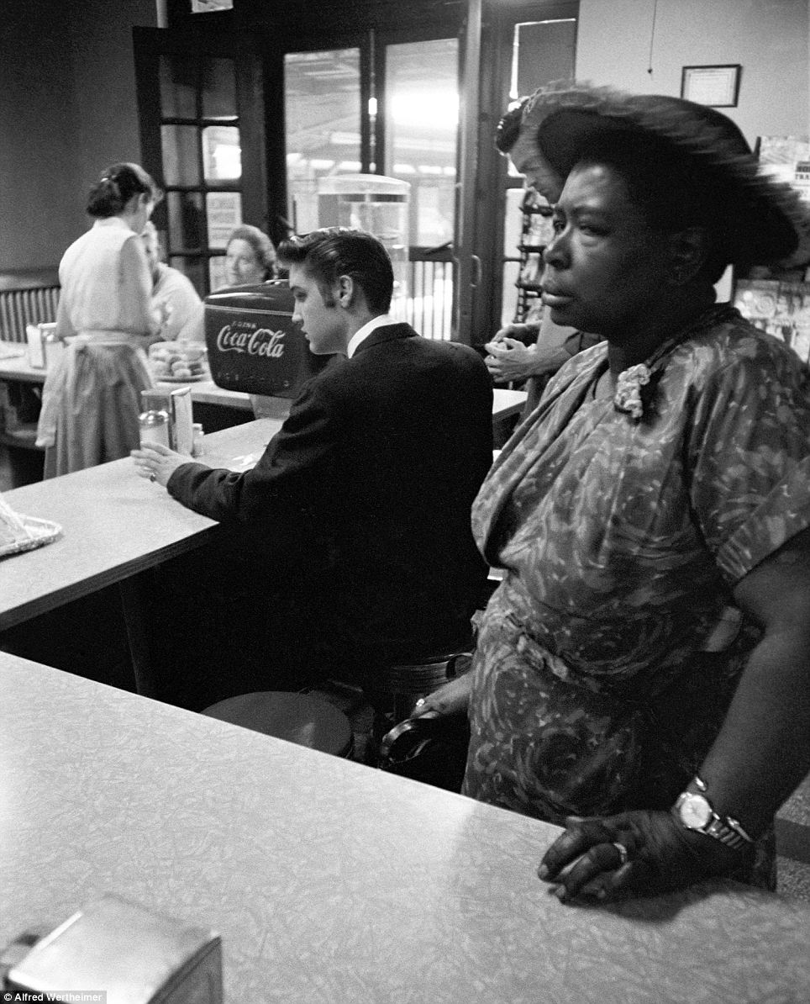
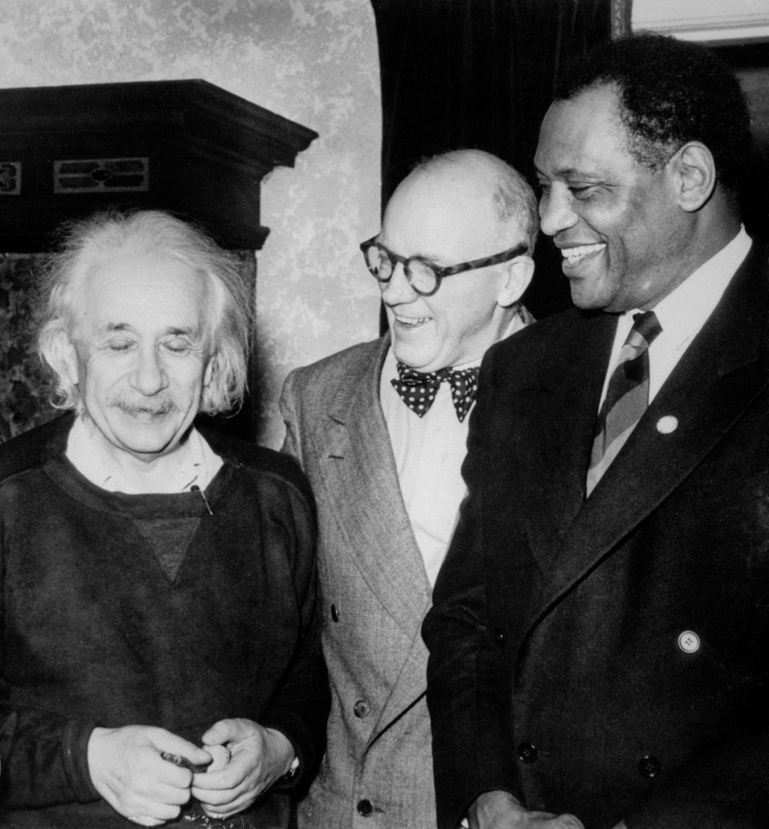
Elvis shot eating at a Segregated Counter.
Einstein shot with Black Colleagues.

Slide 10
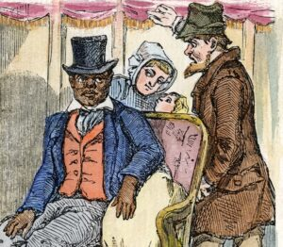
(b) The Influence of the Supreme Court & Congress
Despite the Constitutional guarantees that all Americans were equal, this simply wasn’t the case for African-Americans. None of the 3 branches of US Govt. acted to enforce Civil Rights – either because they were racist themselves, or feared a backlash from racist voters in their states. Even Presidents, reliant on the support of Southern states, did not act to improve Civil Rights.
The Supreme Court should have stepped in earlier to ban segregation laws as unconstitutional, but they didn’t. Indeed, in Plessy v Ferguson 1896 “separate facilities were permitted IF EQUAL.” This case set a legal precedent for racists to argue that equality for African-Americans DID exist.

Slide 11
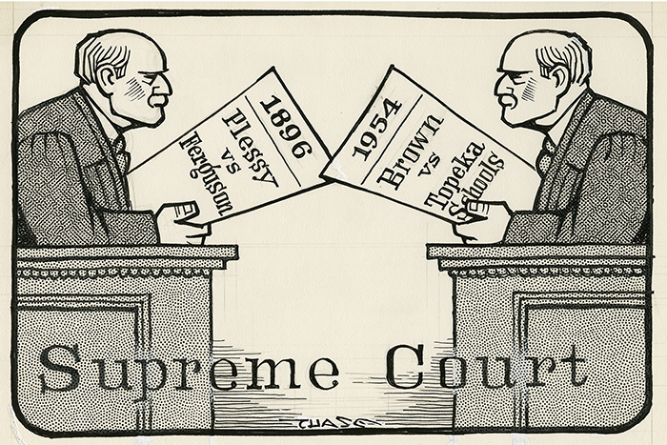

Slide 12
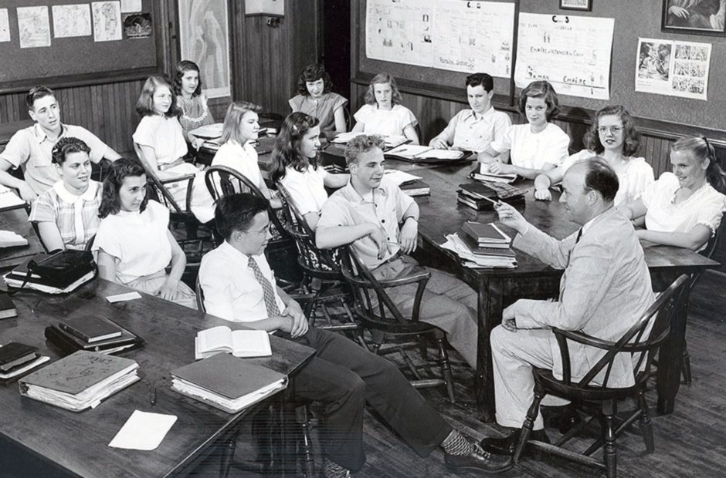
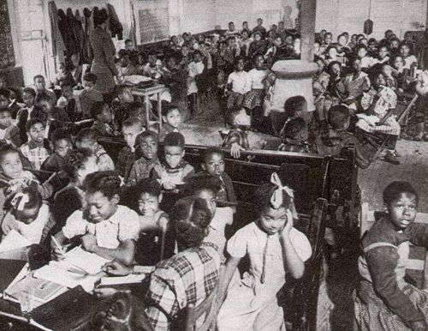
(c) The Importance of Brown v. Board of Education of Topeka
Many American states had Segregated Schools, not just in the South. State spending on the education of white pupils was 4 times that spent on black pupils. The principles established in Plessy v Ferguson 1896 (“Separate, but Equal”) were clearly being breached & Civil Rights groups felt that this was an important area to attack. The National Association for the Advancement of Colored People (NAACP) focused on challenging segregated education THROUGH THE COURTS. Petitioning Congress had clearly failed (as many politicians feared the racist reaction against any changes to the law) so this new litigious tactic soon saw some states improve African-American schools … just to maintain segregated education!

Slide 13
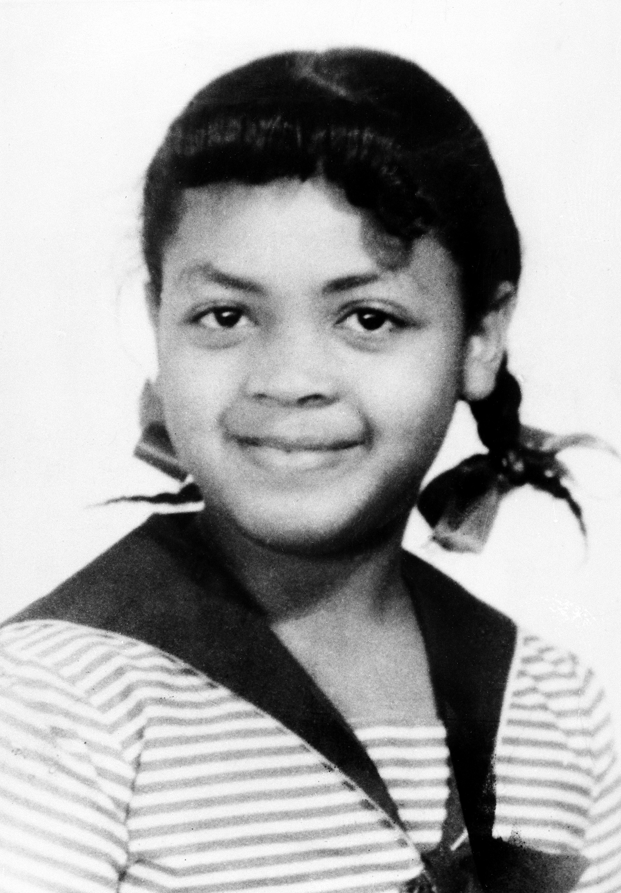
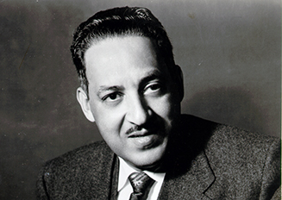
(c) The Importance of Brown v. Board of Education of Topeka
BROWN v. BOARD OF EDUCATION OF TOPEKA, 1954
Linda Brown’s parents applied for their daughter to attend the Sumner Elementary School in Topeka, as it was nearer their home than her current school. The Board of Education rejected Linda on grounds of race, as Sumner School was a “Whites Only” School. The NAACP supported the Browns mount a legal challenge, but the local court rejected the case & cited Plessy v Ferguson 1896. Undeterred, the NAACP persuaded the Browns to appeal to the Supreme Court with NAACP lawyer, Thorgood Marshall, leading the legal challenge. Before Judge Earl Warren, Marshall argued that “Separate Schools were damaging African-American children psychologically even if they were equal in terms of funding & facilities.” On 17 May 1954 the Supreme Court unanimously ruled segregated schools were “unconstitutional.” President Eisenhower really regretted appointing Earl Warren.

Slide 14
“To separate children from others of similar age and qualifications solely because of race generates a feeling of inferiority as to their status in the community that may affect their hearts & minds in a way unlikely to ever be undone. We conclude that in a field of public education the doctrine of “separate but equal” has no place. Separate educational facilities are inherently unequal. Therefore, we hold that the plaintiffs & others similarly situated are deprived of the equal protection of the laws guaranteed by the Fourteenth Amendment.”
From Chief Justice Earl Warren’s Brown v Topeka ruling, 17 May 1954
How do you think this speech would be received in the South? Whose words is Warren echoing?

Slide 15
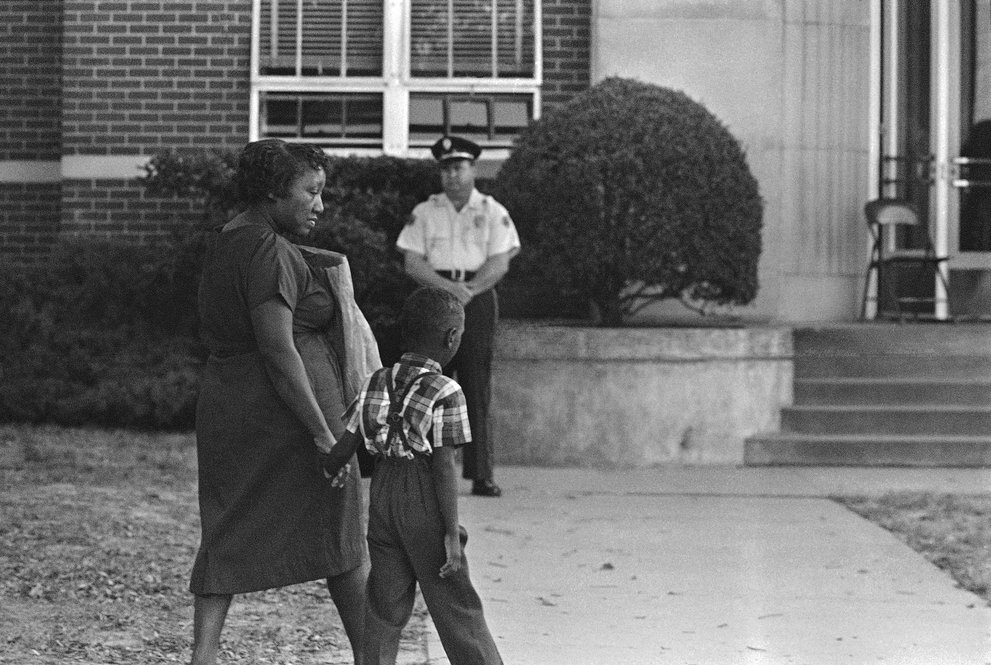
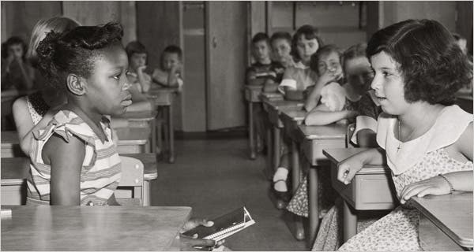
(c) The Importance of Brown v. Board of Education of Topeka
The Supreme Court ruling in May 1954 finally broke the precedent of Plessy v Ferguson 1896. The ruling meant that Segregated Schools had to “DESEGREGATE” at last. A year after the original Brown v Topeka 1954 decision, another Supreme Court ruling ordered desegregation to occur “with deliberate speed and all states should make a prompt & reasonable start.” Celebrations were short-lived & immediate impact was limited. Some states in the North began to integrate, but the Deep South dragged their feet with integration & resisted making the necessary changes. Black pupils faced anger after integration and, in many cases, their education actually suffered – segregated black schools closed & talented black teachers lost jobs & careers.

Slide 16
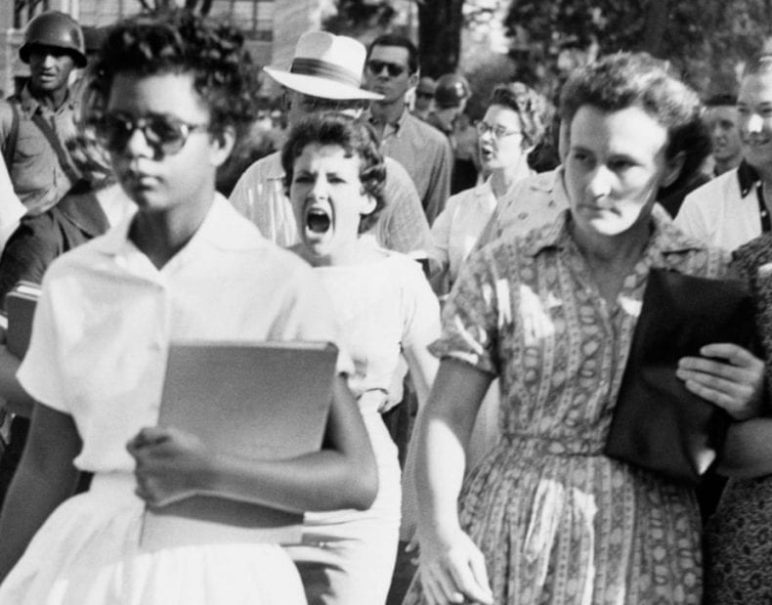
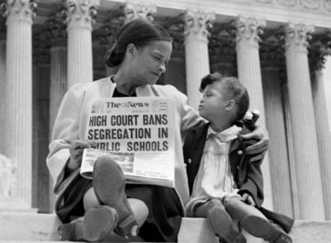
(c) The Importance of Brown v. Board of Education of Topeka
In some Southern town & cities, segregation became more extreme – “WHITE FLIGHT” saw people leave areas that had become predominantly black and a division of neighborhoods became apparent even after integration attempts.
Despite negativity, the Supreme Court ruling was a great victory for the NAACP and certainly saw an increased awareness of African-American Civil Rights. Brown v Topeka 1954 created a new legal precedent with which to challenge the segregation of Plessy v Ferguson 1896 and more legal cases & campaigns could follow. The US political system (or, at least, the Legislative) seemed supportive of black citizens.
Hope was given to Civil Rights campaigners for further changes – after education, other areas could become targets for NAACP activities.

Slide 17
Exam-Style Question
Explain two effects of
the Brown v. Topeka
decision on the USA.
(8 marks)

Slide 18
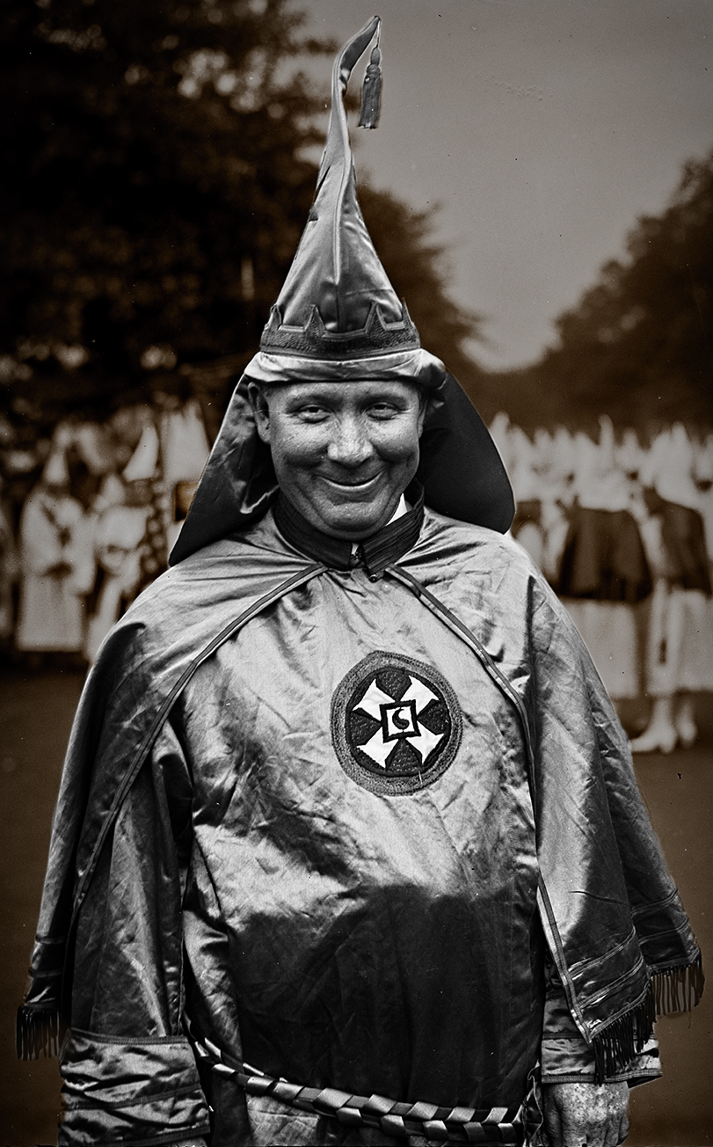
(d) Revival of the Ku Klux Klan
Hiram Wesley Evans, Dallas.
Southern States referred to the day that the Brown v. Topeka case was published as “Black Monday.” White Southerners were outraged and swore to maintain segregation. In the city of Indianola, Mississippi, the first ever White Citizens’ Council was set up – many more WCCs followed in rapid succession. These groups organized peaceful protests & petitions, tried to pressure States to resist integration, but the conditions were ripe for a revival of the White Supremacist group – the KU KLUX KLAN (KKK). KKK membership grew rapidly across the South 1955 to 1960, although the numbers never reached the terrifying peak levels seen in the 1920s. Burning crosses, white hoods & robes and racial hatred became a familiar sight.

Slide 19
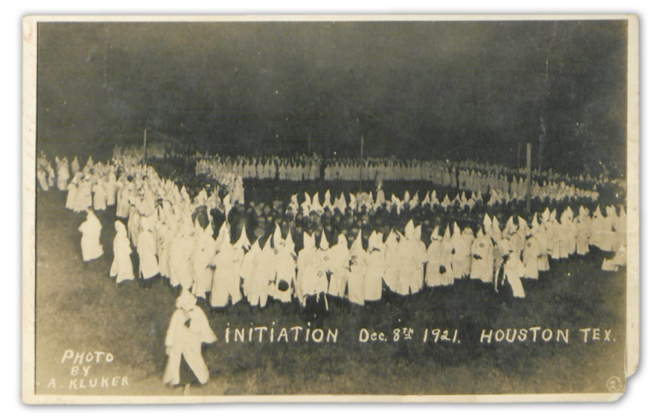

Slide 20
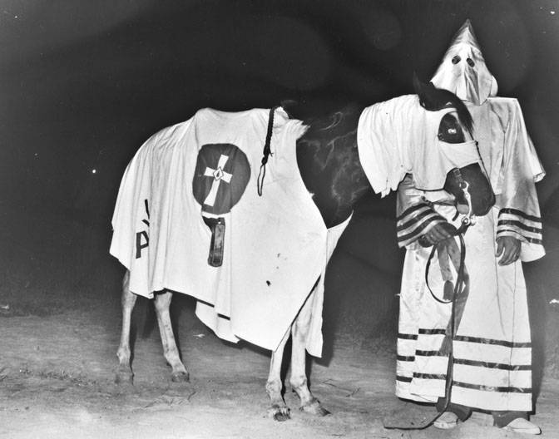
Vidor, Texas, 1971.

Slide 21
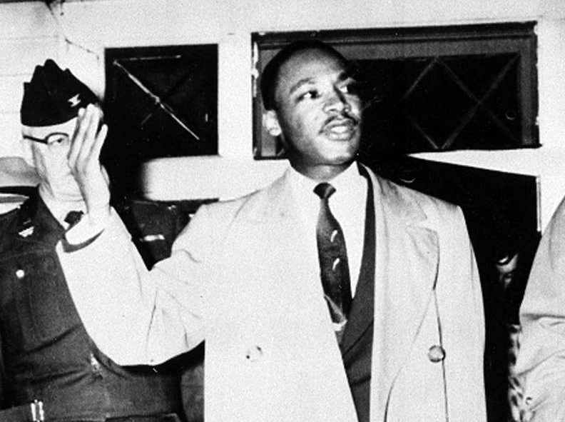
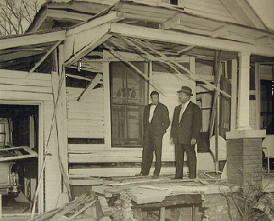
(d) Revival of the Ku Klux Klan
Targets of the KKK were Civil Rights protestors – black or white. After the initial growth of KKK activities, following the Brown vs Topeka case, the Klan further expanded as an opposition group to anybody demanding black Civil Rights. As the Civil Rights movement saw success, the KKK became ever more extreme. Their traditional evil actions of beatings, lynchings & and shooting victims continued, yet the Montgomery Bus Boycott (organized by MLK in the wake of Rosa Parks’ arrest) saw the first KKK bombing in 1956. On 30th Jan. 1956, while MLK spoke in Montgomery, his wife and 10-week-old daughter were terrified by a bomb at the front-door. Only the house was damaged and, when an angry black mob demanded a revenge attack, MLK persuaded them not to use violence.

Slide 22
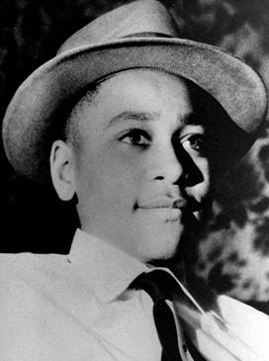
(d) Revival of the Ku Klux Klan
Perhaps the worst example of the increased violence against African Americans in the South is the murder of Emmett Till. Raised in the North (in Chicago) this 14-year-old visited relatives in Money, Mississippi in the summer of 1955. On 24th Aug., after boasting about his “white girlfriend back home,” Till was dared to go into Bryant’s Grocery Store and chat-up the white owner’s wife, Carolyn. Till bought some bubble-gum and his friends stated that he whistled at her, but Carolyn claimed he flirted and touched her. 4 days after the event, in the dead of night, the white owner & his half-brother dragged Till from bed, beat him, shot him in the head & dumped his body in a river. Emmett Till was found on 31st August 1955.

Slide 23
‘It would appear that the state of Mississippi has decided to maintain white supremacy by murdering children. The killers of the boy felt free to lynch him because there is in the entire state no restraining influence of decency, not in the state capital, among the daily newspapers, the clergy nor any segment of the so-called better citizens.’
From a NAACP statement released after the murder of Emmett Till

Slide 24
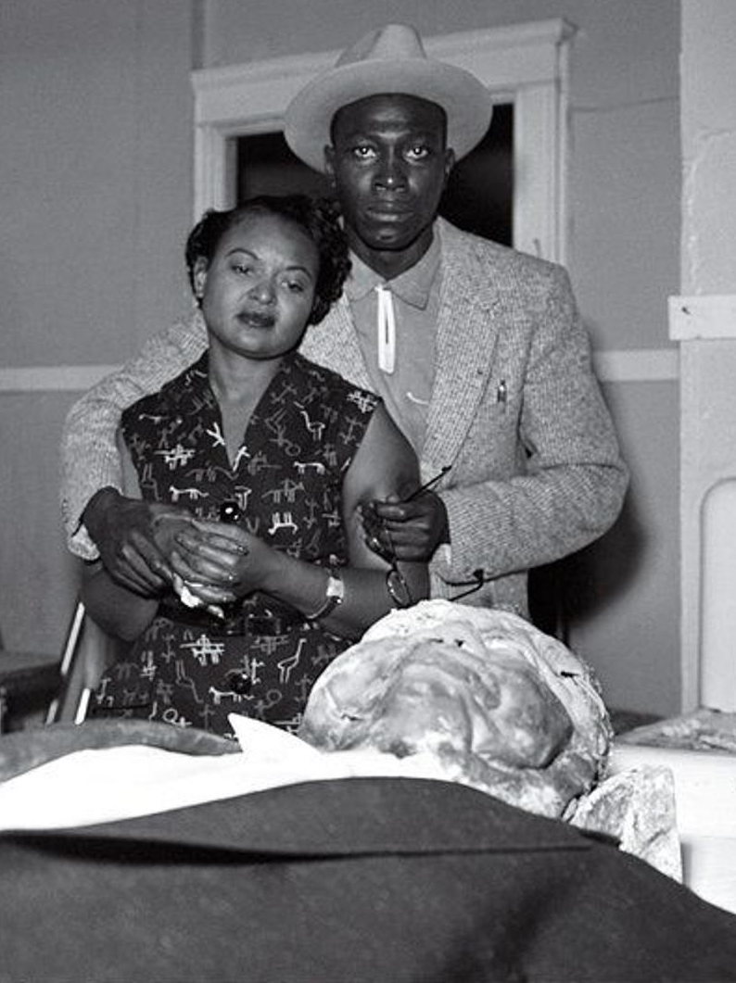
(d) Revival of the Ku Klux Klan
The Mississippi authorities wanted to bury Till quickly, but his mother insisted the body was sent back to her in Chicago. His battered face made him unrecognizable, so Mamie Bradley left Till’s coffin open so that the world could witness what had been done to her son. When photos of Till’s body were published, black & white people were aghast. The trial of Till’s killers, Bryant & Milam, took just over an hour – the all-white, all-male jury finding the defendants “Not Guilty.” The lack of justice was clear to all – even after Bryant & Milam had confessed to beating and killing Till in a magazine article, the “Double Jeopardy” rule protected them.

Slide 25
‘The white people in the region raised a defense fund approaching $10,000 for defendants Bryant & Milam. They hired 5 local lawyers, who produced expert witnesses – including a doctor and an embalmer – to testify that the bloated, decomposing body had been in the river for at least 10 days and, therefore, could not have been Emmett Till. Sheriff Strider took the stand for the defense and said the same thing: “If it had been one of my boys, I couldn’t have identified it.” In most of the US, this conflict over the identity of the body could have been resolved by basic police work.’
From a US magazine reporting the trial of Bryant & Milam, 3 Oct 1955

Slide 26
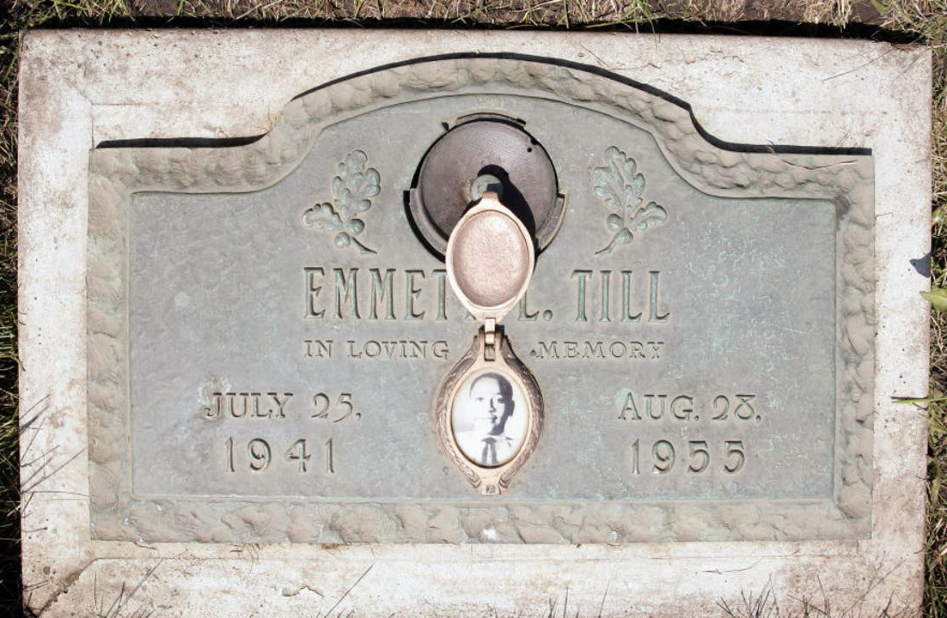
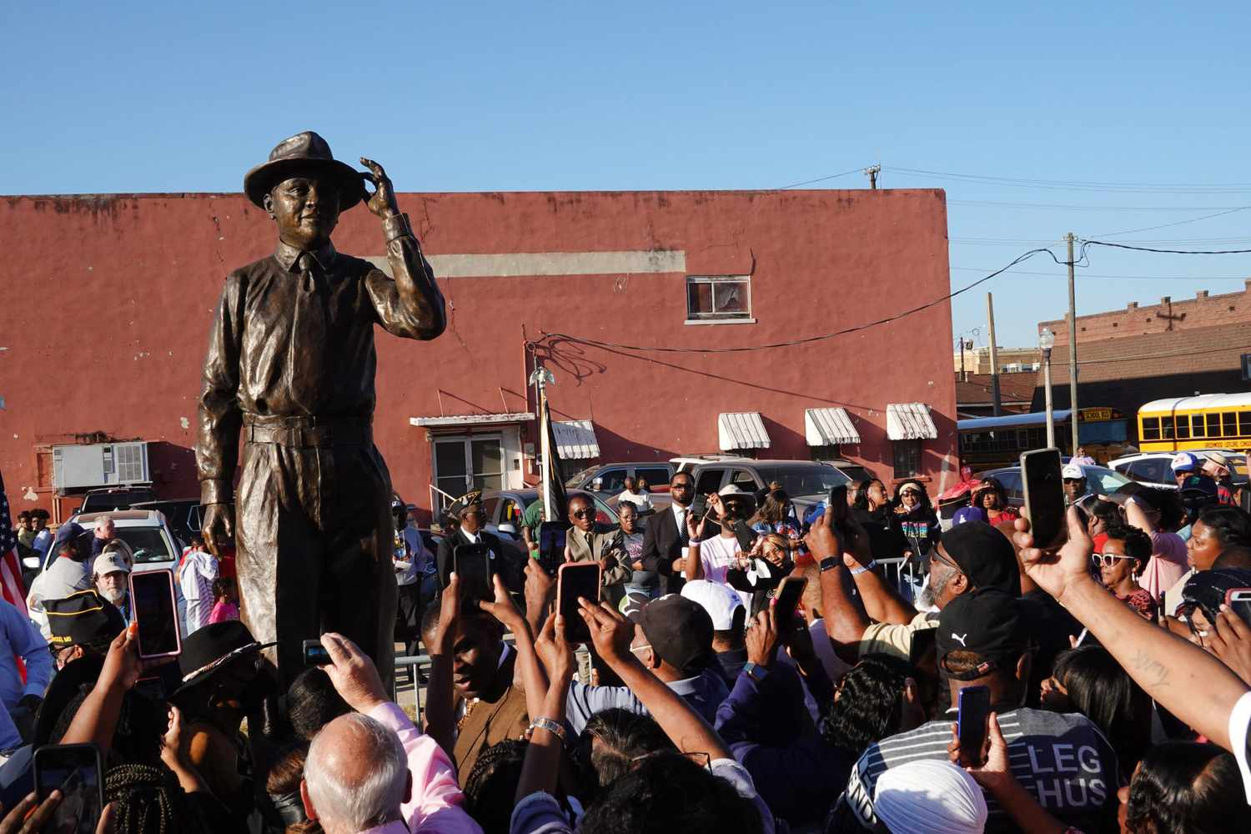
(d) Revival of the Ku Klux Klan
The impact of Emmett Till’s death was quite different to most other killings of African Americans – most lynchings were always followed by acquittals – because the Till case garnered such publicity. As a result its new consequences were two-fold:
White Americans in the North saw how extreme Southern racism was. Increased awareness of African Americans followed.
African Americans began to be much more active in attempts to bring about change. Young men & women around Till’s tender age joined the Civil Rights movement in the 1960s. Many see Till as a CATALYST for change & a CATALYST for civil rights.

Slide 27
Exam-Style Question
‘The main effect of the Brown v. Topeka decision on African Americans was the increase in violence against them.’
How far do you agree?
You may use the following in your answer:
Brown v. Topeka
The murder of Emmett Till
You must also use information of your own.
(16 marks)

Slide 28
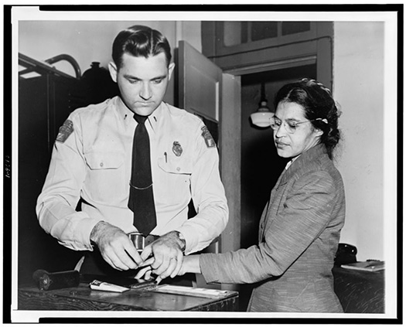
(e) Key Events & Significance of the Montgomery Bus Boycott & Little Rock
In Montgomery, Alabama, buses were segregated on 1st Dec. 1955. Rosa Parks boarded the bus and sat in the “colored” first row. When extra passengers got on at the next stop, a white man had no seat. The driver instructed the whole first row to stand, so the white man could sit down, but Rosa Parks refused. The driver simply called the police and they arrested Rosa Parks immediately.

Slide 29
“I thought about Emmett Till and, when the bus driver ordered me to move to the back, I just couldn’t move.”
Rosa Parks’ description of what happened on 1 Dec. 1955

Slide 30
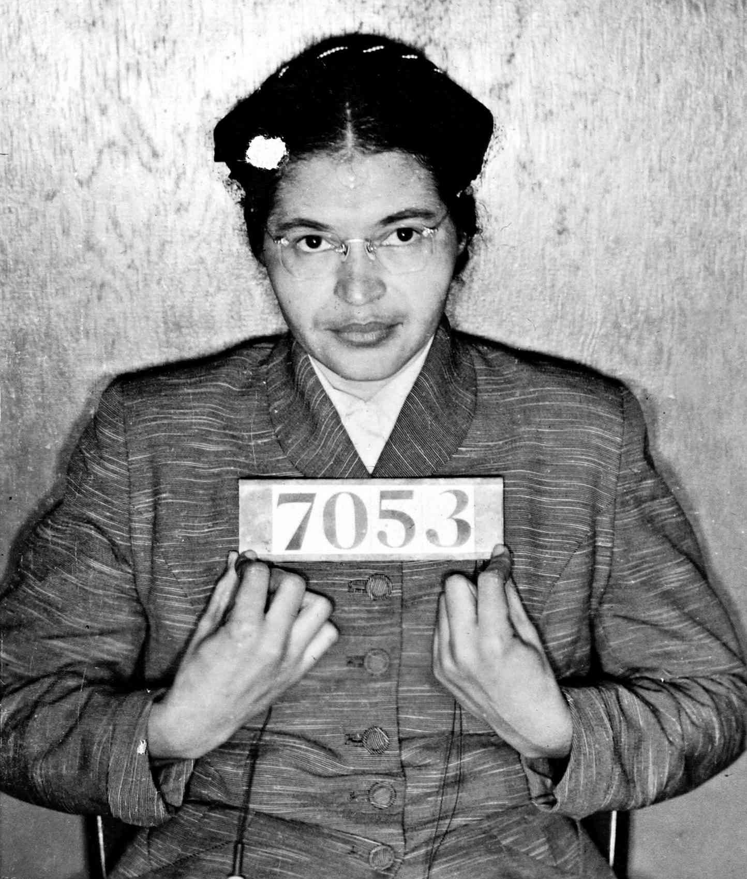
(e) Key Events & Significance of the Montgomery Bus Boycott & Little Rock
The Montgomery branch of the Women’s Political Council had been fighting racial discrimination on buses since 1950, as black women were routinely bullied by white drivers. Rosa Parks was certainly not the first to be arrested for breaching segregation laws. A boycott had already been threatened to Mayor Gayle, so it was Rosa Parks’ arrest that sparked the Montgomery Bus Boycott. The WPC called for all African Americans to boycott buses on 5th Dec (Parks’ trial day). 90% didn’t.

Slide 31
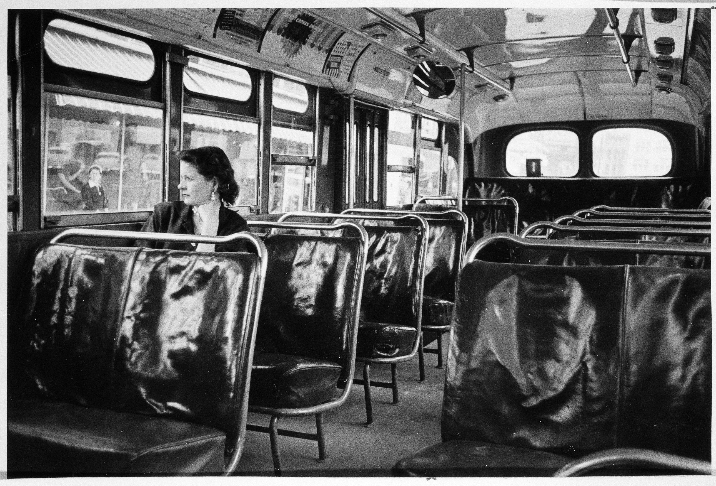

Slide 32
‘Another negro woman has been arrested and thrown into jail because she refused to get up out of her seat on the bus for a white person to sit down. It is the second time since the Claudette Colvin case that a negro woman has been arrested for the same thing. This has to be stopped. Negroes have rights, too, for if Negroes did not ride the buses, they could not operate. ¾ of the riders are Negroes, yet we are arrested, or have to stand over empty seats. If we do not do something to stop these arrests, they will continue. The next time it may be you, or your daughter, or mother.’
From a WPC leaflet made by President Jo Ann Robinson, 1 Dec. 1955

Slide 33
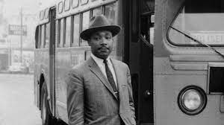
(e) Key Events & Significance of the Montgomery Bus Boycott & Little Rock
The establishment of the Montgomery Improvement Association, at Holt Street Baptist Church on 5th Dec. 1955, was the next important move in bus boycott. MLK was chosen as the M.I.A. chairman and he stated the following terms to end the bus boycott:
Drivers treat all African Americans with respect
Black drivers for routes with mostly black riders
African Americans should not have to leave their seats in the “colored” section for whites to sit
When the Bus Company refused these terms on 8th Dec. 1955, the boycott continued for 381 days.

Slide 34
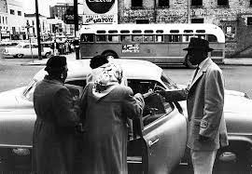
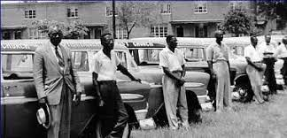
(e) Key Events & Significance of the Montgomery Bus Boycott & Little Rock
To overcome the difficulties of boycotting buses (as many African Americans needed to get to work or carry heavy items) the black Taxi Companies offered lower fares. Some white workers also gave lifts to black colleagues. Yet the white supremacists soon struck back – pressuring those giving lifts to stop & restoring an old law allowing minimum taxi-fares to be raised out of reach of most African-Americans. Finally, the M.I.A. organized a car-pooling system and the support of Churches proved essential for success; Ministers allowed meetings in their Churches to plan and raise money for shared cars – extra shoes were even bought for those whose shoes were worn out.

Slide 35
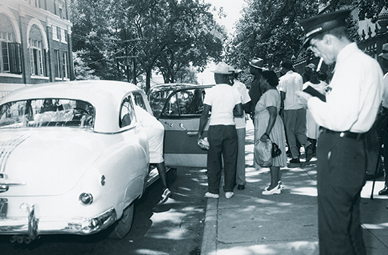
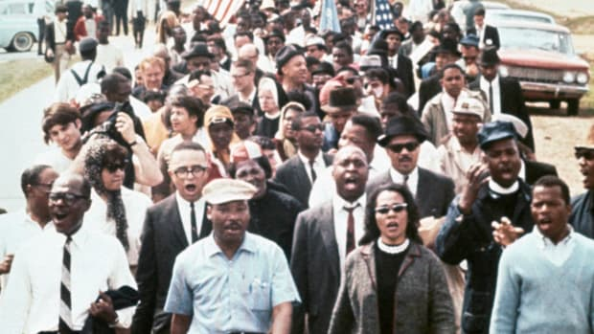
(e) Key Events & Significance of the Montgomery Bus Boycott & Little Rock
The boycotters still faced 3 major problems from the angry white citizens of Montgomery:
Verbal + Physical harassment while waiting for pool-cars to arrive.
Pool-car drivers were often arrested for minor offences.
Laws that stopped large gatherings were used as an excuse to arrest a group waiting for a pool-car to arrive.
Worse still, violence against the black community reached new levels in 1956 – when MLK’s house was bombed, plus Churches bombed & the homes of other Civil Rights leaders and Church Ministers.

Slide 36
‘The MIA was the first of its kind, an organization based in the Deep South that specifically adopted a direct action tactic (bus boycott) to challenge racial discrimination. The MIA was also the first predominantly black civil rights organization to operate independently of the NAACP. Although the MIA was not the catalyst to the Montgomery Bus Boycott, it played a significant role in the success of the protest and desegregation of the buses, a year later. The MIA took responsibility for maintaining the boycott & the morale of the protestors and was in charge of providing alternative transportation for those who refused to ride the buses. Its car pools formed an effective means for the most impoverished black employees who could not walk to work to continue their employment.’
From an African American History website
What impression does the author give about the Montgomery Improvement Association? (6m)

Slide 37
(e) Key Events & Significance of the Montgomery Bus Boycott & Little Rock
Inspired by the cohesion of car-pools & the speeches of MLK, the boycotters maintained their protest for 381 days. Media coverage raised awareness & attracted support for integration too. The NAACP stepped in with a legal challenge, just as it had with segregated education. Browder v. Gayle, 1956 argued that segregated buses violated 14th Amendment Rights (equal protection of the law for all US citizens). On 22nd Feb. 1956, 90 MIA members were arrested for “disrupting lawful business” & jailed until their trial on 19th March. They were all found ‘Guilty’ & fined, but the trial exposed white bus drivers + the campaign gained support. In June 1956, Browder v. Gayle, 1956 ruled that all buses should be desegregated – using Brown v. Topeka 1955 as a precedent. Both WCC appeals to the Supreme Court failed in Nov. & Dec. 1956 and the bus boycott ended on 20th Dec. 1956 – black bus riders could sit wherever.

Slide 38
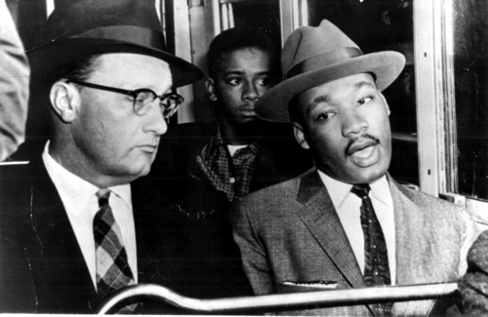
Glenn Smiley was a white campaigner for black civil rights and had led non-violent protests to integrate tea-rooms in LA Department Stores in the 1940s.
He supported the non-violent approach of the MIA in Montgomery and wanted to be the first white man to ride a fully-integrated bus alongside MLK.

Slide 39
‘The Montgomery Bus Boycott was a turning point in the civil rights movement. Black protestors saw that, by acting together, they had significant economic power. During the boycott, the Bus Company’s revenue went down by 65%. Local businesses lost custom. It was estimated that the boycott caused losses of about $1,000,000. Therefore, white businessmen became anxious to resolve the dispute. Success was also due to solidarity in the black community. People walked together or shared cars + taxis to get to work … They resisted intimidation and tried to avoid violence. Crucially, there wasn’t a way of rigging the system: the Bus Companies needed black passengers.’
From a School Textbook, published in 2010

Slide 40
(e) Key Events & Significance of the Montgomery Bus Boycott & Little Rock
It can also be seen as unsuccessful, too – it was limited to transport in Montgomery (other facilities in Montgomery stayed segregated for years); membership of racist groups rose sharply; violence against African Americans increased. After integration, 20th Dec. 1956, patrols of the Ku Klux Klan intimidated black bus queues, integrated riders were attacked by snipers & bombs were used against Churches & civil rights leaders. The struggle for Civil Rights wasn’t by any means over.
The bus boycott can be seen as very successful – buses in Montgomery were integrated; seating was first come first served basis; bus drivers couldn’t order African Americans around onboard. The most significant part, however, was that it proved a direct non-violent protest worked to achieve change. The Tallahassee Bus Boycott, 1956-58, had a same result. It showed how support could be attracted via publicity, how effectively African Americans could organize themselves, how vital Churches were for unity & how MLK would lead future attempts to achieve integration.

Slide 41
Exam-Style Question
‘The Montgomery Bus Boycott was the most successful civil rights 1950s event.’
How far do you agree?
You may use the following in your answer:
The Montgomery Bus Boycott
Brown v. Topeka
You must also use information of your own.
(16 marks)

Slide 42
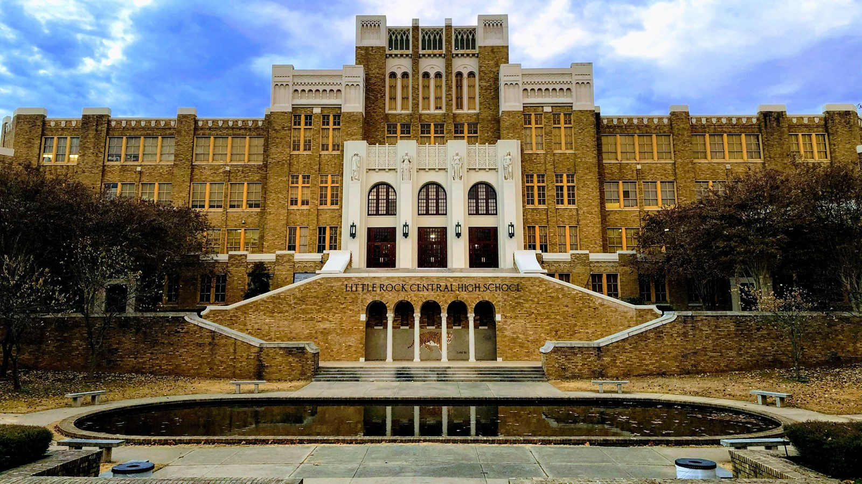
(e) Key Events & Significance of the Montgomery Bus Boycott & Little Rock
Despite the Brown v Topeka, 1955 ruling that desegregation had to take place, BY 1957 NOT ONE SCHOOL IN THE DEEP SOUTH HAD BEEN INTEGRATED.
Southern Senators had signed THE SOUTHERN MANIFESTO that stated the Brown ruling was an “abuse of the Supreme Court.”
Southern Governors supported WCCs and closed some schools to actively prevent integration occurring.
President Eisenhower did nothing to enforce the Supreme Court decision either.

Slide 43
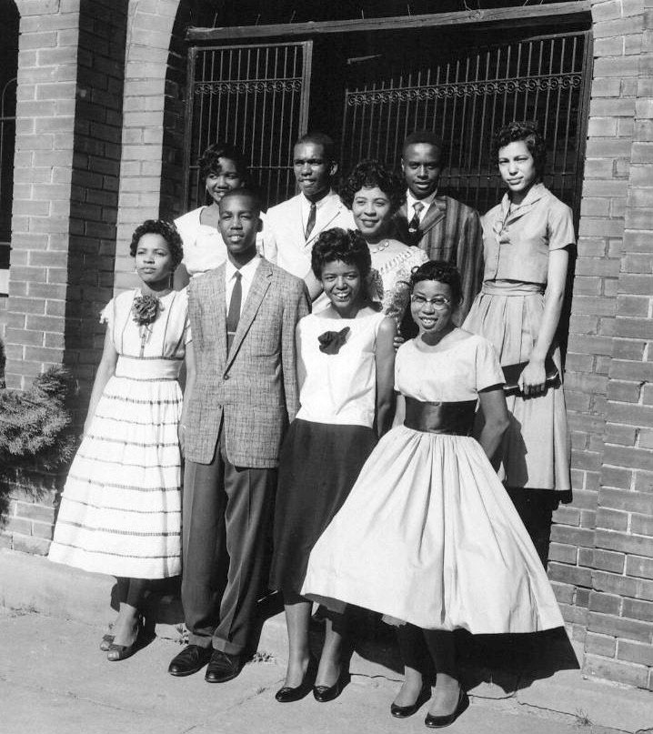
(e) Key Events & Significance of the Montgomery Bus Boycott & Little Rock
The all-white Central High School in Little Rock, Arkansas, was ordered by a Federal Court to start integrating in 1957. The white community & Governor Orval Faubus was furious. Obeying the order, the school took applications from African Americans and selected 25 students to start in Sept. 1957. These families received so many threats from white neighbors that, by the start of the semester, only “THE LITTLE ROCK NINE” were left – Thelma Mothershed, Minnijean Brown, Elizabeth Eckford, Gloria Ray, Jefferson Thomas, Melba Beals, Terrence Roberts, Carlotta Walls, and Ernest Green.

Slide 44
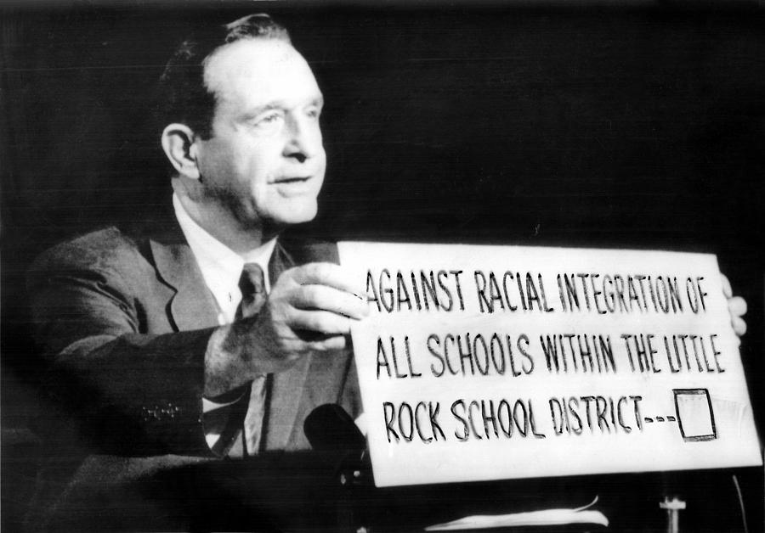
(e) Key Events & Significance of the Montgomery Bus Boycott & Little Rock
Orval Faubus announced, the day before the students started, that he had ordered an armed guard to stop the students entering the school “for their own protection.” He knew exactly what he did; on 4th September 1957, an angry mob of white citizens surrounded “THE LITTLE ROCK NINE” and screamed abuse at them. The state troops did, indeed, stop them entering the school – so they went home. News Reporters & TV cameras caught the whole event & it was broadcast across the USA and the rest of the world. Southern racism was becoming a national debate.

Slide 45
(e) Key Events & Significance of the Montgomery Bus Boycott & Little Rock
Orval Faubus announced, the day before the students started, that he had ordered an armed guard to stop the students entering the school “for their own protection.” He knew exactly what he did; on 4th September 1957, an angry mob of white citizens surrounded “THE LITTLE ROCK NINE” and screamed abuse at them. The state troops did, indeed, stop them entering the school – so they went home. News Reporters & TV cameras caught the whole event & it was broadcast across the USA and the rest of the world. Southern racism was becoming a national debate. (Hazel Bryan, seen yelling at Elizabeth Eckford on TV, received hate-mail & her parents removed her from the Central High School altogether.)

Slide 46
“I walked up to the guard who had let the white students in … When I tried to squeeze past him, be raised his bayonet and then the other guards moved in and raised their bayonets … I was very frightened and didn’t know what to do. I turned around and the crowd came toward me … Somebody started yelling “Lynch her! Lynch her!” I tried to see a friendly face somewhere in the mob … I looked in the face of an old woman and it seemed a kind face but, when I looked at her again she spat on me. They came closer, shouting “No n***** bitch is going to get in our school!”
From Elizabeth Eckford’s recollections of 4th Sept. 1957

Slide 47
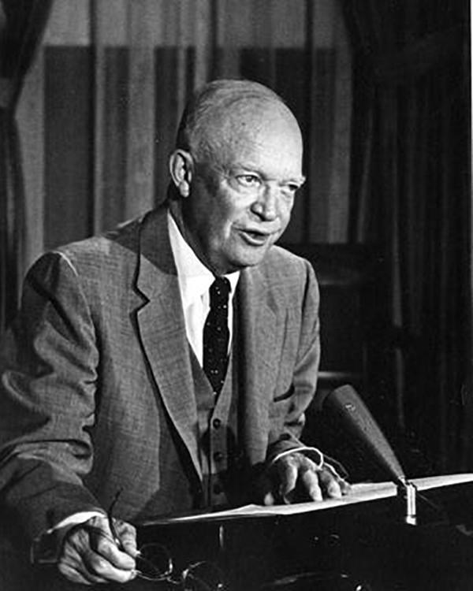
(e) Key Events & Significance of the Montgomery Bus Boycott & Little Rock
Over the next few days, troops & crowds continued to stop “THE LITTLE ROCK NINE” entering the school. On 12th Sept 1957, President Eisenhower met Orval Faubus to try to persuade him to let the kids attend. A Federal Judge began legal proceeding against the Governor + ordered the state troops to stand down. The Police successfully accompanied the students into class on 23rd Sept 1957, but a riot broke out outside the school – so the students were sent home. Eisenhower was so ashamed by all the negative TV coverage, he bowed to media pressure + ordered 1,200 Federal Troops to take charge of the State Troops. On 25th Sept. 1957 (3 weeks after school had started) “THE LITTLE ROCK NINE” went to classes.

Slide 48
“Mob rule cannot be allowed to override the decision of our courts … At a time when we face grave situations abroad because of the hatred of Communism bears towards a system of government based on human rights, it would be difficult to exaggerate the harm that is being done … Our enemies are gloating over this incident … We are portrayed as a violator of those standards which the people of the world united to proclaim in the Charter of the United Nations.”
From a TV address by President Eisenhower, 24 Sept. 1957

Slide 49
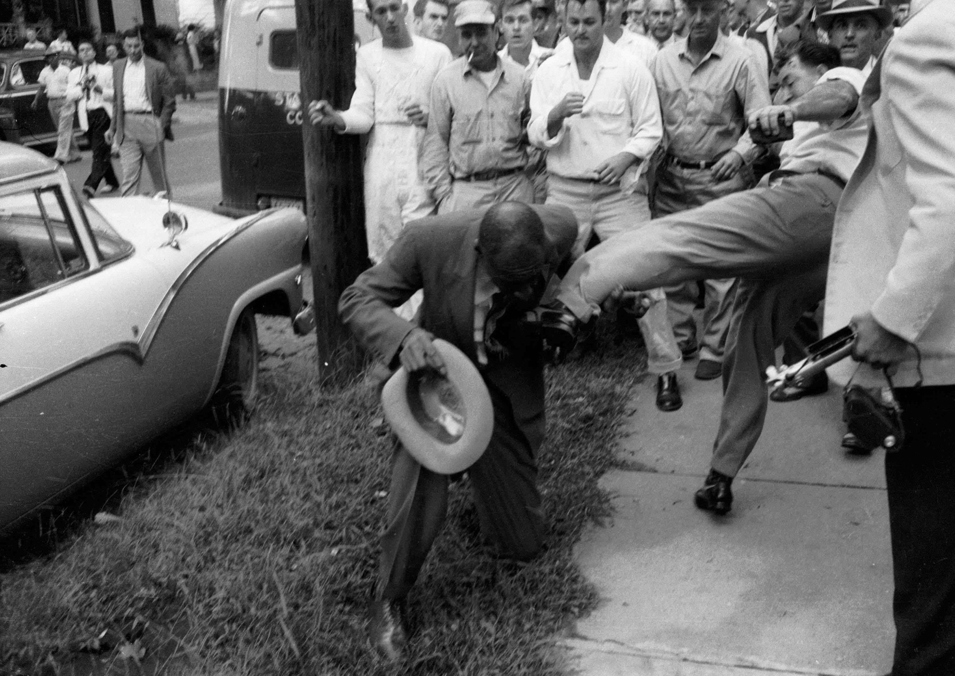
(e) Key Events & Significance of the Montgomery Bus Boycott & Little Rock
The army troops protected ”THE LITTLE ROCK NINE” for the rest of the school year, but their families still experienced harassment & violence every day. In Sept. 1958, Governor Faubus closed all high schools in Little Rock while Arkansas fought the Supreme Court over desegregation.
In a public poll, 72% of Little Rock citizens were against school integration, but the Supreme Court stood by the precedent of Brown v. Topeka, 1955. By the start of the school year in August 1959, all schools were forced to re-open & continue integrating fully. Little Rock schools were not significantly integrated until the 1970s.

Slide 50
(e) Key Events & Significance of the Montgomery Bus Boycott & Little Rock
The Little Rock intervention by Eisenhower was the ONLY time the White House has enforced a Supreme Court ruling. It clearly demonstrated that the Federal Government COULD successfully OVERRULE a State decision. Eisenhower was forced to act following media attention & all the negative publicity damaged the USA & made them look hypocritical intervening in Korea & Vietnam. Little Rock certainly proved that the Supreme Court victories were not enough for civil rights campaigners. The real downside was that integration in the South left many African American kids feeling their education suffered.

Slide 51
Exam-Style Question
Explain two effects of
the events at Little Rock
in Sept. 1957on the USA.
(8 marks)

Slide 52
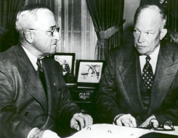
(f) The Significance of the Civil Rights Act, 1957
While the Supreme Court had taken action by 1957, the President & Congress – the other 2 parts of Federal Government – had not. Democrat President Truman had failed to get a 1948 civil rights bill passed (blocked by “Dixiecrats”) & Republican President Eisenhower said he supported civil rights. But Eisenhower resisted any change to the Law … until peoples’ attitudes towards African Americans changed. The positive achievements of the Brown case & the Montgomery Bus Boycott, however, put pressure on the President & Congress to pass a Federal Law for black Civil Rights. A new bill was drawn up in 1956.

Slide 53
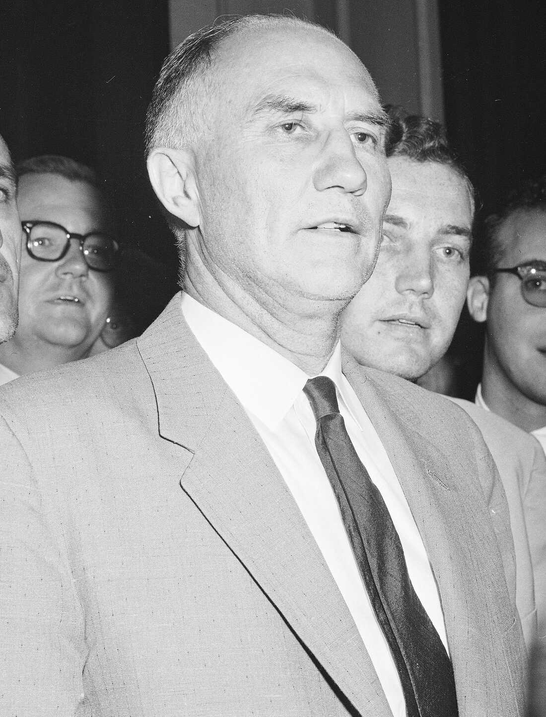
(f) The Significance of the Civil Rights Act, 1957
The 1956 Civil Rights Bill was blocked by a leading “Dixiecrat” named Strom Thurmond. He made the debate last much longer than the time allowed by filibustering for 24 hours and 18 minutes – the longest filibuster in history! This meant that the Bill was rejected. Eisenhower tried again with a revised version of the Civil Rights Bill, but again the “Dixiecrats” like Democrat Leader in the Senate, Lyndon B. Johnson, delayed progress. But a weak version of the Bill was final passed & Eisenhower signed the Civil Rights Act, 9th Sept. 1957:
The US Commission of Civil Rights was set up, to investigate how African Americans were being stopped from voting in different States.
Federal Courts could prosecute States who tried to prevent people from voting.

Slide 54
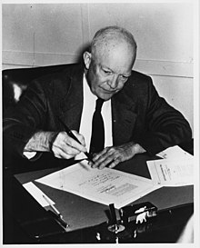
(f) The Significance of the Civil Rights Act, 1957
The Civil Rights Act, 1957 had little immediate impact. Federal Courts were limited by the fact that Juries were likely to reach “Not Guilty” verdicts when States were prosecuted. Though it was not a significant step forward in the struggle for Civil Rights, it is important because it was a FIRST STEP – for the first time in 82 years, the Federal Government had tried to improve the Civil Rights of African Americans. Congress had, at last, proved willing to act. Eisenhower thought it would pacify all the protestors for change, but he could not have been more wrong – disappointment in the weak 1957 Civil Rights Act saw more demands!

Slide 55
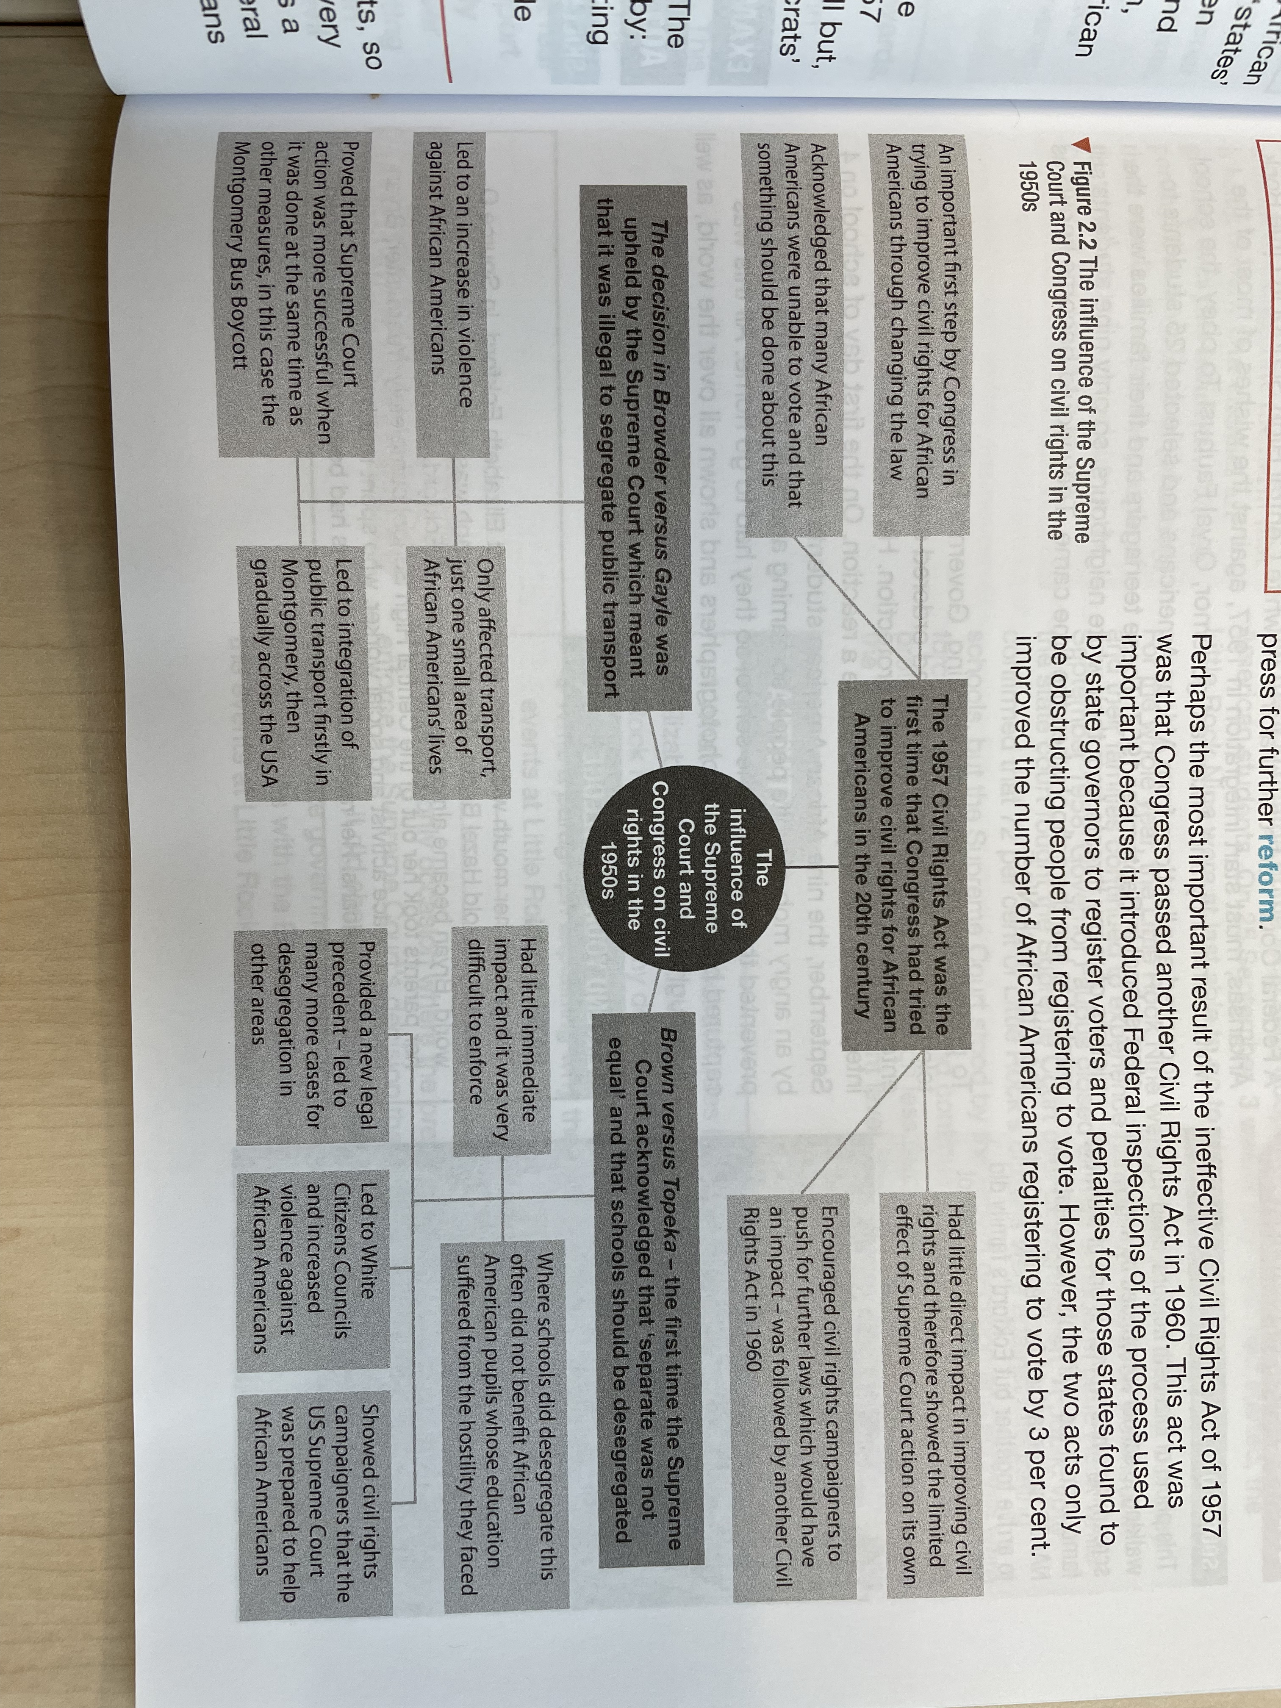

Slide 56
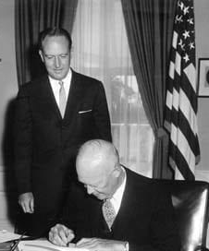
(f) The Significance of the Civil Rights Act, 1957
Perhaps the most important result of the ineffective Civil Rights Act, 1957 was Congress passing the Civil Rights Act, 1960. The 1960 Act went much further than the 1957 Act; practical not just theoretical:
Federal inspections of processes used by States to register voters.
Penalties for States found to be actively stopping people voting.
Despite two Civil Rights Acts, however, the number of African Americans registering to vote only rose by 3%. More had to be done.

Slide 57
Unit 2 Recall Quiz
What were “Jim Crow” Laws?
What was the name of the 1896 court case that ruled facilities could be “separate, but equal”?
What do the letters NAACP stand for?
What was the decision in the Brown v Topeka, 1955 court case?
Give three examples of who white extremists reacted to calls for improved black civil rights.

Slide 59
Unit 2 Recall Quiz
Who was Emmett Till?
Who was President 1945-1953 + who 1953-1961?
When did the Little Rock Nine try to join the Central High School in Little Rock?
How did the African American community avoid not using buses for 381 days?
What was the decision in Browder v. Gayle, 1956?

Slide 61
Unit 2: Explaining
Explain why Brown v Topeka, 1955 was significant in improving black civil rights.
Why do some historians consider the death of Emmett Till so important for the civil rights movement?
Explain why the Montgomery Bus Boycott was successful in ending bus segregation?

Slide 63
Unit 2: Challenge
Explain why the Federal Government took so long to act to improve civil rights.
Which events of the 1950s helped create publicity for the civil rights movement? Why was publicy so important for change?
Which had the greatest positive impact – Brown v Topeka, 1955; the Montgomery Bus Boycott; or the Little Rock Nine?

