Slide 1
Edexcel IGCSE History P1: Depth Study 7
A Divided Union: Civil Rights in the USA, 1945-1974

Slide 3
Edexcel IGCSE History P1: Depth Study 7
A Divided Union: Civil Rights
in the USA, 1945-1974
1. The Red Scare and McCarthyism

Slide 4
(a) Reasons for the Red Scare
THE AMERICAN
POLITICAL SYSTEM

Slide 5
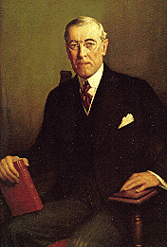
(a) Reasons for the Red Scare
When the USA gained independence from Britain, the US Constitution was produced in 1791. The Constitution established a brand new system of Government for the country. As a federation of individual states (each with its own government) the Federal Government is based in Washington DC to govern the whole country. The ‘EXECUTIVE’ administrates laws, the ‘LEGISLATIVE’ makes the laws & the ‘JUDICIAL’ evaluates the laws.

Slide 6
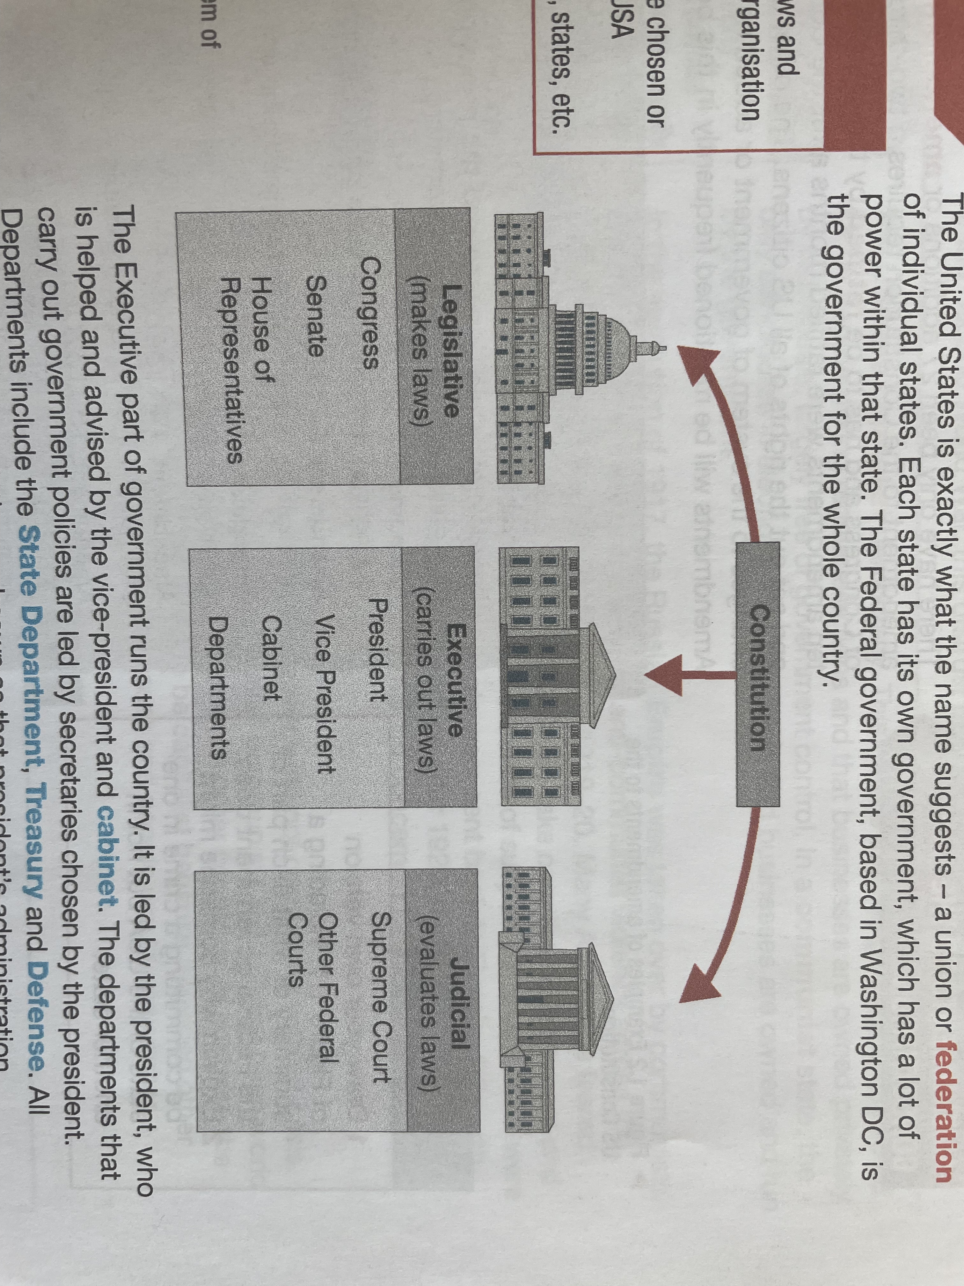

Slide 7
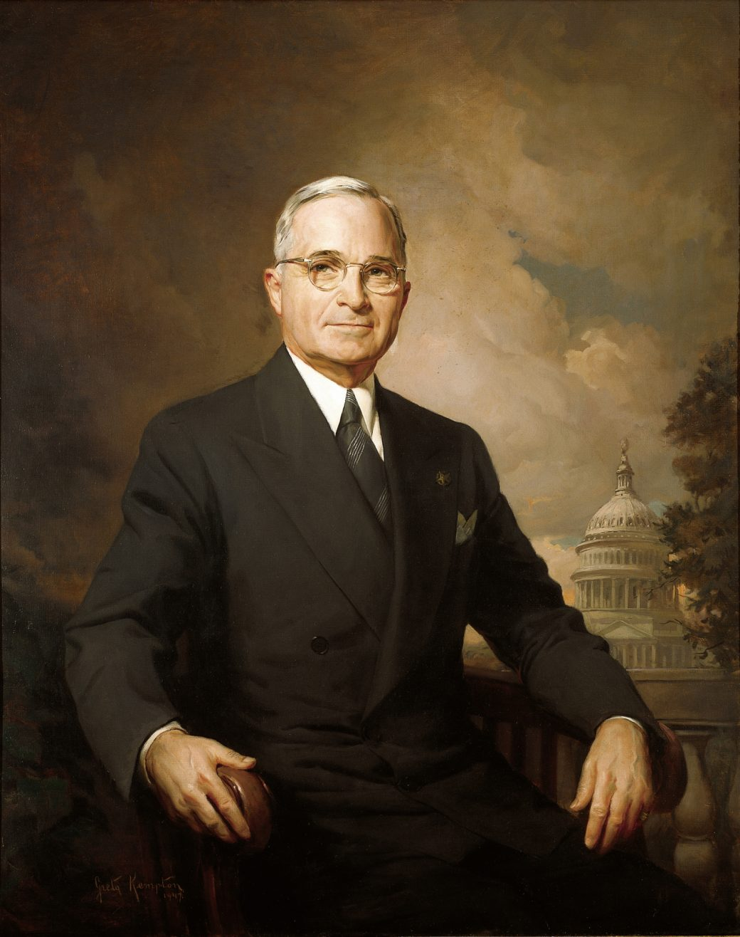
(a) Reasons for the Red Scare
New laws are made by Congress and this is made up of 2 Houses – the Senate & the House of Representatives. The Supreme Court & other Federal Courts ensure laws passed are always constitutional & clear. Judges are chosen by the President, then approved by the Senate. The President, Vice-President & Congress members are elected by US citizens. Presidential elections & Congress elections are separate. The US system of Government is designed to limit the powers of each part – Congress’s laws can be vetoed by the President or Supreme Court and Congress can impeach a President if necessary.

Slide 8
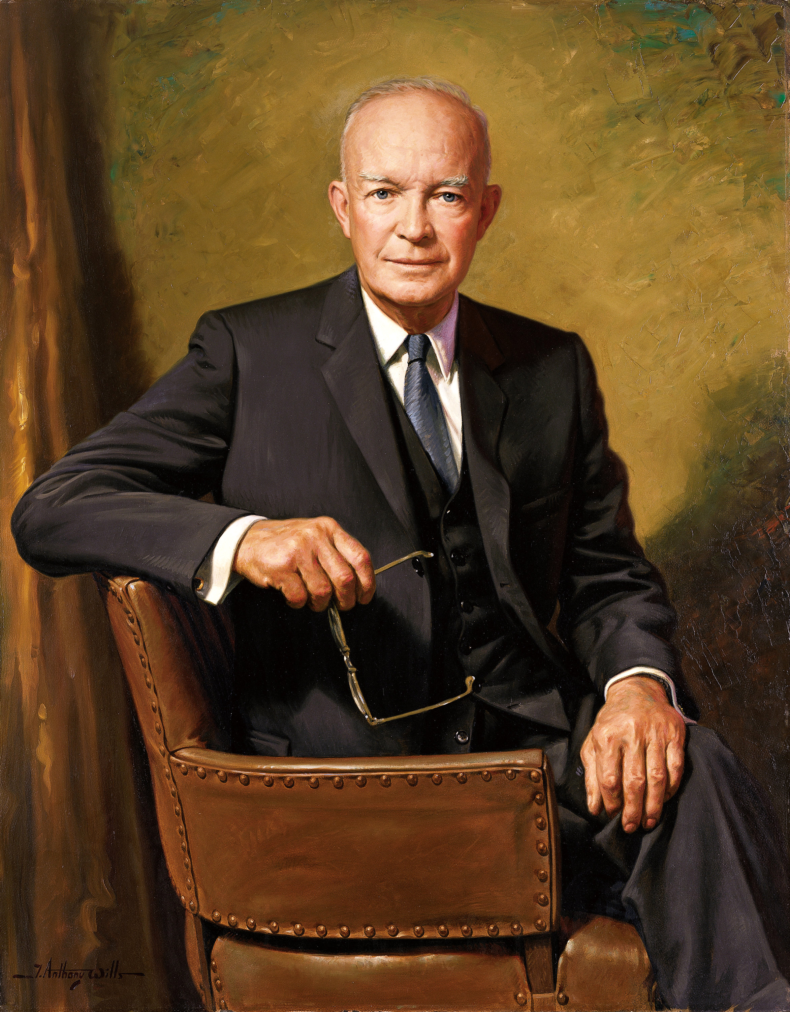
(a) Reasons for the Red Scare
Each state government also has its own political system – including a Governor, a Legislature & a Supreme Court. While the Federal Government controls foreign policy & taxation, state governments control laws that apply in each state. Laws on education & use of the death penalty fall into this category. In the period 1945-1974, Federal Govt. decisions were often countered with a cry of “States’ rights!” or state governments had to defend their own decisions.

Slide 9
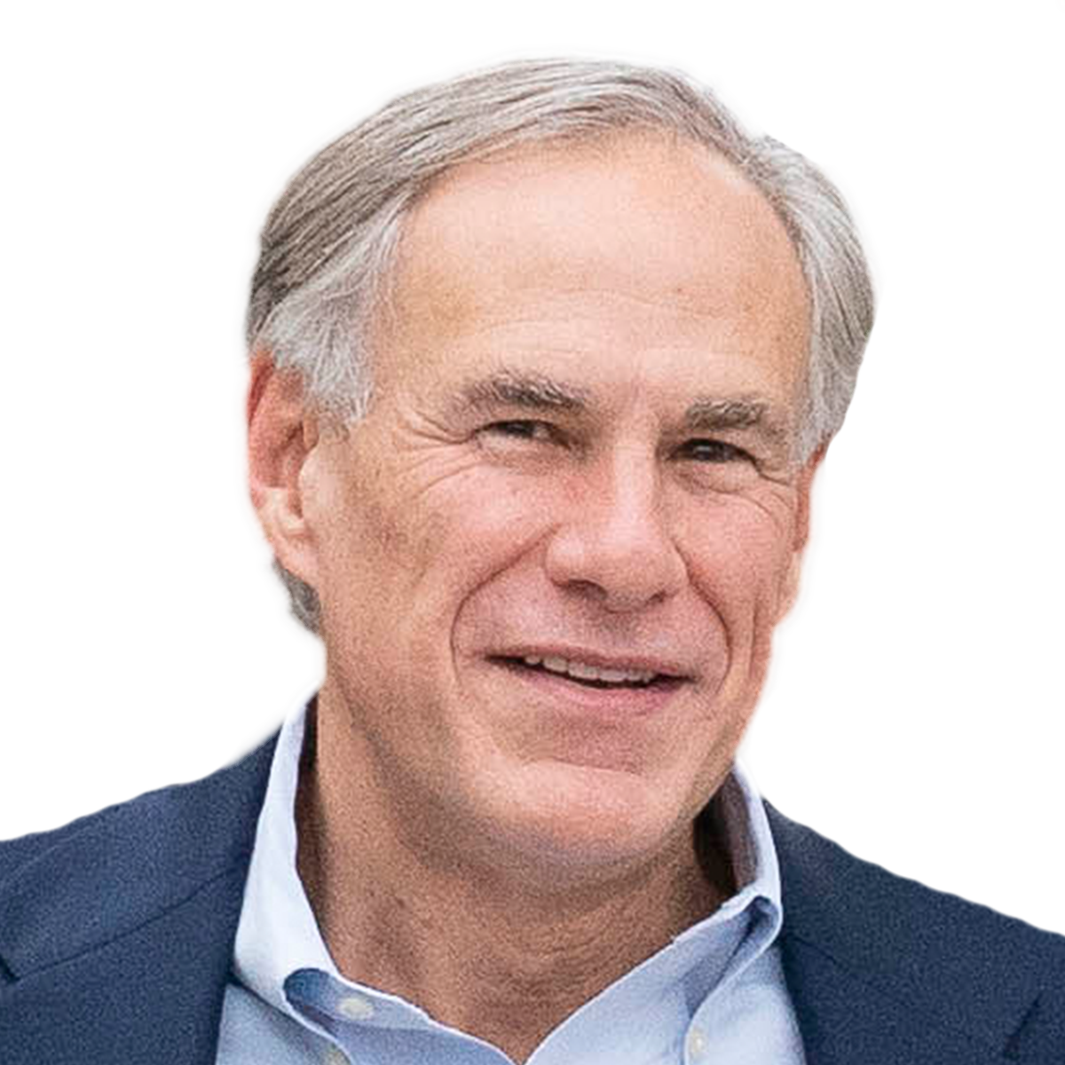
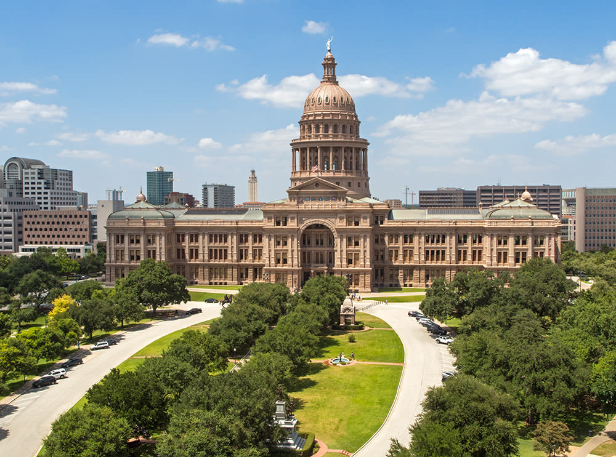
GOVERNOR
ATTORNEY GENERAL

Slide 10
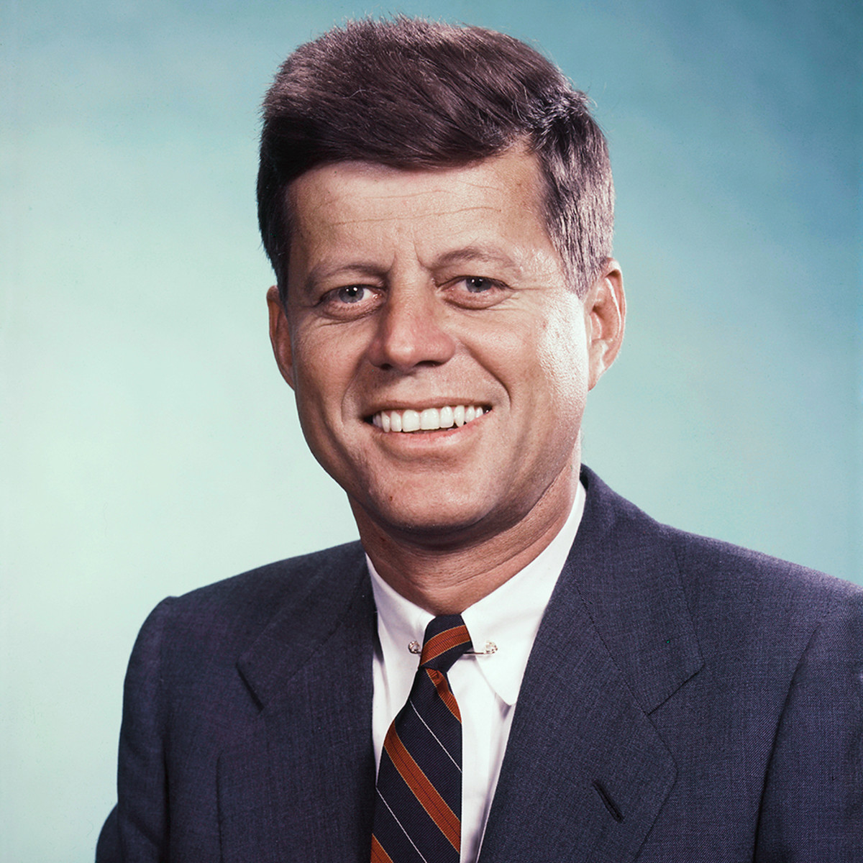
(a) Reasons for the Red Scare
Amendments to the US Constitution require a 2/3 majority of both Houses of Congress & has to be ratified by 3/4 of the states. The first 10 Amendments were all ratified just months after the Constitution was made final – all the other 17 since have made changes to the system of government or given new rights to citizens. Amendments are often cited in the many Civil Rights arguments, 1945-1974.

Slide 11
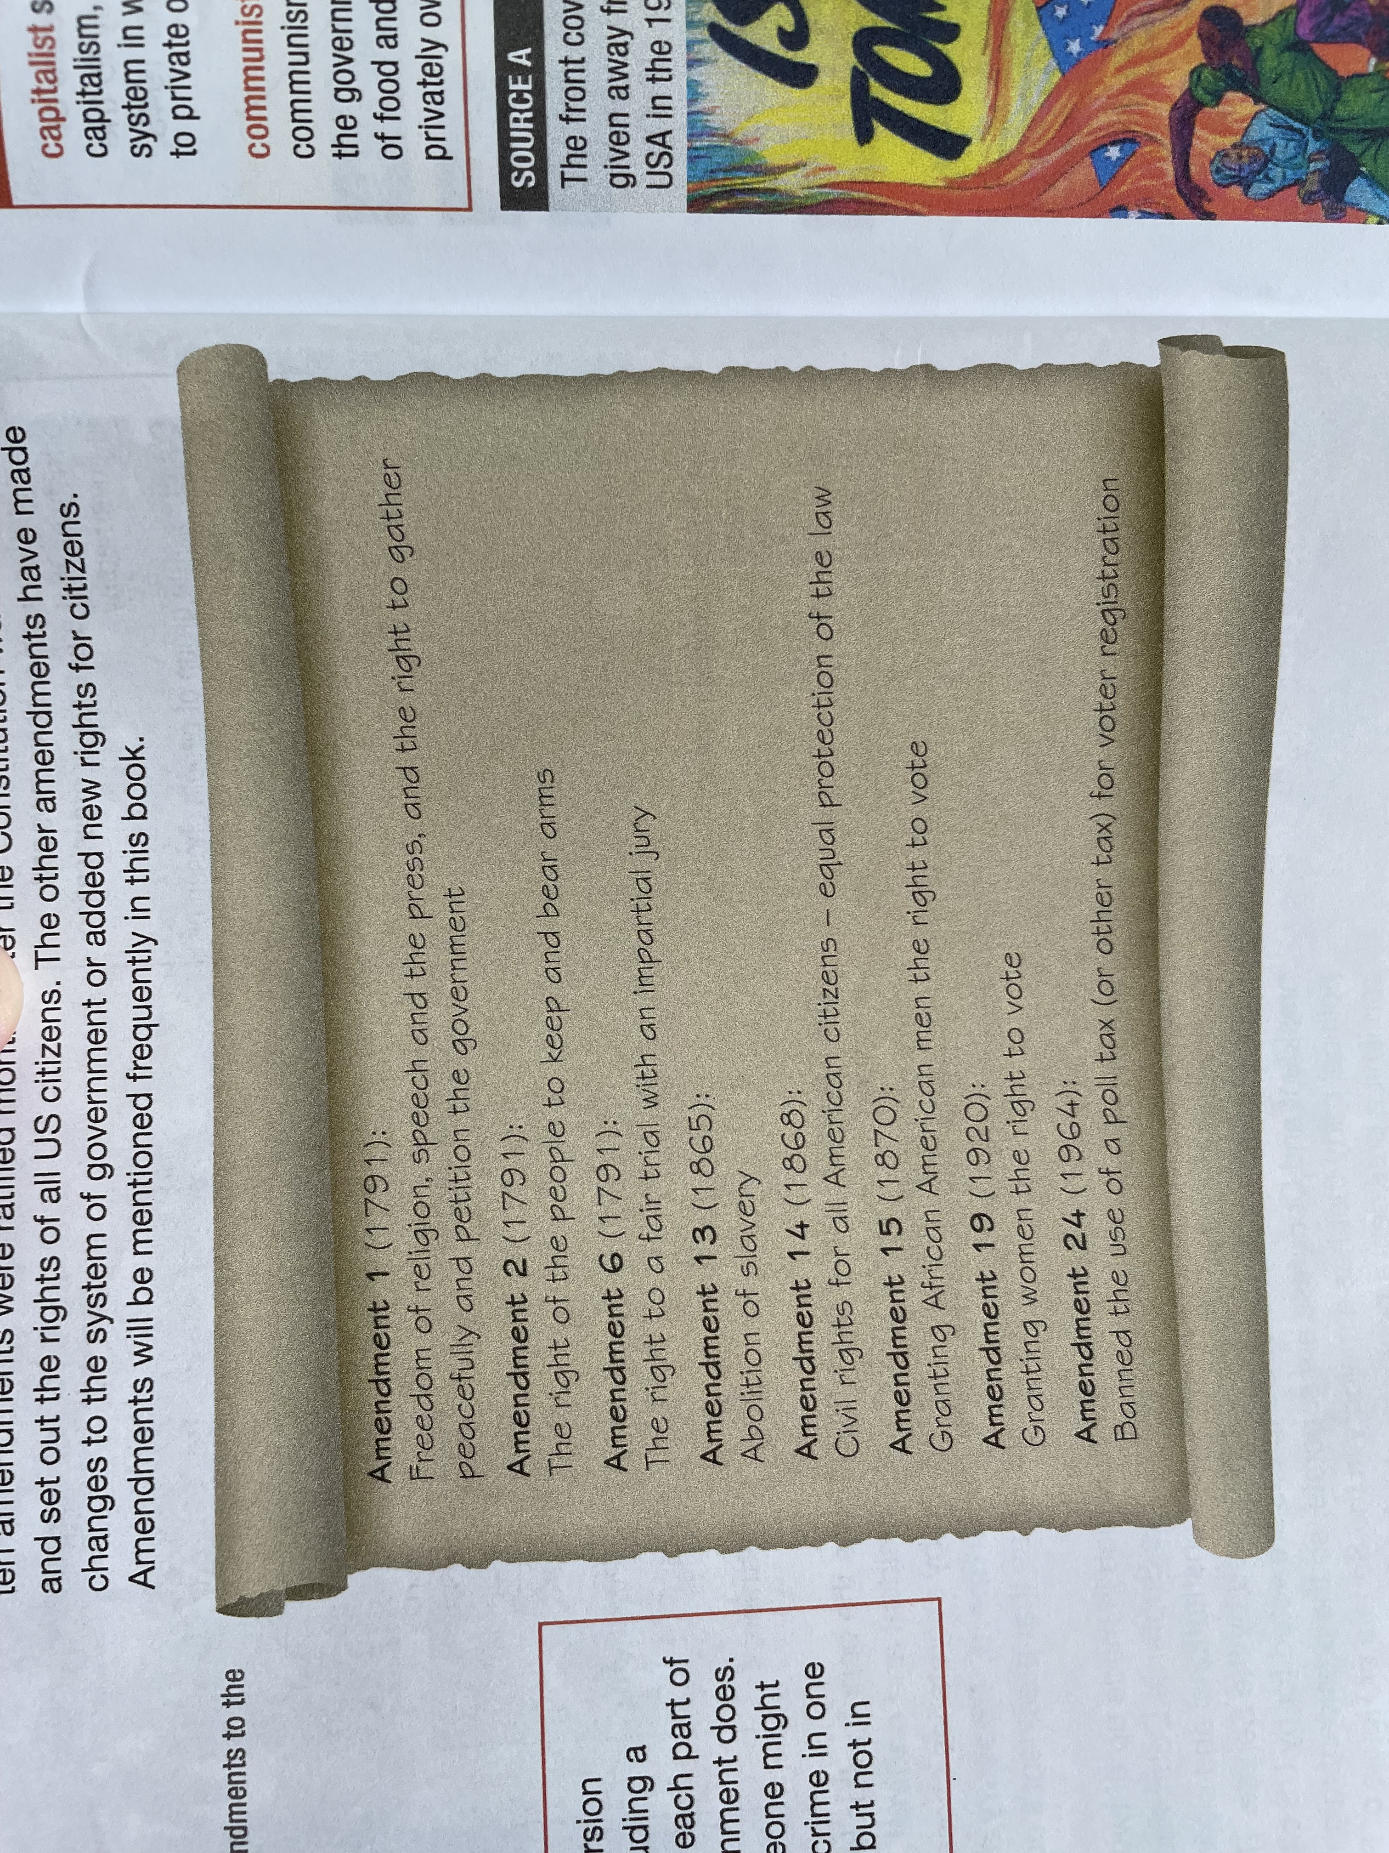

Slide 12
(a) Reasons for the Red Scare
THE COLD WAR

Slide 13
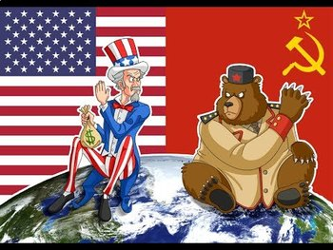
(a) Reasons for the Red Scare
The end of WW2 in 1945 saw the USA & her allies defeat Germany & Japan. The USA & the Soviet Union emerged as opposing Superpowers. Despite being on the same side during WW2, their ideological differences were developing into distrust and a Cold War was clear. If “hot war” is actual fighting, “cold war” is the peacetime war of words, spying and propaganda between USA and USSR, 1945-1989.

Slide 14
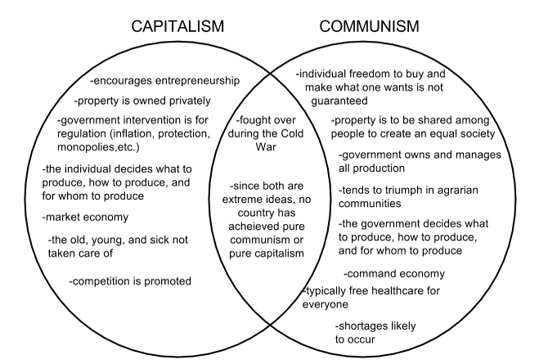

Slide 15
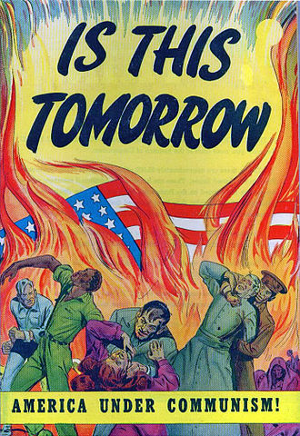
(a) Reasons for the Red Scare
The Russian Revolution of 1917 saw the Russian Tsar Nicholas II overthrown by ruthless Bolshevik Communists. As a result of this violent murder of the Russian Monarchy, there was a wave of fierce anti-Communism across America – the first US “Red Scare” 1919-1920. US citizens were fearful that immigrants from Eastern Europe would attempt to make the US Government into a Communist one. Thousands of people who were “suspected Communists” were arrested and many Russian immigrants were returned to the USSR. Largely calmed by 1920, the fear of Communism did not disappear completely.

Slide 16
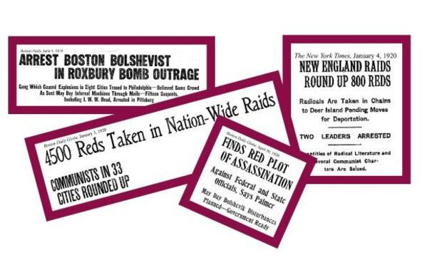

Slide 17
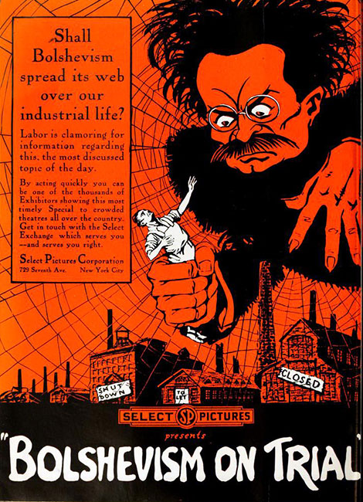
(a) Reasons for the Red Scare
The US fears of Communists forcing the US Government out of power were not without basis in reality. Bolshevism in 1917 aimed to bring about a “World Revolution” and to “Encourage others towards Communism.”
By contrast, the USA wanted the rest of the World to be Capitalist as this would help her trade and US Companies could become richer and richer. Labor Unions, demanding fairer pay and more rights, soon became an easy target to tarnish members as “Reds” … even though Amendment 1 & 14 guaranteed Freedoms & Civil Rights for all Americans.

Slide 18
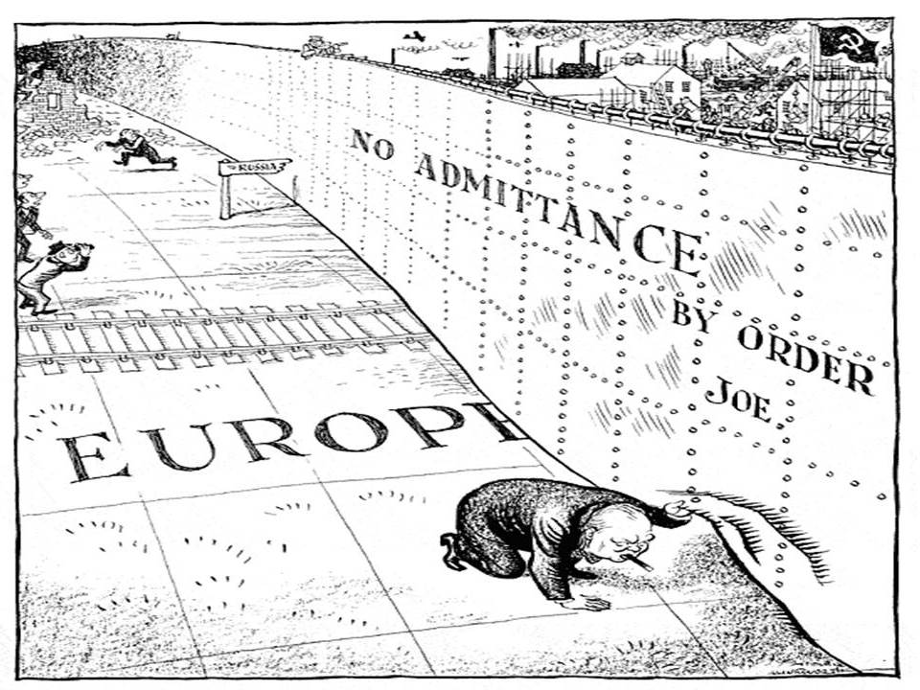
(a) Reasons for the Red Scare
In 1945, as WW2 neared its end, Eastern Europe was liberated from the Nazis by the Russian Red Army. After ‘V.E. Day’ the Red Army remained in liberated countries and Feb-Jul 1945 saw Communist Governments established across Eastern Europe. The USSR saw these as a “Buffer Zone” protecting them from the West (25,000,000 Soviets had been slaughtered in WW2). The West saw these as “Satellites of Soviet control” and Winston Churchill claimed that an “Iron Curtain” had descended over Eastern Europe in 1946.

Slide 19
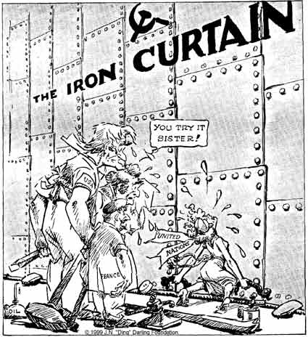
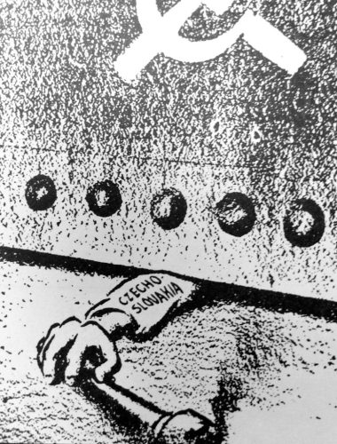

Slide 20
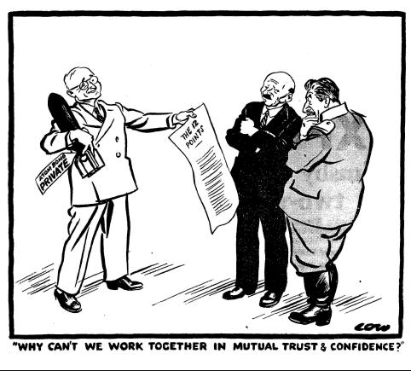
(a) Reasons for the Red Scare
The development of the atomic bomb, with the USA successfully testing one on 16 July 1945, was the decisive factor in developing a Cold War. Dropping atomic bombs on Japan on 6 Aug & 9 Aug 1945, the USA not only sought to bring about V.J. day but also to warn the USSR that they had won the Arms Race and edged ahead of the USSR as now a deadly weaponized Superpower. Stalin was determined to catch up with Truman and immediately boosted the Soviet atomic research programme with money & men; scientists in the USSR and spies in the USA.

Slide 21
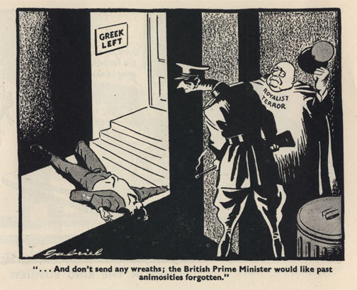
(a) Reasons for the Red Scare
In 1946, Greek Communists tried to overthrow the Government and was encouraged to do so by the USSR. This was seen by the USA as part of the anticipated “Communist takeover of Europe” so they sent money & men to stop the Greek Government falling. From 1946-1949, the USA propped up the anti-Communists & the struggling British forces in Greece until the Communists finally accepted defeat on 16 Oct. 1949. The USA had seen how their intervention could help.

Slide 22
“Today, nearly every nation must choose between opposing ways of life. I believe the US must support peoples resisting attempted control by armed minorities or outside pressures. I believe our help should be mainly economic aid to restore economic stability and orderly political progress.”
From President Truman’s Speech, 12th March 1947
How do you think this speech would be received in Moscow? How would it be received in Budapest?

Slide 23
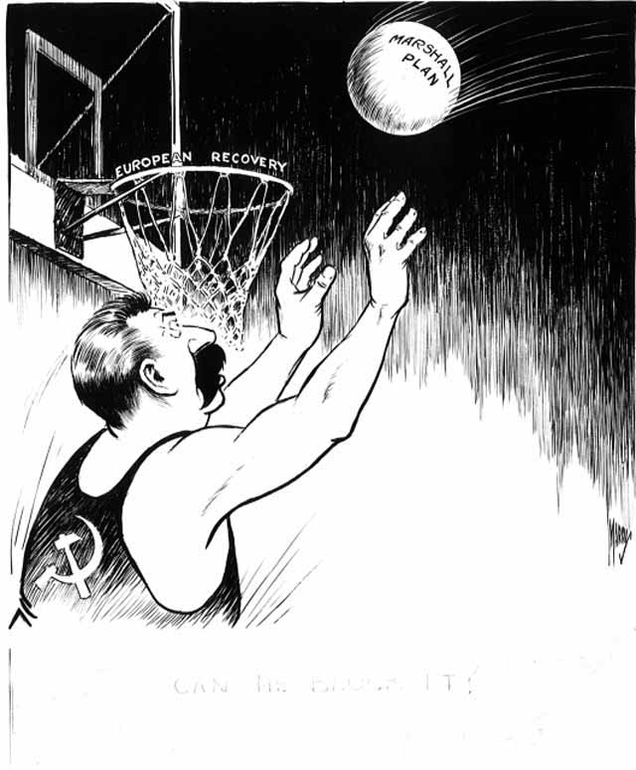
(a) Reasons for the Red Scare
To prevent European countries becoming Communist, President Truman announced the “Truman Doctrine” – a US promise to support any nation resisting takeover by other nations. This was a clear dig at the USSR’s attitude in Europe and a pretty obvious attempt to offer any country fearing Communist takeover aid to resist. The Marshall Plan followed – an economic aid package, millions of dollars, to solve financial problems that were likely to see a nation fall under communist control. The USSR barred its satellites taking US aid.
CAN HE BLOCK IT?

Slide 24
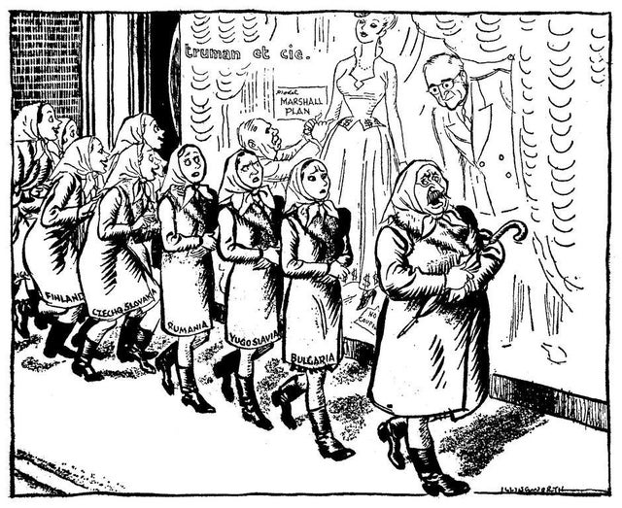

Slide 25
‘Even though there was pressure on Truman at home, he did deliberately exaggerate the threat of Communism to get support for his policy in Greece and to get the Truman Doctrine passed. He and Secretary of State, Dean Acheson, exploited the Soviet threat as they wanted the US to take a more active and forceful role in the world. This included “getting tough with Russia” as Truman put it in 1946. It was time, he said, to stop babysitting the Soviets.’
From a Modern History Textbook
What impression does the author give about the US Government and the threat of Communism? (6m)

Slide 26
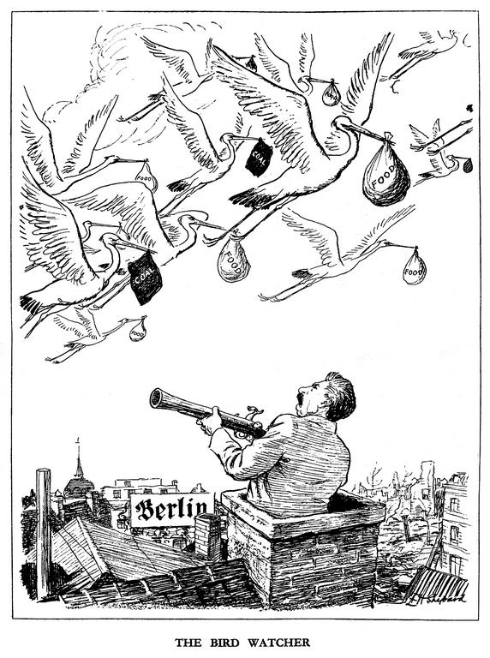
(a) Reasons for the Red Scare
The Cold War looked like it might turn into Hot War in Germany, 1948-1949. The Allies controlled 4 zones of Germany, 1945, (Berlin, sat in the Soviet sector, was also divided into 4 zones). In 1946, the West’s 3 zones combined to form West Germany and, by 1948, there were signs of recovery from WW2 in West Germany … proving that West was best! In June 1948, Stalin blockaded all of Berlin & cut off all supply lines by road, rail & canal. Truman used airports in each Allied zone so that supplies got through (1,500 planes per day) & Stalin was dared to shoot these down … but didn’t … and, in May 1949, Stalin reopened blocked routes & denied the moral defeat via propaganda.

Slide 27
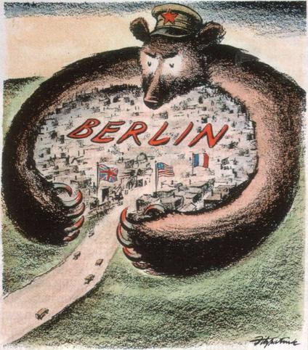
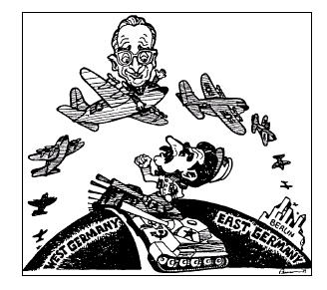

Slide 28
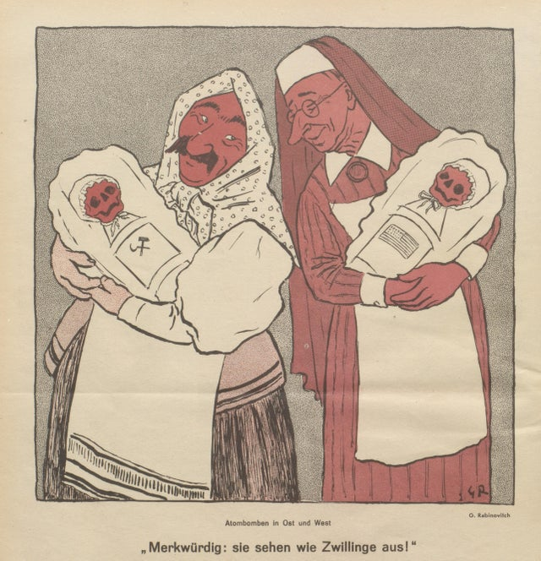
(a) Reasons for the Red Scare
Events in Europe 1949-1950 convinced many Americans – including many in the US Govt – that the USSR wanted World domination. Soviet support was clear in the Chinese Civil War & the Korean War. China fell to Communism in 1949, uprisings in Malaya, Indonesia, Burma & the Philippines, then 1950-53 Korea became another satellite state spot for “hot war”; USSR supporting North Korea & USA the South. Neither side made noteworthy gains, although the South took a few miles above the 38th Parallel. More worrying for the USA, in August 1949, the USSR successfully tested an atomic bomb. The USA’s advantage evaporated.

Slide 29
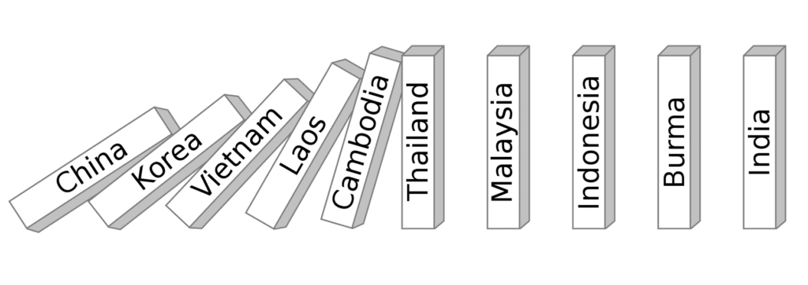
President Eisenhower’s “Domino Theory”

Slide 30
Exam-Style Question
Explain two effects of
the Cold War on the USA.
(8 marks)

Slide 32
(a) Reasons for the Red Scare
EVENTS IN
THE U.S.A.

Slide 33
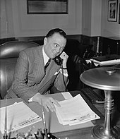
(a) Reasons for the Red Scare
J. Edgar Hoover (not President Herbert Hoover!) was the director of the Federal Bureau of Investigation (FBI). His strong anti-Communist views can be blamed for many arrests of suspected Communists in the first Red Scare, 1919-20. After WW2, the FBI started to create files of evidence on those the FBI suspected of spying for the Soviets. Hoover was so worried about spies working in Federal Govt. Depts, in 1945, he wrote to President Truman. In March 1947, Truman issued orders that any Govt. employee could be removed on “reasonable grounds” that they were disloyal to the USA.

Slide 34
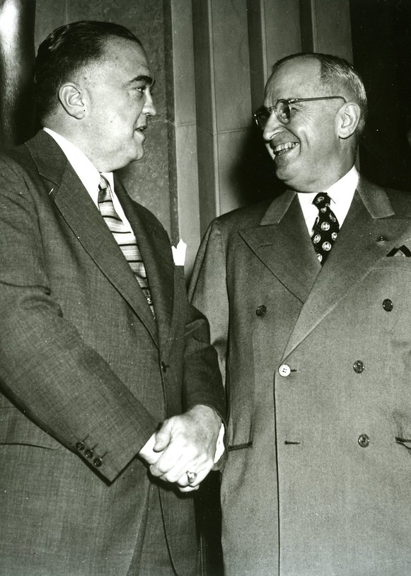
(a) Reasons for the Red Scare
The FBI under Hoover set up FEDERAL LOYALTY BOARDS – to investigate all Government employees for possible links to Communism.
3,000,000 Govt. workers were investigated 1947-1951 and 3,000 were fired or forced to resign as they were considered a security risk. Despite this, no actual evidence of Soviet spying was ever found by the FBI.
Inspired by the Executive’s attitude, states, cities & private businesses began to check for Communist sympathies & thousands of employees (or “suspects”) lost their jobs.

Slide 35
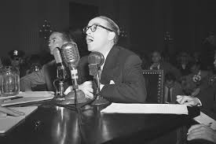
(a) Reasons for the Red Scare
The House Committee on Un-American Activities had been set up in 1938, originally to monitor extremist groups, but in 1947 it began public hearings on the threat of Communism. Hoover was chief-witness and saw the Committee as educational to the US public & vital in exposing traitors. Indeed, the FBI began secretly passing intelligence to the Committee. The one essential question asked of suspects was “Are you now or have you ever been a member of the Communist Party?” Criminal trials followed the answer to this question, depending on the affirmative.

Slide 36
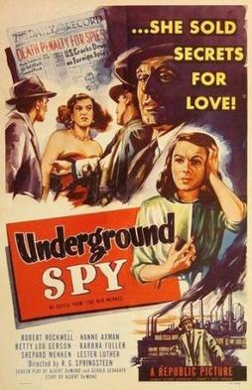
(a) Reasons for the Red Scare
The 1940s saw millions of people regularly going to the Cinema, but there was a concern that Communists would use films to spread their propaganda. Oct. 1947, the House Committee called 41 writers, producers & directors to investigate Reds in Hollywood. 19 were named as Communists and, when ordered to appear before HUAC, 10 refused to answer any questions under the First Amendment. All 10 were immediately jailed for Contempt & blacklisted from working in Hollywood ever again. The publicity investigating Hollywood created for HUAC also increased the US “Anti-Communist hysteria” and saw film-makers start to make anti-Communist films to appease the FBI.

Slide 37
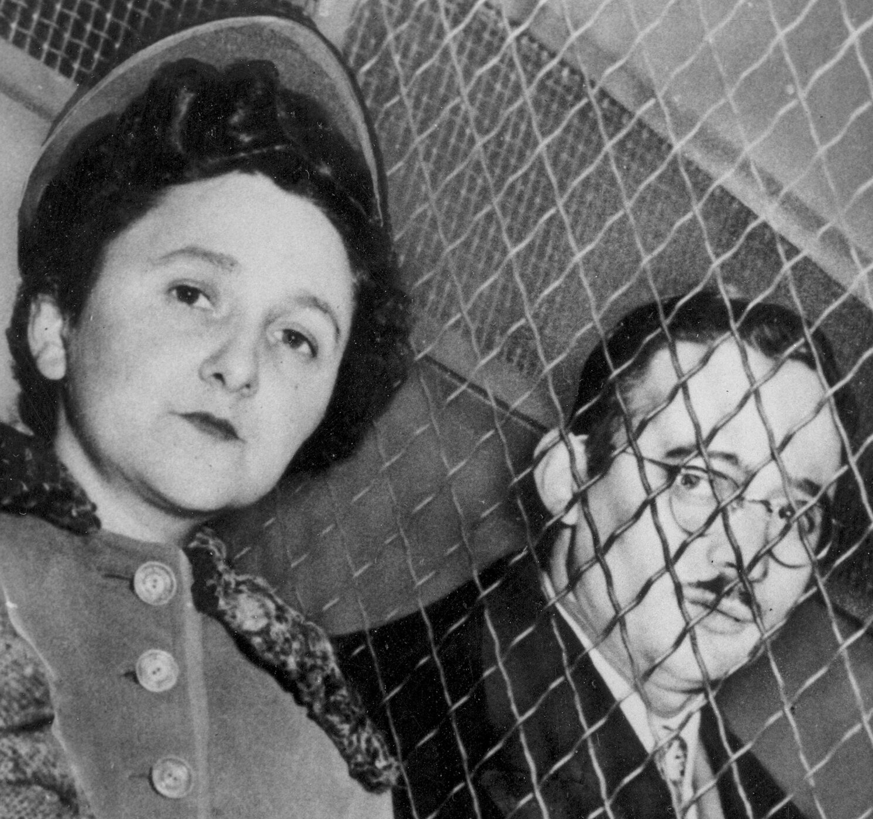
(a) Reasons for the Red Scare
The Alger Hiss Case, 1948-50
An important advisor to FDR in WW2, Alger Hiss was named in 1948 as a member of a Communist group. Hiss denied this during a HUAC hearing, but Richard Nixon insisted Hiss was leaking info to the Soviets. After a trial in 1949, Alger Hiss was sentenced in 1950 to 5 years in prison – not officially convicted of spying, the Hiss case proved that Hoover’s warning about “high office Reds” was true.
The Rosenburgs Case, 1950-53
In Feb. 1950, Klaus Fuch was arrested in the UK for passing atomic bomb secrets to the USSR. Fuchs was sentenced to 14 years & he named David Greenglass, his sister & brother-in-law (Ethel & Julius Rosenburg). Despite weak evidence against the Rosenburgs, they were tried in March 1951, dubiously found ‘guilty’ & executed on 19th June 1953. A Communist conspiracy seemed very evident!

Slide 38
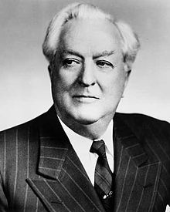
(a) Reasons for the Red Scare
During the trial of Alger Hiss in 1949, the Soviets declared that they had successfully tested an atomic bomb. US fears of Communism could not be higher – Congress passed the McCarran Internal Security Act in August 1950, which enforced all Communist organizations to register with the Federal Government. The Rosenburgs were on trial while the Korean War raged and many US citizens blamed the Rosenburgs both for the Soviet atomic bombs & the North Korean invasion of South Korea! Ordinary Americans were convinced, what with the FBI investigations + HUAC hearings, that Communist spies were everywhere. Many were terrified & suspicious of neighbors, whilst being terrified of being accused of being “Reds” themselves.

Slide 39
(a) Reasons for the Red Scare
In 1952, the McCarran Internal Security Act was made even stronger & took away key Amendment 1 rights:
No Communist was allowed a US passport
Communists were barred from certain jobs
In an “emergency” anybody suspected of “subversion” could be put in a Detention Camp without a trial.
President Truman tried to prevent the Act becoming law, but Congress was seemingly swept along on a huge tide of anti-Communist hysteria – mostly caused by the activities of Senator Joseph McCarthy.

Slide 40
Exam-Style Question
‘The work of the HUAC was the main reason for the Red Scare in the 1940s.’ How far do you agree?
You may use the following in your answer:
The work of HUAC
The Cold War
You must also use information of your own.
(16 marks)

Slide 42
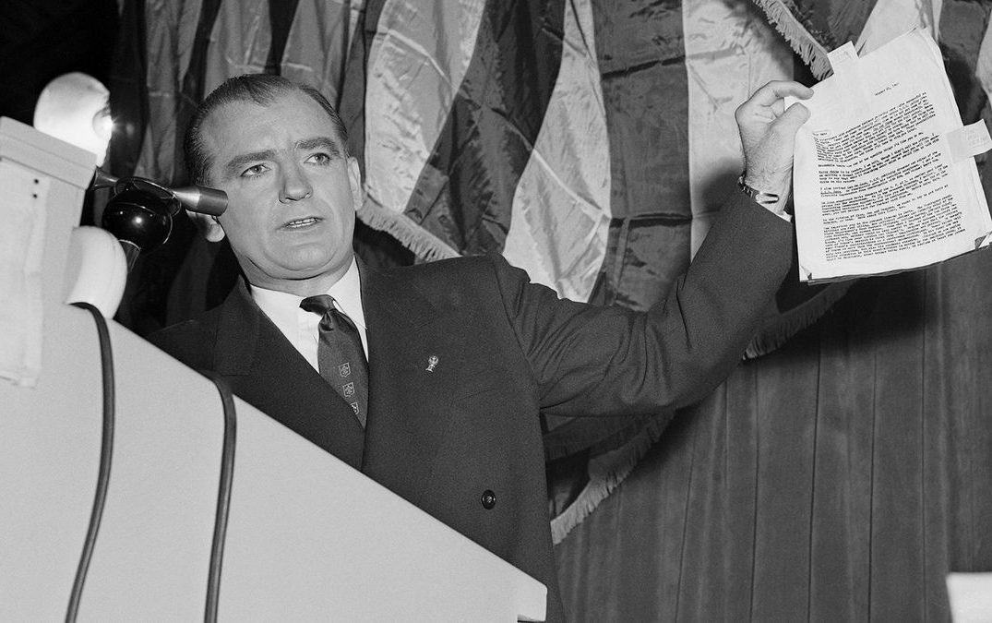
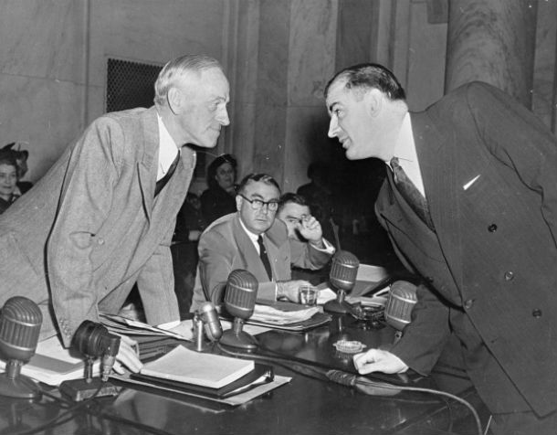
(b) Methods used by McCarthy & Growth of Opposition
Joseph McCarthy had been a rather unimpressive Senator for Wisconsin since 1946 but, after the Hiss trial, he made a speech in 1950 that stated he had a list of 205 members of the Communist Party who worked for the US State Dept. Each speech after that gradually reduced the list to 57. The Congressional Tydings Committee investigated McCarthy’s claims, but found all his accusations untrue. McCarthy then called Senator Tydings “Un-American” and “a Communist sympathizer.” Senator Tydings was not re-elected later on in 1950 ans lost his seat in the Senate.

Slide 43
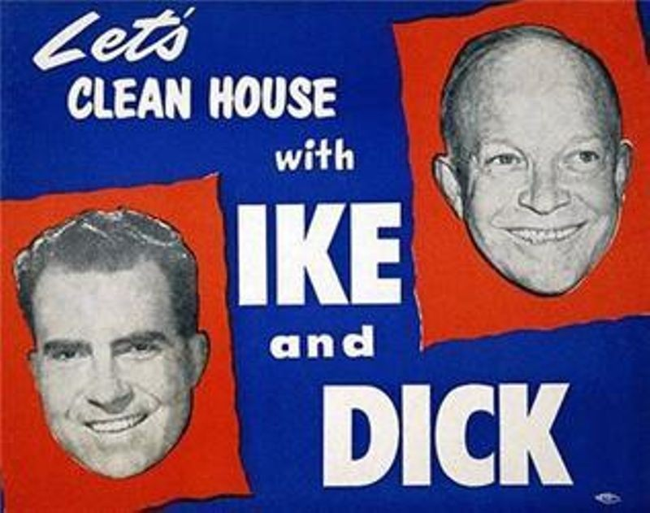
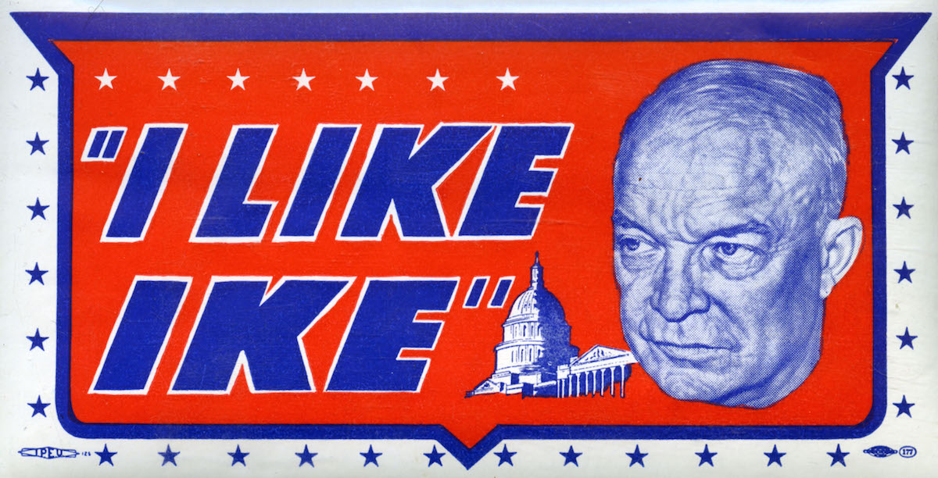
(b) Methods used by McCarthy & Growth of Opposition
Joseph McCarthy had his finger on the pulse of US fears. His unfounded & untrue accusations helped explain why the Korean War & the Cold War as a whole was failing for America. Despite Tyding’s findings, the Republican Party permitted further investigations. Indeed, chasing Communists out of the country became the main feature of the 1952 Republican election campaign and Eisenhower swept to power on an anti-Red tide. The new President immediately made Joseph McCarthy the Chairman of the Government Committee on Operations of the Senate – tasked with sniffing out Soviet sympathizers in Govt. Depts.

Slide 44
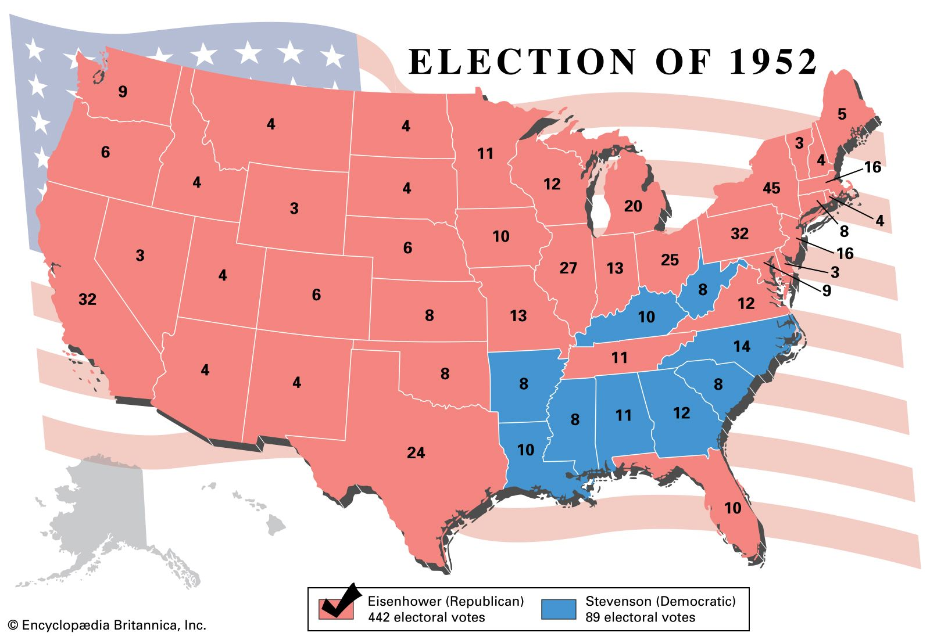

Slide 45
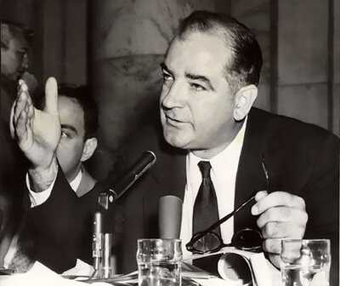
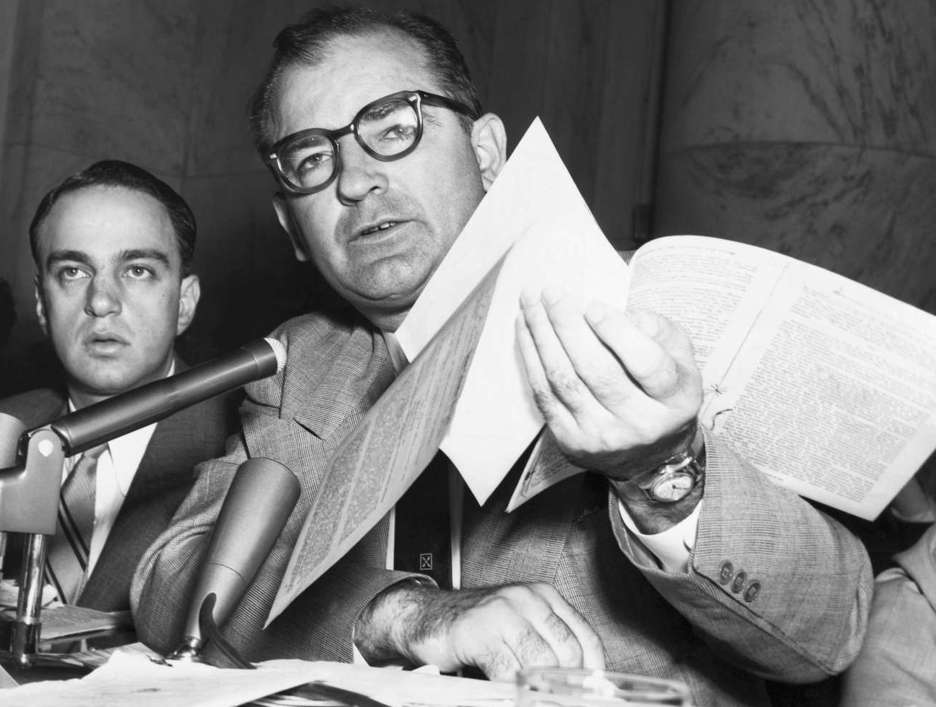
(b) Methods used by McCarthy & Growth of Opposition
McCarthy held hearings in private, then in public. Using a bullying & aggressive style of questioning, the higher profile the suspect the more publicity McCarthy gained. His aim in the hearings was to get confessions and, using FBI intelligence AND FABRICATED EVIDENCE, his hearings worried Democrats & US journalists. When Senate oppnents spoke out against “McCarthyism” he simply attacked them by calling them “Commies” or too “soft on Communism.” NOT A SINGLE PERSON ACCUSED OF SPYING WAS CONVICTED, BUT THIS DID NOT DENT McCARTHY’S POPULAR APPEAL. Thousands attended his speeches, millions enjoyed his TV spots & just being accused by him was enough for all the US to assume guilt.

Slide 46
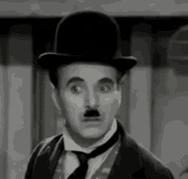
CHARLIE CHAPLIN
How did the famous comedy actor fall victim to McCarthyism?
What was McCarthy’s “evidence” against Charlie Chaplin?
When was Chaplin denied entry back into the USA?
Where did Chaplin live for the rest of his life after McCarthyism banned him for the USA?

Slide 47
(c) Reasons for McCarthy’s Downfall
Over time, McCarthy’s accusations grew ever more extreme. He accused General George Marshall of promoting the “Communist drive for world domination” via his 1948 Marshall Plan to help Eastern Europe & his failure to stop China falling to Communism in 1949. President Eisenhower (a fellow General) let his friend be tarnished & vilified because he was equally afraid of an accusation himself! Opinion Polls in 1953 showed that McCarthy remained popular with the majority of the US public. It was McCarthy himself, however, who brought about his own downfall.

Slide 48
(c) Reasons for McCarthy’s Downfall
McCarthy was leading a new Senate Sub-Committee on Communist influence in the Army by Autumn 1953. In Spring 1954, the Army-McCarthy hearings began and, unlike earlier public hearings, they were televised. The public were stunned to see how bad McCarthy bullied those being investigated and the tide began to turn. The Army, too, robustly defended itself & evidence of McCarthy’s abuse of Congressional privileges to the press. On 9th March 1954, Ed Murrow broadcast an episode of SEE IT NOW totally devoted to criticizing McCarthy – splicing his speeches & Senate Committee footage together to emphasize how unfair his accusations were. On 2nd December 1954, the Senate condemned McCarthy for “Improper Conduct” 67:22. He continued his work, but the press largely ignored him. He died from alcoholism & liver failure in 1957.

Slide 49
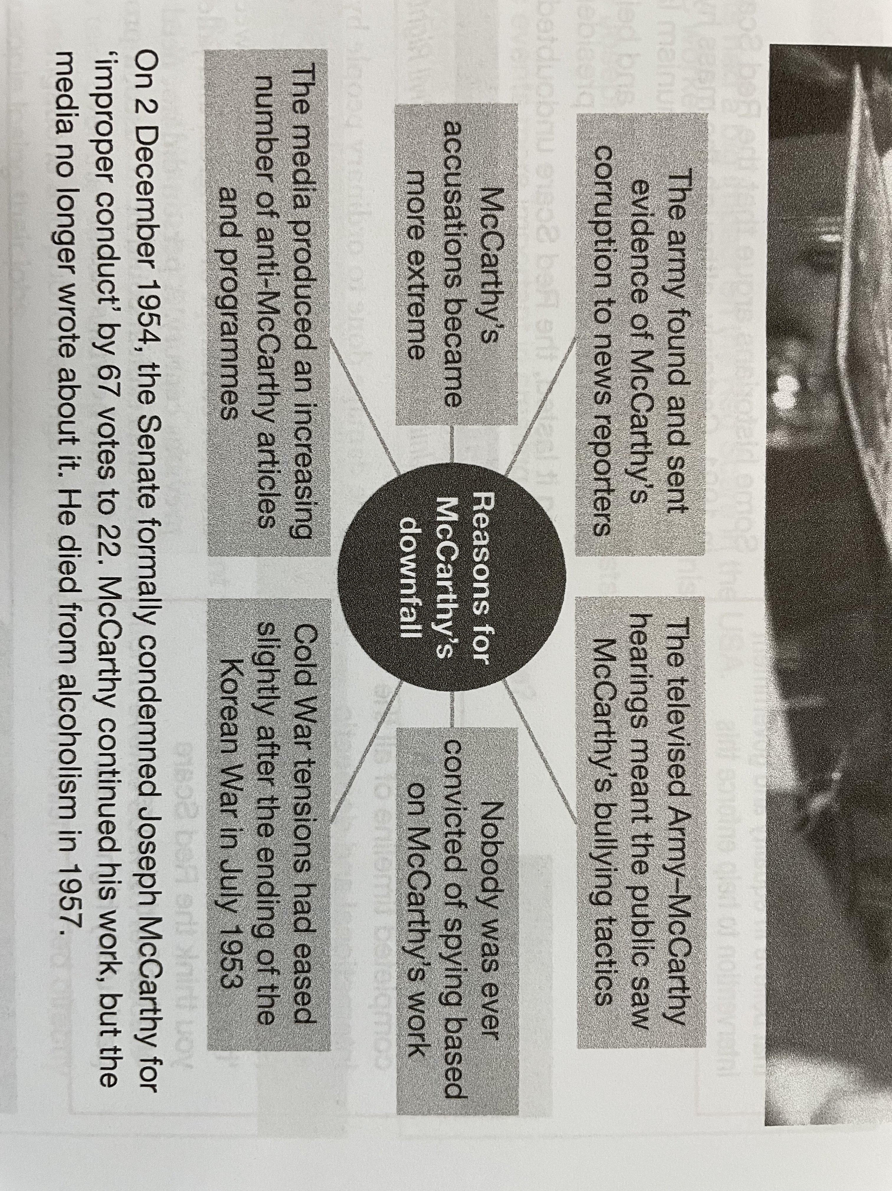

Slide 50
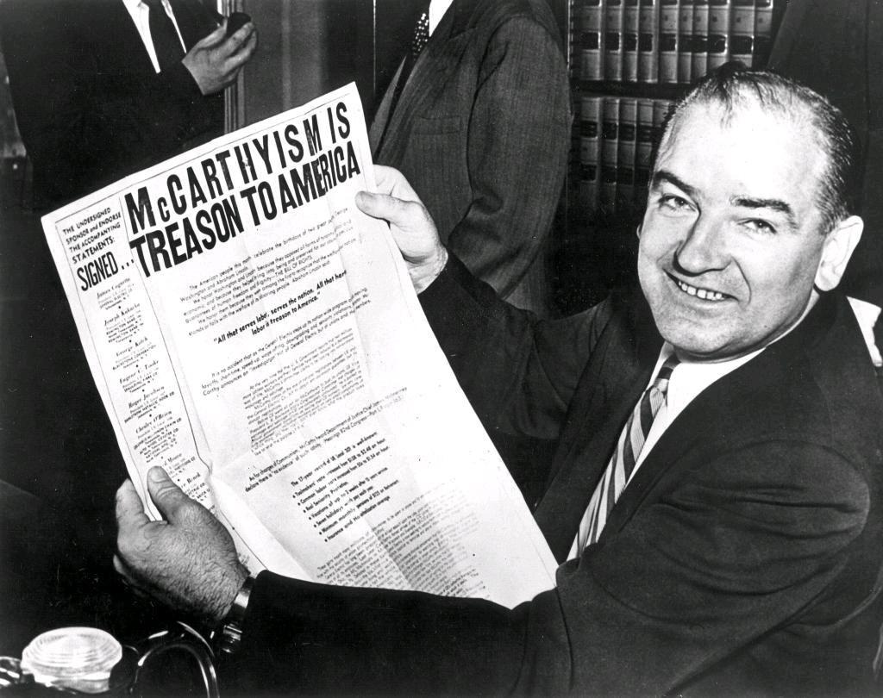
(d) Overall Impact of McCarthyism on the USA
The direct impact of “McCarthyism” was:
Thousands lost their jobs & careers
Companies & Institutions suspected employees of Communist sympathies
State Departments lost intelligent & talented workers who could have resisted extreme US policies later on
The indirect impact of “McCarthyism” was:
Hysteria about the “enemy within” rife
Thousands informed on people to FBI
Fewer joined unions or discussed politics
USA seen as intolerant by rest of the World

Slide 51
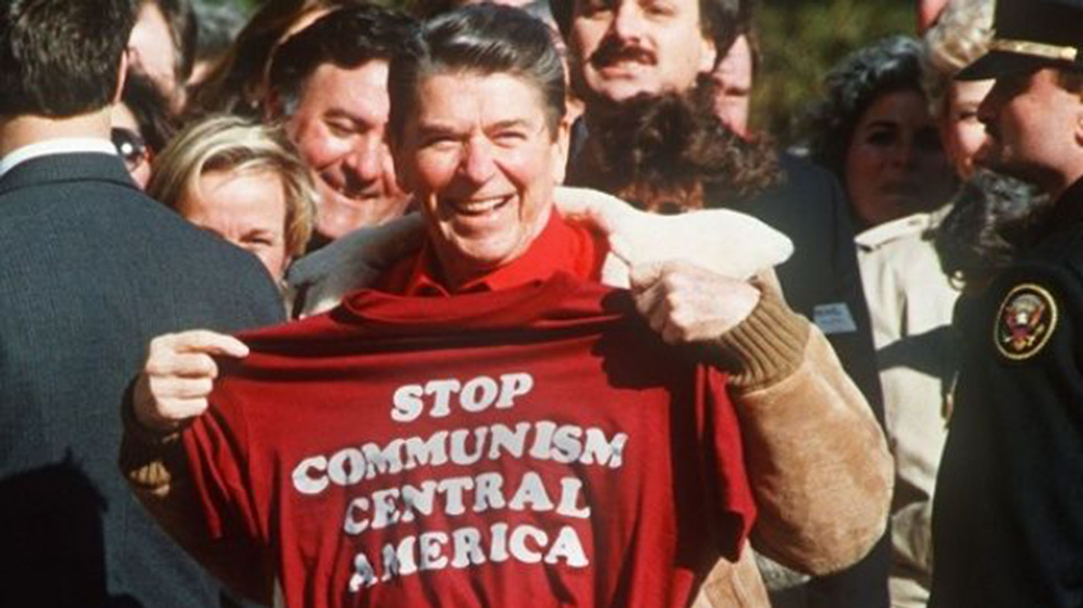
(d) Overall Impact of McCarthyism on the USA
Historians debate the extent to which the Red Scare lasted in America – some arguing that it persisted until the end of the Cold War in 1991. While the mass hysteria of the 1946-54 cooled down, US anxiety & fear of Communism lasted much longer. American foreign policy was firmly anti-Communist & being seen as “tough on Communism” was important in elections – even in the 1980s & 1990s. No matter how long it lasted, the Red Scare certainly had a MASSIVE impact on the USA – the so-called land of the free.

Slide 52
‘The damage done to ordinary people by the anti-Communist hysteria was massive. Hundreds lost their jobs due to the blacklists or for having been called before the Committee. Firms could be blacklisted as well as people, damaging their ability to conduct business. 1950-1952 saw 117 people cited for contempt of Congress and jailed – more than in the whole of the previous century. A person did not need to be a Communist to suffer. Anyone who was radical could be accused; a problem which continued in the USA long after the hearings ended.’
From a Modern History Textbook
What impression does the author give about the impact of the Red Scare? (6m)

Slide 54
Unit 1 Recall Quiz
What are the main differences between Capitalism and Communism?
Why did people in the USA fear Communism?
Give two reasons why the Red Scare happened.
What does “HUAC” and “FBI” stand for?
Who were the following people – J. Edgar Hoover; Joseph McCarthy; Alger Hiss; Ethel & Julius Rosenburg?

Slide 56
Unit 1 Recall Quiz
What were the Hollywood Ten imprisoned for?
What were the terms of the McCarran Act?
What methods were used by Joseph McCarthy to find Communist spies in the US Govt.?
Give three impacts of McCarthyism on the USA.
In what years did the following happen – the start of HUAC’s investigation into spies; the trial of Hiss; the Rosenburg trial; the Soviet bomb?

Slide 58
Unit 1: Explaining
Why did international events have a big impact on the Red Scare in the USA?
Explain how the FBI + HUAC worked together to create anti-Communist feelings & fear od spies in the USA.
Describe the methods used by Joseph McCarthy to uncover Communists in the US Government and Army.

Slide 60
Unit 1: Challenge
Were international or domestic events more important in creating the Red Scare?
Why did so many people believe the accusations of Joseph McCarthy?
Explain why anti-Communist hysteria reached a peak in the 1950s.

