Slide 1
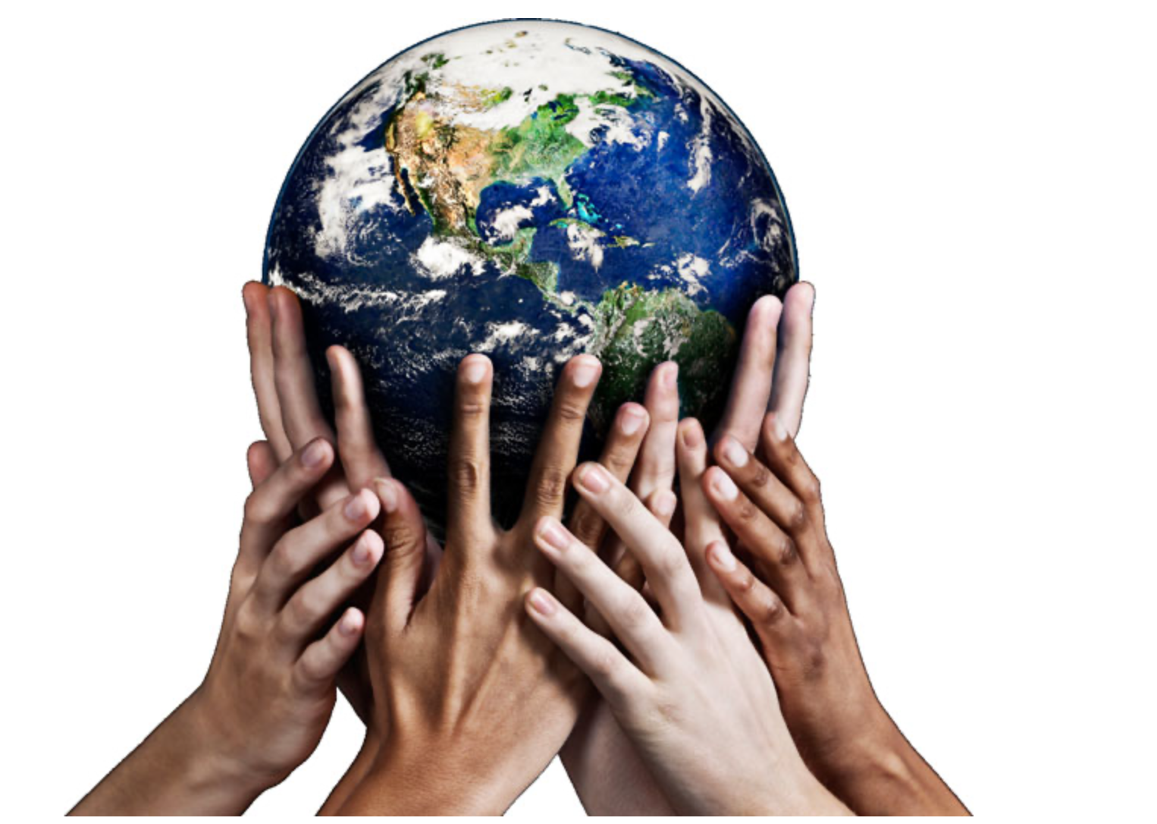
Global citizenship IGCSE

Slide 2
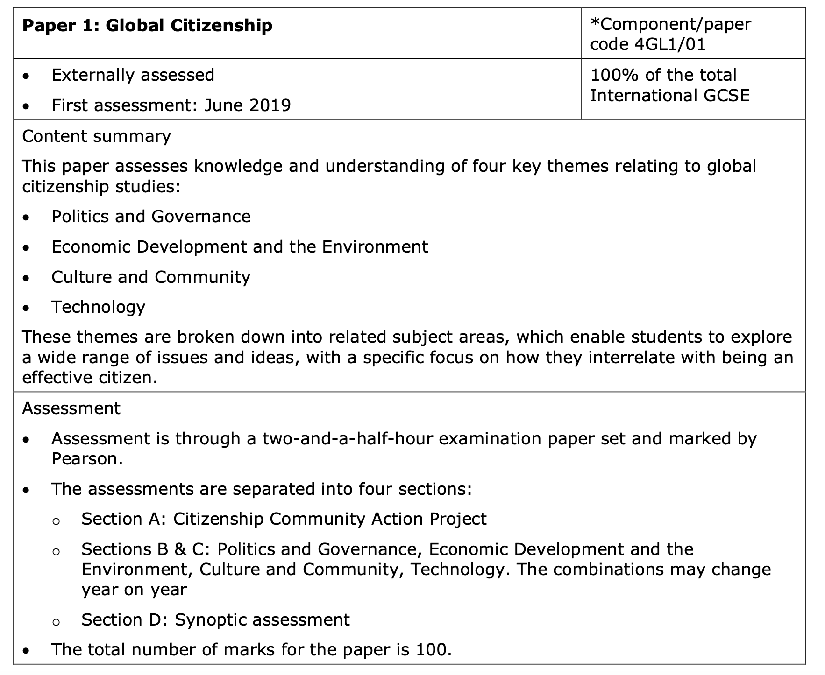

Slide 3
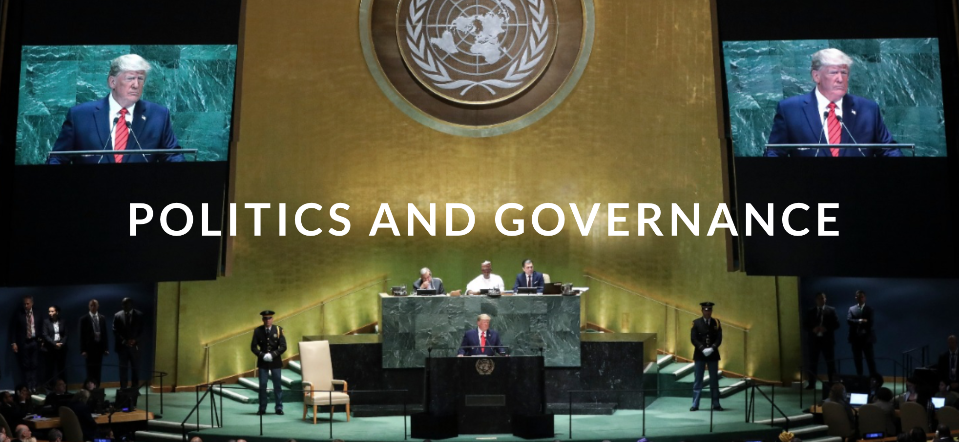
POLITICS AND GOVERNANCE
This theme provides an opportunity to develop an understanding of the local, national, international and global dimensions of political activity, as well as offering a chance to explore political themes affecting all of our lives. For many people, the state exists as the central unit in global politics, but the state exists in many forms and with a variety of different systems of government. There has been a shift towards a system of global governance in which emerging international institutions have sought to create a body of international law. This covers almost all elements of the interaction between these states, including human rights recognition and protection. Despite the seemingly distant, global nature of much of this development, the individual, or maybe even global citizen, can and does still does make a difference.

Slide 4
What you will learn
1 Key citizenship ideas and concepts in response to systems of governance, state and sovereignty.
2 The relationship between rights and responsibilities of citizens; the politics of their country; the politics of others.
3 Concepts of participating in democracy; own contribution to democracy and governance.

Slide 5
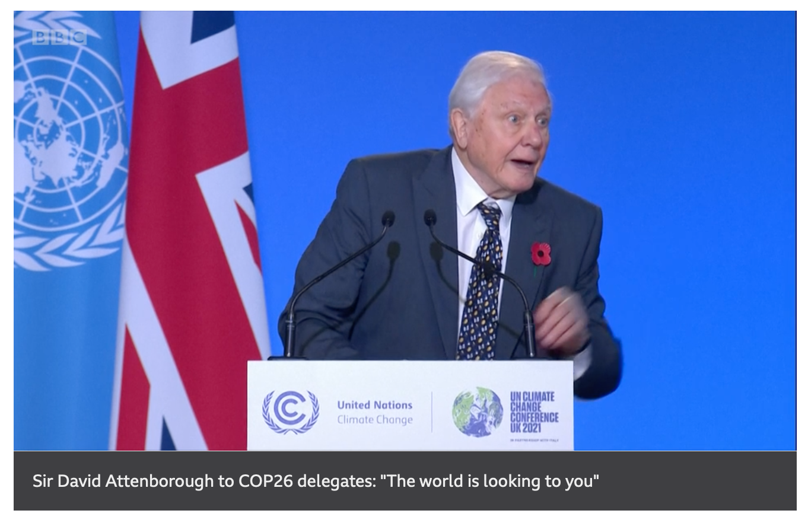
World leaders meeting
https://www.bbc.com/news/world-59125138

Slide 6
Human rights
​1.3a) Human rights; Universal Declaration of Human Rights; the nature and type of human rights from civil and political to economic, social and cultural. LO: To understand the historical development of human rights. To investigate different kinds of rights and be able to explain their significance.

Slide 9
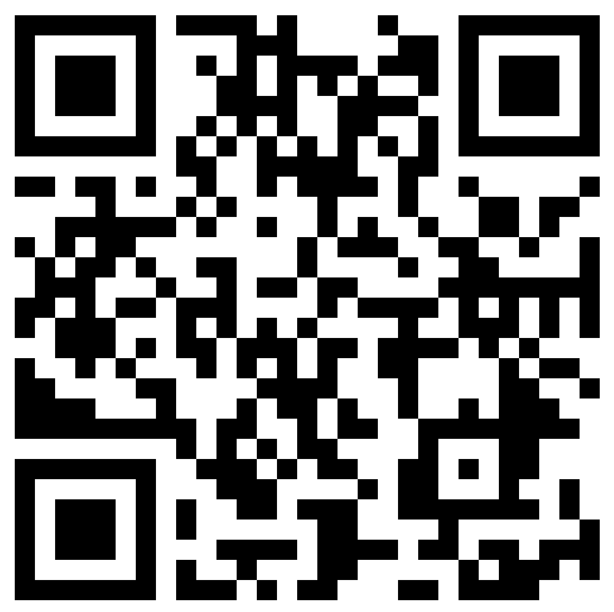
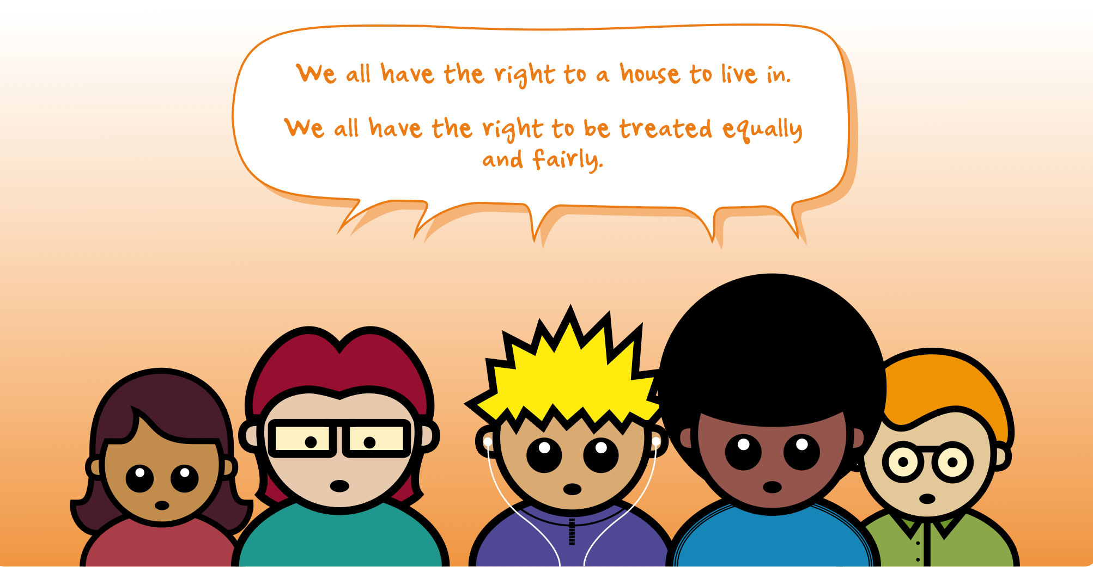
Task
1. On your own, think about this definition of human rights.
What human rights do you think we all have?
Share on the padlet: https://padlet.com/BISHumanities/wsbemuxfxuzu2hf9
2. In groups: Discuss the list of human rights that you each came up with.
Explain why you think these are human rights that all human beings should have.
3. Are there any examples that you disagree on?
Compare the rights you came up with to the rights on the cards.
Which are the same and which are different?

Slide 10
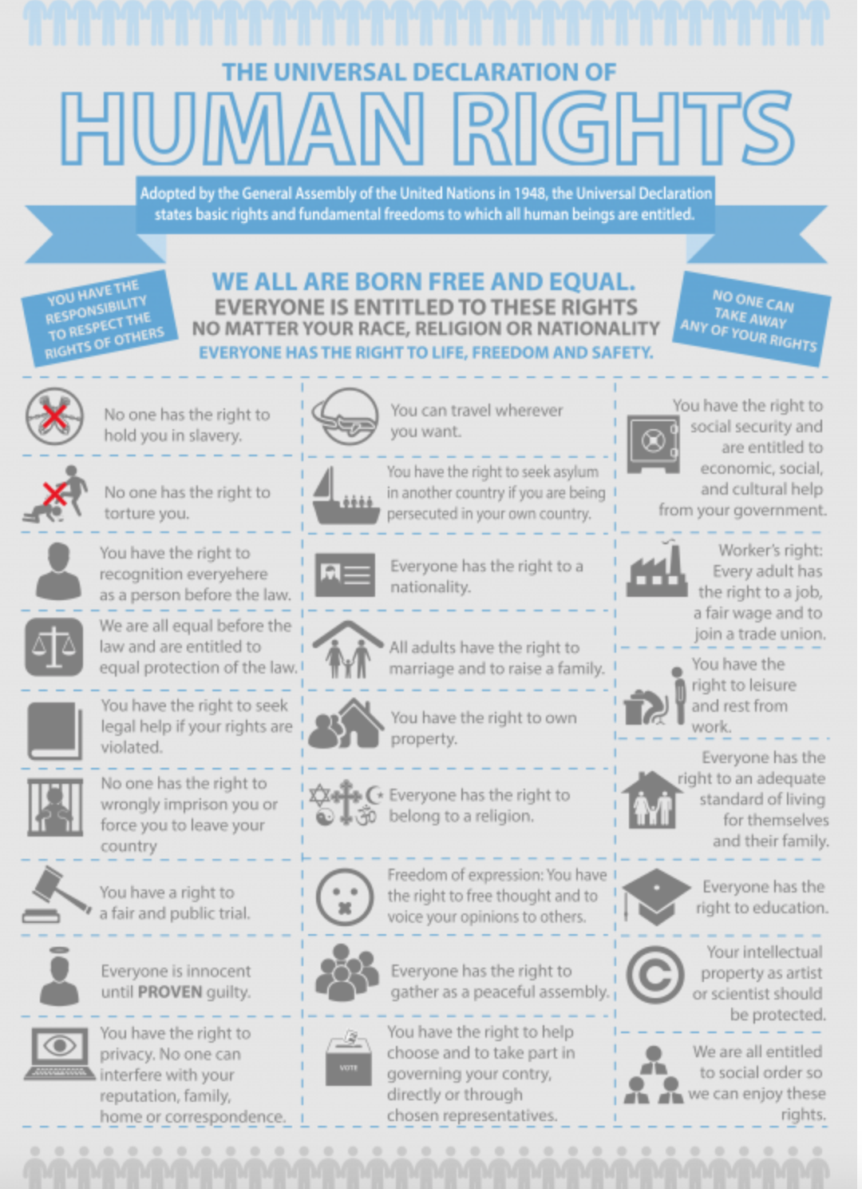
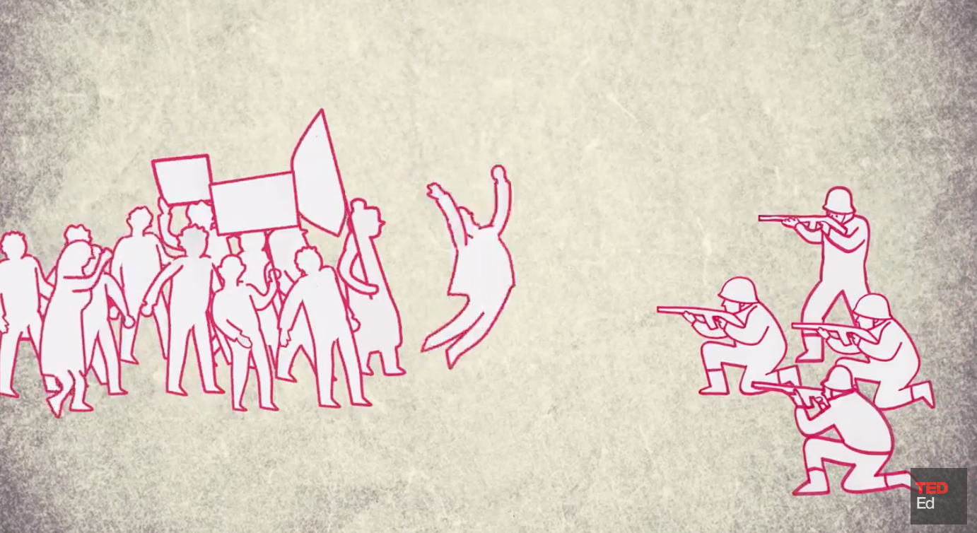
https://www.youtube.com/watch?v=nDgIVseTkuE

Slide 11
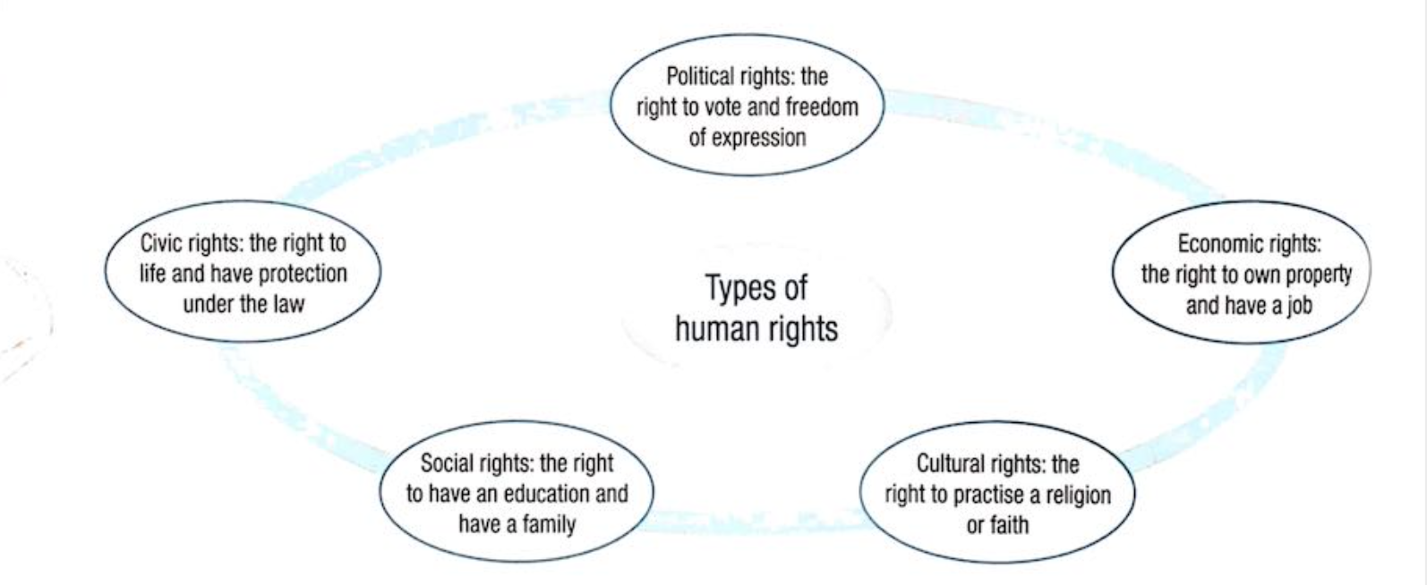
The different types of Human rights
Look at the Universal declaration of human rights and categorize the rights under these headings

Slide 13
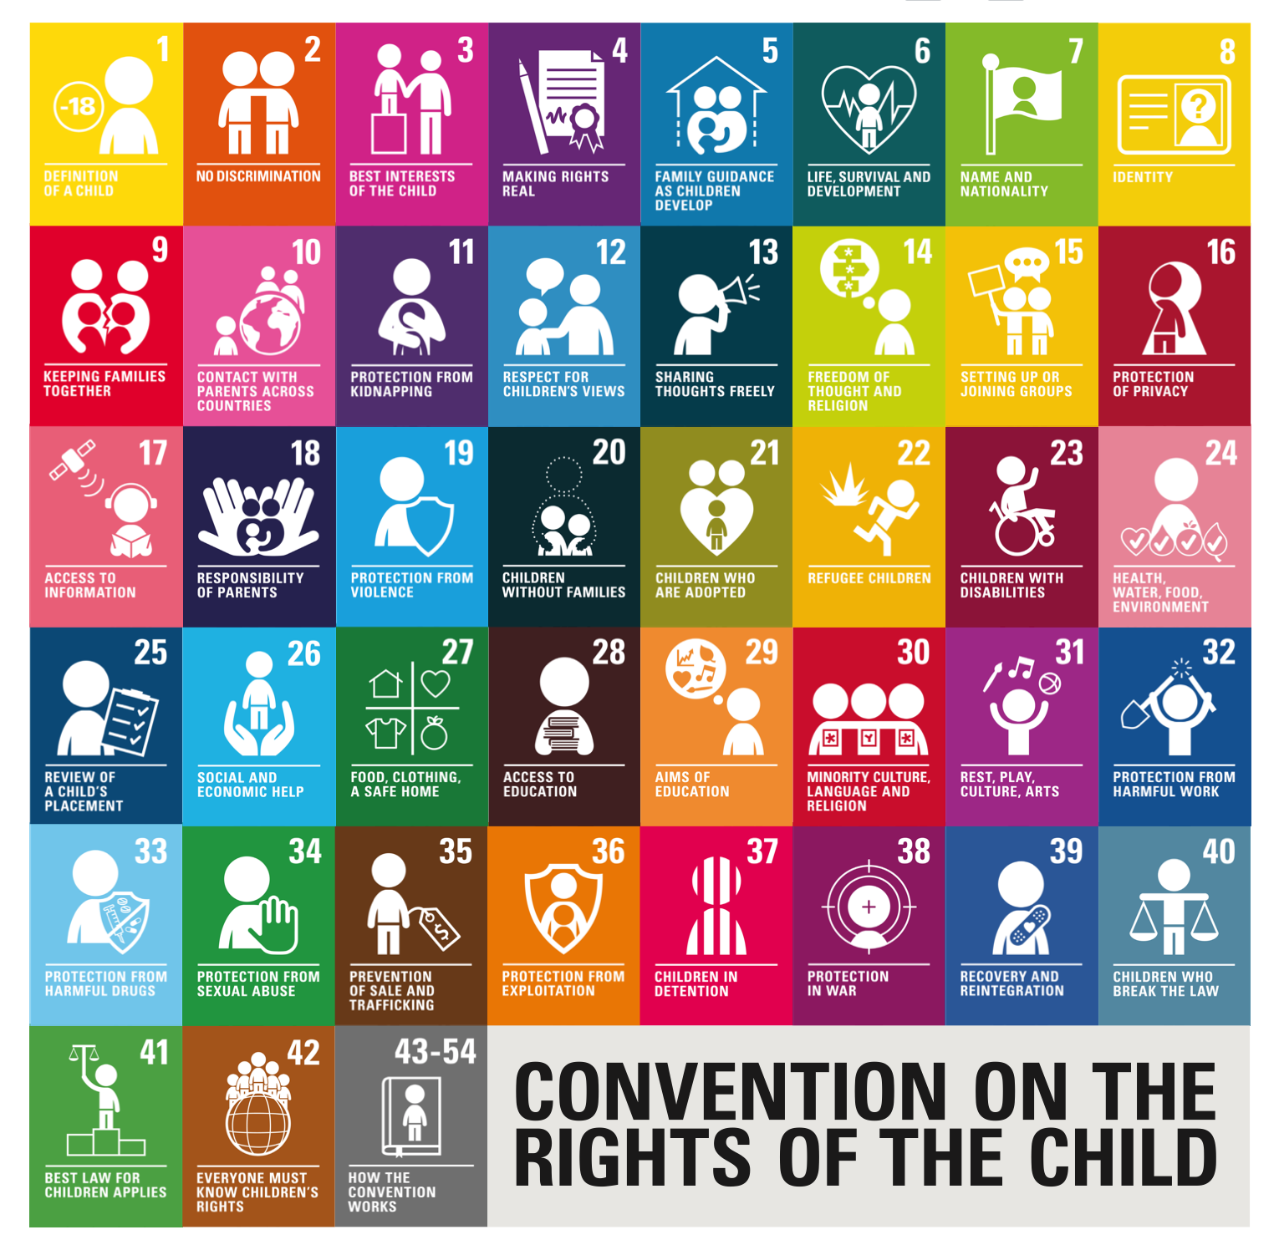
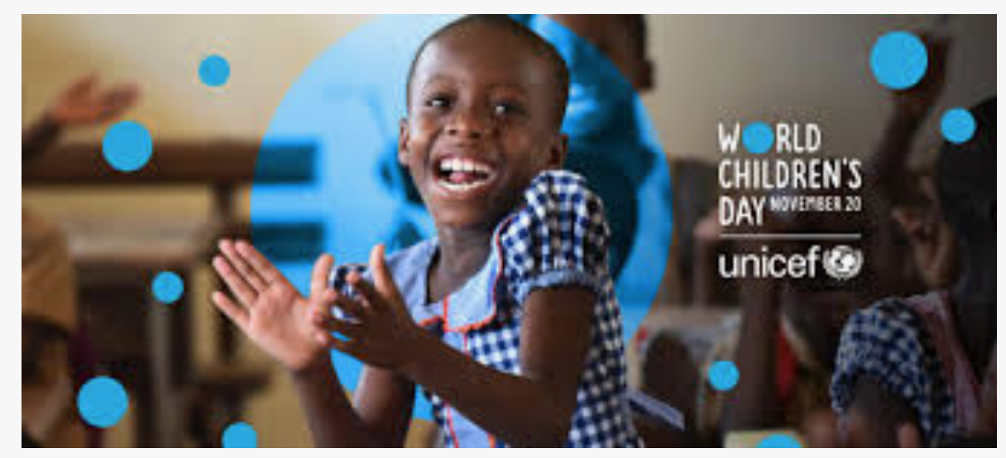

Slide 14
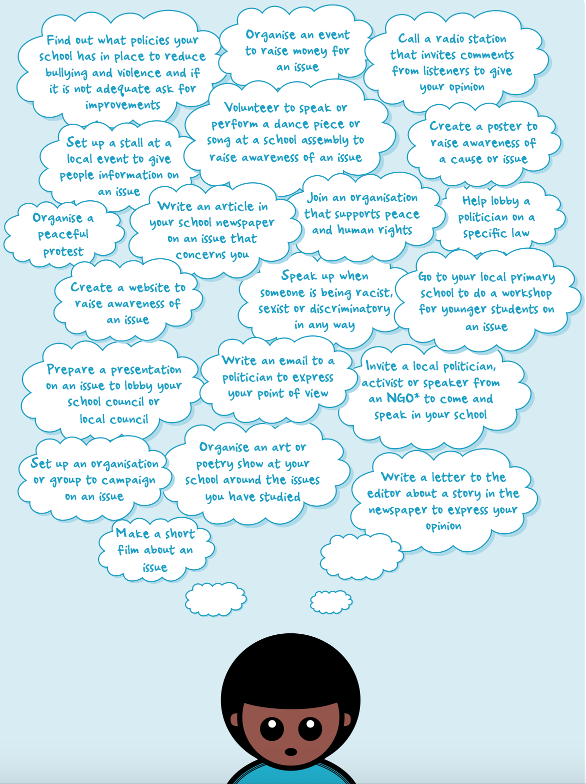
Extensions
What could you do?
Citizenship action project

Slide 15
‘No country should interfere in the laws of another country’
To what extent do you agree with this view?

Slide 16
Protecting people’s rights
1.3b) Differing cultural interpretations of human rights; human rights during conflict, humanitarian intervention and peacekeeping.
LO:
To start to consider which human rights might matter the most to themselves and others living in different places.
To consider what rights children should be entitled to receive.
To appreciate how human rights can apply in a variety of real-life challenging contexts.

Slide 17
At what age do people have the legal right to do each one of the following activities?
The age of criminal responsibility (10)
The ability to buy a pet
Get a part-time job (13)
To get married with your parents’ permission
The age of consent (16)
To drive a car (17)
To vote
Buy tobacco
Make a will (18)
Questions:
Why does the law has age limits and why do these vary from country to country?
Are there age limits that seem unfair or illogical, that should be changed?

Slide 19
https://www.youtube.com/watch?v=oh3BbLk5UIQ
What are the key points in the development of human rights?

Slide 22
UN peacekeeping and human rights protection:
https://peacekeeping.un.org/en/promoting-human-rights
Discuss the role of the UN in peace-keeping, conflict prevention and international justice, in support of human rights

Slide 23
Protecting people’s rights
1.3b) Differing cultural interpretations of human rights; human rights during conflict, humanitarian intervention and peacekeeping.
LO:
To start to consider which human rights might matter the most to themselves and others living in different places.
To consider what rights children should be entitled to receive.
To appreciate how human rights can apply in a variety of real-life challenging contexts.

Slide 24
Rights and Freedoms
1.3b) 1.3c) Duties of citizens to respect the rights and freedoms of others and the law.
LO:
To understand freedoms and how they impact on people’s everyday lives.
To consider how one person’s rights and freedoms can impact on others and how the law tries to manage this.

Slide 25
Refer back to the list of human rights in the UDHR and highlight which rights relate to discrimination

Slide 26
At what age do people have the legal right to do each one of the following activities?
The age of criminal responsibility (10)
The ability to buy a pet
Get a part-time job (13)
To get married with your parents’ permission
The age of consent (16)
To drive a car (17)
To vote
Buy tobacco
make a will (18)

Slide 28
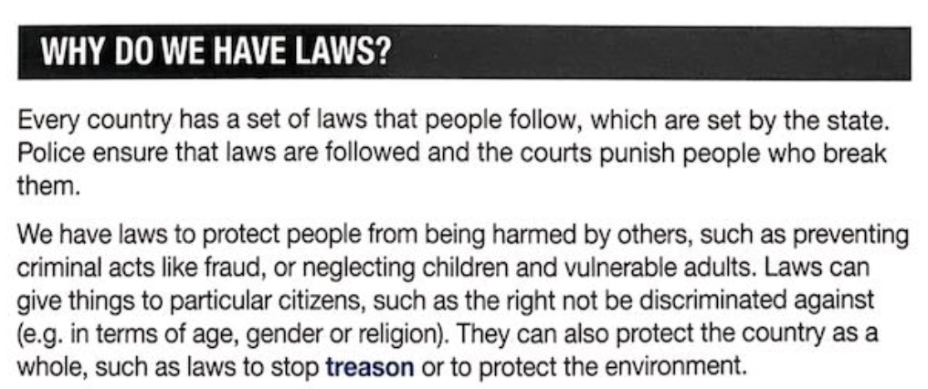
Example 2: Kenya bans plastic bags
There is a plastic bag ban in Kenya. The aim of this is to stop plastic pollution, which is damaging drainage systems and harming cattle as they would eat the plastic bags. Since the ban in 2017, the government claims that there has been a 80% reduction in plastic bag use and litter has been reduced. By respecting the law, people are able to benefit from the effects of everyone else’s actions.
Example 1: Smoking ban in cars with children in UK
https://www.bbc.co.uk/news/health-34402622

Slide 29
Challenging the law
People may challenge the law if they feel it does not respect their rights and freedoms.
For example, in1963 Martin Luther King spoke for racial equality in Washington DC. He was joined by 200,000 demonstrators.
This event led to changes in civil rights laws which made discrimination illegal on the basis of colour, race, gender, religion or nationality illegal.

Slide 31
Questions to consider
What is a right. Give some examples
What are freedoms. Give some examples
What are some real- life examples of moral responsibility.
How does the law affect people’s rights and freedoms. Does it support rights and freedoms or limit them?
How might laws be changed to make sure that all people’s rights and freedoms are met?
‘I have my freedoms. I’m not bothered about other people’ How far do you agree with this view? Give reasons for your opinion, showing you have considered different points of view.

