Slide 1
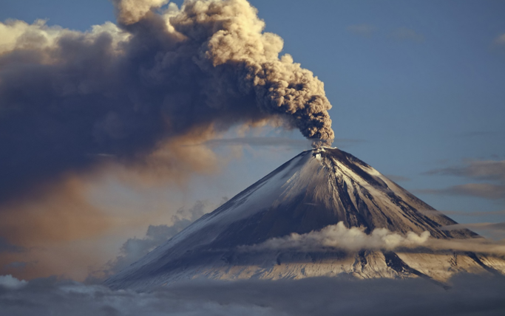
Types of volcanoes
LO:
I can define the word volcano and distinguish between active, dormant and extinct volcanoes
I can identify the key features of a composite volcano
I can identify the key features of a shield volcano

Slide 2
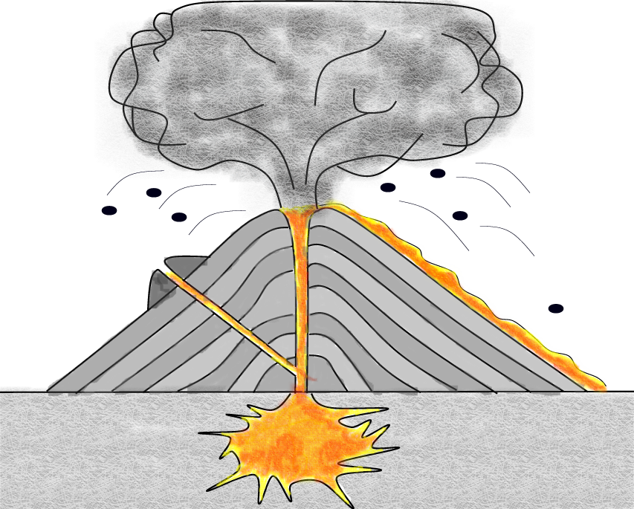
Starter TASK: Study the volcano diagram below. Label the features at A, B, C, D & E.
Maybe these will help!
Secondary vent
Cone
Vent
Lava flow
Main vent
Ash cloud
Magma chamber
Crater
Pyroclastic flow
Volcanic bombs
Lahars
Secondary cone
B
Ash cloud
C
Volcanic bombs
A
Lava flow
D
Main vent
E
Magma chamber
At which plate boundaries would we find volcanoes?
Constructive, destructive, transform and collision.

Slide 4
Activity Level
This looks at how long ago the volcano exhibited any sort of life.
Active: Have erupted in the last 80 years - there are about 540 of them in the world.
Dormant: Resting but which may erupt again in the future.
Extinct: Dead and will not erupt again
Note: How active a volcano is largely depends on where it is found in the world. Certain regions are more volcanically active than others, for example the Ring of Fire which runs all the way round the edges of the pacific ocean.

Slide 5
Shape and composition
Shield
Composite

Slide 6
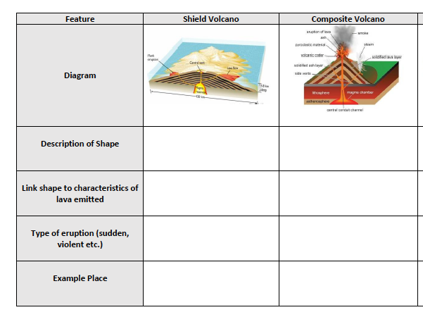
The 2 main types of Volcano
Watch the the video to the left, use this website : Three types of volcnoes to complete the sheet:

Slide 7
Use the information on weebly to complete this table

Slide 8
Shield volcano
https://www.youtube.com/watch?time_continue=26&v=byJp5o49IF4

Slide 9
Shield volcanoes:
Shield volcanoes have very runny lava (they are not viscous); because of this they do not have an ‘explosive’ eruption. Lava spreads quickly across the landscape. With each eruption a new layer of rock is built on the previous one. Gradually a wide dome of rock is built up. It is called a shield volcano because it looks like a curved shield lying on the ground (or an upside down dinner plate). The slopes of a shield volcano are very gentle. The Hawaiian islands are a chain of shield volcanoes

Slide 10
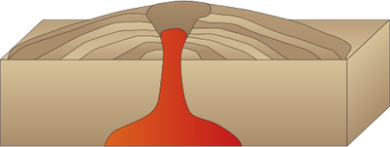
TASK: Read through the resources of the Queen Mary Peak shield volcano. Draw a sketch of a shield volcano and annotate your sketch to show all the characteristics of a shield volcano.
Broad peak
Wide long slopes
Gentler eruptions
Gentle slopes
Runny lava
Constructive plate boundary
Plate
Plate
MANTLE

Slide 11
Composite volcano
https://www.youtube.com/watch?v=1u1Ys4m5zY4

Slide 12
Composite volcanoes:
Composite volcanoes are the most common type of volcano. When you think of a volcano you are probably picturing the classic shape of the composite volcano. They are formed by hardened layers of lava and ash from successive eruptions. The lava is viscous (therefore thicker than with shield volcanos) and it cools and hardens before spreading very far. The eruptions tend to be very violent. Mount Etna in Sicily, Italy is an example of a Composite Volcano.

Slide 13
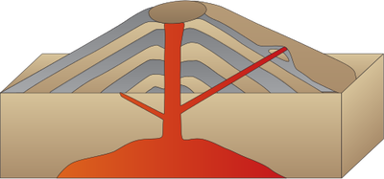
TASK: Read through the resources on Mt. Pinatubo composite volcano. Draw a sketch of a composite volcanoe and annotate the sketch to show all the features of a composite volcano.
Violent eruptions
Steep slopes
Layers of ash and lava
Viscous or sticky lava
Plate
Destructive boundary
Plate
MANTLE

Slide 14
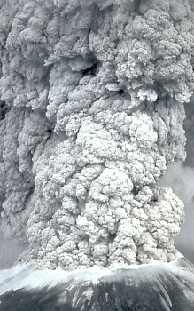
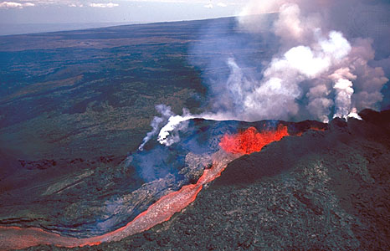
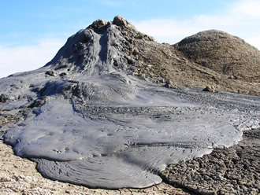
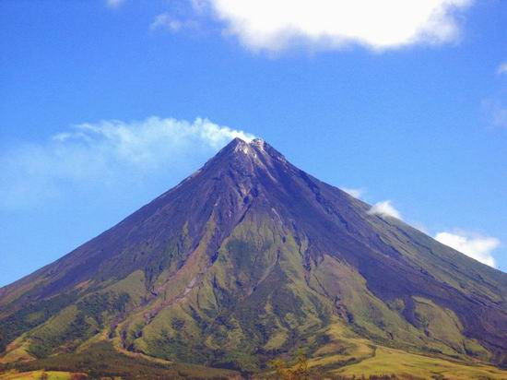
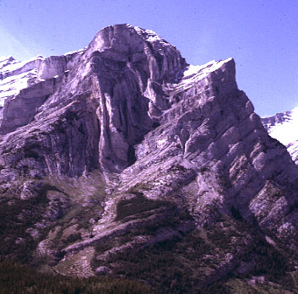
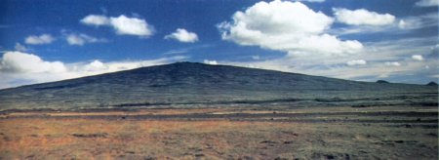
Odd one out! Progress check TASK: Cross out the images that are not shield volcanoes. Write a reason for your choice.
A
B
C
NO
YES
NO
D
F
NO
YES
E
NO

Slide 15
Read the various answers to exam question below. Discuss then use the mark scheme to score each answer. EXAM QUESTION: Explain three differences between shield and composite volcanoes. (7 marks)
Response 1
Shield volcanoes are broad and composite volcanoes are steep. For example Mt Pinatubo and Queen Mary’s Peak.
Response 2
Shield volcano are volcanoes at constructive plate boundary such as Queen Mary’s Peak. But composite volcano like Mt Pinatubo is at destructive plate boundary. Mt Pinatubo is in the Pacific ring of fire. This is a place where lots of volcanoes are located.

Slide 16
Exam practice TASK: Explain the differences between shield and composite volcanoes . (7 marks)
Marks | Response
0-2 | Explain one difference or list 2 differences.
3-4 | Explain 2 differences. Maximum three marks if only list the differences without any explanation.
5-6 7 | Explanation 3 distinct differences or student explain two differences. Include specific case study detail
Possible answers
Shield volcanoes form at constructive boundaries whereas composite form at destructive boundaries.
Shield volcanoes eruptions are less explosive than composite volcanoes.
Composite volcanoes cause more damage to life and property than shield volcanoes.
Examples of shield volcano is Mauna Loa in Hawaii. Mt. Pinatubo in the Philippines is a composite volcano.

