Slide 2
Notes:
Lesson 1:Brainstorm - what types/systems of political power do they know? Can they explain how they work?

Slide 3
What does DEMOCRACY mean?
What are its benefits as a system of government? What are its disadvantages?

Slide 4
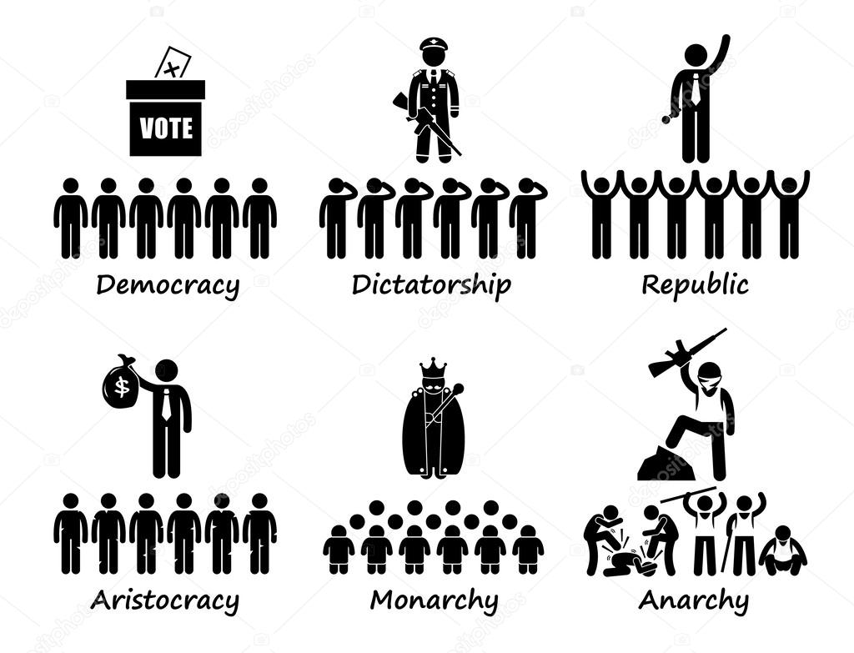
Types of political power
Monarchy
Dictatorship
Theocracy
Direct Democracy
Representative Democracy
Junta
Anarchy
Notes:
Lesson 1: Task: expanding understanding of political systems.
Knowledge capture sheet. Watch the video and read the information sheets. Collect basic information on the different political systems.

Slide 5
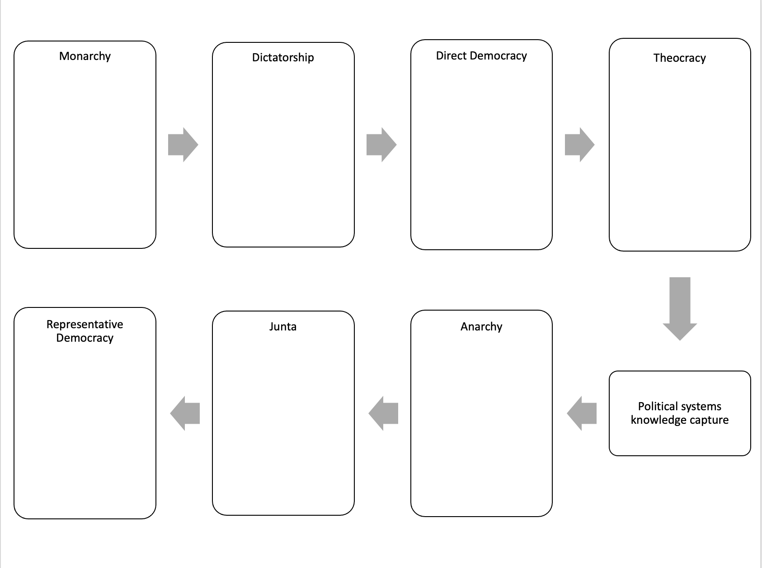

Slide 6
