Slide 1
What do these percentages represent?
82.6%
19.9%
100%
34.4%

Slide 2
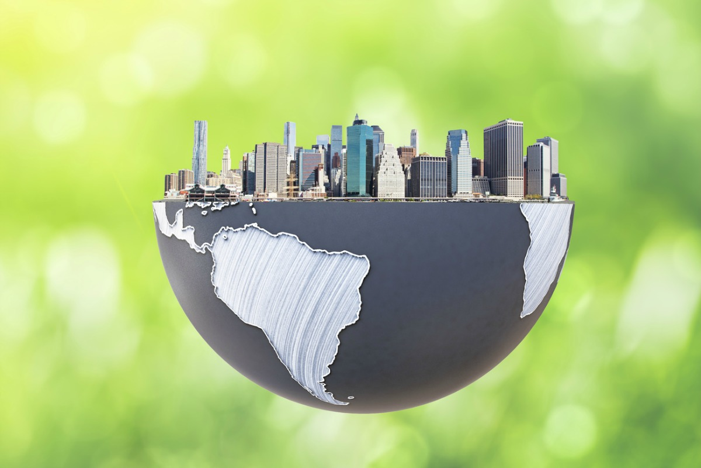
Trends in Urbanisation
Lesson Outcome:
1. All will be able to describe the differences in rates of urbanisation around the world over the last 50 years.

Slide 3
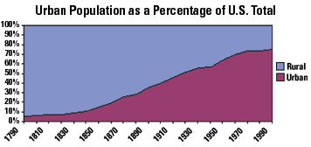
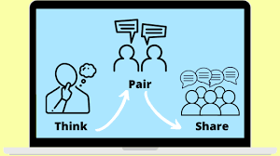
Starter Challenge – Think, Pair, Share
Write a brief description of what the graph opposite is showing.
Check with your neighbour to see if you have reached the same conclusion about what the graph is showing.
Be ready to share with the class.

Slide 4
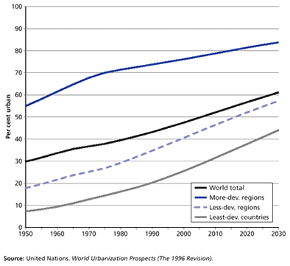
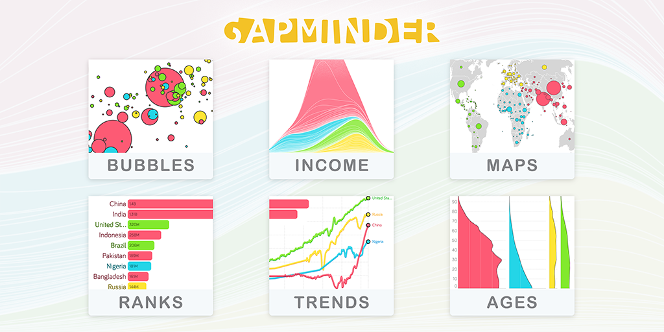
Challenge 1 - Describing trends in urbanisation
Your challenge is to use the various data sources at your disposal (you can use additional sources as well) to create a piece of work on the varying rates of urbanisation around the world over the last half a century.
Your work (it could be a piece of writing, a short video or a PPT/Slide Presentation) must include:
What the global situation was like around 50 years ago (how urbanised were places)
What has happened over the last 50 years
Specific examples of how regions or countries have urbanised over the last 50 years
Comparisons between countries / regions
Extra Challenge – What is likely to happen by 2050 and why?

Slide 5
World Urbanisation Trends, 1950-2030
World Urbanisation Trends, 1950-2030
World Urbanisation Trends, 1950-2030
https://www.gapminder.org/videos/gapmindervideos/gapcast-2-urbanization/
https://www.gapminder.org/videos/gapmindervideos/gapcast-2-urbanization/
https://www.gapminder.org/videos/gapmindervideos/gapcast-2-urbanization/
https://morphocode.com/global-trends-urbanisation/
https://morphocode.com/global-trends-urbanisation/
https://morphocode.com/global-trends-urbanisation/

Slide 6
Notes:
Optional Visual

Slide 7
Trends in Urbanisation Checklist
1 – An overview of how urbanised the world was in 1960.
2 - Specific examples for different continents / countries including contrasts between continents / countries, using figures.
3 – A description of what happened between 1960 and 2020, with reference to specific continent / country examples.
4 – An overview of how urbanised the world was in 2020.
5 - Specific examples for different continents / countries including contrasts between continents / countries, using figures.
Sentence Starters:
In 1960 certain parts of the world were more urbanised than others, for example…
Between 1960 and 2020 many countries urbanised at different rates, some examples include…
In 2016 there has been a clear increase in the level of urbanisation from 1960, in particular…
Key words:
Urbanised HIC LIC Continent China
Industrialised countries Developing countries

Slide 8
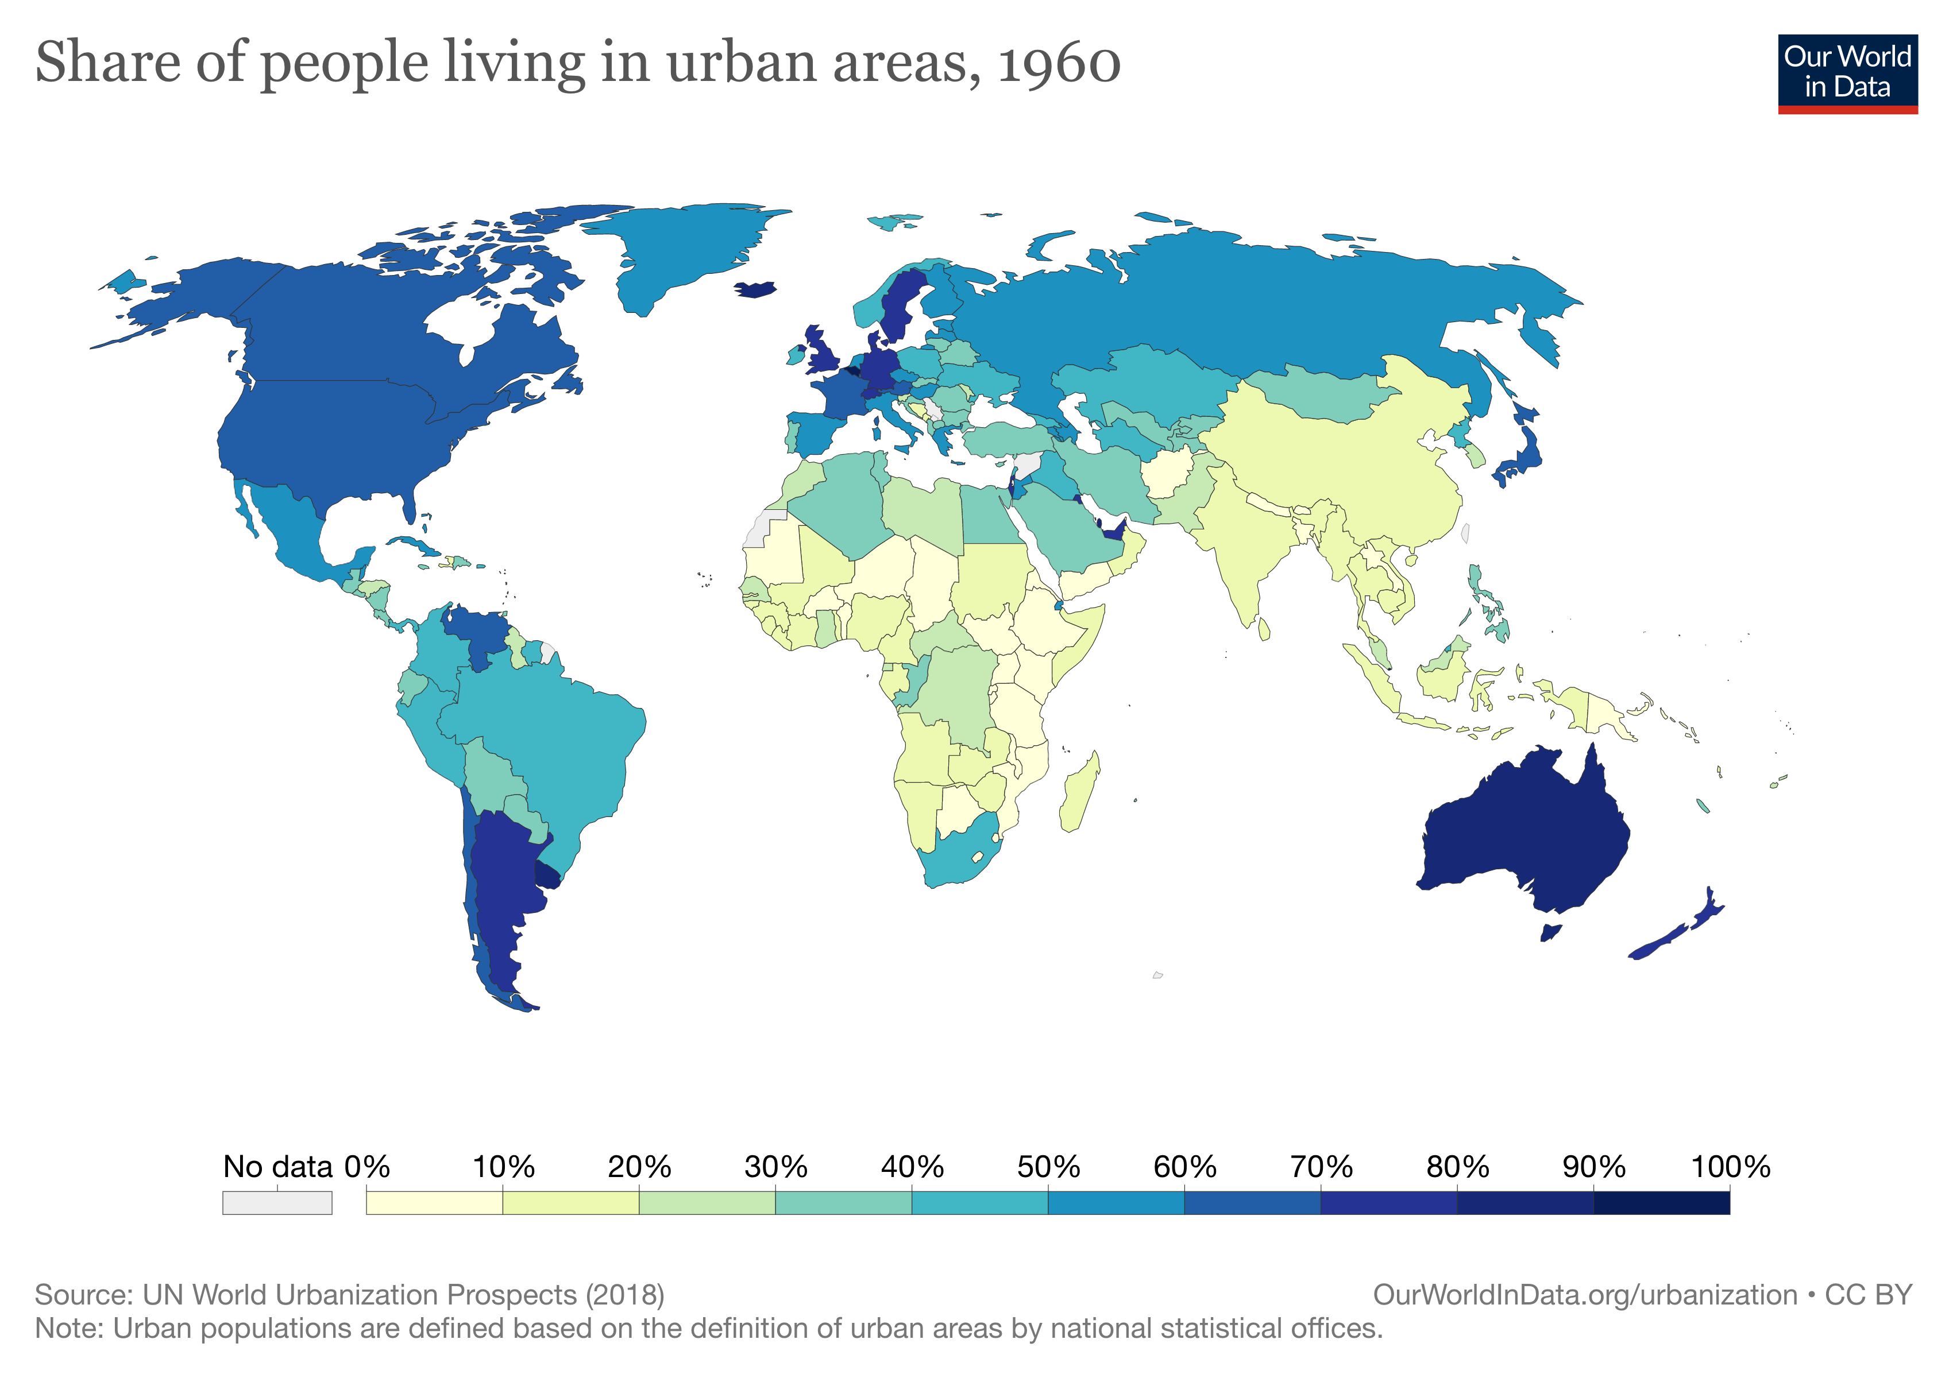
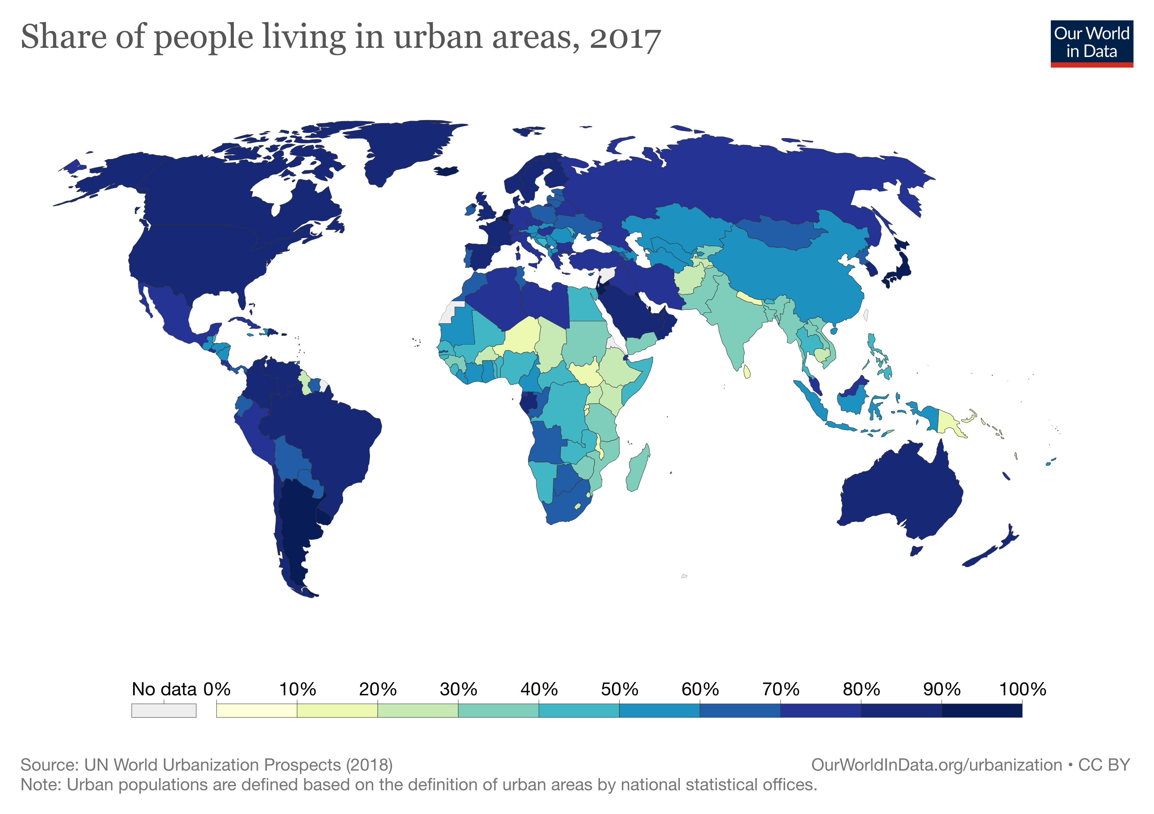
Challenge 2 - Mapping the trends!
Using what you now know, annotate the provided maps to describe the changes that have taken place.
Extra Challenge – Add explanations to your annotations.
Super Challenge – Create a Google Earth Project. Add a marker on each continent and add detailed description / explanation of the changes in urbanisation for each continent. Make sure to include supporting images and data to support your points for each continent.
Notes:
https://ourworldindata.org/urbanization

Slide 10
To Finish
Match the percentage to the country. Write the country name and the percentage on your post-it and pop it on the board.
Countries:
UK
Qatar
Democratic Republic of the Congo
Bolivia
Percentages:
99.2
45.1
69.7
83.9

