Slide 1
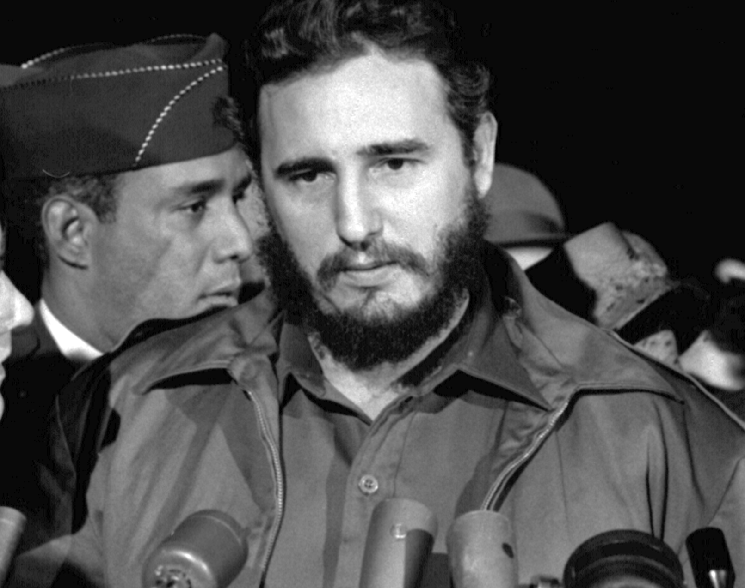
Treatment of minorities in Cuba
Mahault

Slide 2
Persecuted minorities in Castro’s Cuba
Political opponents to PCC
Homosexuals
Religious communities
Cuban artists, painter, singers…
Notes:
PCC = communist party of cuba, castros party

Slide 3
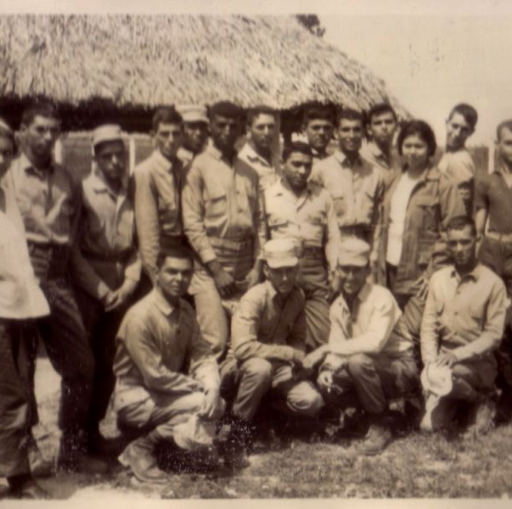
Military Service
UMAPs, Military Units to Aid Production were created in 1965. They were essentially camps to educate teenage boys and allow them for good employment opportunities as adults. This was called their military service.
However, there were some that were turned into labor camps for targeted minorities.

Slide 4
Labor camps
Were sent the homosexuals and some sects like the Jehovah's Witnesses, Catholics Priests, Protestant’s Ministers, intellectuals, farmers who refused collectivizing, anyone who was considered anti-social or a counter- revolutionary.
This was supposed to “re-educate” them to be “normal” and integrated back into society.
Conditions: Forced labor for free in state farms from 10 to 12 hours a day, seven days per week, poor alimentation (rice and spoiled food), unhealthy water, unclean plates, congested barracks, no electricity, latrines, no showers.
Around 35,000 detainees, 72 died from torture, 180 suicides, 507 in psych wards.
These closed in 1968 due to international protests.
Homosexuals were not targeted anymore after that and the government made several efforts to accept and respect gay communities since.

Slide 5
Treatment of political opponents
Political prisoners were held in those camps as counter-revolutionaries, such as CIA operatives or fascists.
The CDR, Committee for the Defense of the Revolution, is organized as such that it reports counter-revolutionary activities in Cuba, such as bombings or attacks.
The CDR constantly monitored the Cuban population, so freedom of speech was very limited.
The CDR was considered by human rights as acting abusively towards the counter-revolutionaries by making their families endure harassment or public humiliation.
A large number of opponents were killed, sometimes without having committed any crime, just because of their political belief.

Slide 6
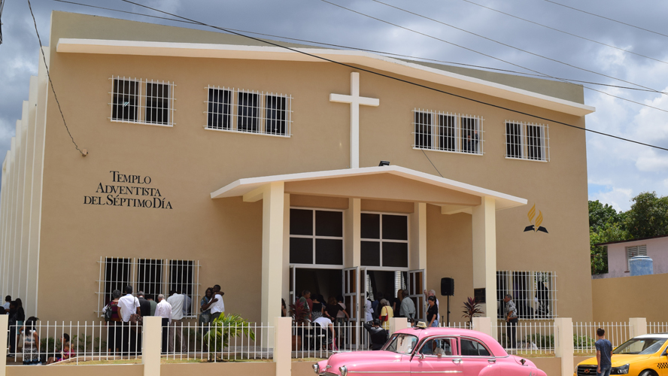
Religion in Cuba
Cuba was declared an atheist country
No religion could proselytize
Government spied on those who went to previously built churches or worshipped in their homes.

Slide 7
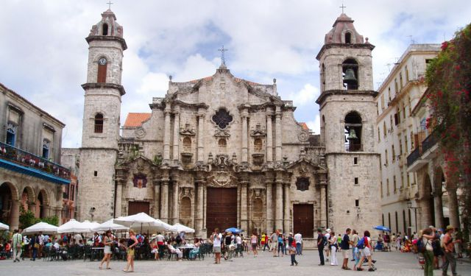
Castro’s Government restrictions towards religions
Blocking construction of new churches or other religious building
Limit the arrival of foreign religious leaders
Import of religious articles was controlled and monitored
Many private churches and other houses of worship, including meetings in private places have been banned.
Religious material was confiscated

Slide 8
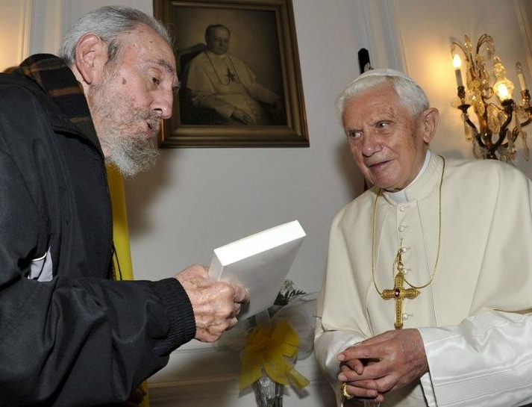
Updated view of religion later in Castro’s Cuba
In 1992, Castro loosened the restrictions on religion and even allowed Catholics to join the Cuban Communist Party
Cuba was considered more as "secular" rather than “atheist” country and religious groups were not persecuted anymore.
Pope John Paul II visited Cuba in 1998, the first visit by a religious leader to the island.

Slide 9
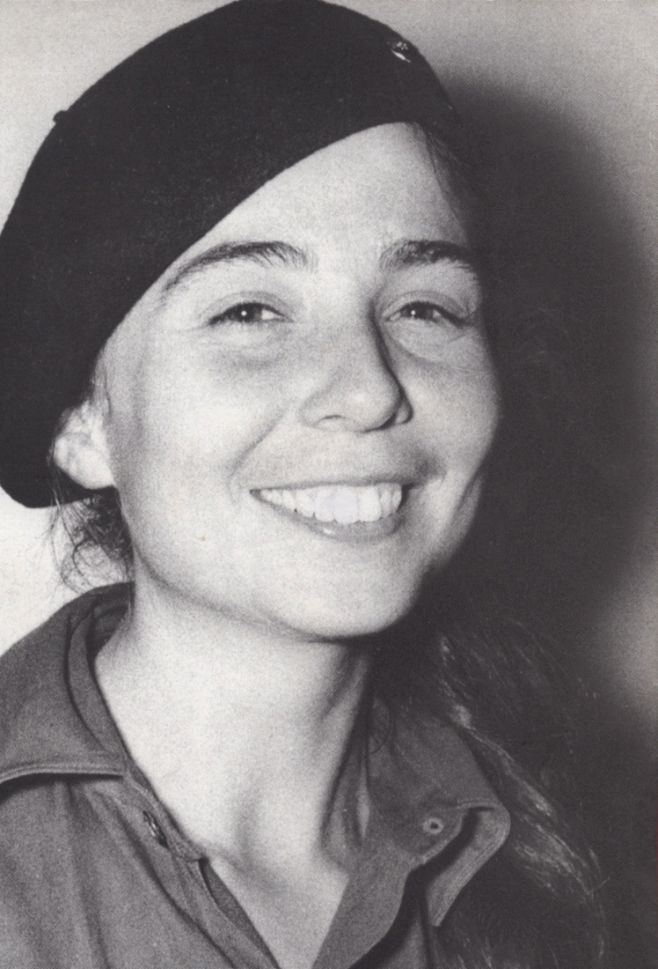
FMC = Federation of Cuban Women
The Federation of Cuban Women works collaboratively with the Cuban Government.
It was founded by Vilma Espín, wife of Raul Castro and very close to both brothers.
She was also a member of the Communist Party and the party's Political Bureau which was crucial to be able to be heard by the government to allow rights and pass some decisions regarding women.
Over 85% of Cuban women are a part of it.
Notes:
They run campaigns to make women aware of their rights, develop non sexist attitudes in schools…

Slide 10
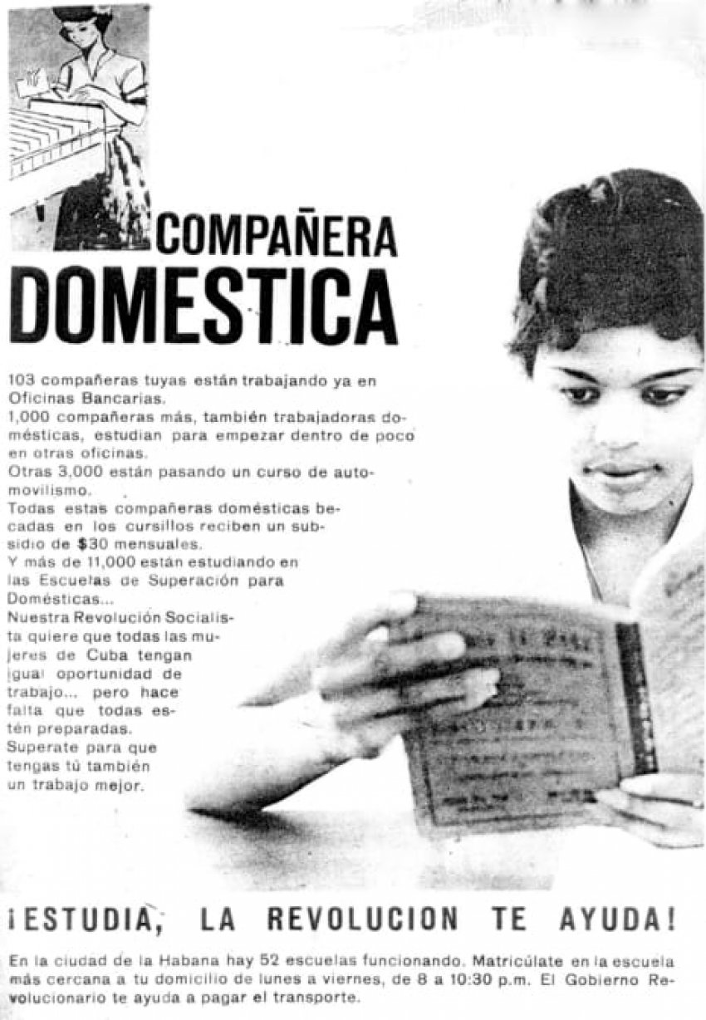
Importance of women
Before Castro’s rise to power in 1959, women had no more rights than in other country, which were very little, they had to be housewives. 70% of women in the national workforce were domestic servants (worked many hours, very little salary)
During the 100 days of Ramón Grau government, women were given the right to vote but power was gained by Batista before new rights could be given.

Slide 11
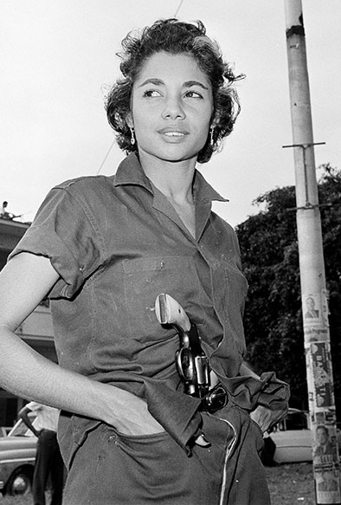
Women’s Rights under the new constitution
Economic -> equal pay for equal work
Political -> 53% of national parliament seats are filled by women in 2020
Social -> By 1961, nearly the whole country was literate, right of abortion, social security equal men/women
Cultural -> These continued only to empower women more and more nowadays
Family -> Household duties to be spilt equally between husband and wife
Opportunities equal to those of men, which could be thanks to communism

Slide 12
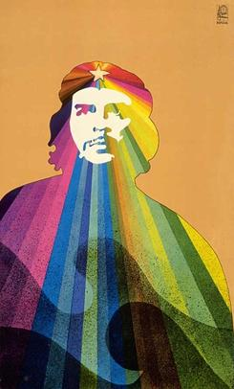
Treatment of artists
After 1959, artists became more isolated from the artistic movement in Europe and America
They continued to produce work, but most was used for propaganda
Theaters, cinemas, concerts, art exhibitions were all censored
“Guerrillero Heroica”,-> heroic guerilla, picture of Che Guevara by Korda

Slide 13
Propaganda image
This depicts the former US president, Richard Nixon, as a psychedelic vampire.
These connotations not being very nice, Americans were often depicted in evil ways like here.

Slide 14
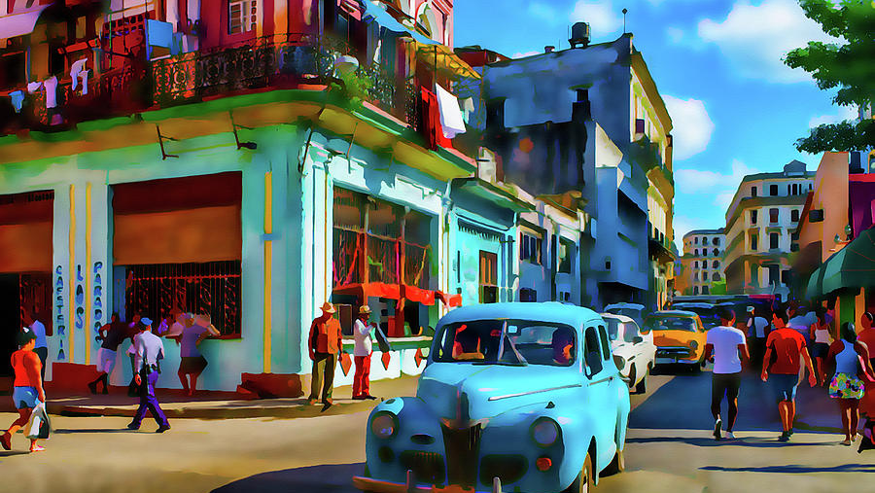
Respect of artists
Salón de Mayo was held in Havana in July 1967
Organized by Carlos Franqui, it was the peak or artistic free expression and uncensored art.
In the 1980s, a lot of artists graduated from the Cuban art school to go teach around the country freedom of expression through the arts.

Slide 15
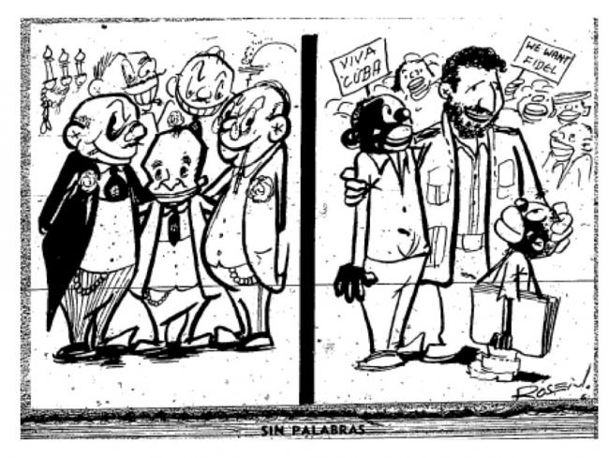
Racial respect from the government
By 1959, Castro and his party had banned all forms of racism.
“No blacks, but citizens”
In 1966, Castro said “discrimination disappeared when class privileges disappeared”
As the Afro-Cubans were at the bottom of the social scale because of racism, this gave them easier access to many things including:
Education
Health
More employment opportunities
Better housing

Slide 16
Racial discrimination from the population
Although racism was banned from the government, it didn’t stop the population to discriminate the Afro-Cubans.
The white population of Cuba couldn’t accept that their former domestics and slaves earned the same wages, had equal employment opportunities and recreational facilities
As racism was banned, a civils' rights movement would be vey dangerous for black people so there was a lot of undercover racism.
Speaking about racism was very taboo and considered counter revolutionary

Slide 17
Propaganda
As much as there was propaganda done by artists, it wasn’t to glorify Castro, it was to drag down the USA and explain why they are so evil.
Castro’s cult of personality wasn’t as strong as the one for other dictators, no street named after him in Cuba, or no money printed with his face on.
The population was supposed to idolize the revolution and the communist movement.
This could be a reason why the counterrevolutionaries and opposants to everyone being equal were so badly treated as it opposed communism.

