Slide 1
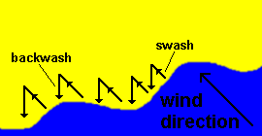
Transportation along a coastline
To know how Longshore Drift (LSD) moves material along a coastline.

Slide 2
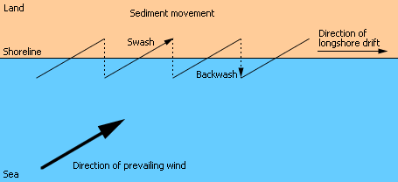
What is long-shore drift?
http://www.youtube.com/watch?v=U9EhVa4MmEs&feature=player_embedded

Slide 3
Longshore drift

Slide 4
Key terms
Swash: the movement of water up the beach
Backwash: the movement of water back down the beach
Destructive waves: types of waves that remove material from the beach
Constructive waves: types of waves that build up material on the beach
Longshore drift: the movement of beach material along a coastline in a zigzag motion
Prevailing wind: the main direction from which an areas winds come from

Slide 5
Longshore Drift
Waves can approach the coast at an ________ because of the direction of the ____________ ______. The _______ carries material up the beach at an angle. The ____________ then flows back to the sea in a straight line at 90 degrees. Continual swash and backwash __________ material sideways along the coast. This movement of material is called longshore drift and occurs in a __________ motion.
In normal conditions more material is _____________ on a beach than is removed. However, during storms _____________ waves can remove more material than is deposited. To limit the amount of material that is transported along a coastline we can use coastal defences called _____________ that trap material on the beach.

Slide 6
Transportation
Waves can approach the coast at an angle because of the direction of the prevailing wind. The swash carries material up the beach at an angle. The backwash then flows back to the sea in a straight line at 90 degrees. This movement of material is called transportation.
Continual swash and backwash transports material sideways along the coast. This movement of material is called longshore drift and occurs in a zigzag motion.
In normal conditions more material is deposited on a beach than is removed. However, during storms destructive waves can remove more material than is deposited. To limit the amount of material that is transported along a coastline we can use coastal defences called groynes that trap material on the beach.

Slide 7
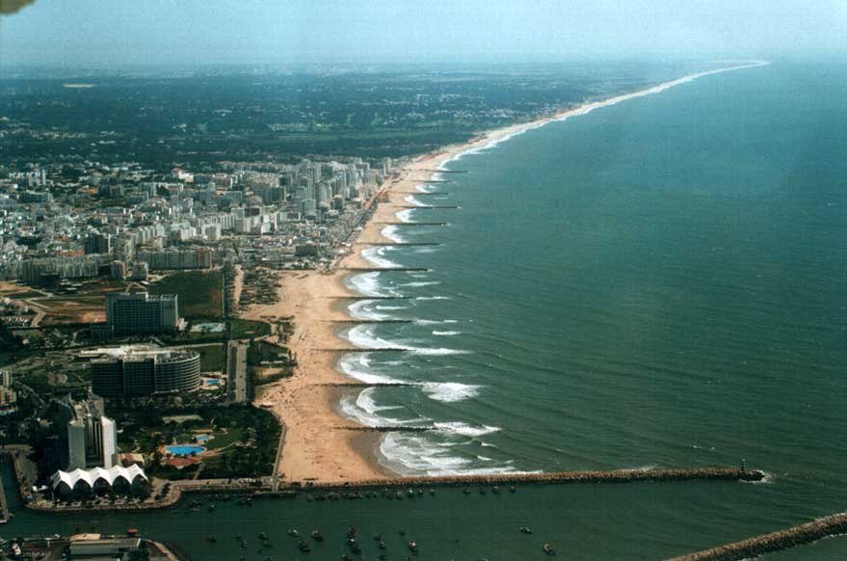

Slide 8


Slide 9
Ms Capper’s answer
Describe and explain the process of longshore drift
Longshore drift is a method of coastal transportation and it refers to the movement of sediment along the coastline.
Waves usually approach the coastline at an angle, which is dictated by the direction of the prevailing wind.
The swash (incoming wave) carries sediment up the beach and the backwash then pulls material back to sea at a 90 degree angle, this is due to the force of gravity pulling the water back down the slope of the beach.
Continual swash and backwash transports material sideways along the coast in a zigzag motion.
Constructive waves (in normal conditions) result in more material being deposited than is removed by longshore drift.
Finer particles, such as sand, are transported further along a coastline than heavier material such as shingle.

Slide 10
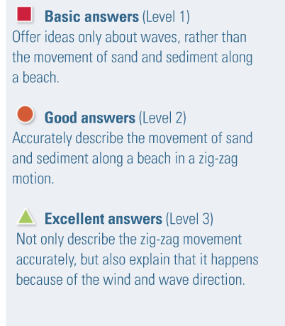
Self assessment: Give yourself a level

Slide 11
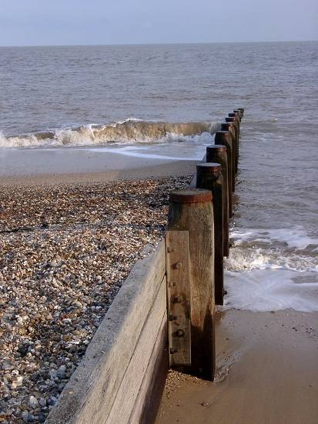
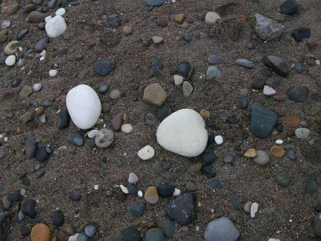
Benefits of Longshore Drift :
Builds up wider beaches at coastal resorts with groynes so more people can use the beach
Provides more beach material further along the coast to help protect coastline from erosion
Waves approach at an angle to the shore
Beach material is higher on the side of the groyne facing the prevailing wind and waves
Eroded material are found down the coast
Beach is wider on the side of the groyne facing the approaching waves

Slide 12
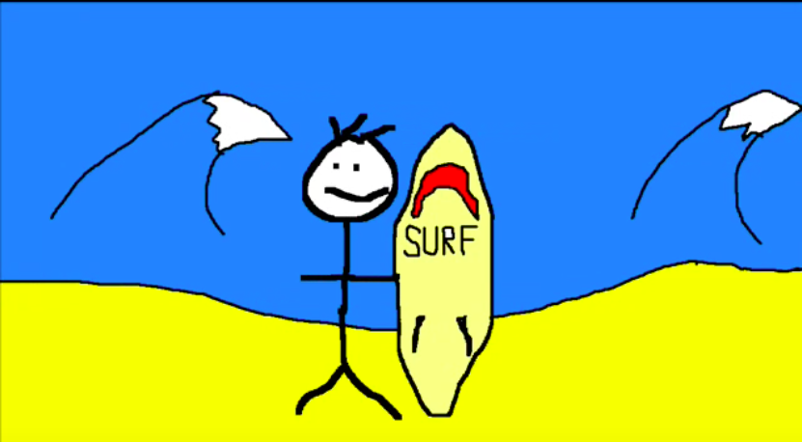
Methods of transportation
There are four ways that waves and tidal currents transport sediment. These can then contribute to the movement of sediment by longshore drift.
Solution - Minerals are dissolved in sea water and carried in solution. The load is not visible. Load can come from cliffs made from chalk or limestone, and calcium carbonate is carried along in solution.
Suspension - Small particles are carried in water, e.g. silts and clays, which can make the water look cloudy. Currents pick up large amounts of sediment in suspension during a storm, when strong winds generate high energy waves.
Saltation - Load is bounced along the sea bed, e.g. small pieces of shingle or large sand grains. Currents cannot keep the larger and heavier sediment afloat for long periods.
Traction - Pebbles and larger sediment are rolled along the sea bed.
Watch: Sticky does coastal erosion
Task: Make your own sticky video, showing the 4 methods of coastal transportation

Slide 13
Coasts
Beaches, spits and bars

Slide 14
Lesson Objectives
To be able to describe and explain the formation of beaches, spits and bars.

Slide 15

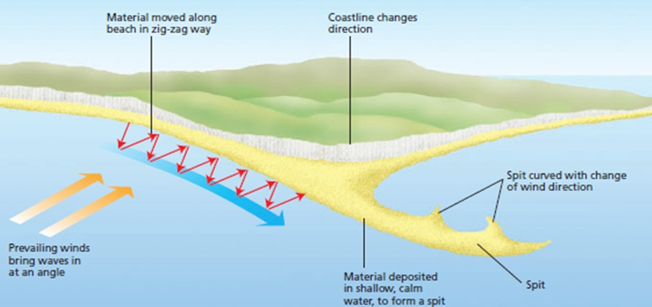
Coastal Deposition
Demonstrate
Be READY TO LEARN
Think like a Geographer
It happens when there is lots of erosion elsewhere on the coast, meaning there’s lots of sediment available.
There’s lots of transportation of material into the area.
LO: To explore the impact erosion, transportation and deposition has on changing coastal environments.

Slide 16
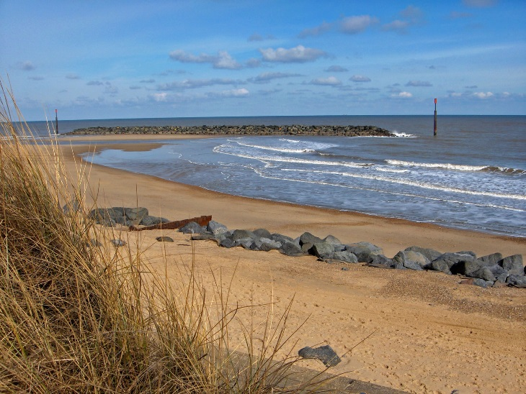
What is a beach?
ACTIVATE
Be READY TO LEARN
Think like a Geographer
Beaches are found on coasts between high and low tide level. Beaches are deposits of sand that lies between the high and low tide levels. Most beaches are formed of sand and shingle (pebbles) as well as mud and silt. They are mainly found in bays because the waves that enter the bay are constructive waves that have a strong swash and build up the beach.
LO: To explore the characteristics and formation of the deposition landforms; beaches.

Slide 17
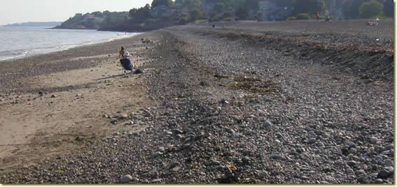
Pebble Beach Profiles
DEMONSTRATE
Be READY TO LEARN
Think like a Geographer
Berms
Increasing particle size
Smaller sediment particles
Large material thrown high onto the beach
LO: To explore the characteristics and formation of the deposition landforms; beaches.

Slide 18
What is a beach berm?
A berm, is a terrace of a beach that has formed in the backshore, above the water level at high tide.
Berms are commonly found on beaches that have fairly coarse sand and are the result of the deposition of material by low-energy waves.
They have a marked change of slope at their seaward edge and a flat or reverse-sloped platform that lies slightly higher than the mean high-water level.
On broad beaches there may be three or more subparallel berms, each formed under different wave conditions.
On some beaches a berm several metres wide may be laid down each summer and destroyed each winter by high storm waves.

Slide 19
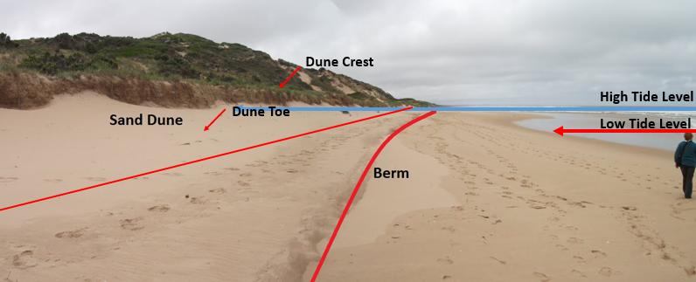
Sand Beach Profiles
DEMONSTRATE
Be READY TO LEARN
Think like a Geographer
LO: To explore the characteristics and formation of the deposition landforms; beaches.

Slide 20
Beach formation
Beaches are made up from eroded material that has been transported from elsewhere and then deposited by the sea. For this to occur, waves must have limited energy, so beaches often form in sheltered areas like bays.
Constructive waves build up beaches as they have a strong swash and a weak backwash.
Sandy beaches are usually found in bays where the water is shallow and the waves have less energy.
Pebble beaches often form where cliffs are being eroded, and where there are higher energy waves.
A cross-profile of a beach is called the beach profile. T
he beach profile has lots of ridges called berms. They show the lines of the high tide and the storm tides.
A sandy beach typically has a gentle sloping profile, whereas a shingle beach can be much steeper.
The size of the material is larger at the top of the beach, due to the high-energy storm waves carrying large sediment.
The smallest material is found nearest the water as the waves break here and break down the rock through attrition.

Slide 21
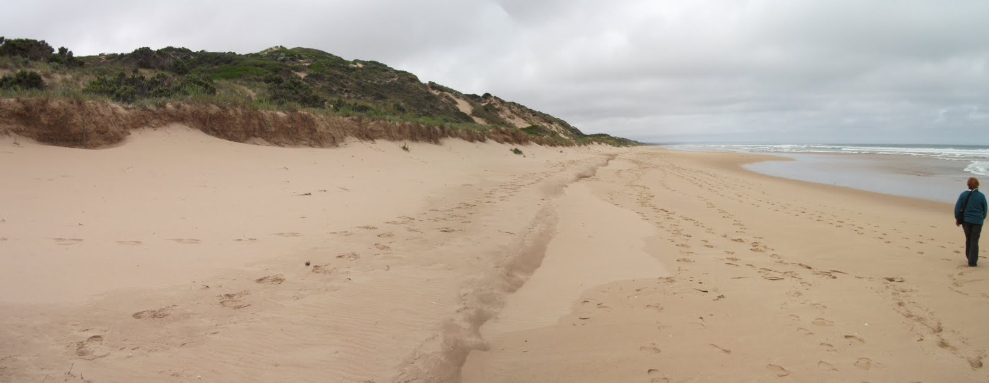

Study Figure 1, a photograph of a beach.
DEMONSTRATE
Be READY TO LEARN
Think like a Geographer
Figure 1
LO: To explore the characteristics and formation of the deposition landforms; beaches.

Slide 22

Study Figure 1, a photograph of a beach.
DEMONSTRATE
Be READY TO LEARN
Think like a Geographer
MODEL ANSWER:
Beaches are formed when constructive waves deposits its load (1) as it loses energy (1).
LO: To explore the characteristics and formation of the deposition landforms; beaches.

Slide 23
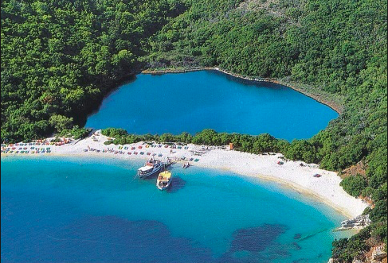
Spits, bars and tombolos
https://www.youtube.com/watch?v=3XBqEbPzgds
https://www.youtube.com/watch?v=Bs-G57JaQm4

Slide 24
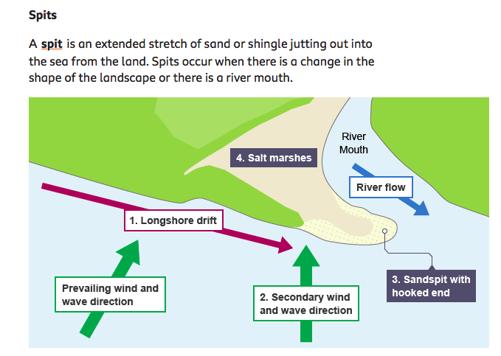
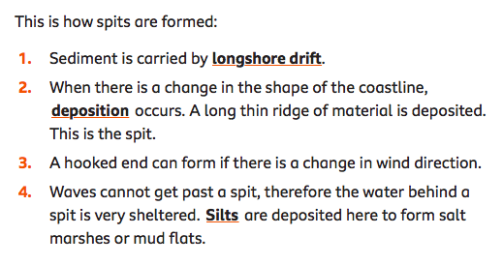

Slide 25
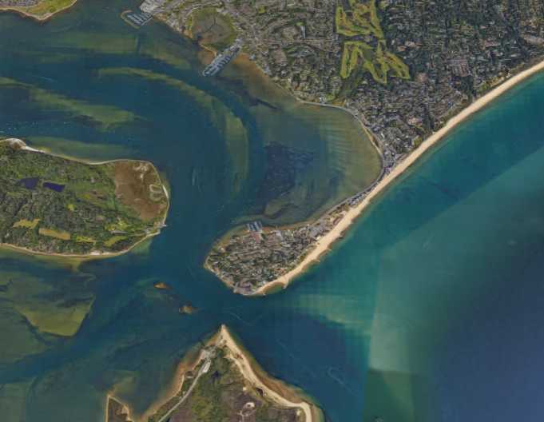
Characteristics of Sandbanks Spit, Dorset
ACTIVATE
Be READY TO LEARN
Think like a Geographer
Proximal end
Lagoon
Distal end
Mudflats and salt marshes
Large hook
Spit
LO: To explore the characteristics and formation of coastal deposition landforms; spits and bars.

Slide 26
Formation of a Spit
ACTIVATE
Be READY TO LEARN
Think like a Geographer
Longshore drift transports sand along the coast.
The coastline changes shape and the waves begin to loose energy.
Deposition starts to build up at the proximal end and the spit grows out into the sea.
The spit is exposed to changes in wind and wave direction which cause the distal end to hook back towards the land.
LO: To explore the characteristics and formation of coastal deposition landforms; spits and bars.

Slide 27
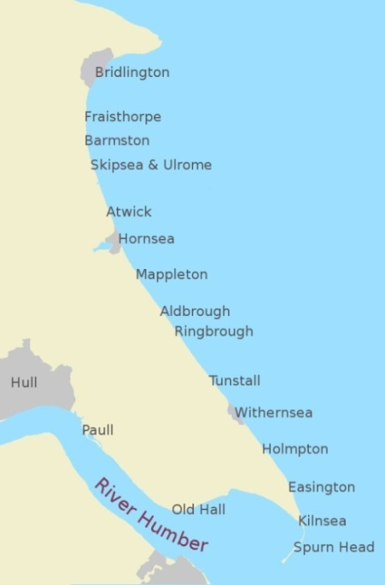

Slide 28
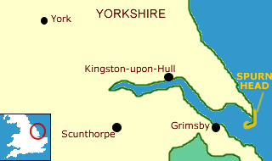
Landform: Spit (deposition)
Example: Spurn Point (Head), Holderness Coastline, East Riding, North-East England.

Slide 29
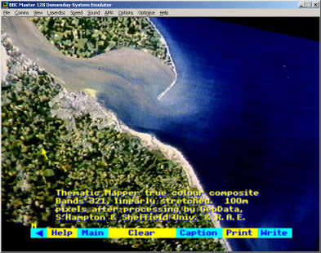
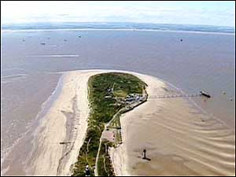
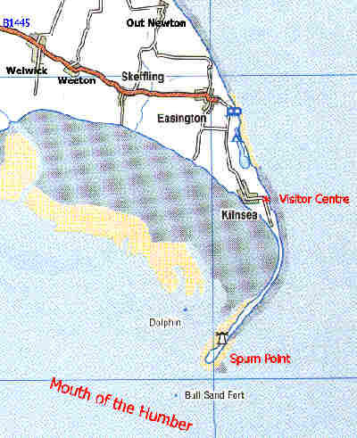
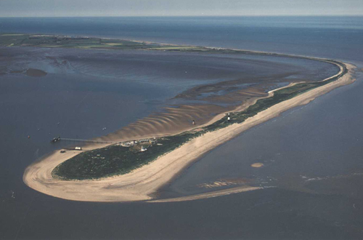

Slide 30
Description
Spurn point is a long narrow ridge of sand and shingle, known as a spit.
It is located at the southern most point of the Holderness coastline in East Riding, Yorkshire.
One end of the spit is attached to the land and sand and shingle then extends out into the sea in the direction of the coastline.
Spurn point is over 3 miles long, although in some places it is only 50 metres wide.
It is like a beach that goes out into the sea instead of hugging the land.

Slide 31
Formation
The soft and easily eroded boulder clay, that forms much of Holderness, provides plentiful material for longshore drift.
Prevailing winds approach the Holderness coast from the north-east and move material along the coastline from north to south. This movement is known as longshore drift.
The energy in the waves transporting the material is reduced where the North Sea meets the Humber Estuary. As a result the material is deposited. This process is known as deposition.
As more and more material is deposited it builds upwards and outwards forming a spit (a beach that sticks out to sea).
Waves cannot get behind the spit and this has created a sheltered area where silt is deposited and mud flats have formed.

Slide 32
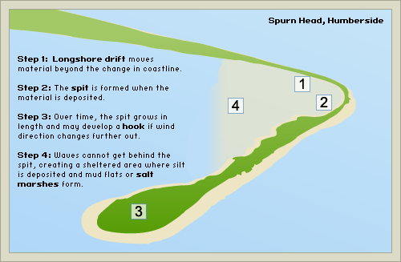
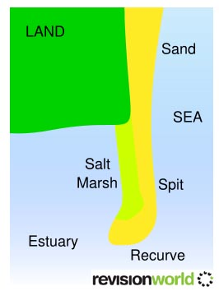

Slide 33
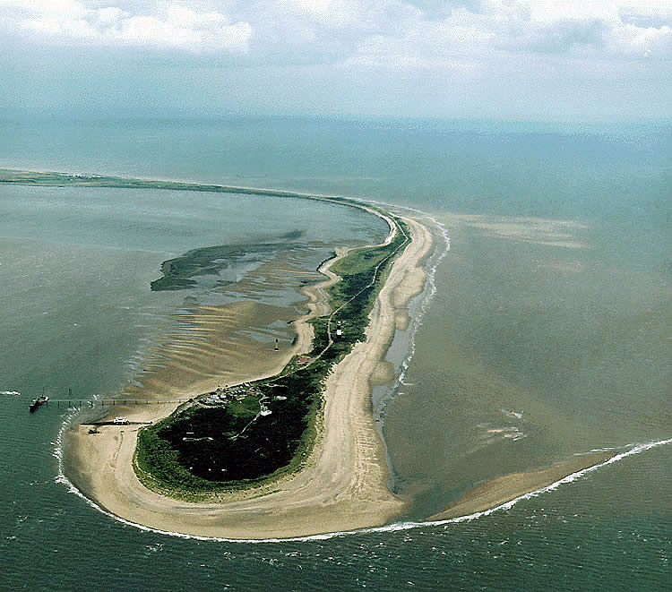
Eroded material is deposited where the coastline changes direction
Groynes have been built here to stop Spurn point being washed away
The old lighthouse
The second lighthouse
The lifeboat crew’s houses
Docking facilities
The Vessel Traffic Services tower

Slide 35

Management
In the middle of the 19th century a series of groynes were built on the shore to check the erosion. This was later found to be a bad idea as it stopped the natural movement of the sand around the point, and it also failed to stop the erosion.
There is a policy of managed retreat at Spurn Point today, this is a soft engineering technique and it means that nature is being allowed to take its course.
Human management north of Spurn Point is having an impact though. Groynes that have been built to protect settlements along Holderness e.g. Hornsea and Withernsea reduce the amount of beach material arriving at Spurn Point. The point has already been breached several times in the past and sections of it today are only 50 m wide.

Slide 36
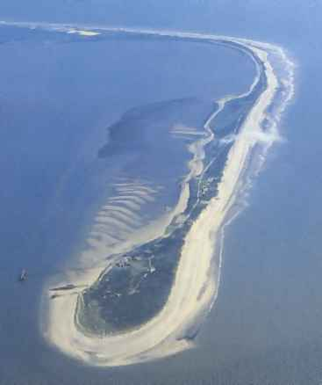
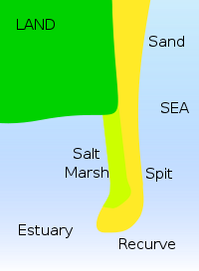
Coasts : Features of Deposition: Spits
12
As cliff and beach material is transported along a coast by longshore drift, if the flow is interrupted or slowed down, the material is deposited to form a range of coastal features.
A SPIT is unable to extend right across an estuary due to the force of the river current finding a route out to the sea.
It is RECURVED at the end in the direction of the strongest of the two currents.
In Spurn Point’s case, the North Sea current is more powerful than the River Humber current, so the spit curves in towards the estuary.
SPIT:
A linear beach that extends from the shore across a river estuary or along the coast – but doesn’t join on to any other feature.
e.g. Spurn Point, E. Yorkshire
Possible Questions :
Describe and explain the formation of a coastal spit (7)
Is this a
SPIT
TOMBOLA or
BAR ?

Slide 37
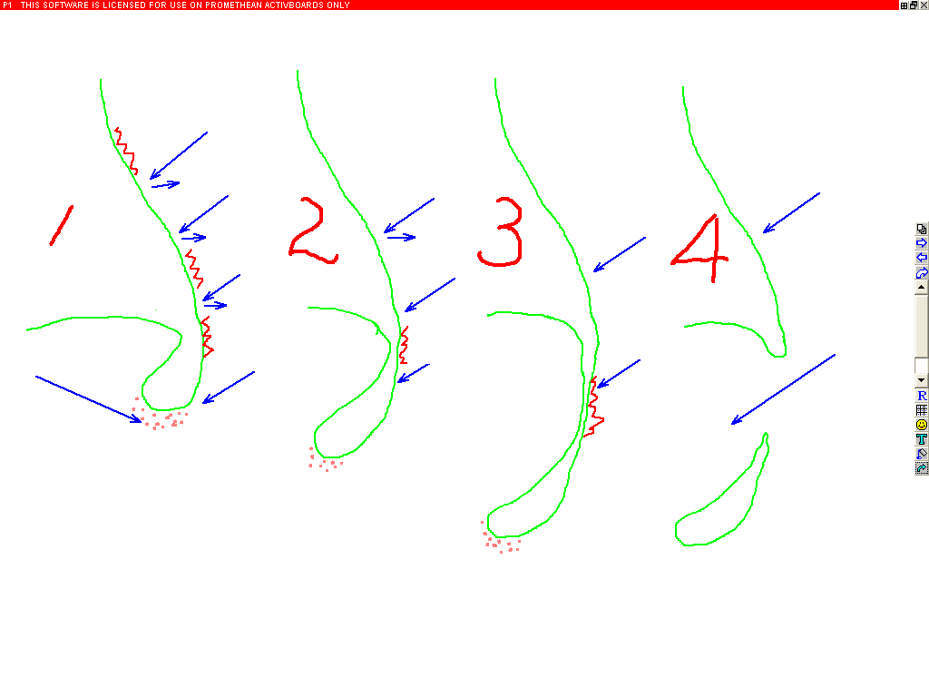
Coasts : Features of Deposition / Evolution of Spurn Head, E. Yorkshire – A SPIT
14
A : Sea erodes the coast and Longshore Drift transports material down the coast
B : The North Sea and R. Humber currents meet, slow down & deposit their material. The N.Sea current is stronger so the recurved spit bends in to the Humber channel.
A
C
River Humber Current
North Sea Current
D
B
E
C : As the Spit head grows southwards, erosion still takes place up-coast
D : The neck of the spit has more erosion than deposition – so gets thinner
E : The sea breaks through the neck, the spit head is an island and is eroded away

Slide 38
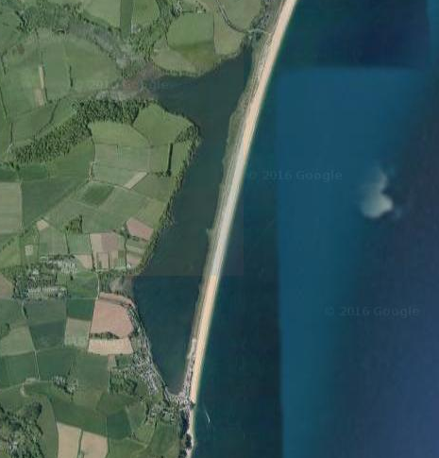
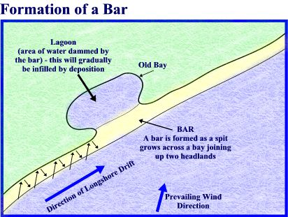
How is a bar formed?
ACTIVATE
Be READY TO LEARN
Think like a Geographer
Slapton Ley Bar, Devon, United Kingdom
1. A spit joins together two headlands.
2. A bar cuts off the bay between the headlands from the sea.
3. A lagoon can form behind the bar.
LO: To explore the characteristics and formation of coastal deposition landforms; spits and bars.

Slide 39
On your worksheets, label the characteristics of Sandbanks Spit, Dorset. Using the photograph of Slapton Ley Bar, draw a diagram to show a bar.
Demonstrate
Be READY TO LEARN
Think like a Geographer
Sandbanks Spit
Slapton Ley Bar
Large hook
Distal end
Spit
Lagoon
Mudflats and salt marshes
Proximal end
LO: To explore the characteristics and formation of coastal deposition landforms; spits and bars.

Slide 40
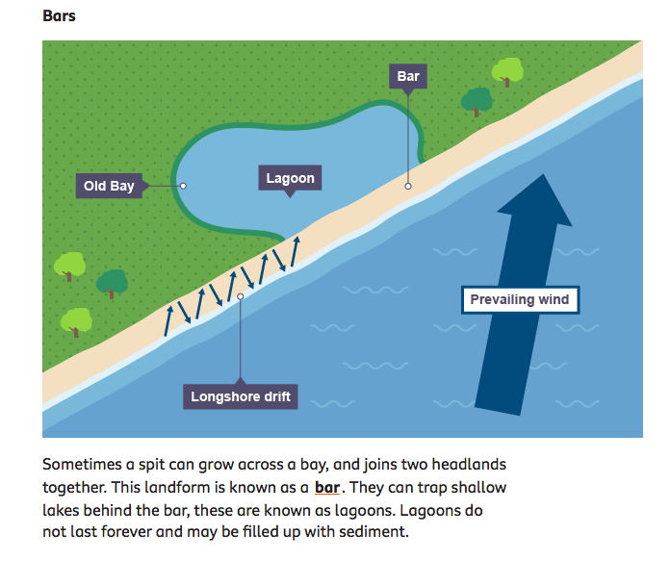

Slide 41

On your worksheet, explain the formation of Spits and Bars.
ACTIVATE
Be READY TO LEARN
Think like a Geographer
LO: To explore the characteristics and formation of coastal deposition landforms; spits and bars.

Slide 42
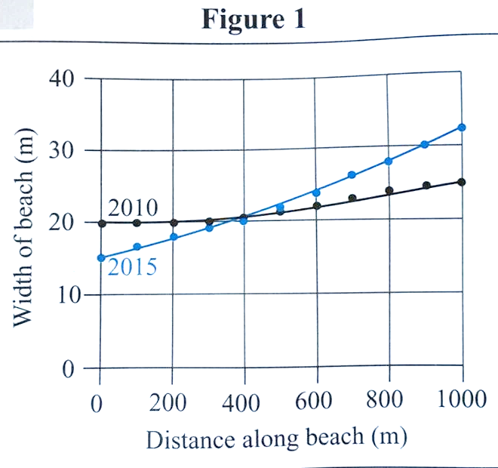
Study Figure 2, a graph showing how the width of a beach varied along its length in the years 2010 and 2015.
Demonstrate
Be READY TO LEARN
Think like a Geographer
Figure 2
The total volume of material on the beach in Figure 2 increased between 2010 and 2015 because large amounts of material, carried by sea water, were deposited on the coast. (2)
Reason 1:………………………....
…………………………………………
Reason 2:………………………….
…………………………………………
LO: To explore the impact erosion, transportation and deposition has on changing coastal environments.

Slide 43
Study Figure 2, a graph showing how the width of a beach varied along its length in the years 2010 and 2015.
Demonstrate
Be READY TO LEARN
Think like a Geographer
Figure 2
The total volume of material on the beach in Figure 2 increased between 2010 and 2015 because large amounts of material, carried by sea water, were deposited on the coast. (2)
MODEL ANSWER:
There’s lots of erosion elsewhere on the coast, meaning there’s lots of sediment available (1).
There’s lots of transportation of material into the area (1).
LO: To explore the impact erosion, transportation and deposition has on changing coastal environments.

Slide 44
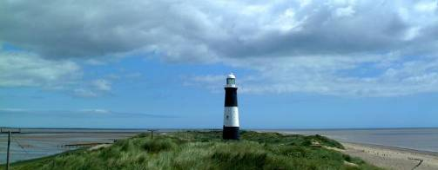
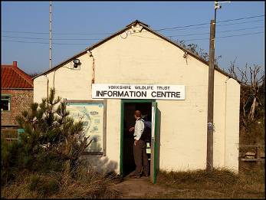

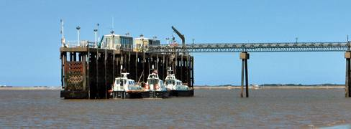
Coasts : Features of Deposition / Features of the spit at Spurn Head
15
Thin neck of spit
Likely breach
Spurn Lighthouse
Deposited river silt (mud)
Direction of the North Sea current
Spurn Lifeboat station
Recent Deposition
Turbulence where 2 currents meet
Direction of the River Humber current

Slide 45
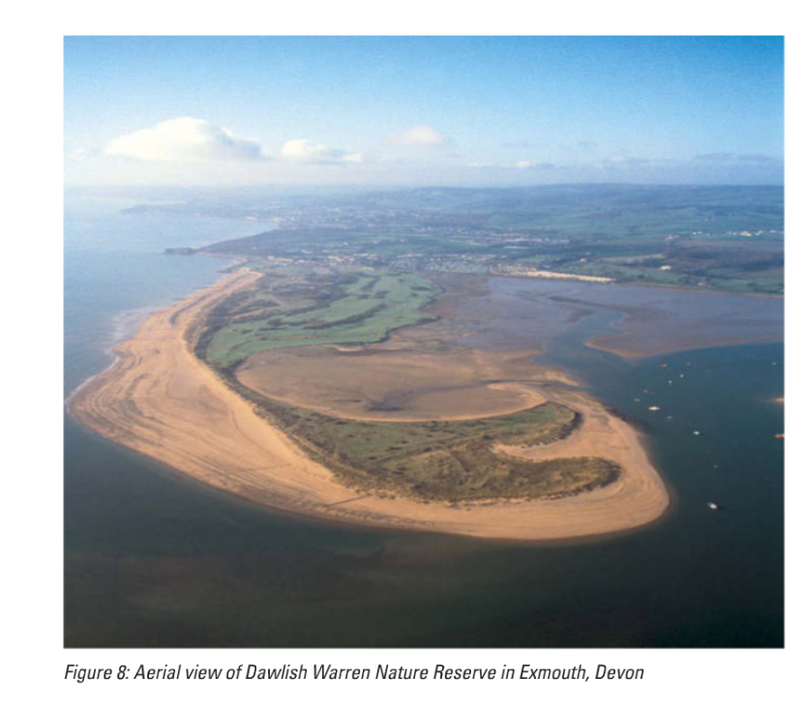
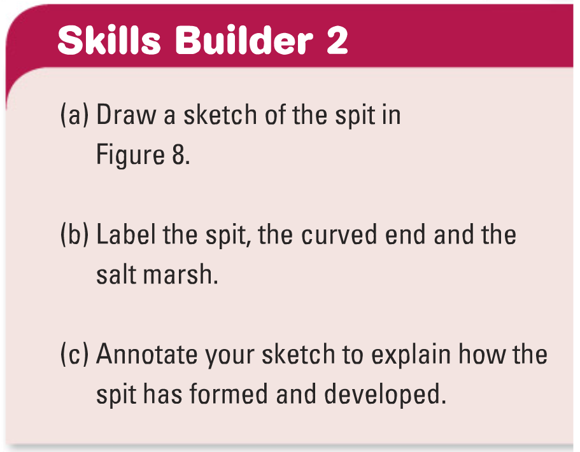
Things you could include…..
Direction of longshore drift
Arrows to show swash and backwash
Area of calm water behind spit
Saltmarsh
Vegetation on spit
Hooked end because of
wind changes

Slide 46
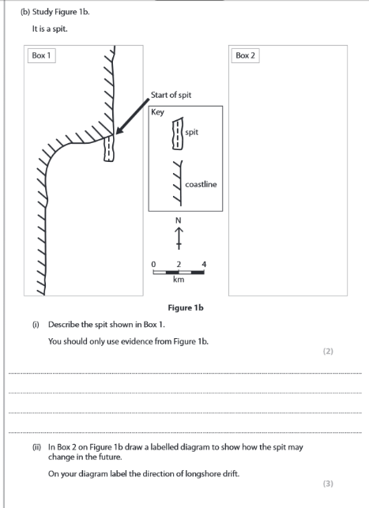

Slide 47
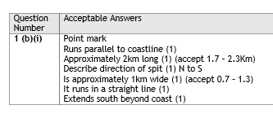
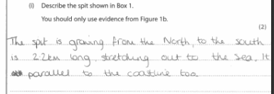
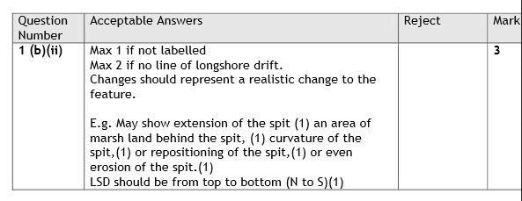

Slide 48
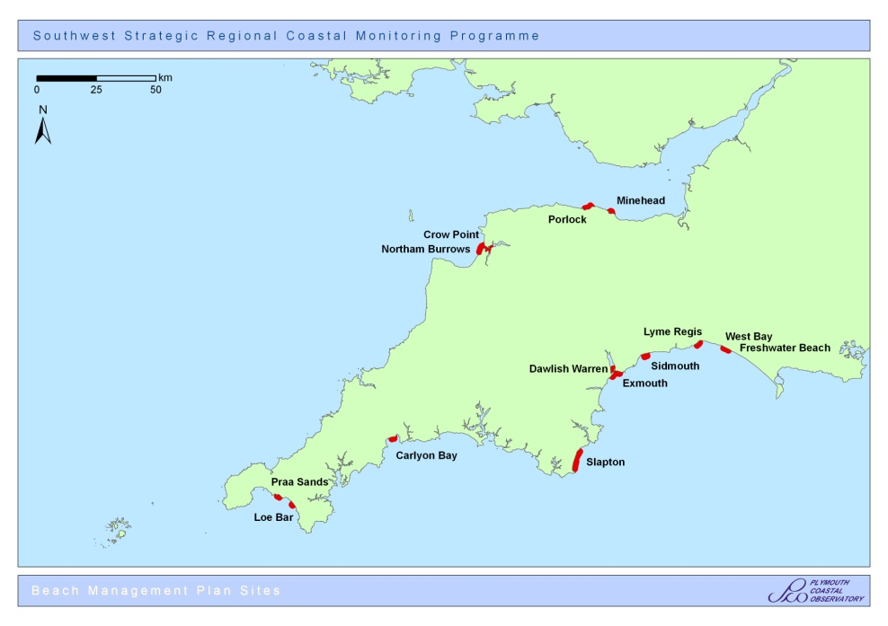
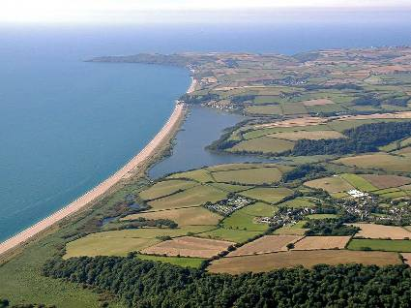
Coasts : Features of Deposition: Bar
13
A BAR is a spit which extends across a bay and reaches the shore on the other side. The water which is cut off becomes a salt-water LAGOON of still water. Eventually, over time the lagoon fills in with wind-blown sand, sediment, reeds and other vegetation and becomes a marsh.
This is SLAPTON LEY in Dorset.
Possible Questions
What is the difference between a Bar and a Spit?
Are these permanent or temporary features of coastal deposition?

Slide 49
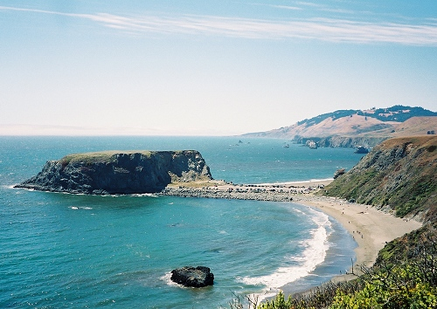
Tombolo

