Slide 1
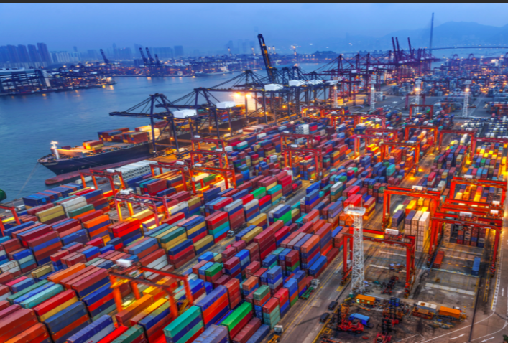
Global trade

Slide 2
What: An overview of contemporary global networks and flows:
Why: How different places become interconnected by global interaction
How: A study of global trade in materials, manufactured goods and services

Slide 5
An overview of global trade in materials, manufactured goods and services

Slide 6
Synthesis
There has been rising industrial demand for resources and due to the global middle class there has been increased consumer demand for food, gas and petrol etc.
The rising middle class also has led to an increase in services such as tourism.

Slide 7
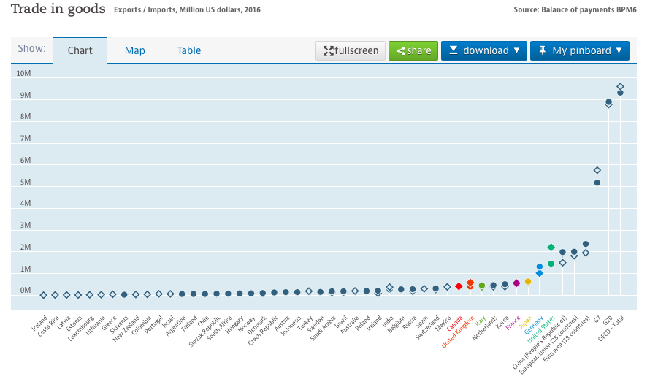
Trade in goods
The 34 OECD member countries are: Australia, Austria, Belgium, Canada, Chile, Czech Republic, Denmark, Estonia, Finland, France, Germany, Greece, Hungary, Iceland, Ireland, Israel, Italy, Japan, Korea, Luxembourg, Mexico, the Netherlands, New Zealand, Norway, Poland, Portugal, Slovak Republic, Slovenia, Spain, Sweden, Switzerland, Turkey, the United Kingdom, and the United States.
The Organisation for Economic Co-operation and Development (OECD) was established in 1961. Today, the OECD is a forum of 34 industrialised countries that develops and promotes economic and social policies. The OECD acts on behalf of and in collaboration with its member governments to promote free market policies and trade.
Task 1 - Click here to be taken to the OECD (Organisation for Economic Co-operation and Development)
Task 2 - Using a copy of the graph above, describe the global pattern in the trade of goods. Make reference to G7, G20 and a comparison between the E.U and PRC.
Extra reading: Kognity 4.2.4
Global trade in manufactured goods and services
https://data.oecd.org/trade/trade-in-goods.htm#indicator-chart

Slide 8
Trade in services
https://data.oecd.org/trade/trade-in-services.htm#indicator-chart
​Task 3 - Using this OECD website page, define 'Trade in Services’.
Task 4 - Using a copy of the graph above, describe the global pattern in the trade of services. Make reference to G7, G20 and a comparison between the E.U and PRC. Task 5 - State the trade that has greater financial importance globally.
Extra reading: Kognity 4.2.4
Global trade in manufactured goods and services

Slide 9
Synthesis: Core and periphery
In the past the developed world ‘core’ regions of Europe and North America exploited the human and natural resources of the much larger and less developed ‘periphery’ regions of Asia, Africa and Latin America.
There has now been a global shift in production e.g. the rise of South Korea, and later China, as areas of innovation in areas such as manufacturing technological components for telecommunications (e.g. Samsung).
There has also been a shift in consumption – e.g. 1 billion mobile devices have been sold in India.

Slide 10
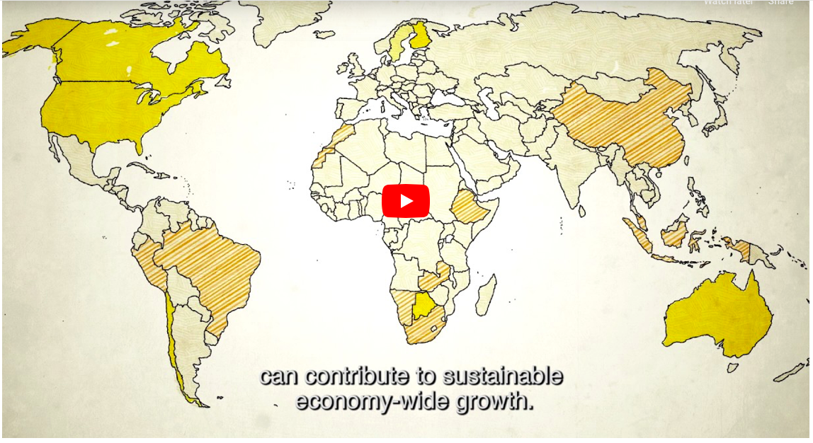
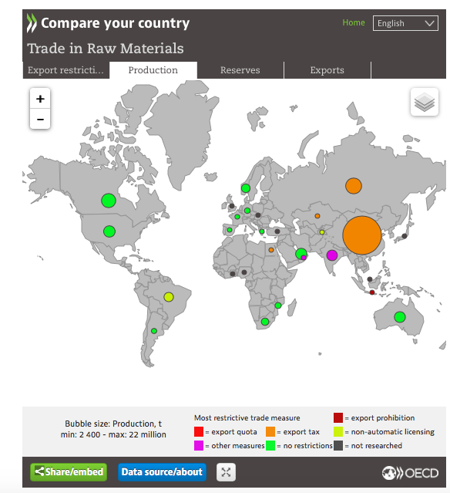
Raw materials
Task 6 - Watch the video below and take notes on how trade in raw materials is important for economic growth and how restrictive export policies can negatively impact development in mineral-rich economies
​Task 7 - Have a play with the interactive map below. This shows countries who produce, have reserves of and export a variety of raw materials. Choose the raw material from the menu on the top right hand side to see the spatial distribution and amount produced by each country.
Extra reading: Kognity 4.2.3
The global trade in raw materials

Slide 11
Concepts
How political, technological and physical processes influence global interactions

Slide 12
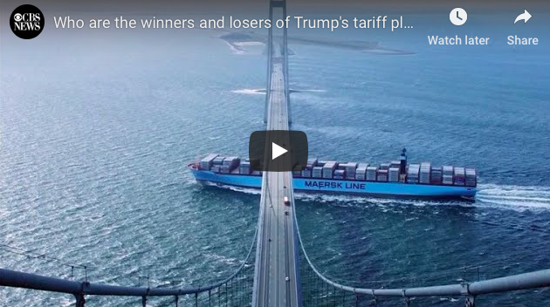
Power struggle
Watch both of the videos below. Take notes on why the tariffs have been imposed by the USA on aluminium and steel imports and what the retaliatory measures have been by those affected.

Slide 13
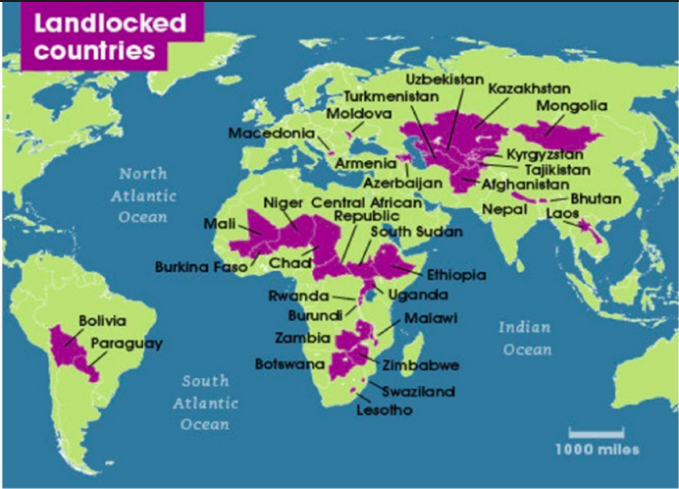
The influence of the physical environment on global interactions

Slide 14
IB Objectives:
The influence of the physical environment on global interactions
Including:
natural resource availability
the potentially limiting effect of geographic isolation, at varying scales

Slide 15
Objectives
What: The influence of the physical environment on global interactions
How: Investigate the positive and negative influence of the physical environment on global interactions
Why: To understand the potential limiting effect of geographic isolation, at varying scales.

Slide 16
What are natural resources?
Natural resources: “stocks of materials that exist in the natural environment that are both scarce and economically useful in production or consumption, either in their raw state or after a minimal amount of processing”.
Source: The World Trade Report, 2010.

Slide 17
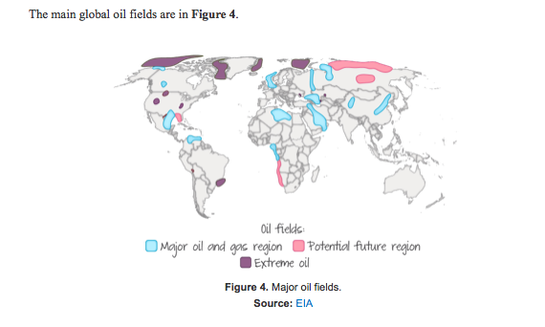
Influence of the Physical Environment
Natural resource availability and global interactions
This section will concentrate on the influence of the physical environment, through natural resource availability, on global interactions. The concepts involved will be examined through a case study, the global trade in petroleum.
Task: Make notes on the trade in petroleum using the resources on the Weebly and kognity 4.3.7 Natural resource availability

Slide 18
The influence of the physical environment on global interactions - natural resource availability
How the discovery of oil transformed the future of Abu Dhabi and the UAE.
France reaches uranium deal with Niger
Diamonds Have Transformed Botswana For the Better
Watch the videos and take notes on the influence of natural resource availability on global interactions.

Slide 19
Influence of the Physical Environment
Geographical isolation
This section will concentrate on the influence of the physical environment, through geographical isolation.
Task: Make notes on geographical isolation and its influence on trade/global interactions using the videos/ embedded textbook on the Weebly and kognity 4.3.7 Natural resource availability

Slide 20
The potentially limiting effect of geographic isolation - remote island nations
What Is Life Really Like In Iceland?
St Helena - challenges of constructing an airport on a remote island
Guam: Why America's Most Isolated Territory Exists
Watch the videos and take notes on the influence of geographic isolation on global interactions.

Slide 21
The potentially limiting effect of geographic isolation - landlocked countries
Nepal's Geographic Challenge
Kyrgyzstan's Geographic Challenge
Why Landlocked Countries Still Have Navies
Watch the videos and take notes on the influence of geographic isolation on global interactions.

Slide 22
Geographic isolation at varying scales
Using p36-38 of the study guide:
Take notes on the extent to which natural resource availability affects global interactions/connectivity
Using p38 of the study guide:
Take notes on the extent to which physical location affects global interactions/connectivity.

Slide 23
Example exam question
“The physical environment has a greater influence than political and technological processes upon global interactions.” Discuss this statement. [16

