Slide 1
Rural Tourism Hotspots
Future possibilities for management of tourism

Slide 2
IB Objective
Evaluate the consequences of unsustainable touristic growth in rural and urban tourism hotspots, including the concept of carrying capacity and possible management options to increase site resilience.

Slide 3
What, how, why???
What: The impacts and management of tourism in a rural tourism hotspot (Machu Picchu, Peru).
Why: So that we can evaluate the consequences of unsustainable touristic growth, including the concept of carrying capacity and possible management options to increase site resilience.
How: Through discussion and examination of secondary source material to build up a case study. To apply our understandings to an IB essay question.

Slide 4
Tourism Hotpots
Hotspots are areas of intense leisure activity that attract above average numbers of visitors.
In order to become a “successful” hotspot the area needs to have both the infrastructure for tourists and the attractions.

Slide 5
For an area to grow it must have resources:
Primary tourist/ recreational facilities: pre- existing attractions for tourism (i.e. climate, scenery, wildlife, cultural and heritage sites and indigenous people
Secondary tourist/ recreational facilities: Facilities that cater for tourism including accommodation, catering, entertainment, shopping and transport.

Slide 6
A “successful” hotspot should…
Have the attractions (primary tourism resources) to attract tourism: e.g. scenic landscapes, heritage and historic buildings, different cultures etc.
Be able cater successfully for the number of tourists visiting the area through: infrastructure developments (i.e. accommodation, transport and public utilities.

Slide 7
Who has the power?
Both public and private initiatives may be involved in catering to the demands of tourism.
For example, the national government typically plays an important role in the promotion of destinations, infrastructural development and employment training.
By contrast, private initiative is more prominent in the development of tourist accommodation and attractions.

Slide 9
Key terms from IB:
Carrying capacity: The maximum number of visitors/participants that a site/event can satisfy at one time.
Environmental carrying capacity - the maximum number before the local environment becomes damaged.
Perceptual carrying capacity - the maximum number before a specific group of visitors considers the level of impact, such as noise, to be excessive. For example, young mountain bikers may be more crowd tolerant than elderly walkers.

Slide 10
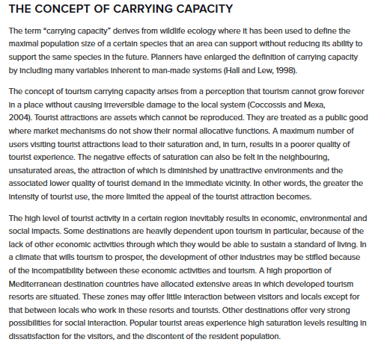

Slide 11
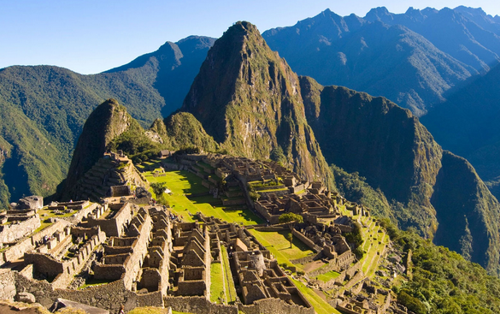
Case Study Machu Picchu, Peru

Slide 12
Why you should visit Machu Picchu

Slide 13
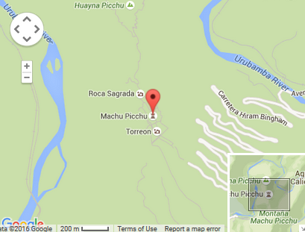
Location

Slide 14
Background info
In 2007 voted as one of the New Seven Wonders of the world
People visit Machu Picchu for its heritage. Heritage tourism is travel to experience the artefacts, historic sites and indigenous people of an area. It is sometimes known as cultural tourism.
2430 meters above sea level
Inca ruler Pachacuti Inca Yupanqui built Machu Picchu in the mid-15th century
Hiram Bingham, an American, found the ‘lost city’ in 1911
It is a no fly zone
UNESCO are considering putting Machu Picchu on its List of World Heritage Sites in danger
It was built by the Inca people
It became a UNESCO World Heritage Site in 1983
Most of the roughly 150 buildings in Machu Picchu were built of granite
It is believed to be abandoned because the Inca’s were afraid of Spanish invasion.

Slide 15
You visit!
http://www.youvisit.com/tour/machupicchu

Slide 16
Human and Physical attractions
PRIMARY TOURISM
RESOURCES
Tourists come and complete the Inca Trail
There are approximately 200 buildings
Most spectacular place in Peru
Rafting trips can be taken down the Urubamba River
Over 400 different plant species
The Inca Trail has ten different climatic zones and sub-zones, from deserts to tropical Andean cloud forest
The trek is 32 kilometres long starting at the railway and ending at the Holy City.
The nearby town of Aguas Calientes has thermal (hot water) baths.

Slide 17
Secondary tourism resources – transport and tours
There is currently no road to Aguas Calientes or Machu Picchu.
There are plans to build a road from Cuzco to Machu Picchu and a cable car running through the valley to the top of Machu Picchu.
There are three train companies to choose from: Inca Rail, Peru Rail, and the Belmond Hiram Bingham train. The Hiram Bingham service is on a gorgeous train gleaming with brass and polished wood and includes a white tablecloth meal with wine during your journey. It’s also much more expensive than Inca Rail or Peru Rail.
Trains also depart Cuzco to the trail head for the Inca Trail. A 4-day trek to Machu Picchu along the Inca Trail can then be completed (26 mile hike). Trekking along the Inca Trail without a guide has been prohibited since 2001. A tour may be purchased from a variety of approved tour operators.
Tickets must be bought for entry to Machu Picchu in advance. These can be bought online and sell out months in advance. Visitors may only enter the Citadel with a tour guide.
To reach Machu Picchu from Aguas Calientes you can either walk the steep 1-hour-plus trail or take the short expensive bus ride, and you have the same options for return to Aguas Calientes.
You can drive (most of the way) to Machu Picchu from Cuzco to the town of Hydroelectrico (there’s a hydroelectric plant there). From there it’s a three hour hike up to Aguas Calientes and then on to Machu Picchu. Many tour companies in Cuzco offer this route as a one- or two-day trip using private vans.
Trains to Aguas Calientes are often sold out weeks in advance. Tickets can be purchased online.

Slide 18
Secondary tourism resources - accommodation
Camping, whilst hiking the Inca trail, is also an option. Camping accommodation will be included when purchasing a tour.
Most visits to Machu Picchu involves some time staying in the larger settlement of Cuzco and the smaller settlement of Aguas Calientes.
Visitors may camp only at designated campgrounds along the Inca Trail. Campgrounds are basic. Hikers eat in a dining tent provided by the tour, with tables and chairs, and the meals are prepared in a kitchen tent. The bigger campgrounds have flush toilets, as do many communities along the trek, and chemical toilet tents are provided. A local hostel close to the campground charges a small amount for a short hot shower on the third night of the trek; otherwise, trekkers wait until after Machu Picchu for a shower in the nearby town of Aguas Calientes.
Aguas Calientes is the main resting point for visits to Machu Picchu. There are 100s of accommodation options from cheap options for budget travellers e.g. hostels (from $30 per night) to premium and luxury accommodations (exceeding $1000 per night).

Slide 19
The benefits of tourism and why is it in danger?
Porters can carry too much and lead to health problems
Tourism is the only income local people get
Jobs are provided e.g. tour guides
Cultures can be exchanged
It encourages conservation
The local area is improved
Landslides occur
A loss of culture
Tour guides leave their families for a while
Since 2011, the number of visitors per day has far exceeded the daily limit of 2,500 agreed by Peru and UNESCO
The site is slowly eroding

Slide 20
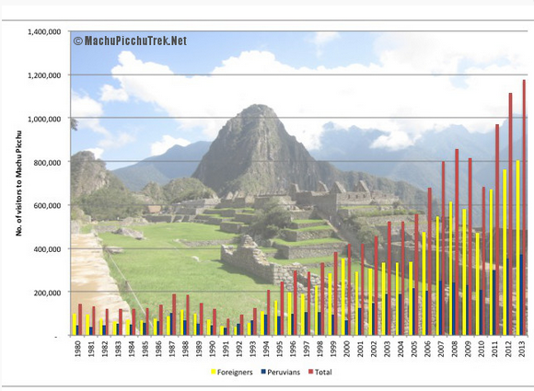
The number of visitors to Machu Picchu each year has grown from the low 10,000s in the 1980s, to a peak of nearly 1.2 million tourists in 2013 – a 700% increase! This chart shows how many tourists visited Machu Picchu annually from 1980-2013. The yellow bar represents foreigners and the green bar, Peruvians.

Slide 21
Machu Picchu Case Study Write Up
For one named rural area (I.E. Machu Picchu, Peru)
1. Describe the distribution and location of primary and secondary tourist resources.
2. Explain the reasons why tourist management is needed (i.e. what are the problems that tourism can bring to Machu Picchu?). Is the curernt situation sustainable?
3. Discuss the strategies designed to manage tourist demands, maximize capacity and minimize conflicts between local residents and visitors and avoid environmental damage.

Slide 22
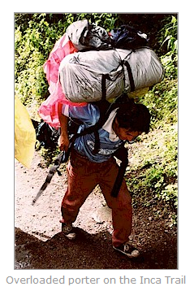
Task: Explain the impacts of tourism at Macchu Picchu and evaluate efforts to maintain the carrying capacity at Machu Picchu
Resources:
Impacts of tourism Machu Picchu
Management strategies at Machu Picchu
Attitudes to management at Machu Picchu

Slide 23
Extra reading
The Telegraph: Will new limits on visiting Machu Picchu save Peru's most famous Inca citadel?
National geographic: Machu Picchu Under Threat From Pressures of Tourism
The Guardian: Is it OK to visit Machu Picchu?

Slide 24
Exam practice
Referring to one example, discuss the strategies that may be used to maintain the carrying capacity of a popular tourist attraction in a rural area (10)
Guidelines: 20 minutes of writing. 1 - 1.5 pages of handwritten work. 10 minutes planning time. Use the A3 worksheet to help you. **Discuss - Offer a considered and balanced review that includes a range of arguments, factors or hypotheses. Opinions and conclusions should be presented clearly and supported by appropriate evidence**

Slide 25
SOME IDEAS FOR THE ESSAY
Define key term (carrying capacity).
Carrying capacity may be maintained through careful management by controlling the number of tourists in time and space.
Problems of environmental damage may be limited by limiting opening hours, imposing a charge, restricting access and parking, zoning of pedestrians and traffic, tourist education by signage and information boards and surveillance by the employment of wardens.
A good answer to meet the top mark-bands 8-10 would need to cover most of these ideas and develop a case study.

