Slide 1
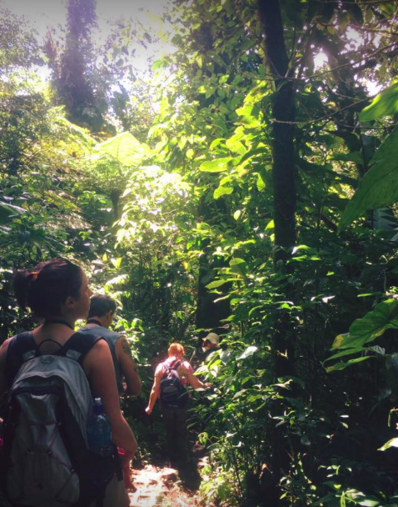
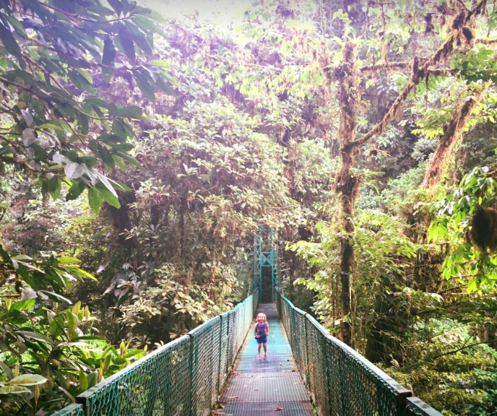
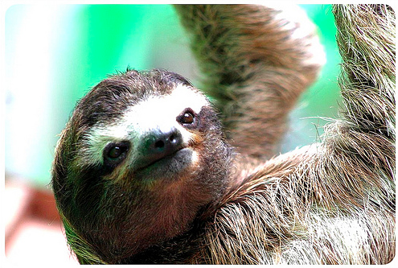
Managing tourism for the future
Key concept: Future possibilities for management of tourism at varying scales

Slide 2
Key concept: Possibilities
What: Managing tourism for the future- sustainable and unsustainable tourism growth
Why: Because tourism has many possibilities and so must be managed in a sustainable way
How: considering future tourism growth
Revising the idea of carrying capacity and unsustainable growth
Defining ecotourism
Evaluating Costa Rica as a sustainable tourism location

Slide 3
Describe future trends in tourism (4)
Textbook page 256
Why may these be happening?

Slide 4
How will we holiday in the future?
Watch each of the videos to consider future tourism scenarios: https://www.forumforthefuture.org/tourism-2023-animations

Slide 5
BOOM AND BUST
A booming UK economy and impressive advances in transport technologies have fueled a growth in travel worldwide. People travel more frequently, for further and at faster speeds than ever before and there are many new reasons to go abroad.
But precarious trade-offs have been needed in order to meet the UK’s emission targets, and many destinations are suffering from serious overcrowding. People are now asking: how long can this growth be maintained?

Slide 6
DIVIDED DISQUIET
Travelling overseas is an unattractive proposition. A toxic combination of devastating climate change impacts, violent wars over scarce resources and social unrest has created an unstable and fearful world. Security is tight and travel is cumbersome, time-consuming and inefficient.
Visitors are highly selective in where and when they travel, cramming into a small number of destinations where tight restrictions and overcrowding compound the problems. Many people have begun to think that holidaying abroad just makes the problems worse.

Slide 7
PRIDE AND PRIVILEGE
A dramatically high oil price has made travel punitively expensive. Cost is the primary concern for holidaymakers as everyone asks: how far can I get for my money?
Although a small, elite market continues to fly regularly, the vast majority of people simply cannot afford the experience. There have been mass redundancies across the travel industry and the affordability of overland routes has led to radical restructuring.

Slide 8
CARBON CLAMPDOWN
Tradable carbon quotas have been introduced for all UK households as part of the government’s bold plans to tackle climate change. The public has clamoured for tough action as environmental impacts are increasingly felt.
Holidaymakers are highly sensitive to the impacts of their travel and seek ethical experiences that are within their carbon budget. Holidaying in Britain is back in fashion and has soared in popularity.

Slide 9
The impact of social media
https://visual.ly/community/infographic/travel/impact-social-media-travel-and-hospitality-industry
Access the infographic- Outline how and why social media has influenced the growth of travel and tourism sectors.

Slide 10
Sustainable tourism
Sustainable tourism is…
Tourism attempting to have a low impact on the environment and local culture, while helping to generate future employment for local people.
The aim of sustainable tourism is…
To ensure that development brings a positive experience for local people, tourism companies and the tourists themselves. Sustainable tourism is not the same as ecotourism.
How do you think sustainable tourism is different to ecotourism?

Slide 11
The difference between sustainable tourism and eco-tourism
Definition: ecotourism is a green or alternative form of tourism that aims to manage the environment sustainably.
Ecotourism is more focused on ecological conservation and educating travelers on local environments and natural surroundings, whereas sustainable tourism focuses on travel that has minimal impact on the environment and local communities.
Ecotourism is a form of tourism, or a category of vacation similar to beach, adventure, health, or cultural, while the concept of sustainability can be applied to all types of tourism.

Slide 12
Read textbook page 254- 256 to add notes to the principles of sustainable tourism

Slide 13
Local People
Sustainable tourism
Visitors
Environment
Source: Taylor Stein 2003
©Pandion Systems, Inc. 2004

Slide 14
Sustainability
Bruntland definition: 'meeting the needs of the present without compromising the ability of future generations to meet their own needs'.
Sustainable development must include consideration of people and the environment. From this broader perspective, sustainability consists of three dimensions:
Economic Sustainability
Social-Cultural Sustainability
Environmental Sustainability
How can we make tourism socially, economically and environmentally sustainable?

Slide 15
6 PRINCIPLES OF SUSTAINABLE TOURISM

Slide 16
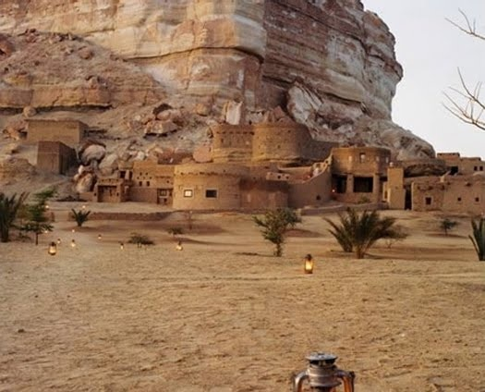
1. Planning control of tourism developments e.g. where they will go and what they will look like.
In the deserts surrounding Cairo, Egypt, you find the eco-lodge, Adrère Amellal. The handcrafted buildings of stone and clay blend into the natural landscape surrounding them, as if they could disappear at any moment.
The #1 reason to stay at Adrère Amellal: with no electricity, the rooms are softly lit with a dozen beeswax candles and the starry desert sky.

Slide 17
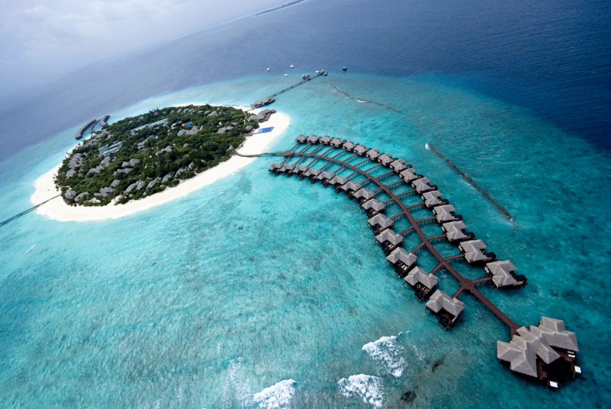
2. Evaluation of available resources and environmental impact assessment before development takes place
e.g. Maldives EIAs prior the construction of new hotels (needed to be set back from the high water mark, have their own sewage treatment services etc)

Slide 18
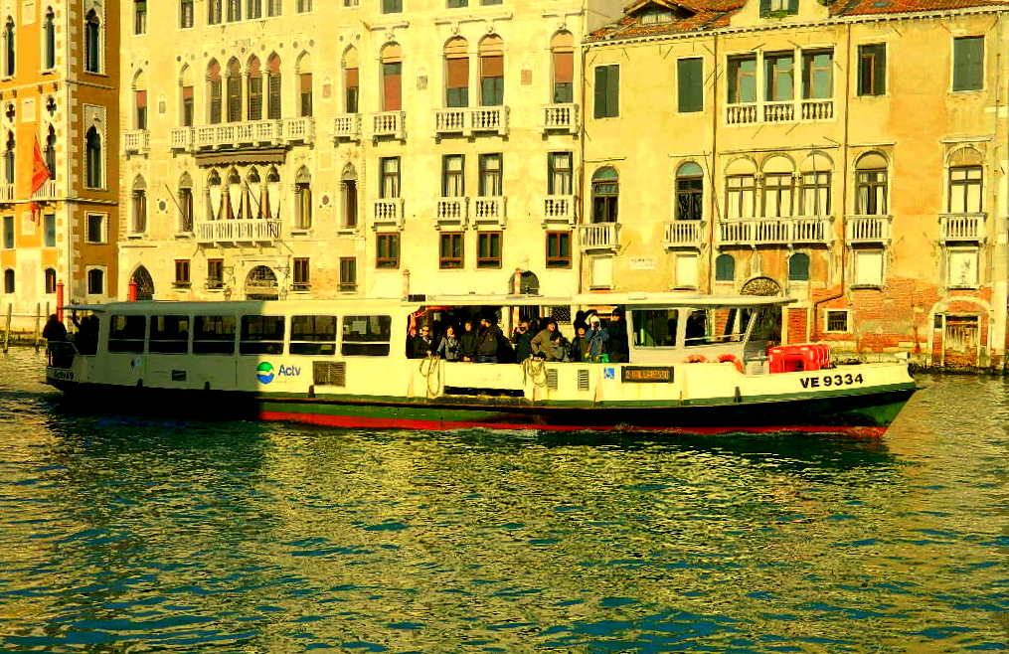
3. Integration of tourism into regional planning e.g. transport planning. Example: Venice have tried to maintain their original population by offering local residents cheaper access to public transportation.

Slide 19
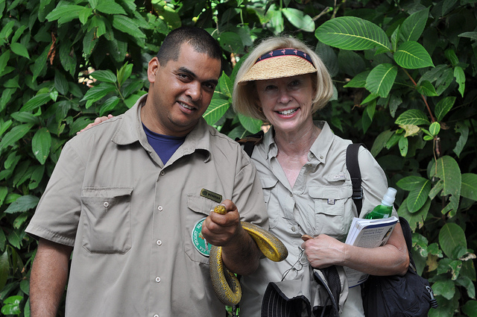
4. Continued involvement and control by local people to invest and run tourism business e.g. The Asa Wright Nature Centre in Trinidad is an eco-tourism destination that employs 50 staff, most of which are local.

Slide 20
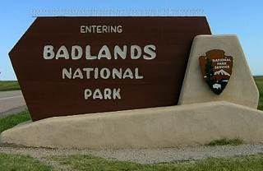
5. Identification of the type of tourism appropriate to the resources and environment e.g. National parks in the US aim to encourage low-density and low impact tourism by educating visitors, planning well designated trails and by imposing fees to enter the area.

Slide 21
6. Establishment and maintenance of carrying capacity that balances conservation and development e.g. to manage the Inca Trail at Machu Picchu, Peru independent hikes, (hikes without an authorized Inca Trail Guide) are no longer permitted. There will be a limit of 500 people per day allowed to begin the trek - about 200 tourists and 300 guides and porters.

Slide 22
Link back to our previous learning… what aspects have been sustainable/ unsustainable?
Unsustainable tourism practices
Sustainable tourism practices
?
Key words:
Carrying capacity
Leakage
Multiplier effect
Enclave resort
Management
?

Slide 23
How possible is it to achieve sustainable tourism?
“Perhaps absolute eco-tourism might mean that one just stays home, vacationing in the backyard and reading, by daylight, past issues of National Geographic?”

Slide 24
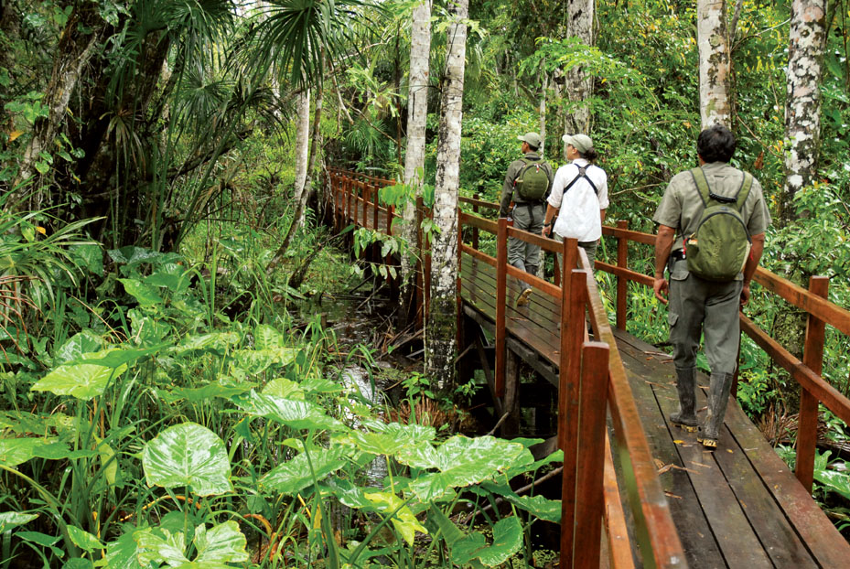
How sustainable is ecotourism in Costa Rica?

Slide 25
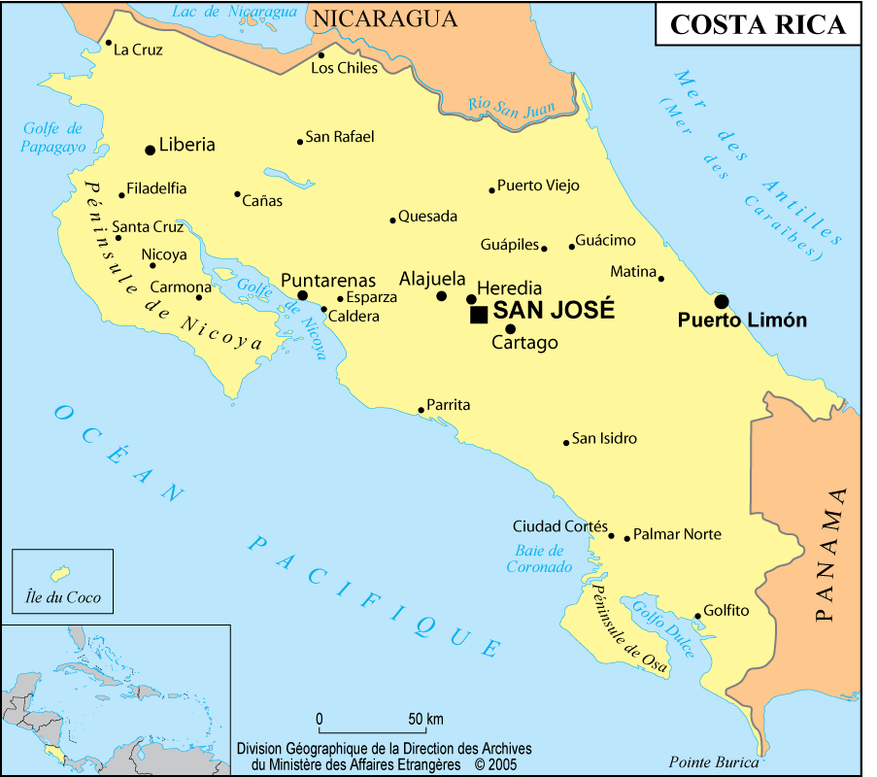

Slide 26
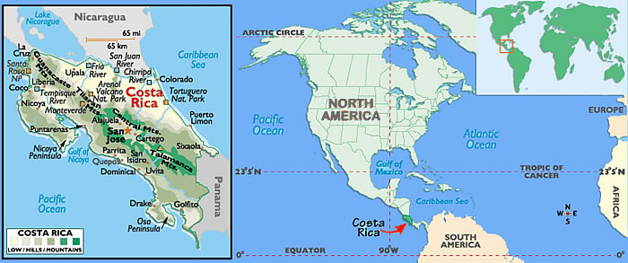
Where is Costa Rica? (different scales)
Describe Costa Rica’s location. Consider the seas, oceans, Tropic of cancer, Equator, nearby countries/continents, location in the world

Slide 27
Why is Costa Rica attractive to Ecotourism?

Slide 28
Key facts:
Costa Rica has gained a worldwide reputation among tourists for its stunning biodiversity - 5% of the world's total within 0.1% of its landmass - varied terrain and at least six distinct types of ecosystem.
Tourism:
GDP: DIRECT CONTRIBUTION - 4.8% of total GDP
GDP: TOTAL CONTRIBUTION - 12.5% of GDP
EMPLOYMENT: DIRECT CONTRIBUTION- 4.8% of total employment
EMPLOYMENT: TOTAL CONTRIBUTION- 12.0% of total employment
Source: https://www.wttc.org/-/media/files/reports/economic%20impact%20research/countries%202015/costarica2015.pdf

Slide 29
National parks
What are these?
National Parks are protected areas because of their beautiful countryside, wildlife and cultural heritage. People live and work in the national parks and the farms, villages and towns are protected along with the landscape and wildlife. National parks welcome visitors and provide opportunities for everyone to experience, enjoy and learn about their special qualities.
How might this benefit Costa Rica?
http://www.bbc.co.uk/education/clips/zhnkjxs

Slide 30
How might Costa Rica benefit from National Parks?
In Costa Rica, the rainforests are being conserved through National Park designation.
Small-scale tourism is a sustainable use, but this brings in little revenue.
In Talamanca, sustainable farming techniques have proved profitable. Previously destroyed forest has been allowed to regenerate with commercial crops planted amongst the trees. The farm is thriving, with organic bananas and cocoa sold commercially. Occasionally trees are felled and buffalos are used to transport the timber without the need for roads.

Slide 31
Costa Rica’s National Parks

Slide 32
Graph Interpretation Skills
Describe the rate of deforestation has changed in Costa Rica from 1960-2010 (4)
Why this may change has happened from 1960-2010 (4)

Slide 33
Activities: Walking and hiking
Activities: Bird watching
Ensures that infrastructure improvements benefit local people as well as tourists
Does not damage the natural environment
Ecotourism in Costa Rica
Activities: Horseback riding
Sea and river kayaking
Consults with local community about planned developments
Is on a relatively small scale
Activities: Canopy exploration
Activities: White-water rafting
Activities: Yoga and Meditation

Slide 34
Ecotourism in Costa Rica
https://www.bing.com/videos/search?q=costa+rica+ecotourism+of+their+rainforest&&view=detail&mid=BB68997C2A037E6AF63DBB68997C2A037E6AF63D&FORM=VRDGAR
Can be conflicts between a countries development and its protection for natural ecosystems
Ecotourism is a type of sustainable development that aims to create local employment while conserving the natural environment

Slide 35
Video notes
https://www.bing.com/videos/search?q=costa+rica+ecotourism+of+their+rainforest&&view=detail&mid=BB68997C2A037E6AF63DBB68997C2A037E6AF63D&FORM=VRDGAR
1. How much of the countries land is protected and by what?
2. How many types of species does Costa Rica have?
3. What is Ecotourism?
4. What are the benefits of ecotourism?
5. How are they educating people about the rainforest and why?
6. What issues are some worried about?
7. Why might they still encourage tourism?

Slide 36
Answers from video
1. How much of the countries land is protected and by what?
More than a 1/4 of land is protected by the National Parks, wildlife refuges and reserves
2. How many types of species does Costa Rica have?
More than 850 species of birds, 250 mammals, around 5% of the World's total biodiversity
3. What is Ecotourism?
Tourists visit places/animals without damaging the area etc
4. What are the benefits of ecotourism?
Money for the country and wages, money from that is also recycled into protecting the rainforest and educating the locals about conservation of their rainforest
5. How are they educating people about the rainforest and why?
Tourists can see the rainforest from the canopy and are educated about the importance of the rainforest and hopefully spread the word about conservation to their own countries. Education programme-about 5000 a year-conservation projects.
6. What issues are some worried about?
Monkeys migration corridors disturbed, monkeys eating rubbish that tourists leave, increased tourism means more hotels without proper planning controls and this can lead to deforestation, the migrant tourism worker are pushing up cost of living and prices of land
7. Why might they still encourage tourism?
Money made from tourism means they can focus on ecotourism and preserve the rainforest

Slide 37
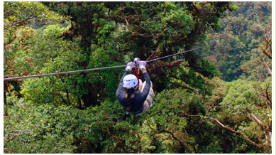
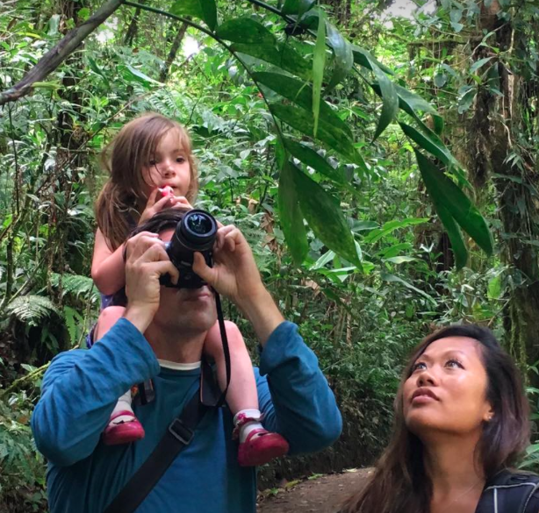
Sustainable tourism in Monteverde
Read page 257-258 in textbook and access http://www.monteverdeinfo.com and complete the case study template for the area.

Slide 38
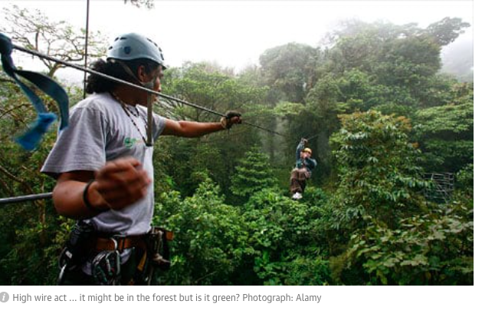
An evaluation…Is the tourism truely sustainble?
https://www.theguardian.com/travel/2007/may/26/saturday.costarica

Slide 39
Write an explanation for the benefits of each of these examples of ecotourism explaining how sustainable they are
Examples of Ecotourism | Explanation of its sustainability
No heavy machinery used in construction
Timber used from an afforestation project
The nature retreat employs only locals
The colours of buildings blend in with the landscape
Buildings fit between trees in the forest. No old trees destroyed.
Buildings are on stilts to reduce humidity and allow natural drainage
Natural light and ventilation minimise energy use
Drinking water comes from natural springs
Rainwater is collected on roofs and used for toilets and showers
Only biodegradable soap, detergents and shampoos are allowed

Slide 40
DEBATE!
“Sustainable tourism can never be achieved”

Slide 41
Example case studies
Benidorm, Spain
http://news.bbc.co.uk/2/hi/uk_news/magazine/7402603.stm
Maldives – sustainable tourism and eco-tourism
http://maldives.net.mv/1720/maldives-a-model-for-sustainable-tourism/
http://au.news.yahoo.com/thewest/full-coverage/carbon-tax/a/-/article/13358846/sustainable-tourism-maldives-style/
http://www.jonathonporritt.com/blog/sustainable-tourism-symposium-maldives
http://www.mynatour.org/destination/protecting-paradise-ecotourism-maldives
Venice
http://greenfieldgeography.wikispaces.com/file/view/Adriatic%20Action%20Plan%20-%20Sustainable%20Tourism%20-%20Italy.pdf/218532206/Adriatic%20Action%20Plan%20-%20Sustainable%20Tourism%20-%20Italy.pdf
Machu Picchu, Peru
http://geographyfieldwork.com/MachuTourismManagement.htm
http://geographyfieldwork.com/MachuTourismAttitudes.htm
Another example of eco-tourism:
Asa Wright Nature Centre, Trinidad – used at GCSE
http://asawright.org/about-the-centre/
The problems of eco-tourism:
http://news.bbc.co.uk/2/hi/science/nature/6179901.stm
Cage diving with sharks. Eco-tourism?!
https://www.theguardian.com/world/2016/jan/29/jaws-new-zealand-town-attack-great-white-sharks-cage-divers

Slide 42
Summary
Can tourism be managed sustainably for the future?
I don’t think it can be managed in a very sustainable way
I think it can be managed in a very sustainable way
Dave
I’m not sure because....

Slide 43
Question and mark scheme from 2011 exam

Slide 45
10 mark questions
To what extent do the advantages of ecotourism outweigh any disadvantages? (10)
Explain why sustainable tourism is necessary but difficult to achieve, referring to one or more examples. (10)
To what extent can tourism ever be made sustainable? (10)
Examine the extent to which sustainable tourism might be successfully implemented in different environments. (10)

