Slide 1
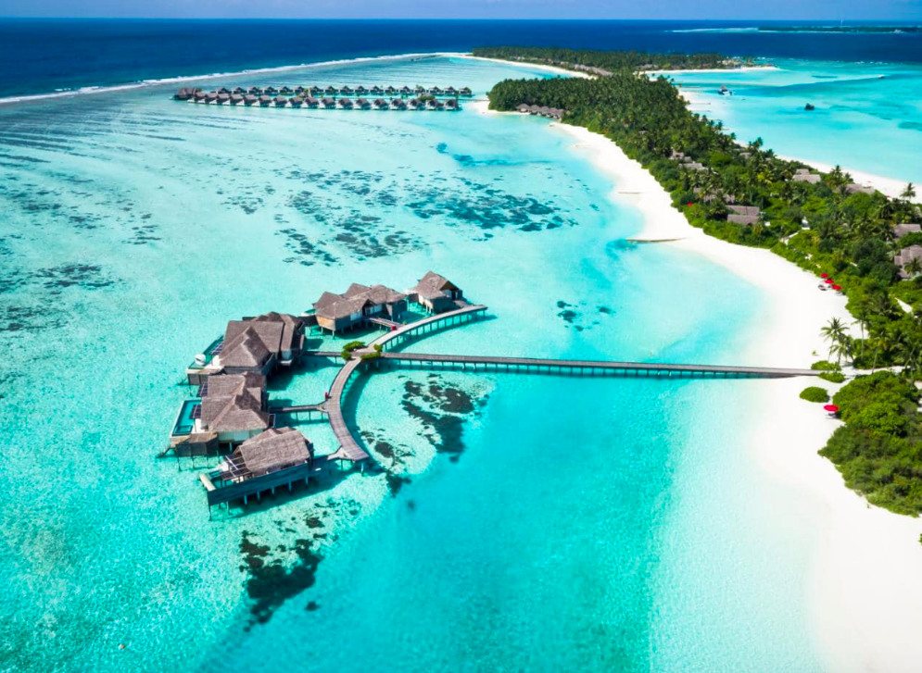

Slide 2
Conceptual understanding: The varying power of different countries to participate in global tourism and sport
What:
The role of TNCs in expanding international tourism destinations, including the costs and benefits of TNC involvement for different stakeholders
Costs and benefits of tourism as a national development strategy, including economic and social/cultural effects
Why: To evaluate impacts using SEEP analysis and the concept of Power How: ​ Developing an understanding of the role of TNCs in the development of the global tourist industry- Power
Identify why certain LICs are attractive locations for the development of tourism- Place Considering the positives and negatives of tourism in LICs using SEEP analysis - Processes Evaluate how tourism can be made sustainable- Possibilities Synthesize information to link to wider geographical understanding such as the SDGs Use learning to answer the essay question: Examine the view that tourism offers a guaranteed route towards economic development for low-income countries. (10 marks)

Slide 3
To what extent does tourism have a positive impact on the development of an area?
Place your post it note on the Continuum

Slide 4
Tourism can contribute to development and the reduction of poverty in a number of ways. Economic benefits are generally the most important element, but there can be social, environmental and cultural benefits and costs.
Tourism contributes to poverty reduction by providing employment and diversified livelihood opportunities. This in turn provides additional income or contributes to a reduction in vulnerability of the poor by increasing the range of economic opportunities available to individuals and households.
Tourism also contributes to poverty alleviation through direct taxation and the generation of taxable economic growth; taxes can then be used to alleviate poverty through education, health and infrastructure development. It should not be forgotten that some tourism facilities also improve the recreational and leisure opportunities available for the poor themselves at the local level.

Slide 5
KEY FACTS
Tourism is a massive industry accounting for 9% of global GDP which has huge economic potential for developing countries.
In 2016, more than 1 billion people travelled internationally. 40% of those journeys ended up in a developing country.
Tourism flows have a huge potential to lift low income countries (LICs) out of poverty.
Tourism represents $300 billion per year flowing from rich to poor countries (3 x bigger than the global aid budget).
Many small countries have benefitted enormously from tourism, however not all money trickles down to local people.

Slide 6
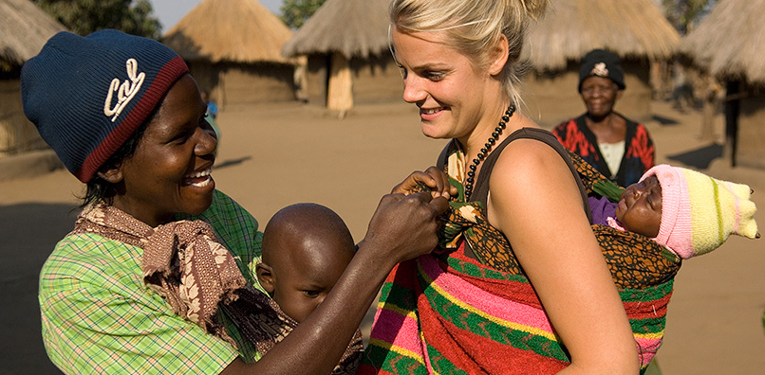
Terminology that could be used
Multiplier effect
Leakage
Mass tourism
Sustainable Tourism/ Ecotourism
Zooification of culture
Enclave resort
TNC

Slide 7
What do the professionals think?
Watch the 2 videos.
As you watch try to list:
good things that tourism brings to a country, and
bad things that tourism brings to a country.
Categorise these using SEEP

Slide 8
TOURISM AND ECONOMIC DEVELOPMENT
https://www.youtube.com/watch?time_continue=106&v=PFhNo7t9OkY
The category of Least Developed Country was first used by the United Nations in 1971 to encourage the international community to recognise these countries as structurally disadvantaged.
Since 1971 only Botswana has graduated from LDC status, and tourism played a very significant role in that process with the annual number of international tourism arrivals increasing by more than half a million visitors between 1985 and 1998.
Cape Verde, Maldives, Samoa and Vanuatu have all been considered for graduation since 1994 and in all four of them tourism has been the single most important factor explaining the socio-economic progress which would form the basis of their graduation.
In the Maldives, annual visitor arrivals tripled between 1985 and 1998, in the same period the proportion of tourism exports to GNP increased from 75% to 89%, making the Maldives the LDC most dependent on international tourism, followed by Samoa and Vanuatu, both with over 20%.
International arrivals to other LDCs grew fast between 1995 and 1998. Angola and Chadexperienced more than 75% growth. Cape Verde, The Gambia, Laos, Mali and Zambia all enjoyed growth above 20%. However, Sudan, Sierra Leone, Sao Tome, Kiribati, Ethiopia, Eritrea, the Central African Republic and Burundi, all saw reductions in international visitor arrivals.

Slide 9
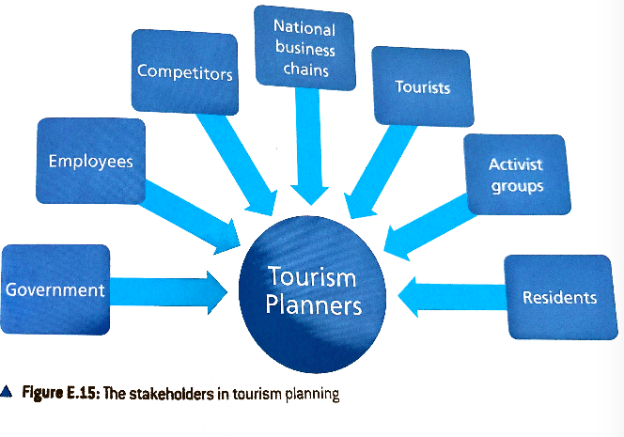
Tourism and TNCs
Many LICs possess the primary tourism resources (beaches, climate, indigenous culture, wildlife, forests) and secondary resources (such as hotels), should tourists wish to access it.
It would be difficult for and tourist to arrange all aspects of their holiday on their own so LICs have had to rely on TNCs to organise and market their product.
Use p243-244 to make notes on some of the TNCs that have an impact on expanding international tourism destinations

Slide 10
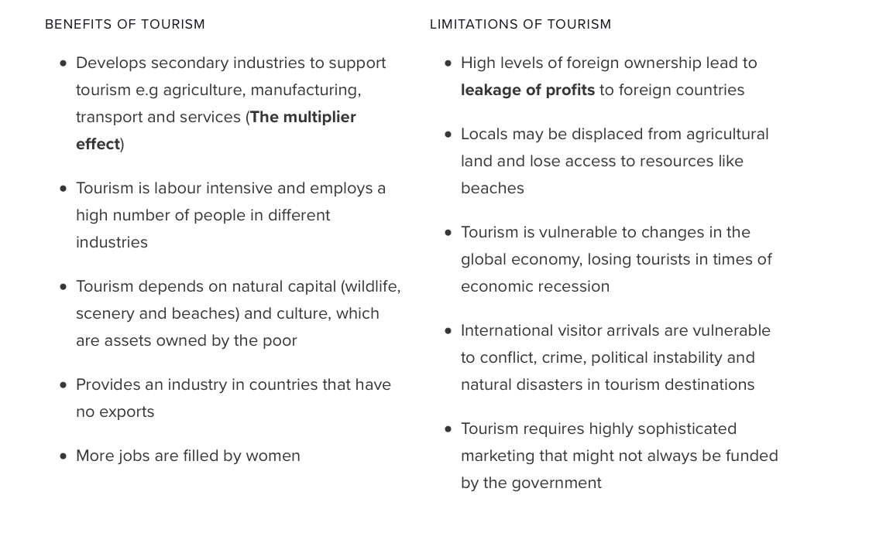

Slide 11
Synthesis understanding

Slide 12
Tourism in Small Island Developing States (SIDs)
Benefits
Risks
SIDs have a small resource base making manufacturing and unlikely development strategy
Tropical islands are well endowed with natural attractions
Tourism not restricted by quotas or tariffs
Provides jobs for locals
Transport costs are high to the remote locations
Tourism can be vulnerable to external shocks (in the Maldives these include sea level rise, tsunamis and global recession)

Slide 13
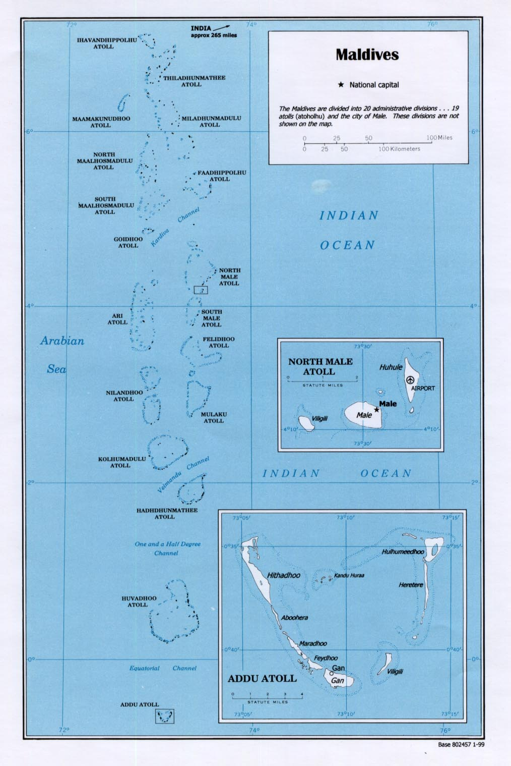
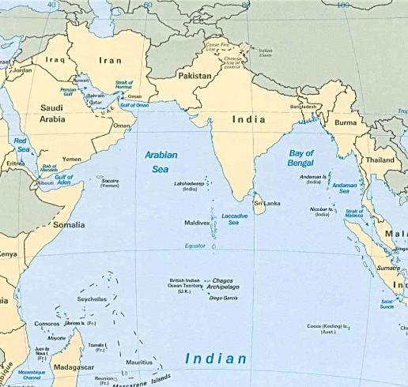
Impacts in small Island states: Case Study Maldives (LIC)
Information:
http://year11geoleileikung.weebly.com/consequences.html
Textbook page: 245- 247
Video:
http://www.youtube.com/watch?v=CxEU_SVc-JE

Slide 14
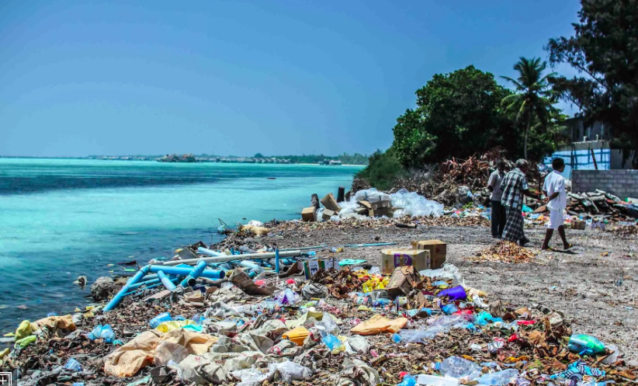
Brief overview of Maldives case study
Benefits
Approx 30% of GDP and 60% of foreign investment
Created direct and indirect employment and income generation- multiplier effect
Issues
Depletion of resources
Pollution: http://www.bbc.com/news/av/world-asia-18073917/apocalyptic-island-of-waste-in-the-maldives
Ownership by TNCs- economic leakage

Slide 15
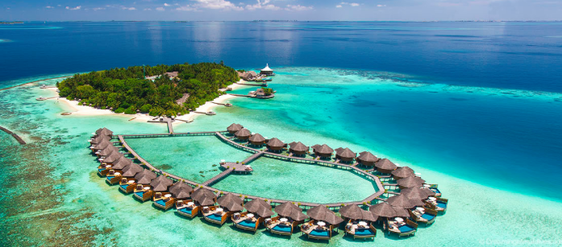
Maldives case study success criteria:
Include some background information about the destination (location, development, industry, attractions etc)- Place
Include social, economic, environmental and political positives and negatives- Processes
Who makes the decisions , what do people feel? Power
How is the tourism being managed sustainably for the future? Possibility

Slide 16
Task: use all of the information on the Maldives to create a coogle

Slide 18
MARK SCHEME
Answer invites debate around “guaranteed”, in addition to recognizing that there are positives and negatives in any case, which in itself makes the statement controversial.
Economic benefits can be discussed for individuals working in the tourist industry or for national income. Expect details of multiplier effects, foreign earnings. This must be balanced against financial losses (leakage of profits from foreign-owned ventures). Good answers should recognize that tourism is not a one-size-fits-all development strategy: it may not be the best strategy in some cases (and parallel strategies might exist).
For band 5-6, there should be an understanding of how tourism may lead to economic development, and an awareness of the limitations of tourism to economic development.
At band 7-8 the general truth of the statement should be explored, using exemplification.
At band 9-10 there should be a balanced evaluation.

