Slide 1
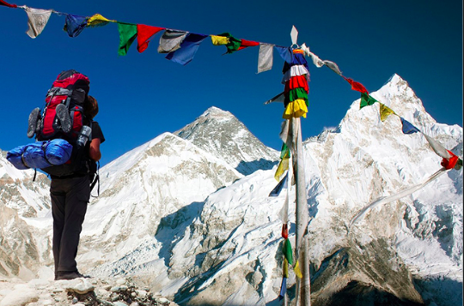
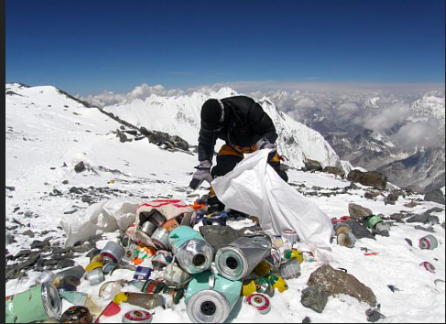
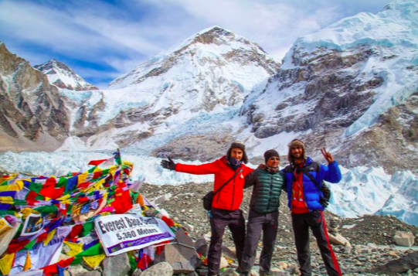
Tourism on Mt Everest
What: What are the impacts of tourism on Everest and Nepal?
Why: What are the problems with people visiting Everest and the Nepal region?
How: Collect information on tourism on Everest
Create a tourism consequences map

Slide 2
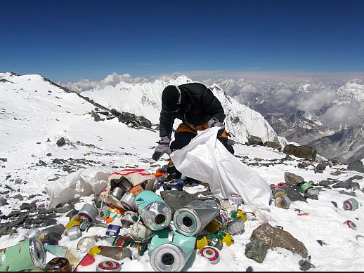
I
Identify – What can you see in the photo?
D
Describe – What is the problem that exists here?
E
Explain – Why do you think the problem has happened? What has caused it?
A
Apply – What are the possible solutions to the problem? Are some more sustainable than others?
L
Link – Is this issue an example of human or physical geography?

Slide 3
Why visit?
Why do people visit Mt Everest?
List as many reasons as you can think of. Can you categorize them?
What reasons do you think have lead to the growth in numbers of people visiting Everest over the past 20 years?

Slide 4
Think: What are the problems with people visiting Everest and the Nepal region?
Positive | Negative

Slide 5
Current Geography in the news…
GEOGRAPHY KEY TERM:
Carrying Capacity
https://www.youtube.com/watch?v=TTU0FR7UMp4

Slide 6
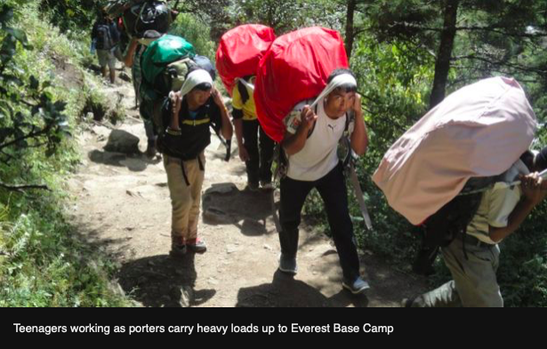
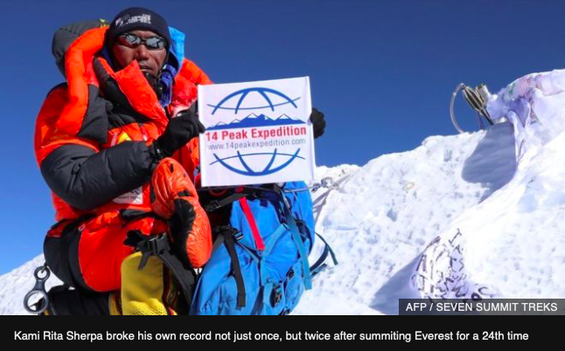
Information race: Everest through the eyes of a Sherpa
How many people have died trying to climb Everest this year? ­­­­­­­­­­­­___________________
How many times has the Sherpa, Kami Rita Sherpa, climbed Everest? _________________
Above what altitude do you normally need supplementary oxygen? __________________
What are some of the reasons for the high death toll on Everest this season? ____________________________________________________________________________________________________________________________________________________
How tall is Everest? _________________
What do the Sherpas do on the expedition? ________________________
How long is the Everest Climbing season? _________________________
What does the Tibetan word for Everest, Chomolungma, mean?____________________
How much do Sherpa guides earn in a season? Between __________________________
How many climbing permits were issued on the Nepal side of Everest? _______________
How much do tour companies charge visitors for climbing Everest? $_______________
How much does the Nepalese government make as a fee for each person climbing Everest? $_________________
How many Sherpas were killed in an icefall in 2014? _______________________
How much compensation did the Nepalese government offer the Sherpas families affected by the icefall? $_______________________
https://www.bbc.com/news/world-asia-48464030

Slide 7
Everest information race answers
How many people have died trying to climb Everest this year? 11
How many times has the Sherpa, Kami Rita Sherpa, climbed Everest? 24
Above what altitude do you normally need supplementary oxygen? 7000m
What are some of the reasons for the high death toll on Everest this season? Overcrowding, bad weather and a record number of permits and an increase in inexperienced climbers
How tall is Everest? 8,848 m
What do the Sherpas do on the expedition? Carry gear, navigate, support climbers
How long is the Everest Climbing season? 3 months
What does the Tibetan word for Everest, Chomolungma, mean? Godesss mother of the world
How much do Sherpa guides earn in a season? Between $5000 and $8000
How many climbing permits were issued on the Nepal side of Everest? 381
How much do tour companies charge visitors for climbing Everest? $30,000 to $130,000
How much does the Nepalese government make as a fee for each person climbing Everest? $11,000
How many Sherpas were killed in an icefall in 2014? 16
How much compensation did the Nepalese government offer the Sherpas families affected by the icefall? $400

Slide 8
What are the problems with people visiting Everest and the Nepal region?
​While watching the video to the left make notes on: -What is the Everest region like and why do people visit? - What the positive impacts of tourism? -What are the negative impact of tourism? Extension: can you categories these into social, economic and environmental impacts?

Slide 9
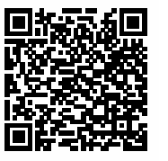
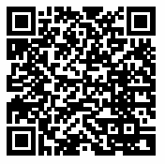
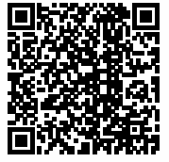
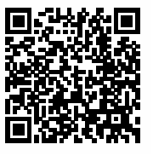
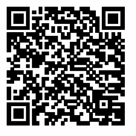
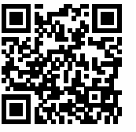
Use these QR codes to add to your detail on the impact of tourism in Everest….

Slide 10
The Butler model (or tourism life cycle)

Slide 11
Consequence map of tourism on Everest
With tourism | Without tourism
In 1 year | In 1 year
In 5 years | In 5 years
In 20 years | In 20 years

Slide 12
Conclusion
To what extent is tourism a good thing for Nepal and the Everest?

Slide 13
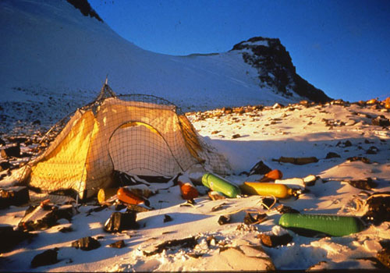
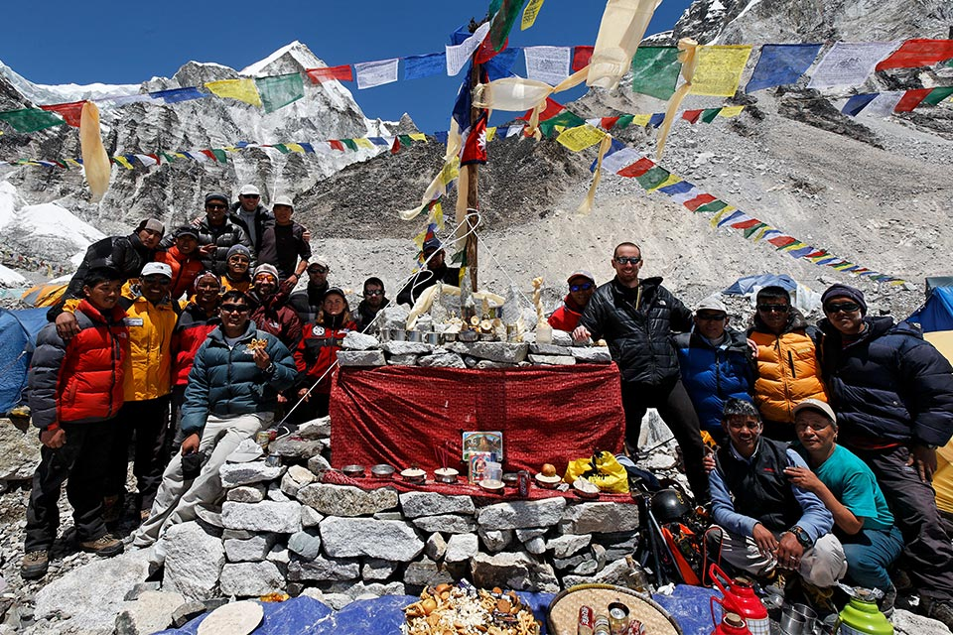
To what extent has tourism benefitted the Sherpas
All positive impacts
All Negatives impacts

Slide 14
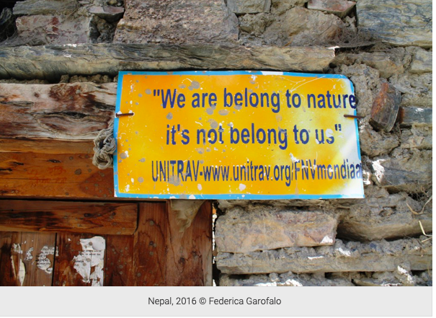
Sustainable tourism on Everest
Sustainable tourism can be defined as “Tourism that takes full account of its current and future economic, social and environmental impacts, addressing the needs of visitors, the industry, the environment and host communities” (UNWTO, 2004).
https://www.lifegate.com/people/lifestyle/sustainable-tourism-in-nepal
Read the above article. Propose one policy to allow tourism on Everest to be more sustainable. Explain how this policy would allow tourism to be sustainable.

