Slide 1
Answer these questions:
How did the number of deaths from natural resources per year change in the last century?
A: Doubled B: remained the same C: Decreased to half
2. How many years have 30- year old women spent in school . Male average is 8
A: 3 years B: 5 years C: 7 years
3: In the last 20 years, how did the percentage of people living in extreme poverty change?
A: doubled B: Remained the same C: Almost halved
4: What percentage of the world’s one year old children are vaccinated against measles?
A: 20 B: 50 C: 80

Slide 2
What were the results we obtained?

Slide 3
Learning objective:
What: To consider how our view of the world may diverge from reality
Why: To understand how we obtain our knowledge of the world (TOK link)
How:
Consider how others view the world and why
To construct a survey and analyse the results for a display

Slide 4
https://www.ted.com/talks/hans_and_ola_rosling_how_not_to_be_ignorant_about_the_world

Slide 5
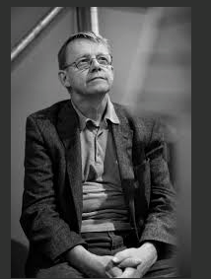
Think- pair- share
How has your opinion changed after watching the video?

Slide 6
What shapes our knowledge of the world?
Personal Bias,
Outdated Facts,
News Bias, (fake news, filter bubbles, etc.)
Skewed Info
Experience, and Intuition

Slide 7
Answer these questions:
How did the number of deaths from natural resources per year change in the last century?
A: Doubled B: remained the same C: Decreased to half
2. How many years have 30- year old women spent in school . Male average is 8
A: 3 years B: 5 years C: 7 years
3: In the last 20 years, how did the percentage of people living in extreme poverty change?
A: doubled B: Remained the same C: Almost halved
4: What percentage of the world’s one year old children are vaccinated against measles?
A: 20 B: 50 C: 80

Slide 8
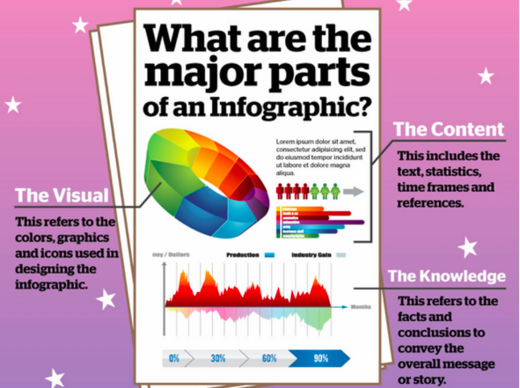
Task: How ignorant is the BISH community ?
Create a survey
Collate the results
Present the results with some analysis of why we got these results using an infographic- link to TOK

Slide 9
What is the aim of infographics?
Success criteria:
What information should the infographic display?
The actual facts
The results from school survey
Why there may be a disparity between our results and the reality: TOK links- what shapes our knowledge of the world?

Slide 10
Infographic making sites
https://infogr.am
https://piktochart.com/?gclid=CjwKEAjw8OLGBRCklJalqKHzjQ0SJACP4BHrG3WKk0ybACSNjUJqZZK_hlTAhpogNSaewzVjfSaFDhoCjD_w_wcB

Slide 11
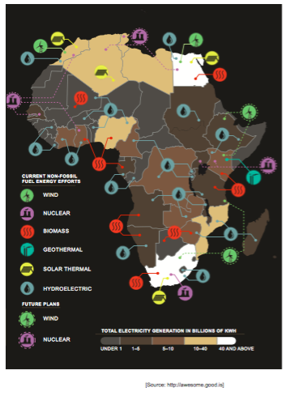
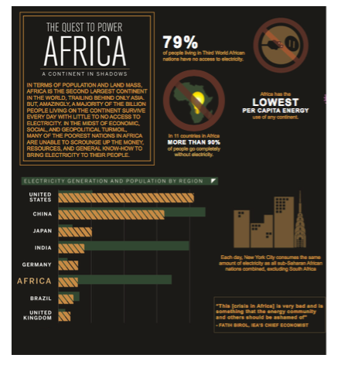
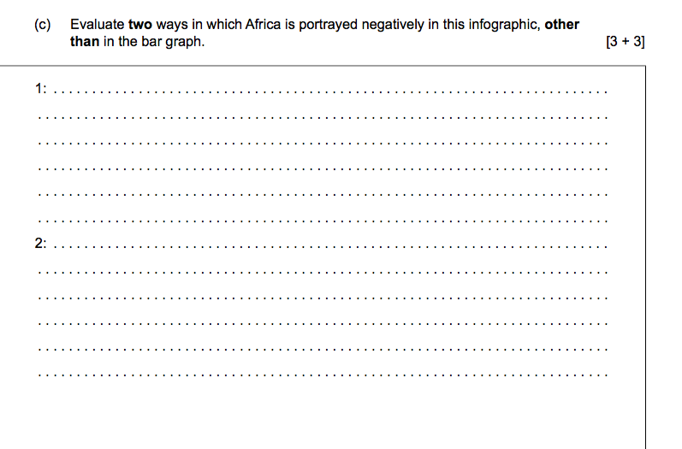
Examine Africa Infographic. How could someone get a misleading impression about development African countries from this image.

Slide 12
On what basis might we decide between the judgements of experts if they disagree with each other?

