Slide 1
‘The World is Shrinking’ Discuss…….

Slide 2
What do you think?
Has the world become ‘smaller’?
Is it right to use the term ‘global village’?
List and briefly comment on changes in communications that have taken place in the last 20 years that could be used to answer the two questions above.

Slide 4
What: How have political, technological and physical processes influenced global interactions
Why: To understand how processes that influence spatial interactions are interlinked in complex ways that accelerate globalization
How: ​By understanding how transport and communication developments have accelerated global interactions

Slide 5
Isochronic map showing time taken to travel certain distances. source

Slide 6
Francis Galton's isochronic map 1881

Slide 8
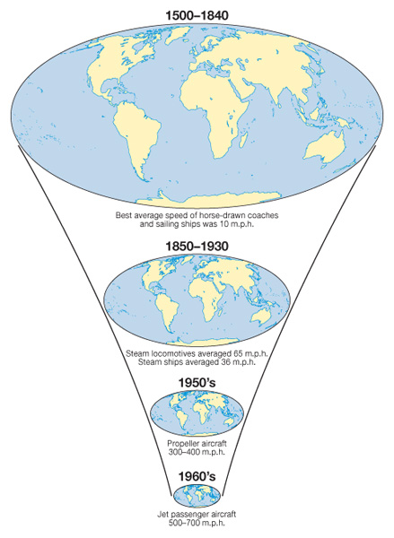
The Time/space convergence

Slide 10
Time taken to circumnavigate the globe

Slide 11
What is distance decay?
The closer together areas are the more likely they are to interact.
Areas further away are less likely to interact – this is the frictional effect of distance making it difficult to communicate over longer distances
Frictional effect has decreased due to:
Improvements in transport
Improvements in ICT

Slide 12
Key terms

Slide 13
We tend to think of distance in terms of travel times.
Travel times are being reduced because of the increase in air travel. Also air travel is becoming more affordable.
For example in the year 2000 Bratislava to London. £75 by bus 22 hours.
2008 Bratislava to London. £40 by low cost airline 2.5 hours.

Slide 14
Time-space convergence:
First suggested by Janelle (1968), it refers to the diminishing time needed to connect two places by transportation due to improving transport technologies.
Time convergence rate: the velocity at which places are moving towards each other.
i.e. Sydney & Brisbane are 1000km apart. In 1902 it took 3 days (4320 mins) by coastal steamer in 2002 it took 1hr 25 mins (85mins) by aeroplane.
so 4320 - 85 = 42mins per year
100

Slide 17
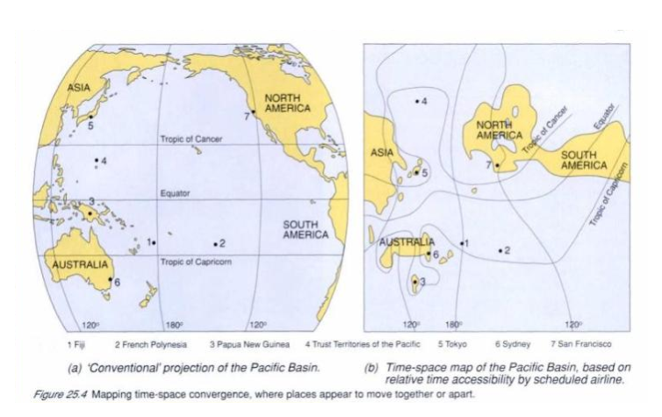
Describe the impact of the time space convergence.
Explain why the impact is not the same for all locations.

Slide 18
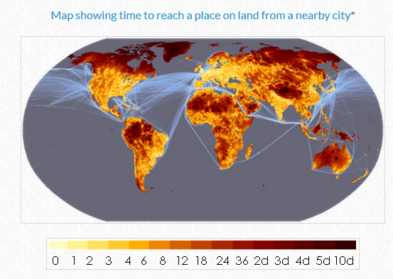

Slide 19
So a reduction in the friction of distance results in time-space convergence.
And therefore increase the interactions between places

Slide 20
Explain what is meant by the time- space- convergence (12)

