Slide 1
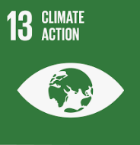
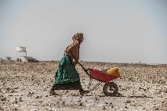
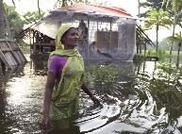
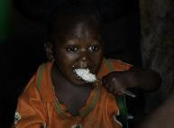
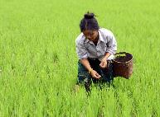
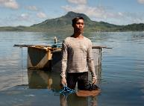
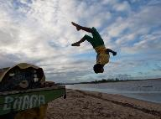
The varying effects of climate change
Notes:
Please note that information about these photographs and their related issues will be provided in subsequent slides so there is no need to go into too much detail about them at this stage.

Slide 2
What: What are the varying effects of climate change ?
Why: To understand that there will be many different impacts of climate change and these will vary globally
How: Categorize impacts and complete a case study of the impacts in Tuvalu

Slide 3
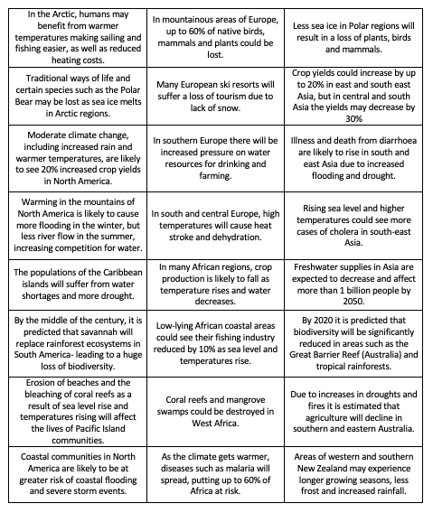
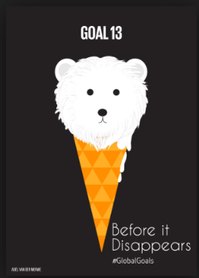
Categorize these impacts into these different categories below

Slide 4
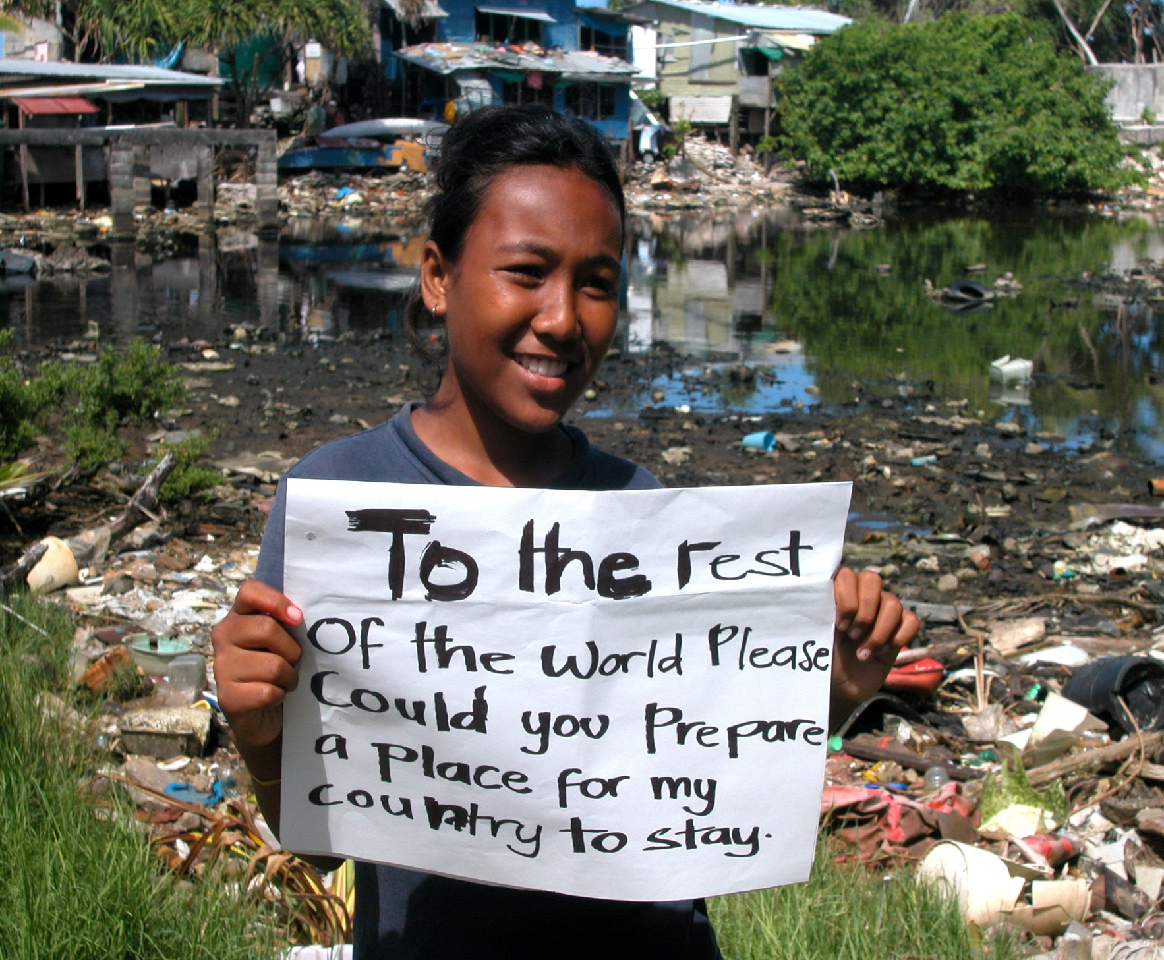
Who
What
When
Where
Why

Slide 5
What is a climate change refugee?
A climate change refugee is a person who has been forced to move due to the change in the climate. This could be due to sea level rise, drought or an extreme weather event.
Where in the world might this happen?

Slide 6
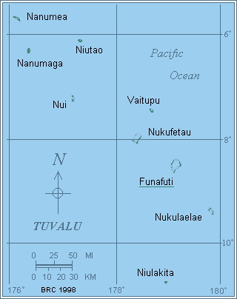
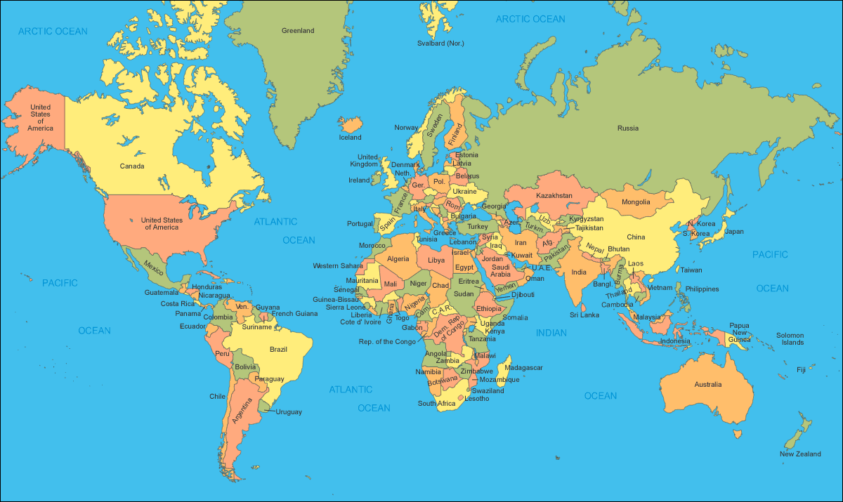
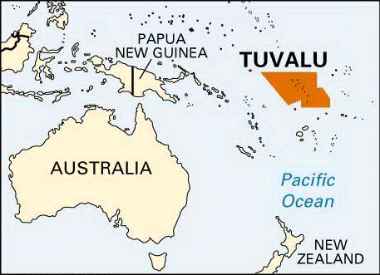
Where is Tuvalu?

Slide 7
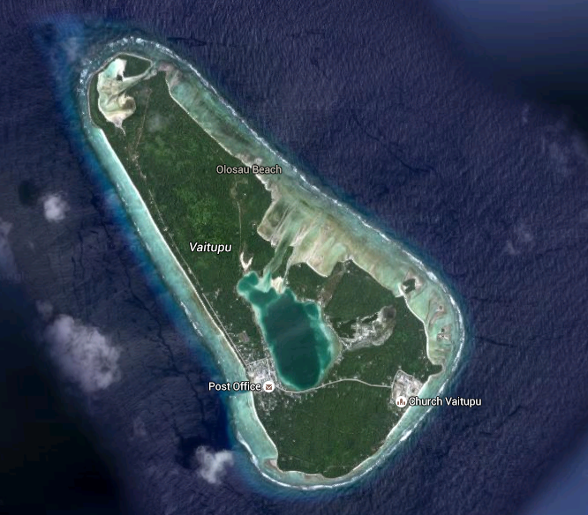
There are 9 island groups which make up the Tuvalu islands.
5 of the islands are coral atolls.
An atoll is a ring shaped coral reef that encircles a lagoon.
Describe where Tuvalu is.
Continent, nearby countries, proximity to the equator.
https://www.youtube.com/watch?v=DSmN8Eq4qEg
https://www.youtube.com/watch?v=EZUunoZtfC0

Slide 8
What problems are the people of Tuvalu facing?

Slide 9
What problems is Tuvalu facing?
Tuvalu is a coral atoll, at least once a year the island is flooded because the water comes up through the holes in the coral.
The islands are low lying, a rise in sea level will increase flooding. Tuvalu is likely to become the first nation to become homeless and will therefore become climate change refugees.
Many of the people on Tuvalu rely on farming. Salt water poisons the soil and therefore crops fail to grow. Livestock e.g. pigs also suffer as they become difficult to feed.
The residents now have to rely on imports – this has increased the amount of rubbish on the islands and has also increased plastic pollution. This has also led to an increase in obesity.
What other problems could they be facing?

Slide 10
Task
Social | Environmental | Political
Divide your page into 3 columns
Read through the text carefully.
Select the social, environmental and political impacts and write them into your table.
Answer the question:
Sea level rise is the biggest threat to Tuvalu, do you agree or disagree? Explain your reasons.
Emerging | Developing | Secure
Choose two reasons for whether you agree or disagree. Write a paragraph for each. | Choose three reasons for whether you agree or disagree. Try to link your answers back to climate change. | Choose three reasons for whether you agree or disagree. Link your answers to climate change and include data to back up your points.

Slide 11
Effects of climate change
Warmer temperatures
Rising sea levels
Destruction of natural habitats, e.g. polar bears
Melting ice/glaciers
Changes to agricultural yields
More extreme weather events, e.g. flooding, heatwaves, drought
Increased migration
Lack of water
Increased health risks
Increased spread of disease
Increased level of conflict
Increased vulnerability of energy sources
Increased maintenance of transport networks
Reduction in forest coverage

Slide 12
Climate change continuum
Most significant
Least significant
All: Place these statements where you would think they go on the continuum Most (taking it even further): Annotate 3-5 to explain why you have placed them where you have Some (taking it further still) : Make inks between the factors (i.e. explain how changes in agricultural yields may lead to increased levels of conflict)

