Slide 1
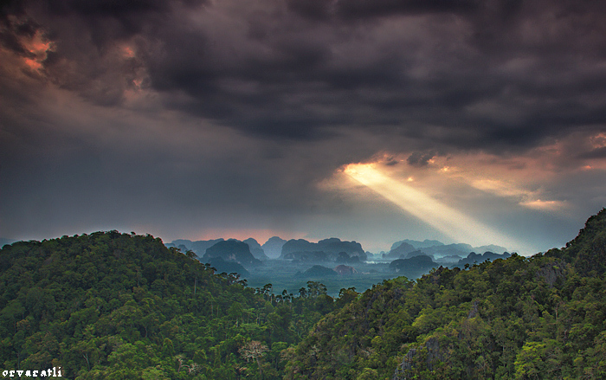
The value of Tropical Rainforests
Why are rainforests valuable and worthy of protection?

Slide 2
Why are rainforests valuable and worthy of protection?
What: Why are rainforests valuable and worthy of protection?
Why: To understand how protecting the rainforest can help us meet SDG 13 and 15
How:
Understanding what goods and services are
Categorizing important rainforest functions as social, economic and environmental
Creating a 1-2 page overview

Slide 3
Organise the following into ‘goods’ and ‘services’
They give us a wide range of natural resources we can harvest, collect or capture to sell and to make money from.
Water and nutrient cycling
Building materials (timber)
Medicines
Air purification (absorbing CO₂)
Protection against soil erosion
Energy from HEP
Employment opportunities
Fish and shellfish
Building materials (timber)
Wildlife habitats
Native food crops (fruit & nuts)
Wild meat and fish
Biodiversity
Water

Slide 4
GOODS
SERVICES
Energy from HEP
Air purification (absorbing CO₂)
Biodiversity
Medicines
Protection against soil erosion
Wild meat and fish
Employment opportunities
Building materials (timber)
Fish and shellfish
Water and nutrient cycling
Wildlife habitats
Native food crops (fruit & nuts)
Water

Slide 5
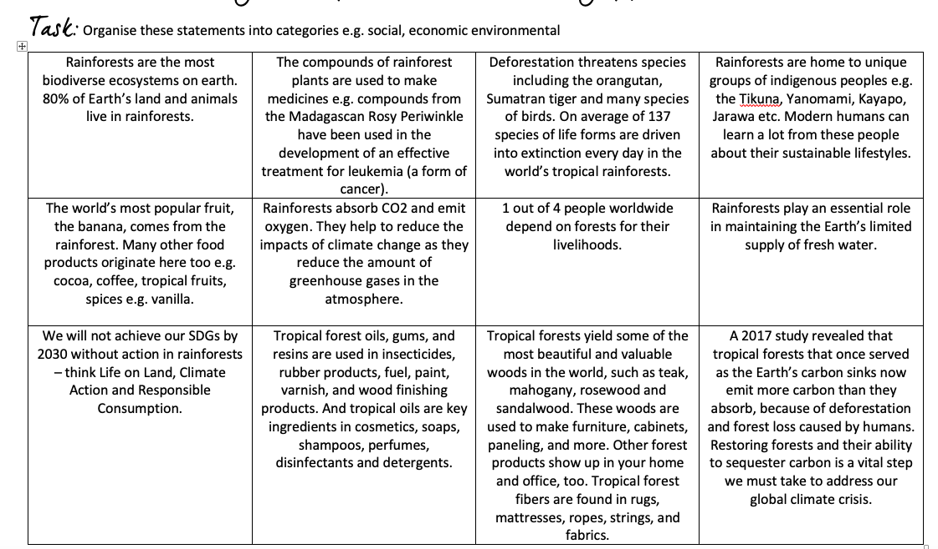

Slide 6
Why are rainforests valuable and worthy of protection?
Success criteria:
Produce 1-2 pages to cover the following:
Include a brief introduction to rainforests e.g. location, key characteristics
Outline the reasons why rainforests are valuable/important. Can you classify the reasons e.g. social, economic, environmental?
Conclusion – Provide a summary to the main question “why are rainforests valuable and worthy of protection?” What do you think are the most important reasons to explain why rainforests are valuable? Can you refer to the balance between development and conservation?
If you complete this work electronically please print a copy for your teacher (make sure it is doubled sided!)

Slide 7
Resources:
https://www.rainforest-alliance.org/pictures/9-rainforest-facts-everyone-should-know
https://www.rainforestconcern.org/forest-facts/why-are-rainforests-important
https://www.rainforest-alliance.org/articles/tropical-forests-in-our-daily-lives
https://ypte.org.uk/factsheets/rainforests/why-are-rainforests-important
http://wwf.panda.org/knowledge_hub/where_we_work/amazon/about_the_amazon/why_amazon_important/
https://www.nationalgeographic.org/encyclopedia/rain-forest/

Slide 8
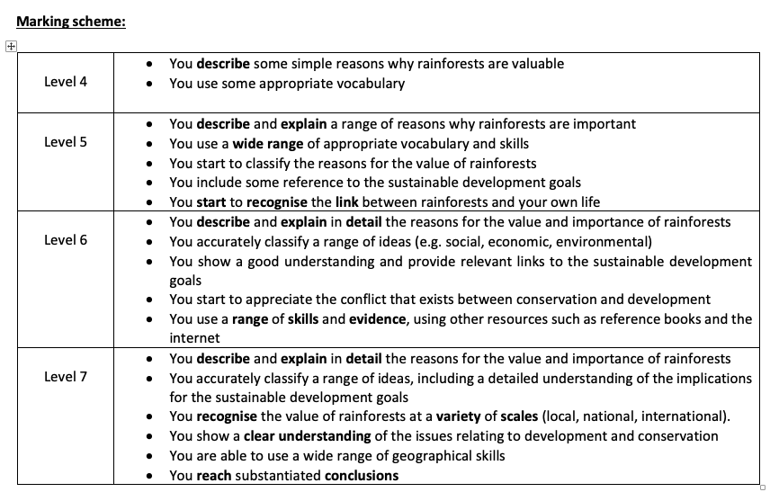

Slide 9
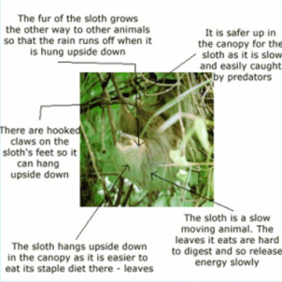
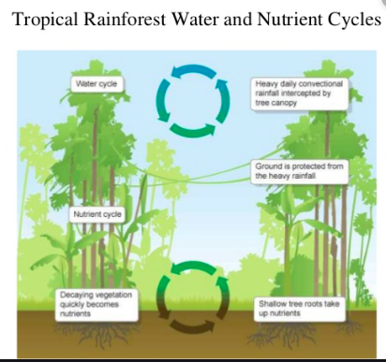
Ways of presenting information in Geography
Target: Give all images a figure number and title.
Graphs
Annotated photos
Diagrams

