Slide 1
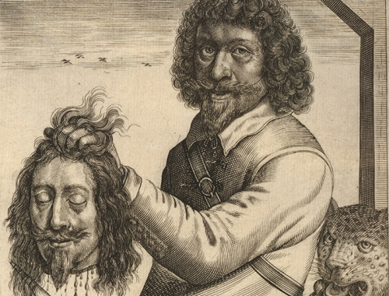
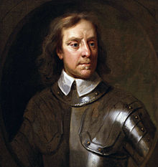
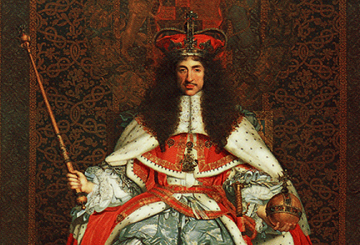
Protectorate and Restoration: Anything new?
L/O: Investigate how far the beheading of King Charles I changed England
BRONZE: What has happened?
SILVER: Why might this have happened?
GOLD: How could this have happened?
January 1649, Charles I executed.
Kings are hated.
1653-1658 - Oliver Cromwell rules Britain as Lord Protector (NO KING)
1660 Charles I’s son is invited back to England. He’s crowned King Charles II in 1661
Notes:
How should we remember the Civil War? Did the Civil War make any difference?

Slide 2
In the English Civil War…
34,000 Parliamentarian Soldiers died in battle.
50,000 Royalist Soldiers died in battle.
At least 100,000 other men women and children died from diseases.
Hundreds of thousands of homes were destroyed.
WHY? All so that a bad King (Charles I) could be got rid of!

Slide 3
NEW ENQUIRY: Did the beheading of King Charles I actually change anything?
1660 – Charles I’s son is invited back to England and crowned King Charles II in 1661
Parliament even sign a document agreeing that Charles has been the lawful King since they executed his dad in 1649!

Slide 4
Draw this line in your book
Arrange the statements along the line depending on how far the events changed England.
No change at all
CONTINUITY
Complete transformation
CHANGE

Slide 5
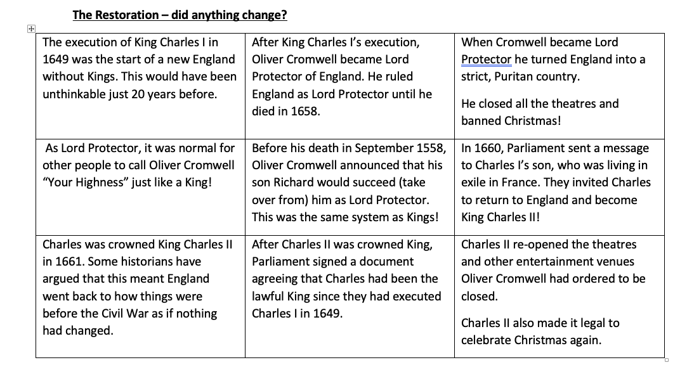

Slide 6
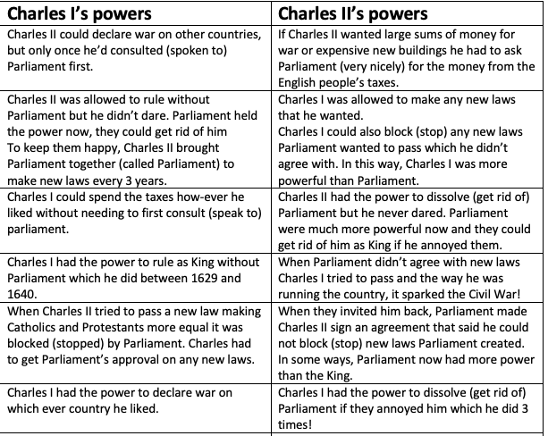
How has Royal power changed after the beheading of King Charles I?

