Slide 1
The Radicalisation of the Legislative Assembly

Slide 2
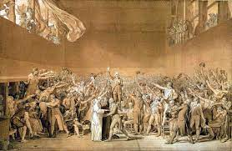
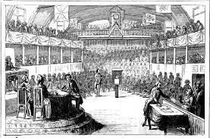
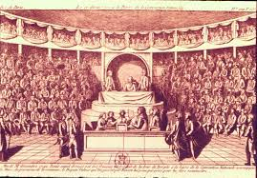
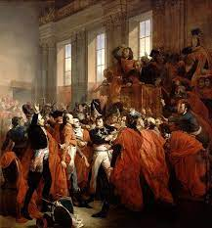
French Legislative Governments – 1789 - 1799
National Assembly (1789-1791)
Legislative Assembly (October 1791-August 1792)
National Convention (Sept. 1792-1795)
Directory (1795-1799)
The National Convention was a single-chamber assembly in France from September 20, 1792, to October 26, 1795, that succeeded the Legislative Assembly. It fractured into even more extreme factions than its predecessor. A result of the increasing divide within the Jacobins was the split between the more radical Montagnards and the Girondins.
The legislature of France from October 1, 1791, to September 20, 1792, during the years of the French Revolution. It provided the focus of political debate and revolutionary law-making between the periods of the National Constituent Assembly and National Convention.
The National Assembly was the first revolutionary government of the French Revolution and existed from June 14th to July 9th in 1789.

Slide 3
The Legislative Assembly
The Legislative Assembly consisted of 745 members, mostly from the middle class.
The rightists within the assembly consisted of about 260 Feuillants, who were staunch constitutional monarchists firm in their defense of the King against the popular agitation.
The leftists were about 136 Jacobins and Cordeliers. They favored the idea to spread the new ideals of liberty and equality and to put the king’s loyalty to the test.
The remainder of the House, 345 deputies, belonged to no definite party. They were committed to the ideals of the Revolution and thus inclined to side with the left but would also occasionally back proposals from the right.

Slide 4
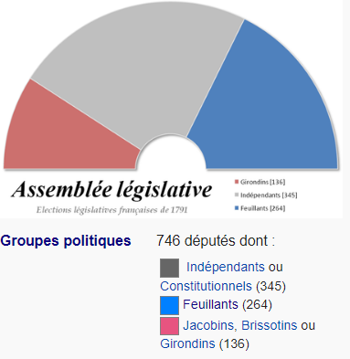
Who were they?
Feulliants
Jacobins
Girondins
Montagnards
Cordeliers
The Plain

