Slide 1
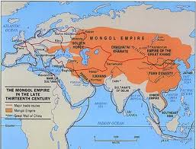
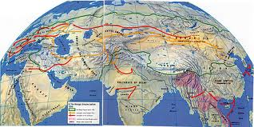
The political impact of Mongol rule was much more significant on the Chinese than it was on the Russians. Fundamentally, the Mongols were nomadic and the Chinese and Russians sedentary. Led by Genghis Khan and motivated by very real economic means, the Mongols established the largest land empire ever known. China lies just south of Mongolia, and was ruled directly by the Mongols. By great contrast, Russia was a cold, more resource-poor area that was ruled by a number of independent princes. The Mongols did not rule them directly but rather, upon defeating them, let them be so long as they remained under Mongol control and paid taxes to the Mongols. The Mongols allowed them to continue to practice Christianity and let the princes maintain rulership in most respects. In China the Mongols defeated the imperial armies and established themselves as direct rulers. Civil service exam became less important and Mongol rulers taxed the people heavily. It boils down to the fact that the Mongols exerted much more influence over Chinese sovereignty, culture, and policy than they did over the Russians. Economically, the effects were similar. In both regions, the Mongols taxed the populace. The tax was comparable in amount and served the Mongols similarly. Mongol rule, however, did bring some economic boon to the whole region. The Mongol empire established a network that allowed for easier long distance trade, with respect to goods, technology, and ideas. As early as 1200, the Mongols were experimenting with gunpowder in China and its export via the Mongol empire was good for the Chinese markets. With buyers as far away as the Middle East, trade was facilitated by Mongol maintenance of the larger empire and subsequent peace that allowed for easier trade. Such ease of trade is characteristic of imperialism, established networks and prevailing peace in Asia and the Middle East allowed for such trade. Although being part of the empire, Russia did benefit by finding a larger market for its chief export, fur, because the Mongol presence was felt less the benefit was notably less. Comparatively, all of the positive AND negative effects felt in both regions were amplified in China but diminished in Russia. The exception to this was the bubonic plague, which the Mongols helped spread. It began in China, but it was largely the Mongol mail system that helped bring it to many parts of Russia, so in this way Russia did suffer as a result of Mongol rule whereas China would probably have suffered either way.

Slide 2
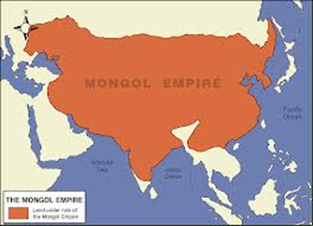
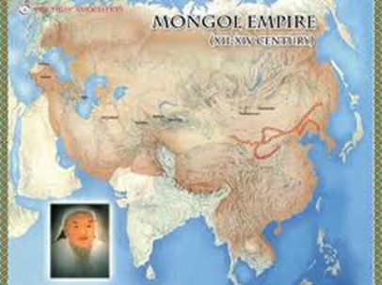
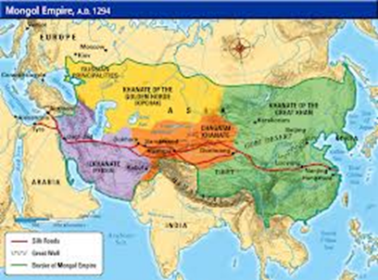
International Mongol News
Globally…
Tolerant rulers
Established Khanate system
Exacted tribute in return for peace and tolerance (otherwise brought terror)
Created a Pax Mongolica
Furthered spread of Islam
International courier (postal system)
Wealth sometimes plundered but also redistributed( poorest received government assistance)
Roads and bridges built originally to service Mongol Military became trade and travel routes
Travelers like Ibn Battuta and Marco Polo write of their extensive travels in the Mongol Empire
Spread of the Bubonic Plague (Black Death)

Slide 3
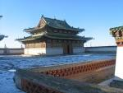
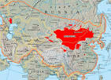
Live From Kharakorum
Central Asian Mongol Capital
Summit place for all Khans to determine successors for Khans
Drew talented individuals from all conquered areas.
Used Muslim and Chinese bureaucrats to build administartion for the Empire
Script and legal code established to promote peace and tolerance
Timurud Empire succeeded ( led by Timurlane) with Muslim capital in Samarkand
Samarkand great Muslim trading city along silk road
Tamerlane’s policy of terror spared artisans and scientists creating a Muslim beacon

Slide 4
 | Political Evidence | Economic Evidence
China | Kept modified civil service system Upper level bureaucracy reserved for Mongols Yuan Dynasty: Kublai Khan direct rule General benevolence when no resistance Religious toleration to consolidate rule | Maintained Silk Roads, Postal System during ; safe travel encouraged international trade Facilitated commerce and communication
Middle East | Ruthless annihilation of resistance (terror tactics) Indirect rule: regents for the Khan | Canal system destroyed Sacked and destroyed Baghdad
Russia | General benevolence when no resistance Religious toleration to consolidate rule; Russian Orthodoxy flourished Heavy Taxes levied and collected by Moscow Princes Indirect rule: regents for the Khan | Outlet for the fur trade from Russia Maintained Silk Roads, Postal System during ; safe travel encouraged international trade Facilitated commerce and communication

Slide 5
The Good, The Bad and The Ugly
The impact of the Mongol conquest on the conquered peoples included:
Death – Destruction - Extortion of wealth – Disease - Displacement
It also included:
✓ the intensification of activity on the trade routes connecting East Asia with the
Mediterranean lands and Europe
✓ the further spread of Islam in Asia
✓ the advancement of Tibetan Buddhism in China
Death: The Mongols inflicted it on a large scale. In battle, their powerful bows caused heavy
enemy casualties. Moreover, mass slaughter of defeated enemy soldiers and civilians was
used as a deliberate policy of terror in order to:
✓ decrease the enemy’s will to fight.
✓ induce cities to surrender without fighting, thus avoiding long sieges, which the Mongol
army could not afford because it needed to keep moving to find grazing land for its
horses.
✓ avoid the risk of leaving enemies behind that might be capable of renewing resistance.
✓ reduce the size of the occupying detachments needing to be left behind.
But:
✓ More urban populations were spared than were massacred. Often spared were artisans,
clerics of all religions, scribes, scholars, merchants, young women, and often officers,
nobles, and administrators.
✓ Mass slaughter was not a Mongol monopoly either in their own time or later

Slide 6
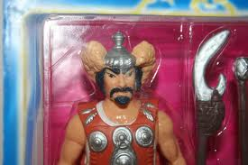
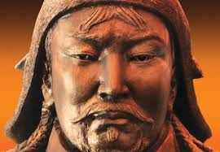
More Good Bad and Ugly
Destruction:
✓ The Mongols often destroyed the towns they attacked, usually as a by-product of the
battle, sometimes deliberately after their conquest. Mongols traditionally had no use for
towns. Destroying them was a practical measure to prevent their use for resistance.
✓ Destruction was a by-product of the Mongols’ conquests, rather than policy. They were
unaware of or uninterested in the damage.
But:
✓ There was a great deal of construction initiated and supported by the Mongols. Many of
the towns the Mongols destroyed rose again a few years later with Mongol help.
✓ Courier services were expanded and many additional way stations were built along trade
routes, where both troops and civilian travelers could get food, drink, lodging, and a
change of horses.
✓ Roads and bridges built originally to service the Mongol military became trade and travel
routes.
Extortion of wealth:
✓ After first plundering the conquered, the conquerors were for a while satisfied with
tribute in the form of demand of silk, grain, precious metals, and sophisticated war
machinery.
✓ Unpredictable and capricious demands were gradually replaced with regular though
intermittently extortionate taxes.
But:
✓ Some of the wealth that flowed to the Mongols was redistributed. Only part made its way
to Mongolia. Much went back to those conquered areas where Mongols settled as
occupying troops, administrators, and governors.
✓ The lot of some segments of the conquered population actually improved, owing to
profits from the trade promoted and supported by the Mongols, to their enforcement of
law and order within their territories, and to their opening of careers to merit, not only
birth or wealth. The poorest classes received something like government welfare
assistance: food, clothes, and money

Slide 7
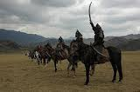
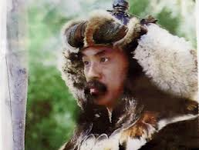
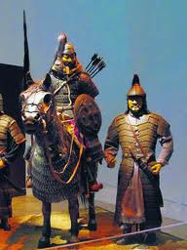
Even More Good, Bad and Ugly
Disease: The association of disease and warfare is commonplace.
✓ Troops live under more unsanitary conditions than is normal.
✓ Unburied corpses often contaminated water supplies.
✓ Among the overcrowded and underfed in besieged cities and in close quartered armies,
an infectious illness could spread quickly.
✓ The existing food supply must be stretched to feed the invading army, leaving little for
the local population and thereby reducing its immune system.
✓ The frequent long-distance travel of military personnel, merchants, and others promoted
the wider spread of diseases.
✓ Of these the Black Death (bubonic plague) was the best known and most severe. This
disease may have been carried by soldiers from Inner Eurasia to the Black Sea, and from
there to West Asia, North Africa, and Europe. This infection killed about one third of the
total population of Europe.
Displacement: During the Mongol campaigns of conquest and later, there was large-scale
enslavement and forced movement of populations.
✓ Many fled in terror when news reached them of an approaching Mongol army.
✓ In conquered territories, the Mongols usually rounded up the craftspeople, and assigned
them to Mongol princes and commanders. These captives, who could number tens of
thousands in a single city, were carried off to Mongolia or other parts of the growing
empire.
✓ This gave rise to considerable population exchanges between Russia, Central Asia,
Persia/Afghanistan, Mongolia, and China.

Slide 8
However
But:
✓ Although captive artisans and young women (destined to be slaves, concubines,
prostitutes, and entertainers) often remained in their masters’ hands for the rest of their
lives, some gained their freedom and married locally, some eventually returned to their
homelands.
✓ The movement of peoples resulted in exchanges of goods, ideas and styles and in
frequent and widespread contact between peoples of widely different cultural, ethnic,
religious, and language backgrounds.
✓ Thousands of people traveled from western and central parts of Eurasia to serve the
Mongol regime in China. Marco Polo was just one of these foreigners seeking opportunity
in Mongol administration.
✓ Islam’s spread among the peoples of the Mongol empire was also helped by the
movement of peoples. Persian became one of the official languages of the Mongol
empire, used even in China. And Persian culture, along with Islam, spread into Central
and Eastern Asia. Starting in the thirteenth century, the Mongol khans of the Golden
Horde and of Persia converted to Islam and threw their governments’ power behind the
Muslim faith.
✓ Buddhism advanced in China owing partly to direct support from the Great Khans,
starting with Khubilai.
✓ Christianity lost out in the long run in Asia, though not through any action of the
Mongols. European leaders had hopes of allying with Mongol leaders against the Muslim
powers that challenged European political and commercial interests in the eastern
Mediterranean. Christianity suffered partly because it did not speak with a single voice:
believers in Latin Catholic, Eastern Orthodox, Nestorian, and other Christian doctrines

