Slide 1
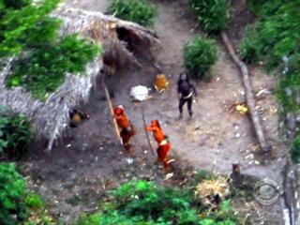

Slide 2
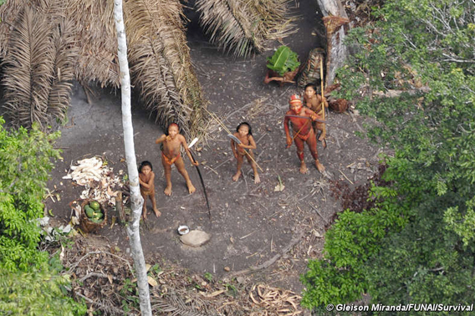

Slide 3
What questions could we ask about these images?

Slide 4
What can we learn from them?
What: The lifestyles of the indigenous people of the rainforest.
Why: So that we can appreciate the lives of groups of people in different parts of the world – including the ways in which their lives are similar and different to our own.
How: by looking at case study of examples of different tribal groups and considering how they use the rainforest sustainably.

Slide 5
Watch the following to explain more about the situation…
http://www.youtube.com/watch?feature=player_embedded&v=16fvTonR_gA
http://www.youtube.com/watch?v=sLErPqqCC54&feature=player_embedded

Slide 6
Video notes
How they have adapted to life in the forest
Their work e.g. farming and fishing
The Tikuna Tribe
Lifestyle e.g. clothes, houses, customs
Threats
https://www.youtube.com/watch?v=RawJ875KCco

Slide 8
Task choice
Either: write an account as a 'day in the life' of one of the Tikuna tribe. Think about:
How you are adapted to life in the rainforest
How you hunt/ collect food/other aspects of work
Where you live
Customs/culture e.g. dress, language, religion, education, ceremonies/festivals
Impacts of the outside world
Or: investigate another example of a rainforest tribal group and create a fact-file about them.
Include similar information to the above

Slide 9
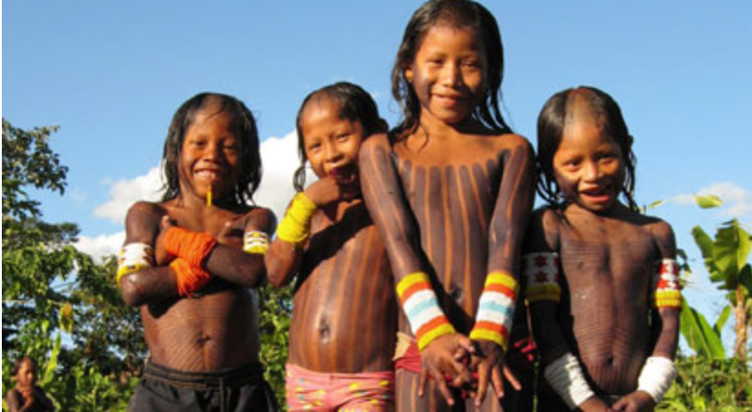
How do the Kayapo Indians use the rainforest sustainably?

Slide 10
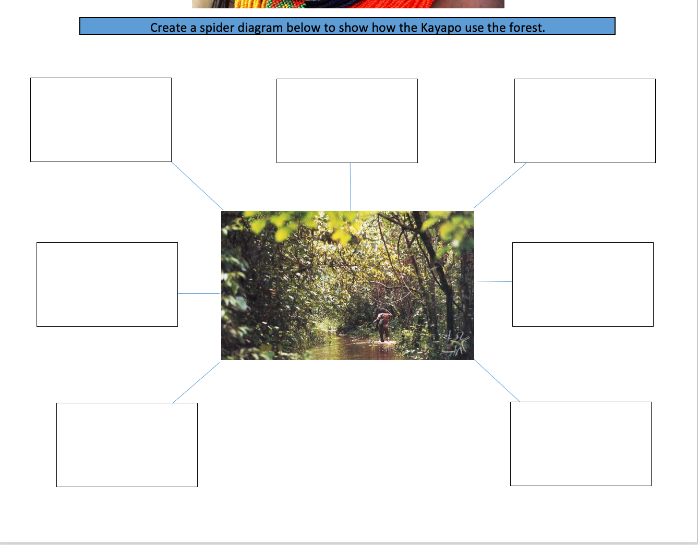
https://www.youtube.com/watch?v=zWRpg6nmnjA
Extra research: https://www.conservation.org/projects/brazils-kayapo-stewards-of-the-forest

Slide 11
Extra Resources
Uncontacted tribes: https://www.survivalinternational.org/tribes/uncontacted-brazil
Rainforest people:
https://kids.mongabay.com/elementary/301.html
Yanomami:
https://www.survivalinternational.org/tribes/yanomami
Kayapo:
http://www.kayapo.org/index-3.html

Slide 12
“Tribal people of the rainforest lead a life that is much worse than ours. They don’t have electricity and all the goods that go with them. They don’t have cars, heated houses, Facebook, Internet, shops and banks”. To what extent do agree with this statement. (Target 100 words)

