Slide 1
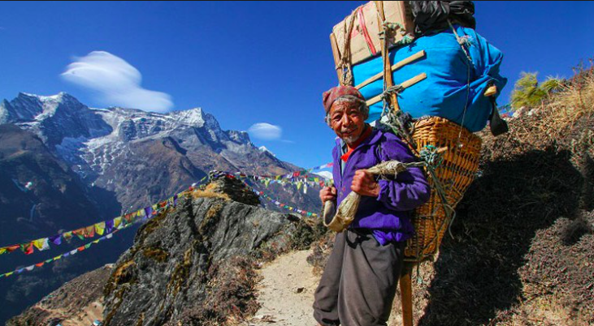
THE PEOPLE OF EVEREST
Objective: To find out who lives close to Mount Everest and how these people help mountaineers to climb Mount Everest.

Slide 2
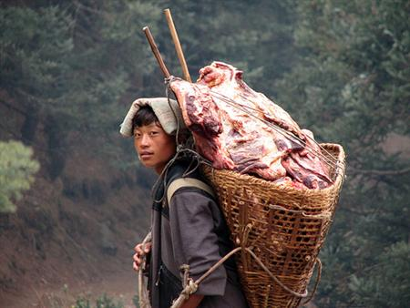
Objectives
Why:
To help build a range of information for our debate: ‘Should a permanent base camp be built on Everest?’
To be able to describe the Sherpa people’s way of life in the Himalayas
To be able to explain whether you think foreign influences have helped or hindered the traditional Sherpa way of life
To be able to explain the impact trekking is having on Mount Everest and the lengths Sherpa’s are going to reduce these impacts

Slide 3
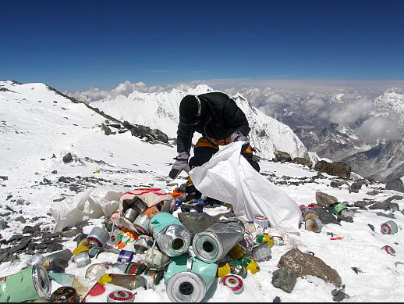
I
Identify – What can you see in the photo?
D
Describe – What is the problem that exists here?
E
Explain – Why do you think the problem has happened? What has caused it?
A
Apply – What are the possible solutions to the problem? Are some more sustainable than others?
L
Link – Is this issue an example of human or physical geography?

Slide 4
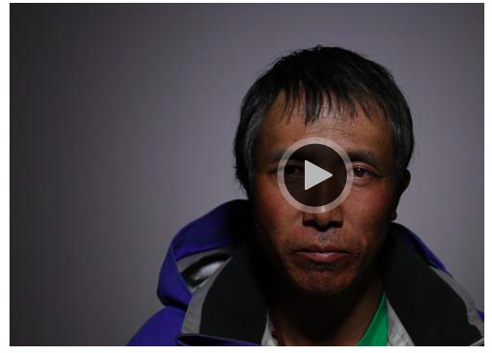
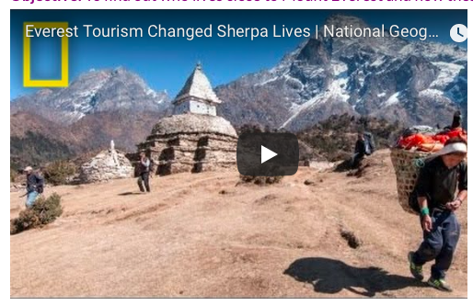
Enquiry questions:
What is the way of life for the Sherpas?
How has tourism impacted them?
Use the videos and resources on the weebly to help you answer these questions.

Slide 5
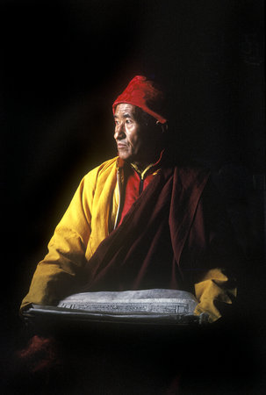
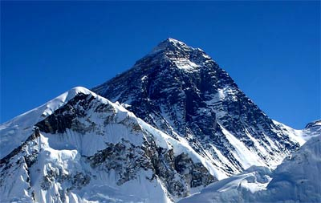
Life In The Mountains!
What does ‘Sherpa’ translate as?
Who where the first to move from Tibet to Nepal?
What was it that brought the Sherpa people to the attention of early European climbers?
Approximately, how many Sherpa's live in
Nepal today?
Where do most Sherpa's live today?
Why do you think they grow their crops on the lower plans while they live in the higher grounds?
Describe how Sherpa's divide their work
Who was Tangzing Norgay? (left)
What has brought wealth to the Everest region of poor Nepal?
What did Sherpa's traditionally work as?
How is Everest regarded in Sherpa homes today?

Slide 6
Life In The Mountains!
Explain the Sherpa religion:
Why was climbing the mountains once thought to be blasphemous?
What does Chomolungma mean?
What is a Puja ceremony? When does it take place?
What are prayer flags? How do they ‘work’?
How have Sherpa's used their fame to benefit themselves?
What is the Sherpa's basic garment called?
What does it look like? (Draw and/or describe)
How has Sherpa's housing changed?
What are the main stables of the Sherpa's diet?
Do Sherpa's eat meat?
Namaste! – Greetings!
What is unusual about the Sherpa language?
Where did the language originate?
How has the language been influences?

Slide 7
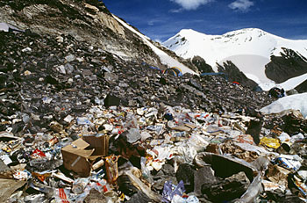
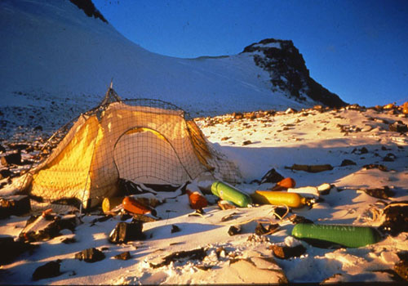
9,000 kg
(Roughly the weight of a fully grown elephant)

Slide 8
Foreign visitors have unavoidably had some impact on the Sherpa peoples way of life
In your opinion, has this had a negative or positive impact on their culture?
Under the title Life In The Mountains select three impacts foreign visitors have had on the Sherpa culture and explain why you think it is an positive or negative impact

Slide 9
Sherpa task- your choice
Choice 1: You need to create a person profile (like you find on the back pages of magazines) for the Sherpa. A photo should be in the middle and this should be surrounded by important information to enable the reader to gain as much information as possible about the people* *Hint – most people think that ‘Sherpa’ is a name given to people who carry the equipment of climbers and have no idea that they are a race of people. Choice 2: The Hardest Job on Earth? You must now carefully read the fact sheet and watch the YouTube videos. Create a job advert for a Sherpa Guide on Everest. The average wage in Nepal is $1300 per year.
The average wage for a two month Everest expedition is between $5000-6000.
You will need to include physical and personal attributes. The mortality (death) rate of a typical Sherpa working on Everest is around 1.2%. That means one out of every 100 Sherpa will die doing their job.
Choice 3:
Write a follow up article for the newspaper who reported ‘Sherpas prepare to clean up Everest’ from the perspective of one of the Sherpas who has just returned from ‘The Death Zone’
You need to write at least three detailed paragraphs about how you prepared for the trip before leaving, why you are helping on this trek and what you so whilst on the trek

Slide 10
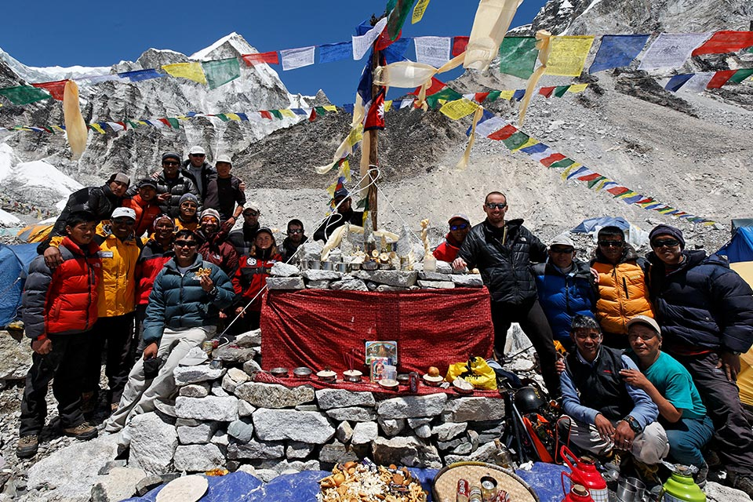
To what extent has tourism benefitted the Sherpas
All positive impacts
All Negatives impacts

